Slide 1
Aging in Place: Strategies to Protect Seniors and Prevent Vacancy

Slide 3
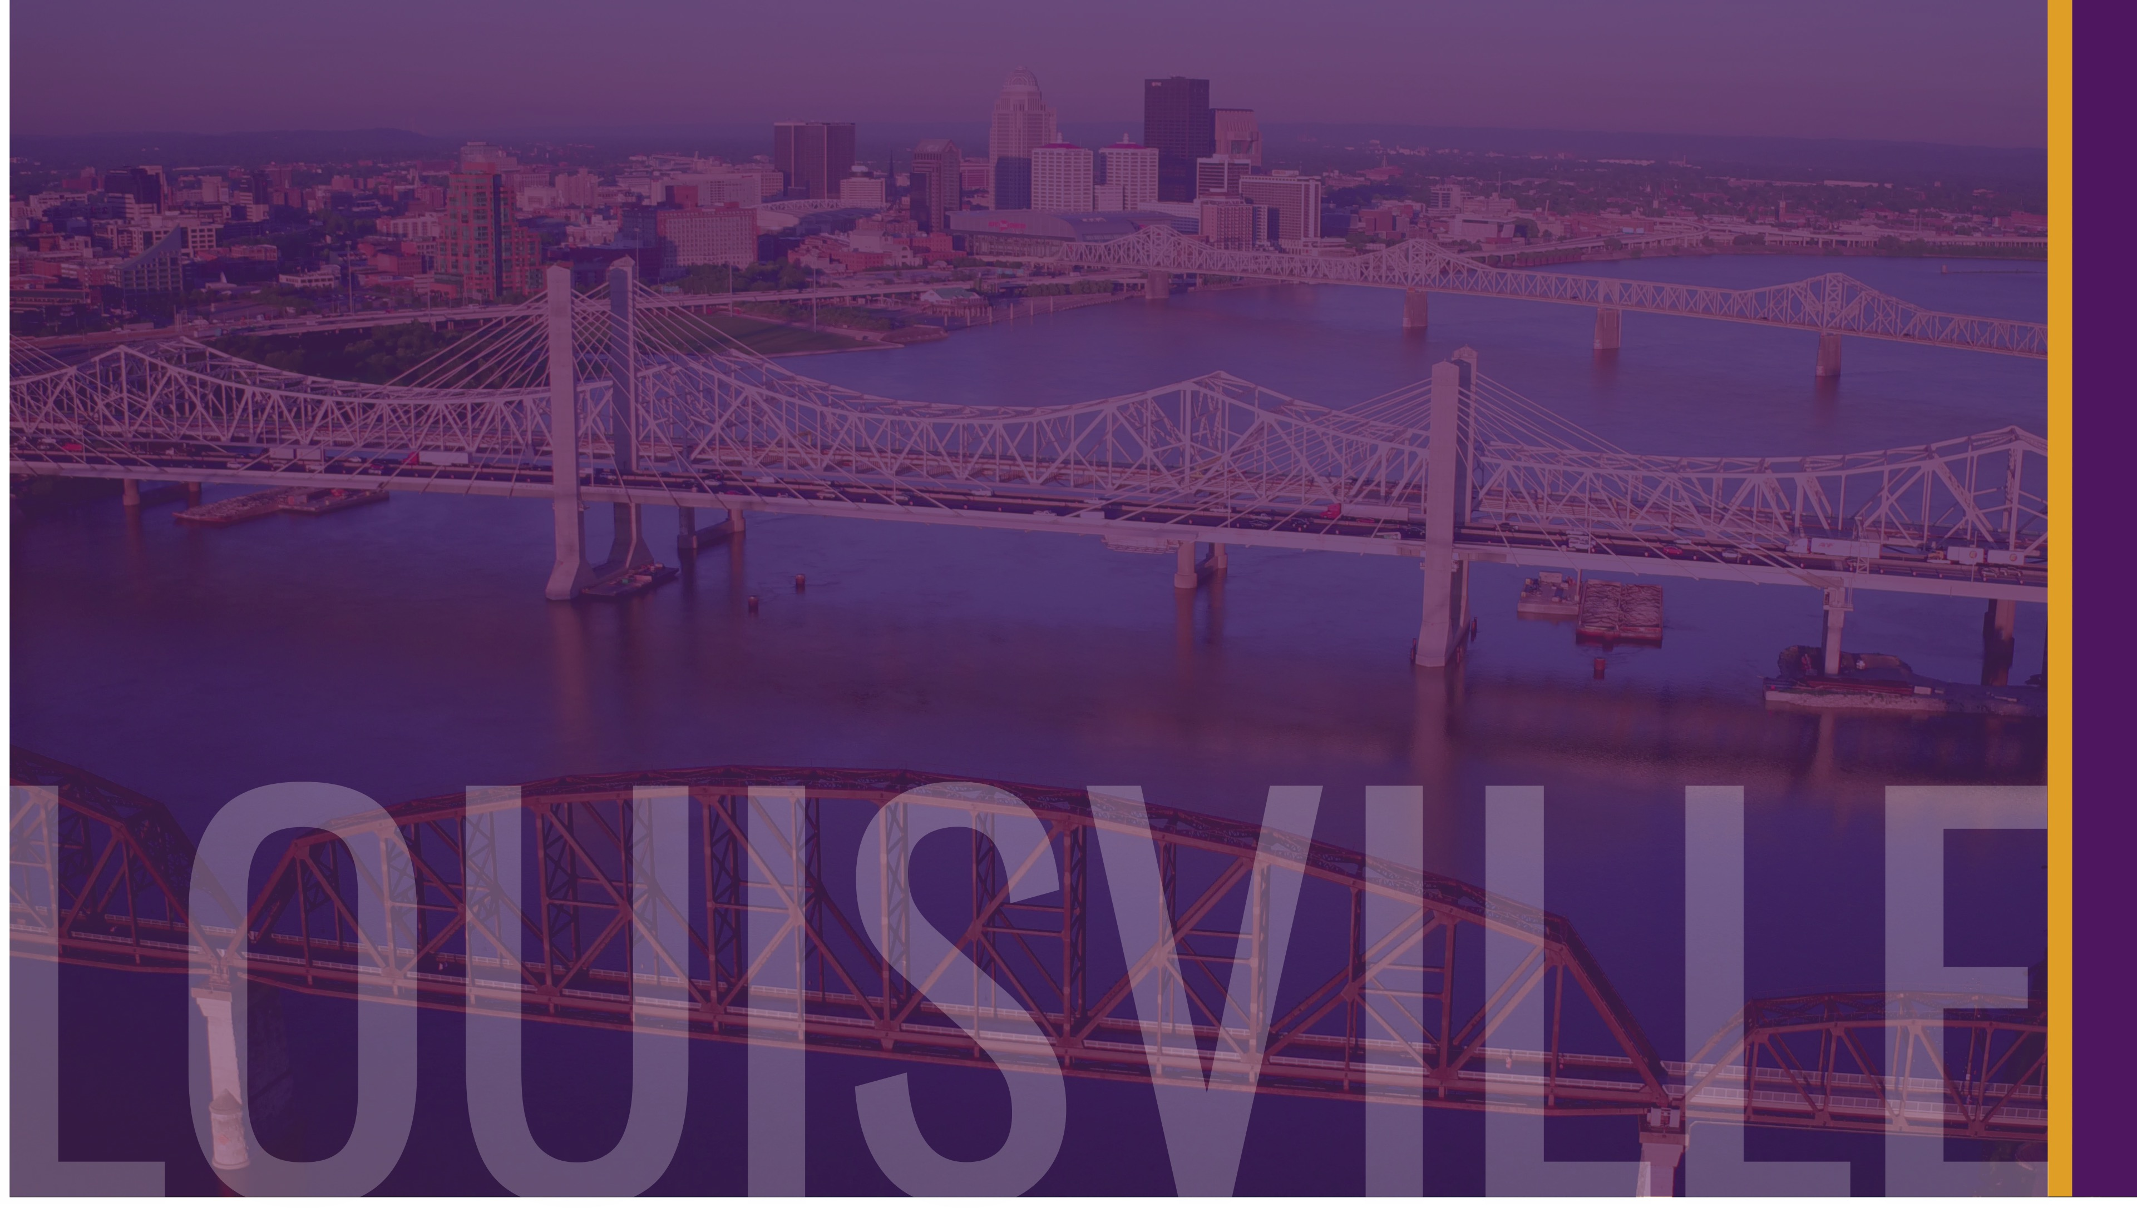
Who are we? - Louisville Forward- Established in 2012 as Louisville Metro Government’s integrated approach to economic and community development - Consists of 3 departments: Economic Development, Codes & Regulations and Develop Louisville - Office of Vacant & Public Property Administration (VPPA) is a division of Develop Louisville - Louisville Forward’s Vision Russell Initiative won a HUD Choice Neighborhoods implementation grant - Many Metro services currently focused in the Russell Neighborhood
Notes:
Within the 3 departments, there are numerous divisions. VPPA being one within Develop Louisville

Slide 4
VPPA Successes 2626 W. Kentucky Street Buyer- L1C4 Properties, LLC Leased - $ 850/month (Section 8)
Before
After
Notes:
Our division (VPPA)’s primary purpose is to acquire vacant and blighted properties and put them back into productive use.
Our Land Bank is the 3rd oldest in the country, turned 30 yrs. old this year!
Foreclosure team- approx. 100 foreclosures per year
Accept donations- biggest problem is 3rd party issues (foreclosures, sold taxes)- in addition to life planning clinics, we partner with Legal Aid to help applicants interested in donating to clear their titles.

Slide 5
Age-Friendly Community
Designation granted by American Association of Retired Persons (AARP) Network of Age-Friendly Communities, an institutional affiliate of the World Health Organization’s (WHO) Global Network of Age Friendly Cities & Communities®
International effort launched in 2006 to help cities prepare for rapid population aging and the parallel trend of urbanization.
Louisville became the 120th member on October 10, 2016.
Age-Friendly initiative led by the University of Louisville (UofL) Institute for Sustainable Health & Optimal Aging in partnership with Louisville Metro Government, Office of Resilience and Community Services, Office for Aging and Disabled Citizens and AARP and many, many community partners.
Notes:
We are also an age-friendly community!

Slide 6
Why be an age-friendly community?
National population aged 65+ projected to double between 2012 – 2050 (43.1 million in 2012, 83.7 million by 2050) *
Baby Boomers largely responsible for increase- turned 65 in 2011, over Age 85 by 2050 *
Kentuckians aged 65+ projected to increase from 25.9 to 39.9% between 2006 – 2016 **
* An Aging Nation: The Older Population in the United States, U.S. Census Bureau)
** Source: 2017 Profile of Older Americans, Administration for Community Living

Slide 7
Age-Friendly City Plan
Age-Friendly Cities charged with developing customized action plan for implementation of age-friendly practices across the 8 age-friendly domains; covered in 4 domain work groups:
Housing- Help ensure people have access to affordable and safe housing as they age; affordability, access to essential utilities and services, universal design, age-in-place modifications, maintenance , community integrations housing options, and overall living environment;
Mobility & Access- Improve transportation; includes availability and affordability of transportation, reliability and frequency of transportation, age-friendly vehicles, driving conditions, and parking;
Social Participation, Respect & Inclusion- Ensure respected and appreciation; accessible and affordable social opportunities/activities, awareness of activities and events, isolation reduction and intergenerational interactions and public education, place and helpfulness in community and family and economic inclusion; to begin;
Community Supports & Health Services- Ensure access to health and community services; accessible and wide-range healthcare services, aging-well services (i.e. disease prevention, preventative screenings, nutritional guidance, mental and health services), and affordable home care services, addresses issues of residential facilities for people unable to live at home, establishing a collaborative network of community services, intergenerational volunteer opportunities, and older adult sensitivity training for emergency care service providers;
agefriendlylou.com
Notes:
Our city’s plan is part of our Housing Action Grant in partnership with Metro, AARP, KIPDA and UofL Institute for Sustainable Health & Optimal Aging

Slide 8
Community Partners
Greater Louisville Aging in Place Alliance (GLAPA)- Networking organization of professionals helping seniors age in place; approximately 15 community organizations
KIPDA- Holds all of the grants for in-home care, personal care attendant waivers (reimbursement for care givers), Medicaid spend-downs, veterans’ programs, LifeLine alert button, needs assessments, social workers go out and and other age-friendly senior services
ElderServe- Non-profit, over 50 years’ experience works with Legal Aid a lot; guardianship, elder mediation (for big transitions, i.e., to nursing home),
Louisville Urban League- Assists African Americans and other minority groups and the disadvantaged attain social and economic equality and stability
Legal Aid Society- VPPA partnership to clear titles and provide life planning documents.
Notes:
Elder Serve- Crime victim advocates go to court with elderly, work with police department for elderly persons who have been exploited; socialization services- read mail, take out to social events; care management- social workers providing help with personal care, utilities, etc., crime victim services- assists victims of elder abuse ages 60 and older- i.e., transportation to court, small home repairs related to crime (broken windows, vulnerable entry points to the home, etc.; assist with interpretation of legal issues; serve over 1,000 victims a year

Slide 9
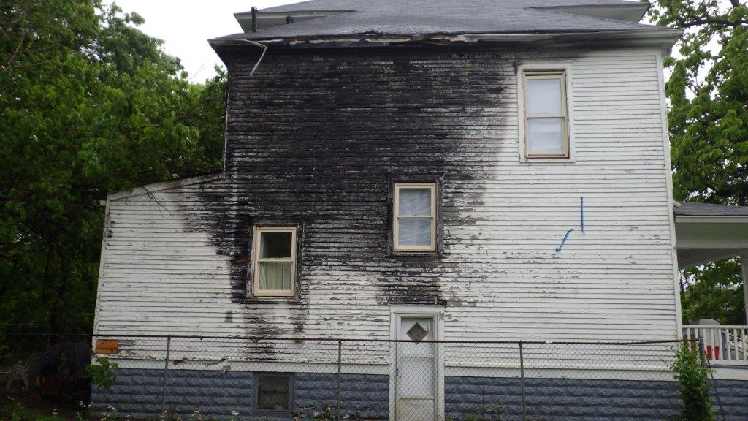
Louisville Metro Office of Housing and Community Development
Administers federal HUD monies
Home Repair Program
Down Payment Assistance
Russell Homeownership Repair Incentive Program

Slide 10
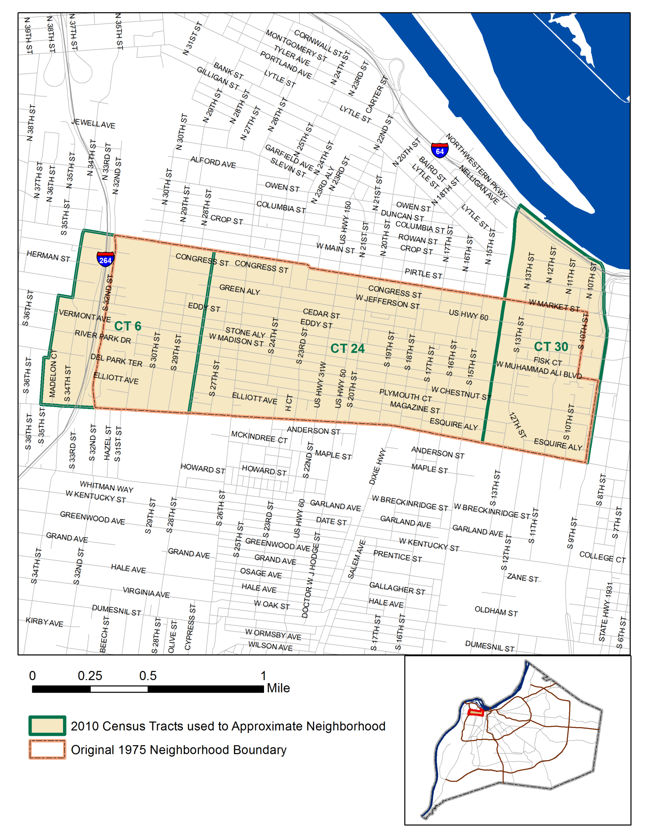
Why the Russell Neighborhood?
Notes:
Named for renowned African American educator Harvey Clarence Russell, Sr.
Encompasses 3 census tracts, 1.406 sq. miles
Population density: Russell: 6,615 people per sq. mi., compared to Louisville at 4,125 people per sq. mile
Development began in the 1870s as street car lines were extended to the area.
Considered one of Louisville’s most fashionable with affluent white families building elegant mansion homes while working-class blacks and whites lived in shotgun houses.
Became “Louisville’s Harlem” by the 1940s.
World War II and Urban Renewal efforts affected many changes to the neighborhood- many middle-class blacks left for newly-integrated neighborhoods, many buildings were razed by the Urban Renewal wrecking ball.
In 2016, Metro received a $29.5 million dollar implementation grant through US HUD’s Choice Neighborhoods Initiative program.

Slide 11
Resident Profile source: Vision Russell- A Roadmap for the Future
 | Beecher Terrace | Russell * | Louisville
# Households | 697 | 3,712 | 244,674
# Residents | 1,331 | 9,590 | 741,000
Average HH Size | 1.9 | 2.6 | 2.5
% HH With Children | 37% | 41% | 31%
Median Age | 25.5 | 28.5 | 37.0
% Children (18 and younger) | 43% | 26% | 26%
% Seniors 62+ | 8% | 8% | 13%
% Black, White, Hispanic** | 92%, 3%, <1% | 91%, 6%, 1% | 23%, 71%, 5%
% HH With 1+ Persons w/ Disability | 30% | 40.8% | 28.6%
Poverty Rate | --- | 59.7% | 17.3%
Average Tenure | 11.9 years | TBD | N/A
% HH on Food stamps in last 12 mo. | 69% | 59.6% | 16.3%

Slide 12
Why the Russell Neighborhood?
Russell Choice Grant
Fear of Gentrification
What can we do as a city to protect our seniors?
Notes:
As Russell continues to redevelop- with developments like as Cedar Street Development, a residential subdivision in the heart of Russell, redevelopment of Beecher Terrace and adjacent neighborhoods, we want to ensure that residents- such as those displaced by the Beecher Terrace redevelopment- are able to stay in the community, if they choose.

Slide 13
Life Planning Clinic
Sponsored by VPPA and Legal Aid Society
$20,000 grant agreement pilot
Initially targeting to the Russell Neighborhood
Notes:
Photo of clinic
Held at the Urban League, in the Russell Neighborhood
Approx. 25 attendees at 1st clinic
very well-received, lots of questions.

Slide 14
Aging In Place Legal Assistance
Partnership between Legal Aid Society and Louisville Metro Vacant and Abandoned Properties

Slide 15
Vacant and Abandoned Properties Partnership with Louisville Metro Government

Slide 16
The mission of the Legal Aid Society is to pursue justice for people living in poverty.

Slide 17
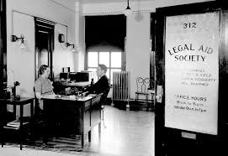
Legal Aid Society Louisville, Kentucky
Non-Profit Law Firm Founded 1921
Staff of 42 (26 Attorneys)
Volunteer Attorney Program
Serving Fifteen Kentucky Counties (Breckinridge, Bullitt, Grayson, Hardin, Henry, Jefferson, Larue, Marion, Meade, Nelson, Oldham, Shelby, Spencer, Trimble & Washington Counties).

Slide 18
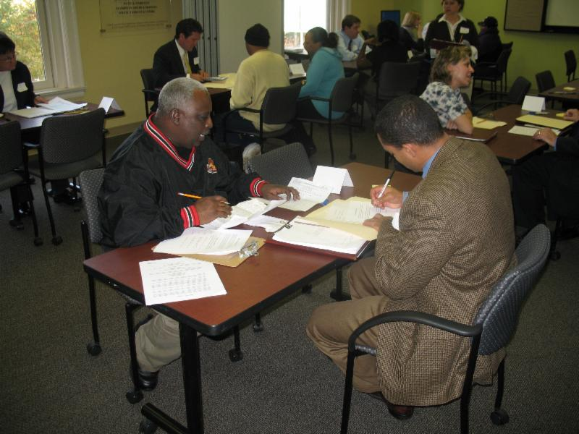
Life Planning Clinics

Slide 19
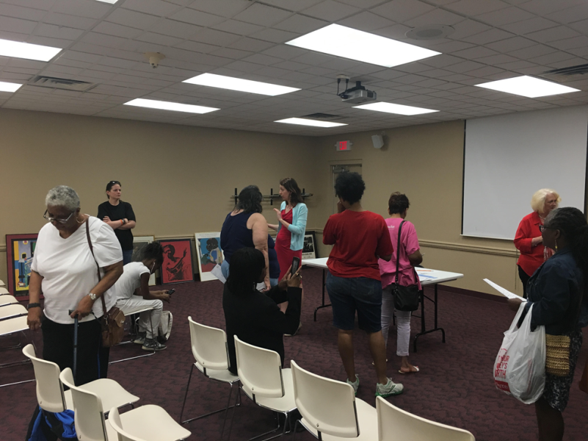
Life Planning Documents
Power of Attorney (Durable/Limited/Springing)
Living Will / Health Care Surrogate Appointment
Simple Will

Slide 20
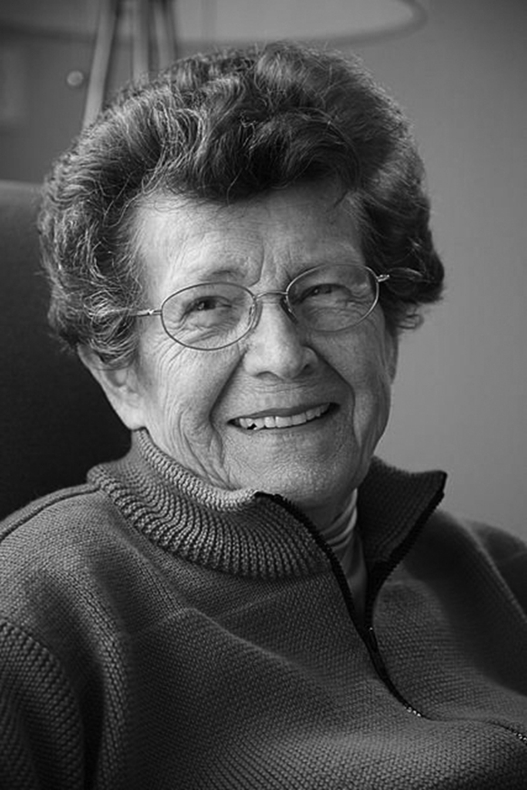
Estate Planning Advice
Real Property
Bank Accounts
Life Insurance
Fiduciary Duty
Medicaid Qualifications
Probate
Special Needs Trusts

Slide 21
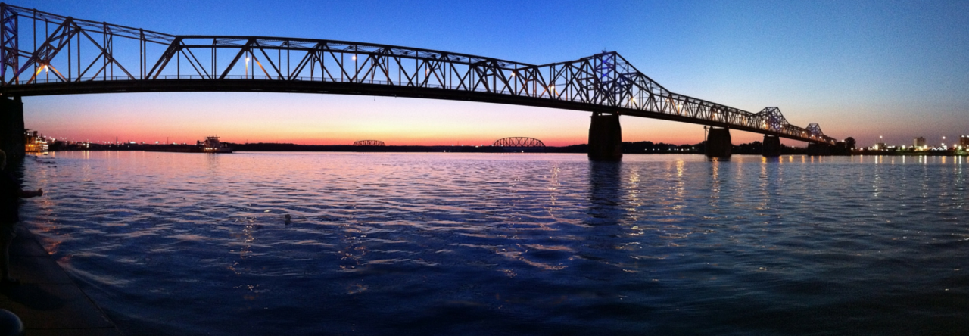
Barriers and Solutions
Myths
Fears – “If I sign a will…”
“I don’t have anything…”
Clear Title
Passage of Property without Planning

Slide 22
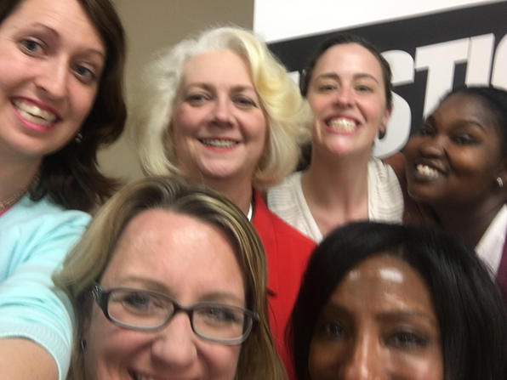
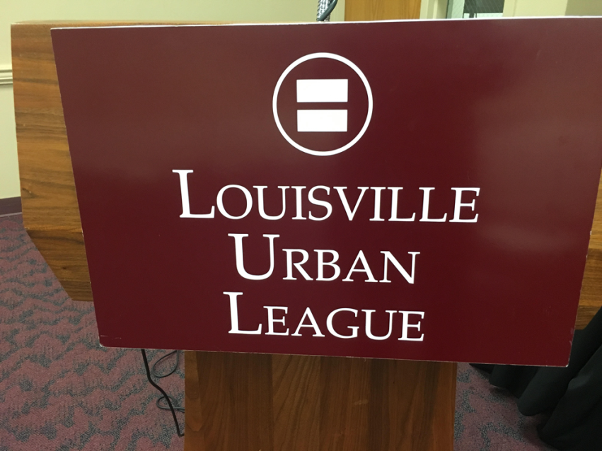
Community Outreach

Slide 23
Community Centered

Slide 24
Professional Services

Slide 25
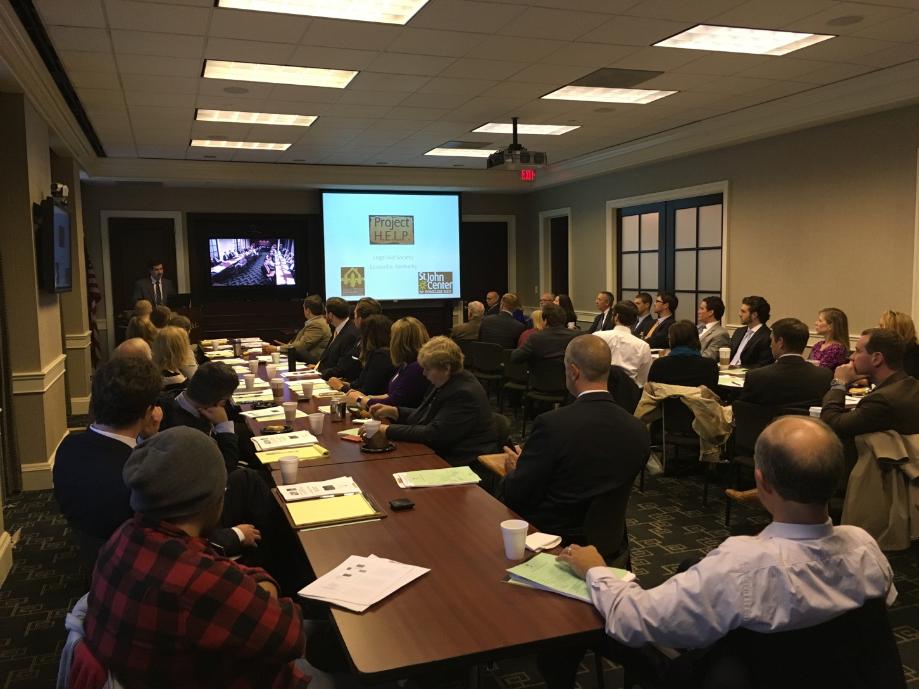
Leveraging Volunteer Resources

Slide 26
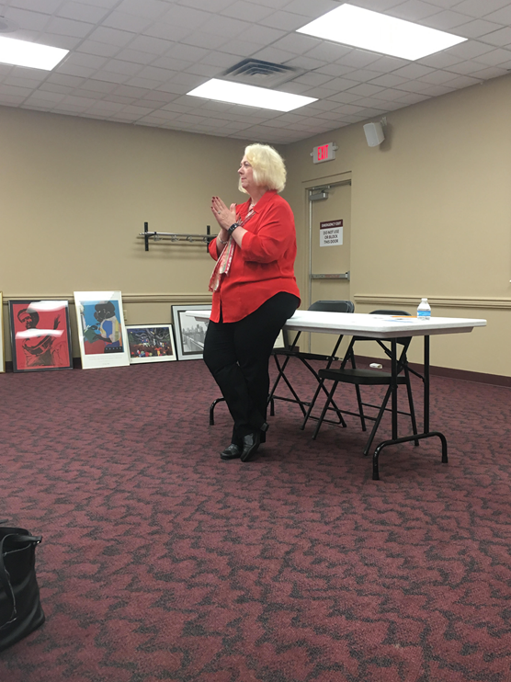
Trust & Accessibility

Slide 27
Marketing
Concerned Pastors Of Russell (CPR, approx. 12 churches)-
Center for Neighborhoods
Urban Strategies
Russell Neighborhood Association
Sweet Peaches
Louisville Central Community Center
Western Library
Chestnut St. YMCA
Metropolitan Housing Coalition- Posted on web site
Office of Housing and Community Development- ailed out to existing housing clients, Will posted on home page
Other Metro Agencies (VPPA, RCS)- posted on home page
Louisville Metro Housing Authority/Vision Russell
Kentucky Center for African American Heritage

Slide 28
Summary
Additional Life Planning Clinics with increased marketing, possibly branching out into other neighborhoods
Increase in clear titles to allow aging in place or donation of property, as owners choose
Continued partnering and support of existing programs within the community
Disposition programs for interested/qualified. Numerous properties within the Russell neighborhood.
Notes:
Photo of a meeting at another of our very active community partners, Louisville Central Community Centers (LCCC)
LCCC has been working in the Russell neighborhood for many years.
Photo of Sam Watkins, immediate past Director, conducting a community function.
As an example, many of the lots for the Cedar Street Development came from Metro’s inventory of vacant properties.
Encourages a variety of price points

Slide 29
Questions?

Slide 30
Laura Grabowski, Director, Office of Vacant and Public Property Administration
Laura.Grabowski@LouisvilleKY.gov
502.574.7308
@LouForward
@LouisvilleForward

Slide 31
Neva-Marie Polley Scott
Legal Aid Society
Louisville, Kentucky
nscott@laslou.org

