Slide 1

Using Data to Determine Blight Remediation Interventions and Outcomes

Slide 2
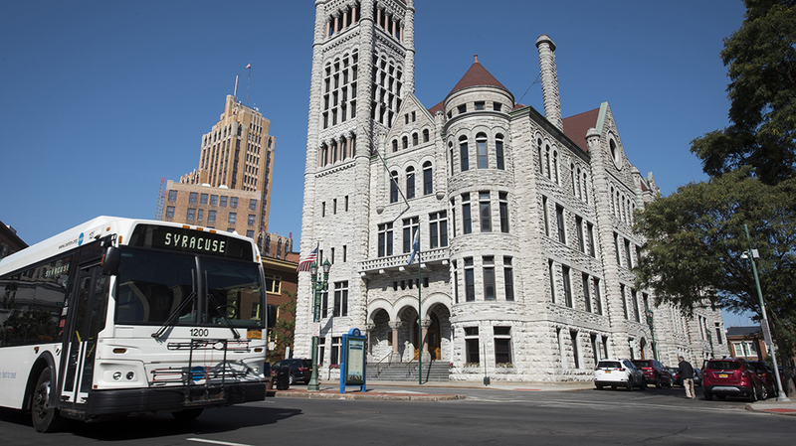

Data Driven Investment:
Tools and Strategies
Cali Nellis Khakoo, Director of Housing and Neighborhood Planning
Belen Cordon, Mapping and Data Analyst

Slide 3

Department of Neighborhood and Business Development
Vacant Property Inventory Management
Leveraging Investments
Proactive Identification of Projects
Strategic Code Enforcement
Tax Foreclosure

Slide 4

Presentation Overview
Data Overview
Vacant and Abandoned Property Outcomes
Targeted Interventions at the Block and Neighborhood Level
Data-driven Initiatives

Slide 5





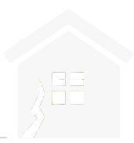
Data Overview
1,796 Total Vacant Structures
1,506 Vacant properties with Open Code Violations
1,100 vacant properties without Vacant Property Registration
100 Structure Demolitions Per Year
356 Demolition Candidates Identified
8 City Emergency Demolitions
Per Year
20 Funded Homeownership Rehabs Per Year
255 SHARP Grants and Urgent Care Cases Per Year
918 in Land Bank Inventory
375 Properties in Tax Foreclosure Pipeline
63 Currently Tax Delinquent Structures Not Yet Targeted
86 Suspected Zombies
1028 tax-current vacant properties

Slide 6







Data Tools
Excel
Access
R
ArcGIS
QGIS
Google Maps
Tolemi’s Building Blocks

Slide 7
Data Points/Types
Condition
Period of vacancy
Fire Damage
Severity of Code Violations
Former Demolition Activity
Location within NRSA
Water Account Status
Block Stability
Neighborhood Concern/Priority
Proximity to Previous Investment
Land Size
Zoning Designation
Deed Status
Sale Date
Assessed Value
Property Size
Property Type

Slide 8
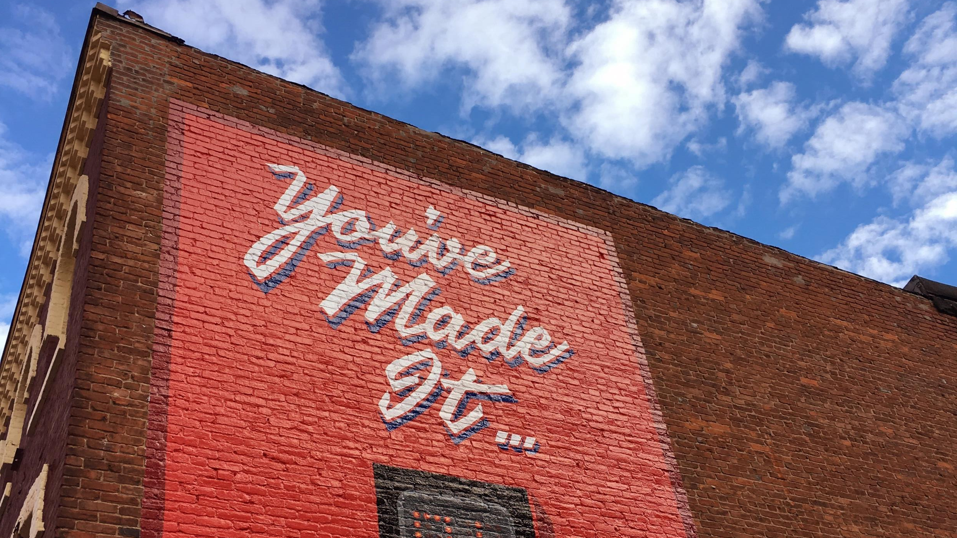
VACANT AND ABANDONED PROPERTY OUTCOMES
Data-driven blight remediation strategies are only as effective as the quality of the data input

Slide 9
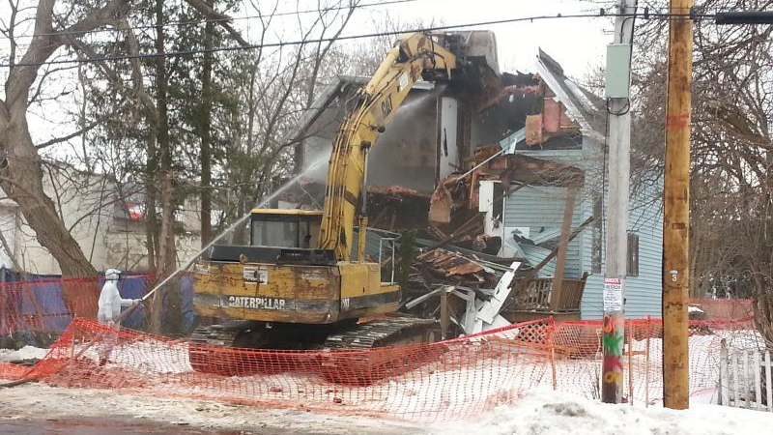
Demolition
Condition
Period of vacancy
Fire Damage
Water Account Status
Block Stability
Neighborhood Concern/Priority

Slide 10
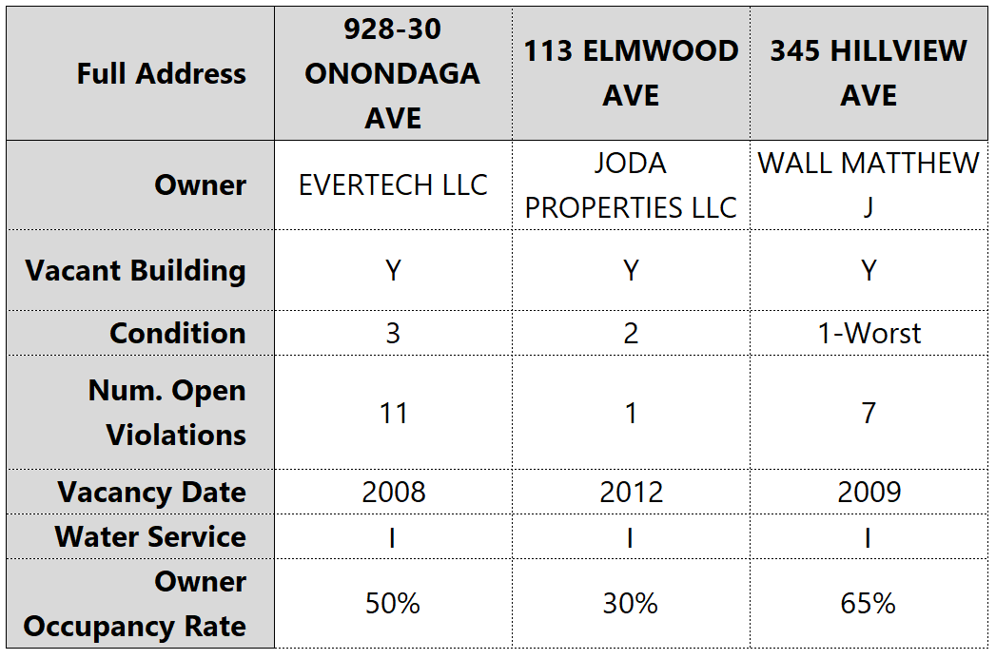
Demolition

Slide 11
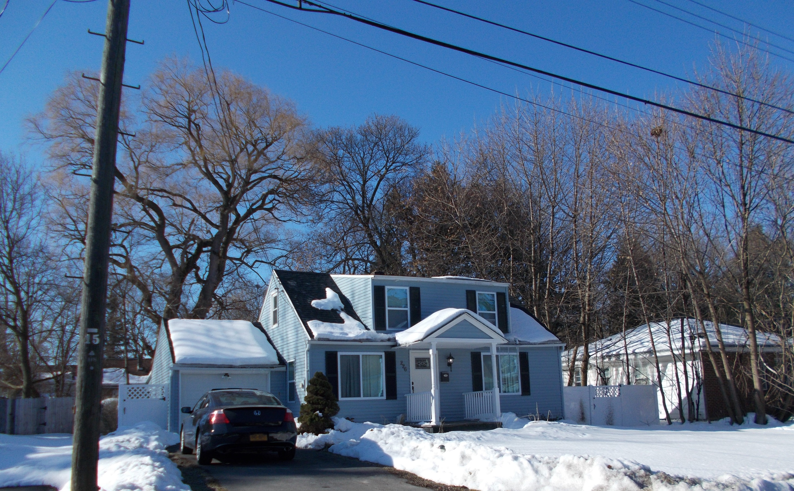
Renovation for Occupancy
Condition
Period of Vacancy
Block Stability
Assessed Value
Property Size
Property Type
Proximity to Previous Investment

Slide 12
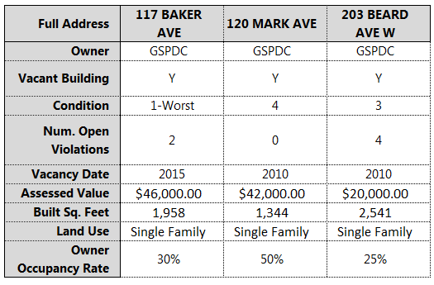
Renovation for Occupancy

Slide 13
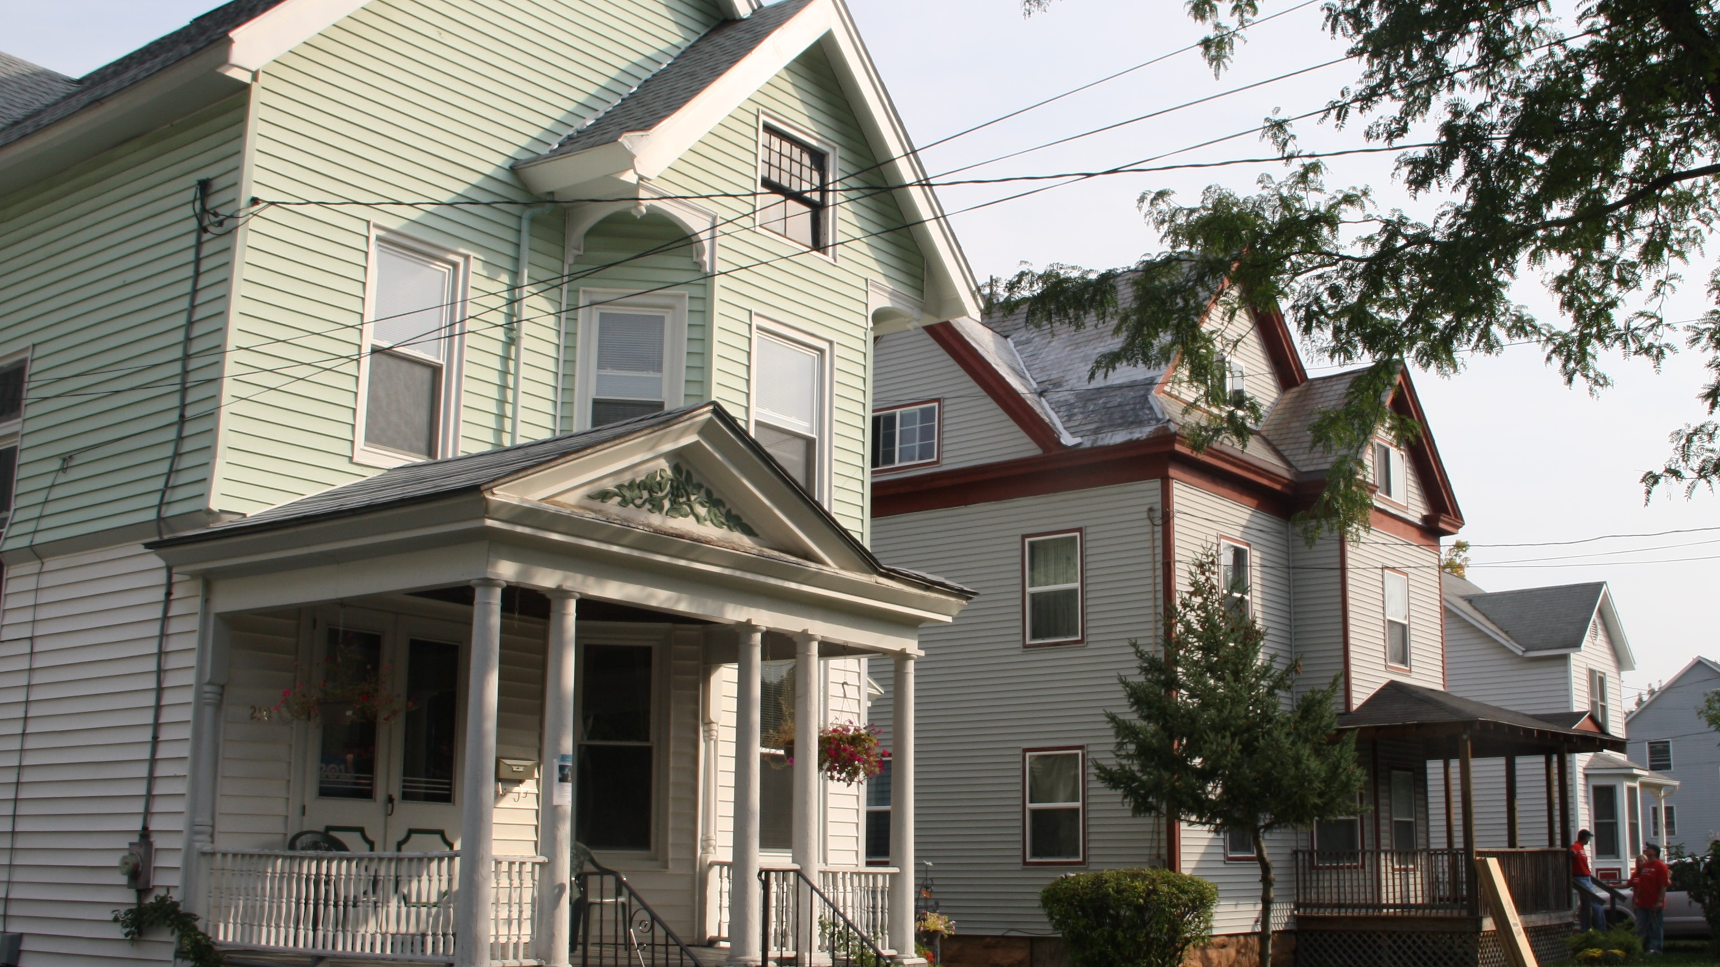
New Construction
Block Stability
Land Size
Zoning Designation
Location within NRSA
Former Demolition Activity
Proximity to Previous Investment

Slide 14
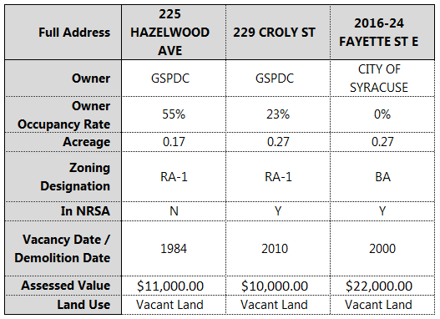
New Construction

Slide 15
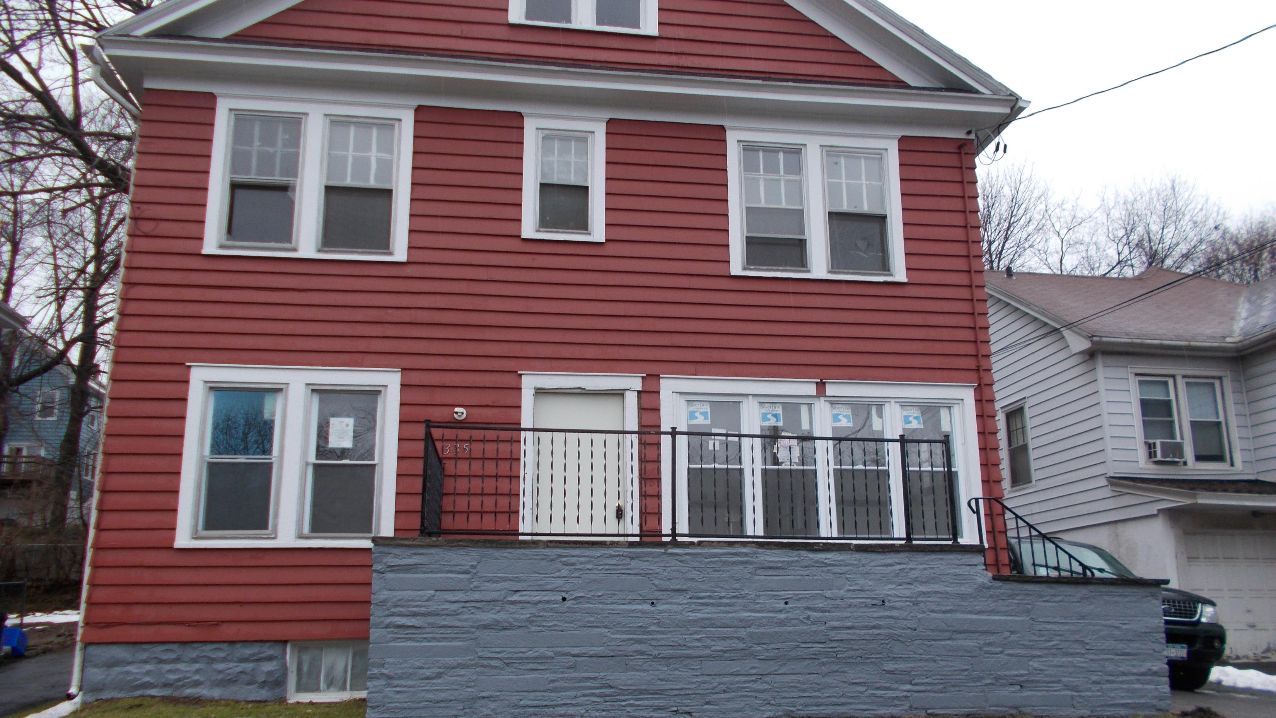
Blight Remediation
Condition
Block Stability
Deed Status
Sale Date
Property Size
Property Type
Severity of Code Violations
Proximity to Previous Investment

Slide 16
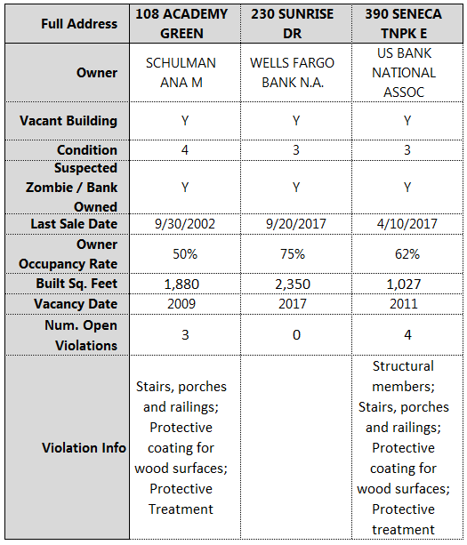
Blight Remediation

Slide 17
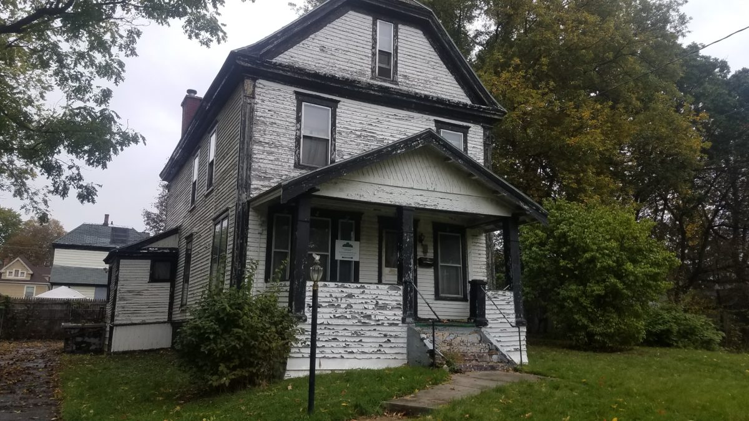
Tax Foreclosure
Tax Delinquency
Occupancy Status
Property Type
Previous Tax Foreclosure Cases

Slide 18
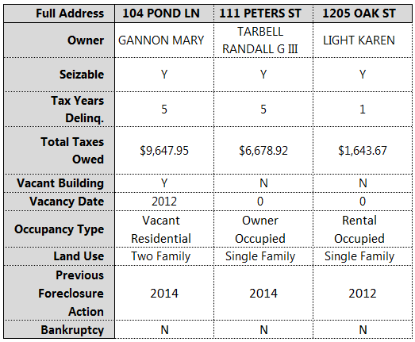
Tax Foreclosure

Slide 19
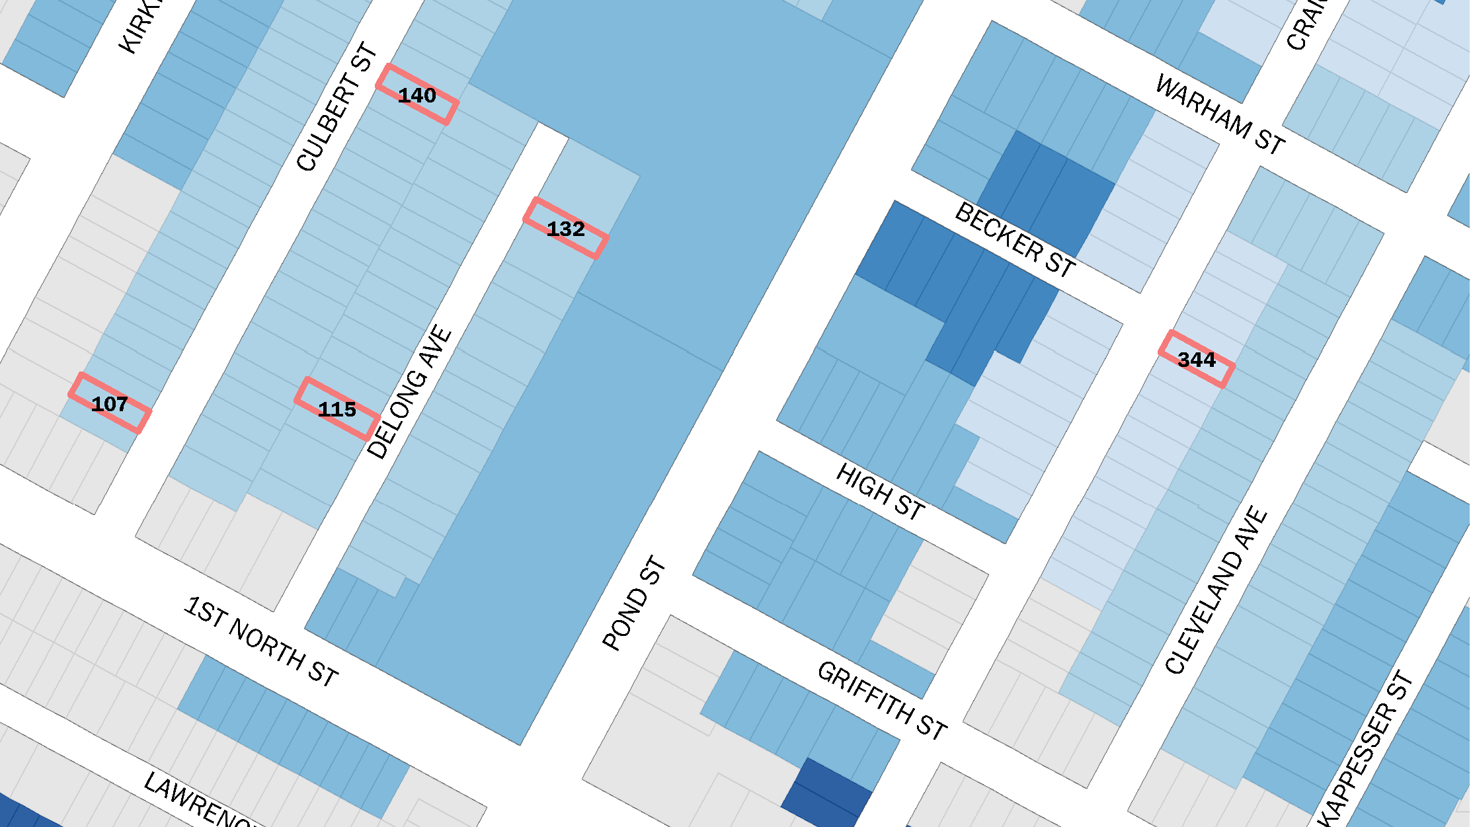
TARGETING INTERVENTIONS AT THE BLOCK AND NEIGHBORHOOD LEVEL

Slide 20
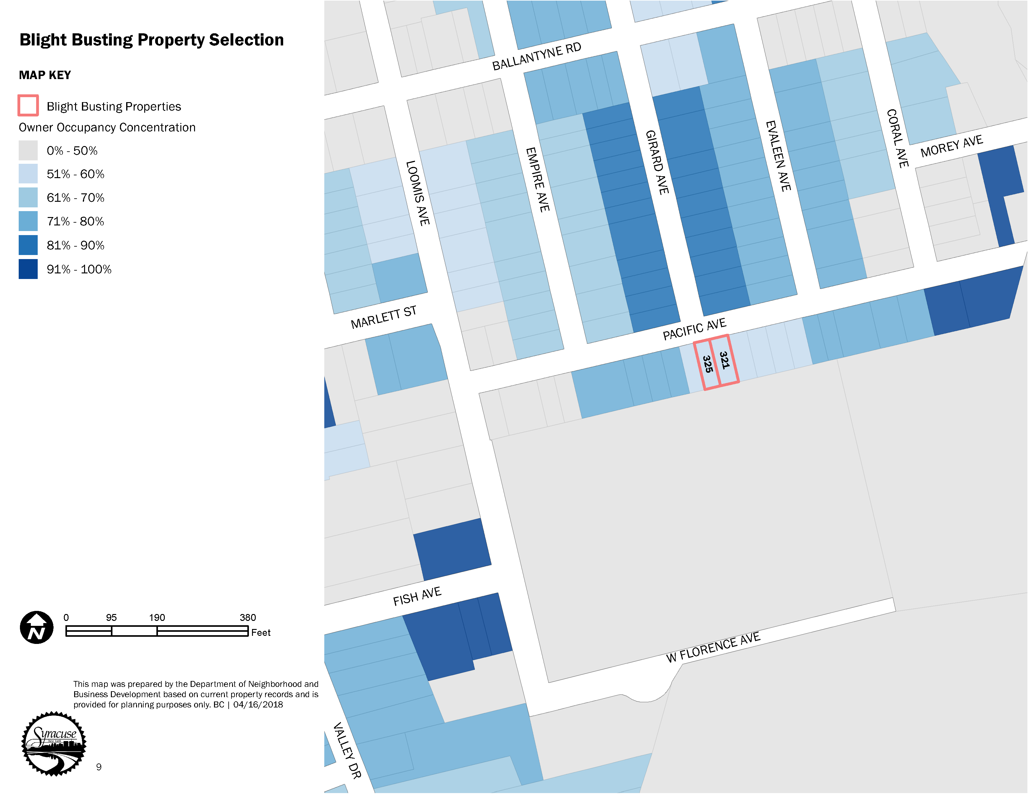
Property-Level Analysis
Use an index or scoring system to identify priority candidates for a program or outcome
Focus effort on properties most likely to have an impact and achieve the desired results
Identify critical factors to be addressed and assign weight to them in the scoring system

Slide 21
Property-Level Analysis
Use an index or scoring system to identify priority candidates for a program or outcome
Focus effort on properties most likely to have an impact and achieve the desired results
Identify critical factors to be addressed and assign weight to them in the scoring system

Slide 22
Property-Level Analysis

Slide 23
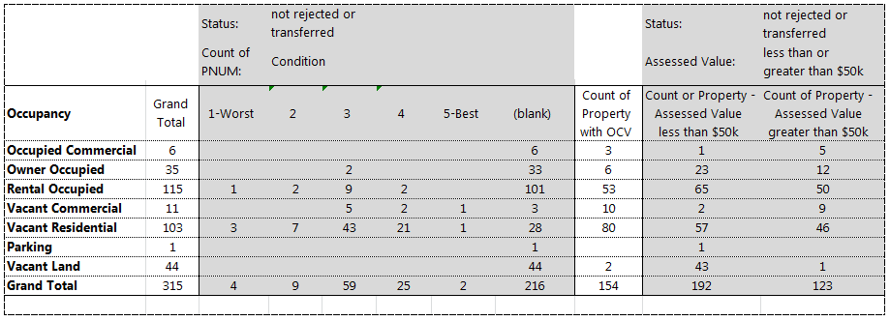
Inventory Analysis
Review properties by desired outcome and related conditions (data points) by using Pivot Tables.

Slide 24
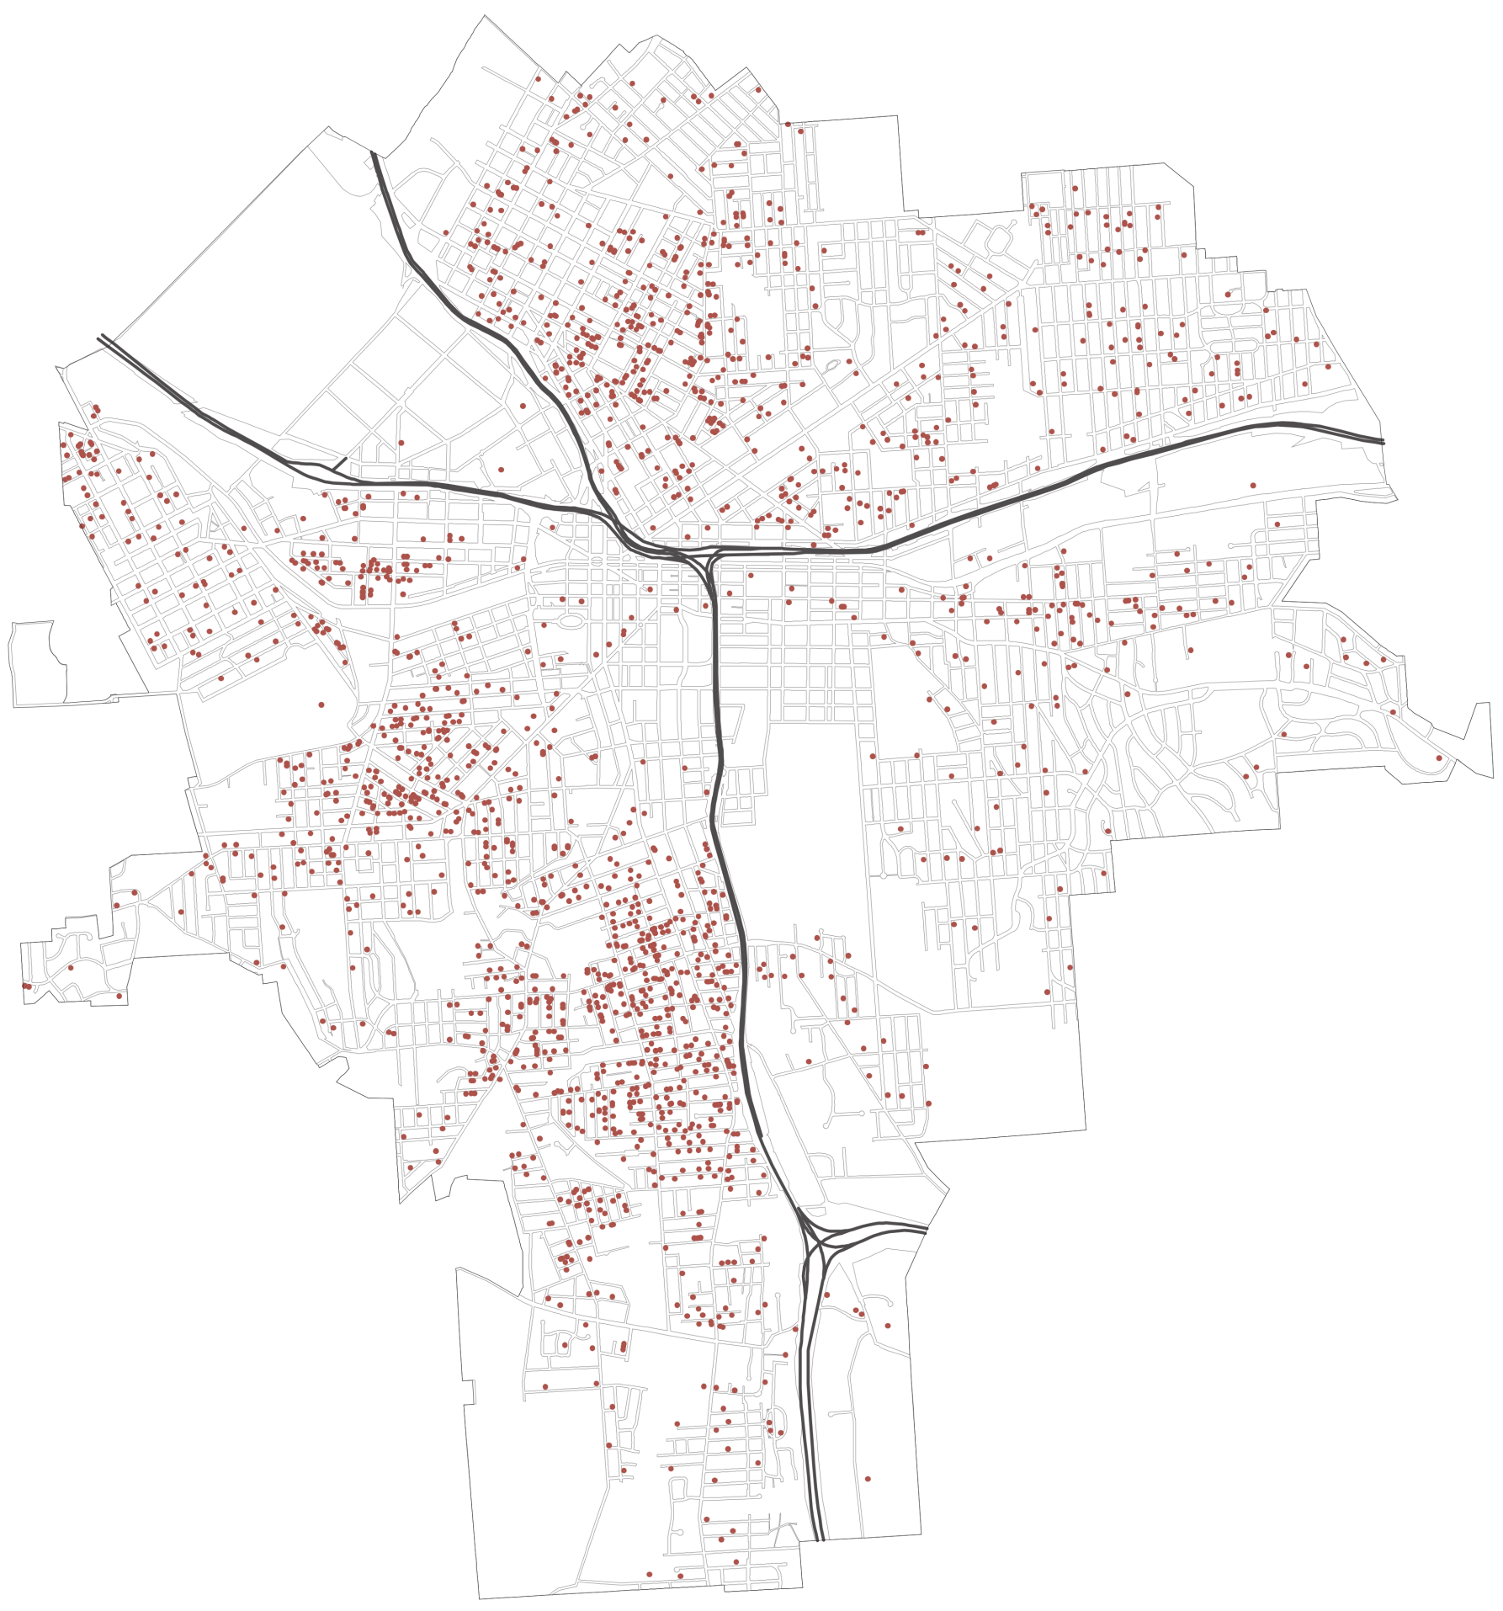
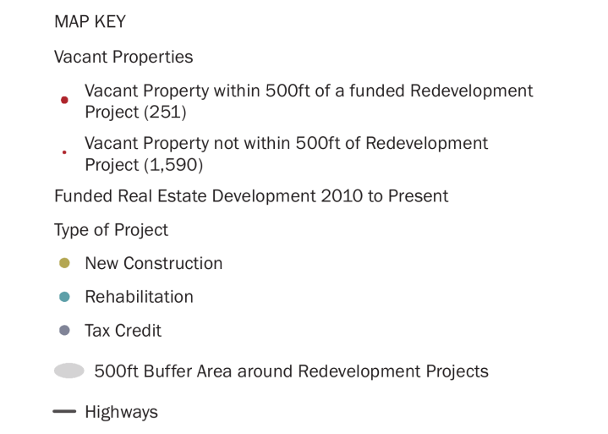
Proximity Analysis
Use area around previous projects (rehabilitations, demolitions, and new construction) to prioritize vacant structures leverage past investment.
Works both at the City- and neighborhood-level to concentrate impact when appropriate.

Slide 25

Proximity Analysis
Use area around previous projects (rehabilitations, demolitions, and new construction) to prioritize vacant structures leverage past investment.
Works both at the City- and neighborhood-level to concentrate impact when appropriate.

Slide 26
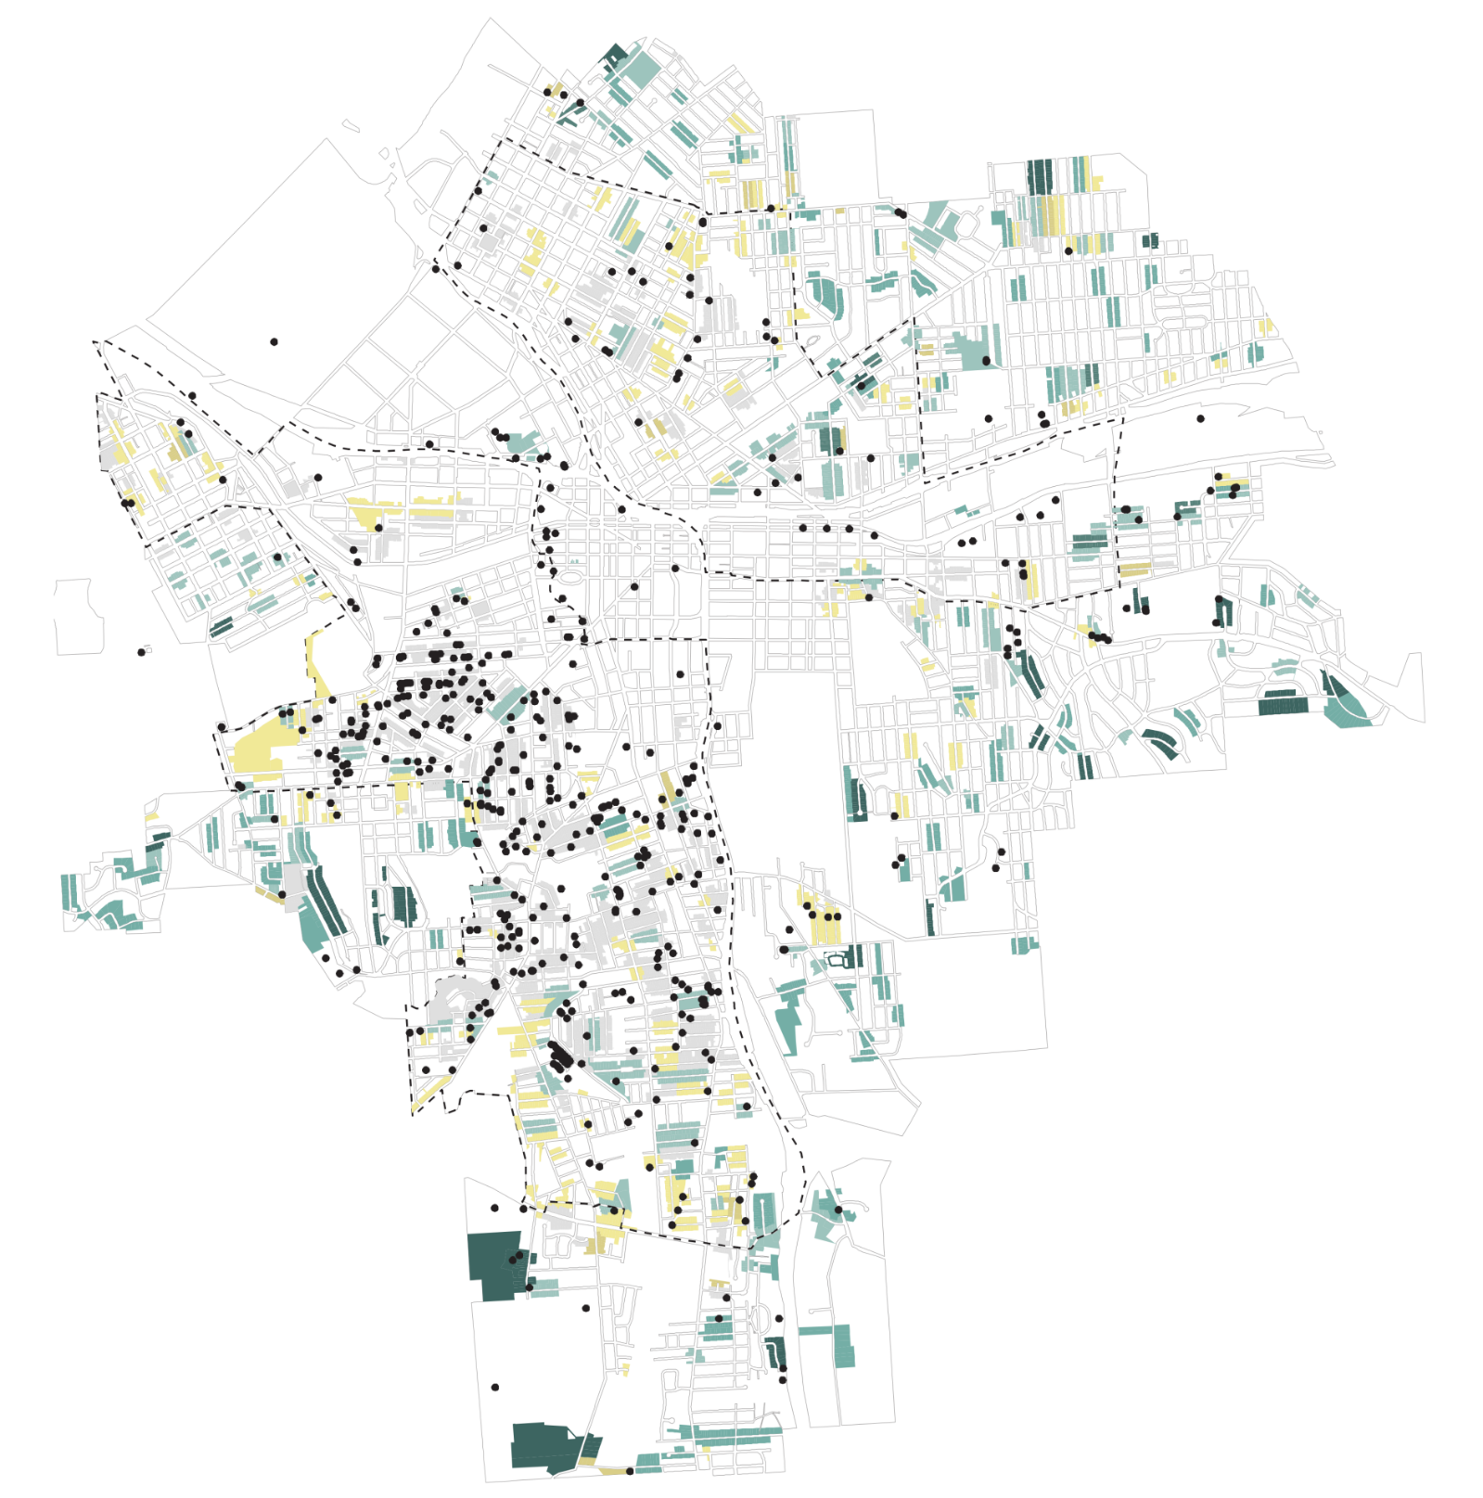

Block Stability Analysis
A scoring strategy to identify target blocks for redevelopment or blight mitigation.
Mapping city blocks by scores above or below median illustrates target areas for the strategy.

Slide 27

Data-driven Initiatives

Slide 28
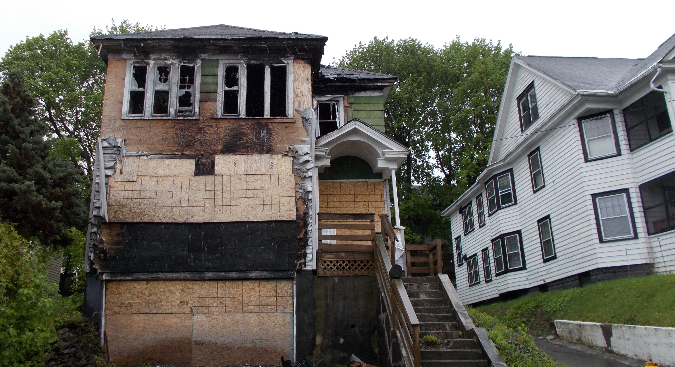
Vacant Property Taskforce
An interdepartmental collaborative initiative dedicated to addressing vacant structures in the City of Syracuse.
  Demolitions
  Blight Busting
  Fire-damaged properties
  Neighborhood blight concerns
The taskforce relies on data-driven property prioritization to leverage the best results for every property addressed.

Slide 29
Vacant Property Taskforce

Slide 30
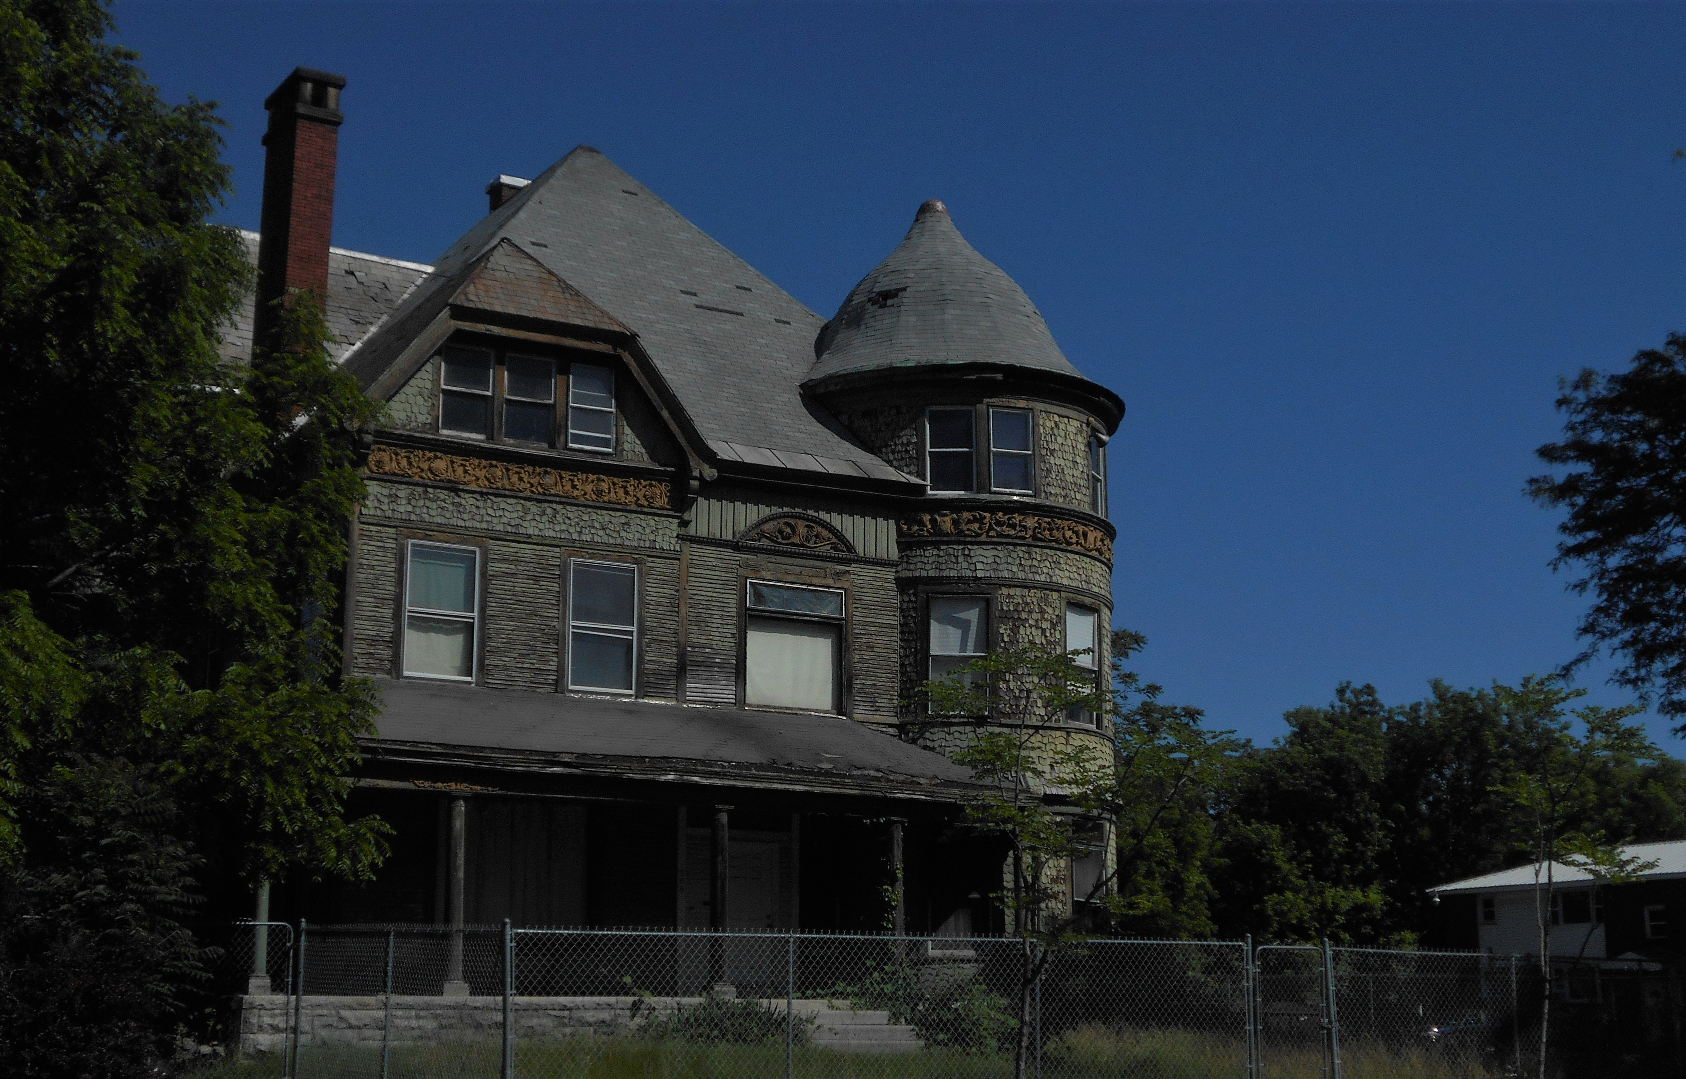
At-Risk Historic Structures Taskforce
A collaboration of the Division of Code Enforcement, Department of Neighborhood and Business Development, and the Syracuse and Onondaga County Planning Agency.
Taskforce working group meets regularly to review inventory of properties which are vacant and historically significant.

Slide 31
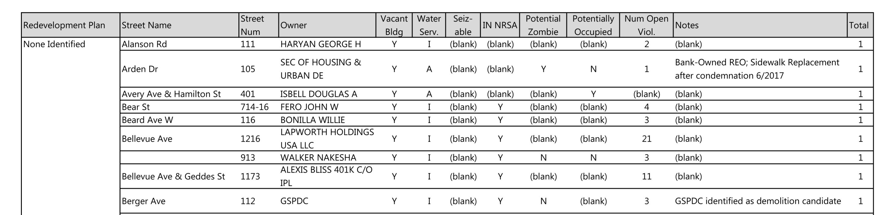
At-Risk Historic Structures Taskforce

Slide 32


Data Driven Investment:
Takeaways
Collaboration is Crucial
Practice Proactive Decision-Making
Combine Available Tools

