Slide 1
Double Duty Linking Vacant Property Remediation to Workforce Development
Martha Brown, City of Milwaukee
Leo Ries, MLK Economic Development Corp.
Carl Quindel, Strong Blocks
Ted Matkom, Gorman & Co.

Slide 2
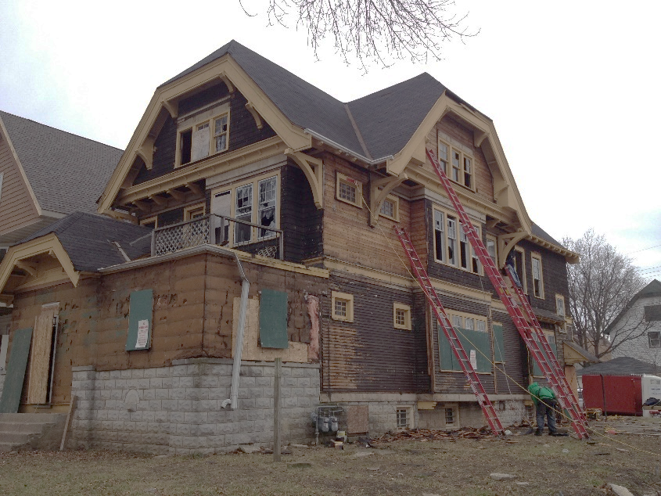
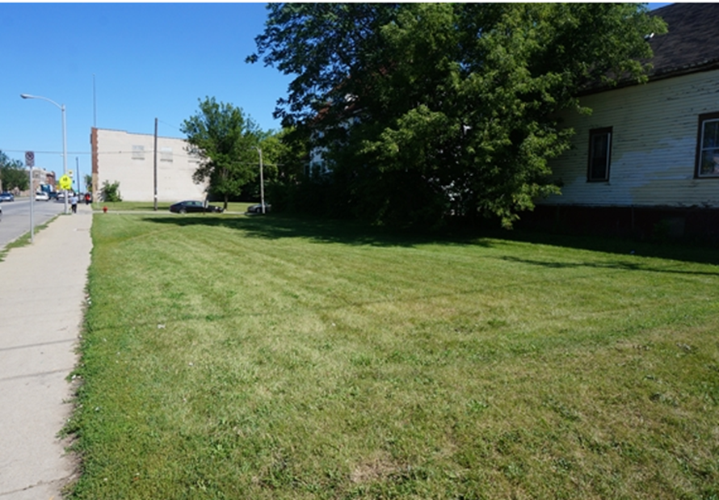
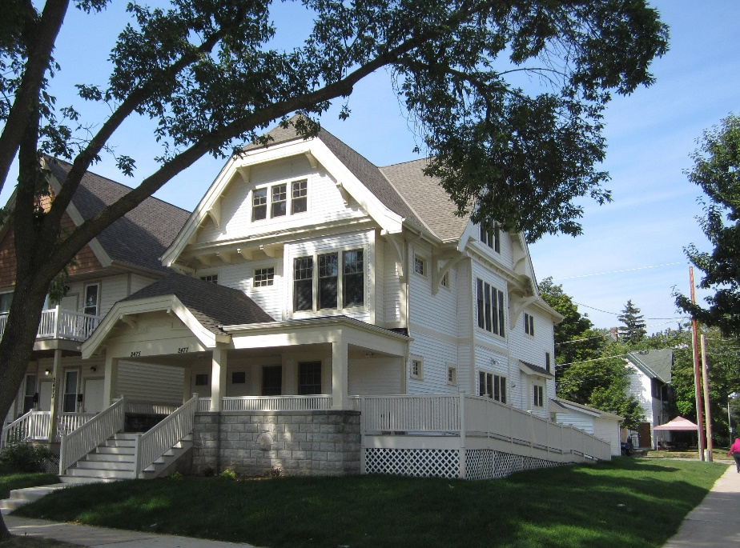
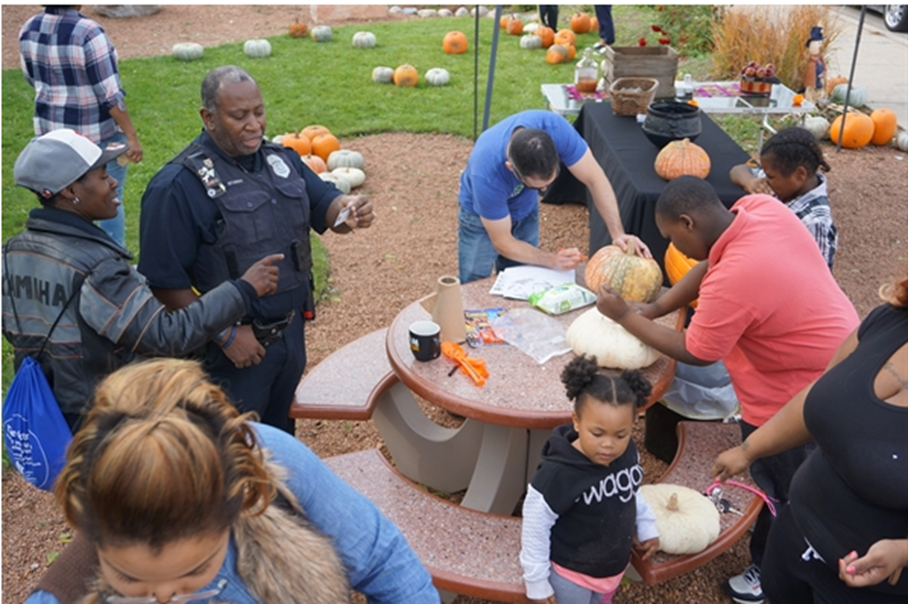
A second chance for property

Slide 3
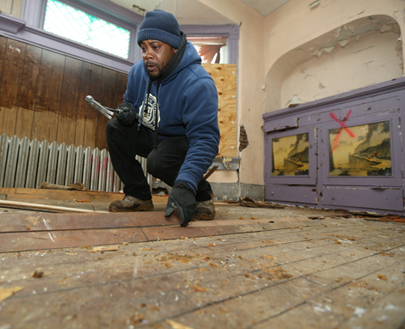
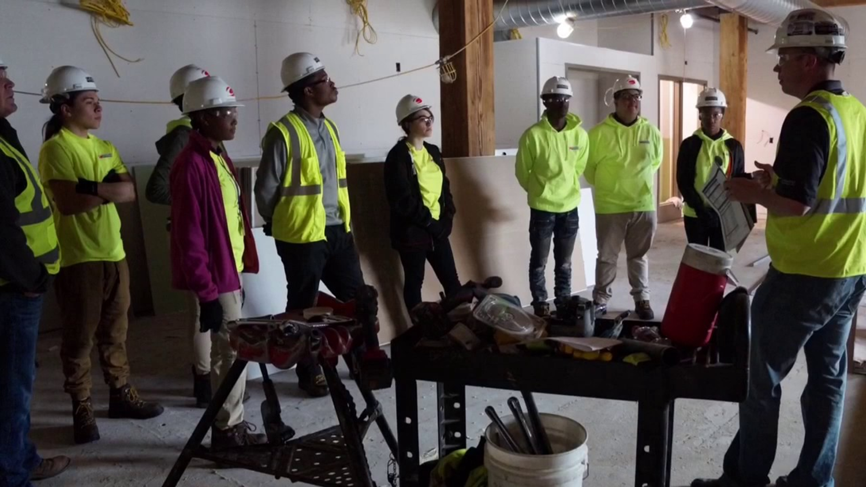
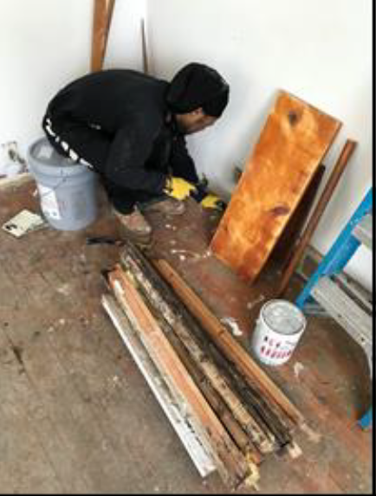
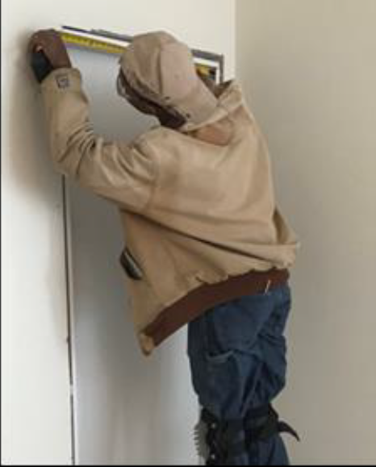
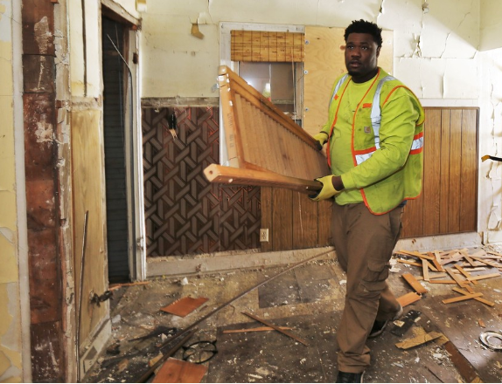
A second chance for people

Slide 4
Second chance strategies Require workforce development as a condition of financing
Milwaukee Resident Preference Program
Projects assisted with Tax Incremental Financing
At least 40% of work hours must be performed by City residents with barriers to employment
City maintains master RPP certification list
Workforce agencies assist individuals with certification process

Slide 5
Second chance strategies Incentivize employment
Milwaukee Employment/Renovation Initiative
Developers buy 5 or more tax-foreclosed houses for $1/property
Rehab grant (up to $10,000) provided after renovation is complete
Grant amount based on hours worked by:
RPP-certified workers
Workers referred by construction training program

Slide 6
Second chance strategies CBO/Developer Partnership
Northcott Neighborhood House/
Gorman & Co.
Northcott operates “Milwaukee Builds”
Basic construction skills training
Certifications
Gorman provides work-site experience at foreclosed properties

Slide 7
Martin Luther King Economic Development Corporation
Established 1993
Outgrowth of Neighborhood and Family Initiative, sponsored by Greater Milwaukee Foundation and Ford Foundation
Mission
Create wealth and jobs
Provide technical assistance to area businesses
Develop affordable rental and owner-occupied houses
Support initiatives that strengthen Harambee community

Slide 8
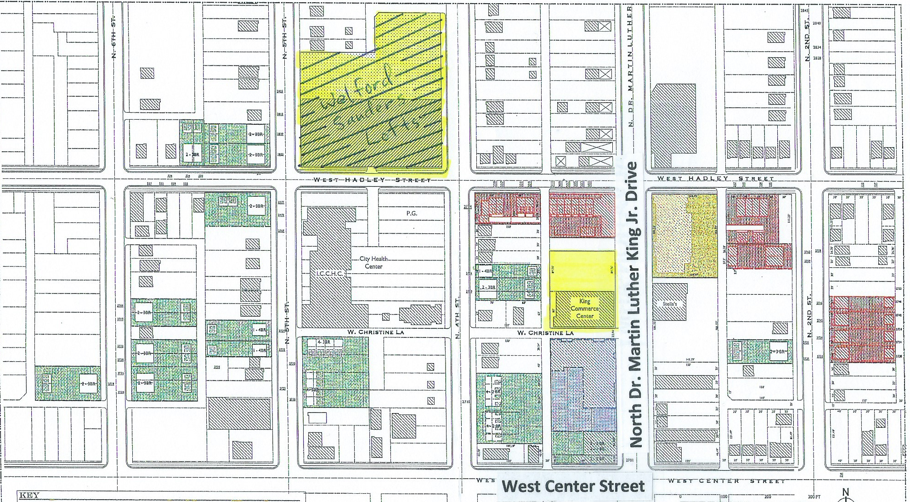

Slide 9
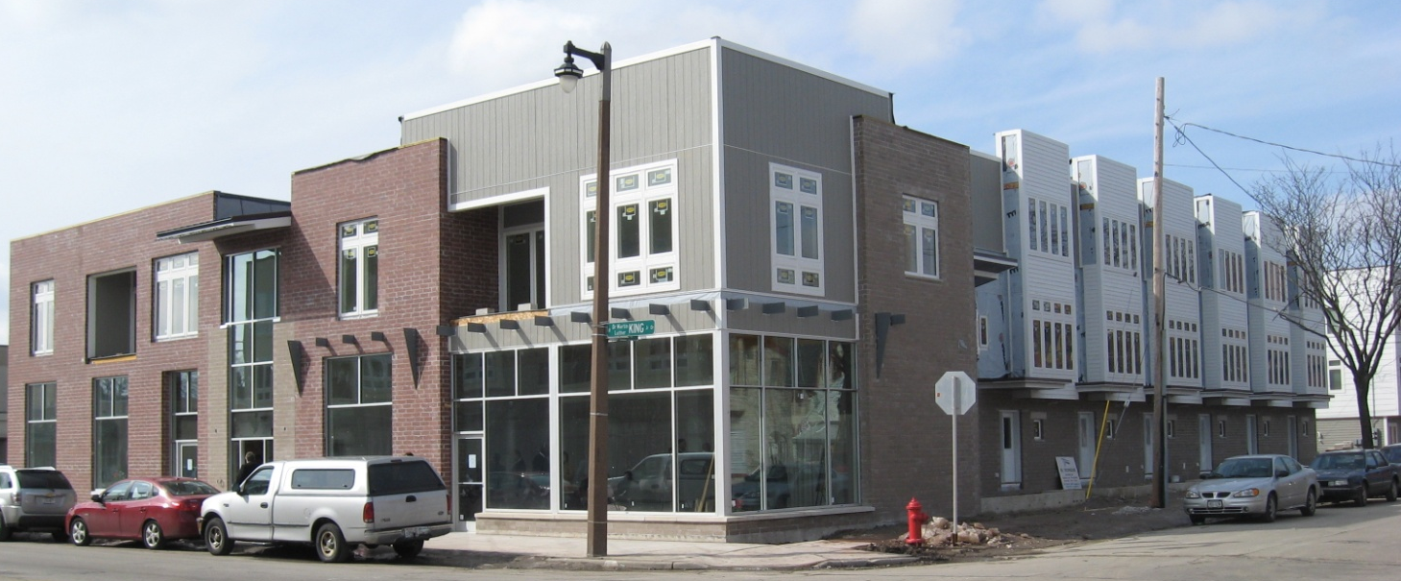
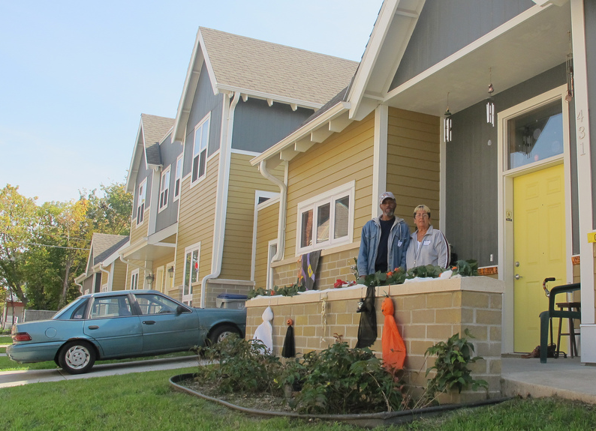
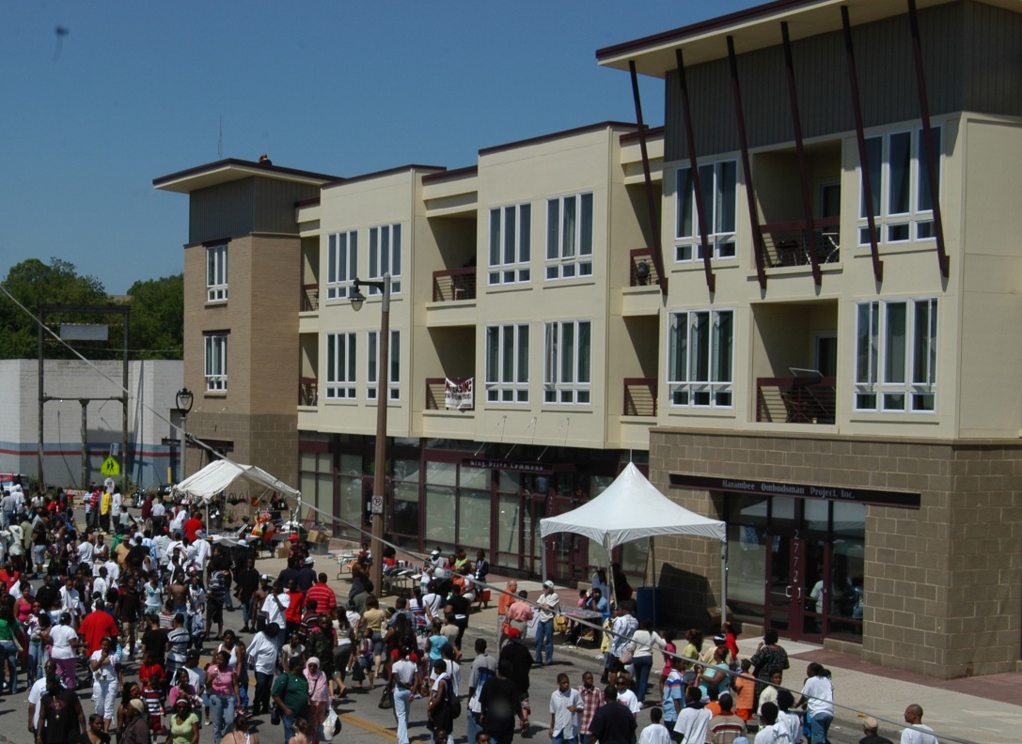

Slide 10
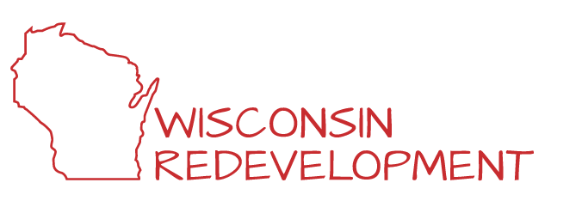
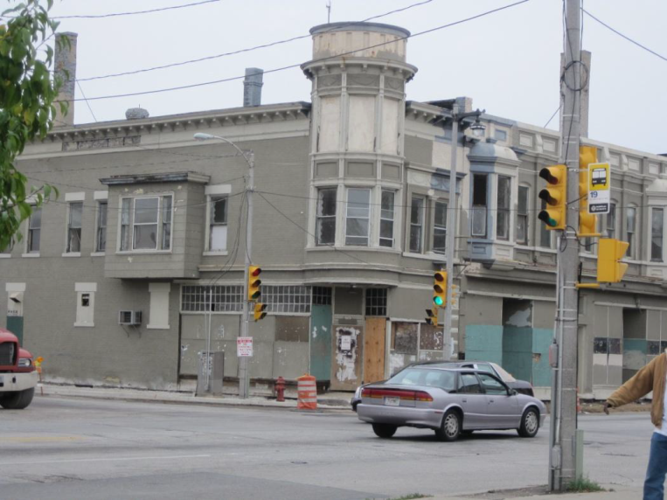
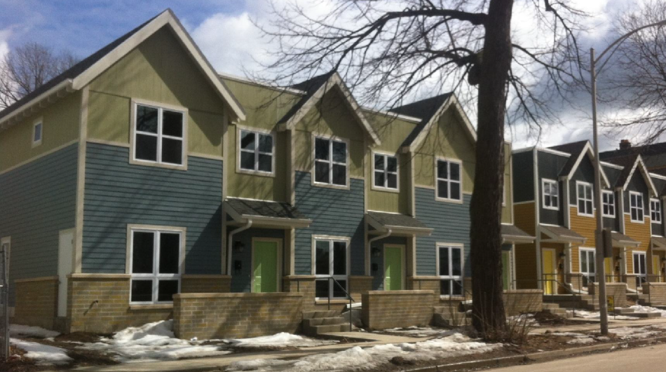
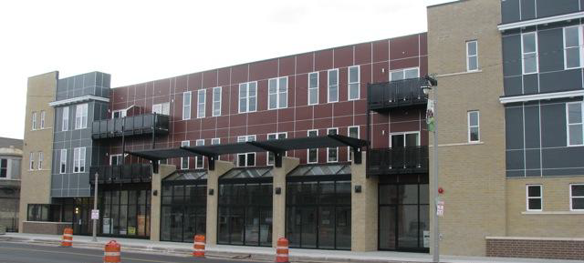

Slide 11
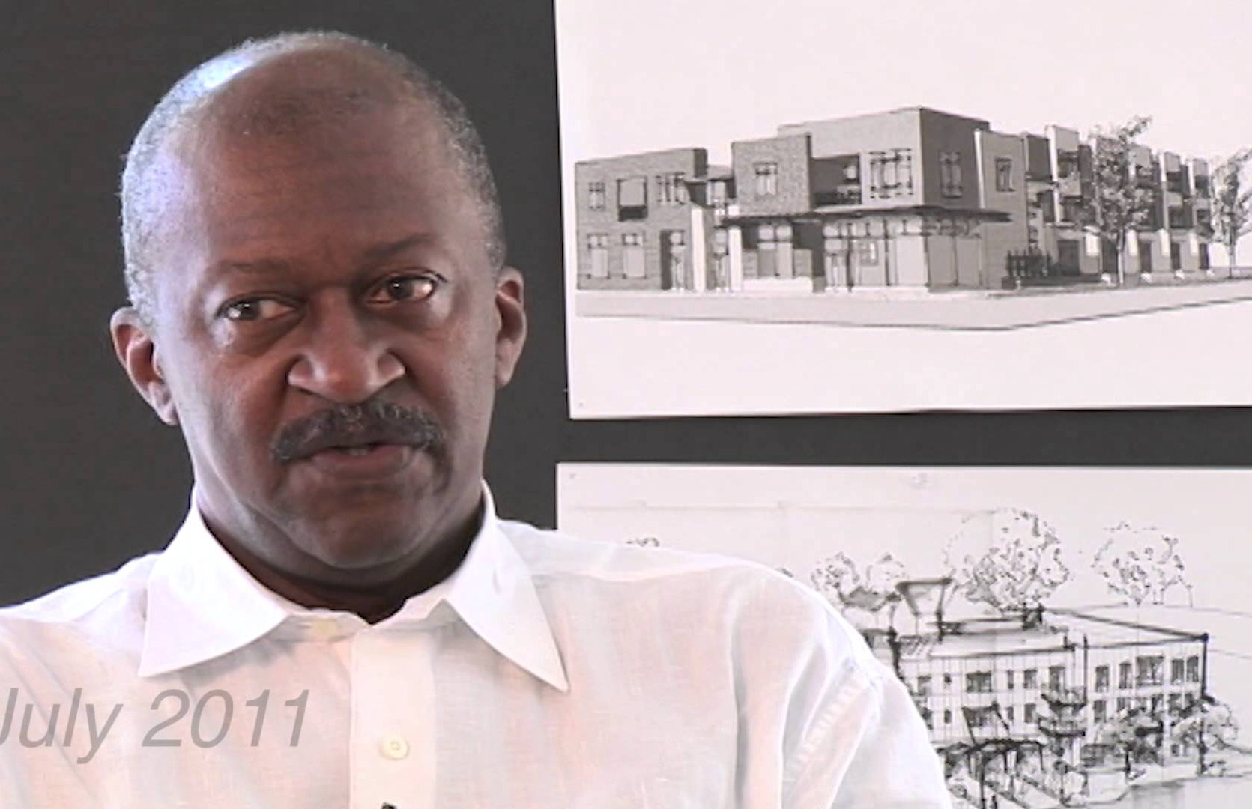
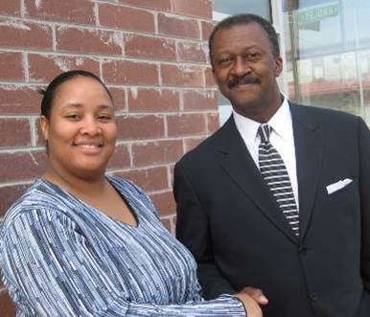
Insert pictures of Welford
Welford Sanders

Slide 12
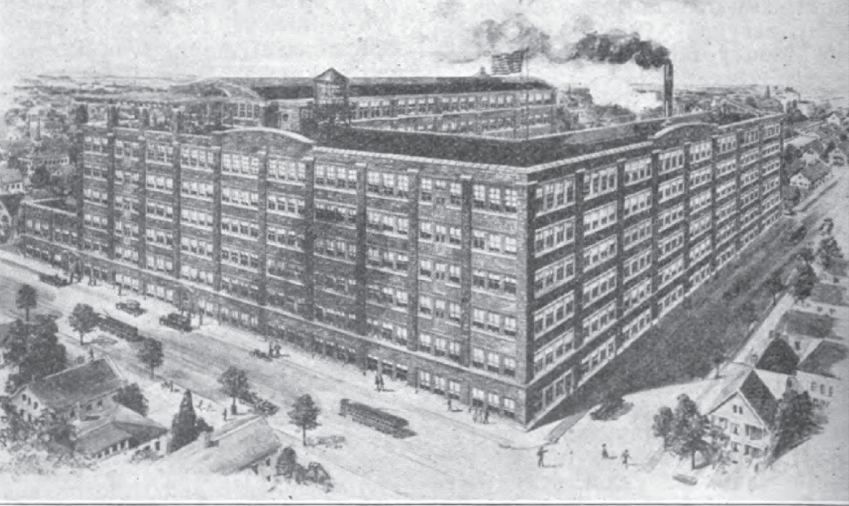
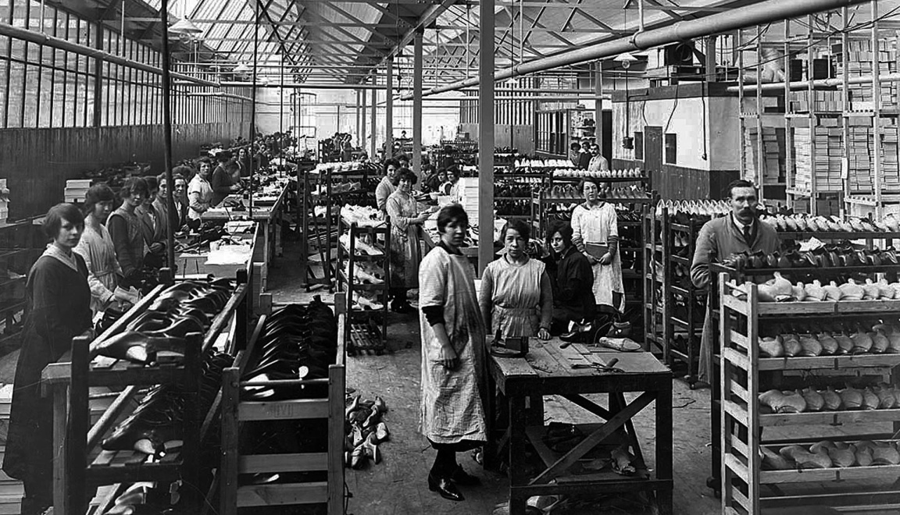
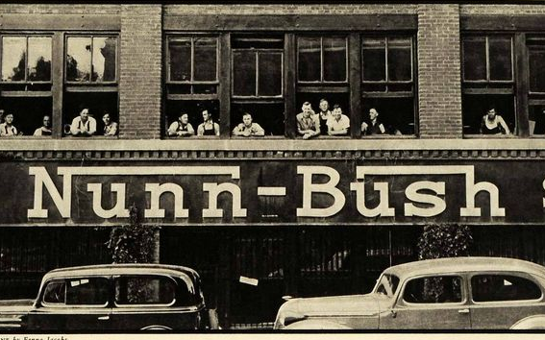
Nunn Bush Shoe Factory

Slide 13
Property history
Built 1916; 190,000 square feet, 7 stories
Factory closed early 1980s
Sold in 1985 to Milwaukee Area Technical College; operated as Milwaukee Enterprise Center-North business incubator
MEC-North closed 2011
Property changed hands 3 times between 2011 and 2014
Final buyer donated property to Martin Luther King Economic Development Corp.

Slide 14
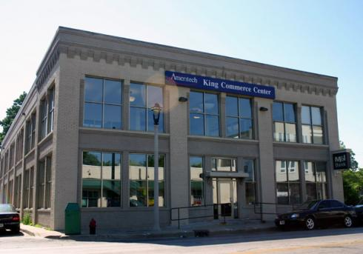

Slide 15
Welford Sanders Historic Lofts and Enterprise Center
Project vision
Adaptive reuse of historic structure – renovation to historic standards
Create 59 housing units affordable to families with incomes under 60% of Area Median Income
Build 35,000 square feet of commercial space – with emphasis on tenants who focus on workforce development and community services

Slide 16
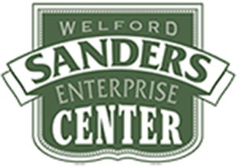
Project financing
$21 million investment
Low income housing tax credits
Historic tax credits (federal and state)
Tax exempt bond financing from Wisconsin Housing and Economic Development Authority
Federal HOME funds from City of Milwaukee
Tax incremental financing from City of Milwaukee
Wisconsin Economic Development Corporation community development grant
Grant from Associated Bank
R-4 Capital, national equity syndicator , purchaser of the federal tax credits

Slide 17
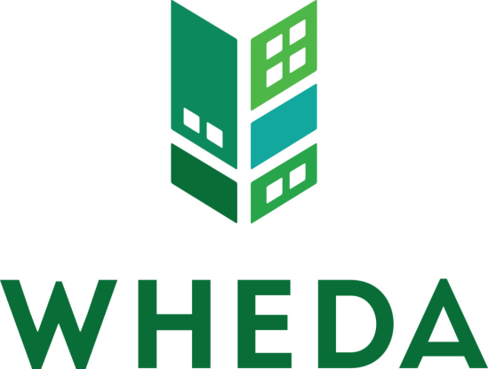
Welford Sanders Historic Lofts and Enterprise Center
Workforce and supplier diversity requirements imposed by:
HUD HOME financing
WHEDA LIHTC financing
City of Milwaukee Tax Incremental Financing (TIF) financing

Slide 18
Welford Sanders Historic Lofts and Enterprise Center
Supplier diversity requirements
HUD Section 3
WHEDA emerging business program
City of Milwaukee small business enterprise program
25% of construction spending with certified SBEs
18% of professional services spending with SBEs
Workforce diversity requirements
WHEDA workforce development program
City Residents Preference Program
40% of work hours performed by RPP-certified workers

Slide 19
Welford Sanders Historic Lofts and Enterprise Center
Meeting the requirements: keys to success
Engage a third party consultant to help design, manage and monitor the supplier and workforce diversity program
Work with a general contractor committed to diversifying the workforce

Slide 20
Welford Sanders Historic Lofts and Enterprise Center
Contractor education and employee recruitment
Pre-bid conference for sub-contractors
Provide information on goals
Prism answered questions and provided coaching to complete necessary paperwork
April job fair
Worked with office tenants who serve unemployed and underemployed individuals
Alma Center
Project Return
Milwaukee JobsWork
Community partners
Northcott Neighborhood House – rehab/construction training program

Slide 21
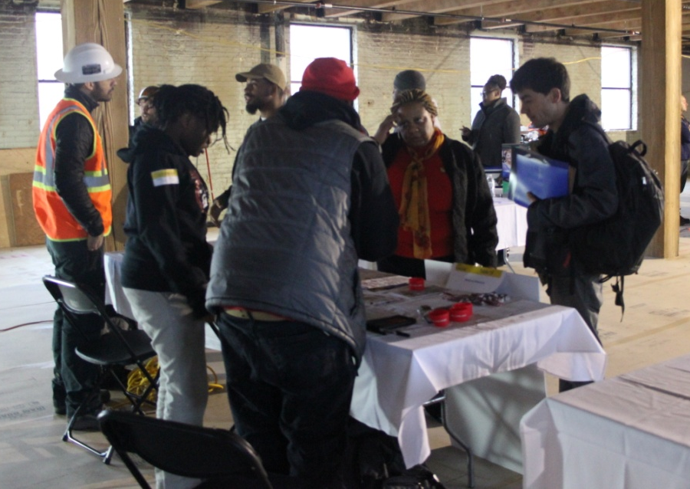
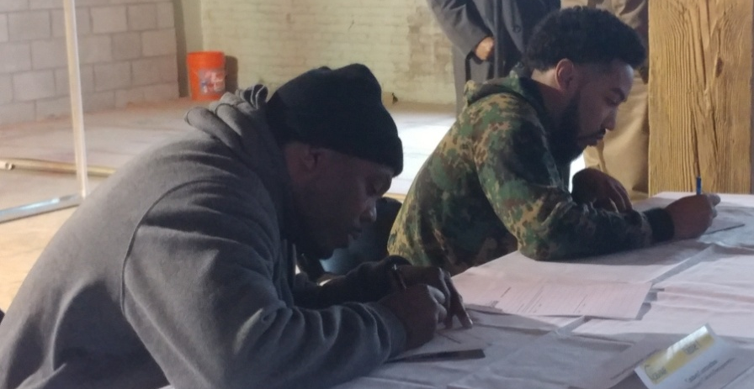
Welford Sanders Historic Lofts and Enterprise Center

Slide 22
Welford Sanders Historic Lofts and Enterprise Center
Lessons learned per Prism and Catalyst
Contractors have standing relationships with subs; challenge to encourage them to use other subs
Help needed to track worker status at every level
The more recruitment partners, the better
If a contractor does not meet goal at project completion, contractor can make it up on another project
“Once RPP workers are on the job, they blend into the workforce; you can’t tell who is who”

Slide 23
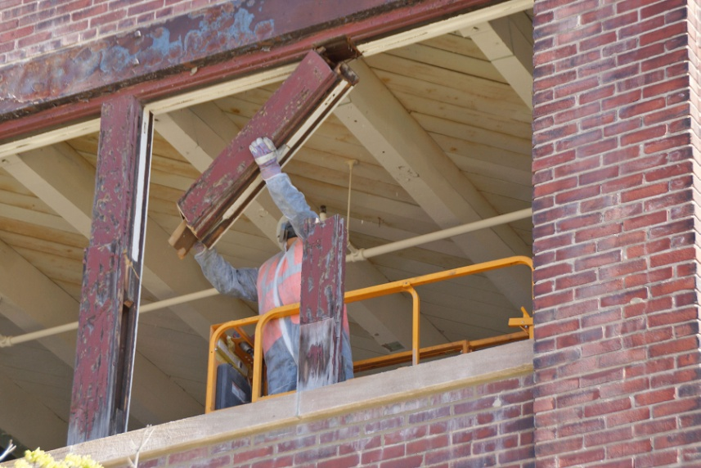
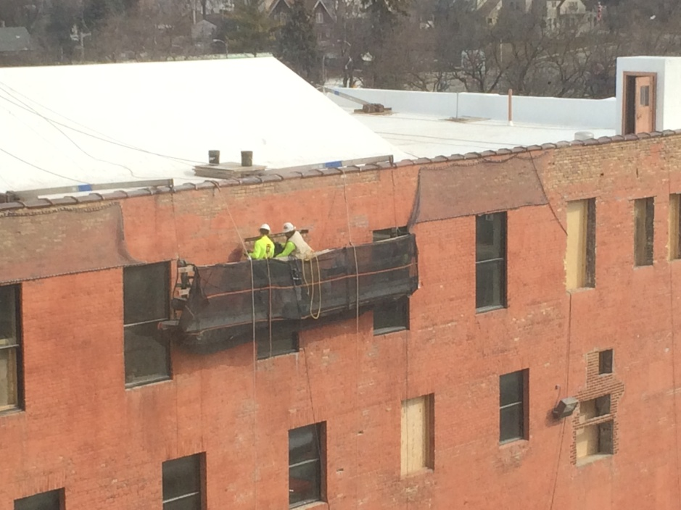
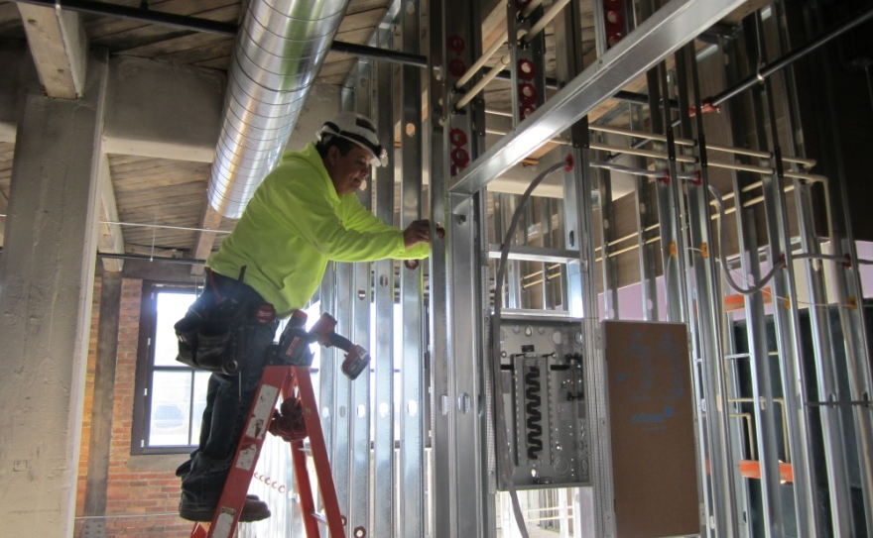
Results (as of 4/30/18)
RPP: 37% of work hours
Contract dollars to SBEs:
Construction: 38%
Professional services: 18%

Slide 24
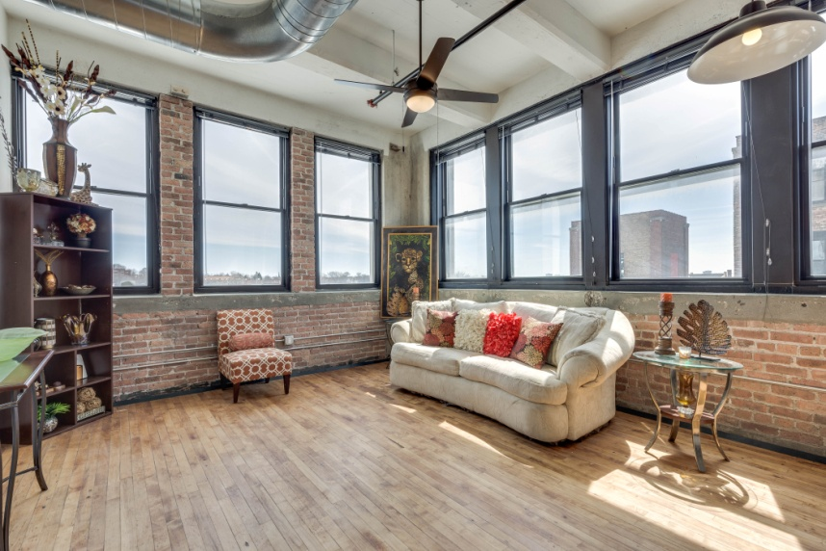
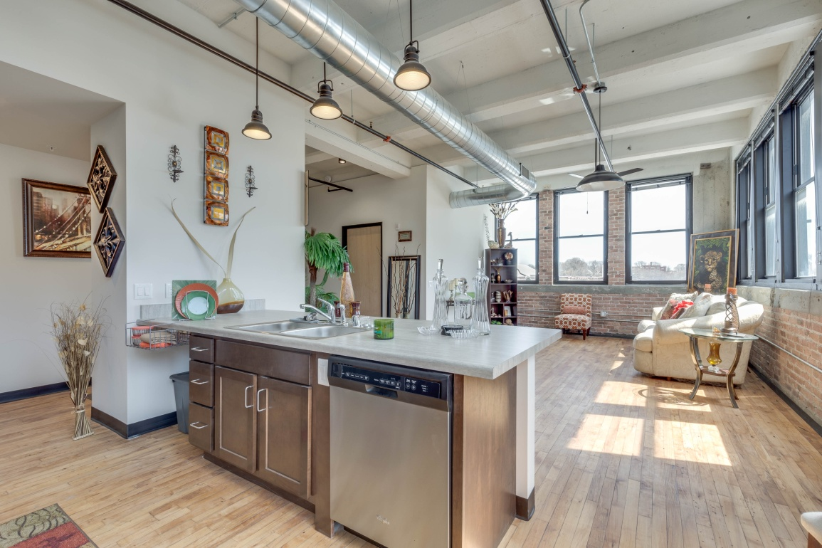
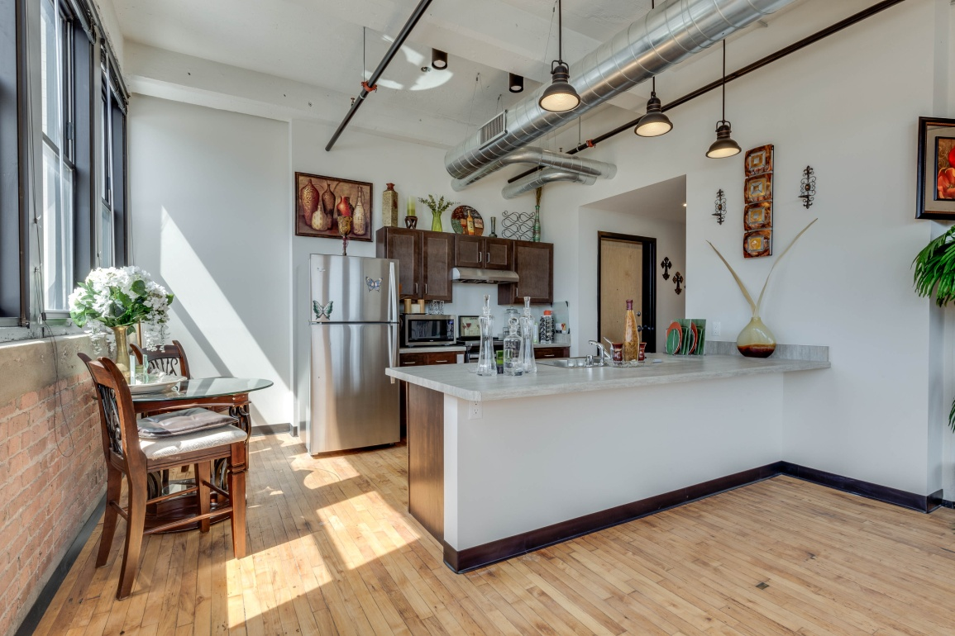
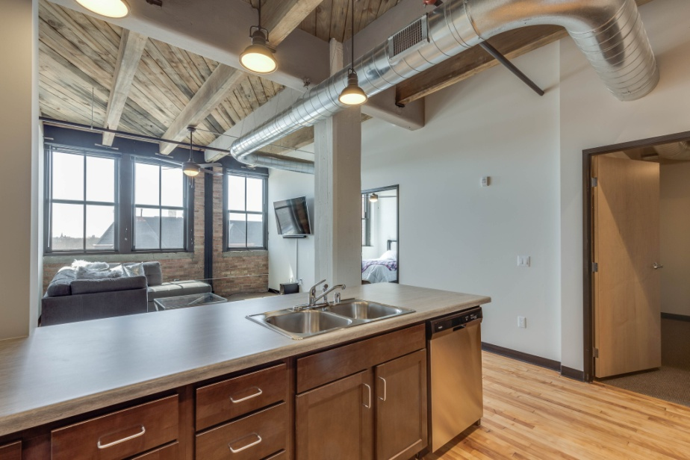
Welford Sanders Historic Lofts and Enterprise Center

Slide 25
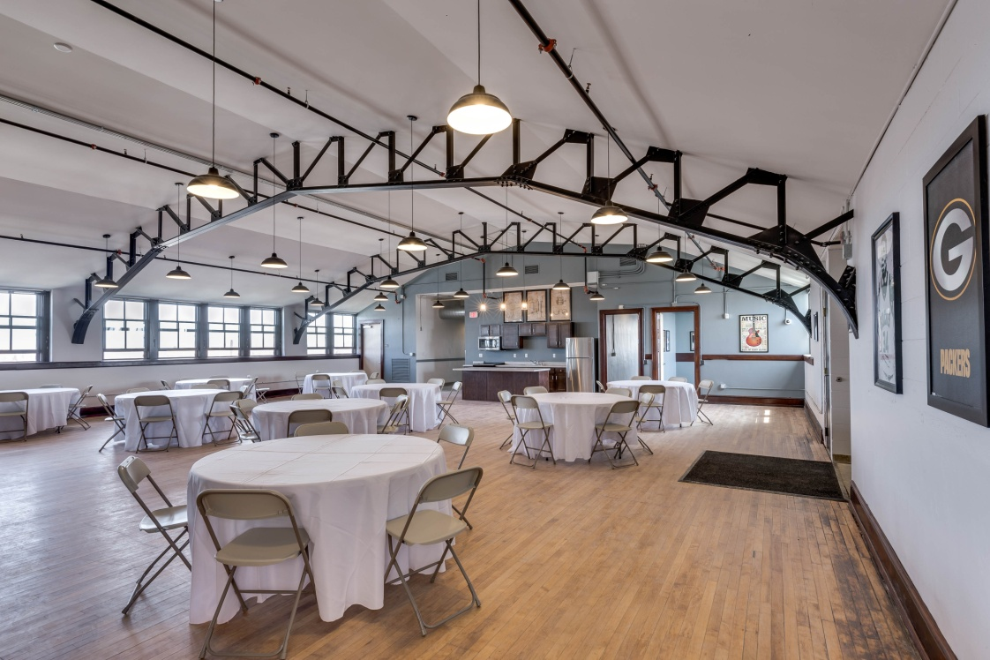
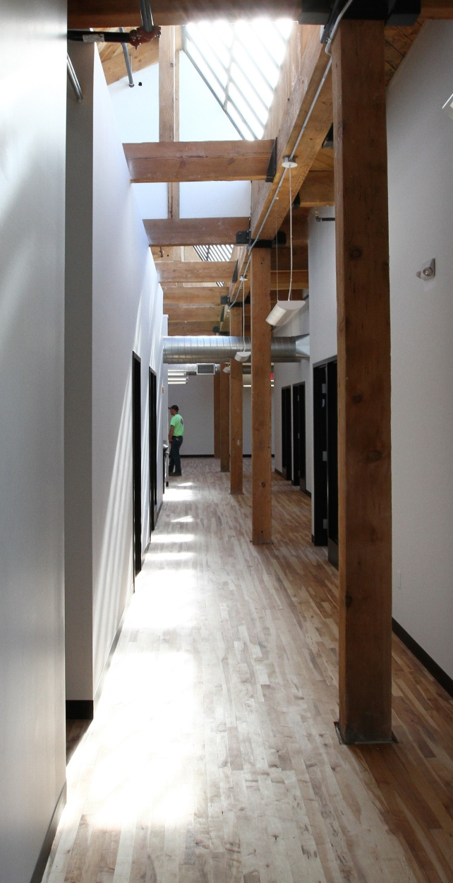
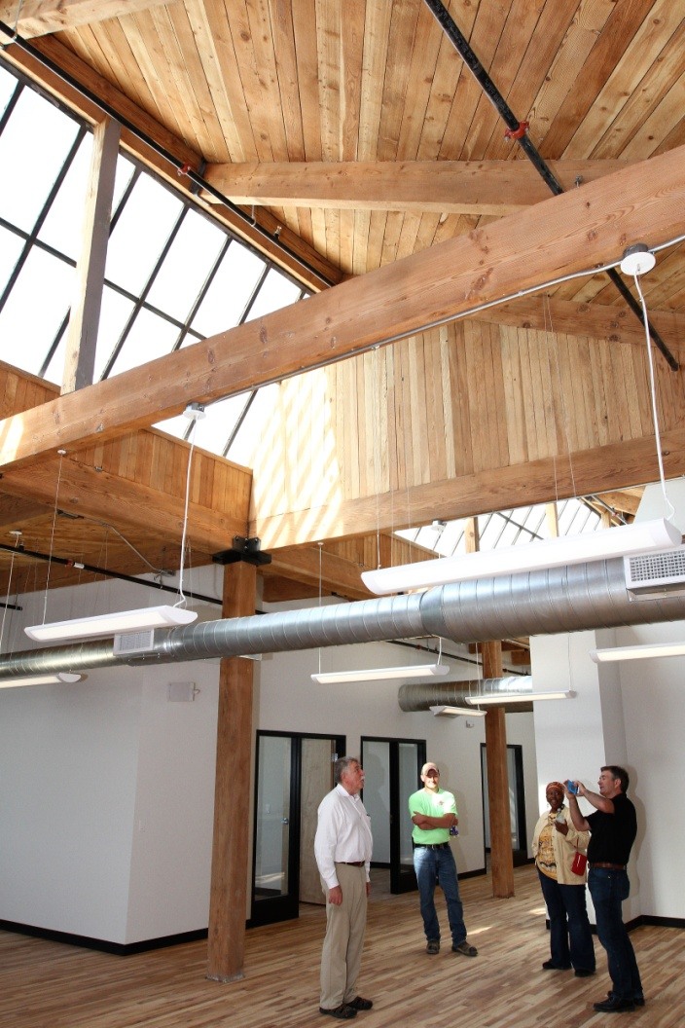
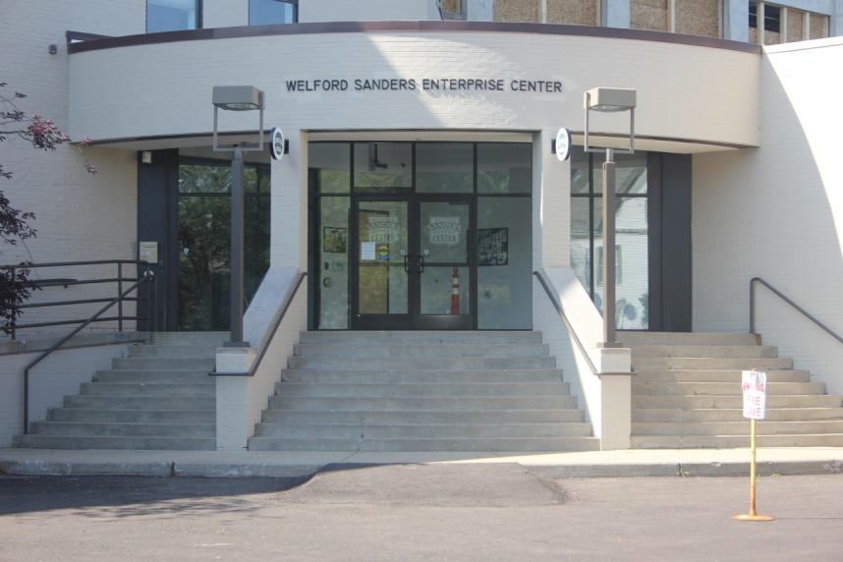
Welford Sanders Historic Lofts and Enterprise Center

Slide 26
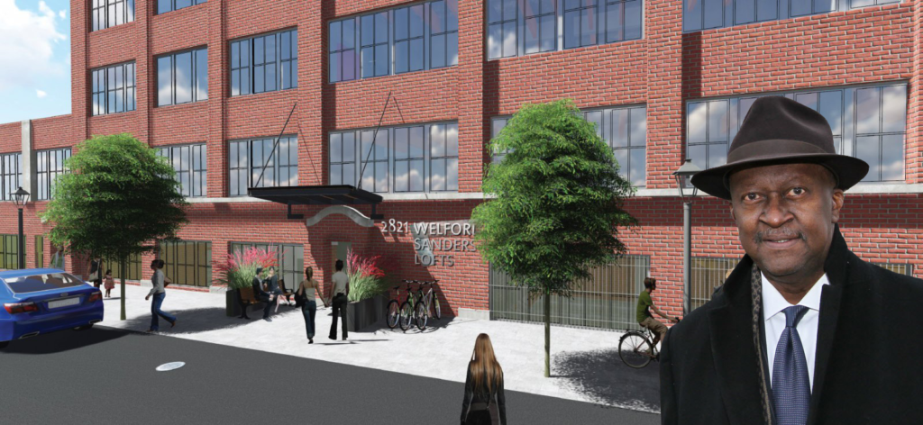
Welford Sanders Historic Lofts and Enterprise Center
Support the Welford Sanders Statue Fund
Go to: www.gofundme.com/welford-sanders-statue-campaign
Send a contribution to: Martin Luther King Economic Development Corporation
2745 N. Dr. Martin Luther King Jr. Drive
Milwaukee, WI 53212

Slide 27
Neighbors Helping Neighbors
Build Strong Blocks
Double Duty: Linking Vacant Property Remediation to Workforce Development
National Reclmaiming Vacant Properties Conference
May 2018

Slide 28
Strong Blocks Real Estate
Carl Quindel Introduction and Overview
Grew up on 41st and Wright
Live on 1st and Locust
Last 13 years working with my neighbors who rent become home owners
970 home sales
620 rehabs
Notes:
This business has a lot to do with who I am…
I grew up on 41st and Wright, went to MPS schools, and went off to Brown University as I worked Summers back home as a roofer and mason, and later as a carpenter
In 2006 I bought and rehabbed my own home on 1st and Locust, where I live today with my Family
Last 9 years
I ran ACTS Housing
brokered more than 900 home sales
managed more than 550 rehab projects
grew the company from 4 to 13 employees.
All of this has convinced me that here in Milwaukee, in the heart of our City, my neighbors have a unique economic opportunity to save money when they own their home…here’s why,

Slide 29
The Milwaukee Opportunity
Milwaukee has an opportunity to create strong blocks. This opportunity is driven by housing abandonment and disinvestment in our central-city, and is enhanced by the large number of strong families who wish to find the stability and community in a block of families striving to own their home.
Notes:
Read the slide
How is this possible? Milwaukee’s central city is a special real estate market where you can purcahse at extremely low prices and we can work with
quality
Local
Family owned businesses to do the work
This means we bought this vacant vandalized foreclosure worked with the Sivongsa family of Three Headed Elephant Construction to rehab it and tomorrow Vivalynn will move in.
One of the families in the program that will be paying $775/mo. as a renter, and save $165 per month on her all in housing costs when she becomes the owner.
OTHER FACTS AS NEEDED
City owns 500+ single family and duplexes
City continues to foreclose on an additional 100+ properties per quarter
Last 5 years, low-priced and distressed homes made up roughly 86% of the market, with a total of 6,200 total units sold at a median sale price of $17k.
Today, we source from City, Banks, FSBO, and investors. More and more off-MLS.

Slide 30
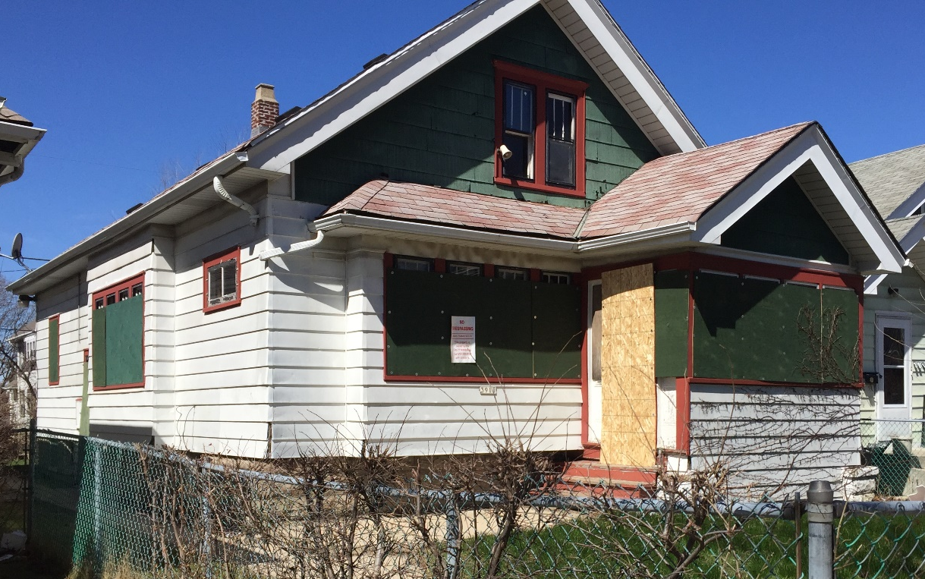
The Milwaukee Opportunity
Notes:
Read the slide
How is this possible? Milwaukee’s central city is a special real estate market where you can purcahse at extremely low prices and we can work with
quality
Local
Family owned businesses to do the work
This means we bought this vacant vandalized foreclosure worked with the Sivongsa family of Three Headed Elephant Construction to rehab it and tomorrow Vivalynn will move in.
One of the families in the program that will be paying $775/mo. as a renter, and save $165 per month on her all in housing costs when she becomes the owner.
OTHER FACTS AS NEEDED
City owns 500+ single family and duplexes
City continues to foreclose on an additional 100+ properties per quarter
Last 5 years, low-priced and distressed homes made up roughly 86% of the market, with a total of 6,200 total units sold at a median sale price of $17k.
Today, we source from City, Banks, FSBO, and investors. More and more off-MLS.

Slide 31
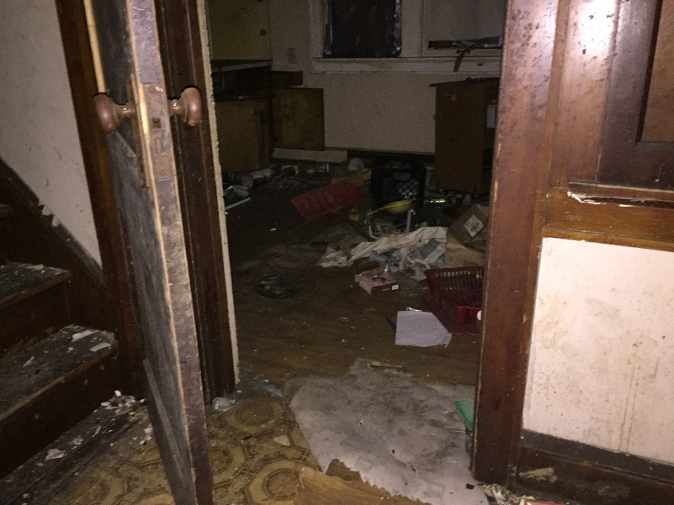
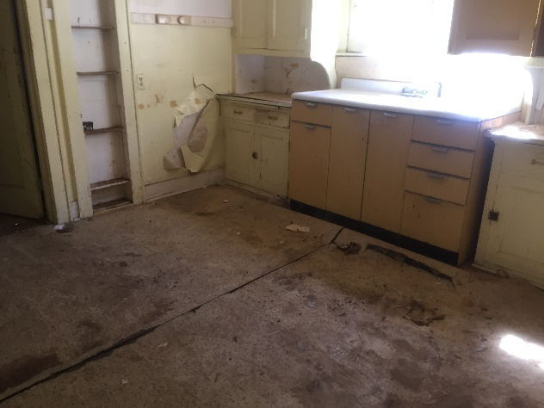
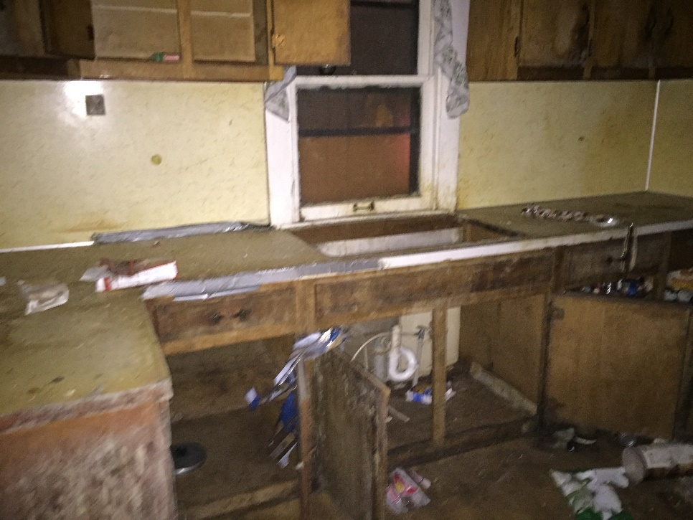
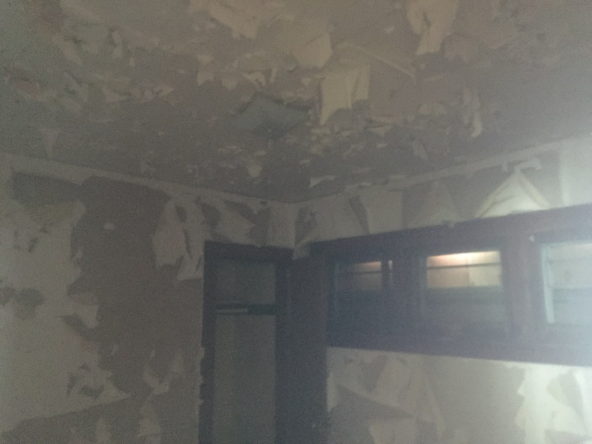
The Milwaukee Opportunity
Notes:
Read the slide
How is this possible? Milwaukee’s central city is a special real estate market where you can purcahse at extremely low prices and we can work with
quality
Local
Family owned businesses to do the work
This means we bought this vacant vandalized foreclosure worked with the Sivongsa family of Three Headed Elephant Construction to rehab it and tomorrow Vivalynn will move in.
One of the families in the program that will be paying $775/mo. as a renter, and save $165 per month on her all in housing costs when she becomes the owner.
OTHER FACTS AS NEEDED
City owns 500+ single family and duplexes
City continues to foreclose on an additional 100+ properties per quarter
Last 5 years, low-priced and distressed homes made up roughly 86% of the market, with a total of 6,200 total units sold at a median sale price of $17k.
Today, we source from City, Banks, FSBO, and investors. More and more off-MLS.

Slide 32
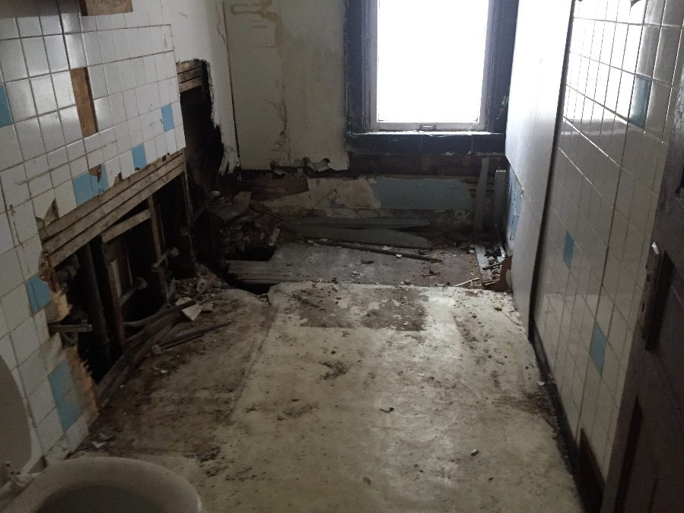
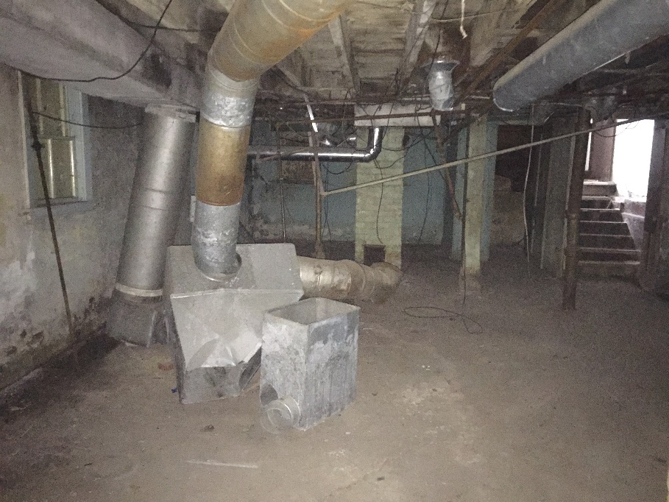
The Milwaukee Opportunity
Notes:
Read the slide
How is this possible? Milwaukee’s central city is a special real estate market where you can purcahse at extremely low prices and we can work with
quality
Local
Family owned businesses to do the work
This means we bought this vacant vandalized foreclosure worked with the Sivongsa family of Three Headed Elephant Construction to rehab it and tomorrow Vivalynn will move in.
One of the families in the program that will be paying $775/mo. as a renter, and save $165 per month on her all in housing costs when she becomes the owner.
OTHER FACTS AS NEEDED
City owns 500+ single family and duplexes
City continues to foreclose on an additional 100+ properties per quarter
Last 5 years, low-priced and distressed homes made up roughly 86% of the market, with a total of 6,200 total units sold at a median sale price of $17k.
Today, we source from City, Banks, FSBO, and investors. More and more off-MLS.

Slide 33
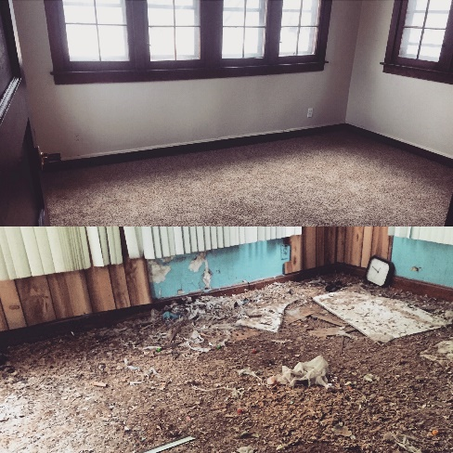
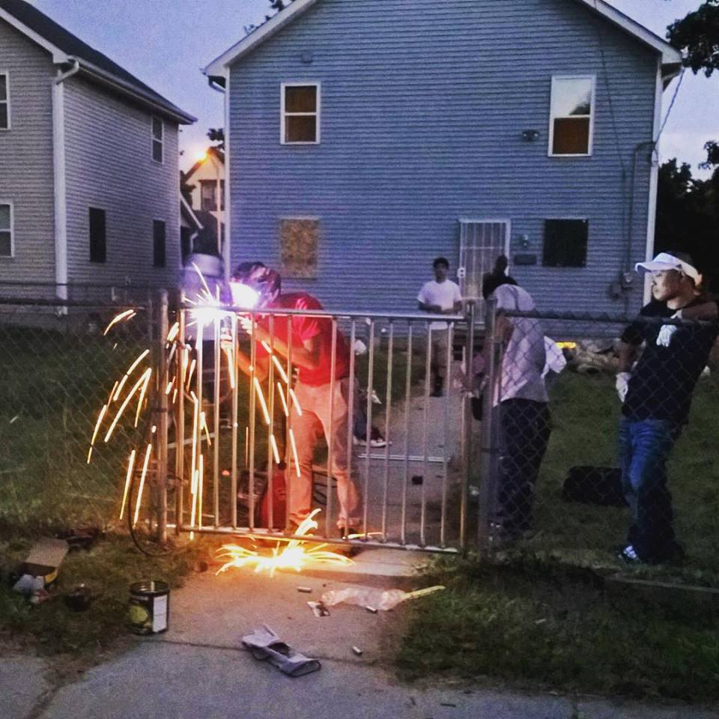
Milwaukee Supply
Supply of Central-City Properties
90,000+ total housing units in neighborhoods Strong Blocks targets.
City of Milwaukee owns 1,000+ properties, which cost us $3.1 Million per year to manage.
Low-Cost Central-City Supply
Purchase price paid by the new resident after rehab can still result in $100+ savings per month on housing.
Notes:
Read the slide
How is this possible? Milwaukee’s central city is a special real estate market where you can purcahse at extremely low prices and we can work with
quality
Local
Family owned businesses to do the work
This means we bought this vacant vandalized foreclosure worked with the Sivongsa family of Three Headed Elephant Construction to rehab it and tomorrow Vivalynn will move in.
One of the families in the program that will be paying $775/mo. as a renter, and save $165 per month on her all in housing costs when she becomes the owner.
OTHER FACTS AS NEEDED
City owns 500+ single family and duplexes
City continues to foreclose on an additional 100+ properties per quarter
Last 5 years, low-priced and distressed homes made up roughly 86% of the market, with a total of 6,200 total units sold at a median sale price of $17k.
Today, we source from City, Banks, FSBO, and investors. More and more off-MLS.

Slide 34
Strong Blocks Approach
The Strong Blocks Approach is Focused on Quality, Sustainability and Community
2
3
4
Search
Purchase
Renovate
Search for properties in disrepair that are blighting the blocks where we can make an impact
Purchase homes that meet our investment and impact criteria.
Remodel homes to move-in and code-compliant condition with team of local professionals.
1
Fundraise
7
6
5
Secure equity capital from social impact investors and loans from local community banks to fund acquisition, rehab, and reserves for a ”multiple” bottom line return.
Manage & Enhance
On-Board Resident
Employ & Contract
Utilize in-house and outsourced services to maintain a strong block by selling homes to our residents, maintaining homes prior to sale, and purchasing new homes on the block or adjacent blocks
Identify highly motivated and qualified families to rent homes with a right to purchase home at fixed price and rent for a timeline to purchase with mortgage financing of as short as 21 months.
Find, train, and employ local unemployed handymen and contractors to participate in the renovation.
Notes:
We have a well-established process on how this works: from finding the right homes to qualifying the right families and providing the necessary resources to make Strong Blocks a success

Slide 35
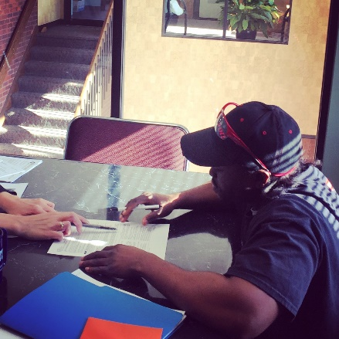
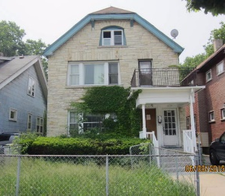
Success Story – W VLIET ST & Michael
9-MONTH Journey to Home Ownership with Michael
5
Owner
4
Sale
Michael now earns the rental income from lower unit, and has a projected average monthly housing savings of $505 per month vs. what he paid as a renter
3
Rent
Michael completed his Buying Plan, got approved for his mortgage, and purchased the property
2
Rehab
Traditional renter leased lower unit, and Michael, a CNC Machinist, qualified and moved-in upper unit/paid option fee towards purchase price; both residents paid rent
1
Purchase
Duplex is renovated by Strong Blocks
Duplex purchased by Strong Blocks.
Rent $725/Month
Purchase Price $85,000
Notes:
If we drill down into the 24-month journey from our purchase to the family’s home purchase, we see that it costs us:
$15,050 for total purchase costs
Another $28,040 for total renovation costs, or a total of $43,090 to purchase-rehab
We then cash flow positive after the family is qualified and moves-in generating net cash of $1,260 over the 21 month period
When we sell, everyone wins, the family becomes an owner and saves $100/month, our investors and lender is repaid, we cover our overhead, and Strong Blocks earns about $3,500 over 24 months.
Important to note that our program fees are included in the development costs (1-4) and that overhead is not true overhead since at higher volumes of homes these numbers come down significantly….this is doing a 24-property fund, the smallest scale our model supports.
Equity Deployed: $306,720
ROI: 15.49% for Investor,
Debt Deployed: $886,800
Company and Fund Overhead would change based on different sized fund…capacity may need to grow some as larger sized funds are raised, but based on projections this number come down significantly per property as we get to 40,100, etc. properties.

Slide 36
Family Success
Jevita at North 24th Place
Long-time renter in healthcare industry with disabled son.
Nearly left Milwaukee after family tragedy.
Dreamed of owning a home with accessibility features to help care for son.
Lacked the financing needed to buy home.
Jevita was a resident in Strong Blocks Rent-to-Own Program and qualified for a mortgage to buy her house after 21 months. As an owner, she saves an estimated $170/month.
Notes:
Today, we source from City, Banks, FSBO, and investors. More and more off-MLS.
When presenting I would just speak to the bold bullets. The audience and judges can read the rest.
City owns 500+ single family and duplexes
City continues to foreclose on an additional 100+ properties per quarter
Last 5 years, low-priced and distressed homes made up roughly 86% of the market, with a total of 6,200 total units sold at a median sale price of $17k.

Slide 37
Strong Blocks PRODUCT
Homes Developed by Strong Blocks
Notes:
If we drill down into the 24-month journey from our purchase to the family’s home purchase, we see that it costs us:
$15,050 for total purchase costs
Another $28,040 for total renovation costs, or a total of $43,090 to purchase-rehab
We then cash flow positive after the family is qualified and moves-in generating net cash of $1,260 over the 21 month period
When we sell, everyone wins, the family becomes an owner and saves $100/month, our investors and lender is repaid, we cover our overhead, and Strong Blocks earns about $3,500 over 24 months.
Important to note that our program fees are included in the development costs (1-4) and that overhead is not true overhead since at higher volumes of homes these numbers come down significantly….this is doing a 24-property fund, the smallest scale our model supports.
Equity Deployed: $306,720
ROI: 15.49% for Investor,
Debt Deployed: $886,800
Company and Fund Overhead would change based on different sized fund…capacity may need to grow some as larger sized funds are raised, but based on projections this number come down significantly per property as we get to 40,100, etc. properties.

Slide 38
Vacant Properties
Notes:
Read the slide
How is this possible? Milwaukee’s central city is a special real estate market where you can purcahse at extremely low prices and we can work with
quality
Local
Family owned businesses to do the work
This means we bought this vacant vandalized foreclosure worked with the Sivongsa family of Three Headed Elephant Construction to rehab it and tomorrow Vivalynn will move in.
One of the families in the program that will be paying $775/mo. as a renter, and save $165 per month on her all in housing costs when she becomes the owner.
OTHER FACTS AS NEEDED
City owns 500+ single family and duplexes
City continues to foreclose on an additional 100+ properties per quarter
Last 5 years, low-priced and distressed homes made up roughly 86% of the market, with a total of 6,200 total units sold at a median sale price of $17k.
Today, we source from City, Banks, FSBO, and investors. More and more off-MLS.

Slide 39
Strong Blocks PRODUCT
Homes Developed by Strong Blocks
Notes:
If we drill down into the 24-month journey from our purchase to the family’s home purchase, we see that it costs us:
$15,050 for total purchase costs
Another $28,040 for total renovation costs, or a total of $43,090 to purchase-rehab
We then cash flow positive after the family is qualified and moves-in generating net cash of $1,260 over the 21 month period
When we sell, everyone wins, the family becomes an owner and saves $100/month, our investors and lender is repaid, we cover our overhead, and Strong Blocks earns about $3,500 over 24 months.
Important to note that our program fees are included in the development costs (1-4) and that overhead is not true overhead since at higher volumes of homes these numbers come down significantly….this is doing a 24-property fund, the smallest scale our model supports.
Equity Deployed: $306,720
ROI: 15.49% for Investor,
Debt Deployed: $886,800
Company and Fund Overhead would change based on different sized fund…capacity may need to grow some as larger sized funds are raised, but based on projections this number come down significantly per property as we get to 40,100, etc. properties.

Slide 40
Strong Blocks Workforce
$4.3+ Million investment in renovations on 117 units
Local network of 50+ vendors (suppliers and contractors)
Pilot program to hire underemployed workers for 100+ hours per property on 27 homes – 2210 hours so far
Currently employ 6 people, hired and trained an additional 11 workers at livable wages.
Notes:
If we drill down into the 24-month journey from our purchase to the family’s home purchase, we see that it costs us:
$15,050 for total purchase costs
Another $28,040 for total renovation costs, or a total of $43,090 to purchase-rehab
We then cash flow positive after the family is qualified and moves-in generating net cash of $1,260 over the 21 month period
When we sell, everyone wins, the family becomes an owner and saves $100/month, our investors and lender is repaid, we cover our overhead, and Strong Blocks earns about $3,500 over 24 months.
Important to note that our program fees are included in the development costs (1-4) and that overhead is not true overhead since at higher volumes of homes these numbers come down significantly….this is doing a 24-property fund, the smallest scale our model supports.
Equity Deployed: $306,720
ROI: 15.49% for Investor,
Debt Deployed: $886,800
Company and Fund Overhead would change based on different sized fund…capacity may need to grow some as larger sized funds are raised, but based on projections this number come down significantly per property as we get to 40,100, etc. properties.

Slide 41
Strong Blocks Workforce
Sourcing
Value
On-boarding Process
Program Partnerships
Market for Skilled Labor
In-House vs. Outsourced
What’s Working?
Lessons Learned
Notes:
We have a well-established process on how this works: from finding the right homes to qualifying the right families and providing the necessary resources to make Strong Blocks a success

Slide 42
Thank youYou
Mission
Providing neighbors a short-term path to homeownership by creating affordable, accessible, and high-quality housing, block by block, in urban Milwaukee neighborhoods.
Vision
Neighbors helping neighbors build strong blocks
3331 West Lisbon Ave Milwaukee, WI 53208
www.strongblocks.com
info@strongblocks.com
@strongblocks
Facebook/strongblocks

