Slide 1
Reimagining Urban Neighborhoods: Partnerships to Reuse Vacant Land in Support of Sustainable Redevelopment
St. Louis
Laura Ginn Project Manager, Green City Coalition (City + MO Dept. of Cons.)
Doug Bisson Community Planning & Urban Design Lead, HDR
Columbus
John Turner Administrator, City of Columbus Land Redevelopment Division
Reza Reyazi Asst. Admin., City of Columbus Land Redevelopment Division

Slide 2
DATA + community
Combining Data-Driven Solutions with Community Knowledge & Priorities to Reimagine Vacancy in St. Louis
Laura Ginn, Green City Coalition Project Manager

Slide 3
context

Slide 4
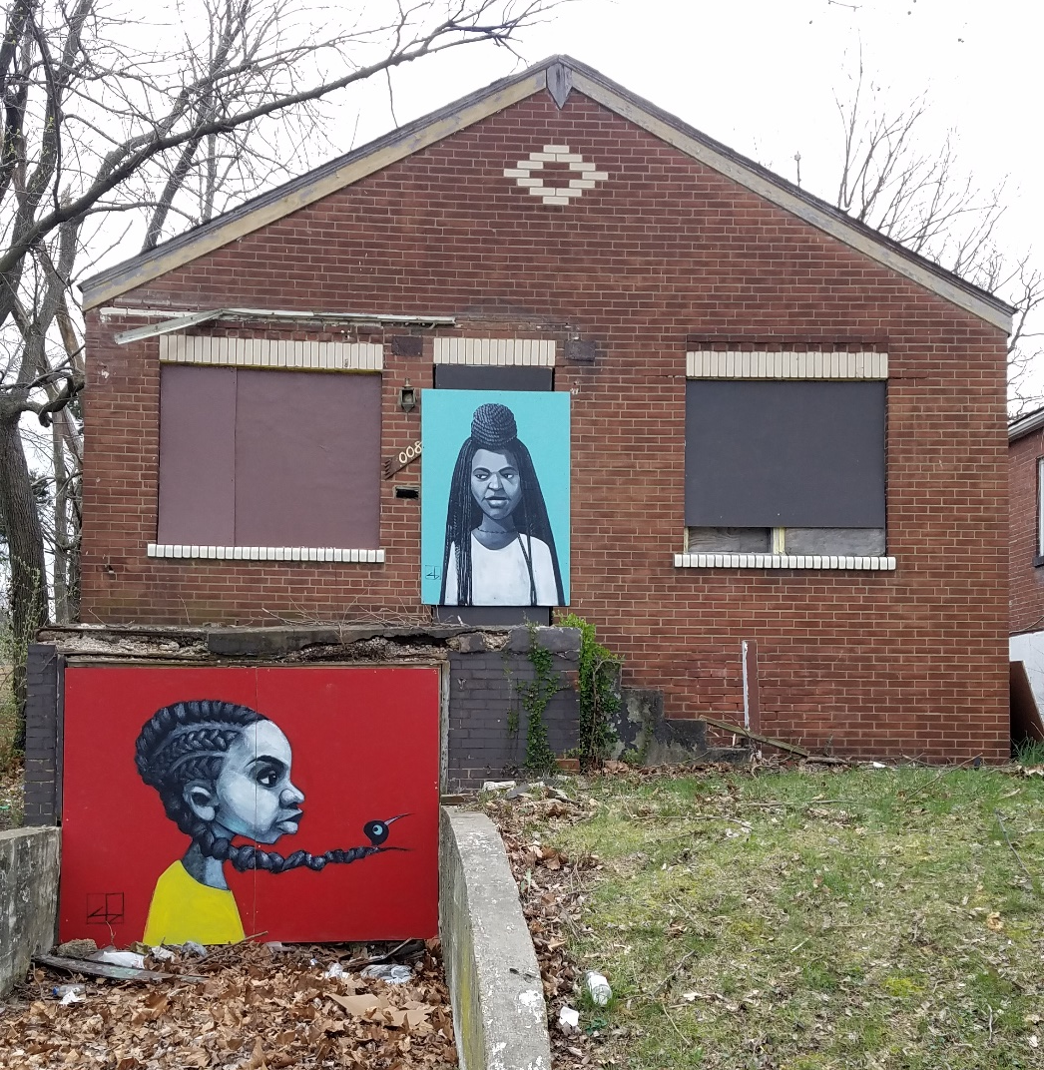
Vacancy in St. louis
~ 7,500 Buildings & ~12,000 Lots
out of ~130,000 parcels (15%)
North City (Delmar Divide): 30% of parcels are vacant
South & Central City: 3% of parcels are vacant
Land Reutilization Authority (LRA)
nation’s oldest land bank
owns about half of all vacant properties
1,886 owned more than 30 years
average ownership tenure: 16 years
2017: 37 acres in / 63 acres out
Privately-Owned Vacancy
primarily buildings
typically end up in the land bank

Slide 5
Vacancy in St. louis
Efforts to Address Vacancy in St. Louis
CCP Vacancy Report 2016
Land Bank Assessment 2017
New Hire: Vacancy Strategist
Mayor’s Office of Resilience – 100RC
Vacancy Collaborative
Neighborhood Vacancy Initiative
Increasing Demolition Program
Vacant Properties Portal
Green City Coalition
Urban Greening Program

Slide 6
Green city coalition
A coalition of organizations, government offices, and neighborhoods working to convert vacancy to vibrancy in North St. Louis – anchored in a formal partnership between the City of St. Louis and Missouri Department of Conservation.
Programs Include:
Implementation of Urban Greening Program demolitions, through data-driven prioritization and community-based planning
Community green space design and implementation
Summer youth employment program – Outdoor Youth Corps
Nature-based programming and events
Community art projects in vacant spaces
Improving demolition standards
Deconstruction program development
Vacancy data transparency
Land trust feasibility study & research

Slide 7
Urban greening program
EPA-mandated consent decree to remove impervious surface and reduce combined sewer overflows
Agreement between MSD and SLDC to spend up to $13.5 million on the demolition of vacant and abandoned buildings, and place deed restrictions on parcels (amount of stormwater absorbed by parcel cannot be reduced)
$13.5 million = ~1,200 buildings
WORKING GROUP MEMBERS
St. Louis Development Corporation
Land Reutilization Authority
City Planning & Urban Design Agency
City Building Division
Mayor’s Office of Resilience
Missouri Department of Conservation
171
5.93
demolitions
impervious acres removed
completed or approved & pending

Slide 8
Data-driven prioritization

Slide 9
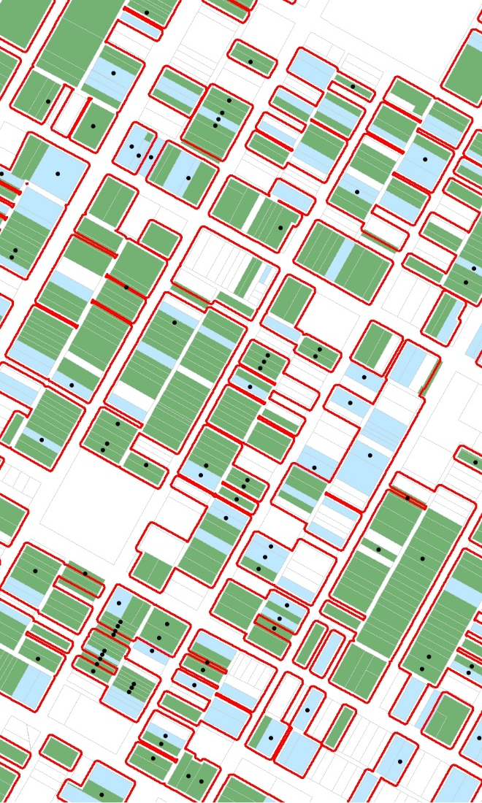
Vacancy demolition
prioritization model
Developed to identify areas of concentrated vacancy where the removal of impervious surface and application of deed restrictions should be focused.
GOALS
Determine ideal locations for the removal of impervious surface, and
The conversion of vacant land to permanent green spaces, with a
Lean toward connecting existing green spaces, and/or filling in nature equity gaps, and an
Emphasis on ideal locations for green infrastructure.
Not just about taking a building down – about creating opportunity.

Slide 10
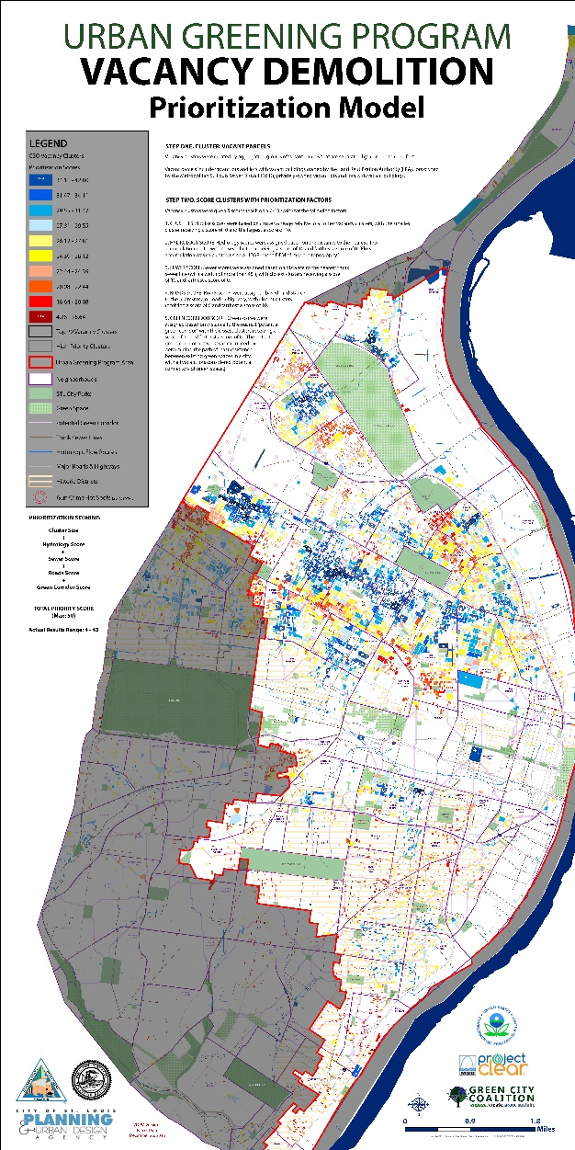
Vacancy demolition
prioritization model
Find all vacant parcels
Aggregate parcels > Vacancy Clusters
Score clusters on
Size of the vacancy cluster
Distance to historic hydrology (MSD trunk sewer lines)
Distance to hydrologic flow paths (current)
Distance from major roads and highways
Potential to connect existing green spaces
Rank clusters
Top 25th Percentile = High Priority
Present High Priority Areas to Community Members for Refinement and Green Space Planning

Slide 11
Vacancy demolition
prioritization model
methods
SCORE | SIZE | HYDROLOGY | SEWER | ROADS | CONNECTIVITY
Input | Cluster Only | LiDAR 2011 ➔ DEM ➔ Flow Direction ➔ Flow Accumulation ➔ Polylines [con > 50k] | Remove Sewer Lines ≥ 48” wide | City of St. Louis Major Roads and Highways | Green Spaces (parks, cemeteries, gardens more than ½ acre) & Vacant Parcels ➔ Linkage Mapper¹
Process | Calculate Size | Euclidian Distance for 10’ x 10’ raster ➔ Polygon received value of highest grid cell within
Normalize 0-10 Scale | Score = 10 (x-min / range) [high outliers removed first and assigned value of 10]
Final Score | Size + Hydrology + Sewer + Roads + Connectivity Total Possible: 50 // Actual Range 4.76 - 42.80
¹McRae, BH & DM Kavanagh (2011). Linkage Mapper Connectivity Analysis Software. The Nature Conservancy, Seattle WA.

Slide 12
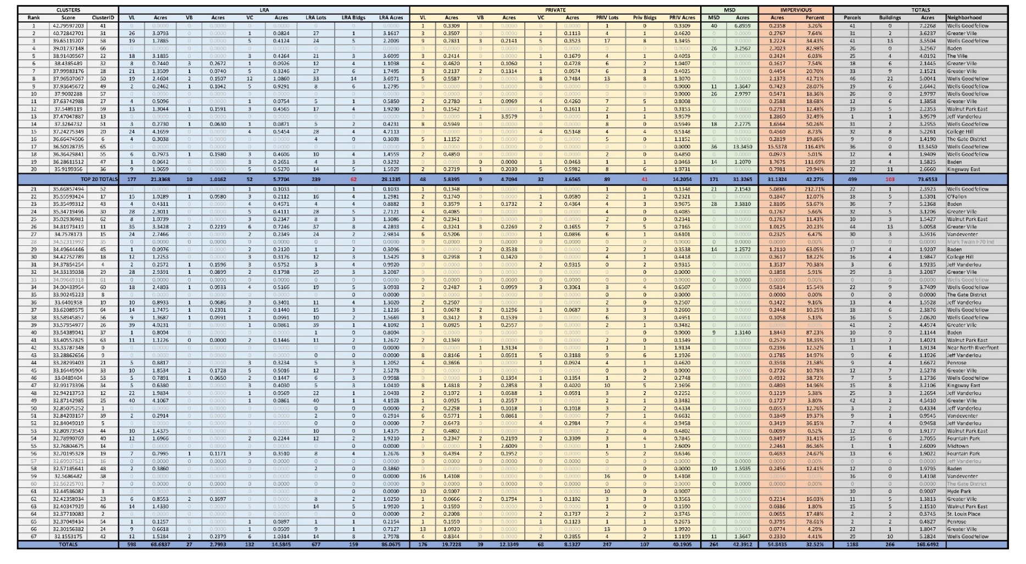
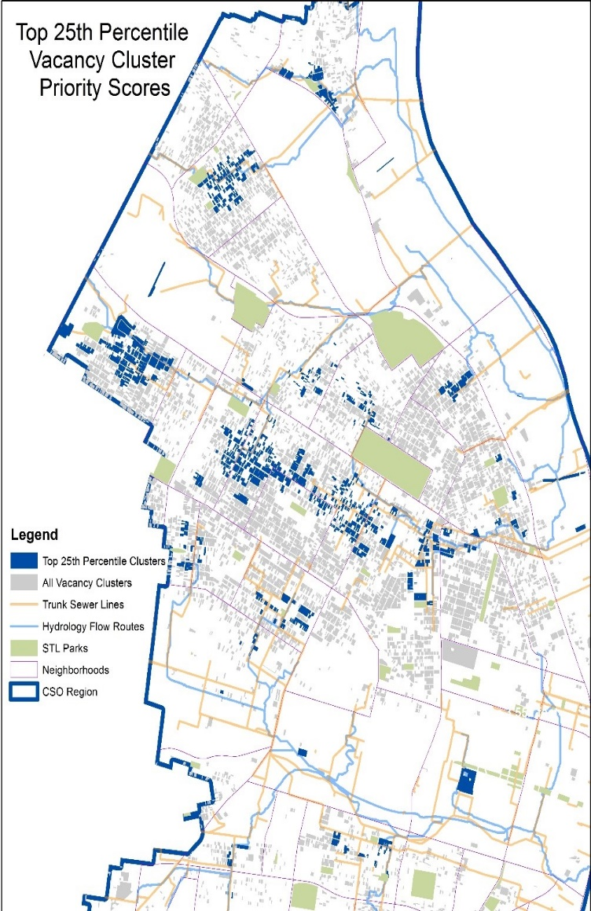
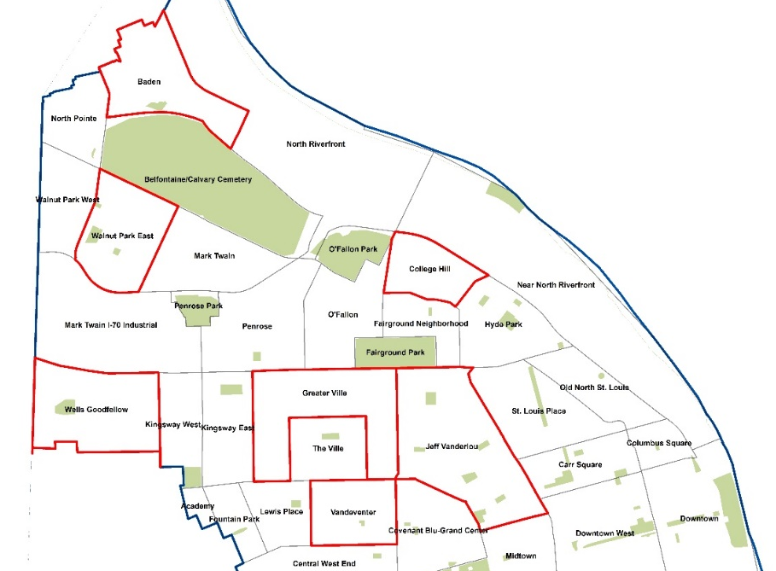
Vacancy demolition
prioritization model
application
> 20,000 Vacant Parcels
(>2,000 acres)
▼
5,605 Vacancy Clusters
▼
476 High Priority Clusters
(231 acres)

Slide 13
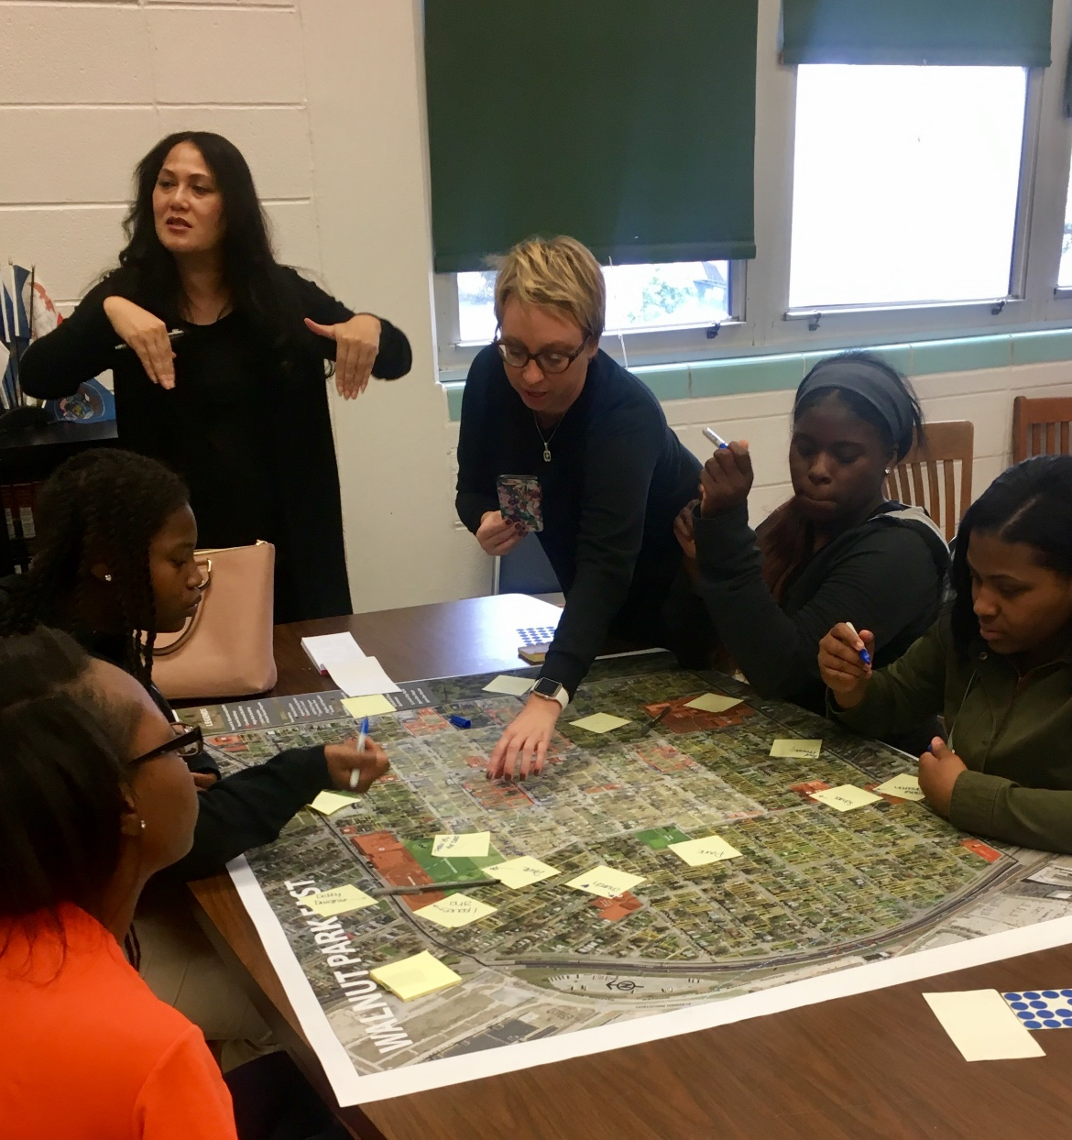
Participatory mapping

Slide 15
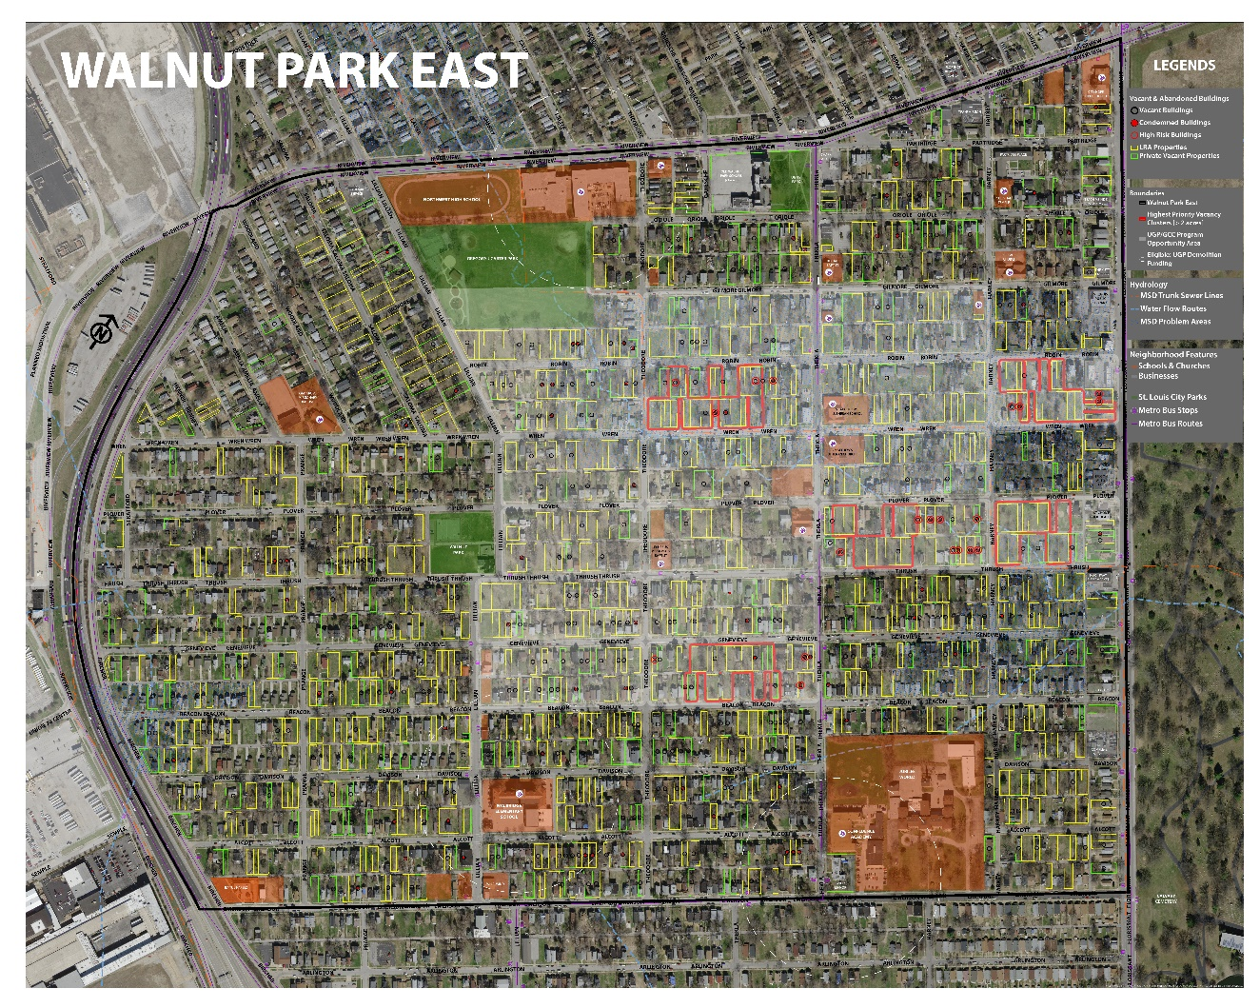
From high priority areas to planning areas
High Priority Areas (top 25th percentile) become Eligible for UGP demolition funds
Mapping exercises focus on:
Neighborhood Assets
Neighborhood Opportunities
Neighborhood Challenges
Residents are asked to outline blocks where demolitions should focus and where community green space would be most desired
Areas where majority of residents agree, and where those agreements overlap with model-determined high priority areas, become the Green Space Focus Area

Slide 16
Merging the two

Slide 17
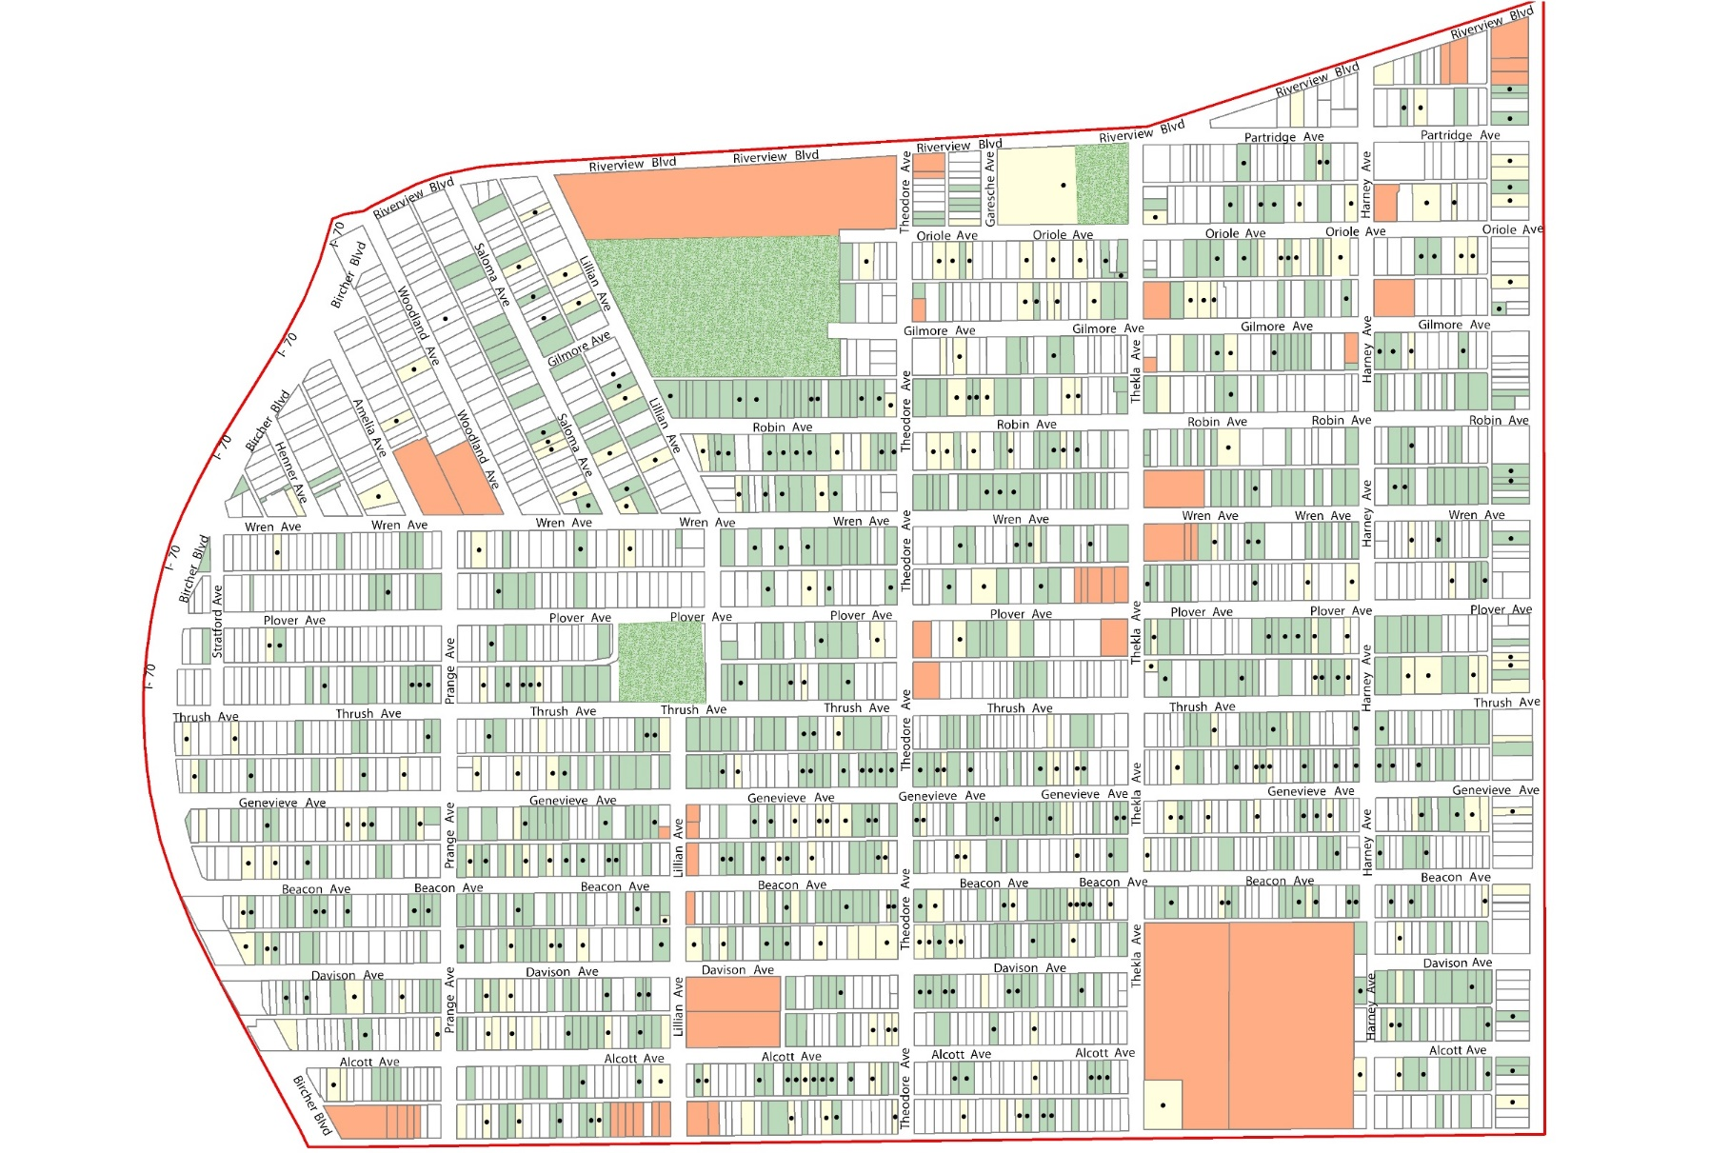
Schools & Churches
NORTHWEST
Parks
Library
LRA Parcels
ST. MATTHEWS
Private Vacant Parcels
FLORISSANT
WALNUT PARK
Vacant Building
ASPIRE / JUBILEE
WALBRIDGE

Slide 18
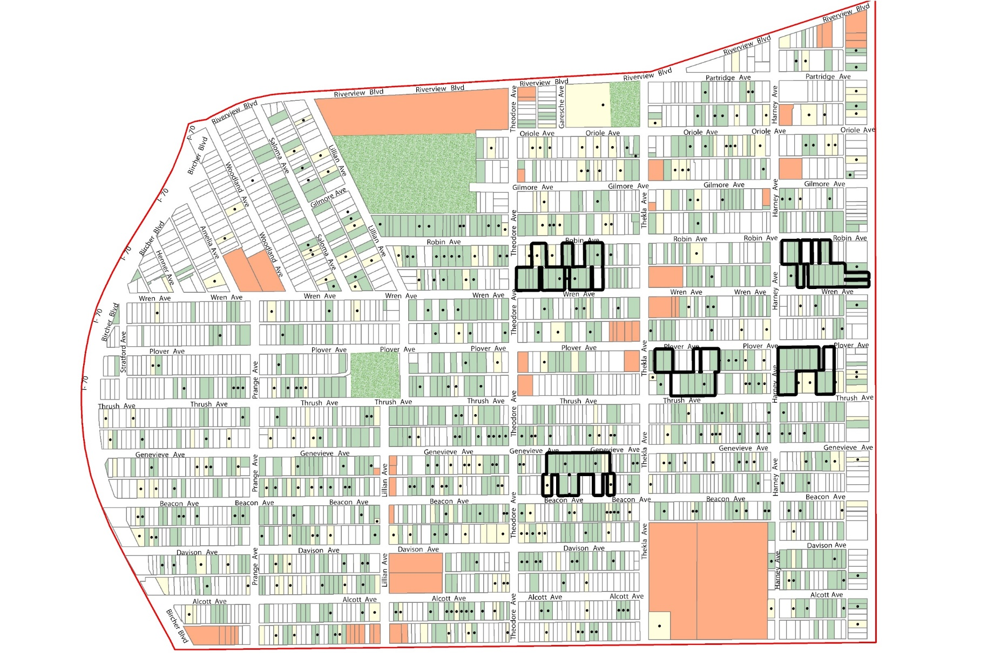
Eligible Area and Highest Priority Vacancy Clusters

Slide 19
Putting It All Together
Highest Priority Vacancy Clusters
Eligible for Urban Greening Program Demolition Funds & Green Space Conversion
Identified by
One Table
Identified by
Two Tables
Identified by
All Three Tables
Identified at Northwest Academy of Law
Youth Workshop

Slide 20
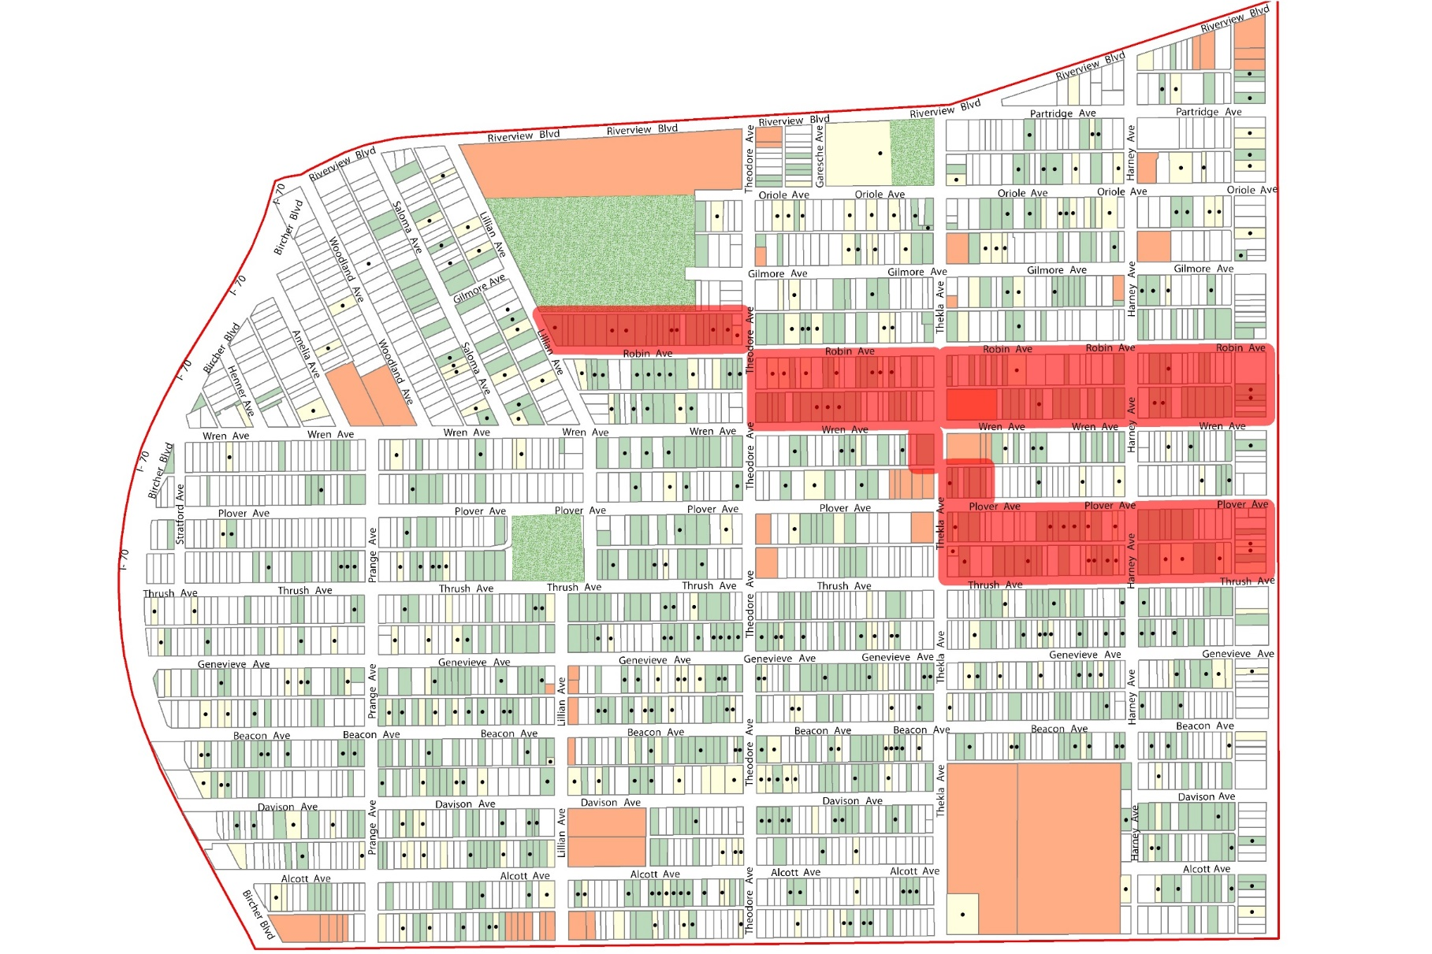
Putting It All Together

Slide 21
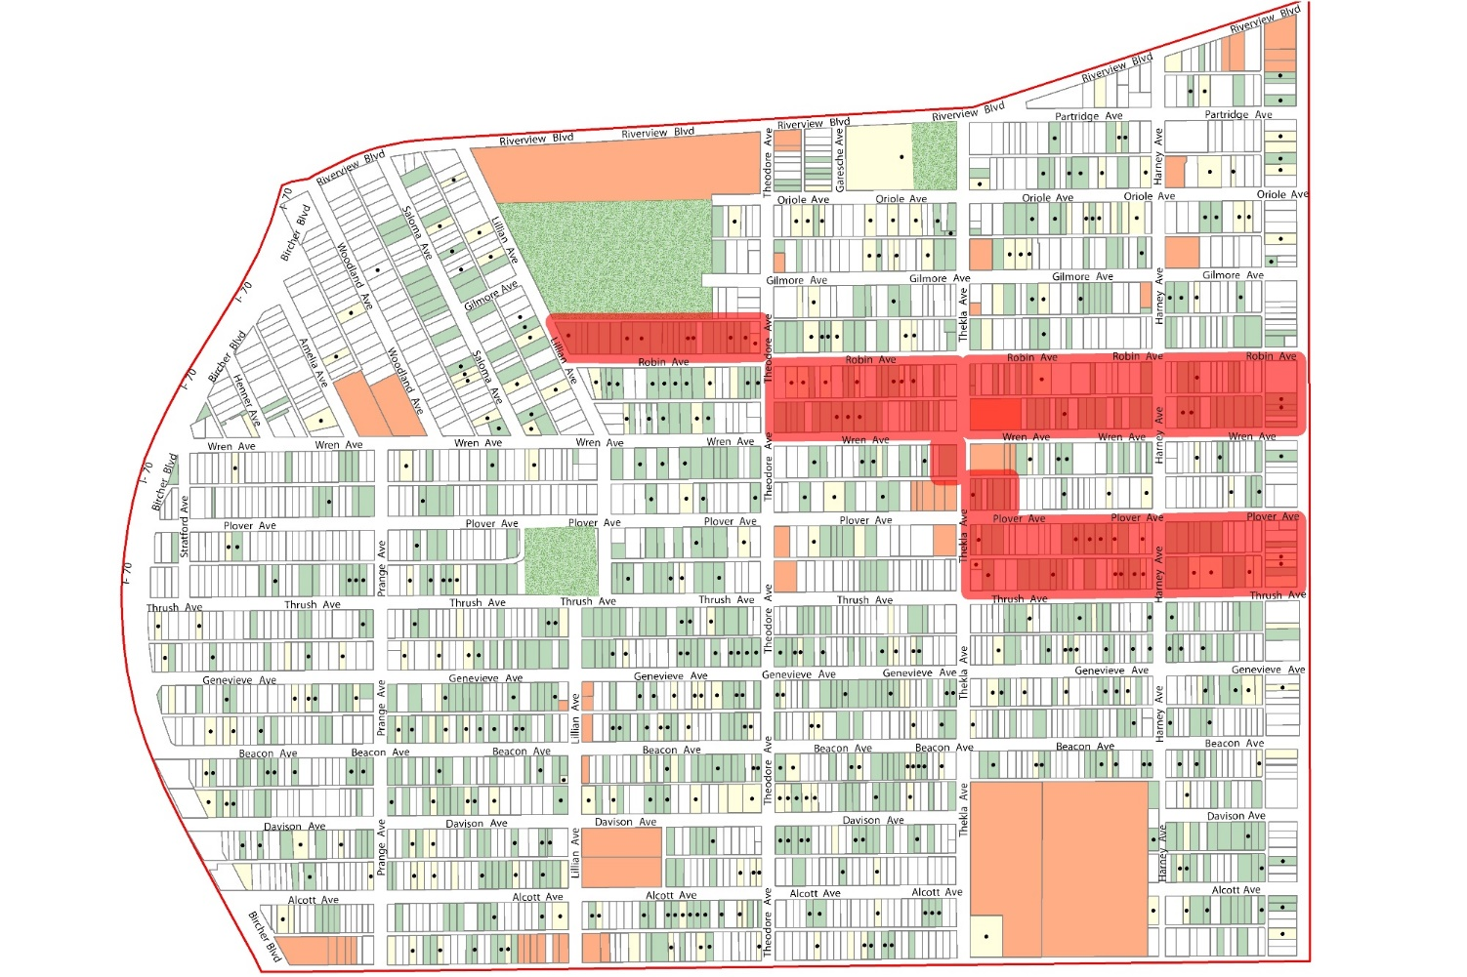
Green Space Focus Area the proposed area to be converted to green space amenity(ies); identified by computer modeling AND residents
Demolition of ALL LRA buildings
HOLDS on ALL LRA lots
Potential Demolition of Privately-Owned Vacant & Abandoned Buildings that are Structurally Condemned
Planning for Green Spaces
Deed Restrictions on Vacant Parcels

Slide 22
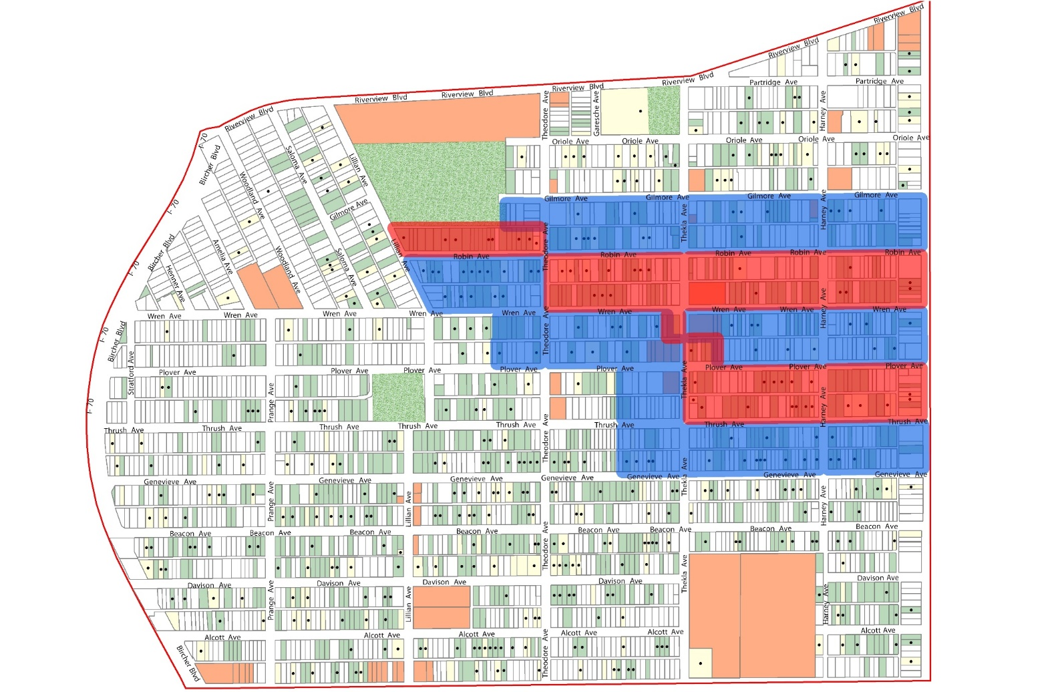
Green Space Adjacent Area blocks surrounding the Green Space Focus Area; primed for redevelopment and infill housing
Assessment of all LRA buildings prior to demolition
City & Partners work to implement redevelopment toolkit (incentives, community benefit agreements, support programs…)

Slide 23
School Zones: High Risk Area within 500 feet of a School’s parcel boundary

Slide 24
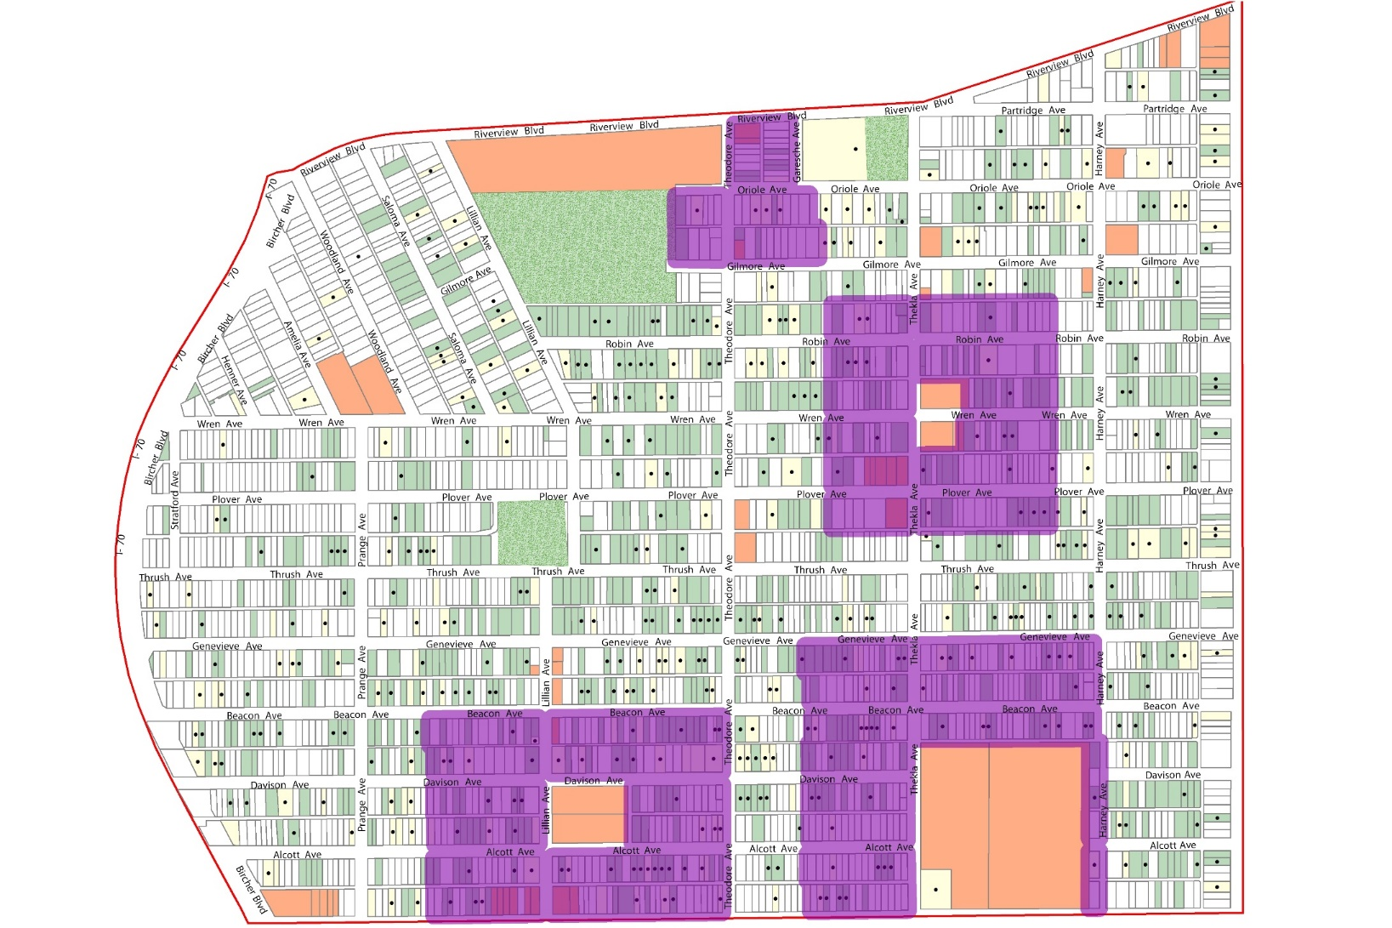
School Zones: High Risk Area within 500 feet of a School’s parcel boundary
Assessment of all LRA buildings prior to demolition

Slide 25
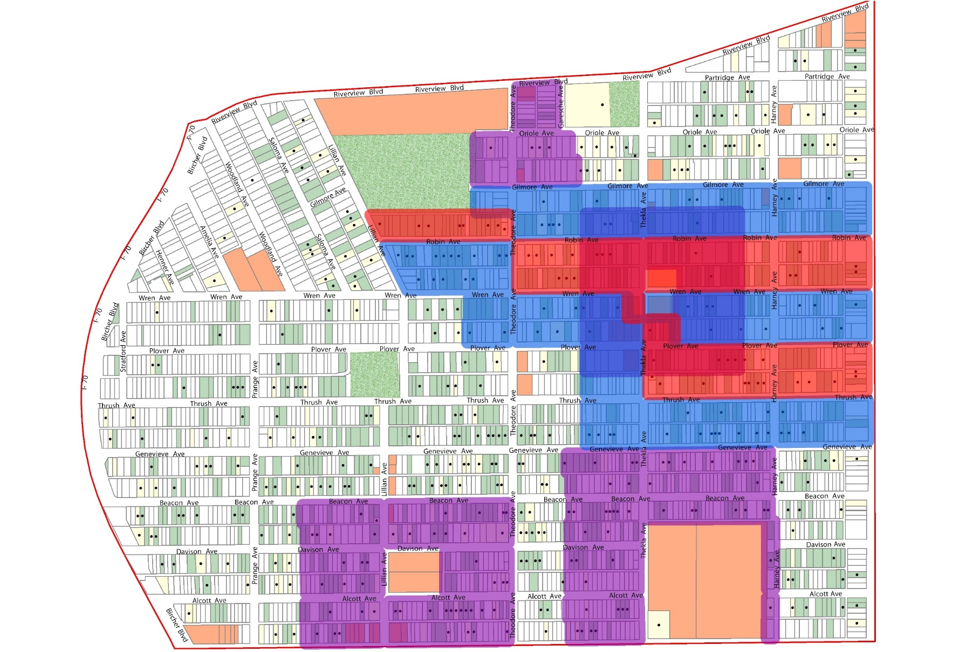
Green Space
Focus Area
Green Space
Adjacent Area
School Zones:
High Risk Area

Slide 26
Proposed Demolitions
LRA Buildings
Immediate
Green Space
Focus Area
28
126
Following Review
Green Space
Adjacent Area
45
School Zone
53

Slide 27
Wells goodfellow

Slide 28
Neighborhood context

Slide 29
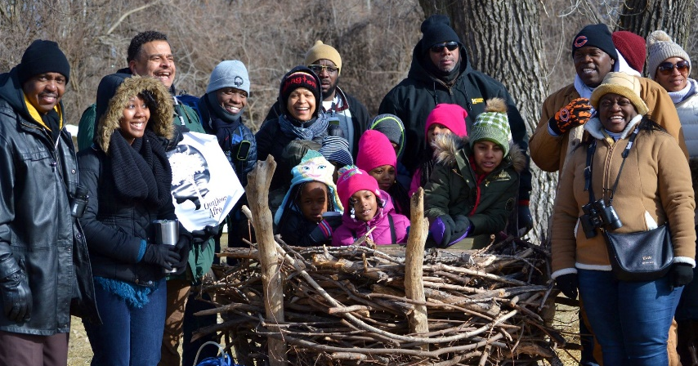
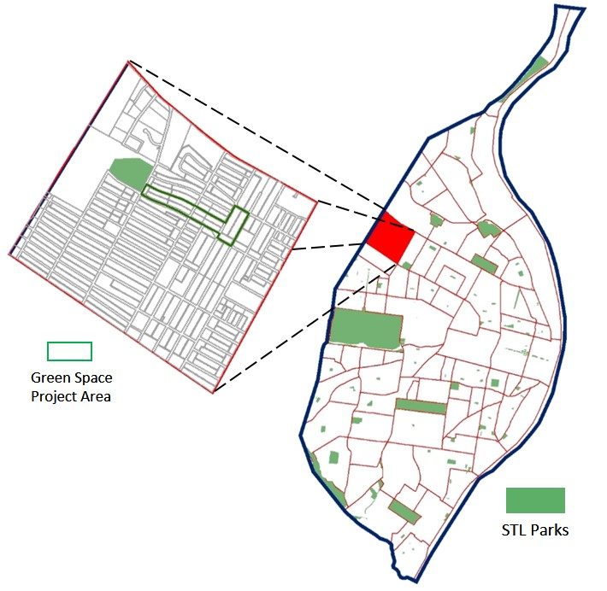
Wells goodfellow planning efforts
Neighborhood Planning Workshops Aug-Nov 2016
Kansas State University Technical Assistance for
Brownfields (EPA) > SKEO Solutions
Community Advisory Committee meets quarterly
Community Events ~6 / year
- beautification / planting projects
- trash sweeps / clean ups
- invasive species removal
- nature-based field trips
77 demolitions; 35 in green space focus area
Xtreme LA Design Challenge
landscape architecture design challenge hosted by
Washington University in St. Louis – urban water focus
Green Space Design Charrette
KSU TAB (EPA) > HDR/CSRA to develop
design renderings for neighborhood green space

Slide 30
Wells goodfellow
NEIGHBORHOOD GREENSPACE PROJECT
Doug Bisson, Community Planning and Urban
Design Lead, HDR

Slide 31
EXISTING CONDITIONS

Slide 33
CHARRETTE PROCESS

Slide 36
REFINED CONCEPT

Slide 37
PLAN VIEW
REFERENCE IMAGES

Slide 38
PERSPECTIVE RENDERING GOODFELLOW GATEWAY

Slide 39
VACANT LOT RETROFIT

Slide 41
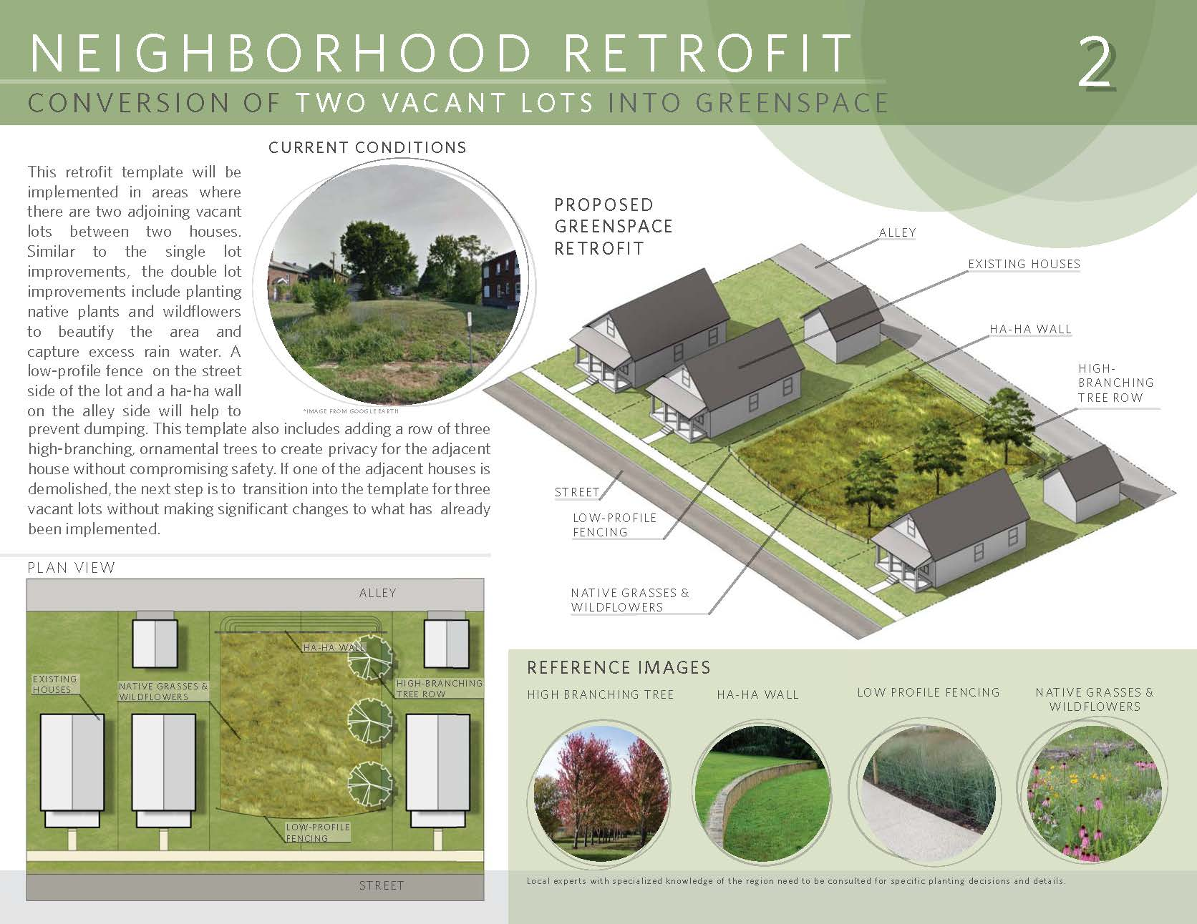

Slide 42
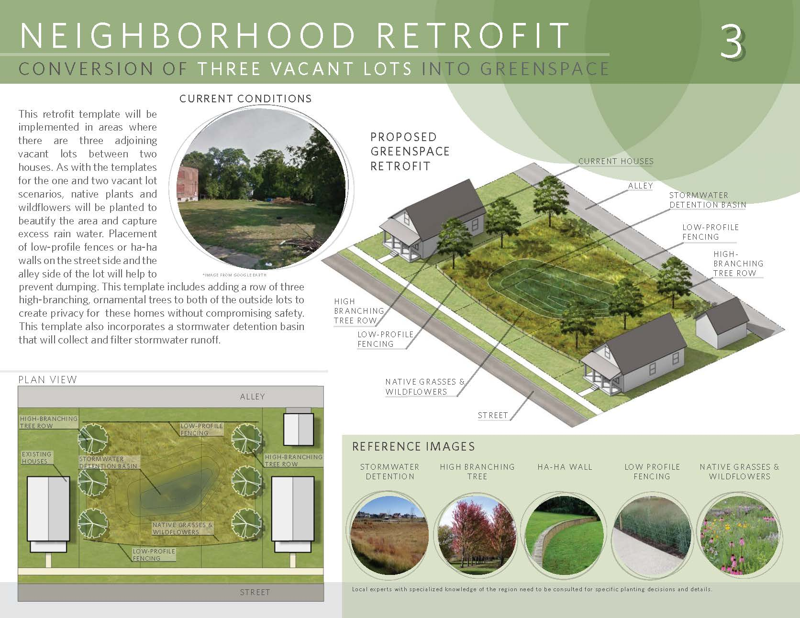

Slide 43
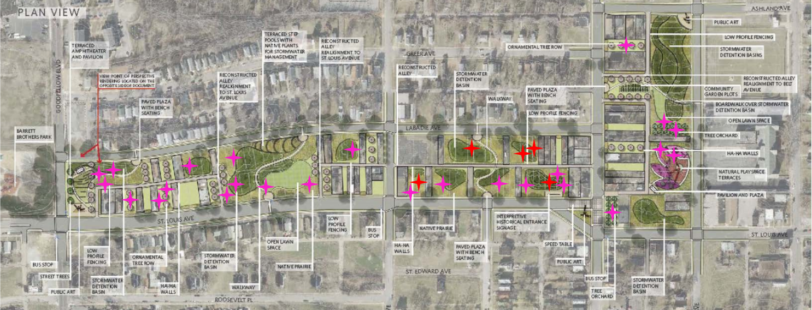
excavations

Slide 44
NEXT STEPS
ROBERT J TRULASKE FAMILY FOUNDATION GRANT
+ NATIONAL FISH & WILDLIFE FOUNDATION GRANT
+ MISSOURI DEPARTMENT OF CONSERVATION COST-SHARE
= EXCAVATION, REGRADING, AND SEEDING FALL/WINTER 2018

