Slide 1

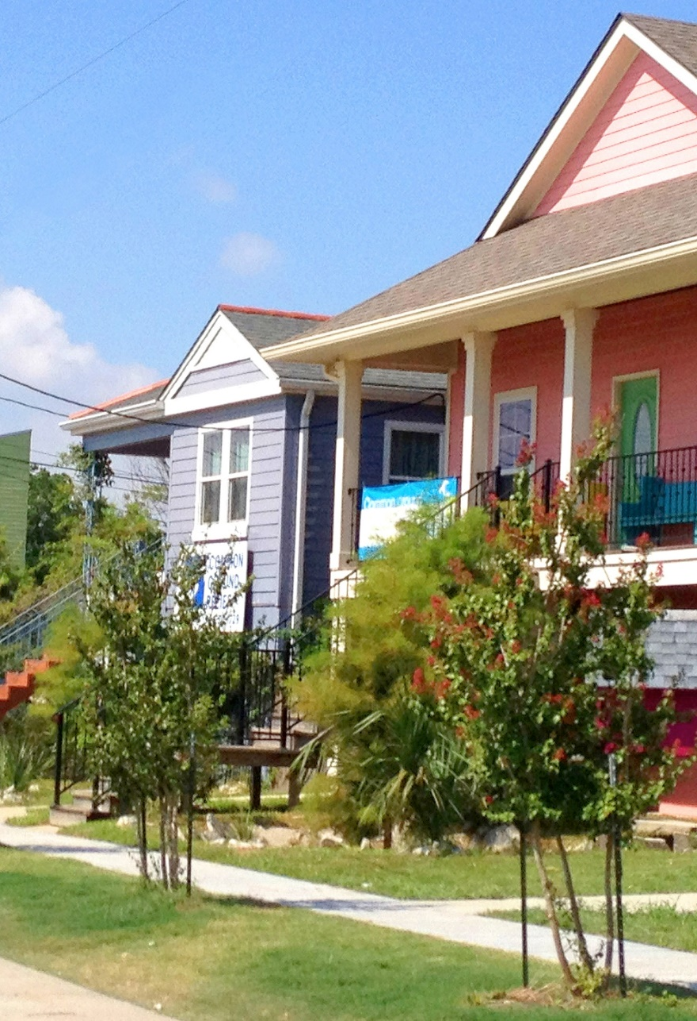
Tracking Trends in Mortgage Foreclosure:
Fast Track Statutes and NY’s Zombie Property Law
Reclaiming Vacant Property
Milwaukee, WI
May 16, 2018
Matt Kreis, Assistant General Counsel for National Initiatives
Center for Community Progress

Slide 2
About Us
Center for Community Progress
Mission: To foster strong, equitable communities where vacant, abandoned, and deteriorated properties are transformed into assets for neighbors and neighborhoods.
Services: Technical assistance, education and training, policy, and research. Focus on systems-level change.
Snapshot: Since 2010, technical assistance has been provided to more than 250 urban, suburban, and rural communities, in over 30 states.
Leadership & Education: Be on the lookout for upcoming webinars, leadership programs, and place-based trainings. Follow us at:
    www.communityprogress.net (website)
    @CProgressNews (Twitter)
    @CenterForCommunityProgress (Facebook)
Notes:
Introduce yourself!

Slide 3
Presentation Outline
Recent Research and Findings (Rob Finn)
Legal and Policy Implications of Fast Track (Judith Fox)
Impact and Utility of Fast Track from a Practitioner (April Hartman)
Leading Approach: NY Zombie Law (Wade Beltramo)
Panel Discussions and Questions (All)

Slide 4
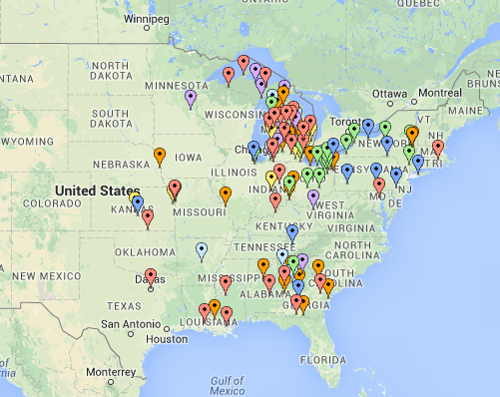
Rob Finn
National Community Stabilization Trust
Notes:
Rob Finn is the National Community Stabilization Trust’s Public Policy Associate, based in NCST’s Washington, D.C. office. Rob’s policy work at NCST focuses on state, federal, and agency advocacy and analysis of legislative, industry and regulatory initiatives impacting neighborhood stabilization, foreclosure processes, loss mitigation and other distressed real estate issues. In private practice in his home state of New Jersey, Rob served as both the Tenant Advocate for the Township of North Bergen and as that township’s Special Housing Prosecutor, enforcing housing, building, zoning and fire/safety codes and rent control and illegal occupancy ordinances. Rob also defended tenants in the Housing Unit at South Brooklyn Legal Services. Prior to his legal career, Rob worked in professional theater as a publicist, designer and director. He received his B.A. from Wesleyan University, his J.D. from Cardozo School of Law, and is admitted to practice law in New Jersey, New York and the District of Columbia.

Slide 5
Judith Fox
University of Notre Dame School of Law
Notes:
Leave slide up during our joint Q+A session

Slide 6
April Hartman
Legal Action of Wisconsin
Notes:
April Hartman is the supervising attorney for Legal Action of Wisconsin’s Elder Rights Project. The state-wide Project provides civil legal aid to elder victims of crimes. She graduated from the University of Wisconsin Law School in 2007 and began working at Legal Action shortly thereafter. April’s areas of practice include tenant/landlord, foreclosure defense, public benefits and general civil litigation

Slide 7
A Milwaukee Story
Notes:
Introduction: LSC 10 years, represent elders, variety of legal issues including municipal citations and foreclosure

Slide 8
The problem from ERP’s point of view
Elder clients, mostly widows
Could not afford or maintain or live alone
Stopped making payments
Thought foreclosure was imminent
Left the housing
Months, years later, received municipal citations
Notes:
Mostly widows; some told to move; Shirley moved to Texas and came back & that’s when she realized

Slide 9
Meanwhile . . .
Devastating city neighborhoods
Targets for crime
Demoralizing
Notes:
(2014) 4,900 vacant properties, 400 in some stage of foreclosure, 360 zombie foreclosures

Slide 10
Shirley Carson
Under water
Vacated in 2010
January, 2011 BONY had filed for foreclosure
April, 2011 obtained default judgment
November, 2012 we filed motion
Notes:
$52,000 loan/modification increased payments; house in disrepair & client in poor health; elder widow
Default – three month redemption claimed $81K was owed

Slide 11
Wis. Stat. s. 846.102 – Abandoned Premises
Amended in 2011
Shortened redemption period from two months to five weeks
Allowed municipalities and the parties to present evidence of abandonment
Judgment shall be entered and sheriff’s sale shall be made upon the expiration of the redemption period

Slide 12
Motion based on Wis. Stat. 846.102
Requested amended judgment of foreclosure
Submitted evidence of abandonment
5 week redemption period
Then, property shall be brought to sale
We lost
Notes:
Negotiated w/creditor
Plaintiff elects the redemption period & can’t force creditor to execute on judgment

Slide 13
Court of Appeals & Wisconsin Supreme Court
BONY argued:
only plaintiff could elect redemption period
trying to force them to take ownership
no deadline to bring a sale
City & Legal Aid Society filed amicus briefs
Notes:
Defendant could not bring motion
Trying to make them eat dirt
5 years to execute a judgment

Slide 14
361 Wis. 2d 23 (2015) Court held:
Once it makes a finding of abandonment, court is required to order the property be brought to sale w/in a reasonable time after the five-week redemption period (based on the totality of the circumstances)
Implicit approval of defendant’s ability to bring motion seeking abandonment finding

Slide 15
Results
City filed motions w/varying degrees of success
Issue got publicity
The banking lobbyists pushed back
Notes:
Help from Common Ground

Slide 16
New 846.102 Abandoned premises
Only upon motion of plaintiff or city
5 weeks to 12 months
If no sale, can satisfy mortgage & walk away
If neither w/in 12 mos., then defendant or city can motion for sale

Slide 17
Results
No more motions
No resources to track what’s happening
Clients still come, but earlier
Statement of Abandonment in the Answer
Stipulate to waive redemption periods and for quick sales
Actions/counterclaims for judicial sale
Notes:
Suggested in the concurrence

Slide 18
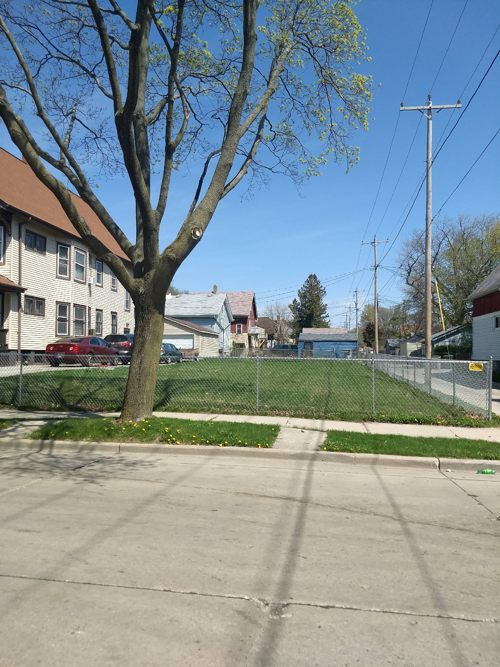
TODAY

Slide 19
Wade Beltramo
New York Conference of Mayors (NYCOM)
Notes:
Leave slide up during our joint Q+A session

Slide 20
Let’s talk!
Questions?

Slide 21
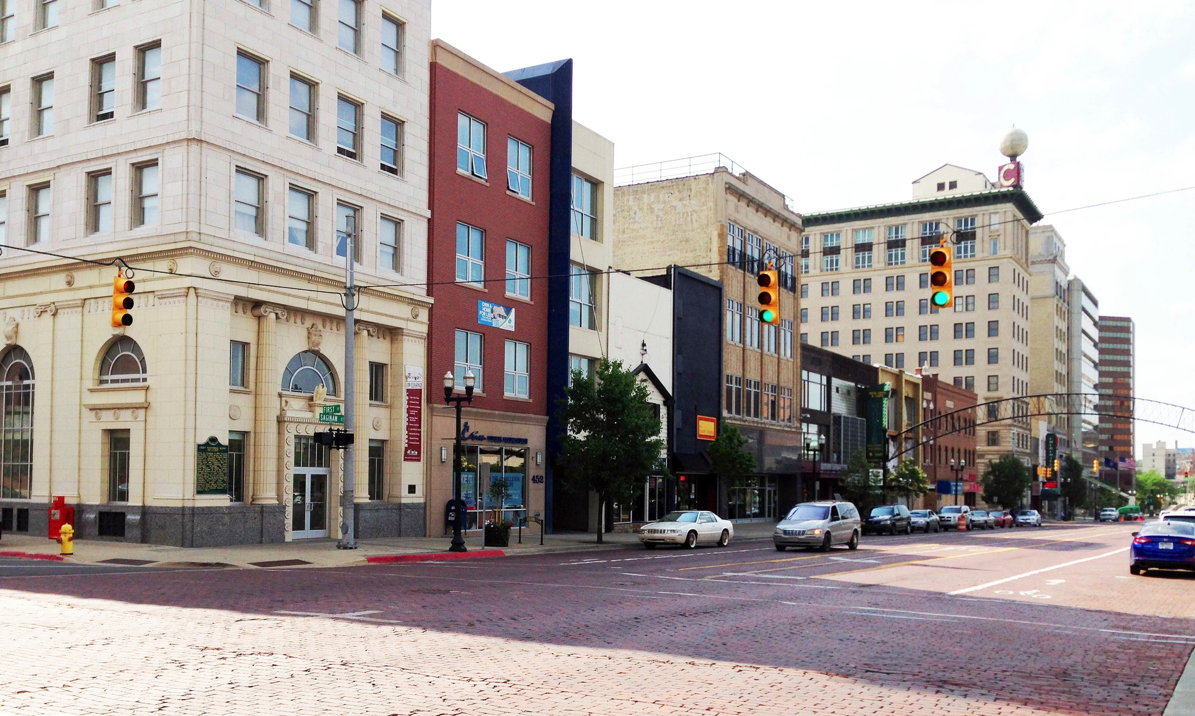
© 2018 Center for Community Progress. The Center for Community Progress owns all copyright for this presentation. You may reproduce copies of this presentation for non-commercial use to share with colleagues at your organization. The presentation may not be copied or reproduced for other purposes without the express written permission of the Center for Community Progress.

