Slide 1
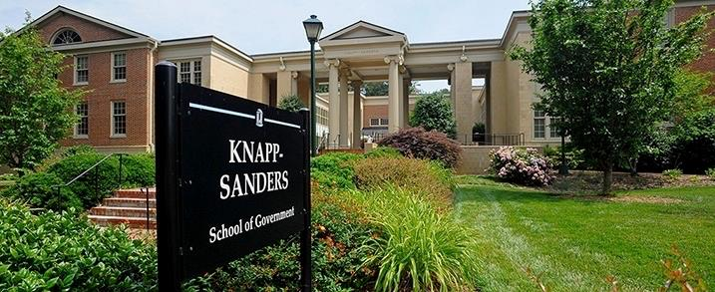

Reclaiming Vacant Properties Conference - Milwaukee
UNC-Chapel Hill School of Government
Graduate Student Experiential Learning
Notes:
We teach

Slide 2
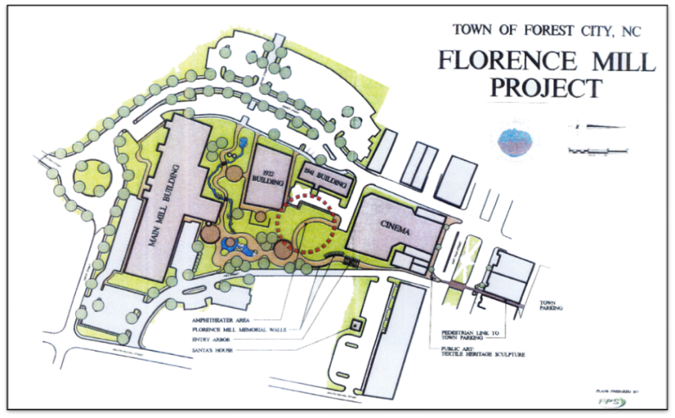
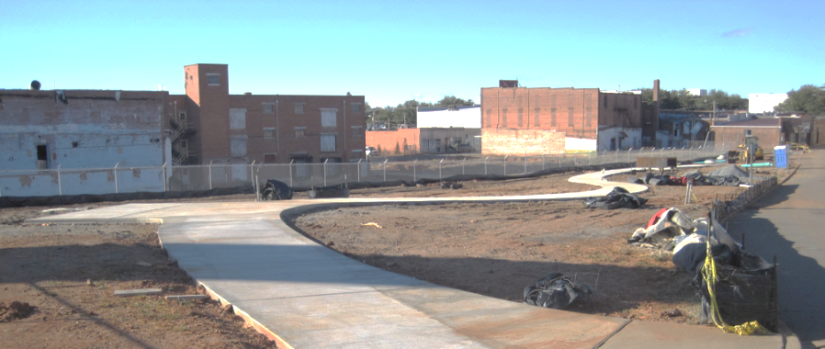
Serving Local Government Clients in
Development Finance & Revitalization
Local Government Law:
  Code Enforcement
  Property Acquisition
  Public-private partnerships
  Public & Private Finance
  Property conveyance
Development Finance:
  Feasible project for developer
  Appropriate public role (if any)

Slide 3
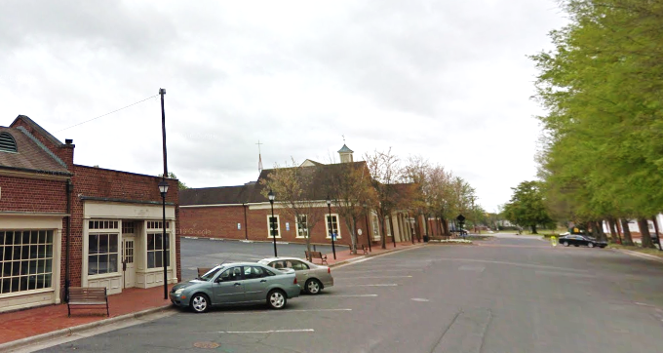
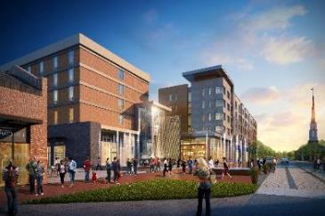
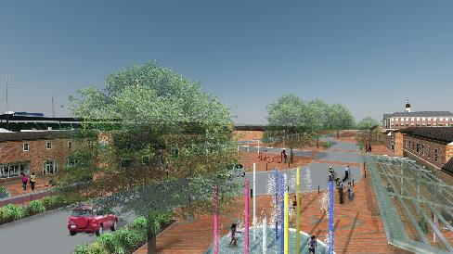
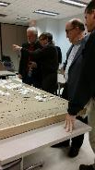
You want to buy your entire downtown?
(Complex, Long-term, High Visibility)

Slide 4
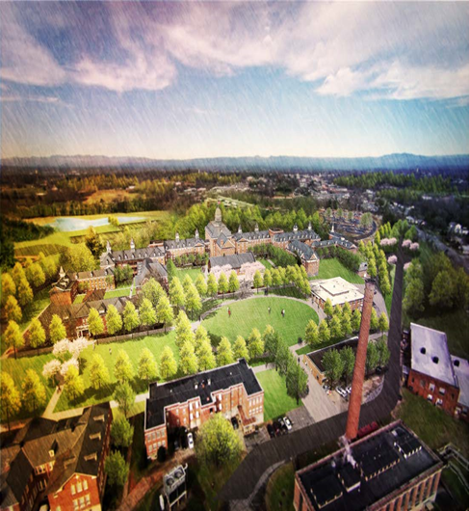
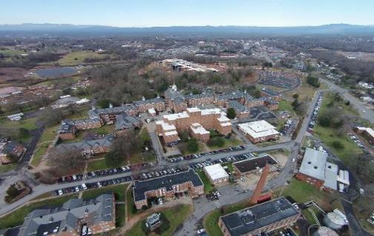
Vacant 52-acre mental hospital sitting on a hill overlooking the town? (+800 acres)

Slide 5
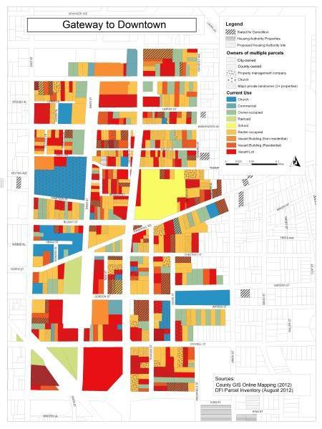
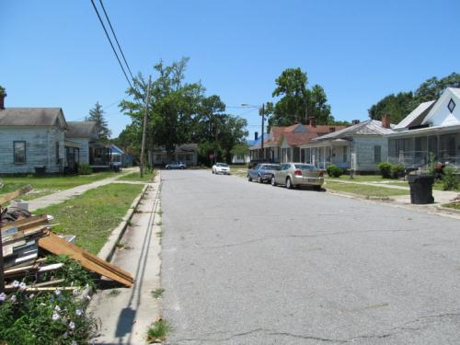
Revitalize distressed neighborhood?
Population 21,500
Notes:
Housing condition inventory, land banking

Slide 6
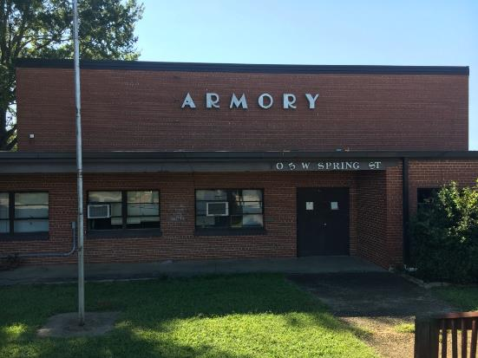
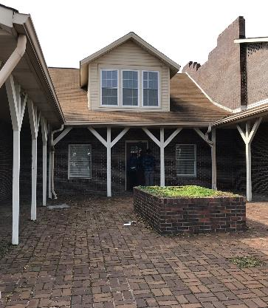
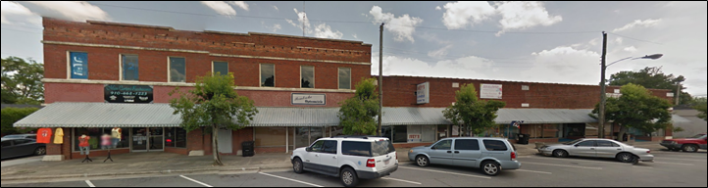
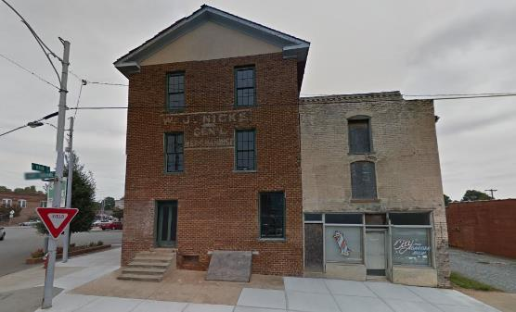
Grad Student Course in Revitalization:
Help Rural & Small Towns at No Charge

Slide 7
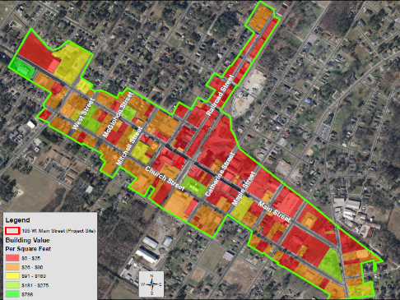
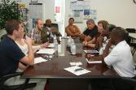
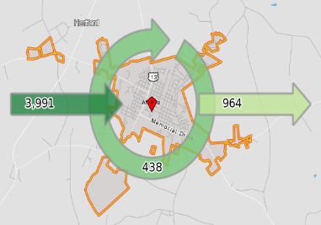
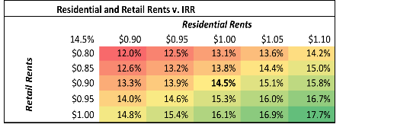
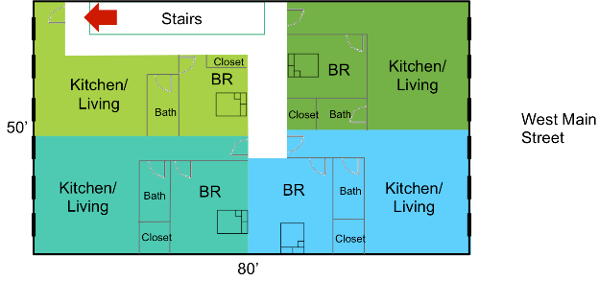
Grad Student Work Product:
Developer Pro Forma & Public Recomm.

Slide 8
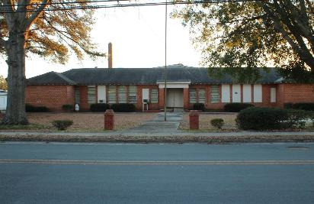
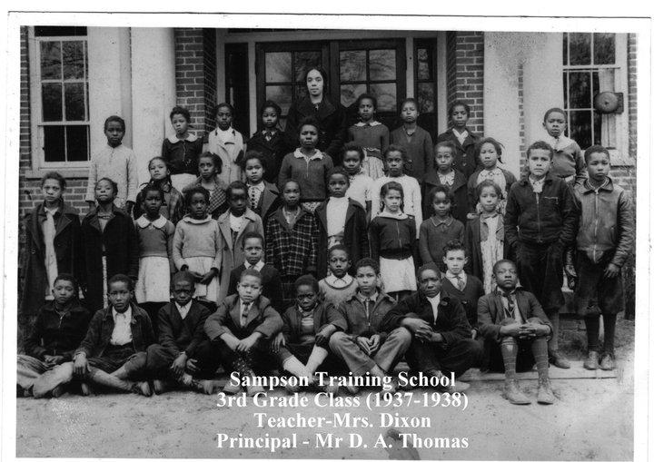
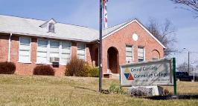
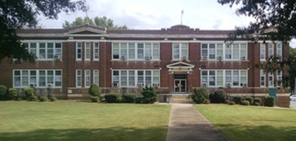
Grad Students Making a Difference:
Affordable Housing Predevelopment
Notes:
“Booker T. Washington of the Tuskegee Institute and Julius Rosenwald, philanthropist and president of Sears Roebuck, built state-of-the art schools for African-American children across the South.”

Slide 9
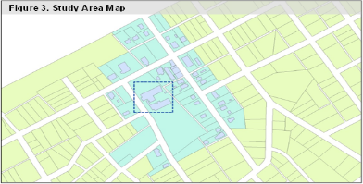
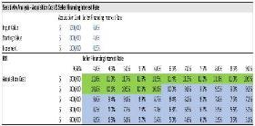
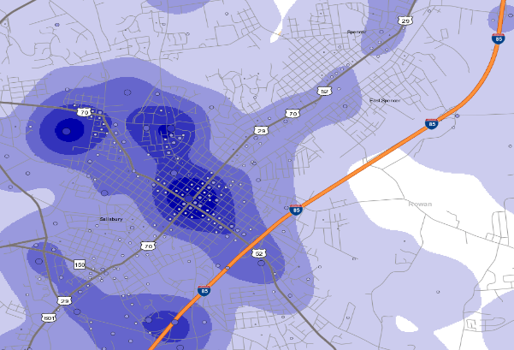
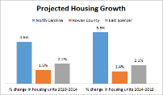
Grad Student Work Product:
Developer Pro Forma & Public Recomm.
Figure 8: Employment Heat Map
Spencer
East Spencer
Salisbury

Slide 10
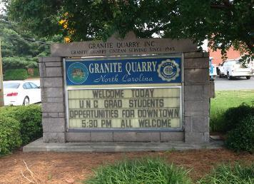
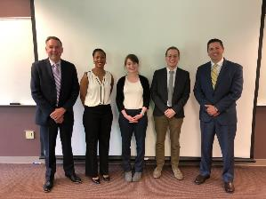
“Please share your best and brightest”
MBA, MCRP, MPA, MPH, and a few JDs

Slide 11
Contact
Tyler Mulligan
Associate Professor of Public Law & Government
Faculty Director, Development Finance Initiative
School of Government at UNC-Chapel Hill
mulligan@sog.unc.edu

