Slide 1
Block Clubs, Bikers, and Baptists The Power of Grassroots Leaders to Stabilize Communities
Lilah Zautner
Manager of Special Projects and Land Reuse - Cuyahoga Land Bank
Vatreisha Nyemba
Manager of Compliance and Program Development - Cuyahoga Land Bank
Paul Huneycutt
Christian Missionary Alliance, Envision Cleveland
Sheila Locatelli
President/CEO - Women of Hope, Inc.

Slide 2
Session Goals
Inspire professionals and grassroots practitioners to forge new, non-traditional partnerships.
And to share the stories of how we…
Adapt the property research process and presentation to the micro-scale for use by non-traditional, often non-professional partners
Vet project proposals using our proven Big 5 assessment – credibility, development capability, capacity, programming, and sustainability
How to use legal and transactional tools to minimize risk while embracing creativity and supporting grassroots organizations in making bold impact

Slide 3
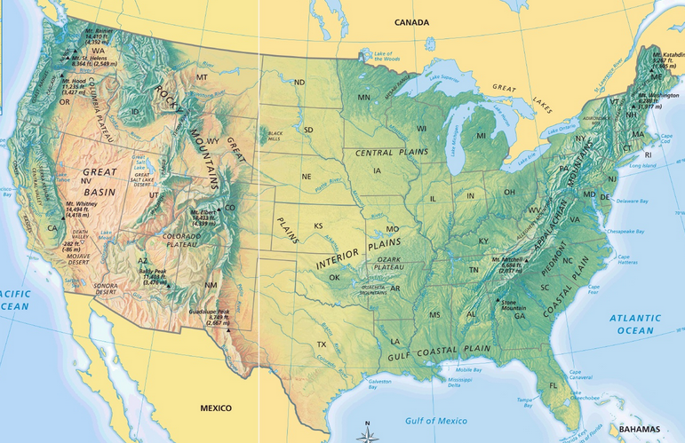
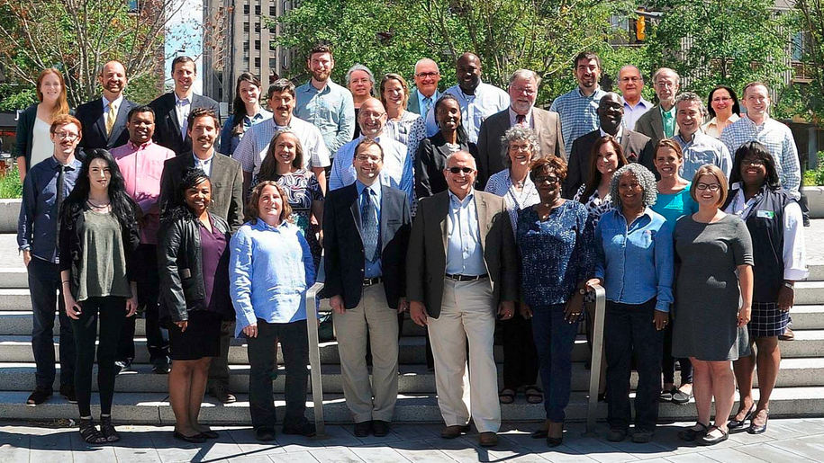
Cuyahoga Land Bank
The Mission of the Cuyahoga County Land Reutilization Corporation is to strategically acquire properties, return them to productive use, reduce blight, increase property values, support community goals and improve the quality of life for county residents.
Created in 2009
Takes in structures and land within Cuyahoga County
Private Non-Profit Corporation
Government Purposed by the County
High Level of Transactional Capability and Flexibility
Approximate $9 Million Annual Budget
Total Properties Transacted | 9,949
Total Properties in Inventory | 4,053
Total Properties Demolished | 6,545
Total Properties Renovated | 1,661
Total Properties sold or gifted to non-profit | 1,138
Notes:
28,699 vacant structures in Cuy County. Of this is estimated that 10-12,000 need to be demolished.
There are about 33,000 parcels with tax delinquency more than 100

Slide 4
Cuyahoga Land Bank Property Pipelines
BANK REO’s
DEED IN LIEU
HUD
GSE’s
TAX FORECLOSED
PROPERTY TRIAGE
RESPONSIBLE FOR MOTHBALL REHABILITATION
HOLD FOR STRATEGIC ASSEMBLY & ECONOMIC DEVELOPMENT
PROGRAMS:
• SIDE YARD • INFILL HOUSING • GREEN SPACE • URBAN GARDENS
DEMOLISH
RESALE TO RESPONSIBLE QUALIFIED BUYER/REHABBER

Slide 5
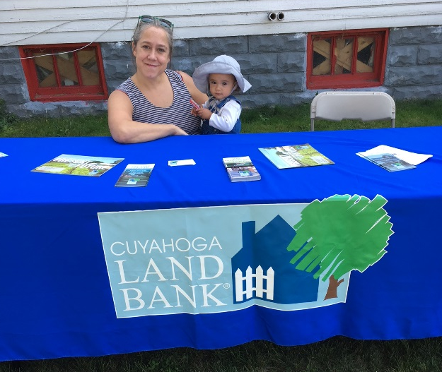
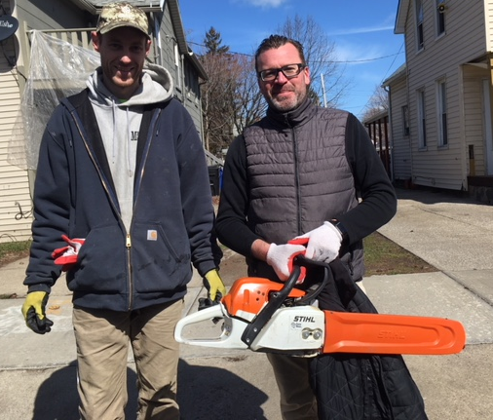
Why Partner? In the face of abandonment you either laugh or cry. I prefer to laugh… …with friends
Partnerships
Result in better planned, higher quality, easier to transact, and better maintained projects.
Leverage hardscapes with heartscapes to create meaningful places instead of generic spaces.
Allow non placed-based organizations to take community redevelopment to scale with only 1.5 staff!
Keys to our success
Accurate, real-time, organized data is key to long term acquisition strategies and trust between partners
Know your strengths and stay in your lane
Asses risk and always have a back up plan
Encourage partners to grow where they’re planted

Slide 6
Creative Collaborations
Special Projects Team
Community Partner
&
Project Manager
President
Executive Assistant
Acquisitions Manager
Information and Planning Specialist
GIS and Research Technician
Assistant General Counsel
Stabilization
Parcel based triage to protect and leverage community anchors
Facilities Match Making
Strategic acquisition for the creation or expansion of facilities that serve special populations
Properties of Interest
Strategic acquisition and sale of economically, environmentally or culturally valuable properties
Assembly and Development
Clearing title and land for urgent and long-term assembly
GIS
Trello
Field Inspection
Walk & Work
Case Research
Property Profile System
NEO CANDO/NST
Spec Writing

Slide 7
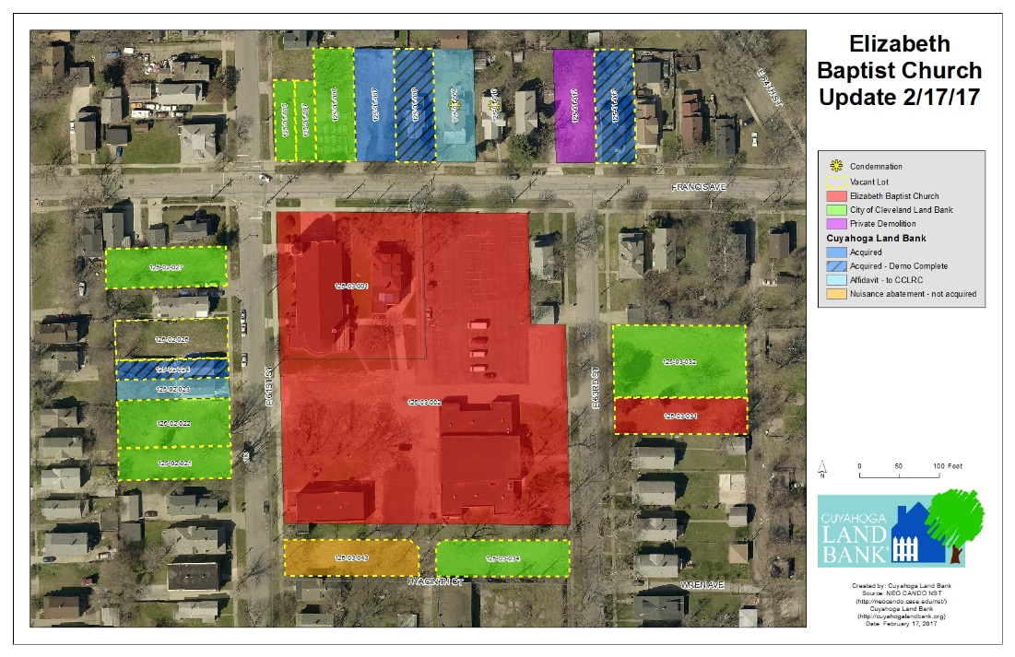
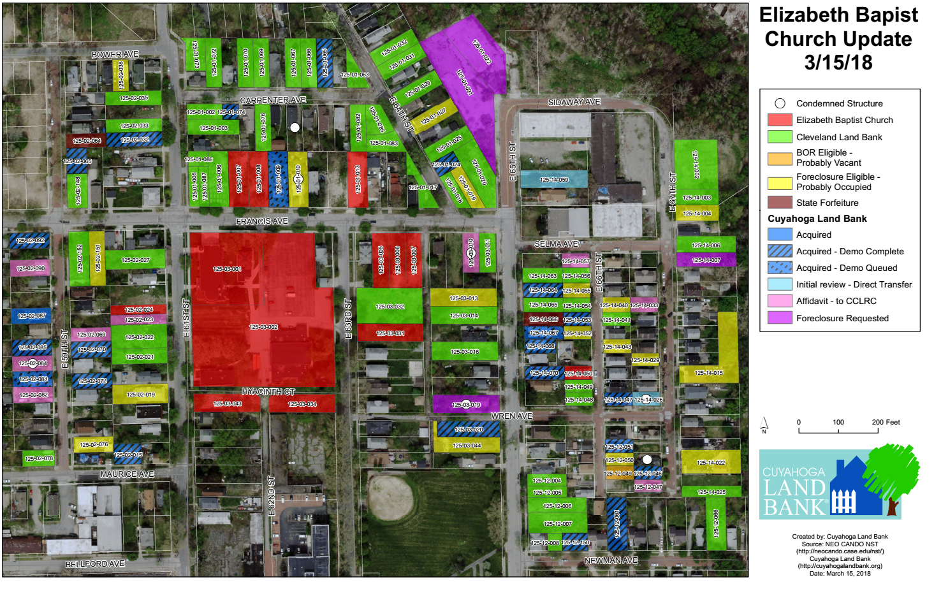
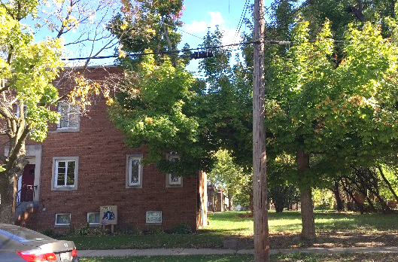
Stabilization Anchor organizations growing where they are planted
Elizabeth Baptist Church
Ongoing, close, working relationships with weekly property tracking and quarterly research and walk & work tours.
Goals for facility expansion, land assembly, greenspace, and nuisance abatement.

Slide 8
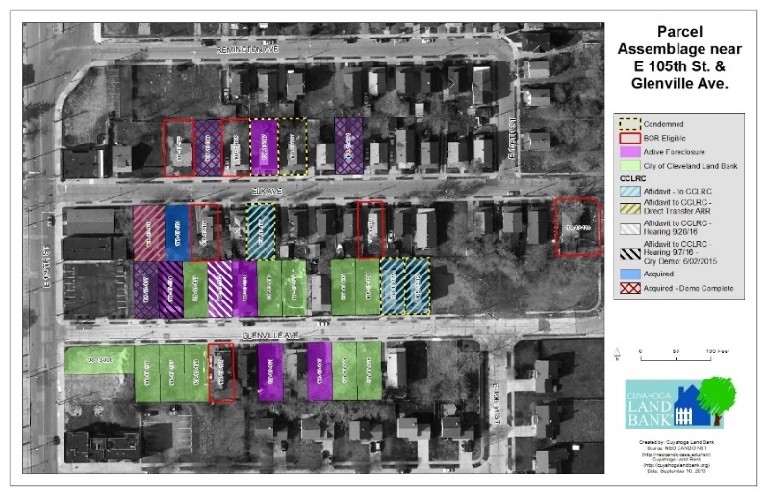
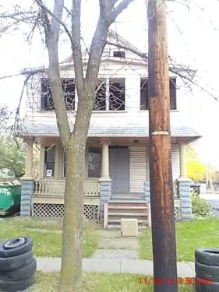
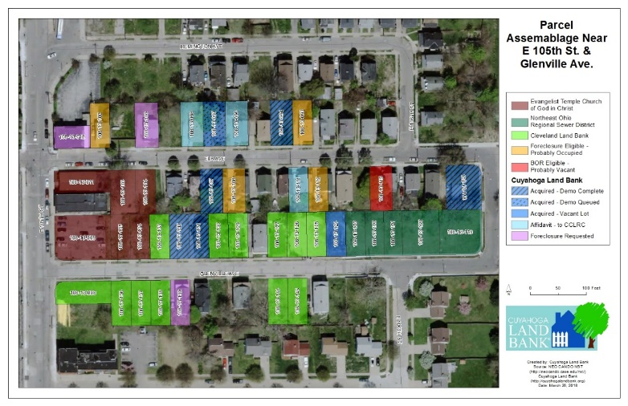
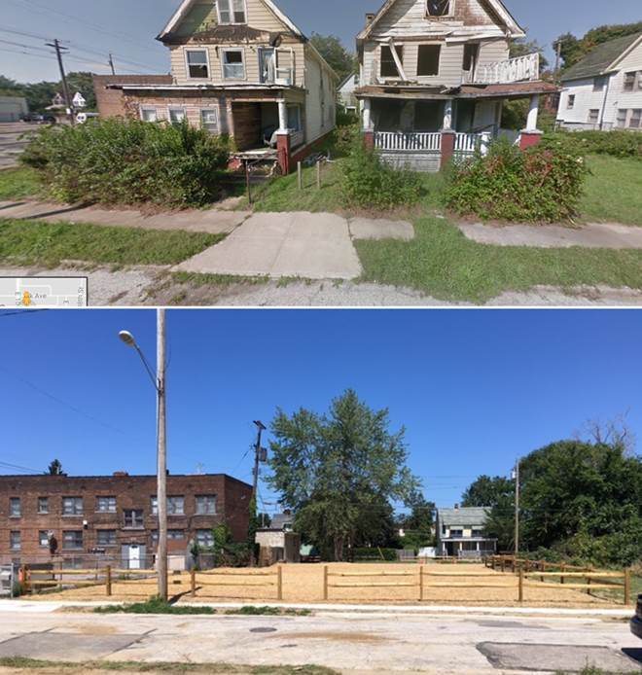
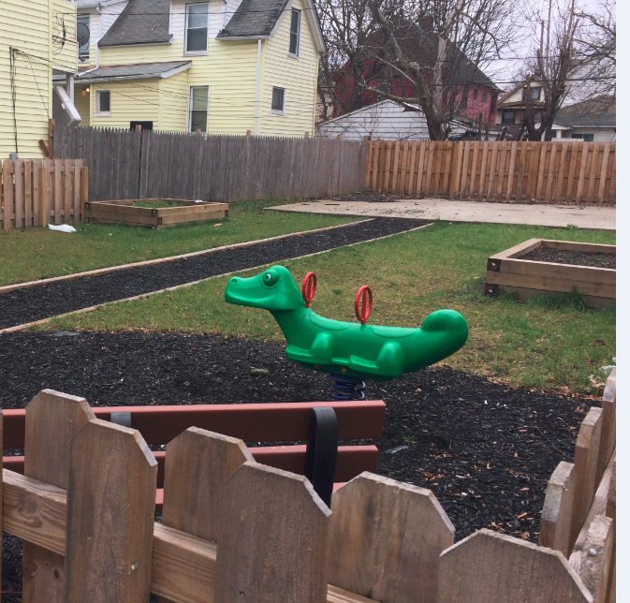
Stabilization Anchor organizations growing where they are planted
Evangel Temple, Church of God
Long term relationships that began with one problem property.
Ongoing research, walk and work tours, technical assistance and NETWORKING!

Slide 9
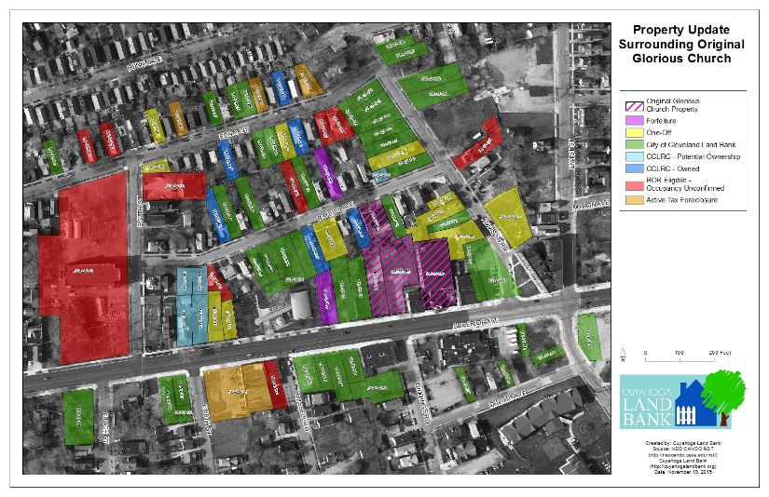
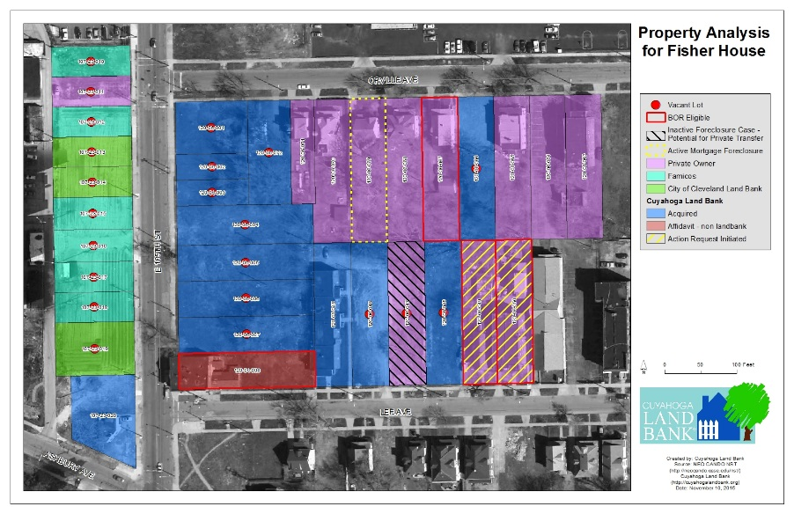
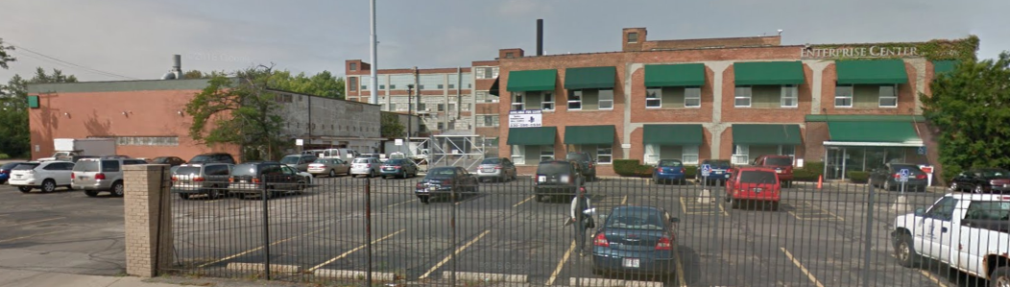
Assembly and Development Clearing the slate
East 105th Building, Fisher House, Original Glorious Church
Project-based transactional relationships with periodic meetings, on-site inspections and weekly tracking.
Research, acquisition, demolition, assembly, and resetting the proforma to encourage traditional and non-traditional development.

Slide 10
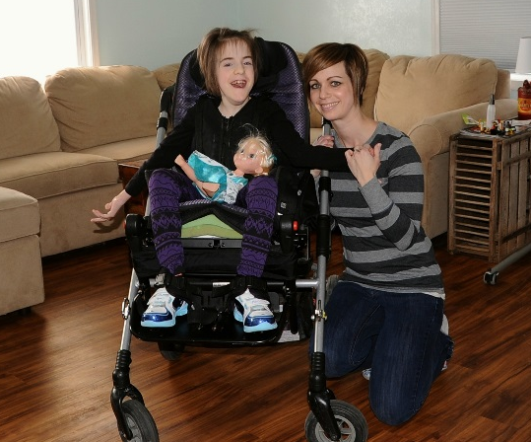
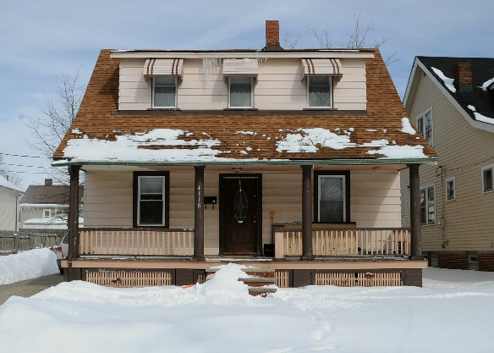
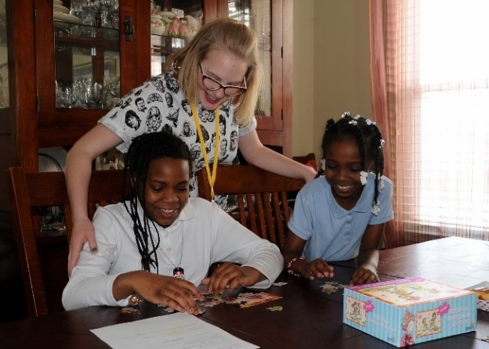
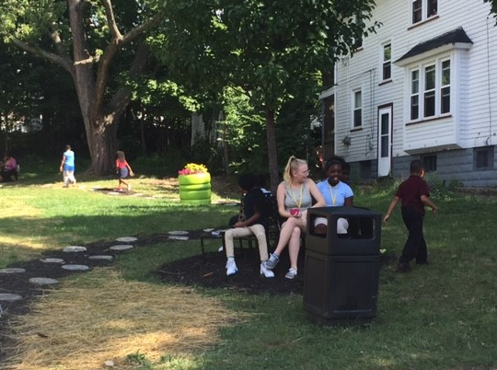
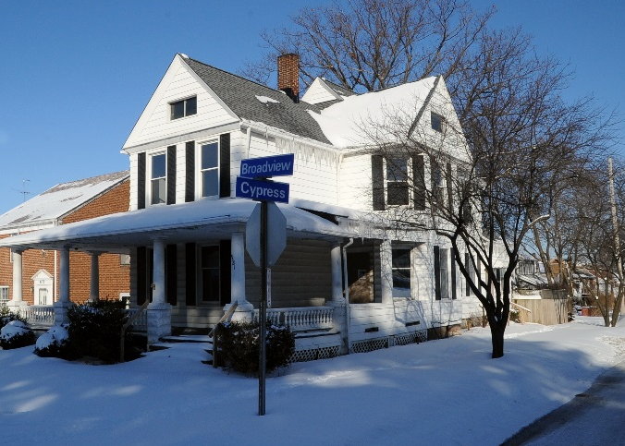
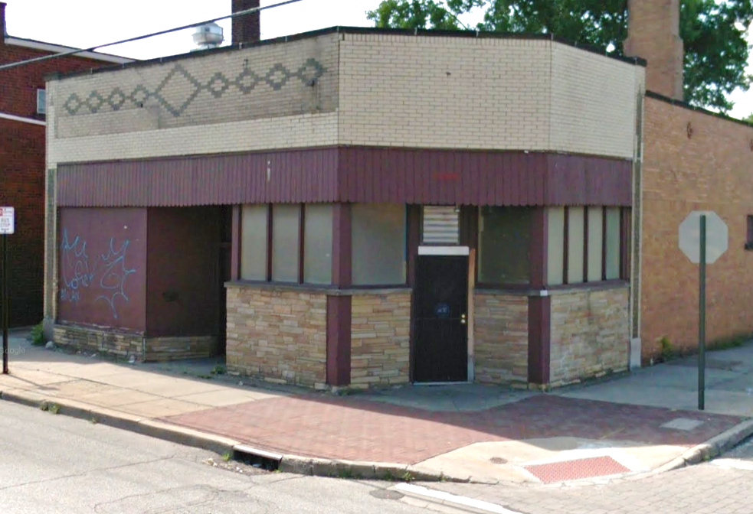
Facilities Match Making Hearts meet hard hats
The Meeting Place, Envision Cleveland
Ongoing or project-based transactional relationships with periodic meetings, on-site inspections and weekly tracking.
Research, pass-throughs, acquisition and sale of properties to be renovated and used for non-profit operations or homes for special populations.
Followed up with ongoing stabilization efforts to support the community and protect the investment.

Slide 11
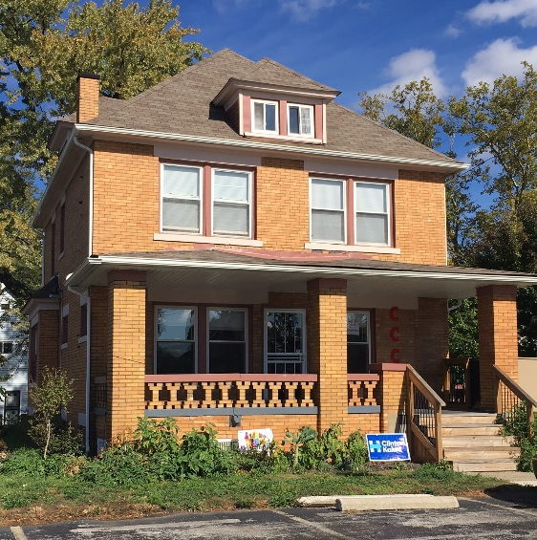
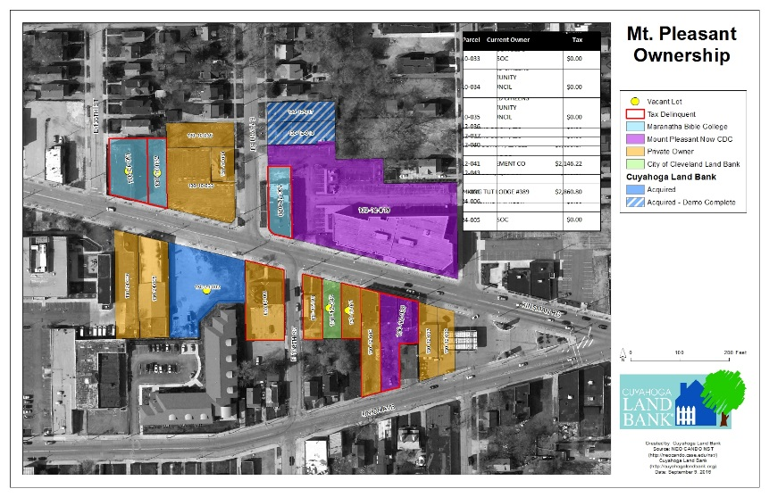
Facilities Match Making Hearts meet hard hats
Concerned Citizens Community Council

Slide 12
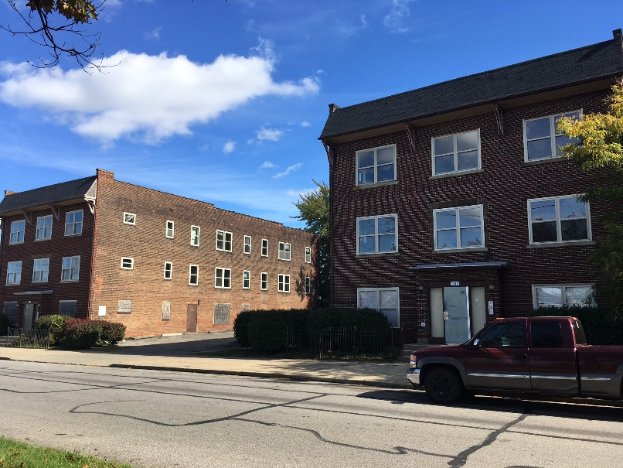
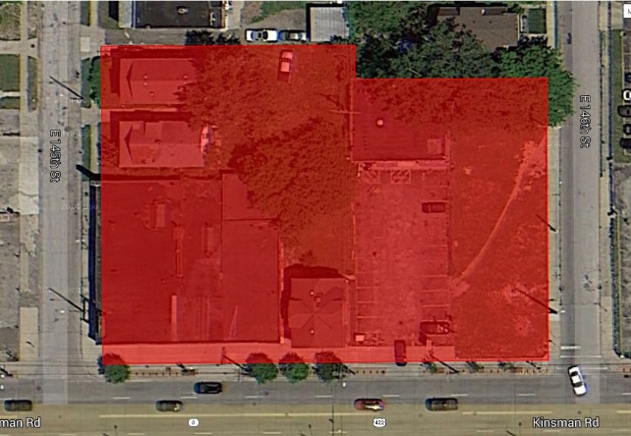
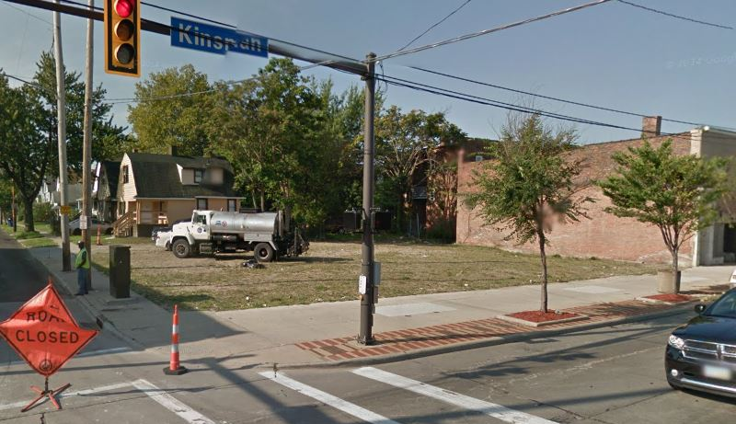
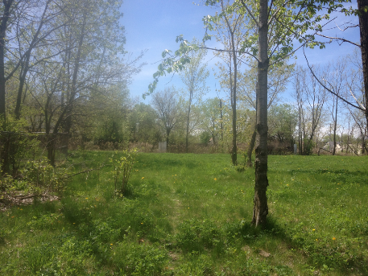
Properties of Interest Just too good to pass up
Kinsman properties
Seize the opportunity to acquire properties before collaborators are identified
Research, acquire, and assemble properties then reach out to select partners with the capacity to bring them back to life
Properties must present significant value to risk acquiring and holding them without an end user

Slide 13
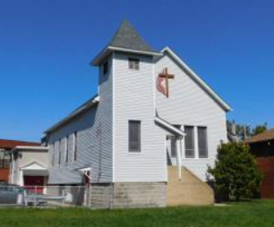
Properties of Interest Just too good to pass up
Oehloff Methodist Church, Hunting Valley acreage

Slide 14
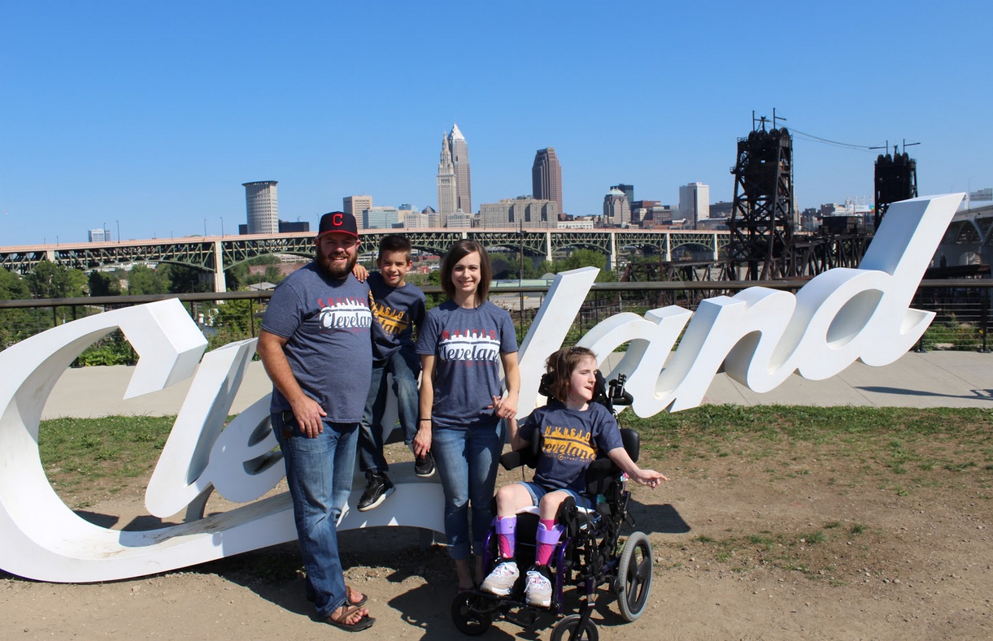
Envision Cleveland seeks to collaborate with individuals, communities, ministries and government to transform neighborhoods across Cleveland.
Envision Cleveland

Slide 15
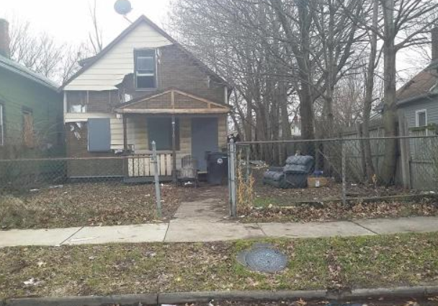
Underlying issues facing our community
Lack of Hope
Lack of Identity
Lack of Family or Belonging
Lack of Resources

Slide 16
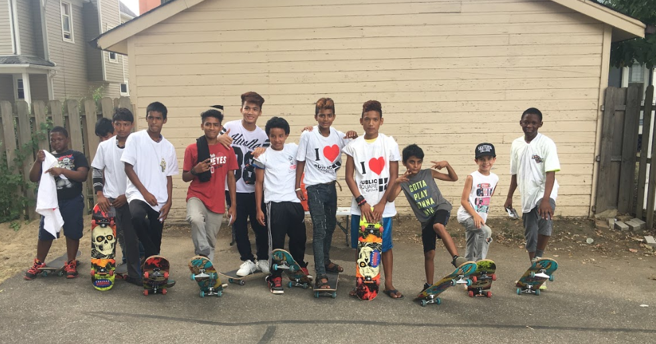
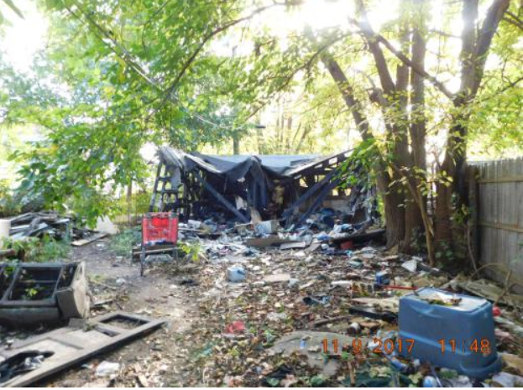
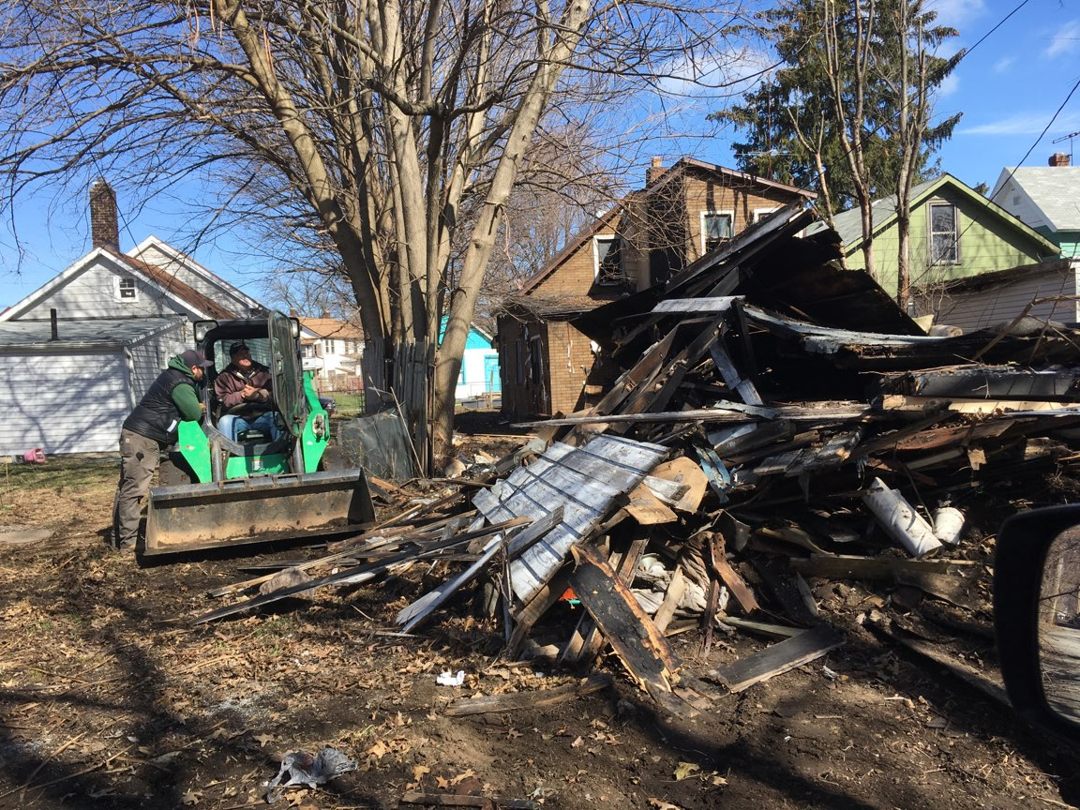
Addressing desperation
A three pronged approach
Restoring hope and identity
Restoring People
Restoring Properties

Slide 17
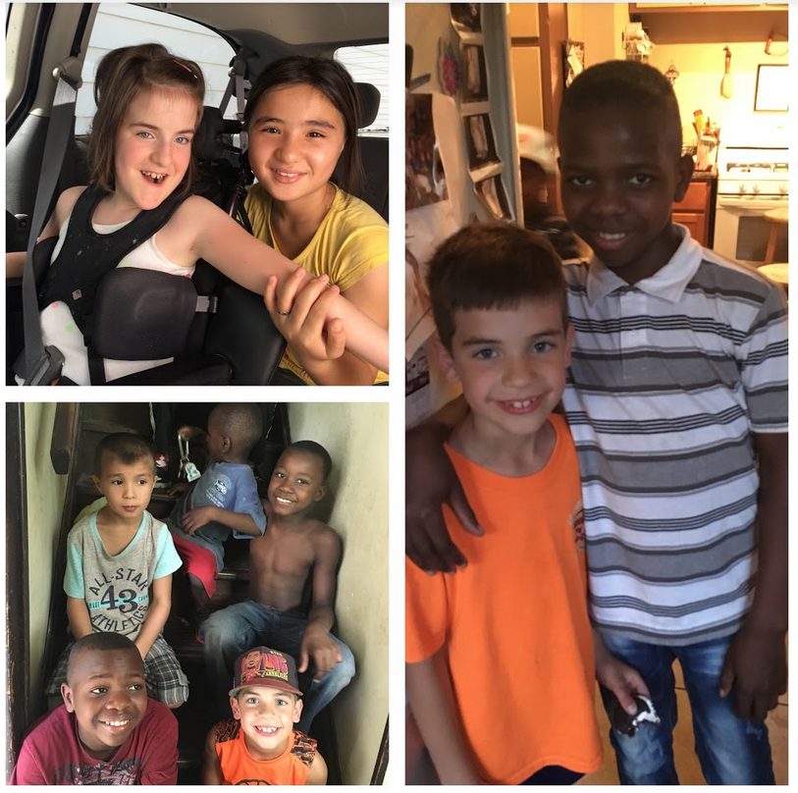
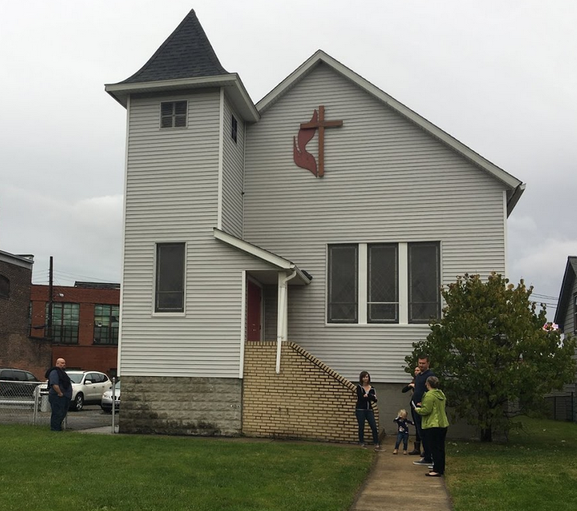
Addressing desperation
A three pronged approach
Reconciliation
People to God
People to People

Slide 18
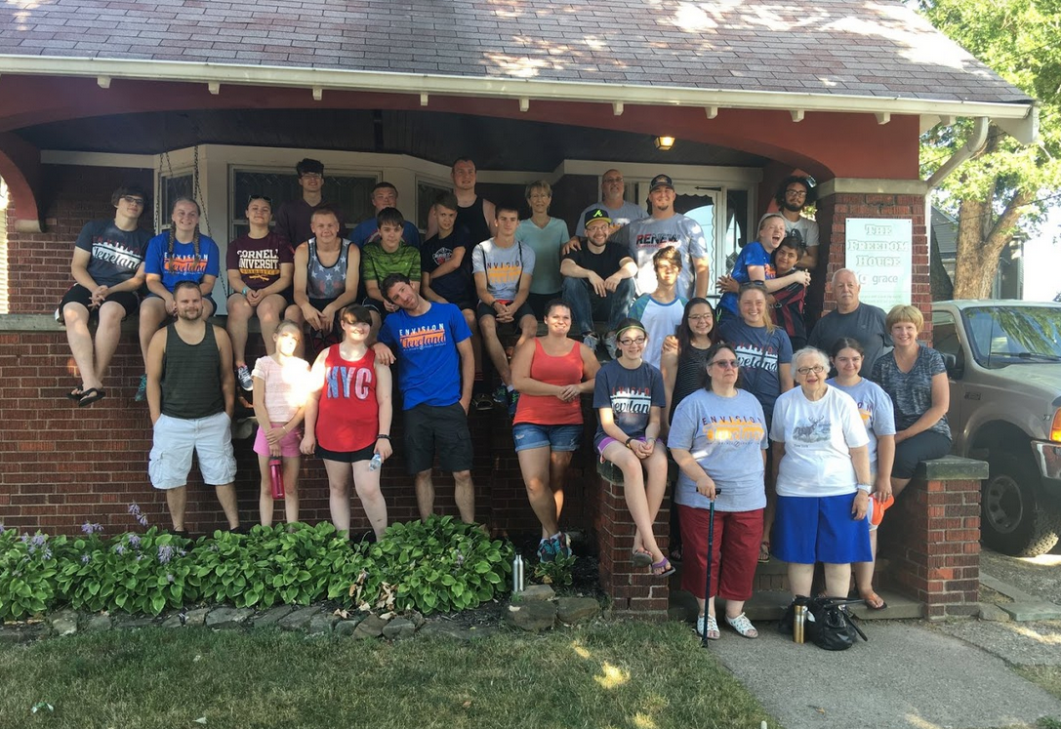
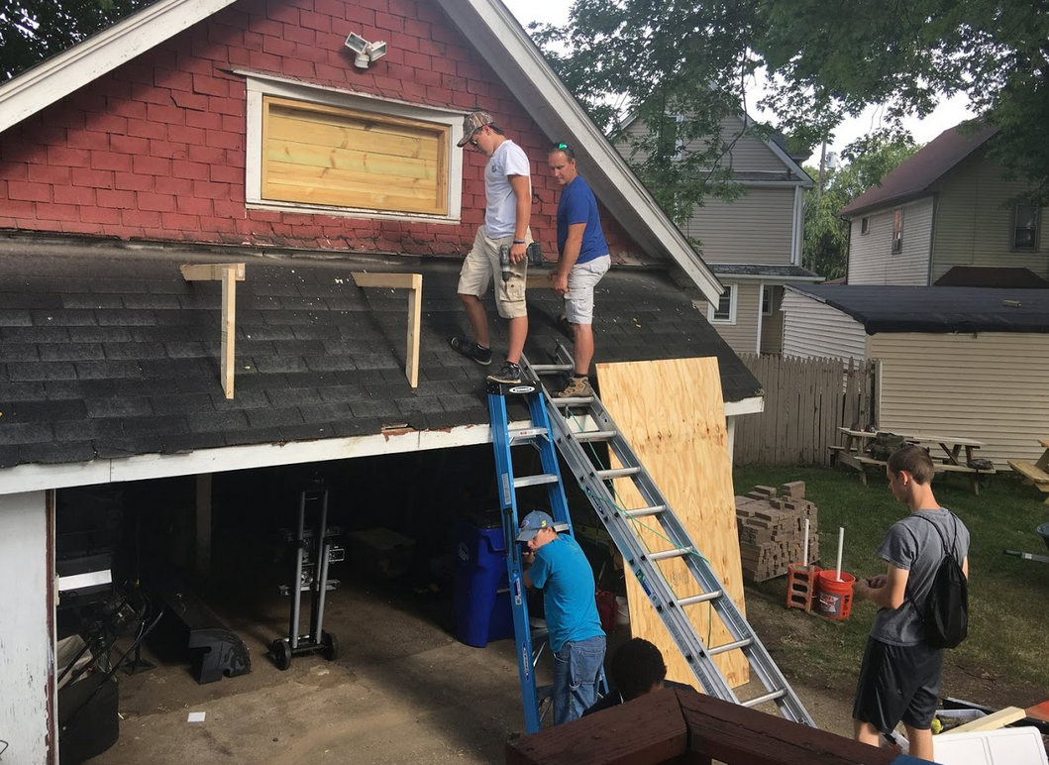
Addressing desperation
A three pronged approach
Resourcing
Teams/ Interns
Volunteers
Education
Financial
Consulting
Service

Slide 19
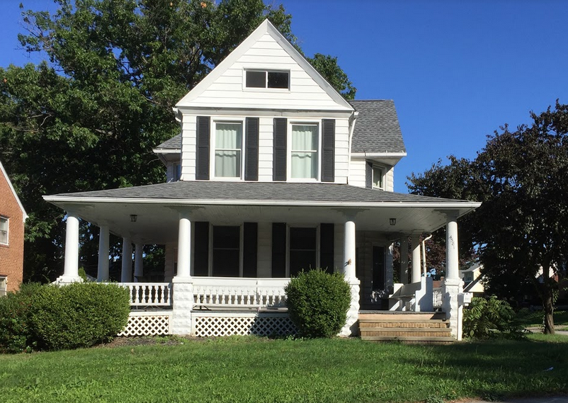
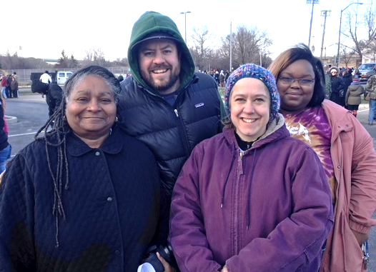
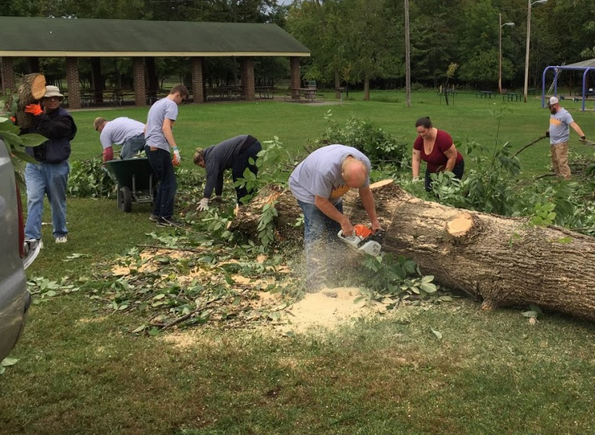
Advantages to working with the Land Bank
The Cuyahoga Land Bank provides…
Legal tools and expertise
Properties for staff housing and facilities
Access to land for greenspace projects
Income generation properties
Support for large scale service projects
Great networking opportunities
The Best Cheer Section!

Slide 20
www.envisioncleveland.org

Slide 21
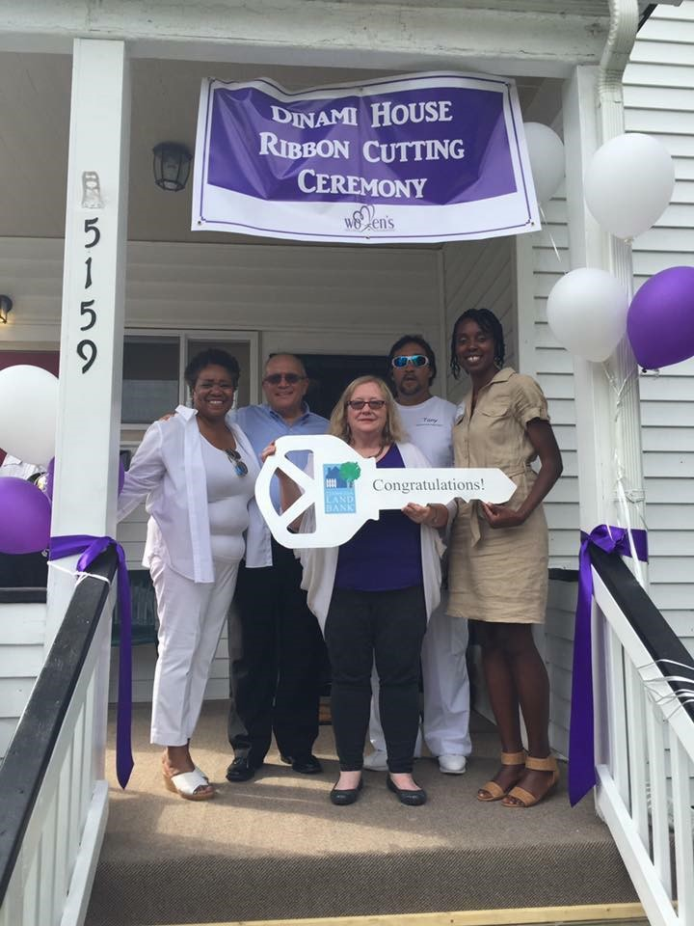
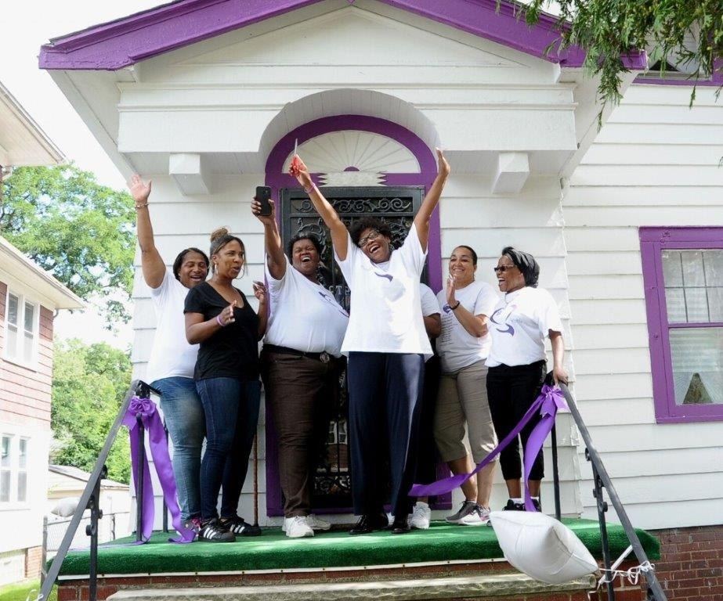
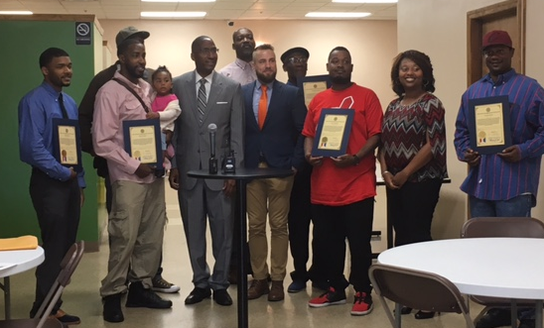
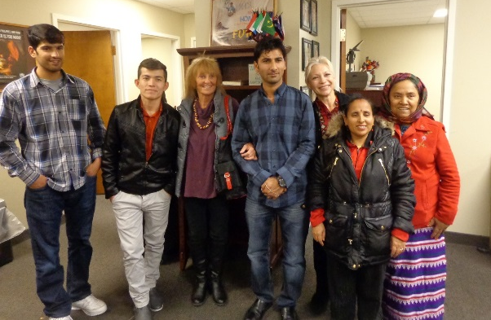
Examples of Non-Traditional Cuyahoga Land Bank Collaborations
Resettlement Agencies
Women’s Wellness Foundation
Passages
Re-Entry & Recovery
Aging Out of Foster Care
Bessie’s Angels
Refugees
Mustard Seed

Slide 22
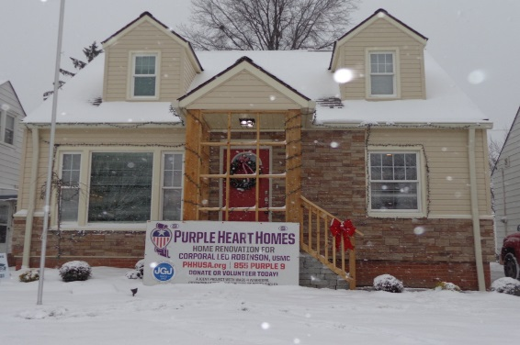
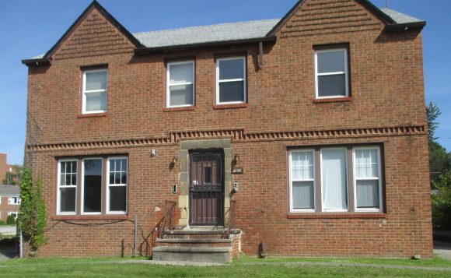
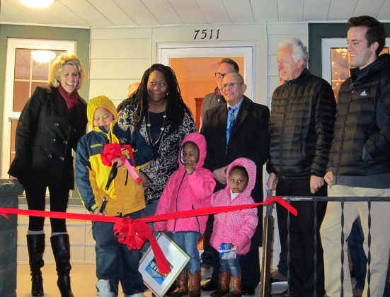
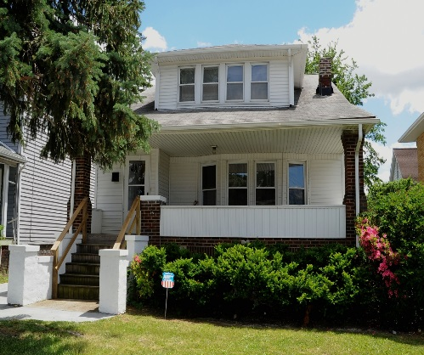
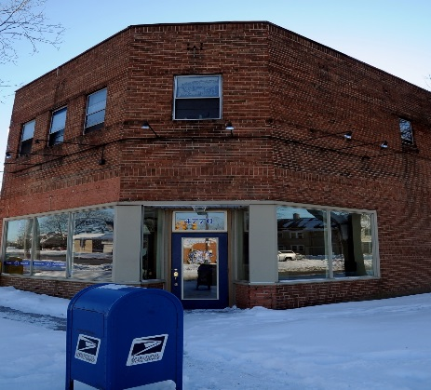
Examples of Non-Traditional Cuyahoga Land Bank Collaborations
Julie Adams House
Woodrow Project
Single Parenthood & Family Homelessness
City Mission – New Horizons
Fatherhood Initiative
Jordan CRC, Inc.
Congregate & Sober Living
Veterans
Purple Heart Homes
Lutheran Metro Ministries
Women of Hope

Slide 23
How to Initiate Non-Traditional Collaborations
Cross-linking With Non-Profits Working With Special Populations
Word of Mouth
Website & Storytelling
Direct Out-Reach: Community Meetings
Key Point: Recognize
Good Ideas/Passion vs. READINESS

Slide 24
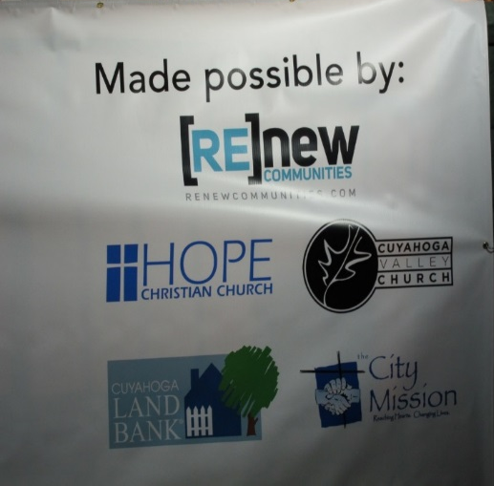
8 Keys of a Non-Traditional Collaboration
Sponsoring Organization
Ideally 501c3
Collaborations
Programming
Currently Active
Exhibits some success & commitment
Feasible Property
In-Reach: within property
Out-Reach: to surrounding community
Community Plan
End Use
Funding for Renovation
Renovation Management Plan
Sustainability Plan
Low cost acquisition, property holding
Researching for needed size, location, etc.
Location for programming
In-kind Labor & materials
Cash
Project management, technical assistance
General Contractor
Program Operations
Property Management
Special Population & Affordable Housing

Slide 25
Big 5: Collaboration Proposal
Credibility of the Organization
Renovation and/or Development Capacity
Operational & Financial Capacity
Programmatic Piece
Sustainability

Slide 27
Collaborative Transaction Process
Initial Discussions
Application & Final Proposal
Letter of Intent
Notice to Proceed
Renovation Begins (DIE program)
Complete Renovation
Ribbon Cutting
Debriefing & Follow-Up
Create your own template for groups to self-evaluate based on your organizational capacity, appetite, and board buy-in.

Slide 28
Women of Hope
Our History
Who We Serve
Services We Provide

Slide 29
Expanding to Provide Housing
Approaching the Land Bank
Preparing for renovation
The Land Bank experience
Future plans

Slide 31
Before
After

Slide 32
Thank You!
Lilah Zautner, Manager of Special Projects and Land Reuse, CCLRC
lzautner@cuyahogalandbank.org
Paul Huneycutt, Director, Envision Cleveland
phuneycutt@envisioncleveland.org
Vatreisha Nyemba, Compliance and Program Development Manager, CCLRC
vnyemba@cuyahogalandbank.org
Sheila Locatelli, Executive Director, Women of Hope
womenofhope2007@gmail.com

