Slide 1
Partnerships in Service of Distressed Neighborhoods: Law School Community Development Clinics
Center for Community Progress
Reclaiming Vacant Properties Conference
May 16, 2018
Ann Eisenberg
University of South Carolina School of Law

Slide 4
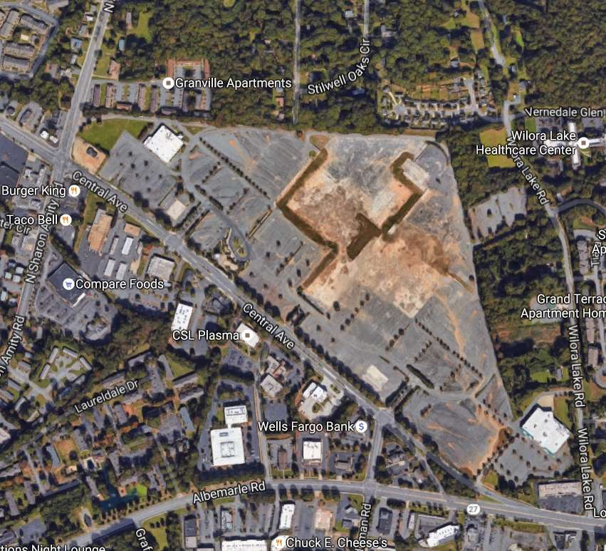
Notes:
The common theme is making extremely complicated problems less complicated; lawyers as problem-solvers; can’t be afraid of a steep learning curve and interdisciplinary work

