Slide 1
WORKING BETTER TOGETHER
Reclaiming Vacant Properties Conference
Milwaukee, WI
5/16/18
LAND BANK + COMMUNITY LAND TRUST PARTNERSHIPS
Tarik Abdelazim, Center for Community Progress
Charlotte O’Connor, Albany County Land Bank Corporation
Lauren Siegmund, Grounded Solutions Network

Slide 2
SESSION OUTLINE
Overview and National Scan of Land Banks
Overview and National Scan of Community Land Trusts
Case Study in CLT and LB Partnerships: Albany, NY
Albany Community Land Trust Background
Albany County Land Bank Corporation Background
Addressing the Challenge
Breakout Session and Report Back
Q&A

Slide 3
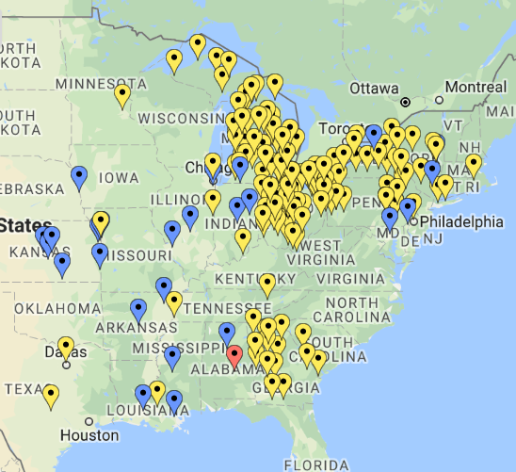
WHAT IS A LAND BANK?
Land Banks are non-profits or public authorities dedicated to bringing vacant, abandoned, or tax delinquent-foreclosed properties into productive use
Land Bank Information Headquarters: http://www.communityprogress.net/land-bank-headquarters-pages-446.php

Slide 4
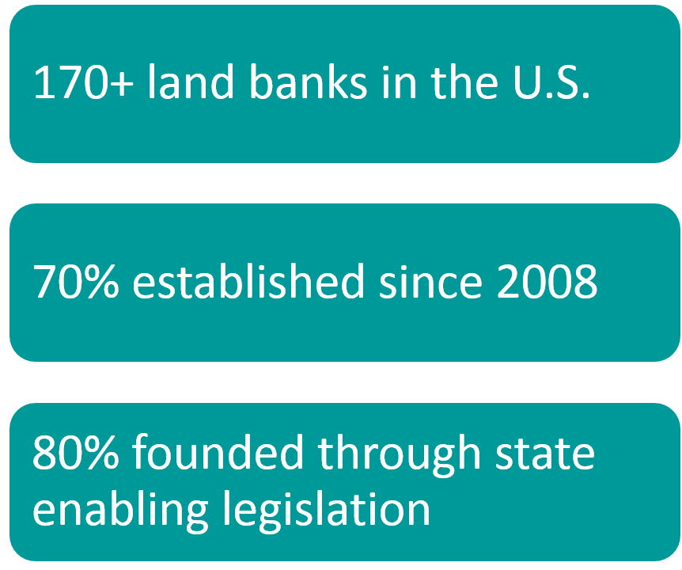
LAND BANKS BY THE NUMBERS

Slide 5
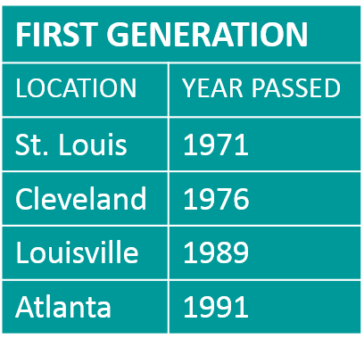
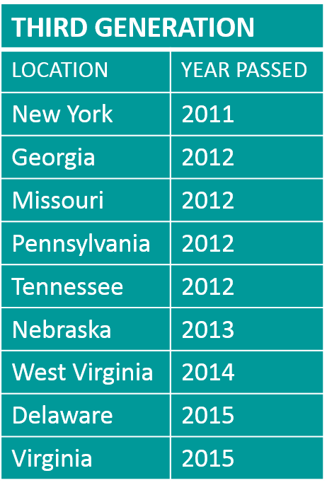
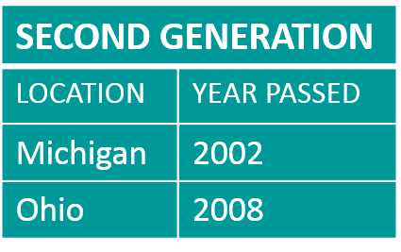
LAND BANKS ACROSS THE NATION: 45-YEAR EVOLUTION
Georgia, Michigan, New York, and Ohio are the states with the most land banks

Slide 6
CORE POWERS OF LAND BANKS
Collaborate on an intergovernmental and regional basis
Acquire through various mechanisms, primarily through the tax foreclosure process at little to no cost (trump bid, credit bid)
Clear title and extinguishment of delinquent taxes
Hold property tax-exempt
Establish and uphold maintenance standards
Negotiate sales (avoid auctions & bureaucracy)
Convey property for other than monetary consideration and consistent with local priorities

Slide 7
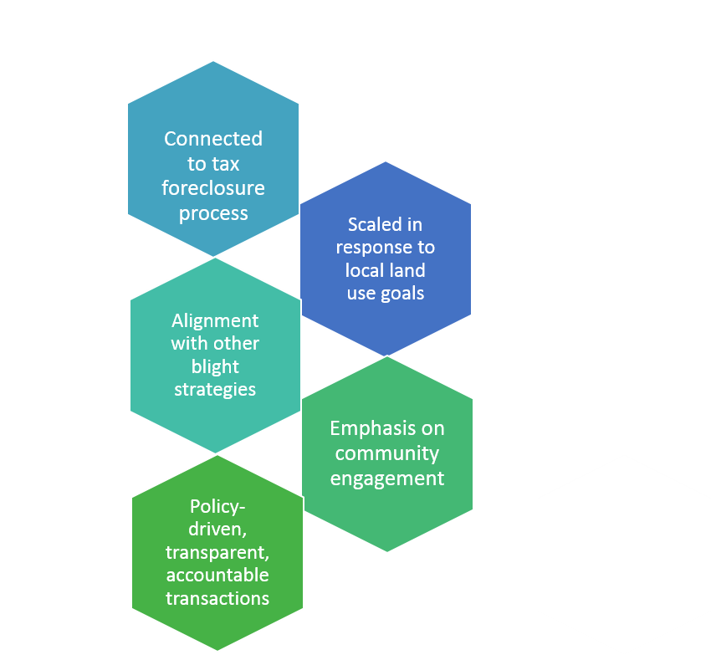
KEY ELEMENTS OF LAND BANKS
An alternative to the speculative auction that generates more predictable outcomes consistent with community needs and desires
Will always need some kind of support—cash or in-kind—proportional to the scope and scale of of vacancy and blight it is expected to resolve

Slide 8
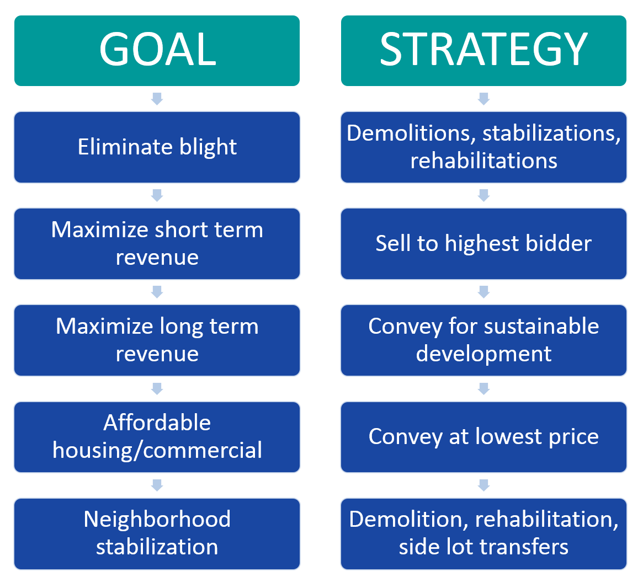
GOALS + STRATEGIES OF LAND BANKS

Slide 9
Grounded Solutions Network cultivates communities
—equitable, inclusive and rich in opportunity—
by advancing affordable housing solutions that last for generations

Slide 10
COMMUNITY LAND TRUSTS
Notes:
Today, I’ll be talking about Community Land Trusts, or CLTs for short, to demonstrate the role that CLTs may plan in a mutually beneficial partnership with land banks.

Slide 11
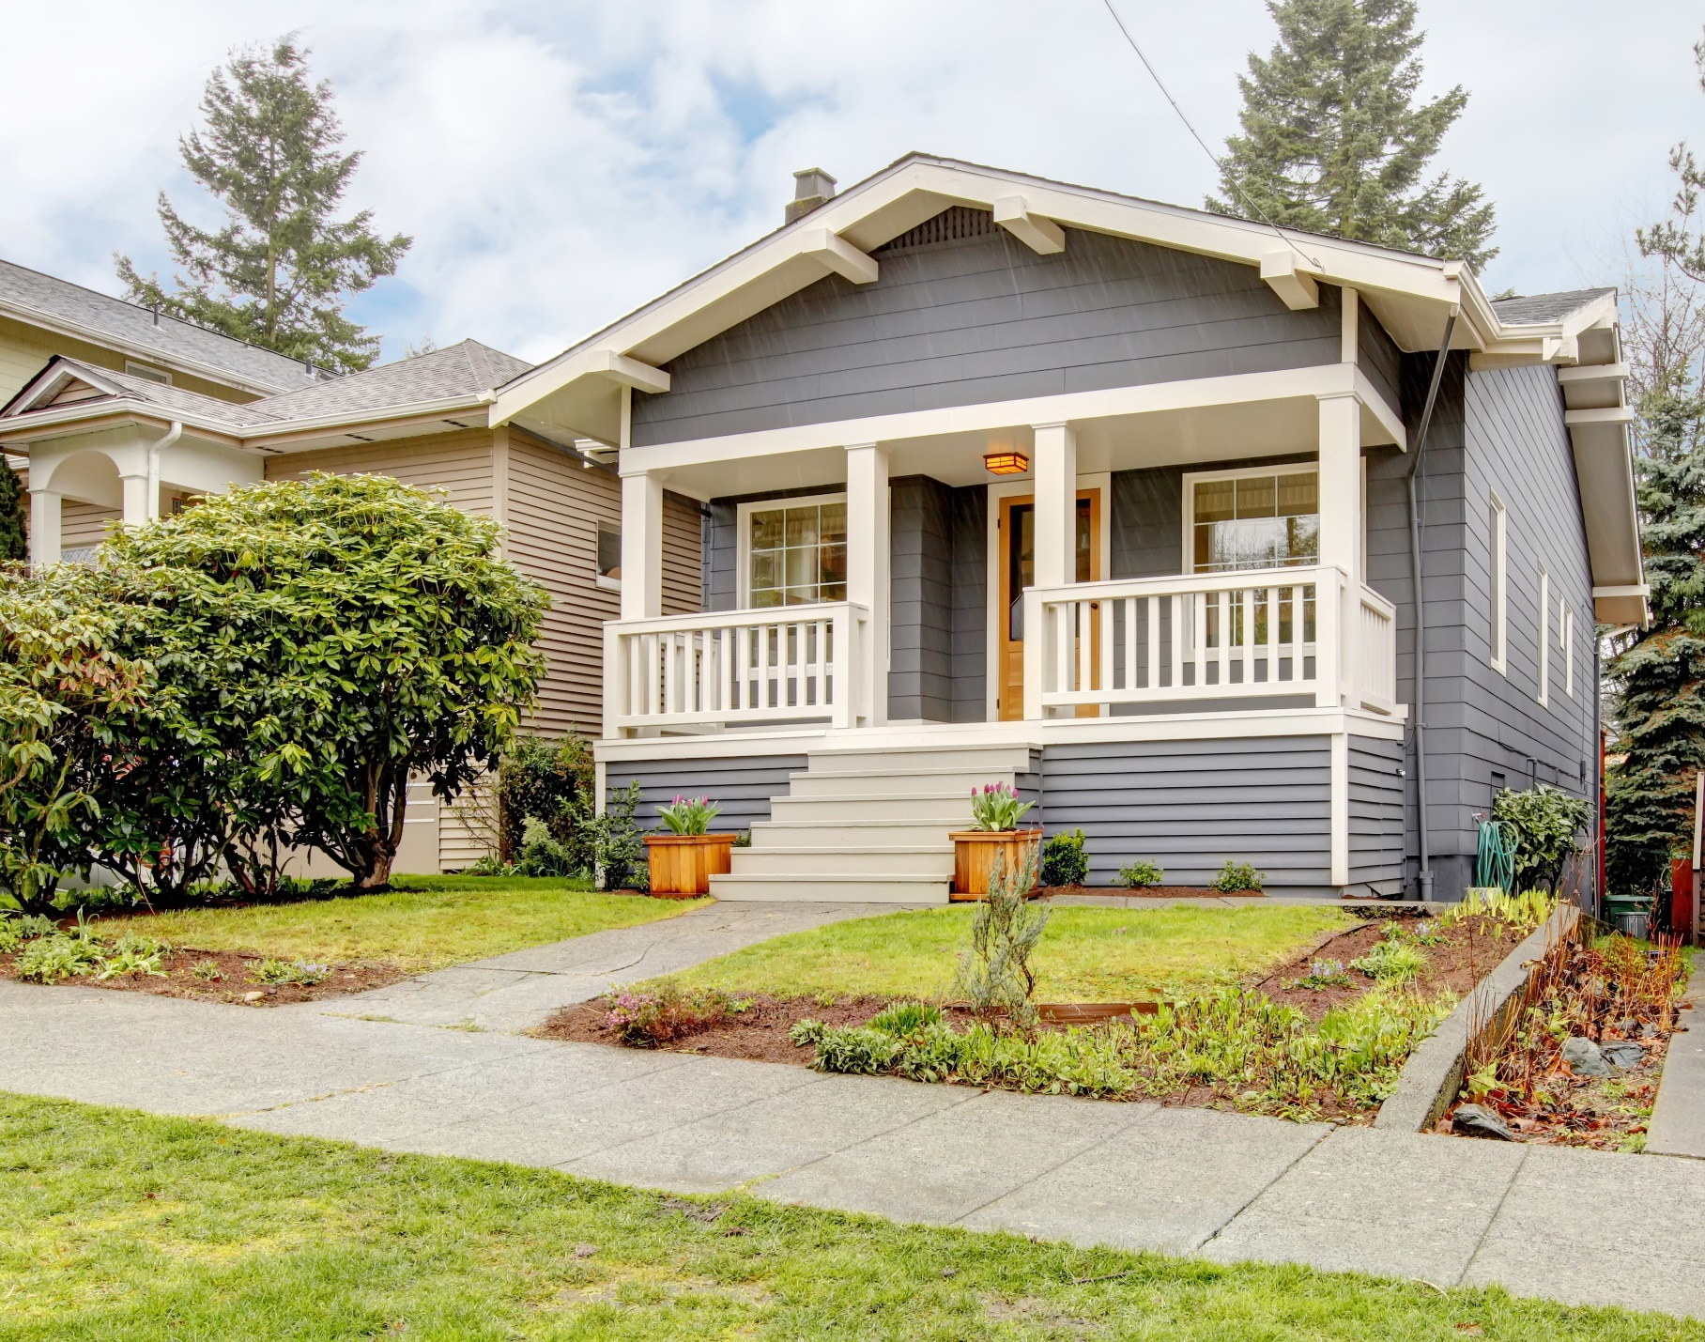
COMMUNITY LAND TRUSTS
Acquire, own and steward land permanently for the common good by providing:
Affordable housing
Commercial spaces
Community spaces
Farming or open land
There are currently about 225 CLTs operating in 46 states.
Notes:
Community land trust organizations acquire, own and steward land permanently for the common good.
CLTs acquire land in a number of different ways. They can purchase land on the open market, they can receive land donations, or they can partner with city agencies, land banks, and other entities to purchase land at a discounted rate. No matter how it’s acquired, once the land enters the CLT’s portfolio, it remains their portfolio in perpetuity and is never sold.
As a CLT acquires land, it thinks about the end purpose of each parcel. The CLT can put land to any number of uses but they are most known for providing affordable homeownership opportunities to households that are excluded from the market. Outside of this model, in the open market, we often ask, “what is the highest and best use” of a property and we answer that question by considering how much money the property could make. On the other hand, CLTs ask, “what is our community’s greatest need?” and they pursue those opportunities within reason.
In addition to providing affordable homeownership opportunities, CLTs have used their land to provide affordable single and multi-family rental opportunities, mixed-income and mixed-use developments, community oriented commercial spaces, community gardens, and much more.

Slide 12
THE AFFORDABILITY GAP
Market Price
$45,000
Affordability gap
$45,000
$200,000
$155,000
What family can afford to buy
Notes:
The way that permanently affordable homeownership– and really all homeownership– programs make homes initially affordable is by closing the affordability gap. Let’s say that in our fictional community, the average market price of a home is $200,000. But, the low-income family that we are trying to serve can only afford to purchase a $155,000 home. There is a $45,000 gap between what our household can afford and what a home on the market costs. This is the affordability gap that Community Land Trusts seek to address.

Slide 13
THE GROWING AFFORDABILITY GAP
$
Market Price
Affordable Price
Years
Notes:
And, unfortunately, in many of our communities where market values increase at a rate faster than income, this affordability gap will neither stay the same nor decline over time. Just the opposite– it will grow.
The goal of CLTs is to be forward thinking and to address those future needs, in part, right now by ensuring that the homes that we steward remain affordable for low-income home buyers in perpetuity.

Slide 14
THE CLASSIC CLT
Generally, a non-profit organization with:
Defined service area
Corporate membership
Tripartite board
Notes:
The “classic” community land trust is an independent nonprofit organization that serves a defined geographic area– typically a neighborhood.
Membership is open to anyone within that defined service area. This is one of the elements that makes the classic community land trust unique. Instead of just serving the direct beneficiaries– those living or working on land trust land– the community land trust is accountable to their entire membership and their entire community.
Classic CLTs have a tripartite board, a board that is divided into three equal groups of representatives.

Slide 15
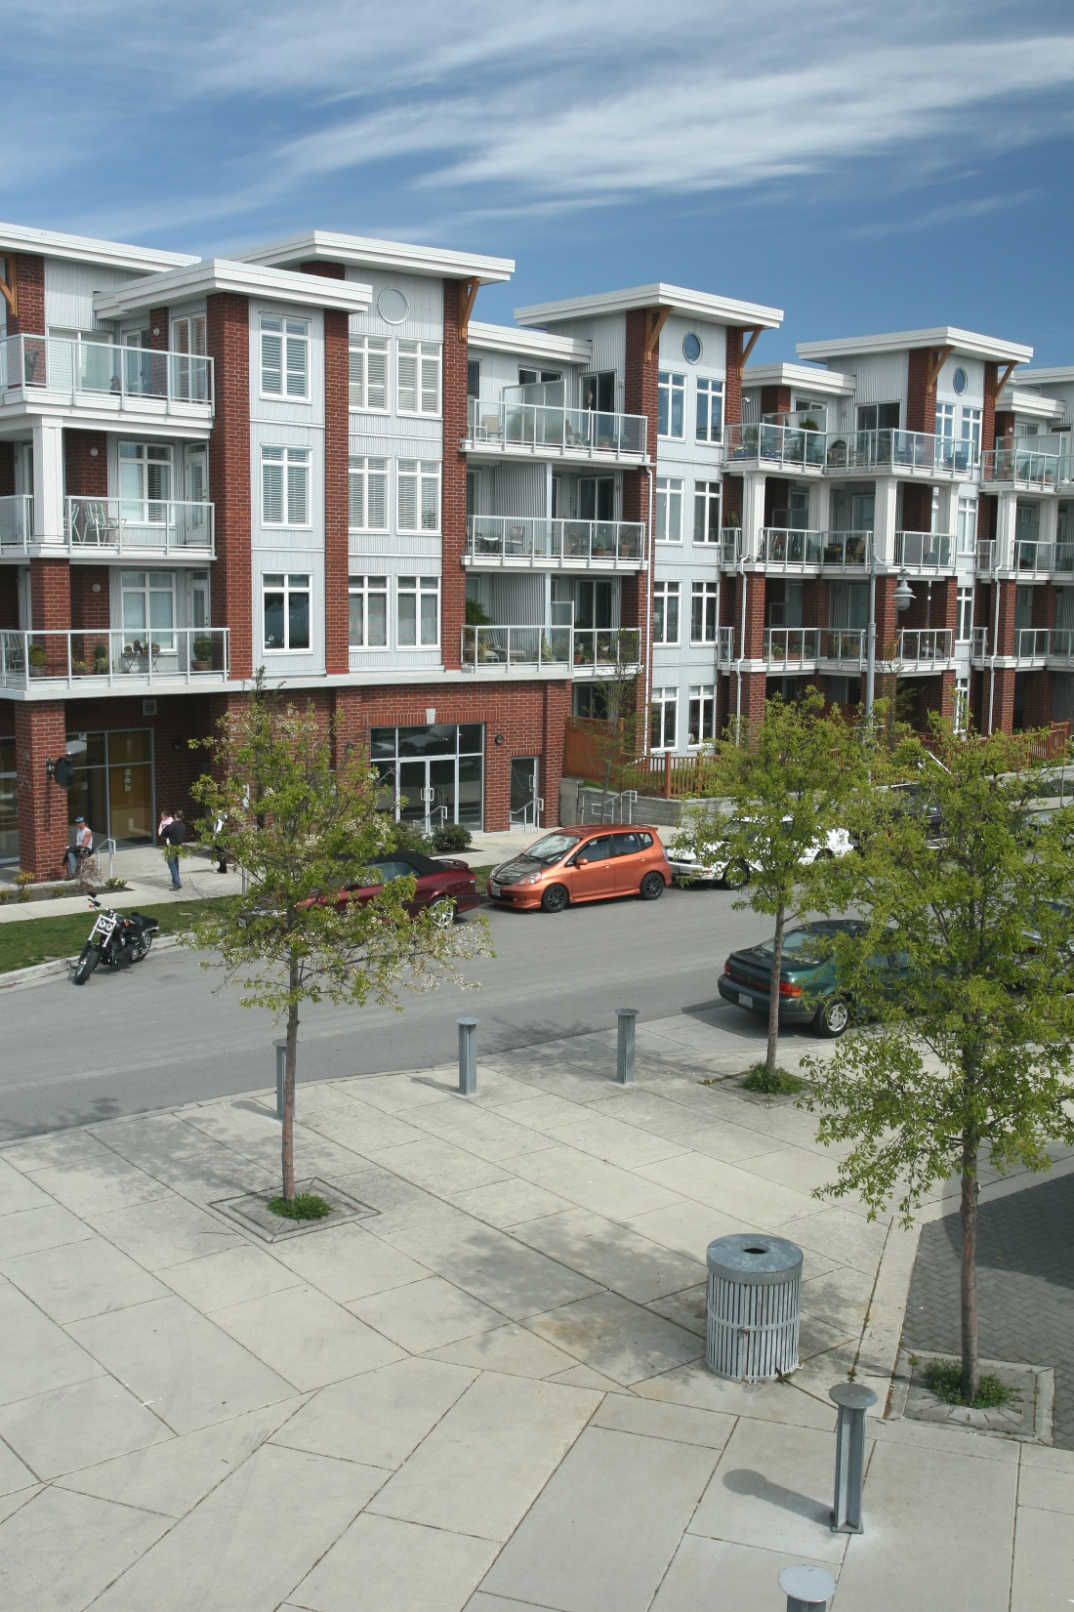
TRIPARTITE BOARD
Lease-holders
Community Members
External stakeholders
Notes:
The first third is made up of leaseholders– people living on or using CLT land.
The second third is made up of community members from the surrounding community.
The final third is made up of technical experts, funders or other stakeholders in the organization.
Because two thirds of the board is made up of community members, they hold the majority of votes. That is part of why we say that community land trusts are community-controlled organizations.

Slide 16
THE CLASSIC CLT + VARIATIONS
Classic CLT:
Variations:
Non-profit organization
Defined service area
Corporate membership
Tripartite board
Program of a nonprofit
Program of a city
City, regional, statewide
No corporate membership
No tripartite board
Notes:
One of the strengths of the CLT model is its flexibility to adapt to local community needs and preferences. So, we see lots of variations on the classic model. For example, instead of being structured as an independent organization, a CLT could be a program of an already established nonprofit like Neighborhood Housing Services or a Habitat for Humanity Affiliate. Some CLTs are structured as a program or a subsidiary of a city or county and are housed within the local government.
While the classic CLT typically serves a single neighborhood, there are many CLTs that operate on a city, regional, or state-wide level. And, sometimes that scale changes over time. For example, CLTs that get started in one neighborhood can spread to the city. Or, CLTs that are established to serve an entire state may focus on particular communities from time to time.
While the classic CLT has open corporate membership, some CLTs are not member-based. This variation is most common when CLTs are a program of an established nonprofit or city. And so, while the organization may not want to change their governing structure to be able to accommodate the classic model, they often strive to gather community input and feedback in other meaningful ways.
Similarly, while the classic CLT has a tri-partite board, that is not true of every CLT. Some CLTs enact the spirit of the tripartite board but are not rigid in the exact equal thirds of representation. Or, if they are operating as a program within a larger entity, maybe the CLT has a formal advisory board that rolls up to a more traditional board.

Slide 17
DUAL OWNERSHIP
Individual owns improvements (home)
Community land trust owns land
Notes:
Regardless of whether a CLT follows the “classic” organizational structure or a variation, they all use a dual ownership model in order to secure the property for the common good and to ensure its ongoing affordability. In a dual ownership structure, the individual– most frequently a low-income homebuyer– purchases and owns just the improvements. The house. The community land trust retains ownership of the land underneath of the home.
Through this dual ownership, the individual owns the home, the CLT owns the land, and a 99 year ground lease binds the two,
Outlining responsibilities,
Stipulating use restrictions, and
Establishing resale restrictions to ensure the permanent affordability of the home

Slide 18
DUAL OWNERSHIP
Ground lease ties improvements and land together…
Notes:
A 99 year ground lease ties the improvements and the land together. This ground lease does a couple of critical things:
First, it outlines the rights and responsibilities of the homeowner and the rights and responsibilities of the community land trust.
Second, it establishes use restrictions– like requiring the homeowner to live in the property as their primary residency.
Third, it establishes affordability restrictions.
99 year renewable (upon resale) and inheritable ground lease ties those together

Slide 19
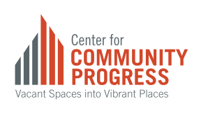
PROMOTING COLLABORATION
Grounded Solutions Network and Center for Community Progress have jointly explored prevalence of and opportunities for Land Bank and CLT collaboration:
National conferences presentations
Conducted national scan
Interviewed practitioners
Wrote a brief white paper and public blog¹ summarizing our findings
“Land Bank and Community Land Trusts: Not Synonyms or Antonyms. Complements,” K. Graziani, E. Thaden, and A. Stup, 11/22/16, http://www.communityprogress.net/blog/land-banks-community-land-trusts-synonyms-antonyms-complements
Notes:
There are a few clear areas where CLTs and Community Land Banks are natural allies and could mutually benefit from collaboration.
Both organizations seek to build equitable communities
Both CLTs and Land Banks aspire to use community land to create more housing, green spaces, and to use land in ways that align with community priorities
Specifically, there are also a lot of opportunities for concrete benefits, for example, by bringing on CLT community residents to act as stewards of land bank property adjacent to their homes, until the land can be handed over to their permanent owner.
This benefits community residents, as they have both an income opportunity and an invitation to help maintain the land in their neighborhood, and
It benefits the land bank, as they have an affordable system in place for maintaining their land until it is transferred over to its next owner

Slide 20
FINDING ALIGNMENT
Addressing common misconceptions:
(1) Mission alignment
(2) Market strength
(3) Similarity of approaches

Slide 21
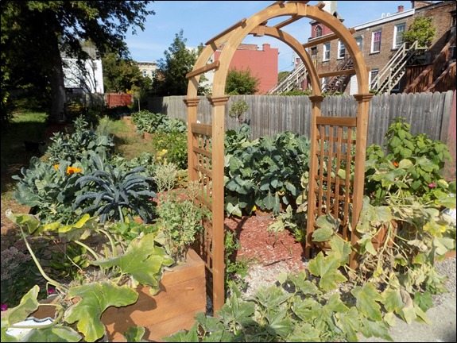
OPPORTUNITIES FOR LAND BANK-CLT COLLABORATION
Shared vision for equitable and economically integrated communities
Pipeline for inventory that is currently stuck and inaccessible (upside down in value, tangled title, and more)
Implementation of comprehensive strategies that include housing, green space, and more
Meet prioritized needs of the communities

Slide 22
CASE STUDY IN CLT + LB PARTNERSHIPS
National scan by Community Progress and Grounded Solutions Network piqued interest of some CLTs and LBs working in same service areas
Albany County Land Bank (ACLB) and Albany Community Land Trust (ACLT) submitted a joint application to Community Progress’ Technical Assistance Scholarship Program (TASP) in Dec. 2016
Requested assistance with exploring formalized partnership opportunities
Albany was selected as a TASP recipient for a April-November 2017 engagement

Slide 23
WHAT IS TASP?
PRIOR TASP WINNERS
Albany, NY
Atlanta, GA
Baltimore, MD
Butte-Silver Bowe, MT
Cleveland, OH
Dallas, TX
Detroit, MI
Gary, IN
Huntington, WV
High Point, NC
Lafayette, LA
Lucas County, OH
Memphis, TN
Rockford, IL
St. Louis, MO
Trenton, NJ
Competitive-based merit scholarship program in search of “changemakers” to spark new innovations in the field of practice
2018 is the fourth program year
Future funding uncertain, but under discussion

Slide 24
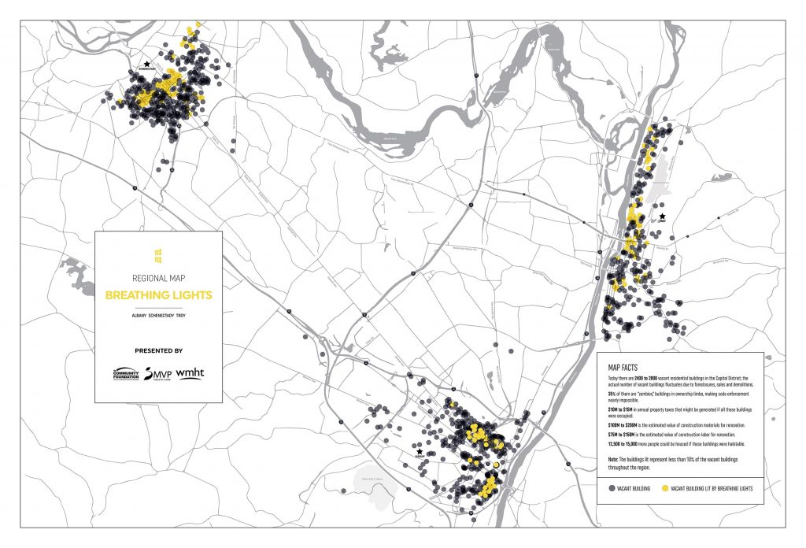
WHY ALBANY, NY?
Knowledgeable Community of Engaged Stakeholders
Housing for All Coalition
Breathing Lights Multi-City Art Installation
Executive Commitment to Deepen Interdepartmental Coordination
Vacant Property Task Force
New Approach to Data Management and Analysis
Cities RISE Initiative, Building Blocks Data Platform
Willingness to Commit Resources to Solutions
Mayor’s $1 Million Dollar Vacant Property Rehab Grant Program
ACLB supported with $250,000 annually from Albany County

Slide 25
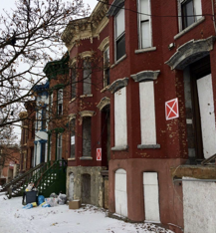
SNAPSHOT OF ALBANY, NY
Legacy City featuring the “hollowed out” phenomenon
Homeownership rate of about 38%
Median Household Income: $49,949 (NYS, $59,269)
Predominantly attached row houses in weak market neighborhoods
New York’s Capital, pop. 98,111 (2016)
55% White , 30% African American , 10% Hispanic
 | CITY OF ALBANY | ALBANY COUNTY
1950 | 139,995 | 239,386
2010 | 97,856 | 304,204
% CHANGE | -28% | 28%
Notes:
Median household income is about 10k less than the entire states MHI

Slide 26
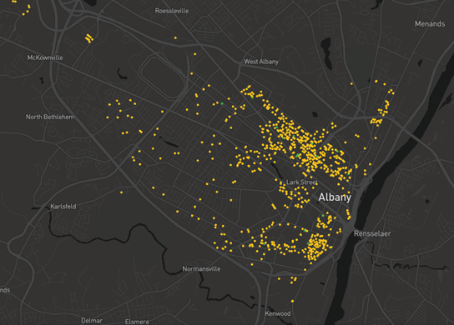
VACANCY IN ALBANY, NY
Vacant properties are concentrated in the city’s most economically distressed neighorboods
There are 1.07 vacant buildings for every 100 people in the City of Albany
Estimated 1,050 vacant buildings
Around 15% of all parcels in Albany are vacant
Notes:
There are 29,700 and change parcels in the city of albany--a whopping 15% of these are vacant parcels--including buildings and lots. ~4.5k
Building blocks map showing every vacant building in the city of albany

Slide 27
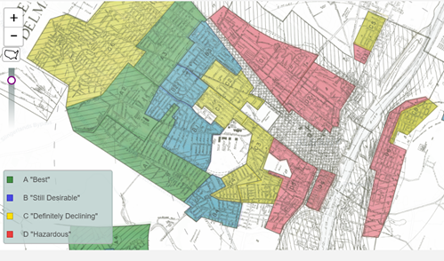
1938 HOLC MAP: ALBANY, NY
Source: https://dsl.richmond.edu/panorama/redlining/#loc=4/36.71/-96.93&opacity=0.8
Notes:
1938 Home Owners’ Loan Corporation (HOLC) Map
University of Richmond’s Digital Scholarship Lab

Slide 28
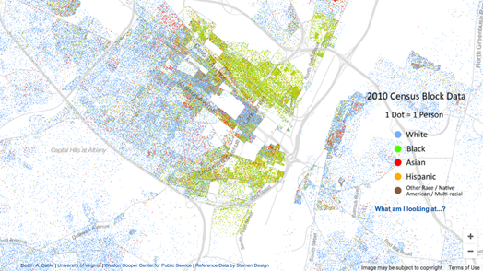
2010 RACIAL DOT MAP: ALBANY, NY
Source http://demographics.coopercenter.org/racial-dot-map
Notes:
2010 Racial Dot Map
University of Virginia, Weldon Cooper Center for Public Service, Demographics Research Group

Slide 29
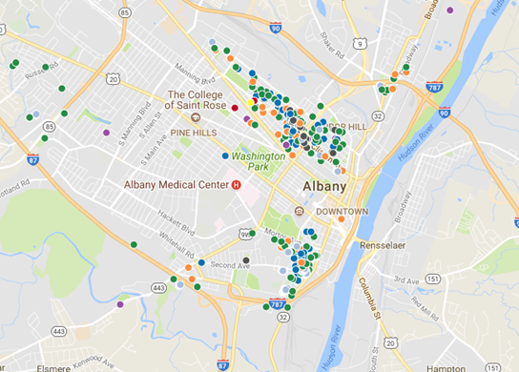
5/1/18 ALBANY COUNTY LAND BANK INVENTORY
Notes:
ACLB Inventory 5-2-18

Slide 30
ALBANY COMMUNITY LAND TRUST (ACLT)
MISSION
To develop affordable housing opportunities for low-income people, preserve housing affordability for future generations, combat community deterioration by promoting economic opportunities in low-income neighborhoods, and educate the general public about ongoing and innovative methods of community development.

Slide 31
ALBANY COMMUNITY LAND TRUST
Community-based non-profit founded in 1987
Manages over 40 rental units occupied by low-moderate income tenants
Has sold over 35 homes to low-moderate income, first time homebuyers
Operates as a traditional Community Land Trust to ensure permanent affordability

Slide 32
ALBANY COUNTY LAND BANK (ACLB)
MISSION
Facilitate the process of acquiring, improving and redistributing vacant and abandoned properties; eliminate the harms and liabilities caused by such properties; return properties to productive use while being consistent with the municipality’s redevelopment and comprehensive plans

Slide 33
ALBANY COUNTY LAND BANK (ACLB)
Non-profit public authority established in 2014
Acquired over 700 tax-foreclosed, vacant, or abandoned properties since 2015
Returned over 240 properties to productive use
Notes:
60+ properties pending sale
Do some full rehabs in house (4 pending under a Neighbors for Neighborhoods Grant and 3 completed in partnership with Habitat for Humanity

Slide 34
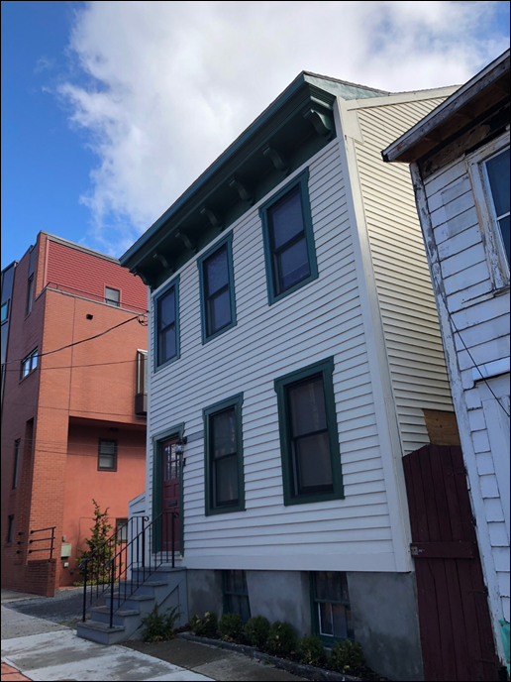
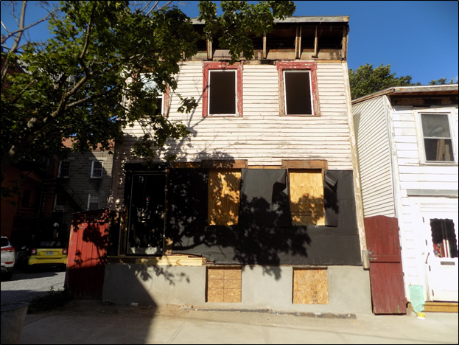

Slide 35
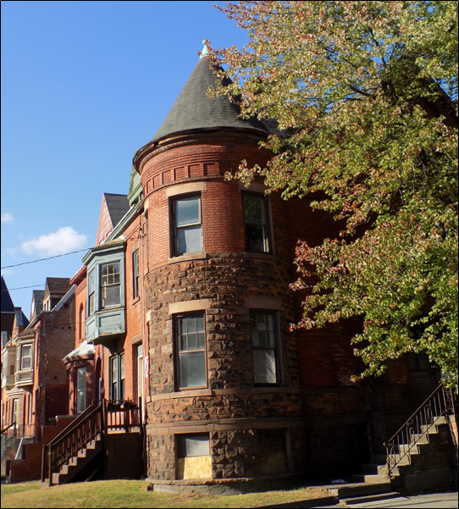
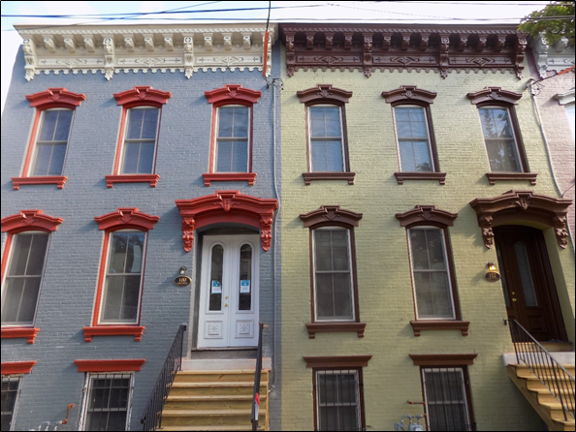

Slide 36
THE CHALLENGE
Concentrated poverty
Generations of disinvestment
Upside down economics

Slide 37
SOLUTION: FORMALIZED PARTNERSHIP + PROGRAMS
Inclusive Neighborhoods Program
Vacant Land Working Group and Resident Learning Exchange
Vacant Land Community Maintenance and Stewardship Pilot Program
Breathing Blocks: Concept, Third Street Corridor Pilot, and Community Event—Lots to Do, Lots for You

Slide 38
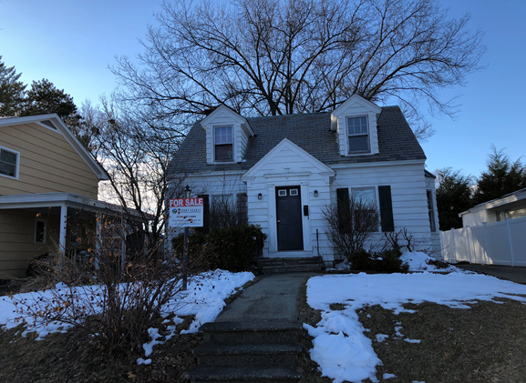
INCLUSIVE NEIGHBORHOODS
PROMOTE INCLUSIVE, MIXED-INCOME NEIGHBORHOODS
Properties valued at or below $100k outside an ACLB focus neighborhood
ACLT has a first look at qualifying properties and 15 days to express initial interest
If interested in acquiring, 30 days to submit a purchase application
Properties will be sold at a discount to ACLT as approved by ACLB’s Board of Directors
Notes:
Inclusive neighorboods was adopted in September 2017. The Land Bank does not acquire properties from albany county on a cyclical basis. Since adoption, the land bank has acquired 2 properties that would qualify for inclusive neighborhoods, but ACLT did not have the capacity at the time to submit an app and purchase the property, despite the discount that would be applied. There’s a backlog of 100+ additional properties approved by AC Leg. for ACLB to acquire so we’re hoping that the next time we get a property that falls under the program’s criteria, ACLT will be ready to acquire

Slide 39
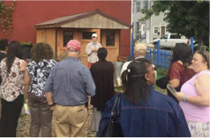
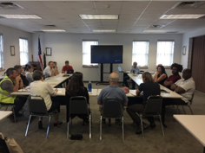
VACANT LAND WORKING GROUP + RESIDENT LEARNING EXCHANGE
COMMUNITY INPUT ON VACANT LAND USES
Incorporated a Vacant Land Working Group into the City’s Vacant Building Task Force
Developed goals and an agenda for the VLWG
Albany community members participated in a Resident Learning Exchange (RLE) in Pittsburgh hosted by GTECH Strategies
RLE participants joined members of the VLWG for a day discussing priorities and visions for vacant land in Albany

Slide 40
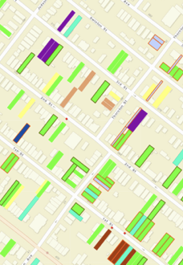
COMMUNITY MAINTENANCE STEWARDSHIP PILOT
CREATE CLEANER, SAFER + FRIENDLIER NEIGHBORHOODS
Tapped into the existing network of ACLT residents and ACLB vacant land
Identified an area in the West Hill neighborhood with a heavy concentration of ACLB and ACLT assets
Program framework designed to incentivize residents to help take care of ACLB vacant lots as community stewards

Slide 41
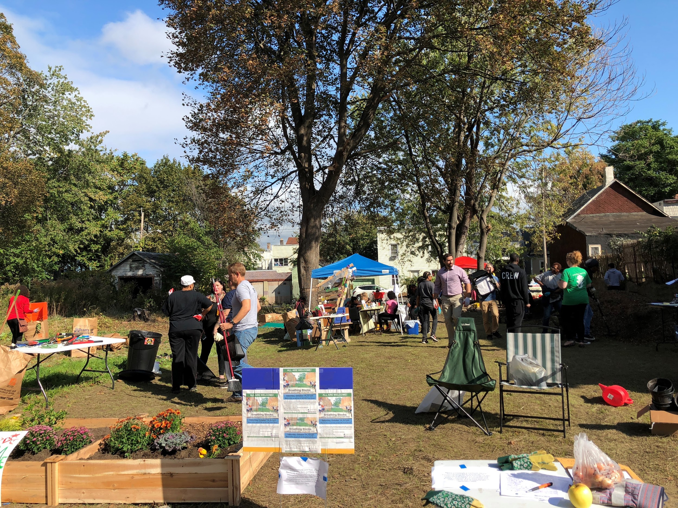
BREATHING BLOCKS
MAXIMIZE IMPACT + PARTNERSHIPS
Engage stakeholders to make a collaborative effort to coordinate resources in a geographically targeted area aka “Breathing Block”
Host a community event to act as a catalyst for resident outreach and activity

Slide 42
BREAK OUT SESSION: QUESTIONS TO CONSIDER
Why is it important to formalize partnerships?
Why is permanent affordability important to consider?
What barriers exist in your community to expand the inventory of permanently affordable housing? Who are the key stakeholders in your community that can help overcome these barriers?
What are some steps you can take to initiate positive change?

Slide 43
THANK YOU!

