Slide 1
Historic buildings and commercial properties

Slide 2
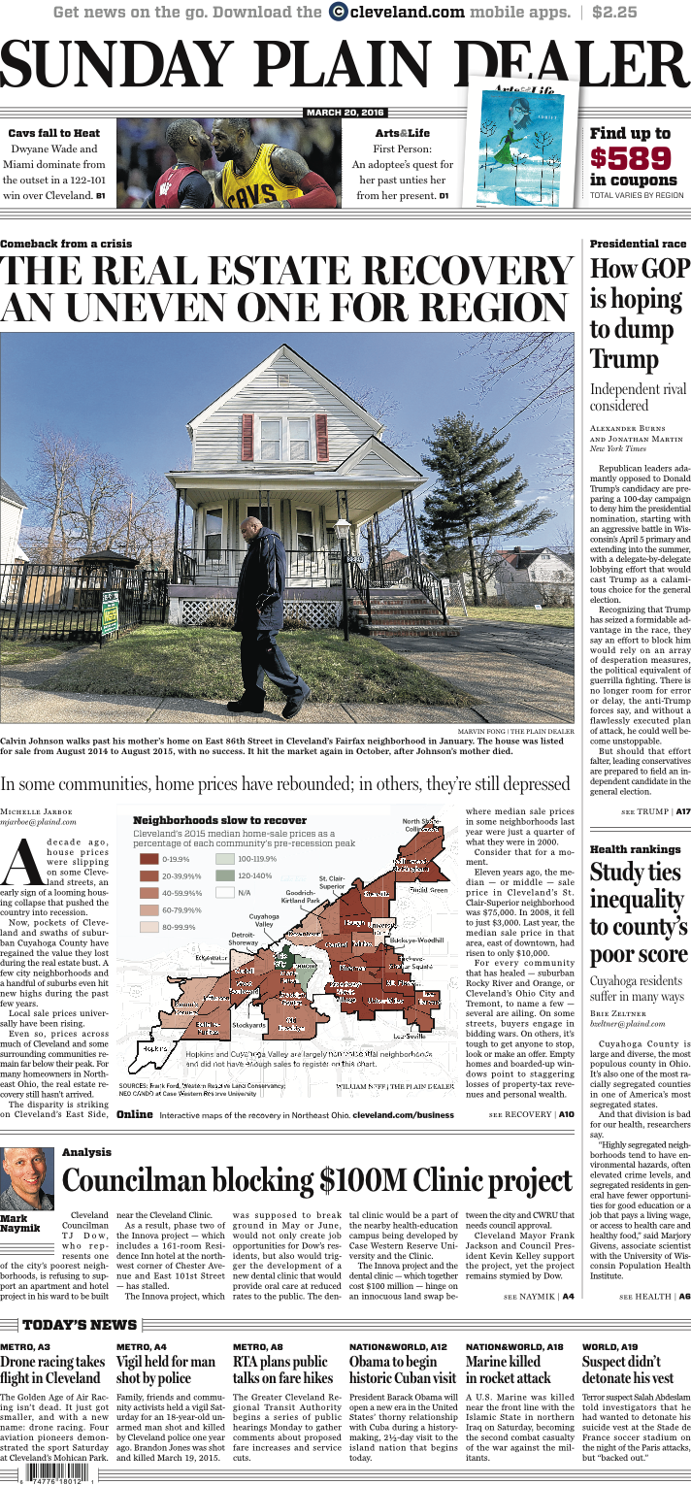
Research. Data. And blight’s human fallout.

