Slide 1
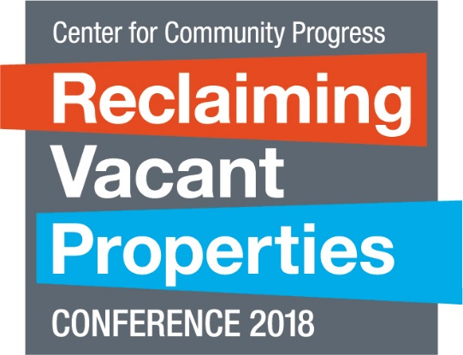

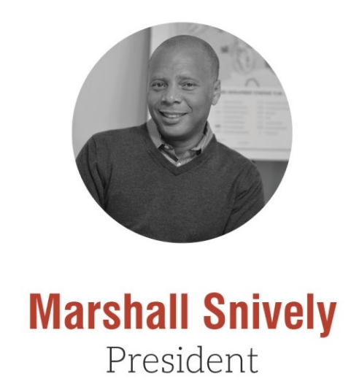
Strengthening Civic Capacity in Smaller Legacy Cities

Slide 2


Slide 3
VISION
  Strong Community
  Strong Economy
  Vibrant City
  Unleashing Lancaster’s Future!

Slide 4
MISSION
Through daring conversations, unique partnerships and measurable outcomes, deliver on our stated Aspirations:
Curate and Engage the Community
Implement Building On Strength
Strengthen Neighborhoods
Grow and Sustain Our Organization

Slide 5
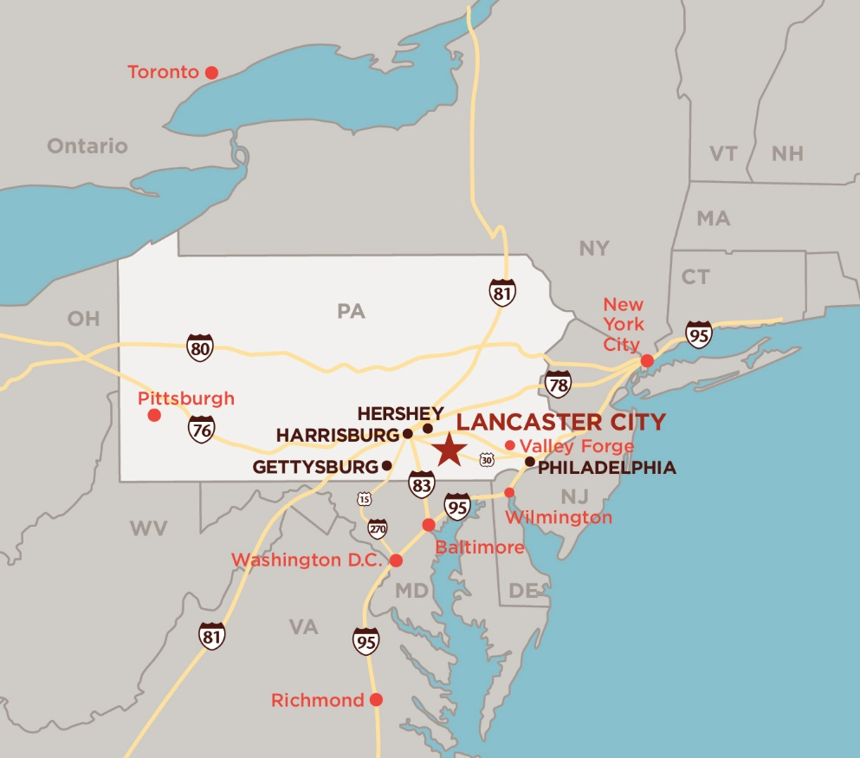
The City of Lancaster, PA

Slide 6
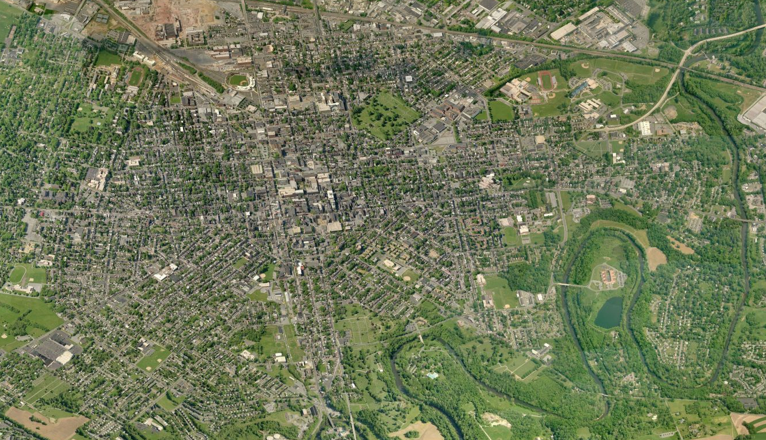
The City of Lancaster, PA

Slide 7
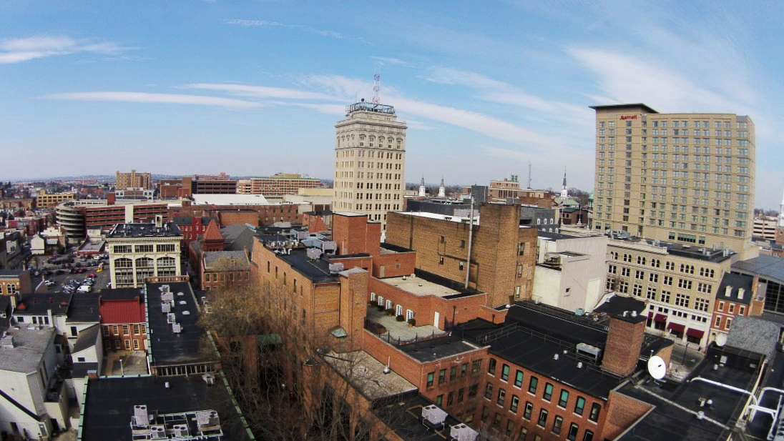
The City of Lancaster, PA
Four square miles
Population of 60,000
40,000 employees
8,000 college students
1 million visitors per year

Slide 8
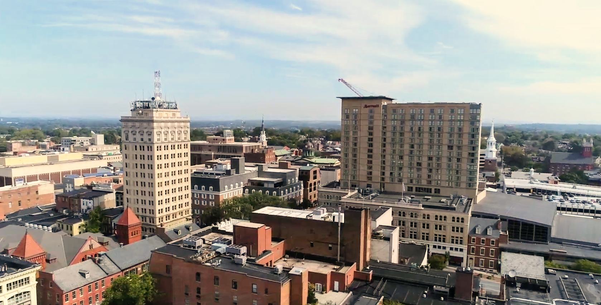
Downtown Lancaster

Slide 9
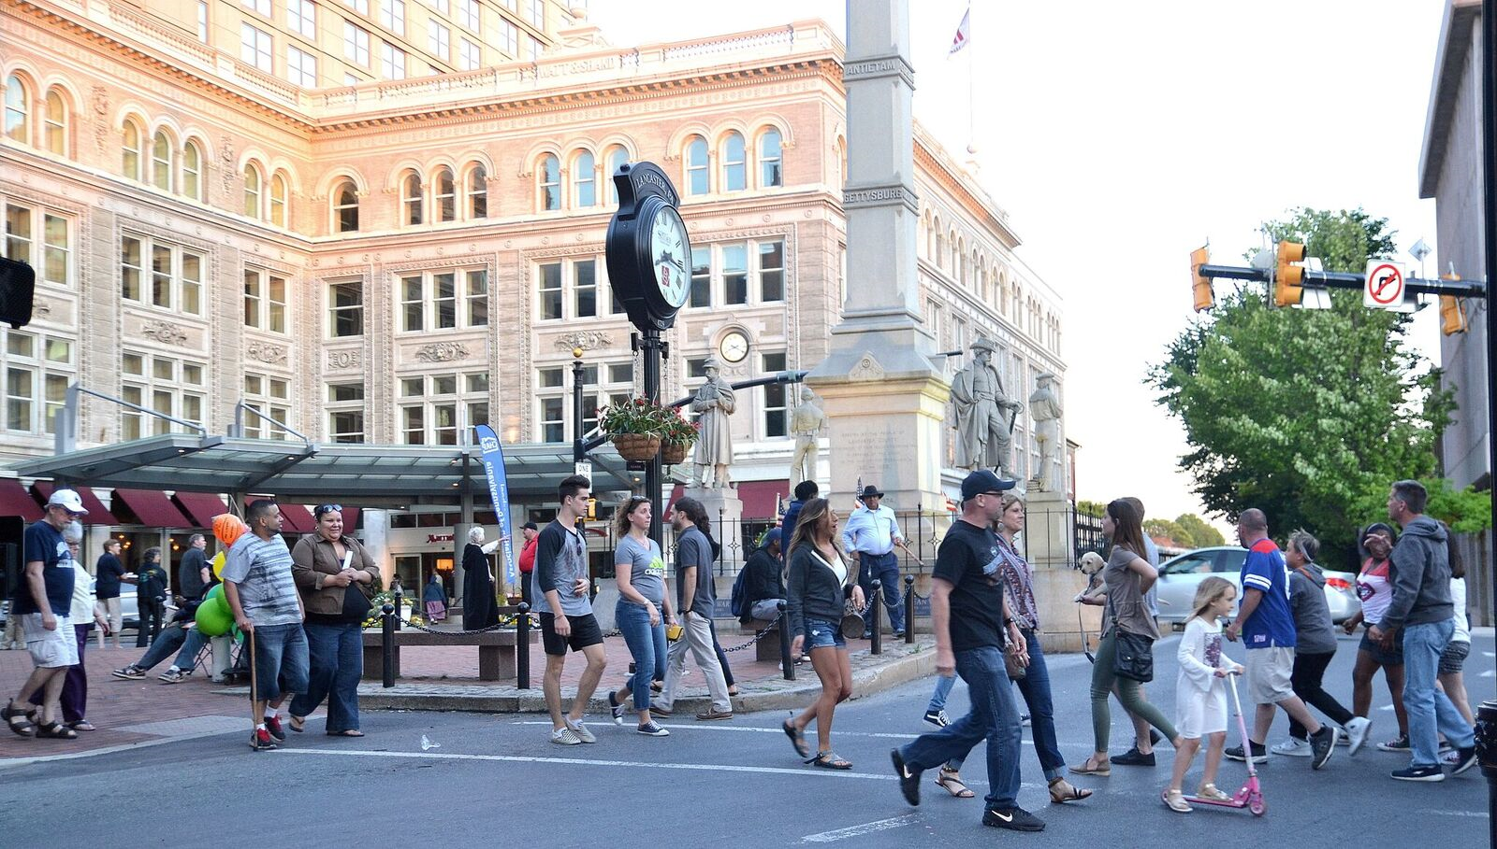
300+ Merchants, Services,
Restaurants, & Cultural Attractions

Slide 10
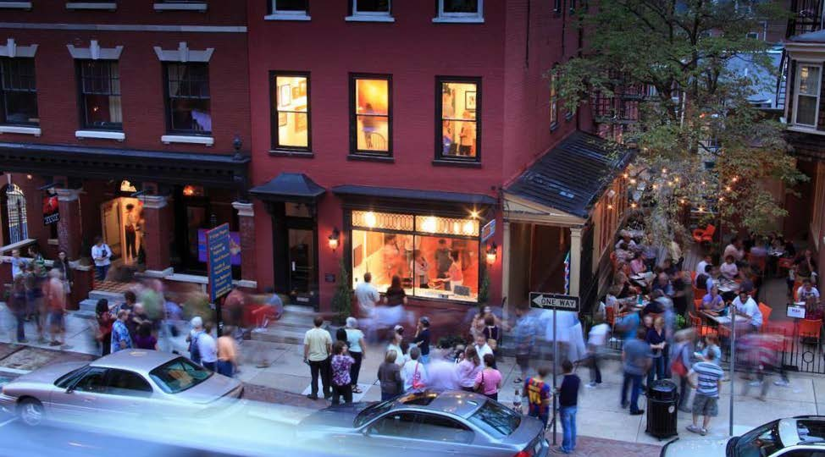
160+ Places to Shop

Slide 11
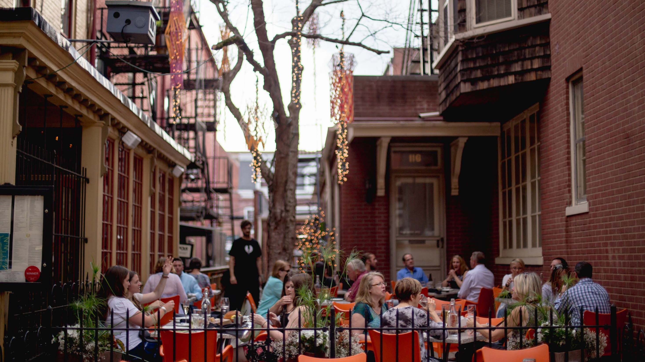
100+ Culinary Choices

Slide 12
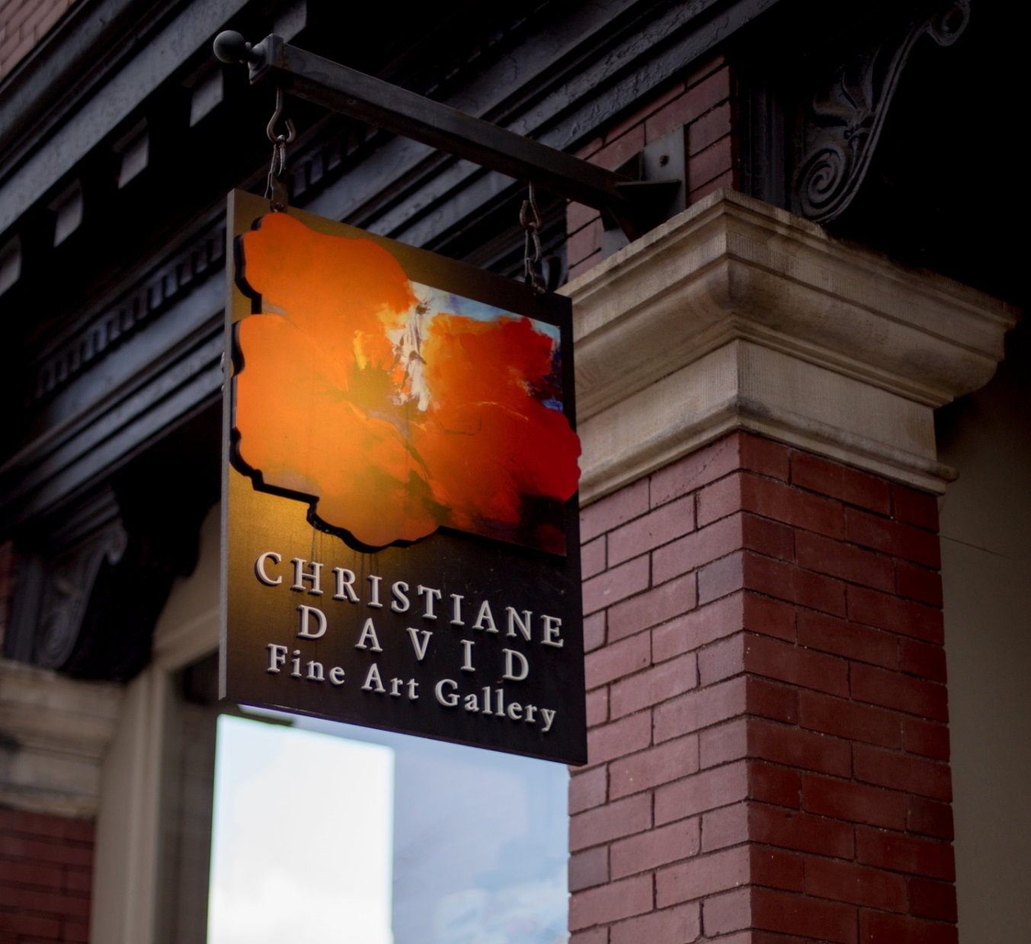
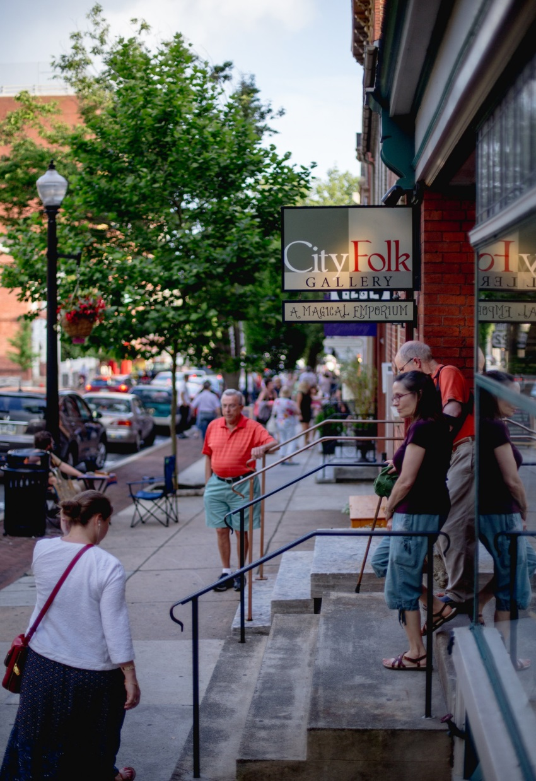
90+ Art Venues

Slide 13
How did we get there?

Slide 14
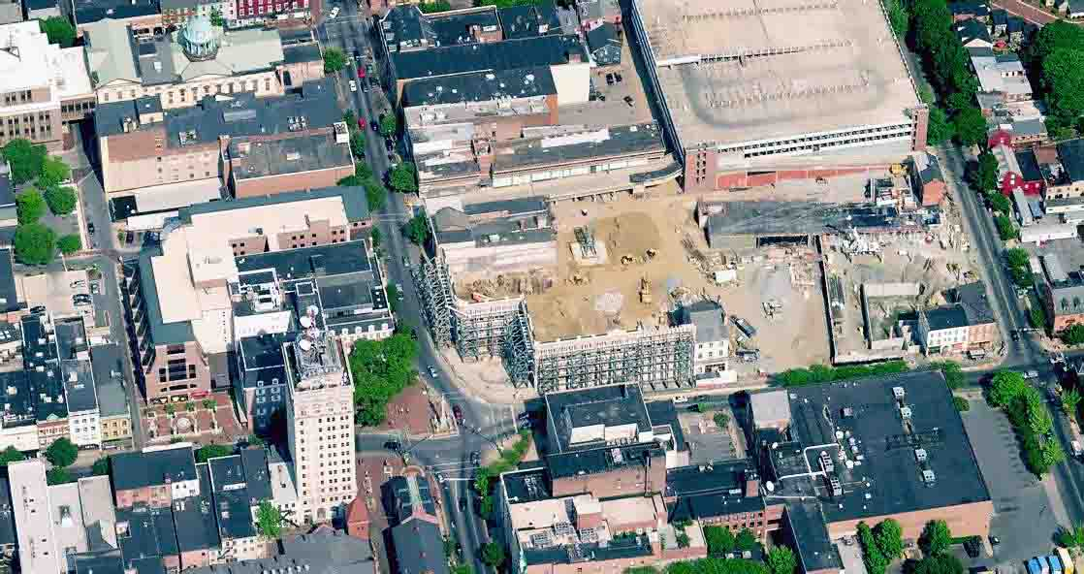
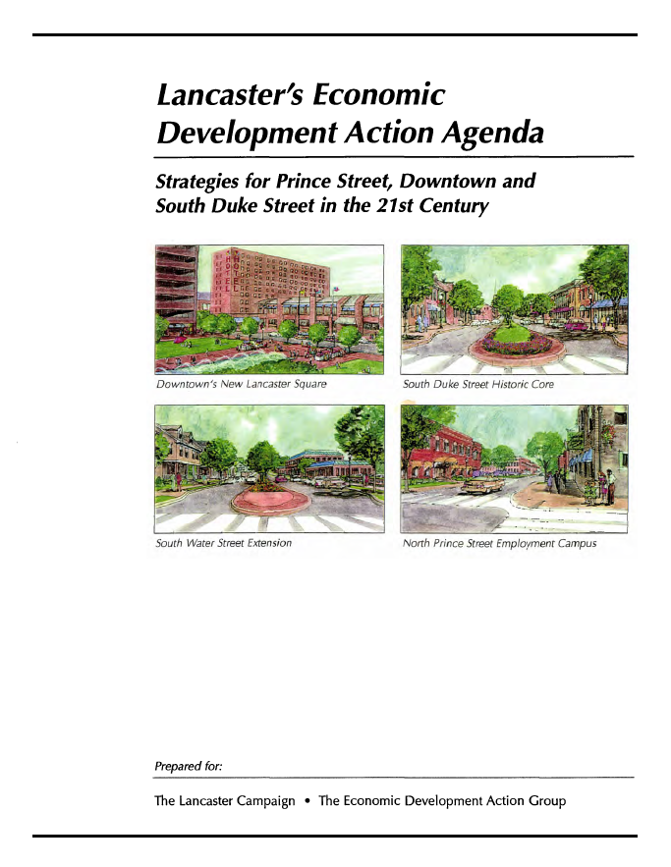
‘LDR Plan’ (1998)
Notes:
Transition slide: Tom references LDR, turns over to Marshall

Slide 15
Businesses relocating / expanding in Greater Downtown bring about
1,000 NEW WORKERS
during period 2010-2016

Slide 16
150+ Net NEW businesses,
~70 Expanded/Relocated
2007 to Present

Slide 17
300+ New housing units
Completed in last 5 years
400 New housing units
Planned over next 2 years

Slide 18
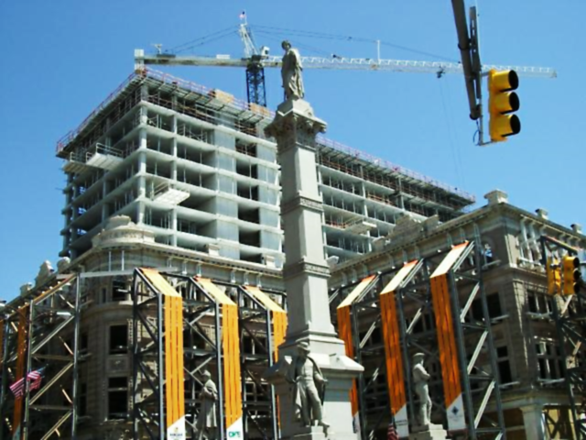
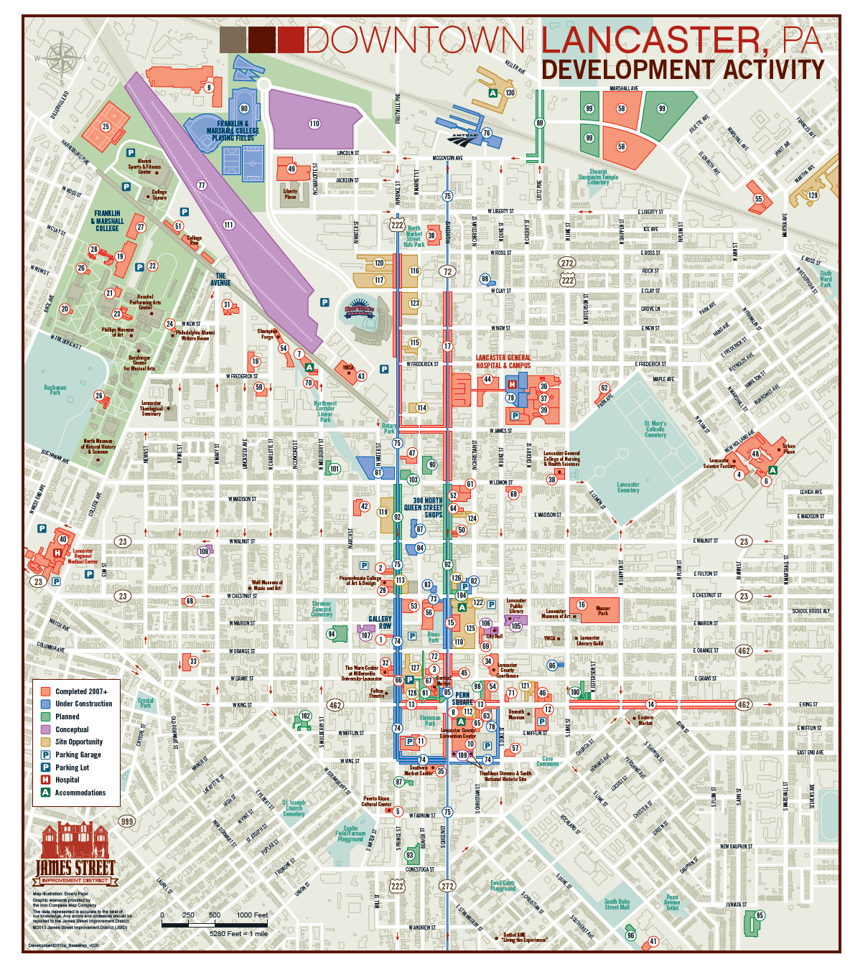
Over $1.5 Billion in Investment
2007-2015

Slide 20












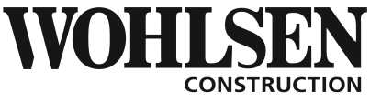

Lead Sponsor
Pacesetters
Planners
Investors
Dennis & Gaye Cox
Craig & Dianne Roda
Bob & Felicia Shoemaker
Scott & Gloria Smith

Slide 21
PLAN FOCUS AREAS
Includes the Downtown Core, in addition to the commercial corridors and gateways (the “Commercial Hubs”), that extend outward from the Downtown Core. These Commercial Hubs were grouped into eight geographies:
1. Downtown Core
2. East King Street
3. West King and Manor Streets
4. South Duke Street
5. South Prince and Queen Streets
6. Harrisburg Avenue/Northwest Gateway
7. Train Station Area
8. New Holland Avenue
These eight areas are important as significant hubs of commercial activity serving the City’s residents and businesses.
7
6
8
1
2
3
4
5

Slide 22
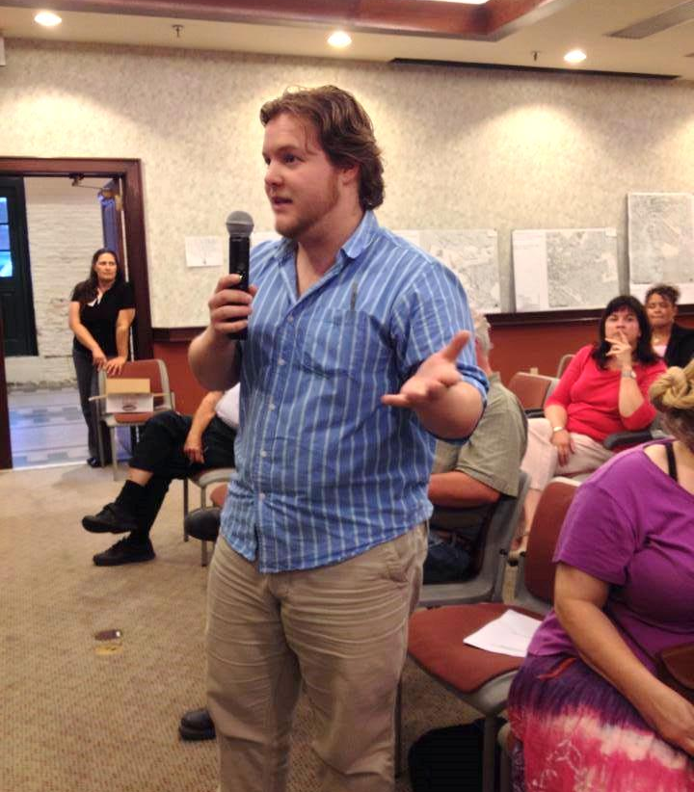
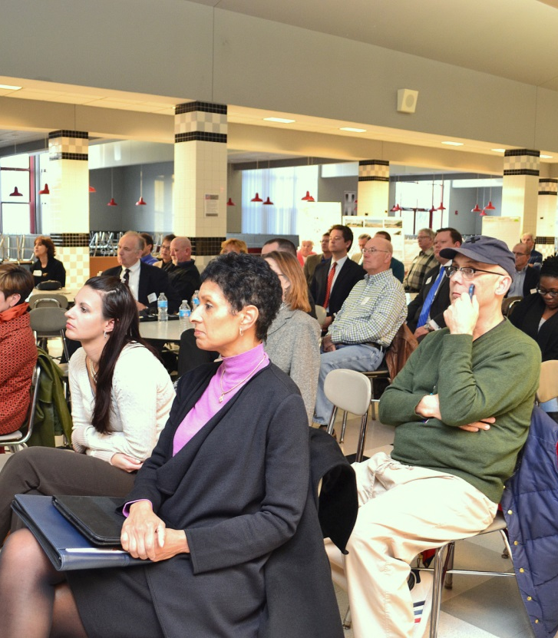
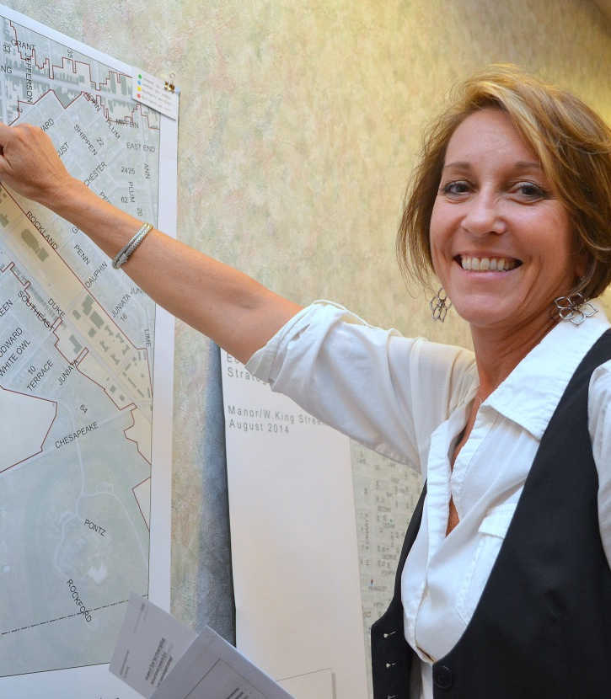
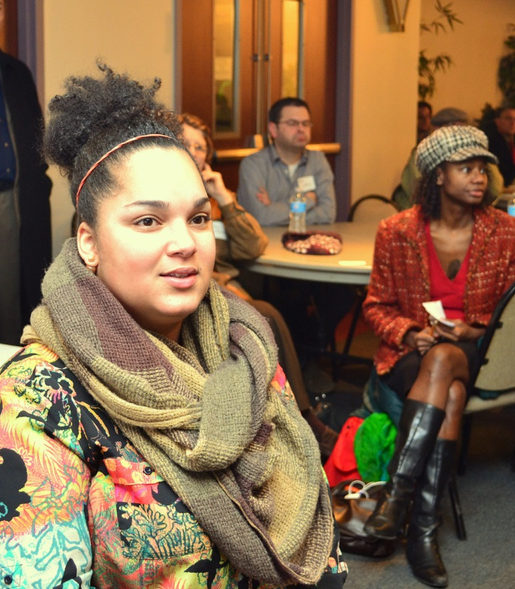
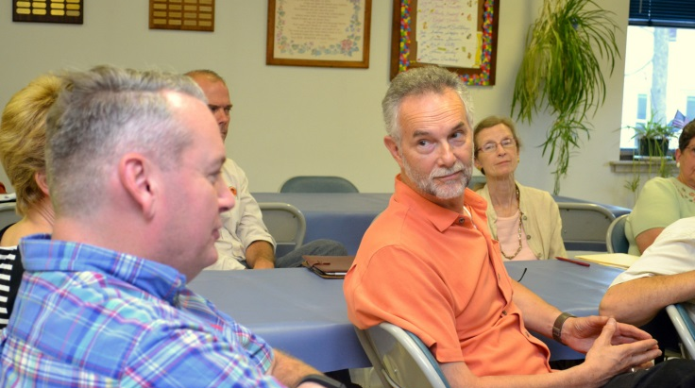
Listening
Sharing
Confirming

Slide 23
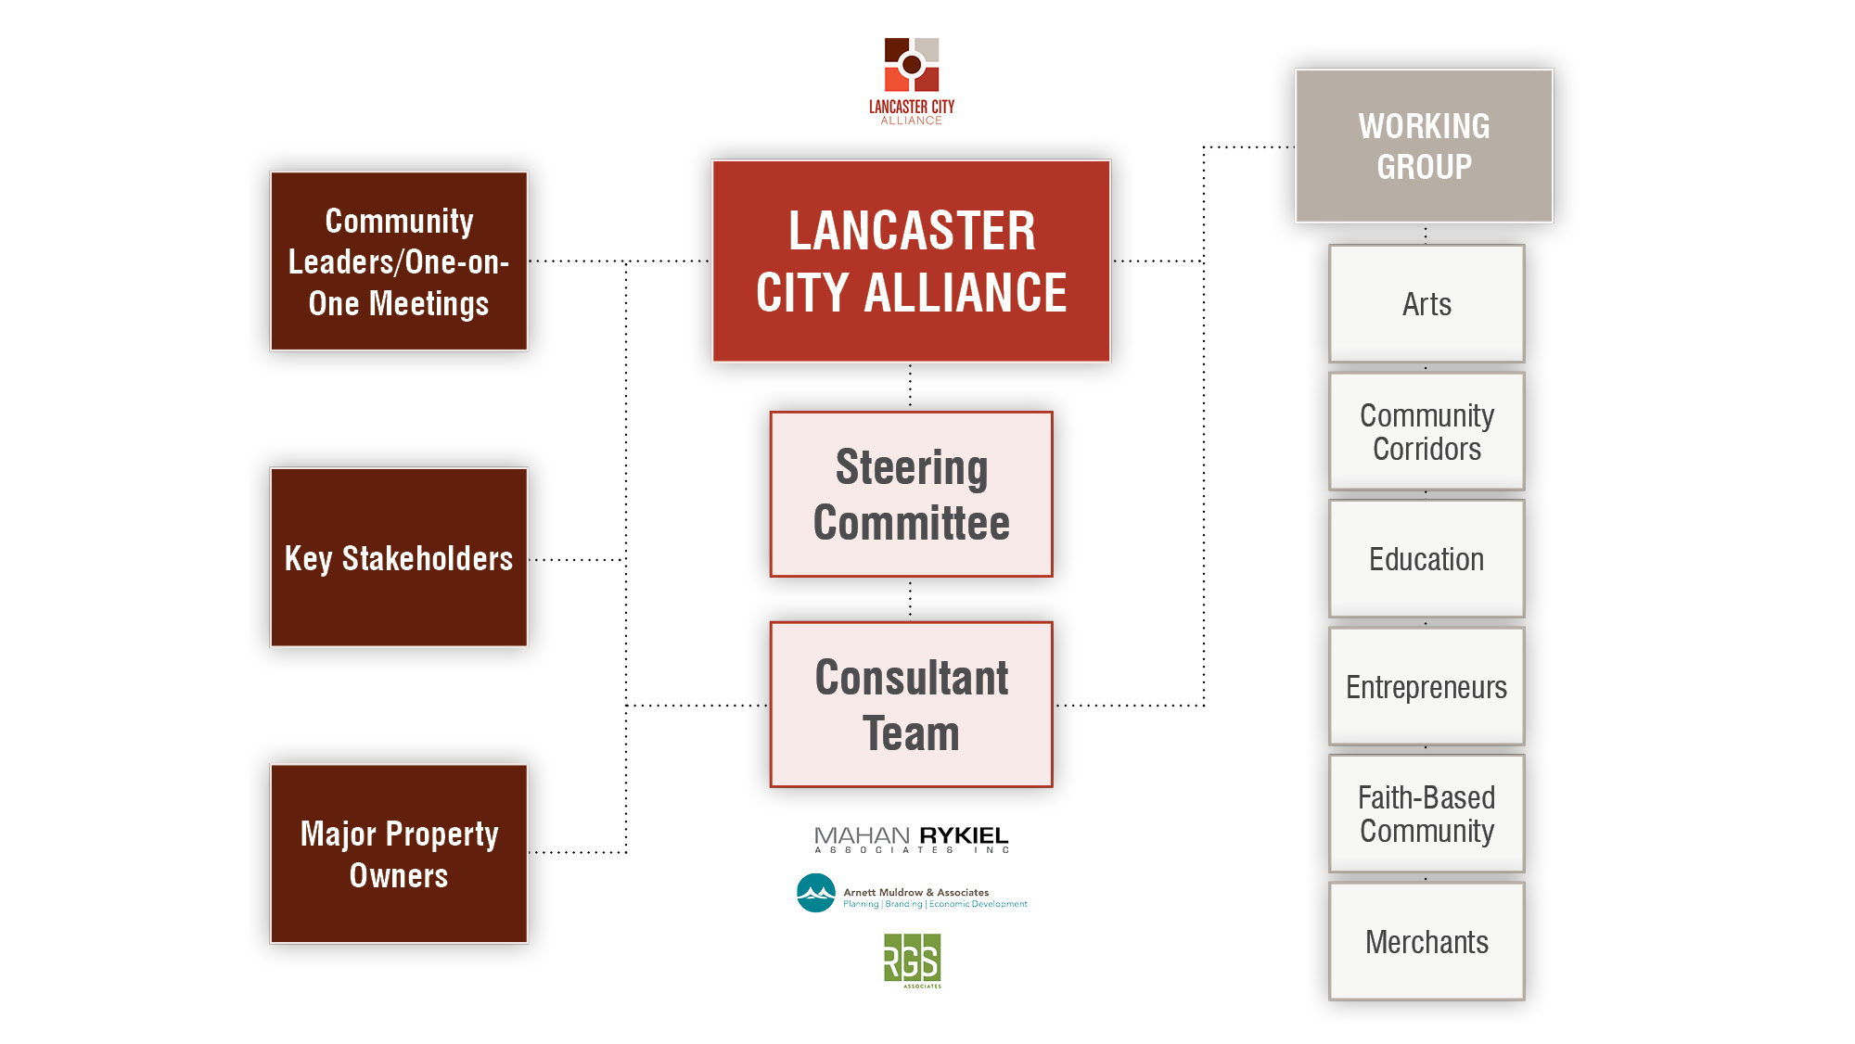

Slide 24
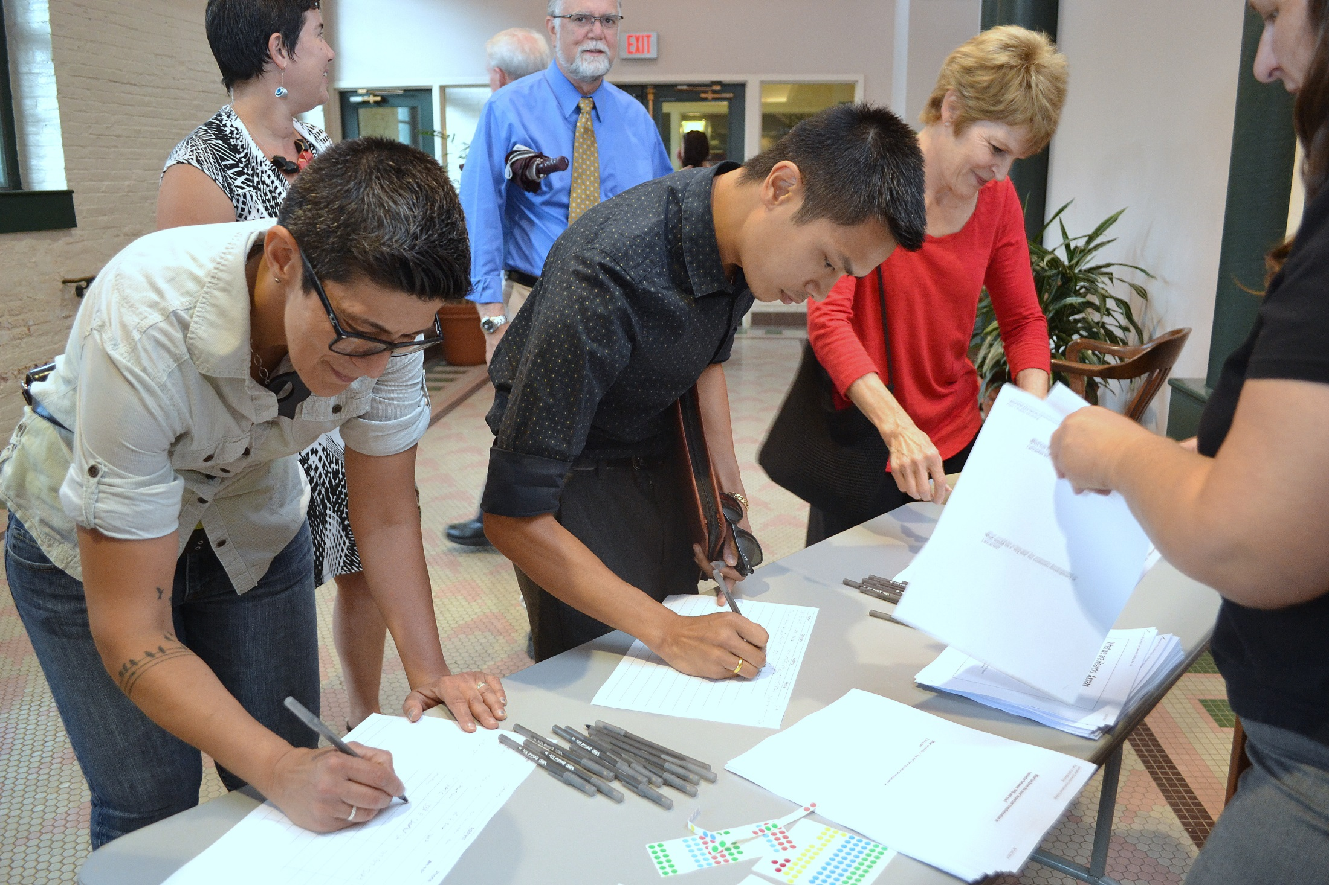
Stakeholder Engagement
Over 1,000 stakeholders involved
100+ Meetings/Forums — Large & Small
1-on-1 Interviews
Focus Groups
Public Surveys
Roundtables
3 Public Meetings

Slide 25
The Plan
15-Year Horizon
4 Broad Strategies
25 Recommendations
  12 Short-Term
  9 Medium-Term
  4 Long-Term

Slide 26
PLAN ASPIRATIONS
Attract and retain talent to the City of Lancaster.
Create jobs that provide a livable wage.
Leverage educational institutions as partners in creating a skilled workforce.
Provide equitable opportunities for all Lancastrians.

Slide 27
PLAN ASPIRATIONS
Cultivate existing Lancaster businesses to grow with continued success.
Encourage targeted economic development opportunities to strengthen neighborhoods and increase property values.
Provide an environment where small businesses and entrepreneurs can thrive.
Be a national model for urban economic development.

Slide 28
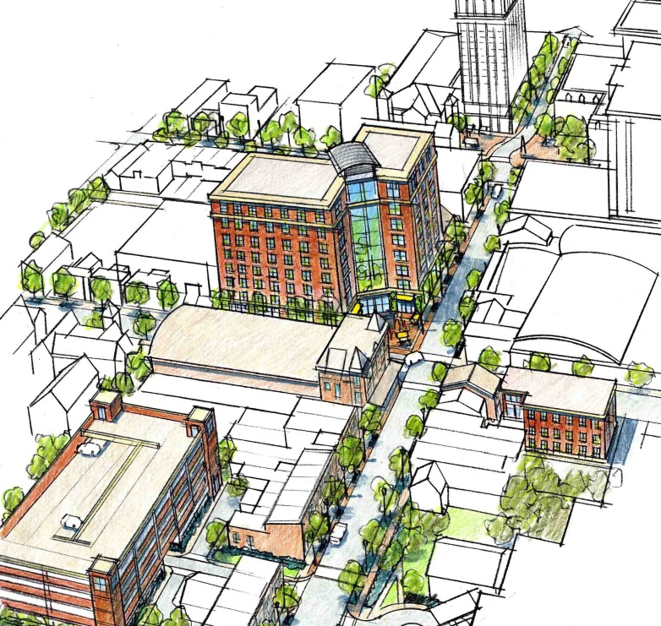
Strategy 1| Recommendations
1A | Investment Sites
1B | Market District
1C | Development Clearinghouse
1D | Business Registration Program
1E | Building the Market
  1E1 | Façade Grant Program
  1E2 | Façade Master Plan
  1E3 | Building Infrastructure Grants
  1E4 | Lancaster High-Speed Internet
1F | Land Bank
1G | Community Land Trust Subsidiary
1H | Plan Funding Program
= In Progress
1 | Expanding Success | Traditional Economic Development

Slide 29
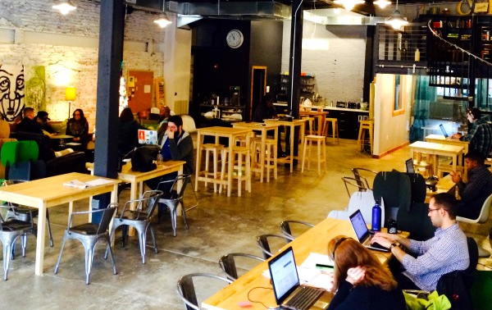
Strategy 2 | Recommendations
2A | Entrepreneurs Forum
2B | Lancaster Creative Spaces Initiative
  2B1 | Lancaster Innovation Center
  2B2 | Harvest Park Lancaster (Food Hub)
  2B3 | The Lancaster Arts Lab
2C | Neighborhood Healthy Food Initiative
The Candy Factory, co-working space for individuals and businesses
= In Progress
2 | Embracing the Collaborative Economy| Cultivating Entrepreneurs

Slide 30
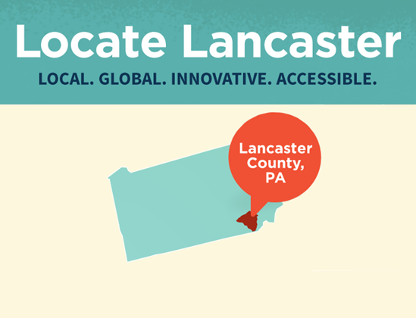
Strategy 3 | Recommendations
3A | Locate Lancaster Residential Initiative
3B | Locate Lancaster Economic Development Initiative
3C | Building the City Brand for Tourism through the Lancaster Office of Promotion
= In Progress
3 | Leveraging the Brand| Marketing Lancaster City

Slide 31
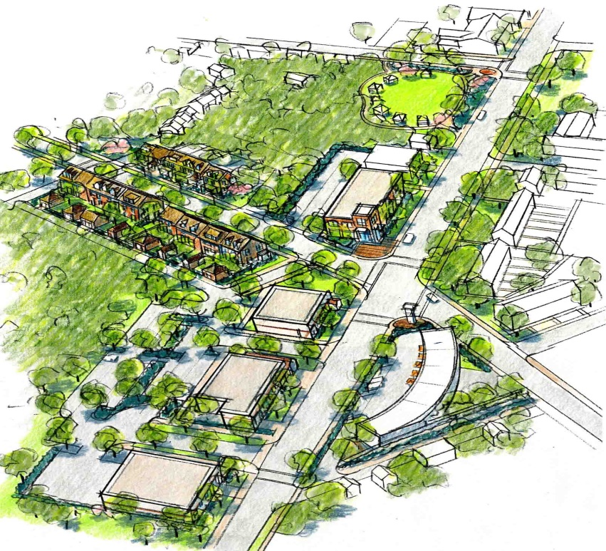
Strategy 4 | Recommendations
4A | Foster Commercial Hubs within Neighborhoods (Economic Development)
4B | Street Network and Improved Accessibility
  4B1 | Convert two-way streets to one-way
  4B2 | Circulator
  4B3 | Bicycle Network
  4B4 | Gateways and Streetscapes
4C | Commercial Hub Partner Organizations
= In Progress
4 | Quality of Life| Reinforcing Commercial Hubs

Slide 32
DESIRED OUTCOMES BY 2030
Increase in the per capita income to 70% of that of Pennsylvania
Create 300 new hotel rooms in the Downtown and Commercial Hubs
See 2,500 new residential units of all types and price points
Achieve 100,000 square feet of new and renovated retail/restaurant space in Downtown and Commercial Hubs

Slide 33
DESIRED OUTCOMES BY 2030
Fill 300,000 square feet of office and flex space
Realize $1 billion in privately led investment
See ongoing private investment that will outweigh public investment in economic development

Slide 34

BUILDING MOMENTUM
JUNE 2015
(PLAN COMPLETION)
34 months
MAY 2018
In just 34 months, 21 (84%) of the plan’s 25 recommendations are
in progress. This is a 15-year plan.

Slide 35
2030 OUTCOMES DASHBOARD
Progress Since June 2015 (as of May 2018)
GOAL BY 2030
*For development-related outcomes, “actual” reflects only projects recently completed and currently under construction.
**For development-related outcomes, “anticipated” reflects projects recently completed and currently under construction, and assumes planned and conceptual development projects will come to fruition.

Slide 36
Privately Led Investment by Commercial Hub
Progress Since June 2015 (as of May 2018)

Slide 37
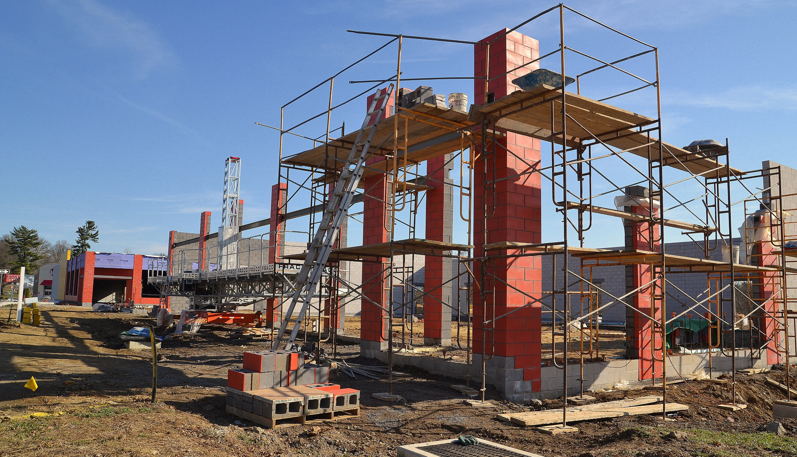
As of May 2018, 16 (40%) of the plan’s 40 designated “investment opportunity sites” are either under development or newly developed.

Slide 38
ORIGINALLY DESIGNATED INVESTMENT OPPORTUNITY SITES
AREA 1: DOWNTOWN CORE-PRIMARY OPPORTUNITIES
1A: Bulova Site
1B: City Crossings Lot
1C: Southern Market
1D: Swan Hotel Corner
1E: Queen and Vine Site (LNP)
1F: Market District Sites
1G: Upper Floor Redevelopment (Throughout Downtown)
AREA 2: DOWNTOWN CORE – SECONDARY OPPORTUNITIES
2A: HDC Property Infill
2B: Prince Street Garage Site
2C: Queen and Chestnut Infill (NW Corner)
2D: RRTA Garage Air Rights
2E: North Queen Street Retail Commercial
2F: West Vine/West Farnum Site
2G: Penn Square Mixed-Use Opportunity
AREA 3: HARRISBURG AVENUE/TRAIN STATION AREA
3A: Northwest Triangle
3B: Train Station North (Keller Avenue Properties)
3C: Train Station West
3D: Train Station South (McGovern Avenue Properties)
AREA 4: NEW HOLLAND AVENUE
4A: Plum and Walnut Anchor
4B: Ross Street Gateway
4C: New Holland Avenue Infill
4D: Burle Office Park Infill Development
AREA 5: WEST KING STREET/MANOR STREET
5A: Manor Street Infill/Property Enhancements
5B: Consolidated Parking Resources (Typ.)
5C: West King Infill Development/Property Enhancements
5D: Upper Floor Redevelopment
AREA 6: EAST KING STREET
6A: Excelsior Building
6B: East King Infill Development
6C: Façade/Property Enhancements
AREA 7: SOUTH PRINCE/SOUTH QUEEN STREETS
7A: The Ironworks
7B: South Prince Infill Development
7C: Façade/Property Enhancements
7D: Rebman’s Redevelopment
AREA 8: SOUTH DUKE STREET
8A: Conestoga Plaza
8B: Conestoga East
8C. Conestoga North
8D: Residential Infill Opportunity
8E: South Duke Square
8F: South Duke Infill Development
8G: Outdoor Market

Slide 39
ORIGINALLY DESIGNATED INVESTMENT OPPORTUNITY SITES
AREA 1: DOWNTOWN CORE-PRIMARY OPPORTUNITIES
1A: Bulova Site
1B: City Crossings Lot
1C: Southern Market
1D: Swan Hotel Corner
1E: Queen and Vine Site (LNP)
1F: Market District Sites
1G: Upper Floor Redevelopment (Throughout Downtown)
AREA 2: DOWNTOWN CORE – SECONDARY OPPORTUNITIES
2A: HDC Property Infill
2B: Prince Street Garage Site
2C: Queen and Chestnut Infill (NW Corner)
2D: RRTA Garage Air Rights
2E: North Queen Street Retail Commercial
2F: West Vine/West Farnum Site
2G: Penn Square Mixed-Use Opportunity
AREA 3: HARRISBURG AVENUE/TRAIN STATION AREA
3A: Northwest Triangle
3B: Train Station North (Keller Avenue Properties)
3C: Train Station West
3D: Train Station South (McGovern Avenue Properties)
AREA 4: NEW HOLLAND AVENUE
4A: Plum and Walnut Anchor
4B: Ross Street Gateway
4C: New Holland Avenue Infill
4D: Burle Office Park Infill Development
AREA 5: WEST KING STREET/MANOR STREET
5A: Manor Street Infill/Property Enhancements
5B: Consolidated Parking Resources (Typ.)
5C: West King Infill Development/Property Enhancements
5D: Upper Floor Redevelopment
AREA 6: EAST KING STREET
6A: Excelsior Building
6B: East King Infill Development
6C: Façade/Property Enhancements
AREA 7: SOUTH PRINCE/SOUTH QUEEN STREETS
7A: The Ironworks
7B: South Prince Infill Development
7C: Façade/Property Enhancements
7D: Rebman’s Redevelopment
AREA 8: SOUTH DUKE STREET
8A: Conestoga Plaza
8B: Conestoga East
8C. Conestoga North
8D: Residential Infill Opportunity
8E: South Duke Square
8F: South Duke Infill Development
8G: Outdoor Market
Denotes Site Recently Developed or
Under Development as of March 2018

Slide 40
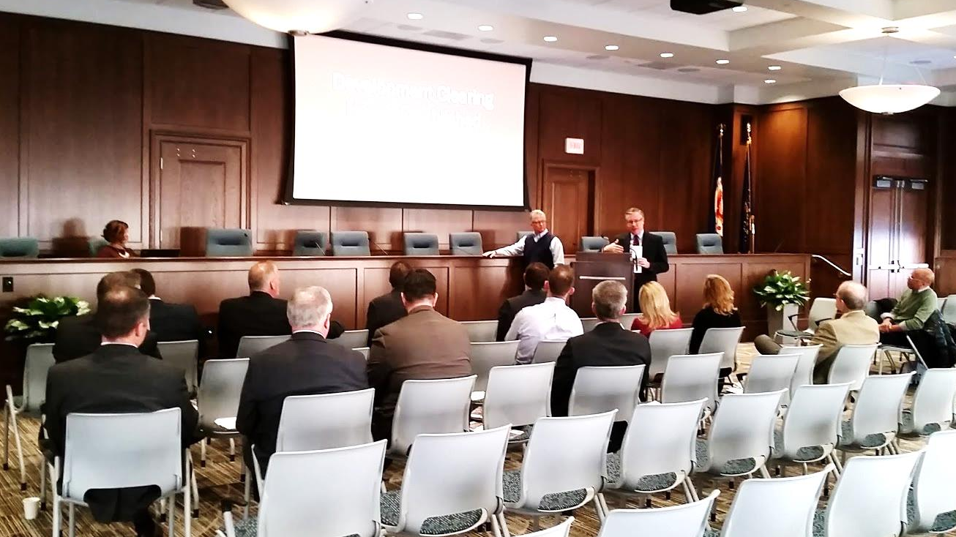
Development Financing Advancements
City Land Bank
$1 Million (over 4 yrs.)
New Market Tax Credits
$19 Million to City development projects since 2016
City Revitalization & Improvement Zone (CRIZ)
$3.55 Million in 1st Year of State Program
Biannual Banker Briefings
Quarterly Finance Squad Meetings

Slide 41
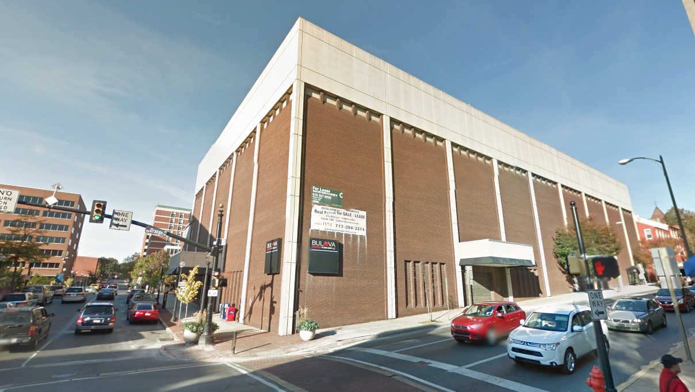
1A | INVESTMENT SITES
101 N. Queen Mixed Use
(EXISTING)

Slide 42
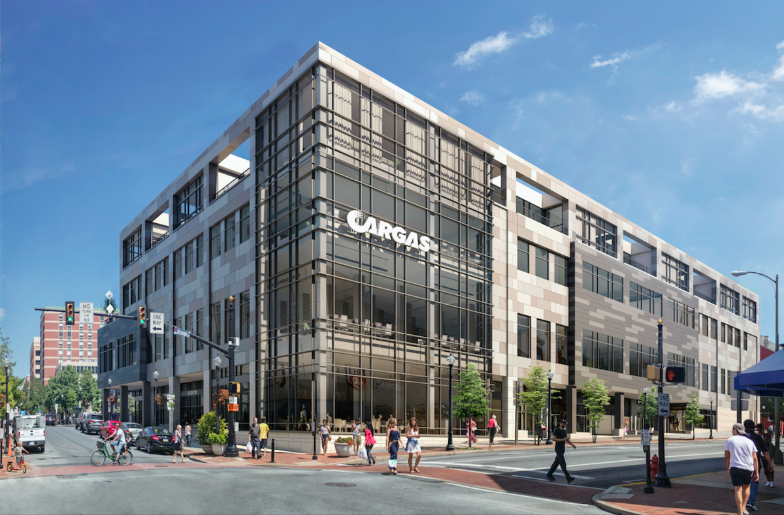
1A | INVESTMENT SITES
101 N. Queen Mixed Use
(UNDER CONSTRUCTION)

Slide 43
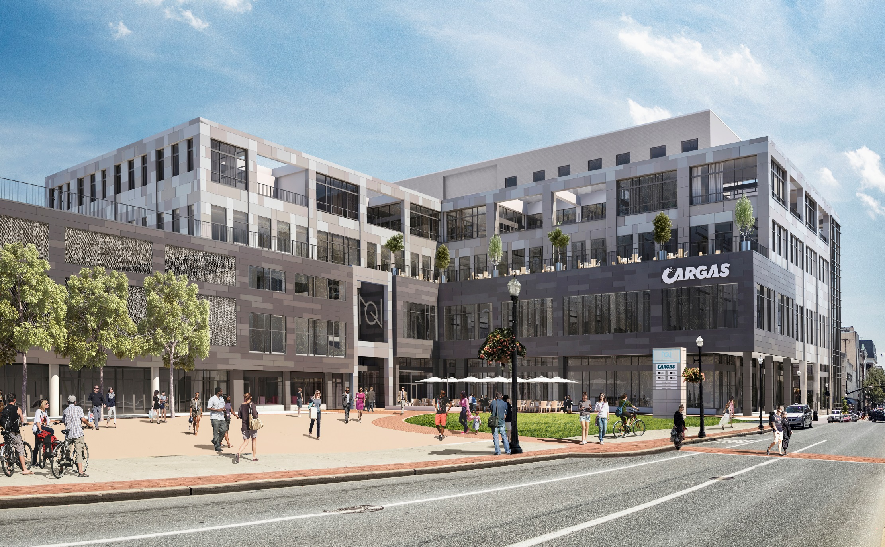
1A | INVESTMENT SITES
101 N. Queen Mixed Use
(UNDER CONSTRUCTION)

Slide 44
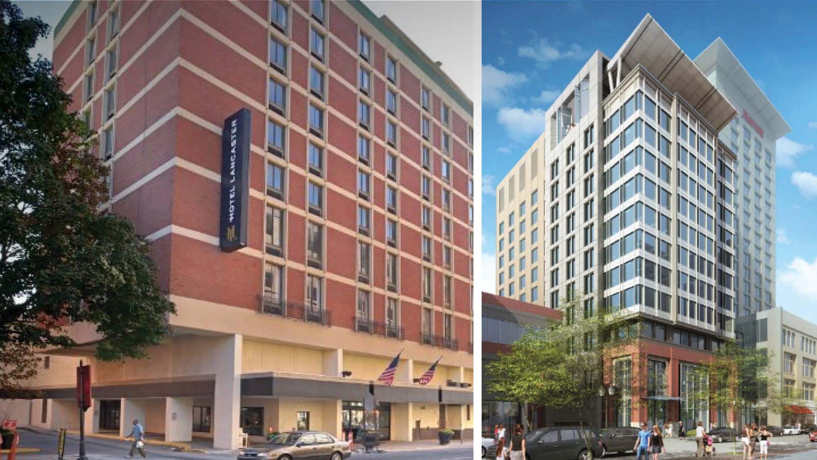
1A | INVESTMENT SITES
Holiday Inn Renovations + Marriott Hotel Expansion
192 New Hotel Rooms Downtown

Slide 45
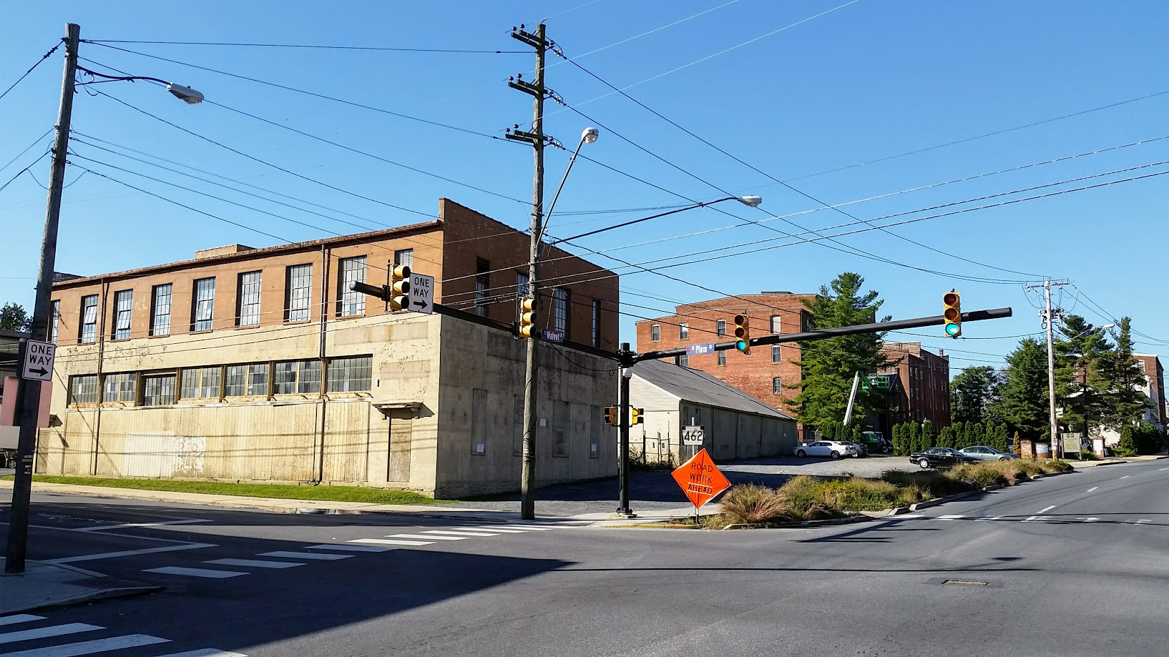
1A | INVESTMENT SITES
Plum & Walnut Anchor
‘Tobacco Avenue’ Mixed Use Redevelopment/Adaptive Reuse
(EXISTING)

Slide 46
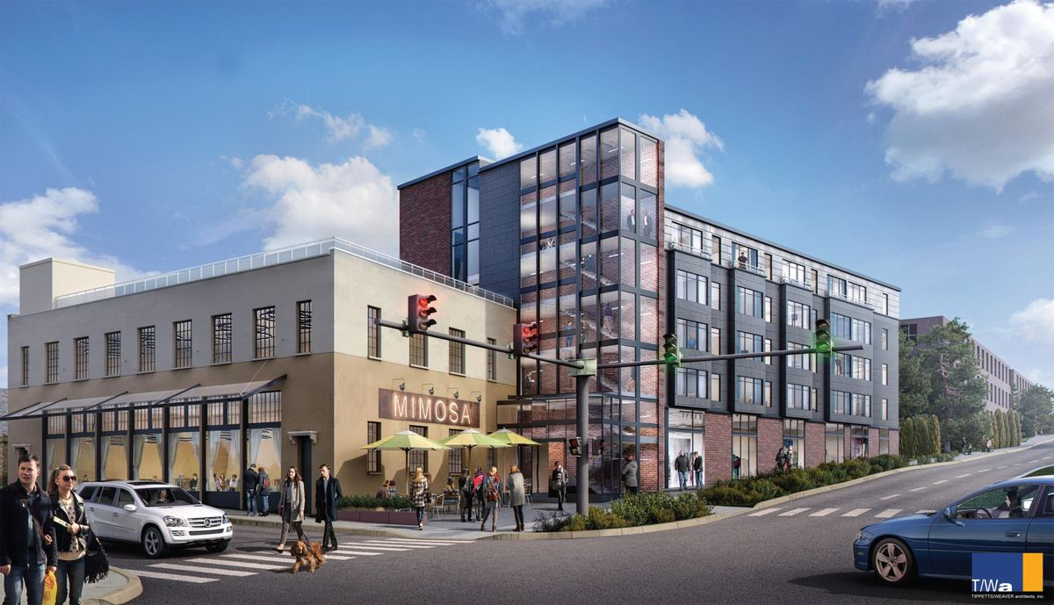
1A | INVESTMENT SITES
Plum & Walnut Anchor
‘Tobacco Avenue’ Mixed Use Redevelopment/Adaptive Reuse
(PROPOSED)

Slide 47
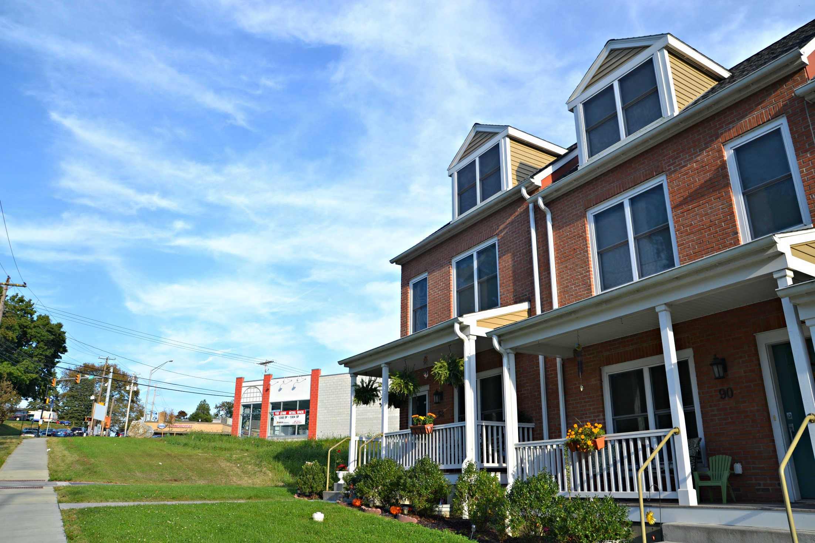
1A | INVESTMENT SITES
Conestoga Plaza
South Duke & Chesapeake Streets

Slide 48
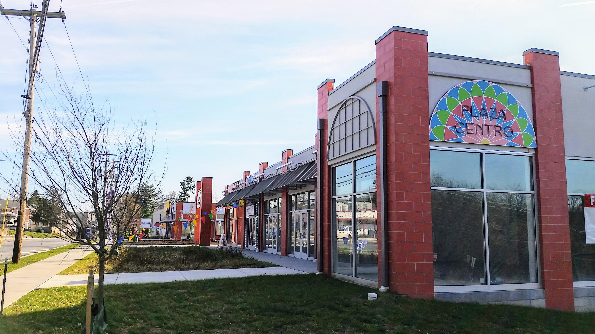
1A | INVESTMENT SITES
Conestoga Plaza
South Duke & Chesapeake Streets

Slide 49
Strategic Partnerships

Slide 50
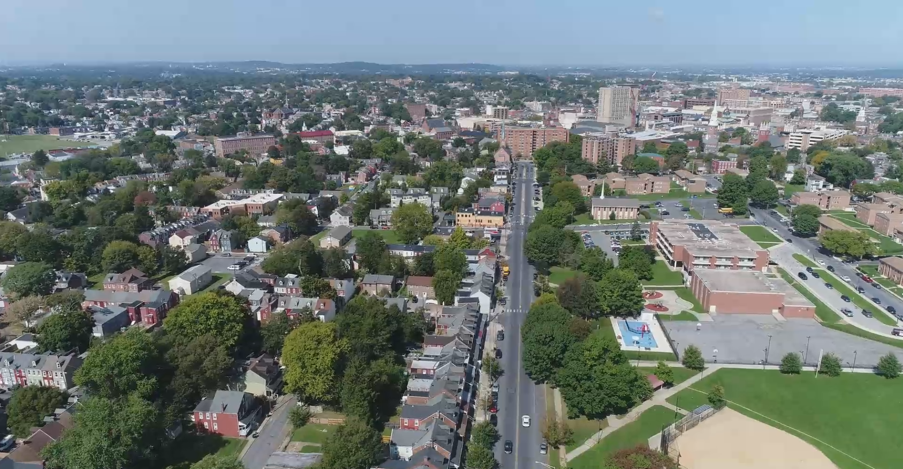
30% Poverty Rate Citywide
40% South of King Street

Slide 51
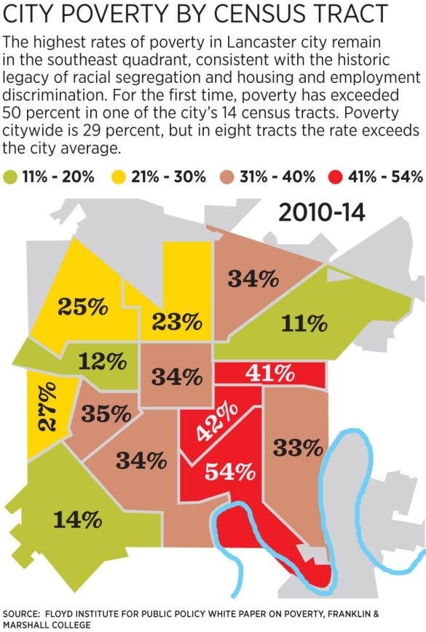
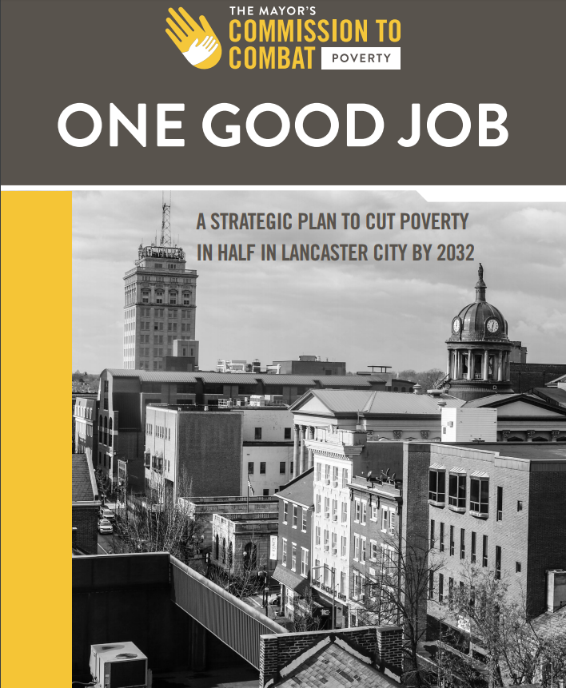

“None of us can tackle these massive issues alone. If we create critical mass by all moving in the same direction, then we can make real progress with individuals, institutions, communities and policies.”
      — Dan Jurman, Chairperson
      Mayor’s Commission to Combat Poverty

Slide 52














Slide 53
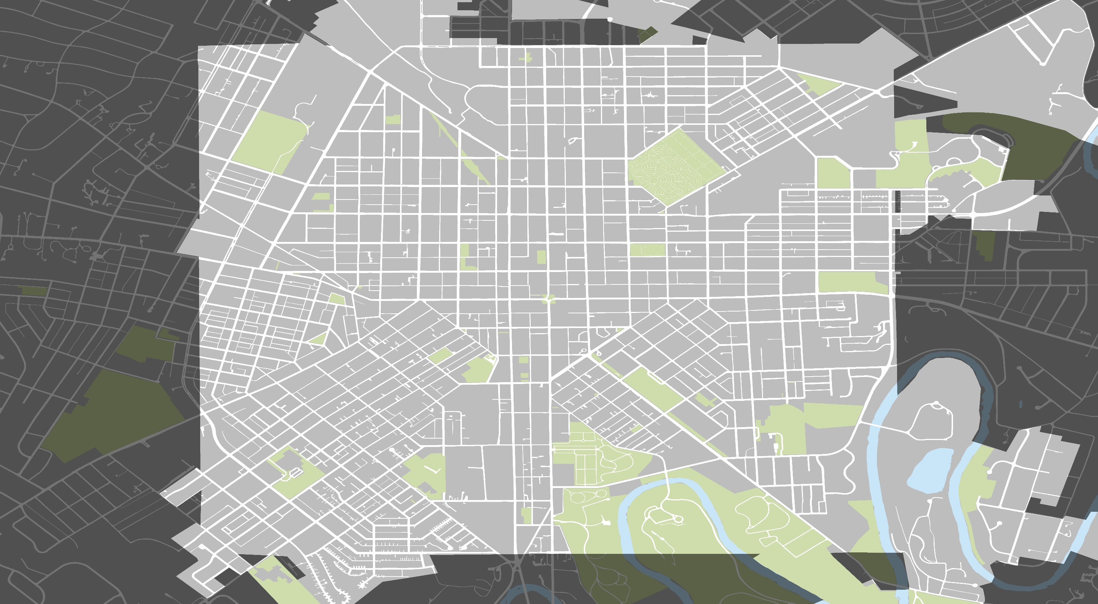


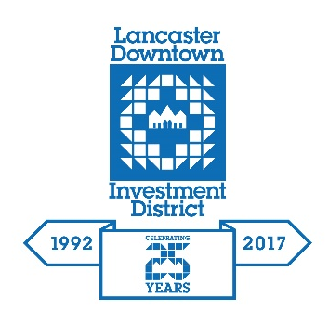


Neighborhood Partner Organizations

Slide 54
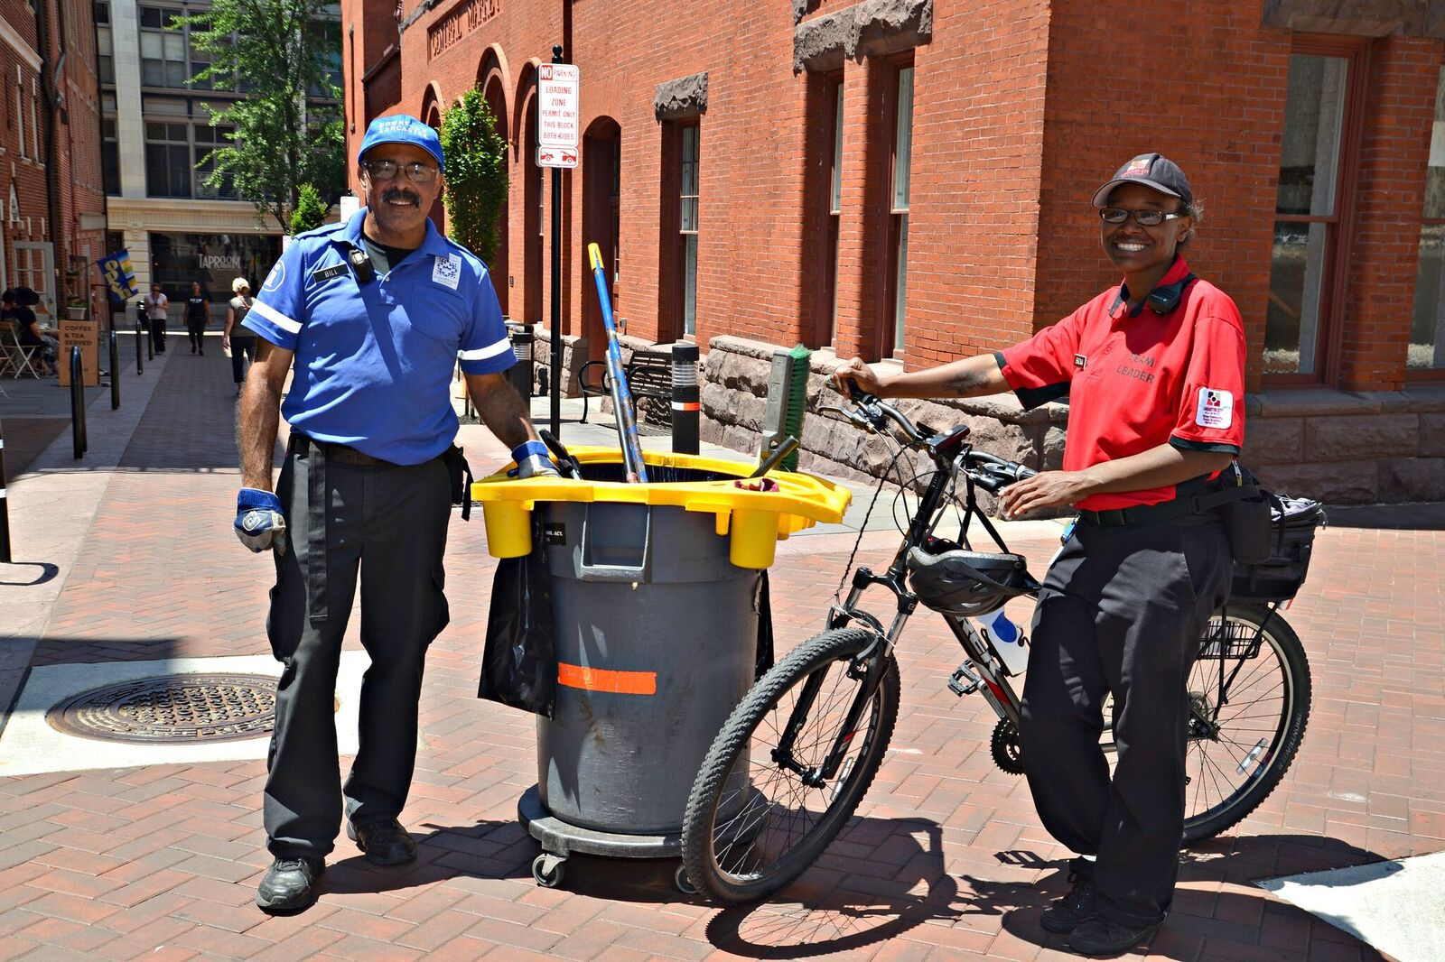
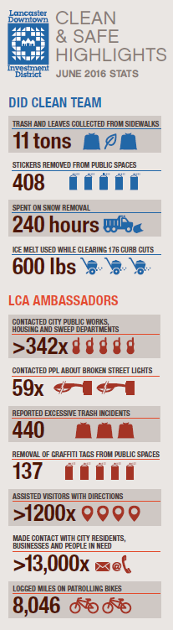
Bicycle Ambassadors & Downtown Clean Team

Slide 55
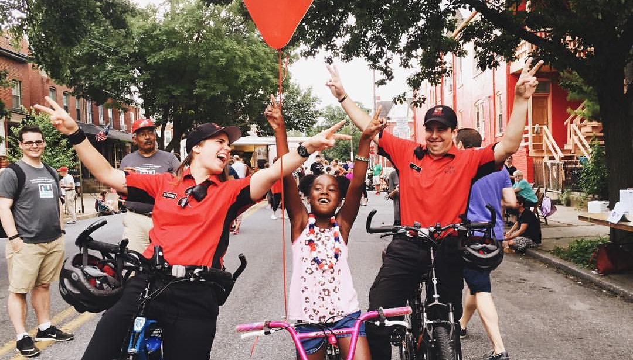
Northeast Lancaster Neighborhood Stabilization

Slide 56
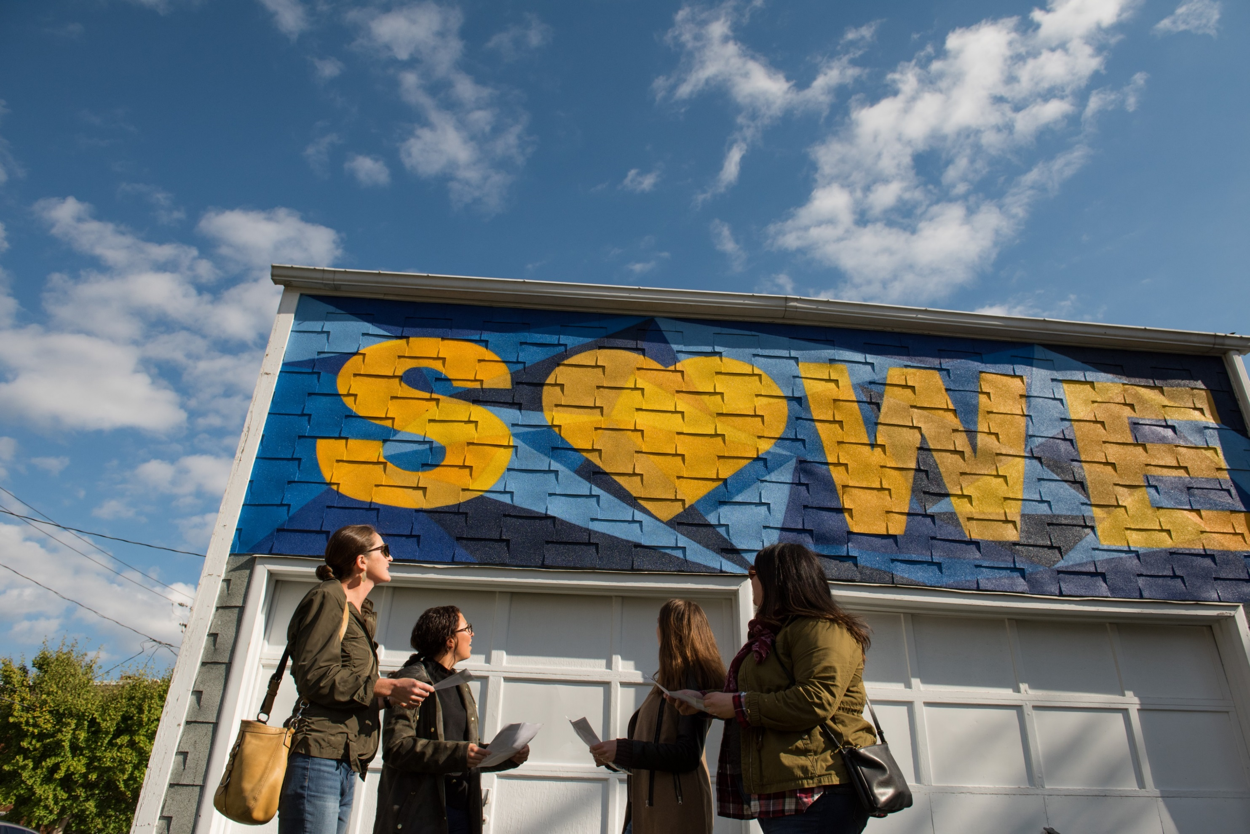
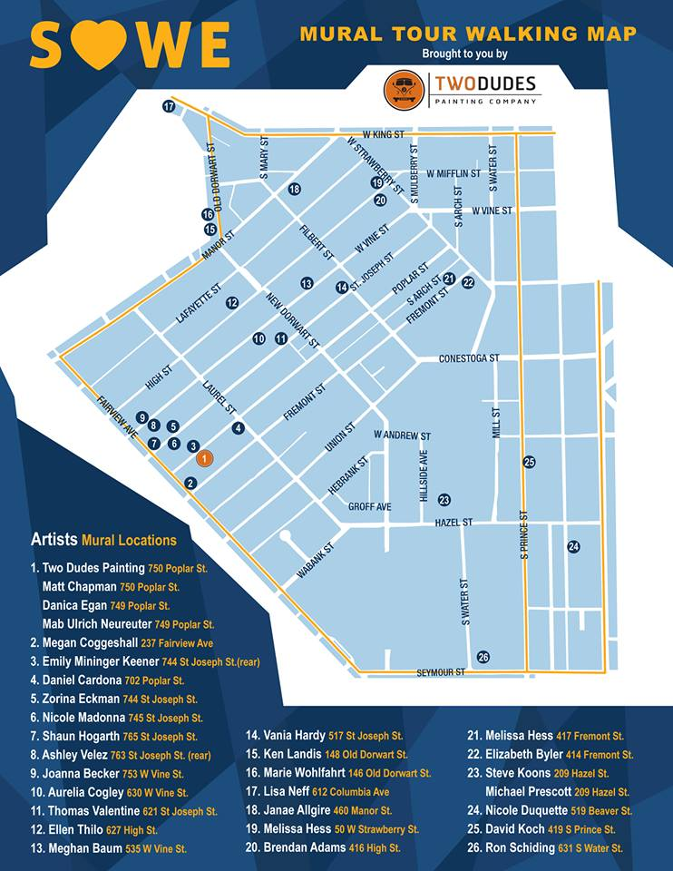
SoWe Mural Project
30 murals and growing

Slide 57
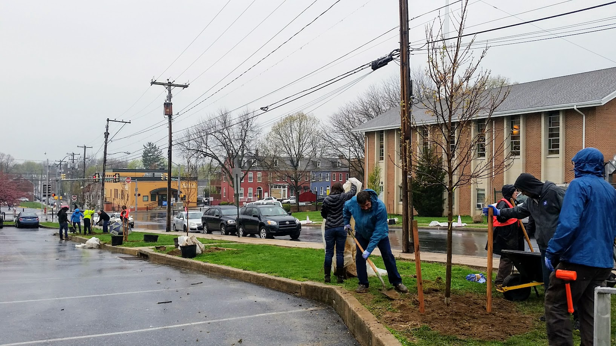
Southeast Arbor Day Tree Planting: 100 Trees
Lancaster Tree Tenders
Over 300 street trees planted since spring 2017
Nearly 600 yard and riparian buffer trees planted
Over 1,500 new street-tree planting sites identified
Over 500 hours of volunteer hours spent

Slide 58
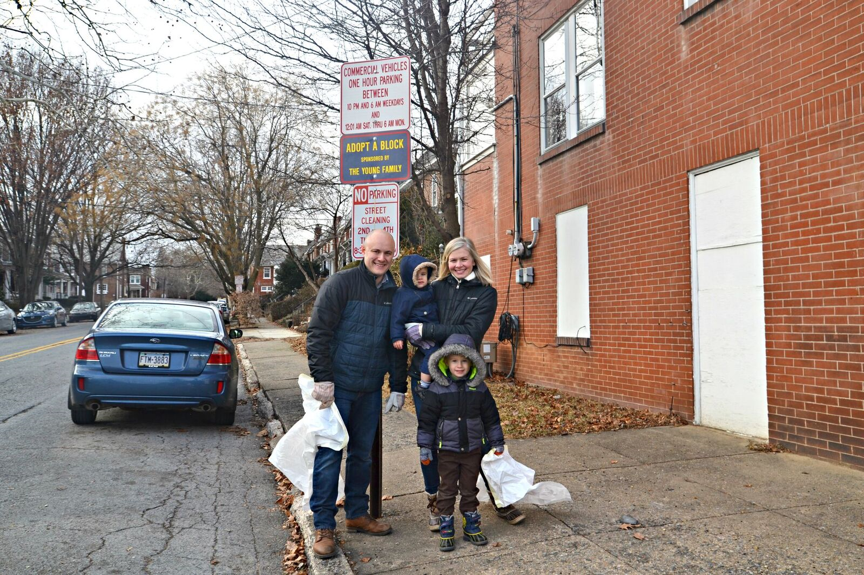
Adopt-a-Block Program
84 participants signed up to date
Over 16 miles of adopted streets

Slide 59
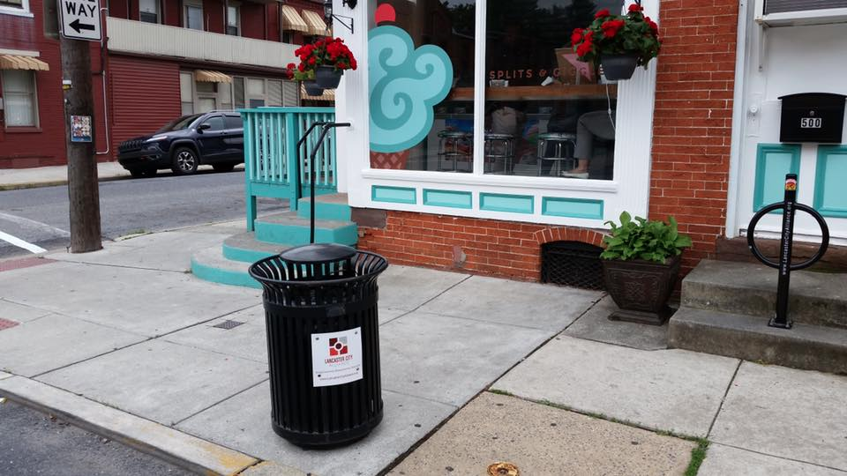
Trash Receptacle Adoption Program
73 installations to date

Slide 60
Leveraging for the Future

Slide 61

Revitalizing South Lancaster
$4.85 million in grants awarded since 2014

Slide 62

WELLS FARGO REGIONAL FOUNDATION
$100,000
Neighborhood Revitalization Strategy
Planning
CITY OF LANCASTER/
S. DALE HIGH FAMILY FOUNDATION
$1.6 million
Street Lighting & Trees
S. DALE HIGH FAMILY FOUNDATION
$100,000
Home Repair Program
WELLS FARGO REGIONAL FOUNDATION
$1.25 million
Neighborhood Revitalization Strategy
Planning & Implementation
S. DALE HIGH FAMILY FOUNDATION
$100,000
Façade Improvements, Street Trees, Trash Receptacles
CITY OF LANCASTER
$1.25 million
Public Space Enhancements
ANONYMOUS DONOR
$200,000
Neighborhood Improvements
STEINMAN FOUNDATION
$250,000
Housing Rehabilitation
Total Committed to Neighborhood Improvement, South Lancaster City:
$4.85 million

Slide 63

S. Prince & S. Queen Street Enhancements
Façade Improvements, Street Trees, Trash Receptacles

Slide 64
Mapping the Future

Slide 65

SoWe Commercial Property Inventory

Slide 66


Slide 67
Building the Future

Slide 68

MISSION
Providing economic opportunities for everyone.
VISION
Lancaster envisions a Lancaster where communities are stabilized, and everyone has an opportunity to thrive, whether that be through living wage work, entrepreneurship, or safe and decent affordable housing. We are dedicated to building mixed income, mixed-use communities that create financial ecosystems that build and retain wealth for all community members.

Slide 69







Slide 70
Questions?

Slide 71

Thank You
LancasterCityAlliance.org

