Slide 1
South Bend’s Resident Legal Assistance Program
Jim Kelly
Notre Dame Law School
May 16, 2018

Slide 2
Land Banking
Land Banking involves acquisition of clear title to abandoned properties for the purpose of making them available for productive use.

Slide 3
Mapping Market Strength

Slide 4
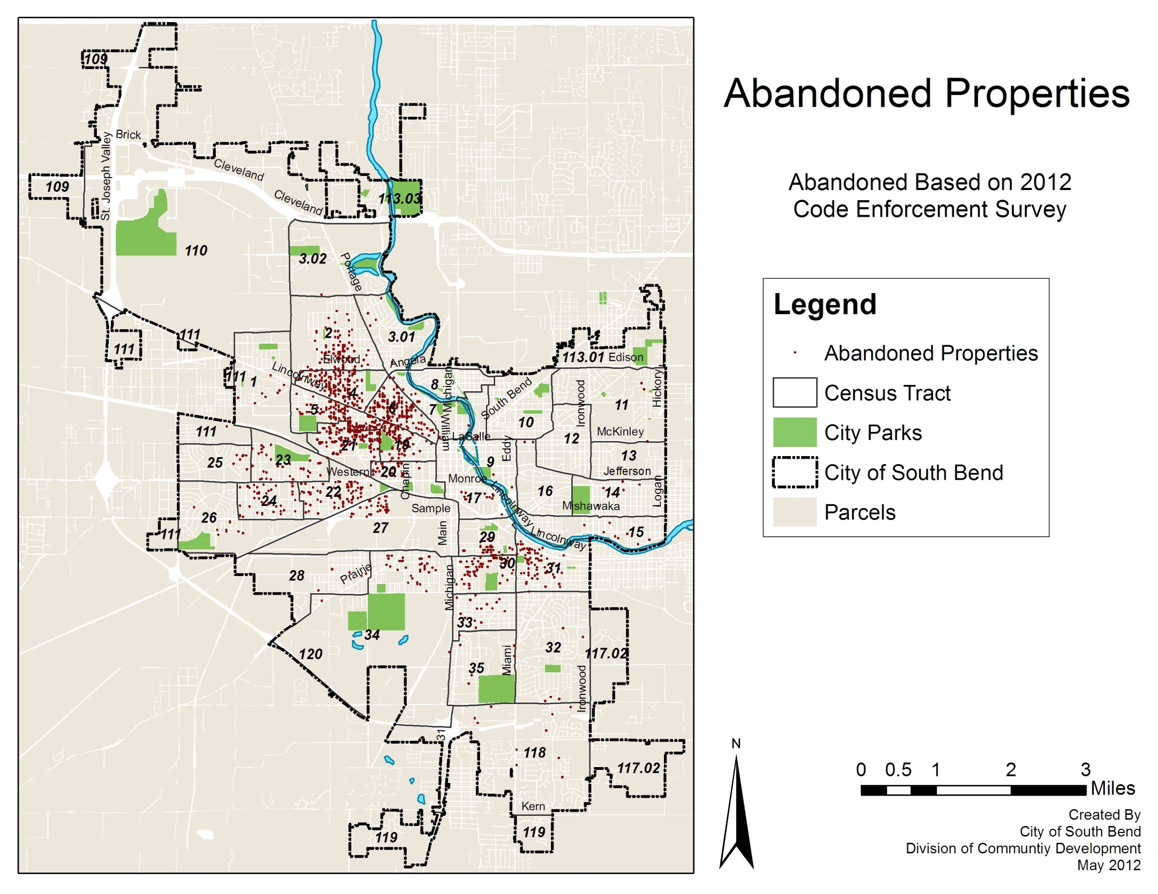

Slide 5
Subsidized Rehab & New Construction

Slide 6
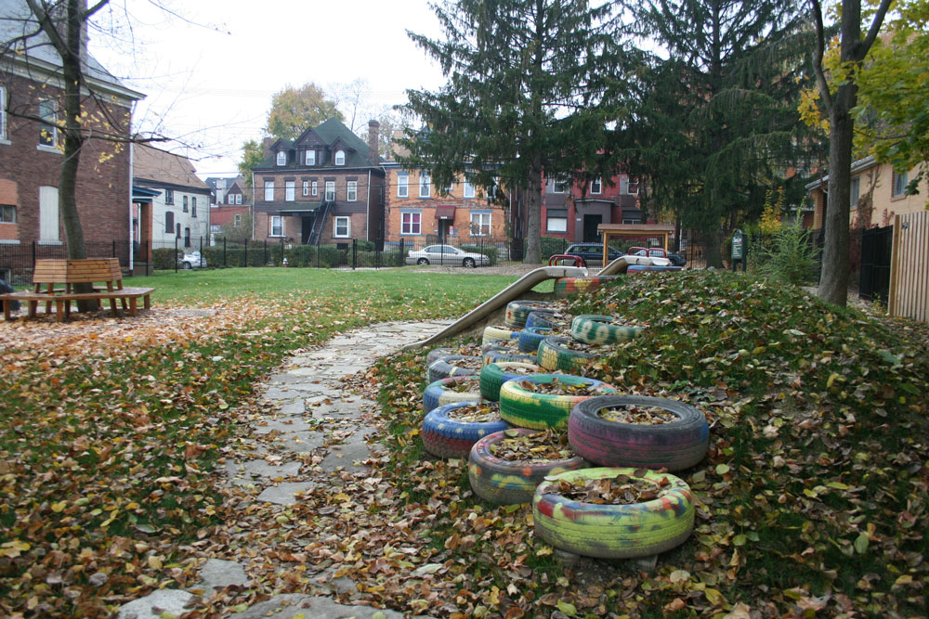
Greening Neighborhoods
Reuse vacant lots as:
Sideyards
Community gardens
Pocket Parks
Urban Agriculture

Slide 7
Commissioners’ Sale
Not all delinquent properties are sold at regular tax sale for full lien value in August.
County takes tax certificate for properties
Not Suitable For Sale or
Not Sold at Sale
County may sell these certificates at less than amount owed and does so in March.
Typically, vacant lot certificates sell for $25.

Slide 8
Resident Legal Assistance Program
City of South Bend and ND Clinical Law Center have formed a partnership to assist residents and community-based orgs to clear title to vacant or foreclosure properties.
ND CLC provides legal assistance free to clients and City pays expenses involved in title-clearing process.

Slide 9
Tax Foreclosure and Quiet Title Processes
After RLAP participant acquires certificate at March sale, title work is ordered to find out who needs to be notified of foreclosure by mid-June.
In late July, we file petition for a tax deed, which is issued in September.
We then bring another lawsuit called a “quiet title” to confirm the RLAP participant as the new owner.

