Slide 1
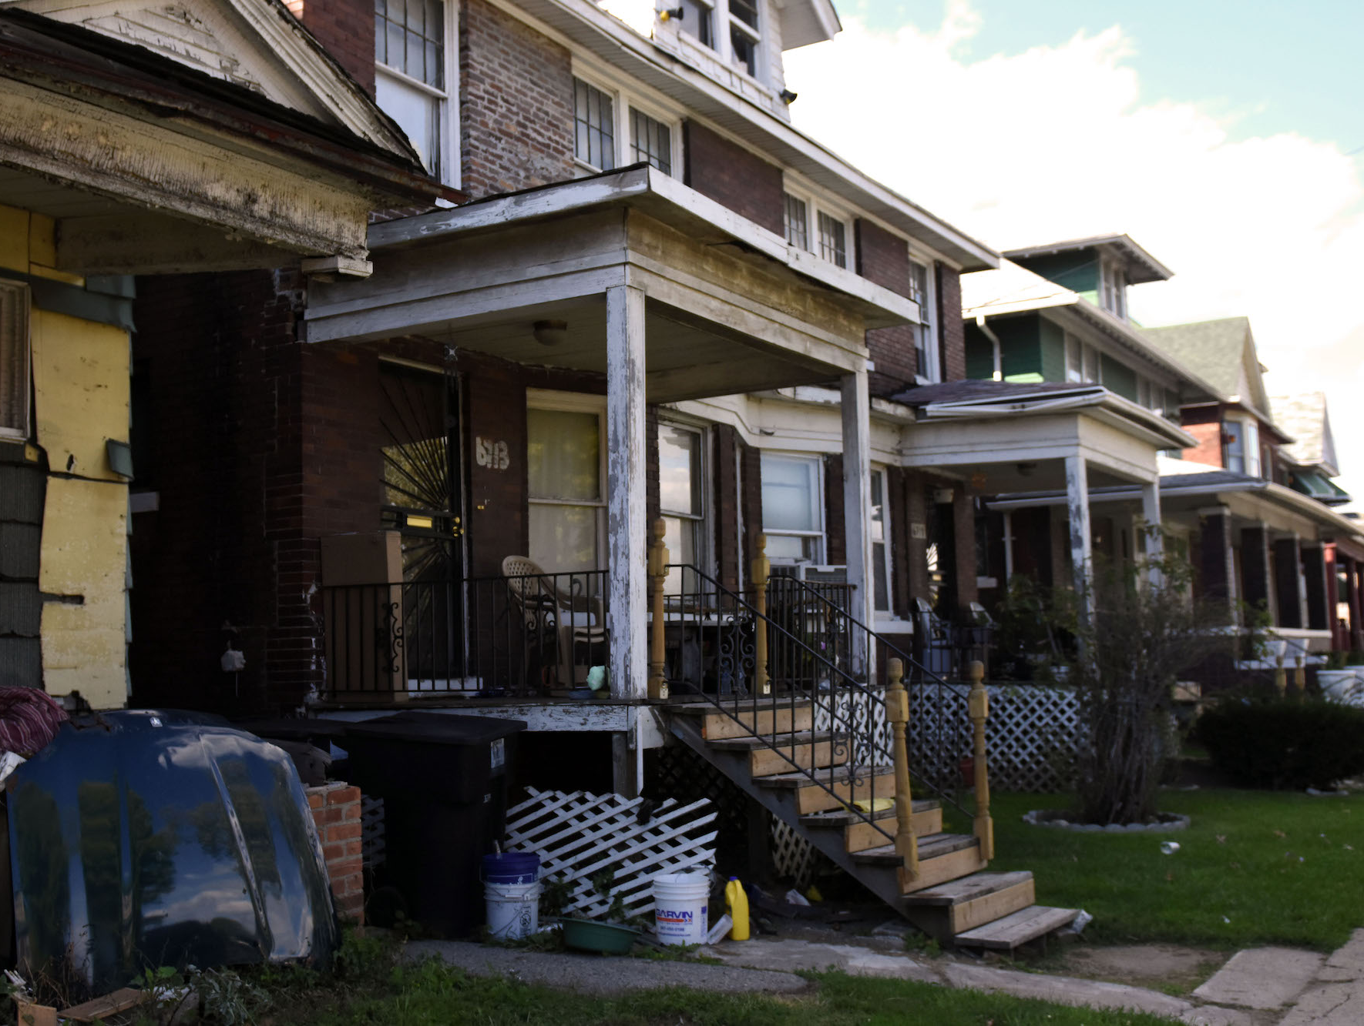
Immigration:
America’s Secret Antidote to the Vacant Property Crisis
Reclaiming Vacant Properties Conference
Wednesday, May 15, 2018
Milwaukee, Wisconsin

Slide 2

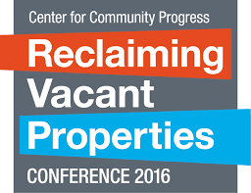
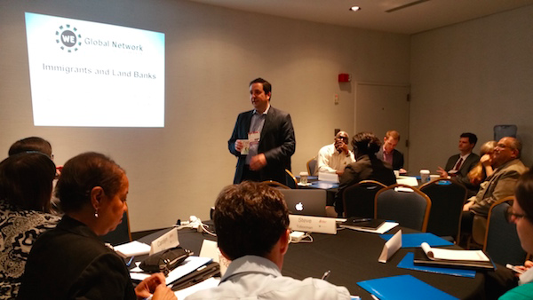

Slide 3
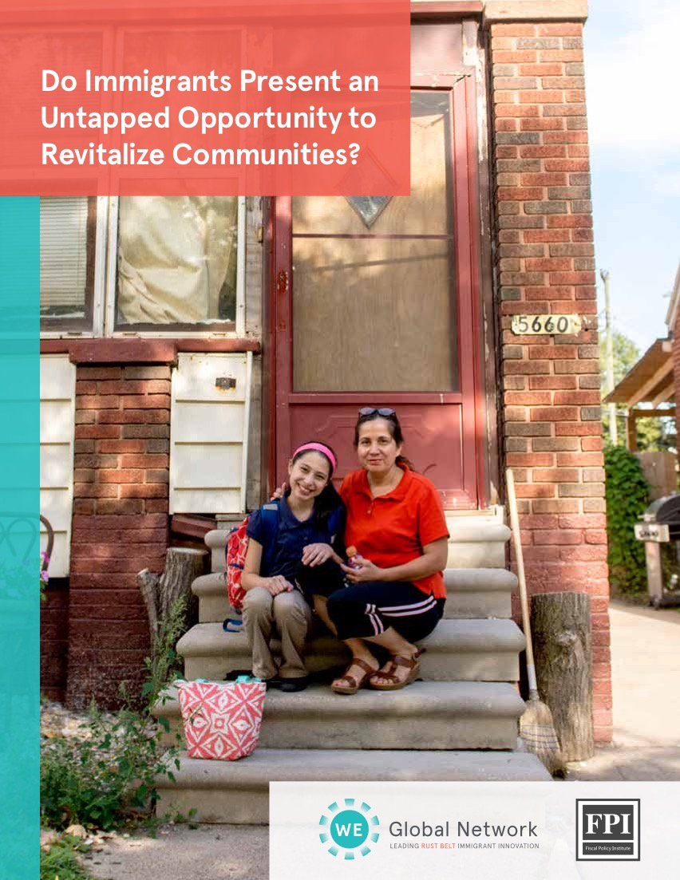
www.weglobalnetwork.org/landbank
Report and Interactive
Data Tool
Starting the Conversation

Slide 4

DO IMMIGRANTS PRESENT AN UNTAPPED OPPORTUNITY TO REVITALIZE NEIGHBORHOODS?
This research is offered to start a deeper conversation about immigrants as an important component of any vacant and distressed housing revitalization strategy.
“Sergio is working to start a neighborhood committee to improve the area, and he also is trying to renovate other homes on his block..”
-Sergio Martinez
DO IMMIGRANTS PRESENT AN UNTAPPED OPPORTUNITY TO REVITALIZE NEIGHBORHOODS?

Slide 5

The Welcoming Economies Global Network strengthens the work, maximizes the impact, and sustains the efforts of local economic and community development initiatives across the region that welcome, retain, and empower immigrant communities as valued contributors to the region’s shared prosperity.

Slide 6
Cities with Declining Population 1960 to 1980
(29 of the 50 Largest Cities saw a mid-20th Century population decline)
St. Louis | -40%
Cleveland | -34%
Buffalo | -33%
Pittsburgh | -30%
Detroit | -28%
Rochester | -24%
Louisville | -24%
Cincinnati | -23%
Minneapolis | -23%
Boston | -19%
Newark | -19%
Birmingham | -17%
Washington, DC | -16%
Baltimore | -16%
Philadelphia | -16%
Chicago | -15%
Milwaukee | -14%
St. Paul | -14%
Atlanta | -13%
Norfolk | -13%
Seattle | -11%
New Orleans | -11%
New York City | -9%
San Francisco | -8%
Oakland | -8%
Kansas City | -6%
Portland, OR | -2%
Tampa | -1%
Denver | -0.3%
Source: Fiscal Policy Institute analysis of Census and ACS data.
Notes:
Note Buffalo and Rochester are among those with the biggest percent drop. Syracuse, Albany, Binghamton, and Utica are not on the list because they are not among the biggest cities (the chart is based on the 50 biggest cities in 1970).

Slide 7
Of the 29 Declining Cities,
14 Rebounded
with an Increase in Population
1980 to 2013
Source: Fiscal Policy Institute analysis of Census and ACS data.

Slide 8
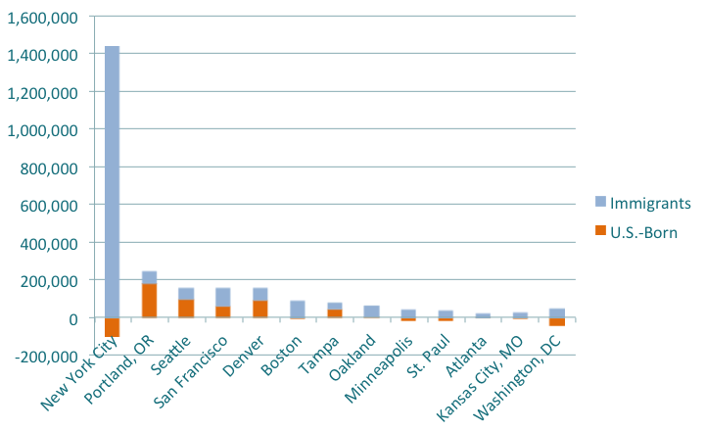
Here are the Cities that Rebounded with an Increase in the Immigrant Population
Source: Fiscal Policy Institute analysis of Census and ACS data.

Slide 9
Here are the Cities that Rebounded
Without an Increase in Immigrant Population
Source: Fiscal Policy Institute analysis of Census and ACS data.

Slide 10
There are none
The only cities that rebounded from mid-20th century population loss did so with a net increase in immigrant population.
Source: Fiscal Policy Institute analysis of Census and ACS data.
Notes:
This doesn’t prove that immigrants cause growth. It may also be that immigrants are drawn to growth.
But it your city’s plan is to grow without immigrants, it is useful to keep in mind that there are no examples of that among major cities in the United States over the past four decades.

Slide 11
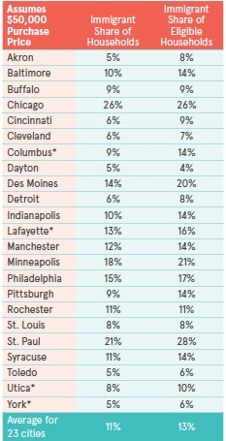
Don’t Leave Immigrants Out of Your Plans
It May Come as A Surprise, But they are as Eligible to Rehab Distressed Housing as others

Slide 12
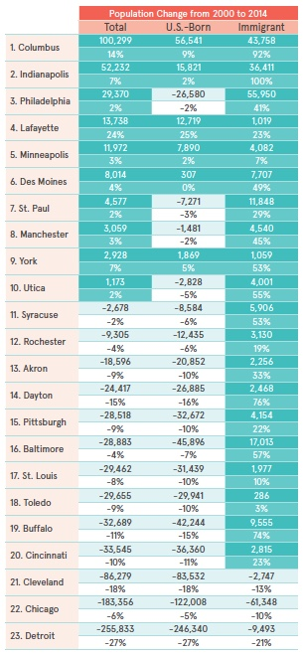
…and, Immigrants are Often a Growing Population In Cities That Are Shrinking

Slide 13
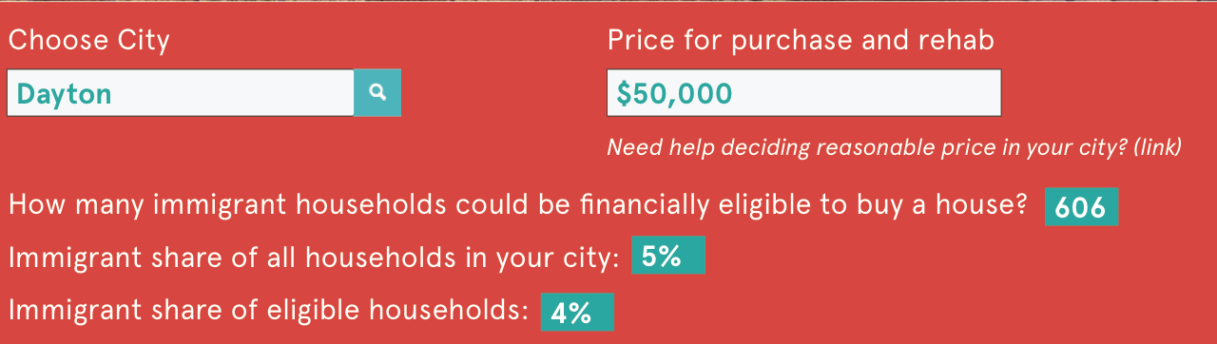
Try the Tool
www.weglobalnetwork.org/landbank

Slide 14

Throughout the 1940s and 1950s, many Puerto Rican migrants settled east and west along Spring Garden Street. Puerto Ricans were not always welcome newcomers, however, and many faced prejudice and discrimination in their neighborhoods. As the Puerto Rican population continued to grow in the 1960s, it expanded east towards the Delaware River and north towards Lehigh Avenue. Neighborhoods that had been suffering for decades due to the decline of manufacturing activity, which resulted in the abandonment of large numbers of factories, loss of jobs and population, and the businesses that served them left the City of Philadelphia.

Slide 15
Vacant Property Strategy
HACE’s community development approach focuses on using the commercial corridor with its unique Latino cultural character as an anchor to rebuild the surrounding core neighborhoods.
Our Main Street Program supports small businesses through technical assistance, access to capital, capital improvements to the corridor and promotions to attract visitors and shoppers to support our businesses.
Equally important, our model targets resources to the residential areas adjacent to the commercial corridor to repurpose vacant properties and land to increase homeownership rates, provide affordable rental housing, and preserve existing housing stock.

Slide 16
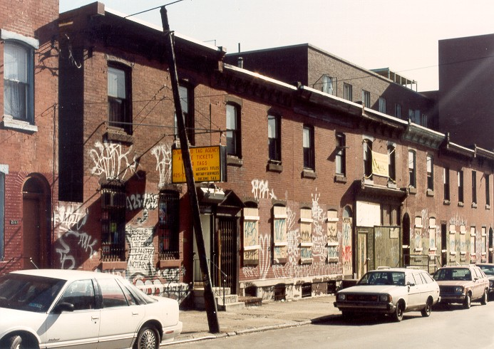
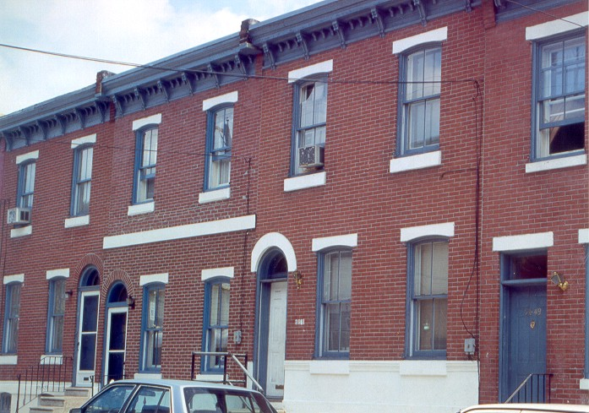
Reclaiming Vacant Properties for Homeownership in proximity to Commercial District

Slide 17

CommonBond Communities:
Working with Immigrant and Refugee Communities
National Vacant Property Conference
May 2018

Slide 18

CommonBond’s Guiding Framework
Mission
Build stable homes, strong futures, and vibrant communities.
Vision
Every person has a dignified, affordable home that supports independence and advancement within a flourishing community
Focus on Residents and Communities
We provide an integration of housing with supportive services that supports residents each and every day. Our property management is mission-centered. High-quality, person-centered property management, combined with resident-focused services, is what sets CommonBond apart from other nonprofits, developers, and for-profit property managers.

Slide 19
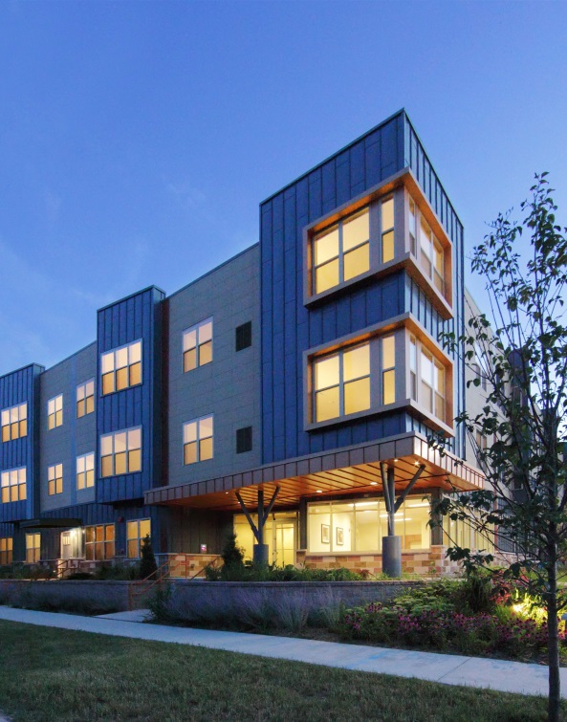
Overview
Established in 1971
110 housing communities
7,000 apartments & townhomes
52 cities
185 units for individuals who have experienced homelessness
Minnesota, Wisconsin, Iowa
Rural, suburban, urban

Slide 20

Who we serve
Serving more than 11,8000 people
Families
Children
Older adults
People living w/disabilities
Individuals who have
experienced homelessness
Average HH income: $21,000
Notes:
]

Slide 21
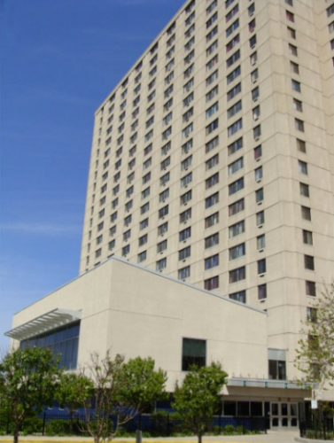
Serving Immigrants and Refugees
Minneapolis and Saint Paul- 3,000 homes
Home to primarily immigrants from East Africa, Southeast Asia, and the Middle East
Many came to the US as refugees
The average household income at these sites is $15,855

Slide 22

Serving Immigrants and Refugees
Support resolving individual
One on one support:
  learning and navigating new systems
  individual challenges that may impact
  success in life and in housing
Adult Education and Advancement Services
  Job search and placement, career laddering
  ELL classes
  Financial literacy and coaching
Community Building and Engagement
Notes:
]

Slide 23
Jessie Hendel
jessie.hendel@commonbond.org
651-290-6249

Slide 24


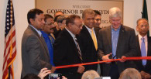


Opportunity Neighborhoods
Notes:
Input: data, Foundation Money, Economic Development

Slide 25
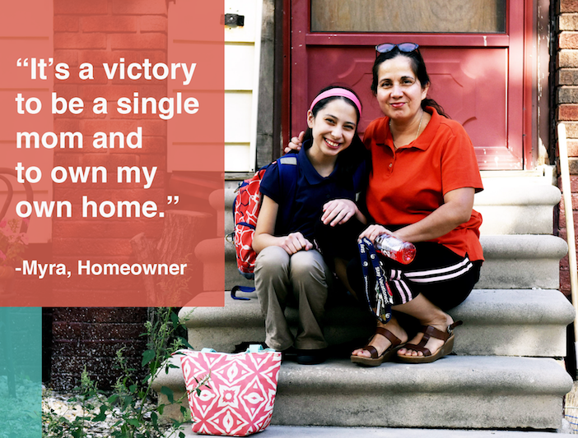

Slide 26
