Slide 1
Don’t Begrudge A Nudge: Intro to behavioral science for code enforcement
Sasha Tregebov
Behavioral Insights Team

Slide 2
1. A “game”

Slide 3
Getting the neurons firing
Bed
Rest
Awake
Tired
Dream
Wake
Snooze
Blanket
Doze
Slumber
Snore
Nap
Peace
Yawn
Drowsy

Slide 4
Take a moment to write the words down that you can remember

Slide 5
Do you remember?
Snore
Wake
Blanket
Nap
Sleep

Slide 6
Did you remember ‘sleep’?
40 -55
% of people who falsely remember
Source: Roediger, H. & McDermott, K., (1995), ‘Creating False Memories: Remembering Words Not Presented in Lists’, Journal of Experimental Psychology: Learning, Memory, and Cognition, Vol. 21, No. 4, pp. 803-814.

Slide 7
In case you don’t believe me…
Bed
Rest
Awake
Tired
Dream
Wake
Snooze
Blanket
Doze
Slumber
Snore
Nap
Peace
Yawn
Drowsy

Slide 8
2. A bit about BIT

Slide 9
Behavioral science + evaluation = results
Impact: Designing and testing simple, low-cost interventions to help people make better decisions for themselves. Proactively addressing code violations, increasing payments, and more.
Finding out what works!
Behavioral Scientists
Evaluation experts
Policy experts

Slide 10
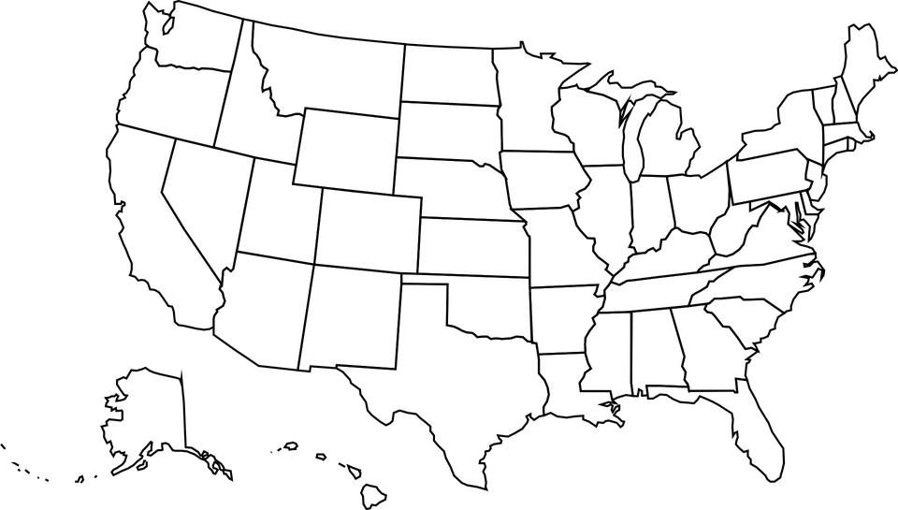
Work in US cities

Slide 11
3. How our brains work

Slide 12
Our two brains
System 1
Fast thinking/Automatic
intuitive, effortless
2x2
Taking your daily commute
System 2
Slow thinking/Reflective
deliberate, analytic, effortful
24x17
Planning a trip overseas

Slide 13
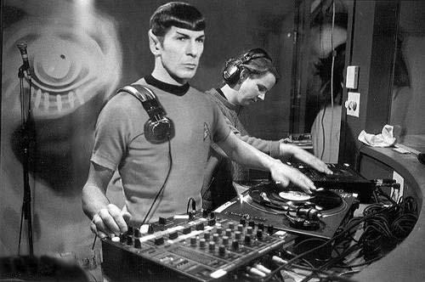
Our two brains
Behavioral science is the study of how humans make decisions and behave, both in System 1 & 2
Behavioral insights applies our understanding to practical challenges, like improving code compliance
It helps us build policies, programs and services that work
for him
– not him

Slide 14
3. Simple rules for applying behavioral insights

Slide 15
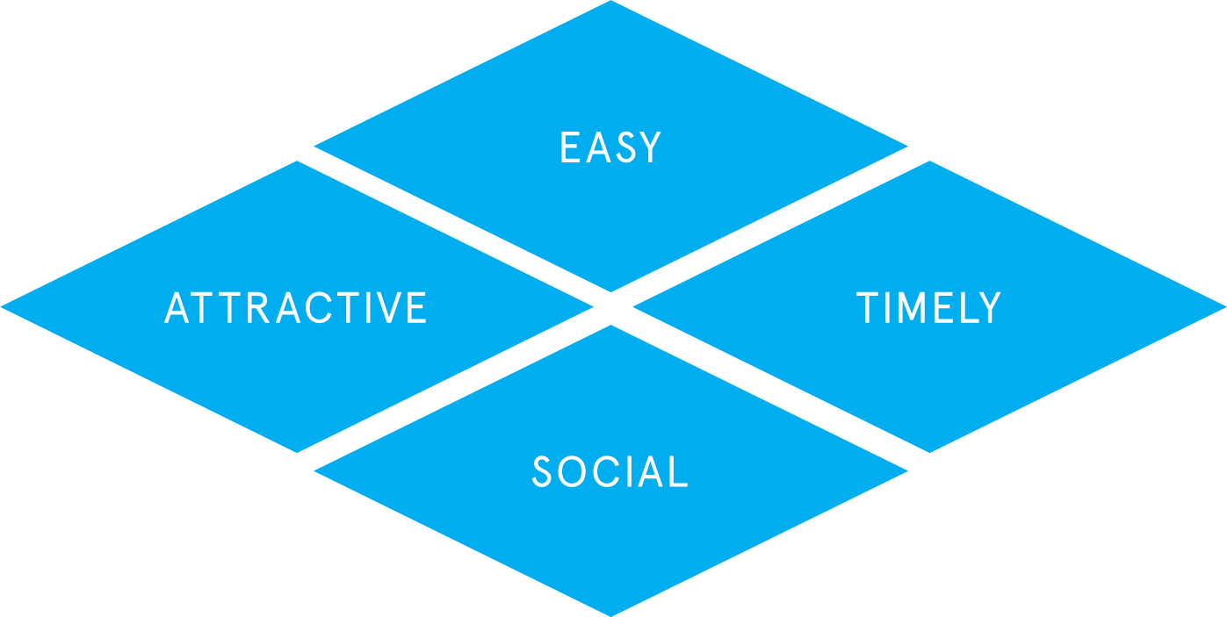
EAST
So how can you use what we know about the brain to generate outcomes?
You’ll hear some examples soon, but our best advice is that if you want residents (or staff) to do something, make it EAST

Slide 16
Notes:
Understand what I need to do, how to do, when to do it.
Plain, concise language, reducing friction costs.
Default options.

Slide 17
Notes:
Get their attention. Personalize communications, use a clear or compelling image. Frame in terms of what resonates (e.g. loss aversion).

Slide 18
Notes:
Social norms extremely powerful.

Slide 19
Notes:
People have limited memories, give them something right when they need it.
Think about when people are motivated. Deadlines.
When people make changes – after switching jobs, etc.
For codes: when do people need to know? Before violation, after complaint, all of the above?

Slide 20
4. How do you know what works?

Slide 21
Evaluation
Humans are really complicated!
Their behavior is highly context dependent
To be sure what works, we need to evaluate
1. Select sample
2. Randomly allocate
3. Measure + analyze results
TREATMENT
CONTROL
Notes:
Talk about my work in OKC

Slide 22
5. BI for Code Enforcement

Slide 23
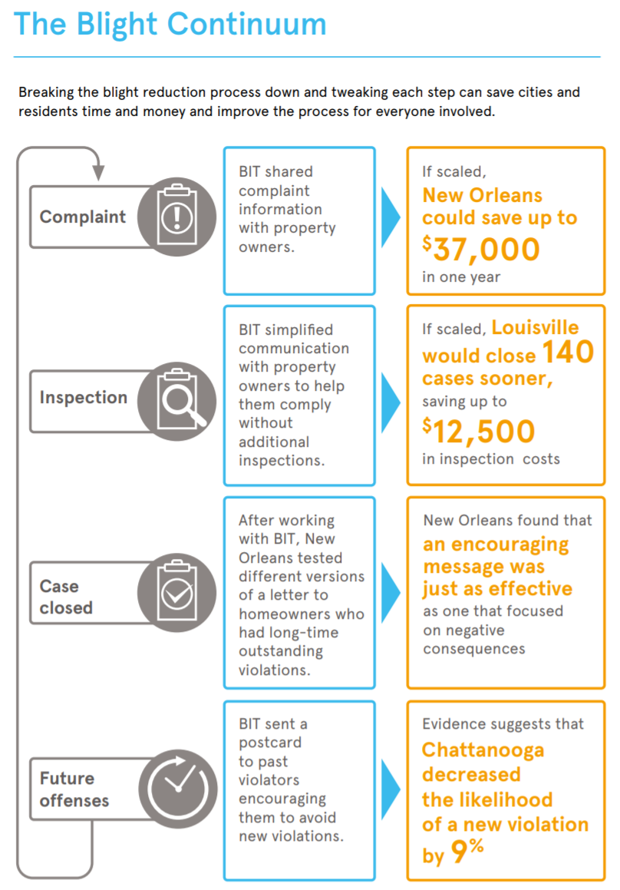
BI for Blight!

Slide 24
Influencing Decisions Using Data
Shireen Deobhakta, Ph.D
Research and Evaluation Consultant
Office of Performance Improvement and Innovation

Slide 25
How Are We Structured?
Citizens
Departments
Performance Partners
Office of Performance Improvement and Innovation

Slide 26
How Do We Measure our Results?
Intervention
Control Group
Treatment Group
Problem
Measurable Outcomes
Plan
Randomization
Do
Check
Analysis
Act
Fact-Based Changes

Slide 27
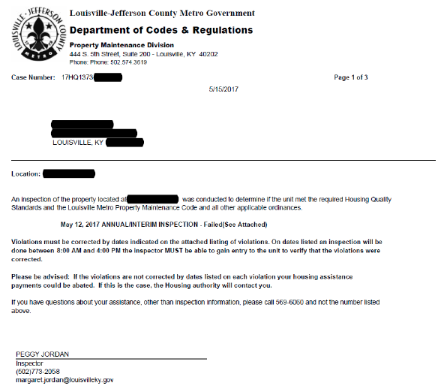
Salience
Simplification
Reciprocity

Slide 28
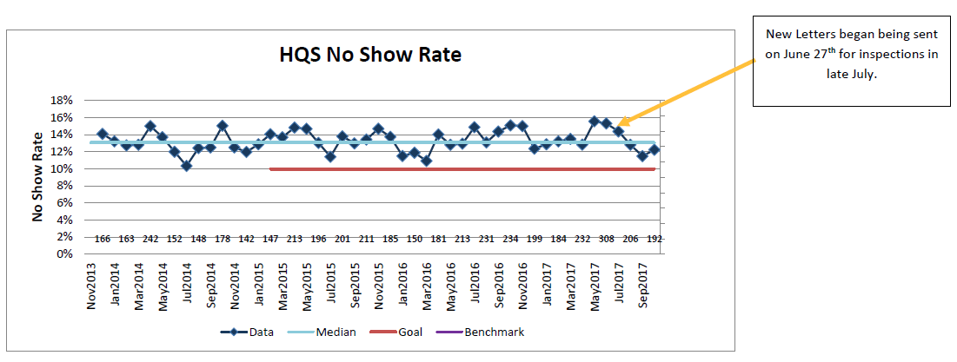

Slide 29
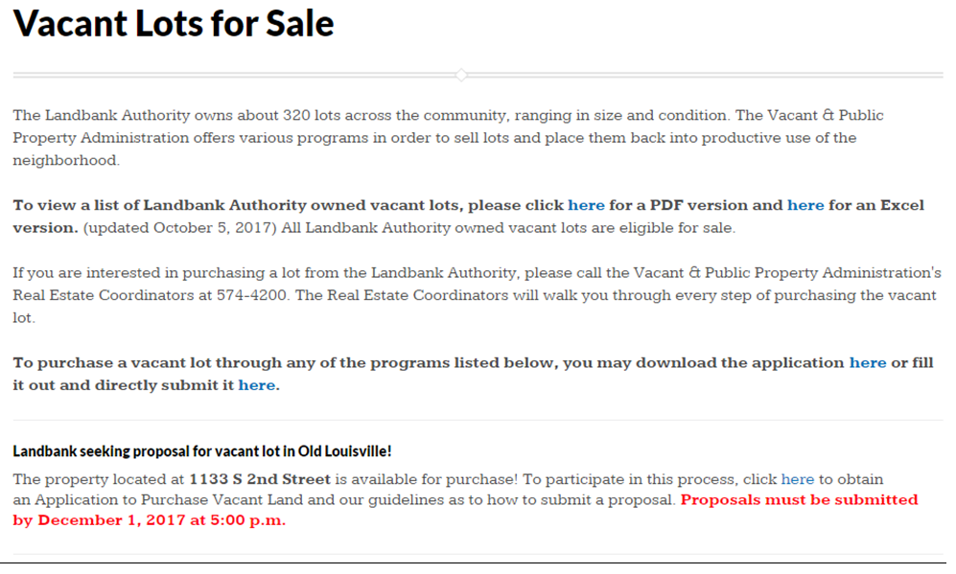
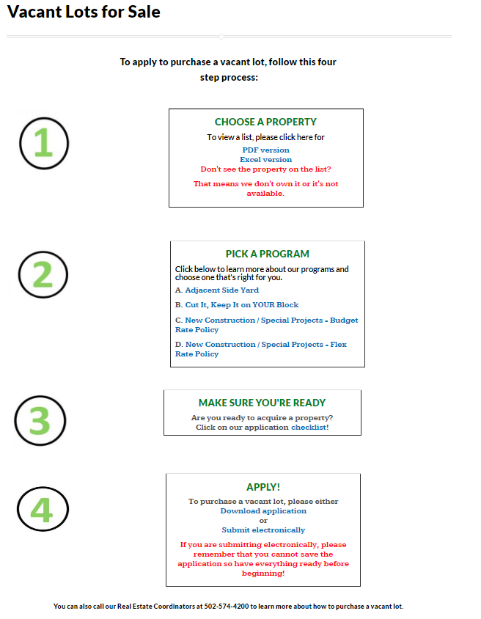
Purpose of Webpage:
List
Programs
Checklist
Application
Behavioral Insights Used:
Salience
Simplification
Reciprocity
Default

Slide 30
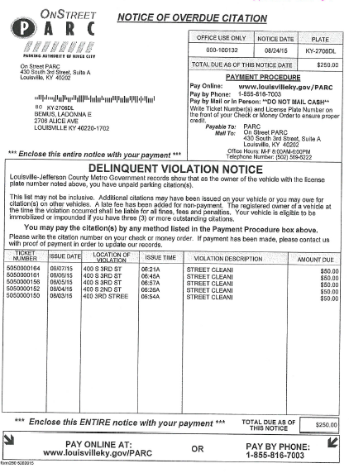
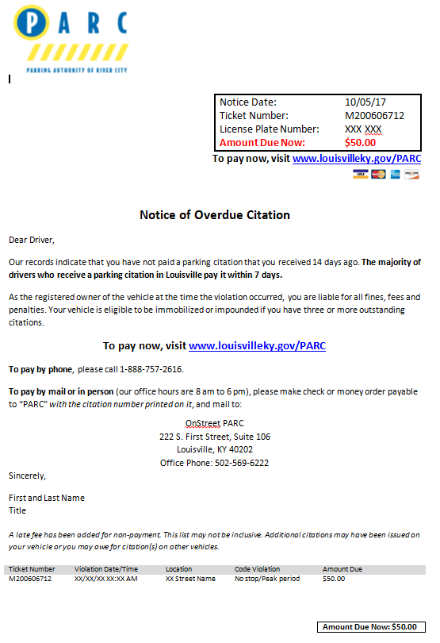

Slide 31
Thank you

Slide 32
City of ChattaNooga
Ed Graham
Code Enforcement Supervisor

Slide 33
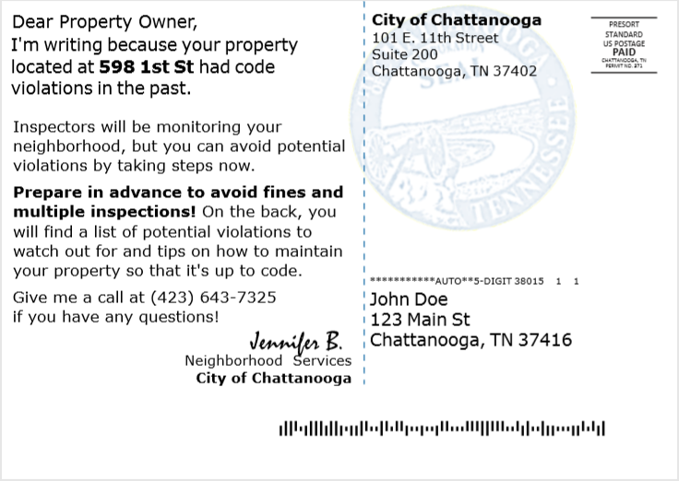

Slide 34
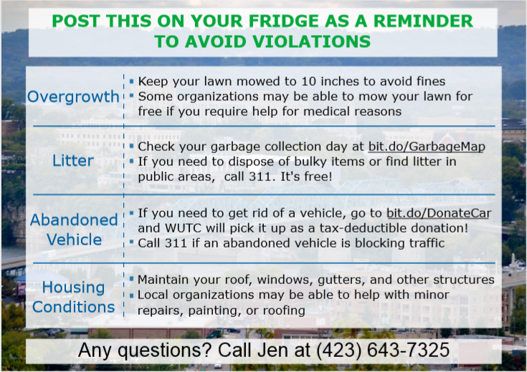

Slide 35
Persuasion not Punishment: Nudging toward Code Compliance in New Orleans
Albert “Snapper” Poche
Director
Code Enforcement and Hearings Bureau
City of New Orleans

Slide 36
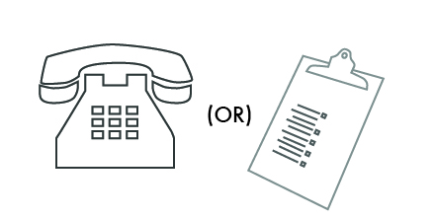
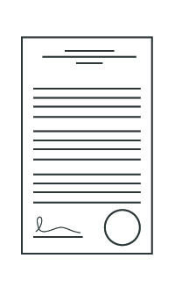
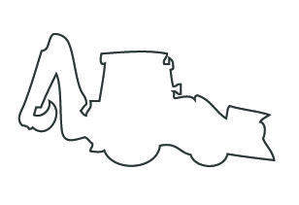
New Orleans Code Enforcement Process
INTAKE
AND INPUT
INSPECT
RESEARCH
NOTICE
COMPLIANCE
SHERIFF’S SALE
HEAR
DEMOLITION
JUDGMENT
LOT CLEARING
Notes:
NOLA process
Used in community meetings to explain our process
Backbone of our BlightSTAT program
-Measure output at each stage in the process
-Compliance after hearings

Slide 37
Diversion Letter
Notes:
Discuss specific attributes of the letter.
Note:
Simple and clear statement up front.
Clear command at bottom
Signed by a person.

Slide 38
New Orleans Code Enforcement Process
INTAKE
AND INPUT
INSPECT
RESEARCH
NOTICE
COMPLIANCE
SHERIFF’S SALE
HEAR
DEMOLITION
JUDGMENT
LOT CLEARING

Slide 39
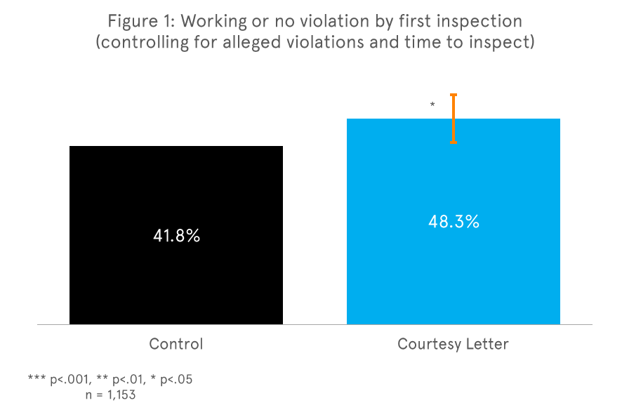
Outcome
Letter increased compliance by 16% (or a 6 point increase).
Saves the Code Enforcement and Hearings Bureau approximately $37,000 per year.
Removes blight faster, cheaper, and easier than any other intervention we’ve considered.

Slide 40
New Orleans Code Enforcement Process
INTAKE
AND INPUT
INSPECT
RESEARCH
NOTICE
COMPLIANCE
SHERIFF’S SALE
HEAR
DEMOLITION
JUDGMENT
LOT CLEARING

Slide 41
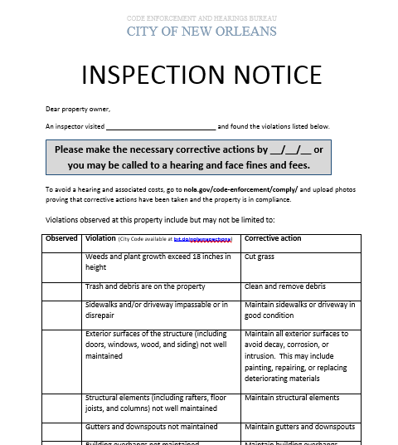
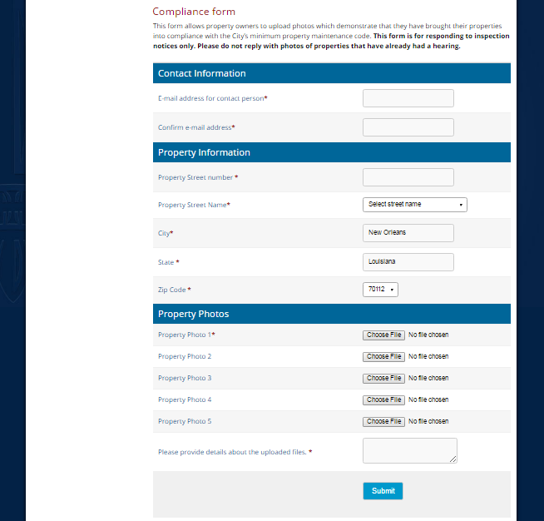
Inspection Notice

Slide 42
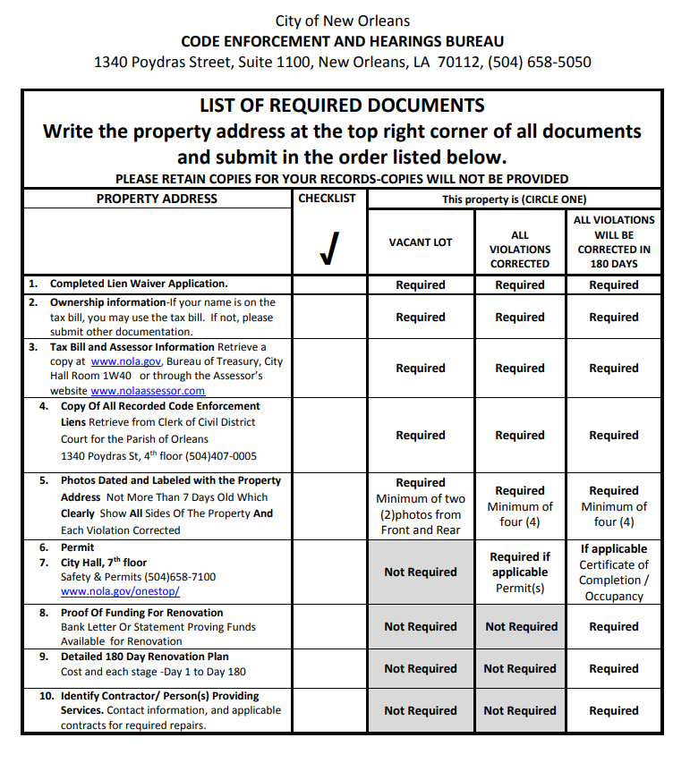
Lien Reduction Program

Slide 43
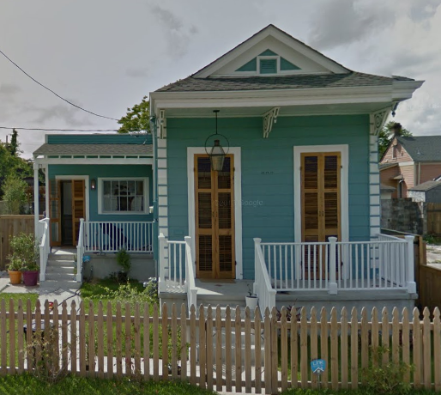
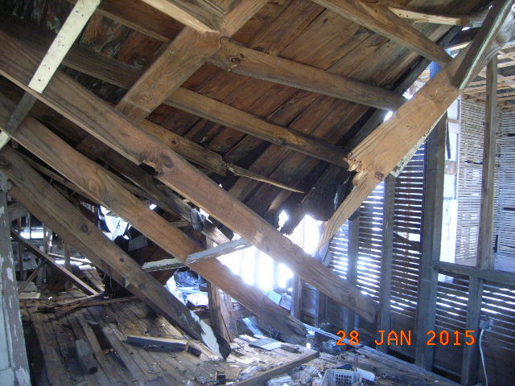
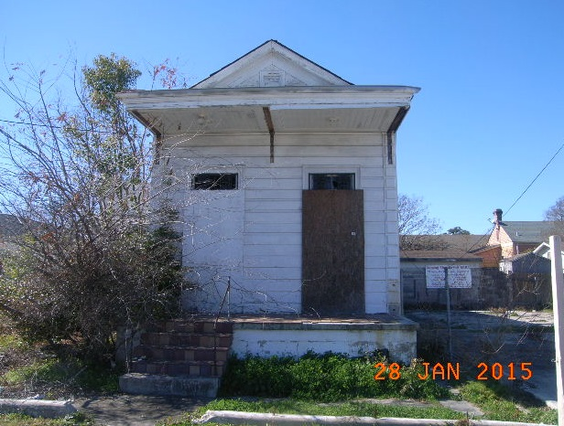
828 – 830 LIZARDI STREET

Slide 44
Thank you
Albert “Snapper” Poche
Code Enforcement and Hearings Bureau
City of New Orleans
504.658.4340
ajpoche@nola.gov

