Slide 1
Uploading
Presentation Recording
in Hubb

Slide 2
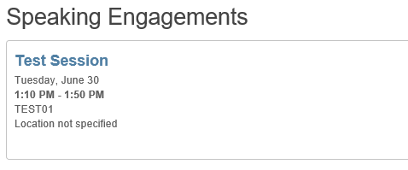
Uploading a Presentation Recording
From the left-hand menu, click on Speaker Details
Scroll down to the Speaking Engagements section and click on the session title you would like to upload a presentation for

Slide 3
Uploading a Presentation Recording
Navigate to the Manage Video tab on the top of the screen
Select Hubb Video from the dropdown menu

Slide 4
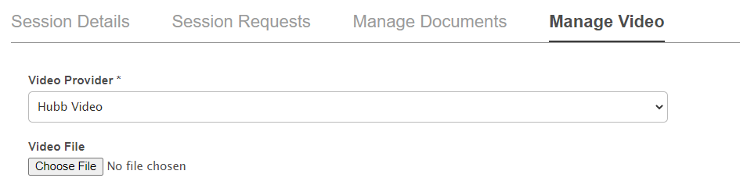
Uploading a Presentation Recording
Click Choose File and find the .mp4 presentation file you would like to upload

Slide 5
Uploading a Presentation Recording
Click Upload. During this process, you may see a loading icon appear. Do not navigate away from the page!

Slide 6
Uploading a Presentation Recording
Once the video status changes to “Video is Processing”, click Save. A green banner will display at the top of the page confirming the save was successful.

