Slide 1
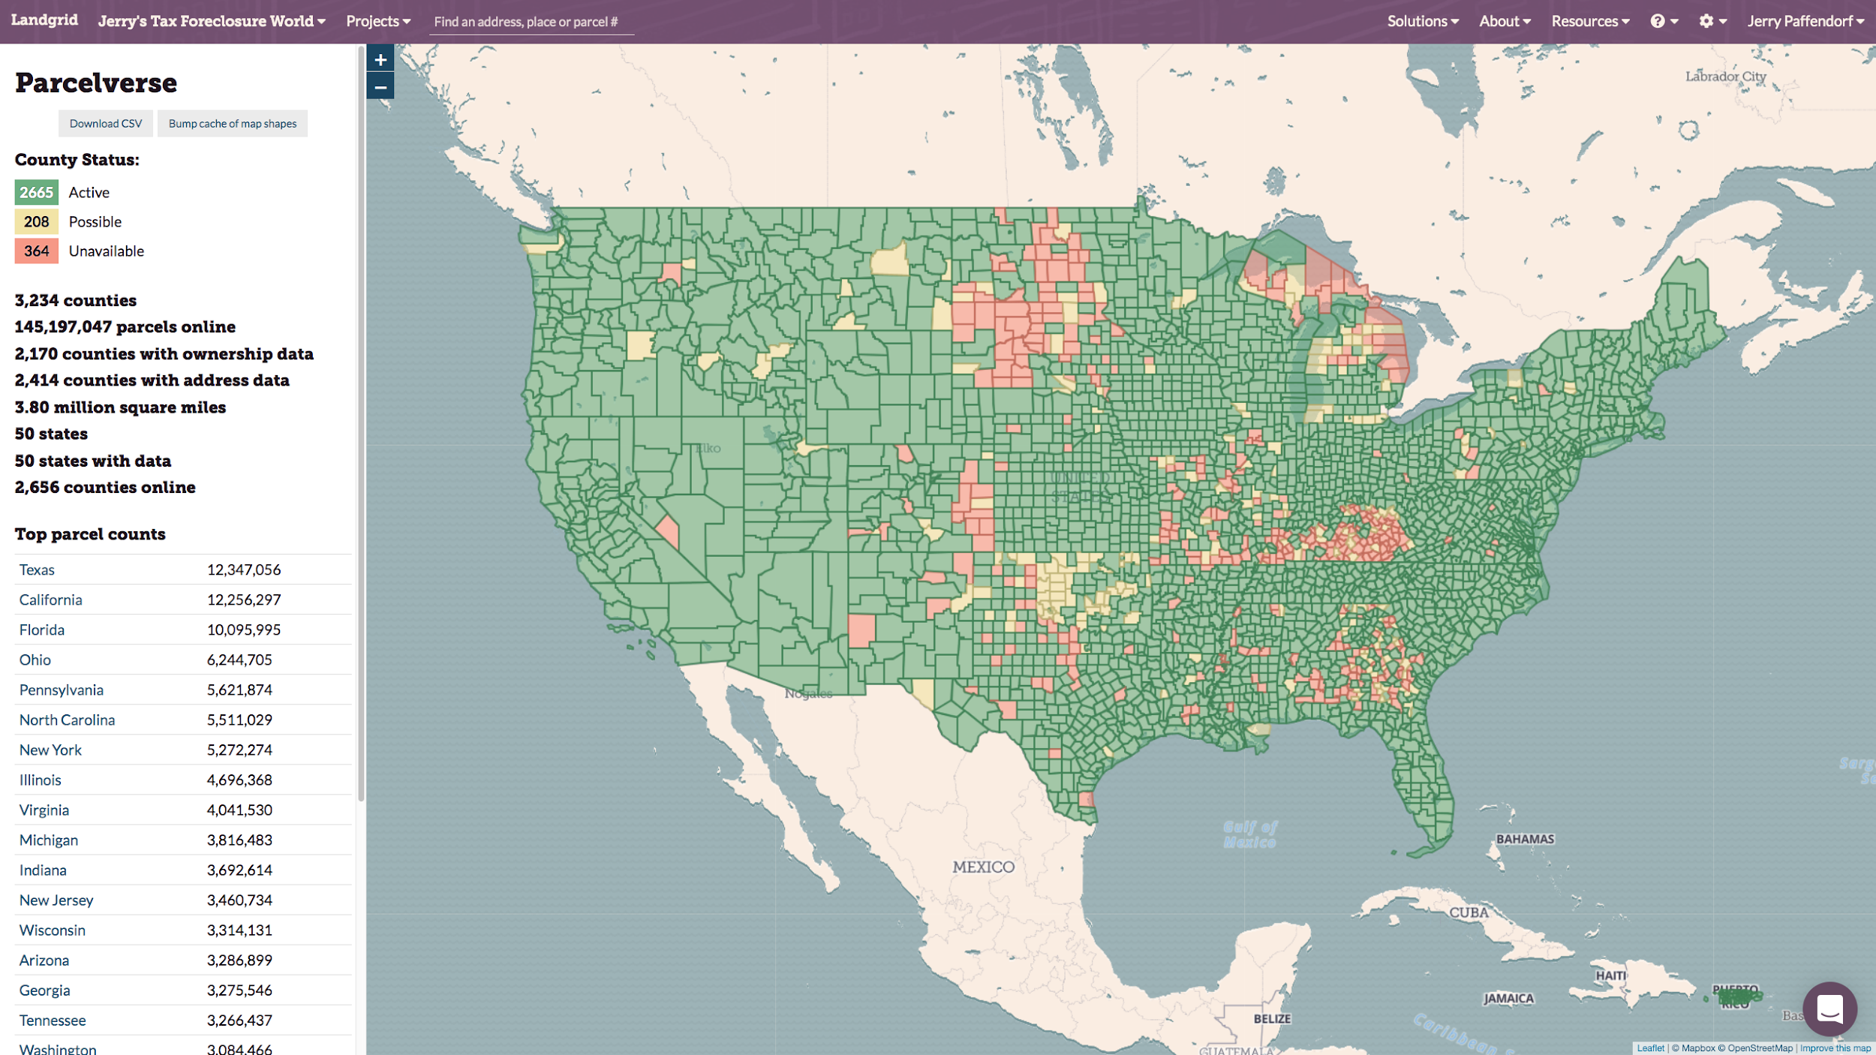
Jerry Paffendorf
CEO, Loveland Technologies
landgrid.com
jerry@landgrid.com @makeloveland 313-649-LAND
Notes:
Intro...

Slide 2
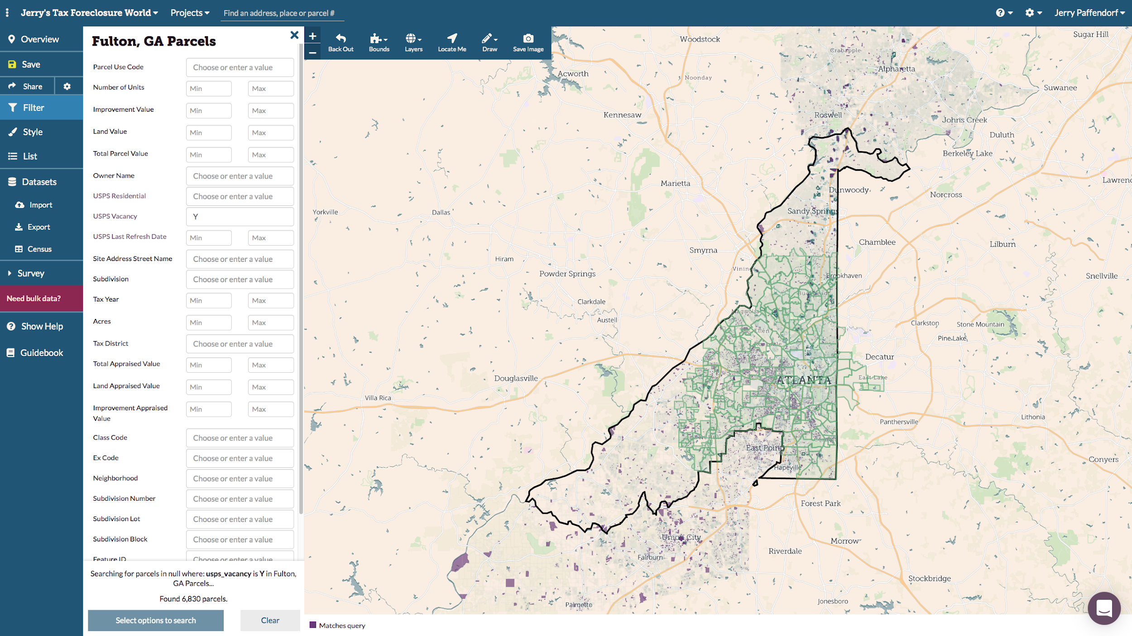
Notes:
Intro...

Slide 3
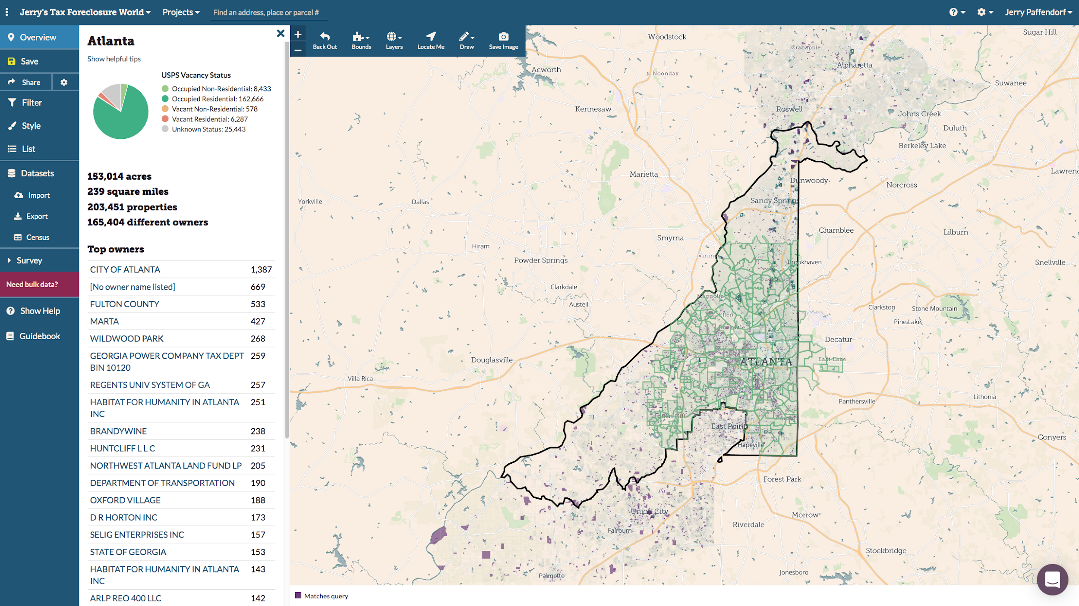
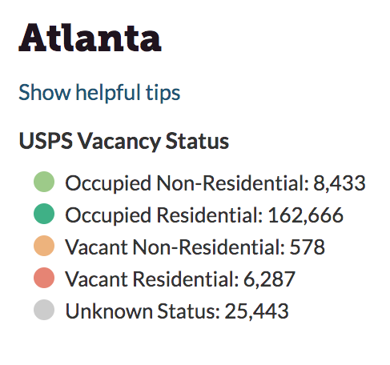
Notes:
Intro...

Slide 4
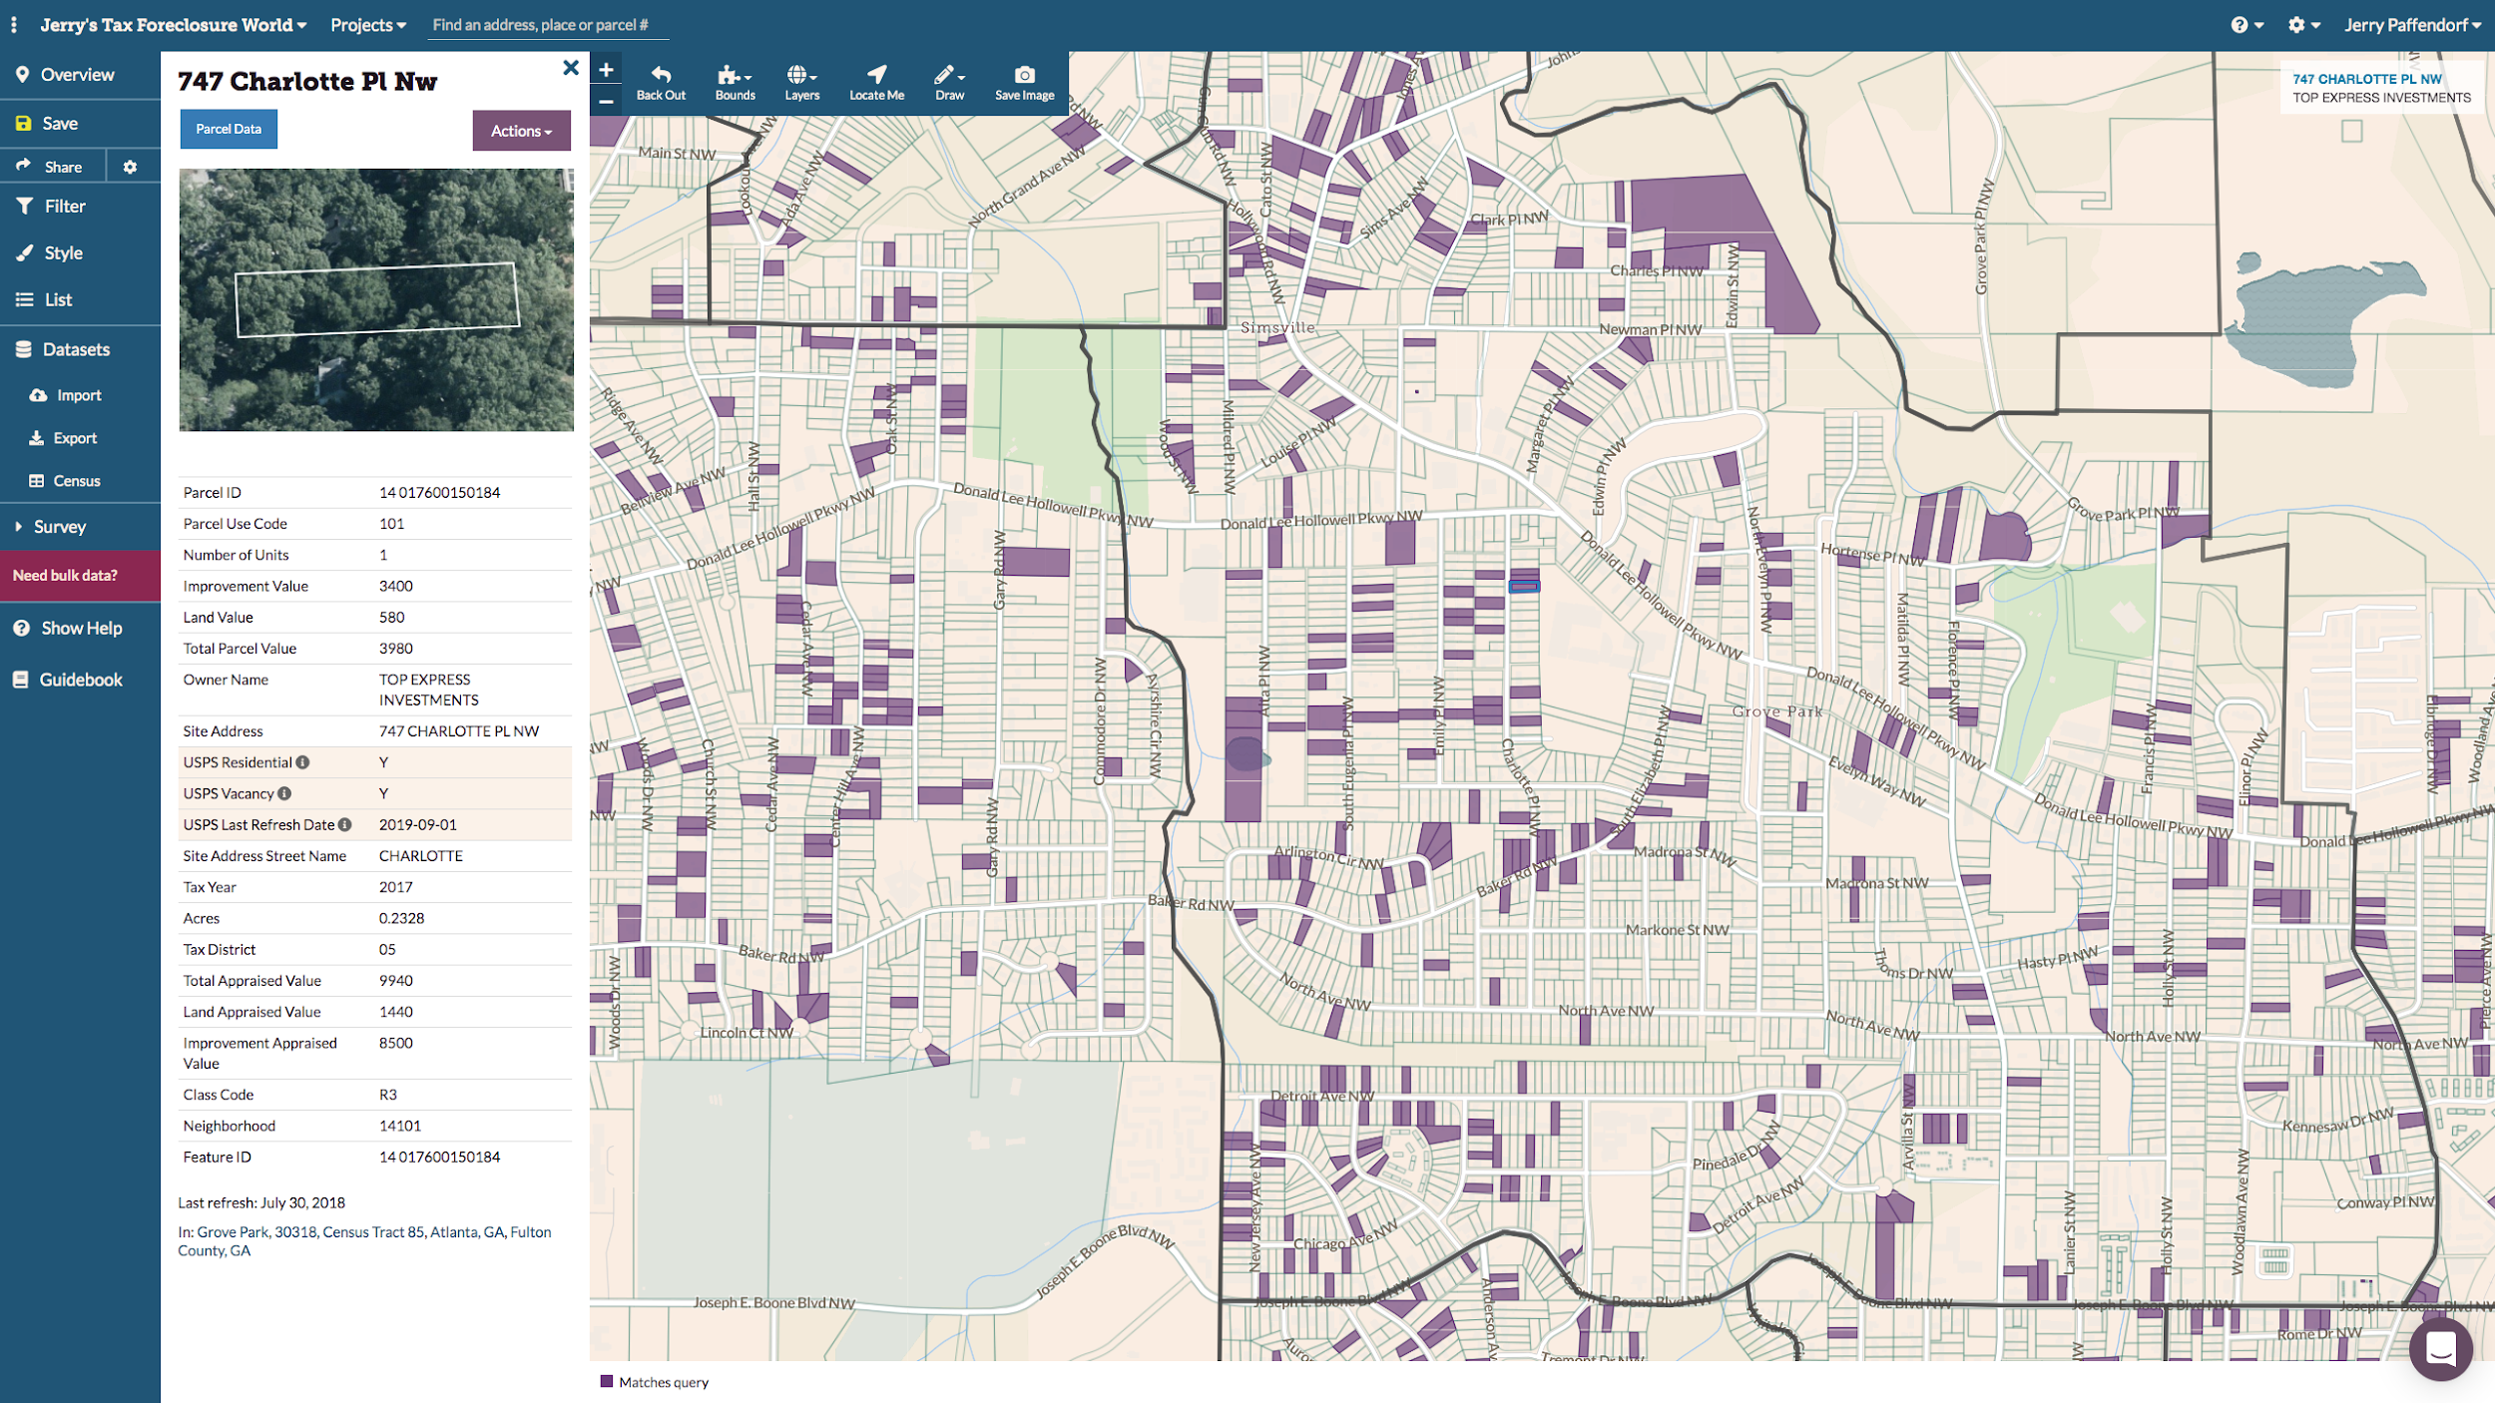
landgrid.com/vacancy
Notes:
Intro...

Slide 5
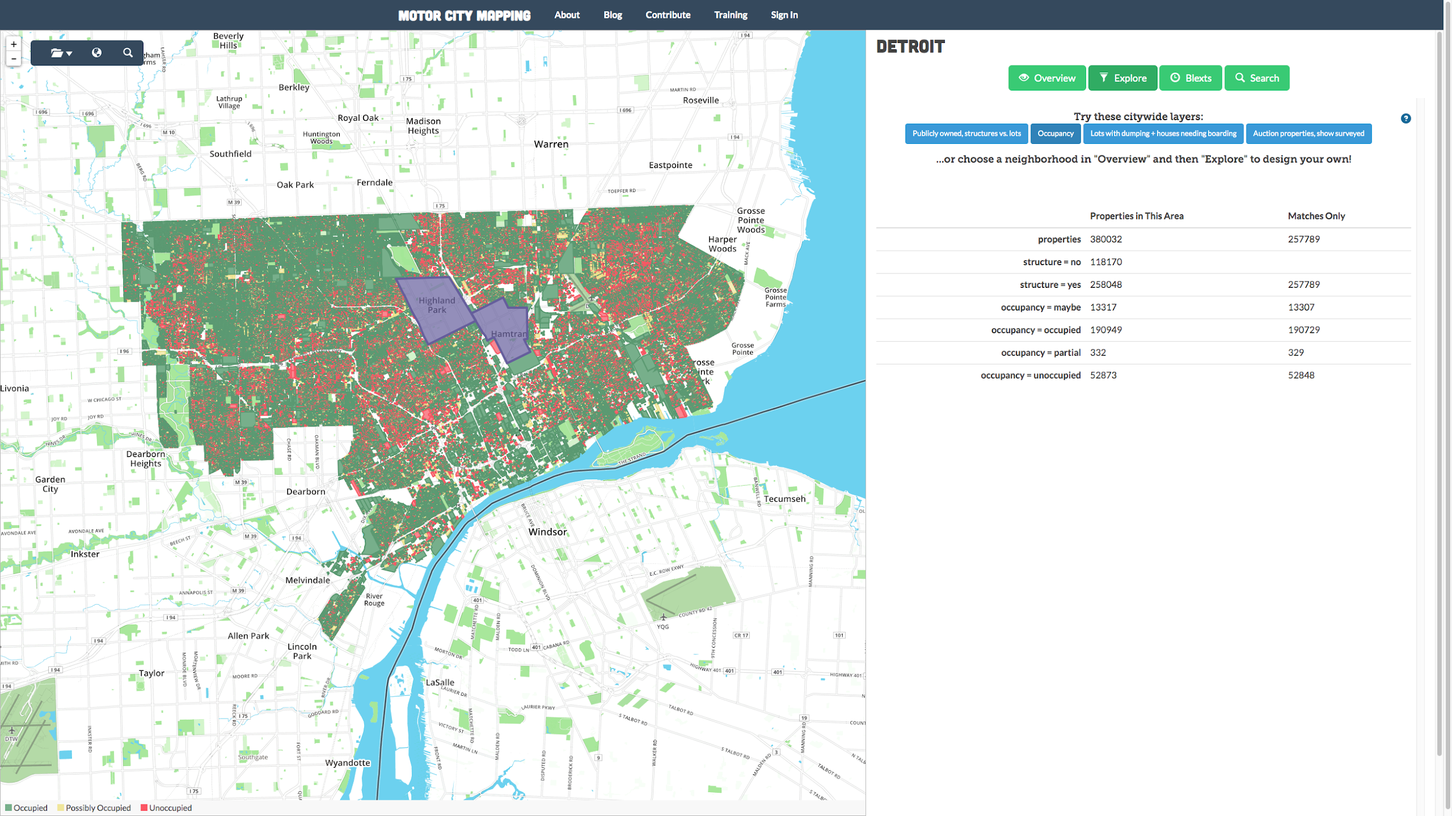
Motor City Mapping
Notes:
This was Loveland’s first major project...

Slide 6
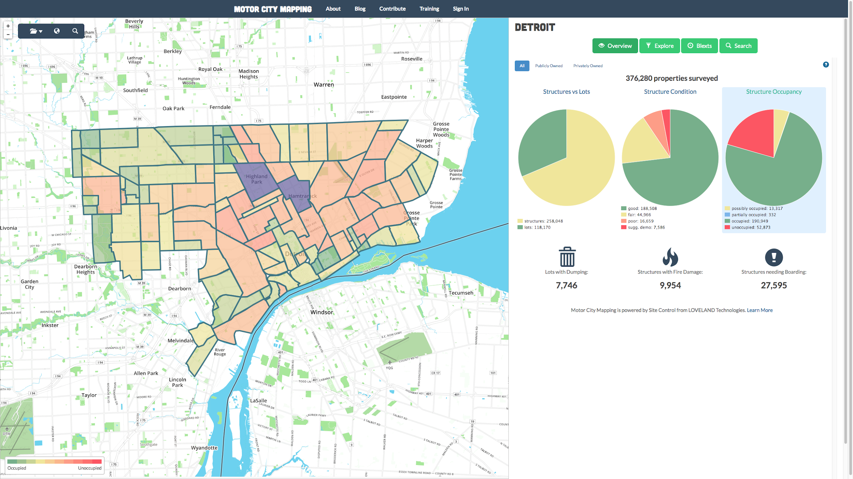
Motor City Mapping
Notes:
This was Loveland’s first major project...

Slide 7
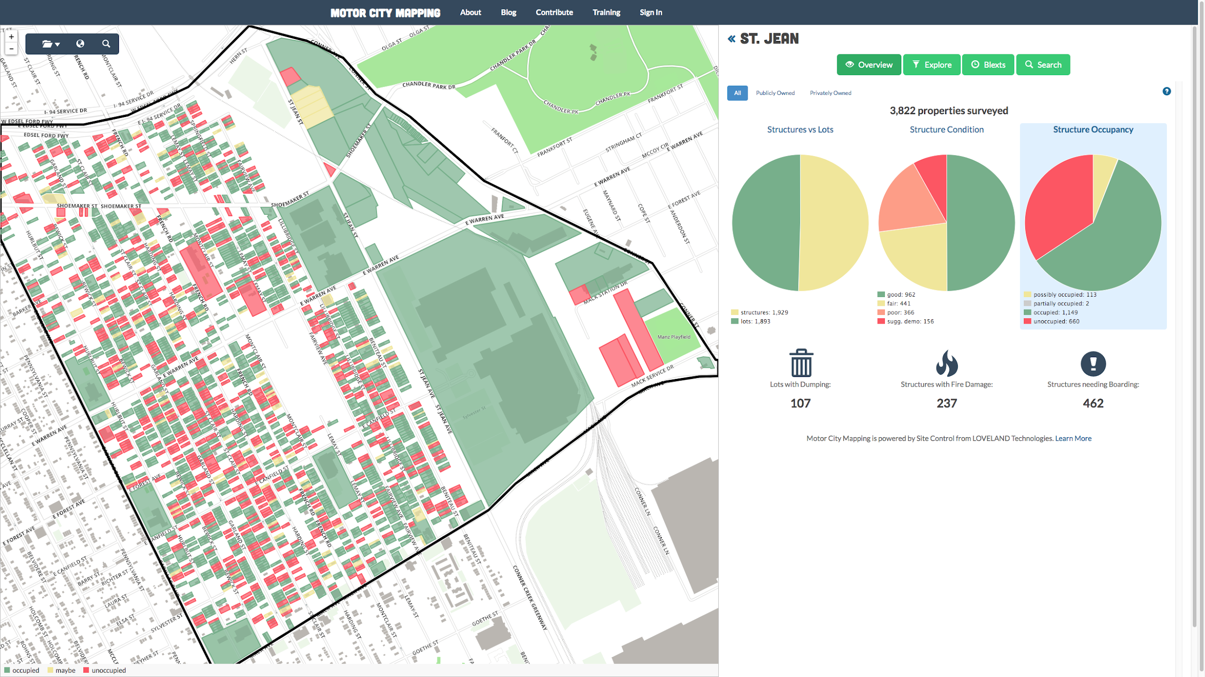
Motor City Mapping
Notes:
This was Loveland’s first major project...

Slide 8
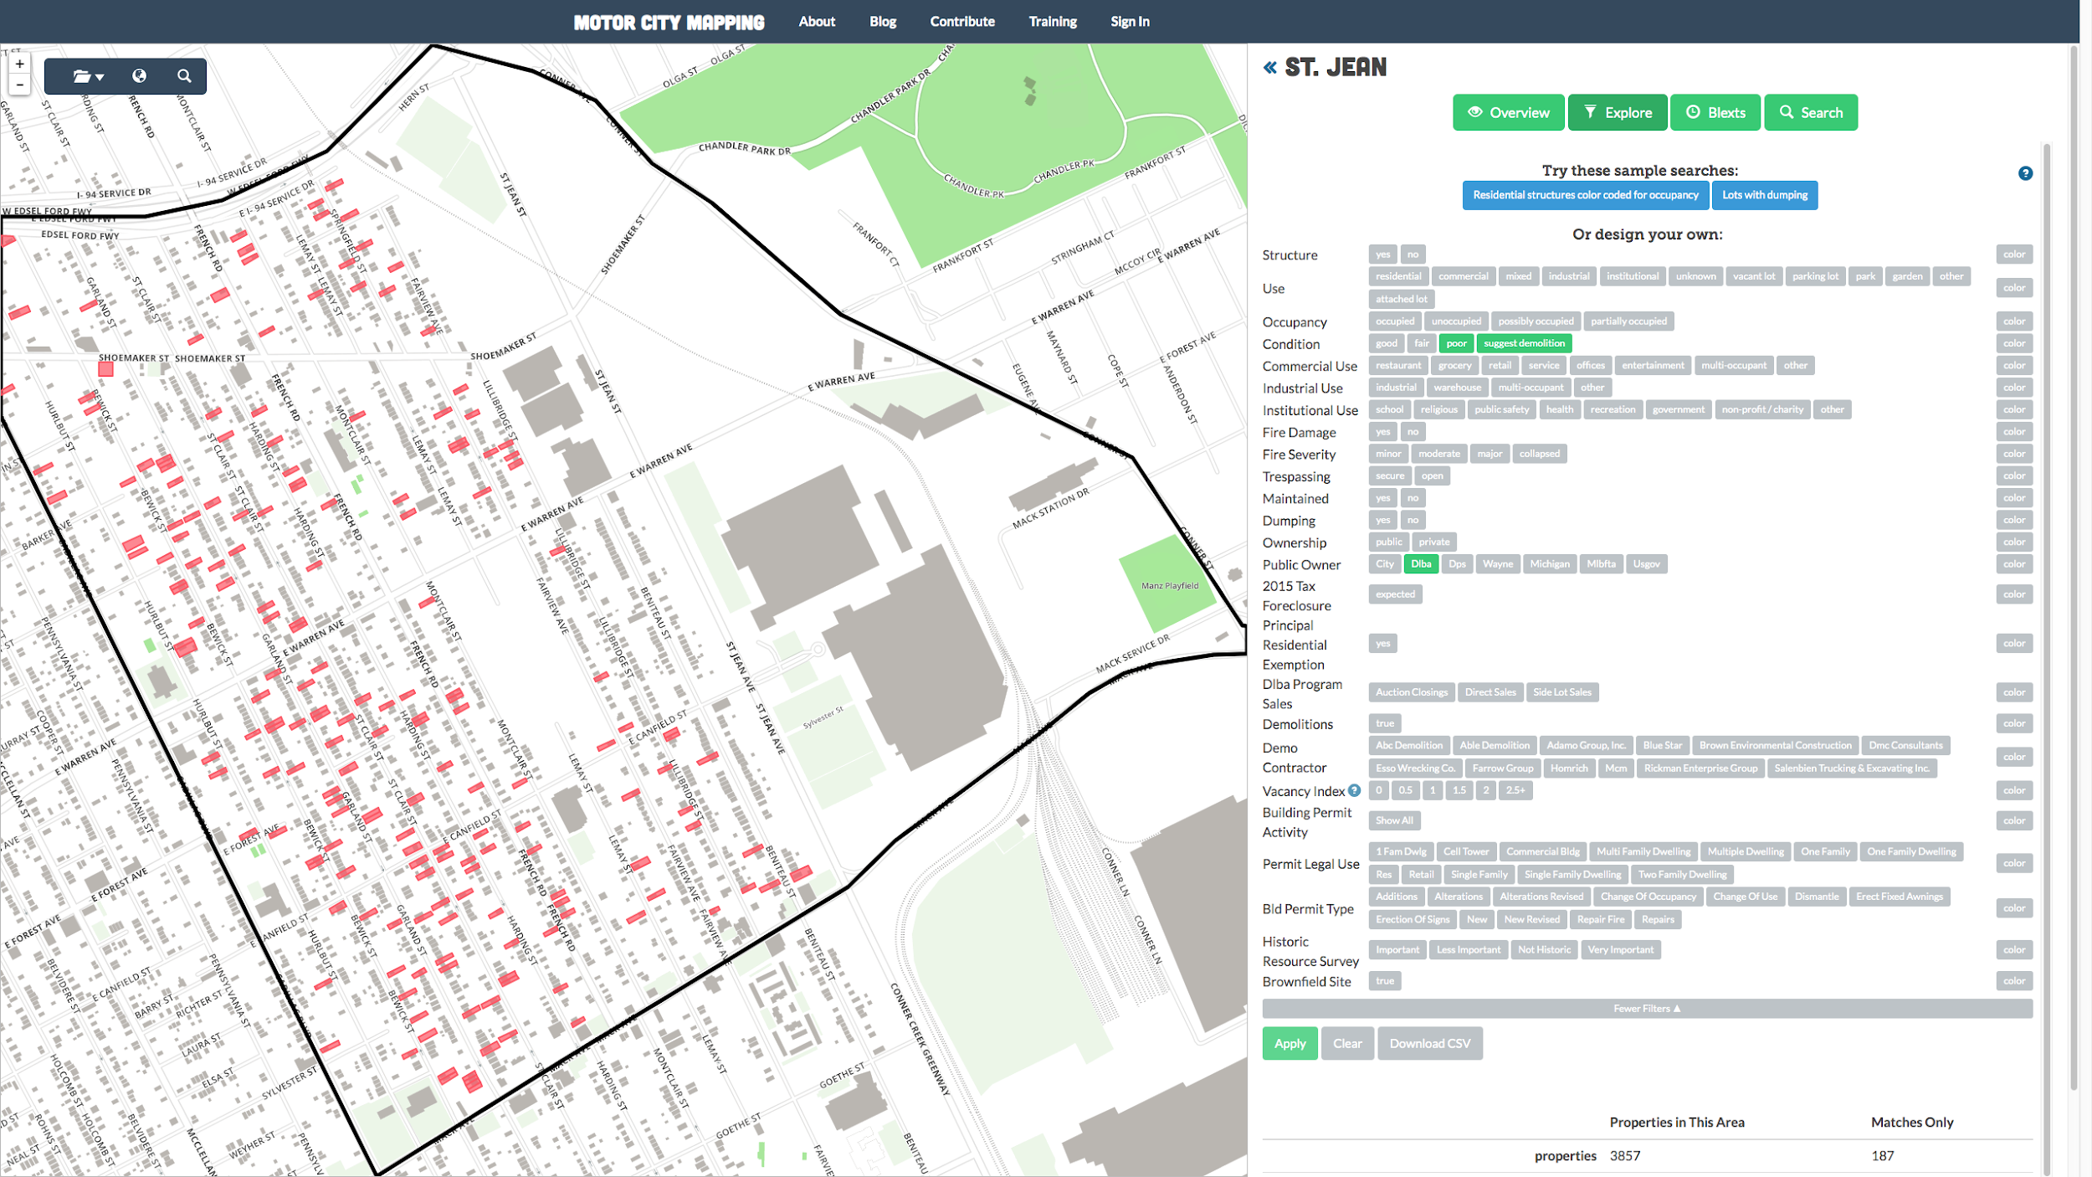
Motor City Mapping
Notes:
This was Loveland’s first major project...

Slide 9
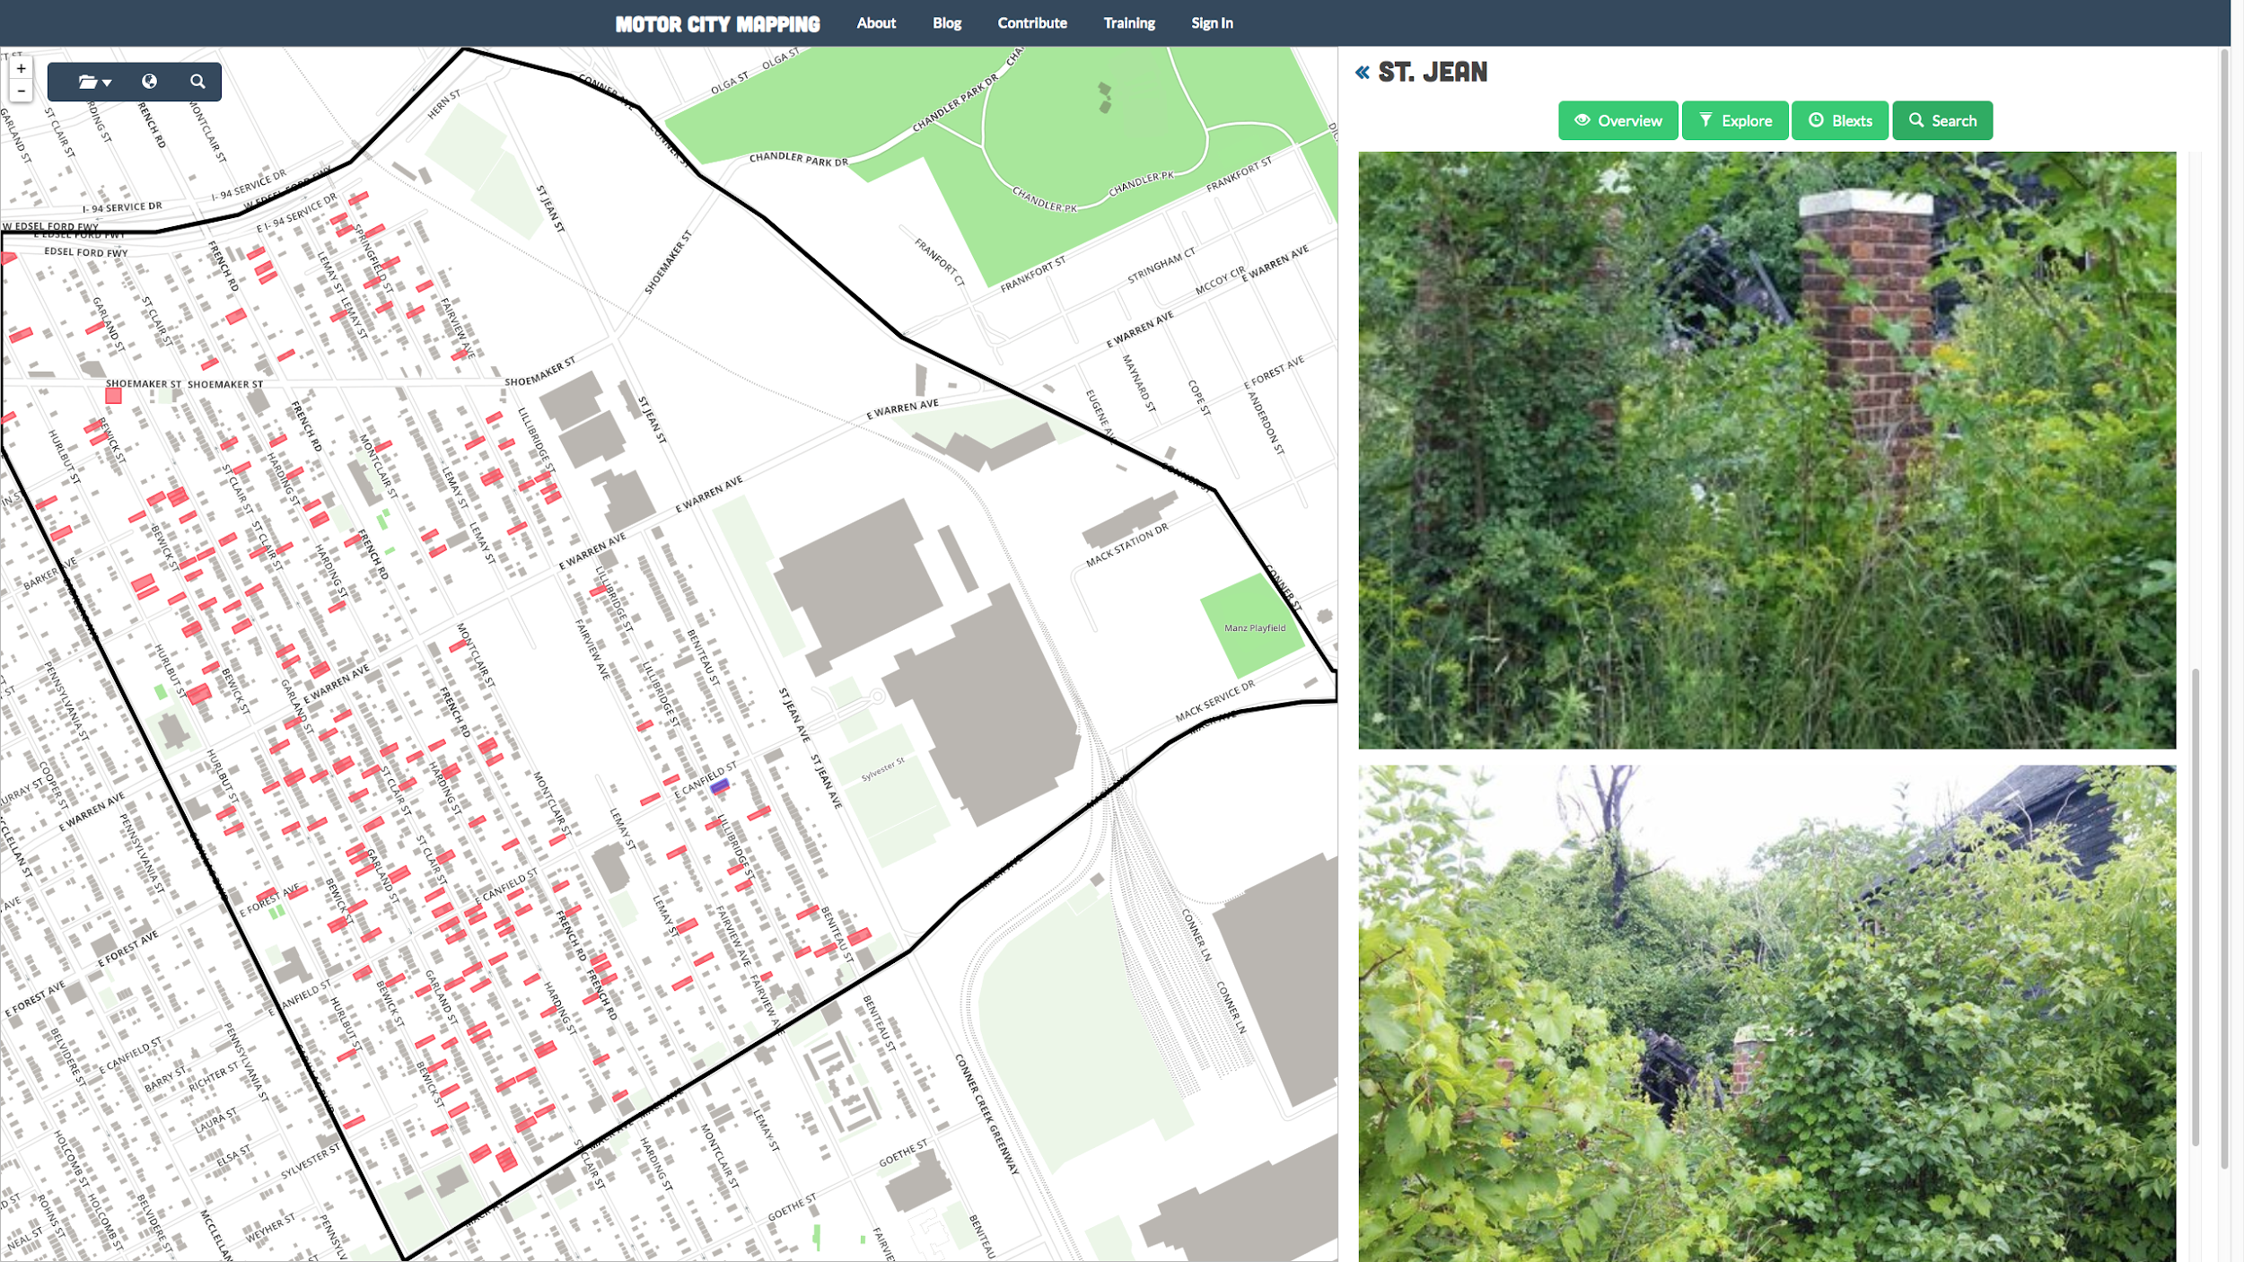
Motor City Mapping
Notes:
This was Loveland’s first major project...

Slide 10
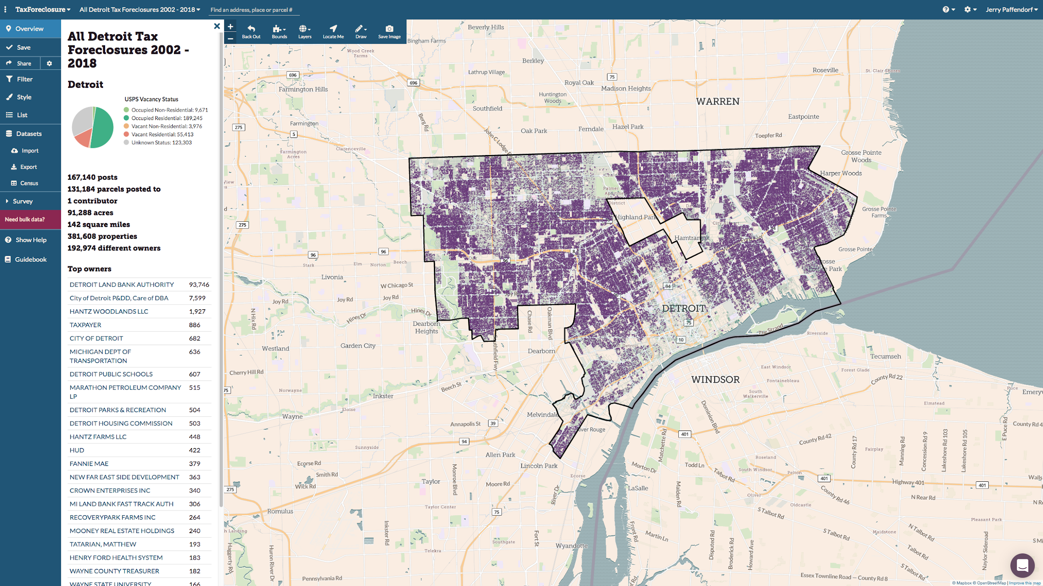
Tax delinquency map
Notes:
...then we started looking at possible next waves of foreclosures

Slide 11
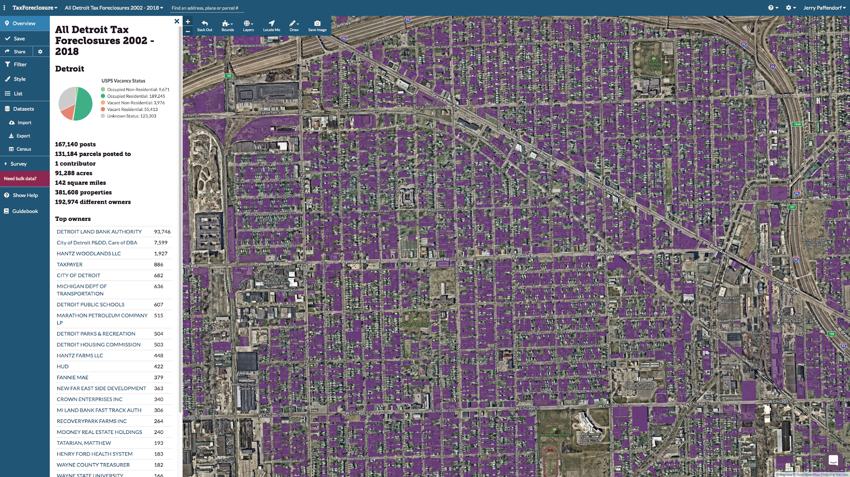
Tax delinquency map
Notes:
...then we started looking at possible next waves of foreclosures

Slide 12
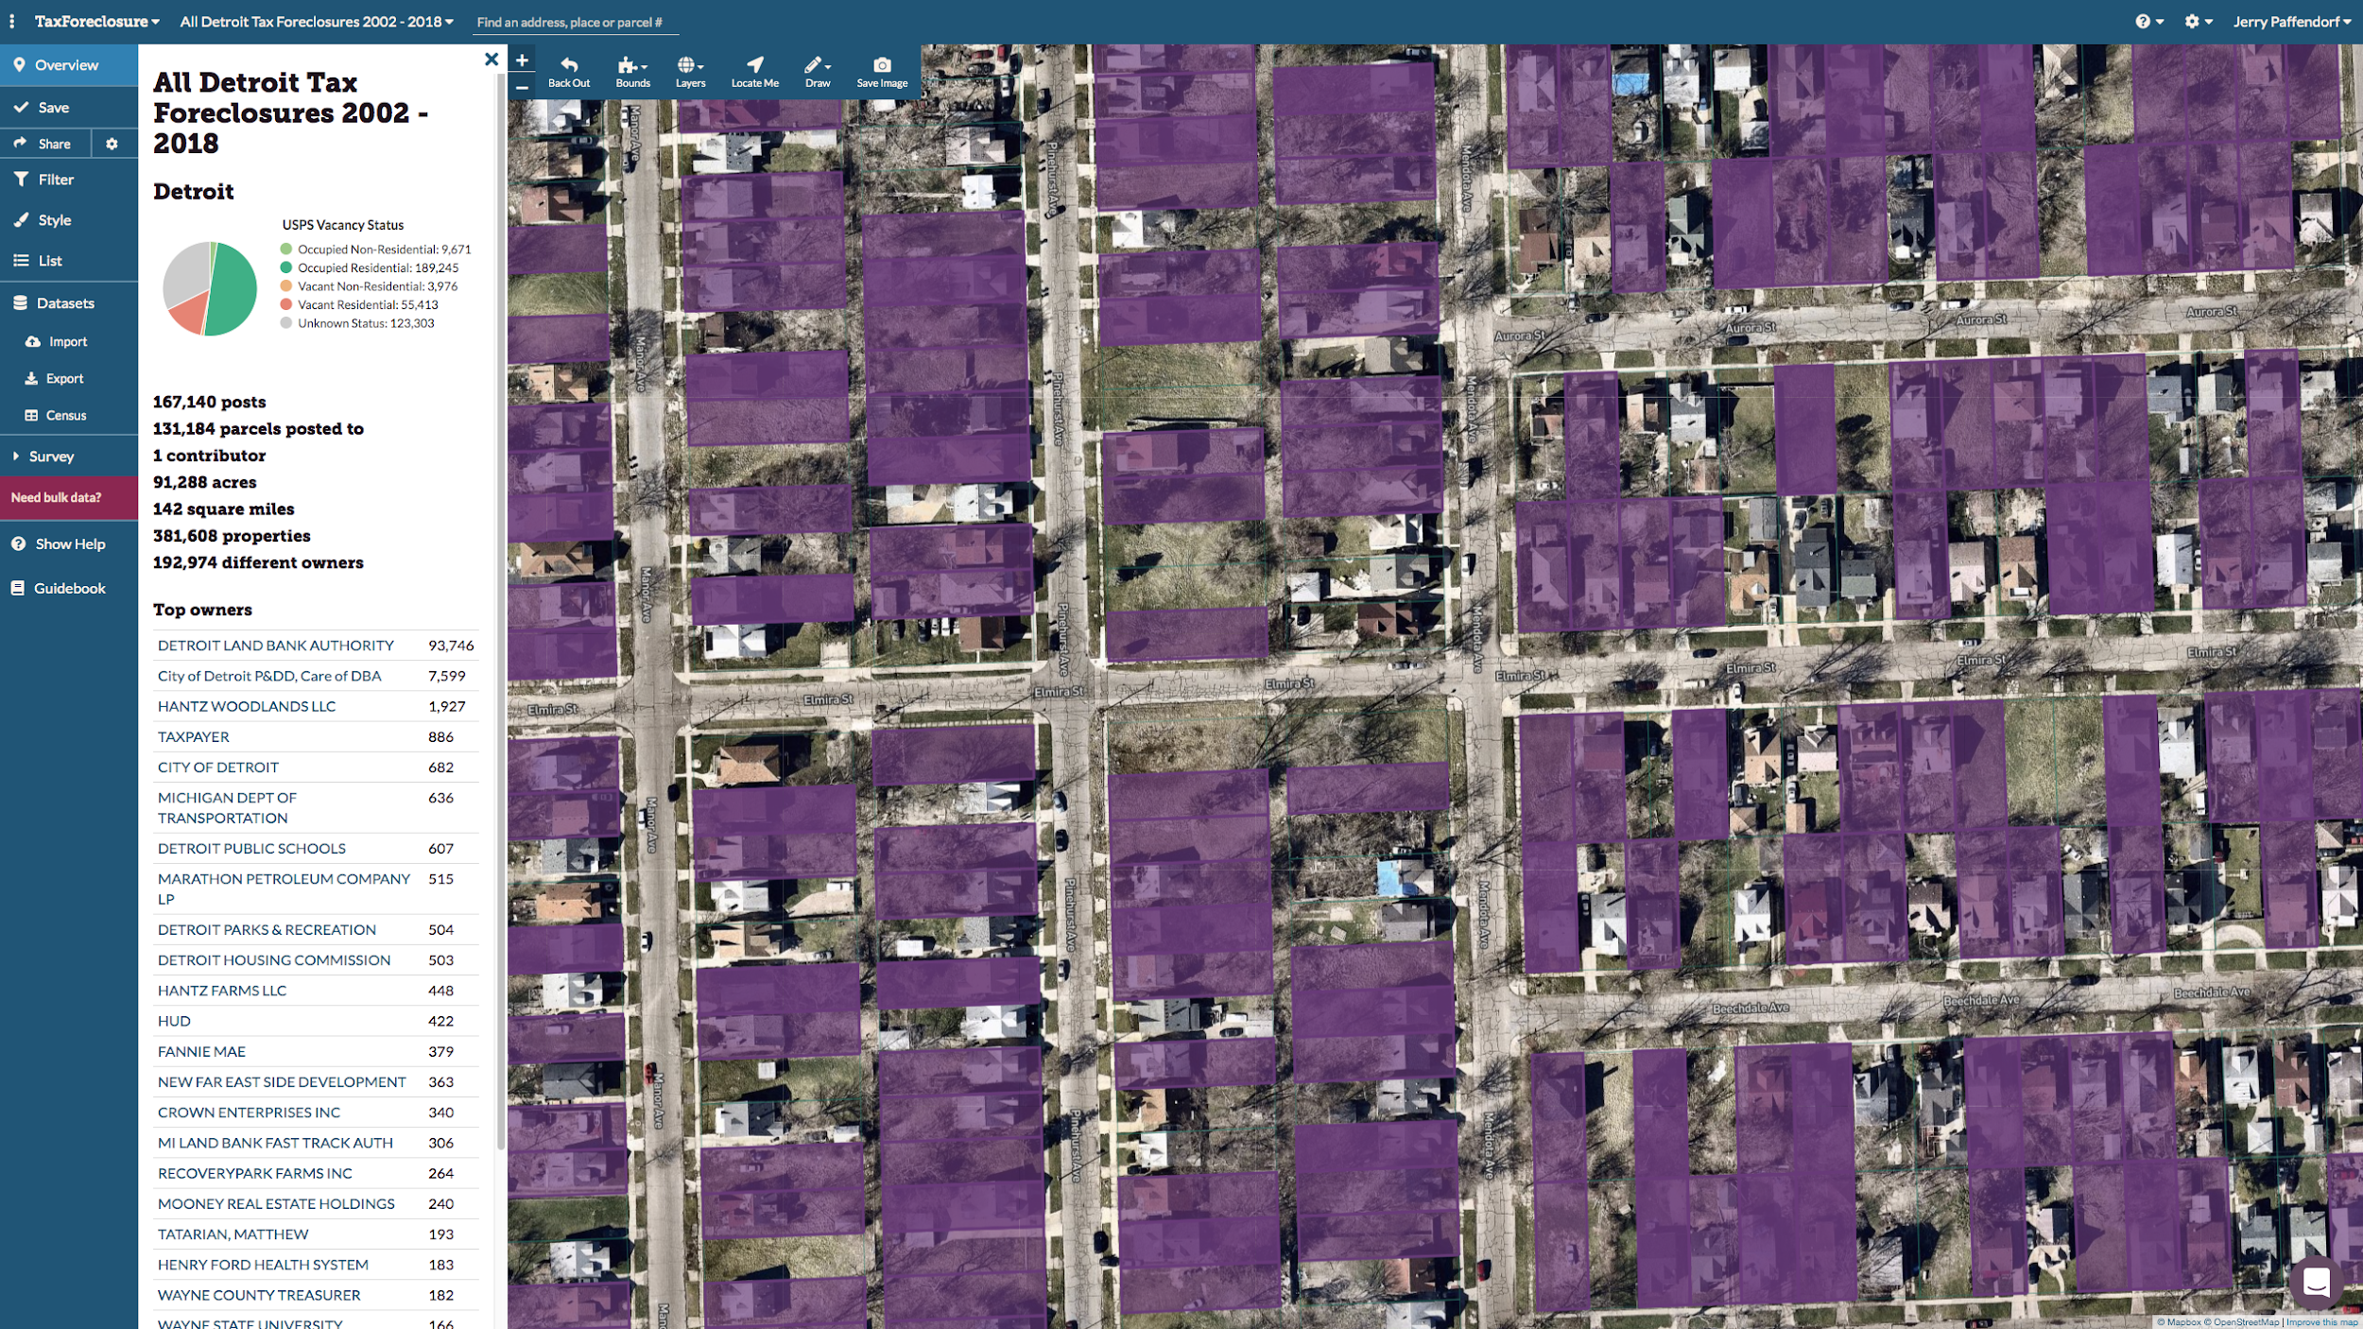
Tax delinquency map
Notes:
...then we started looking at possible next waves of foreclosures

Slide 13
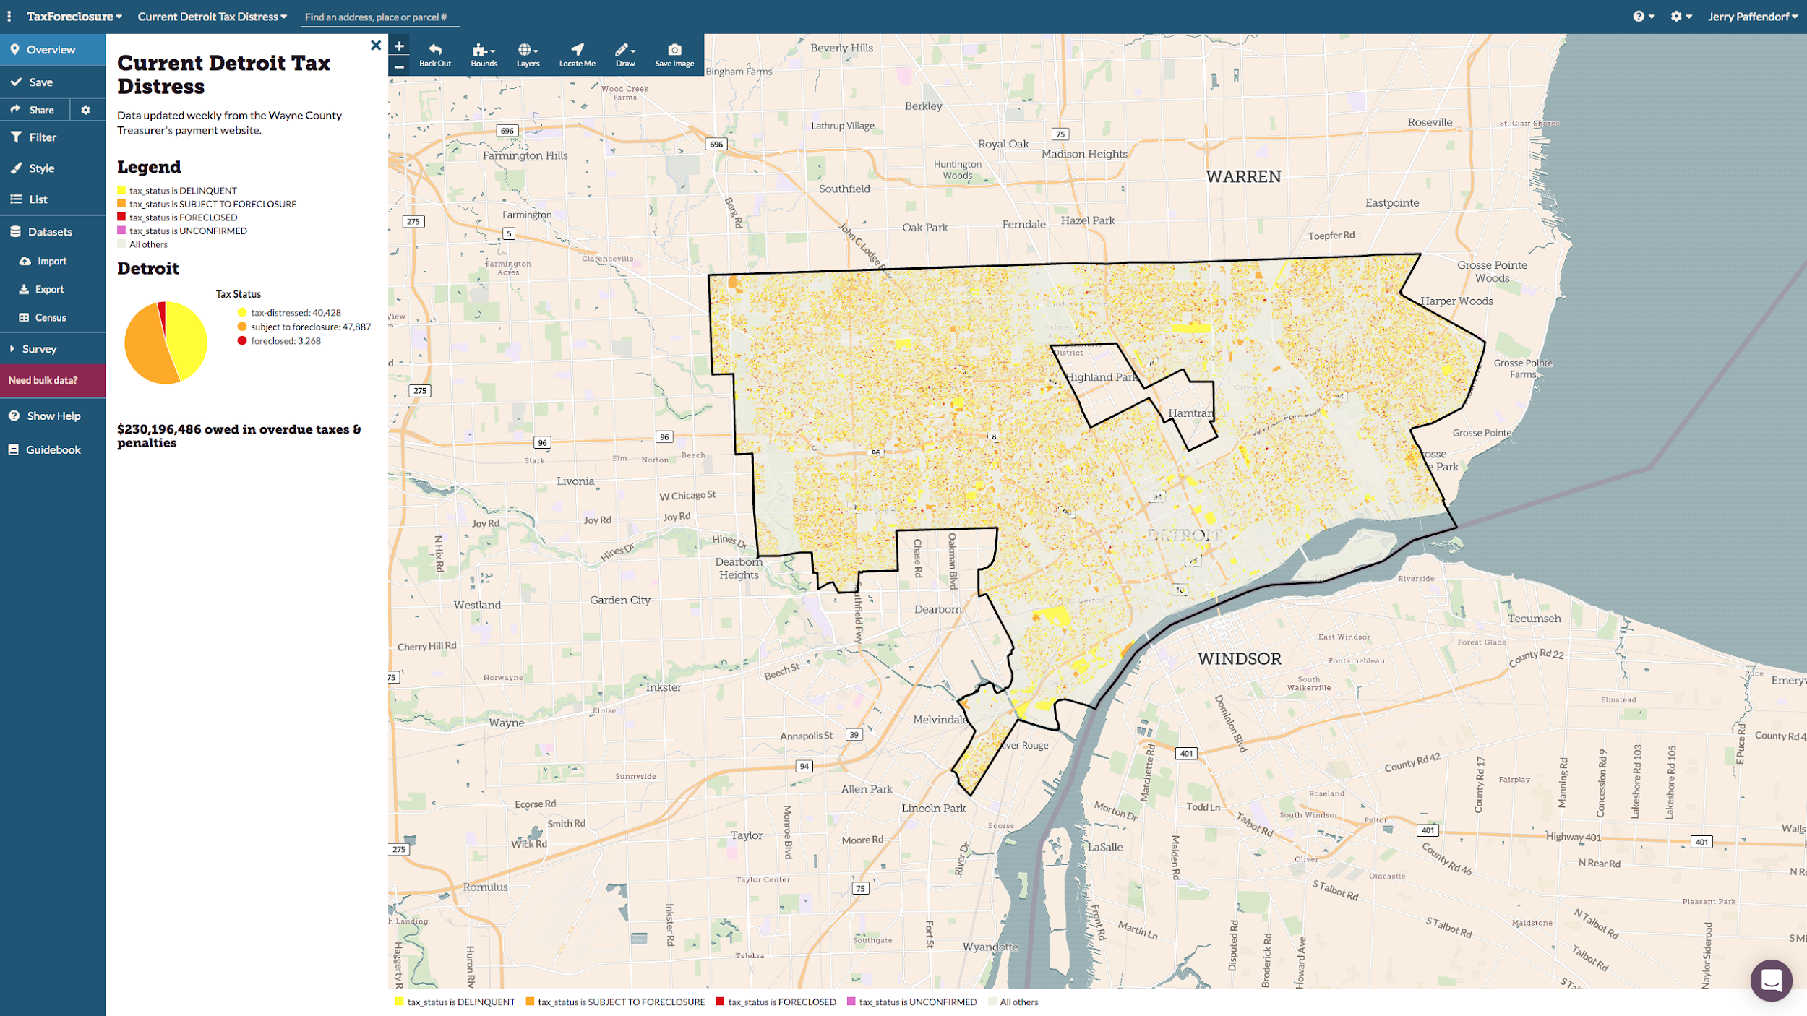
Tax delinquency map
Notes:
...then we started looking at possible next waves of foreclosures

Slide 14
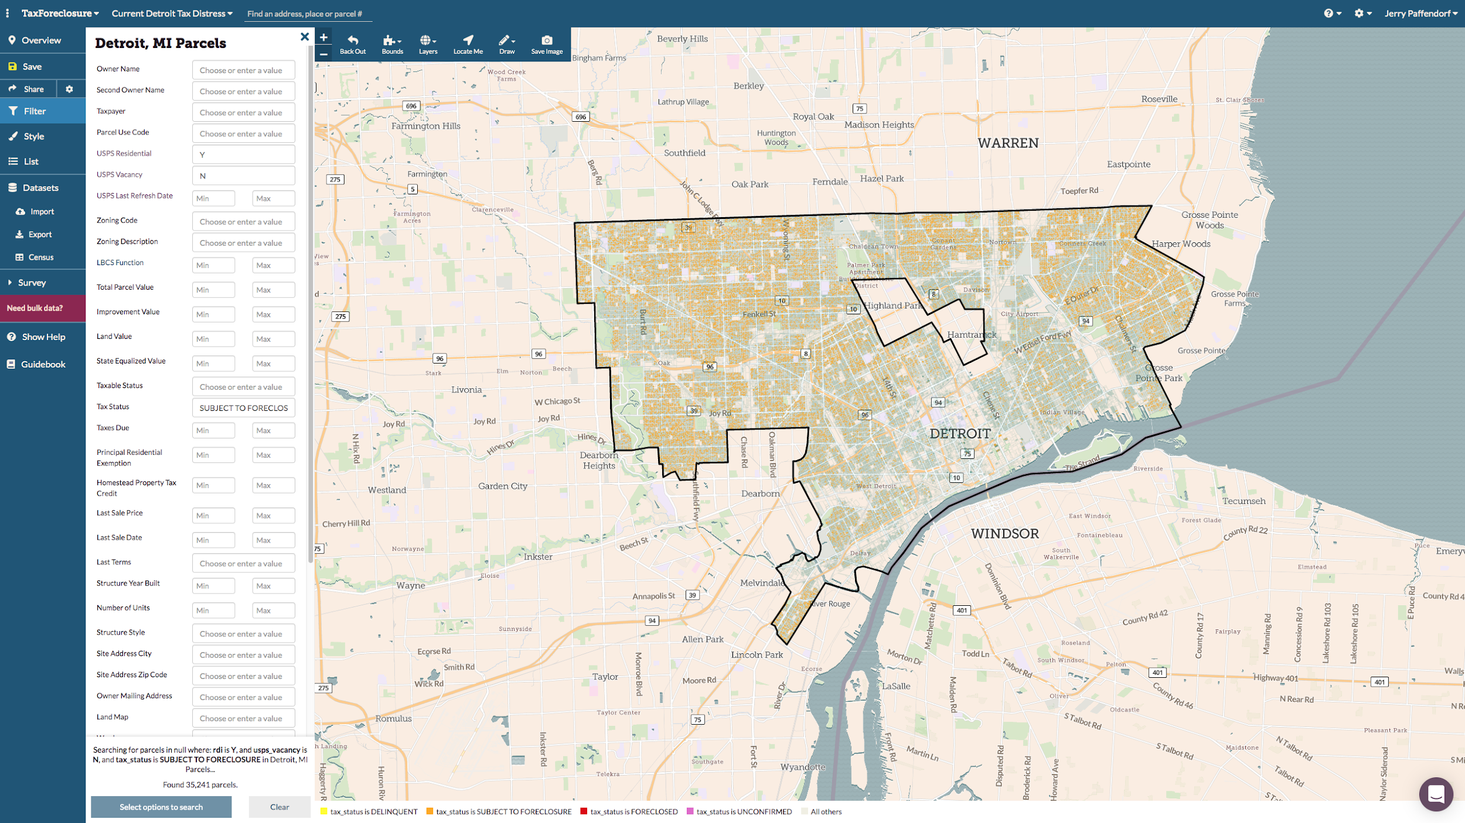
Tax delinquency map
Notes:
...then we started looking at possible next waves of foreclosures

Slide 15
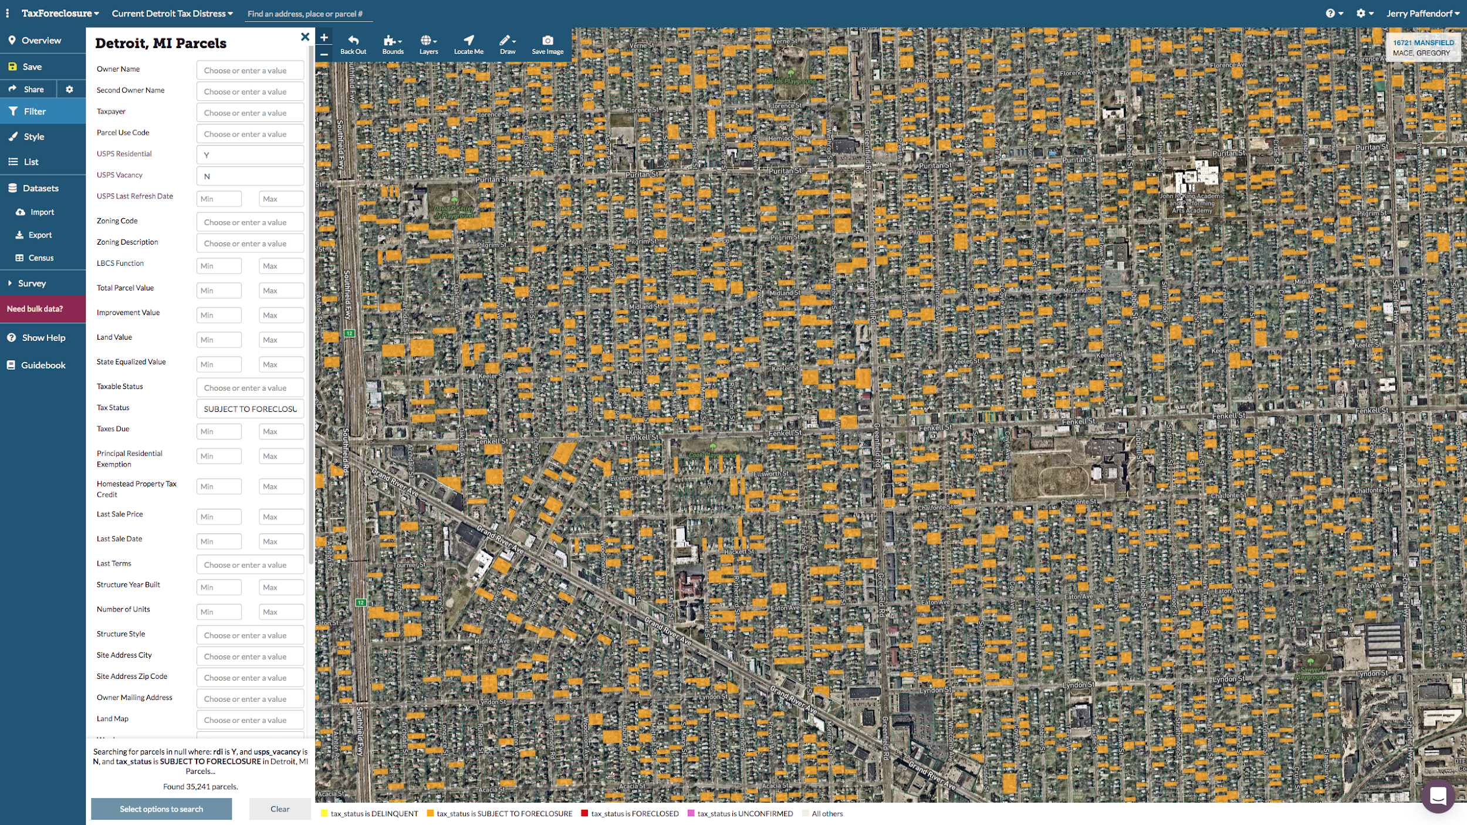
Tax delinquency map
Notes:
...then we started looking at possible next waves of foreclosures

Slide 16
Notes:
… and this brings us to Neighbor to Neighbor study, where every tax delinquent home in the city was visited by surveyors to learn more about how tax foreclosure works on the individual/household level and who it affects.

Slide 17
Notes:
… and this brings us to Neighbor to Neighbor study, where every tax delinquent home in the city was visited by surveyors to learn more about how tax foreclosure works on the individual/household level and who it affects.

Slide 18
Notes:
… and this brings us to Neighbor to Neighbor study, where every tax delinquent home in the city was visited by surveyors to learn more about how tax foreclosure works on the individual/household level and who it affects.

Slide 19
Notes:
… and this brings us to Neighbor to Neighbor study, where every tax delinquent home in the city was visited by surveyors to learn more about how tax foreclosure works on the individual/household level and who it affects.

Slide 20
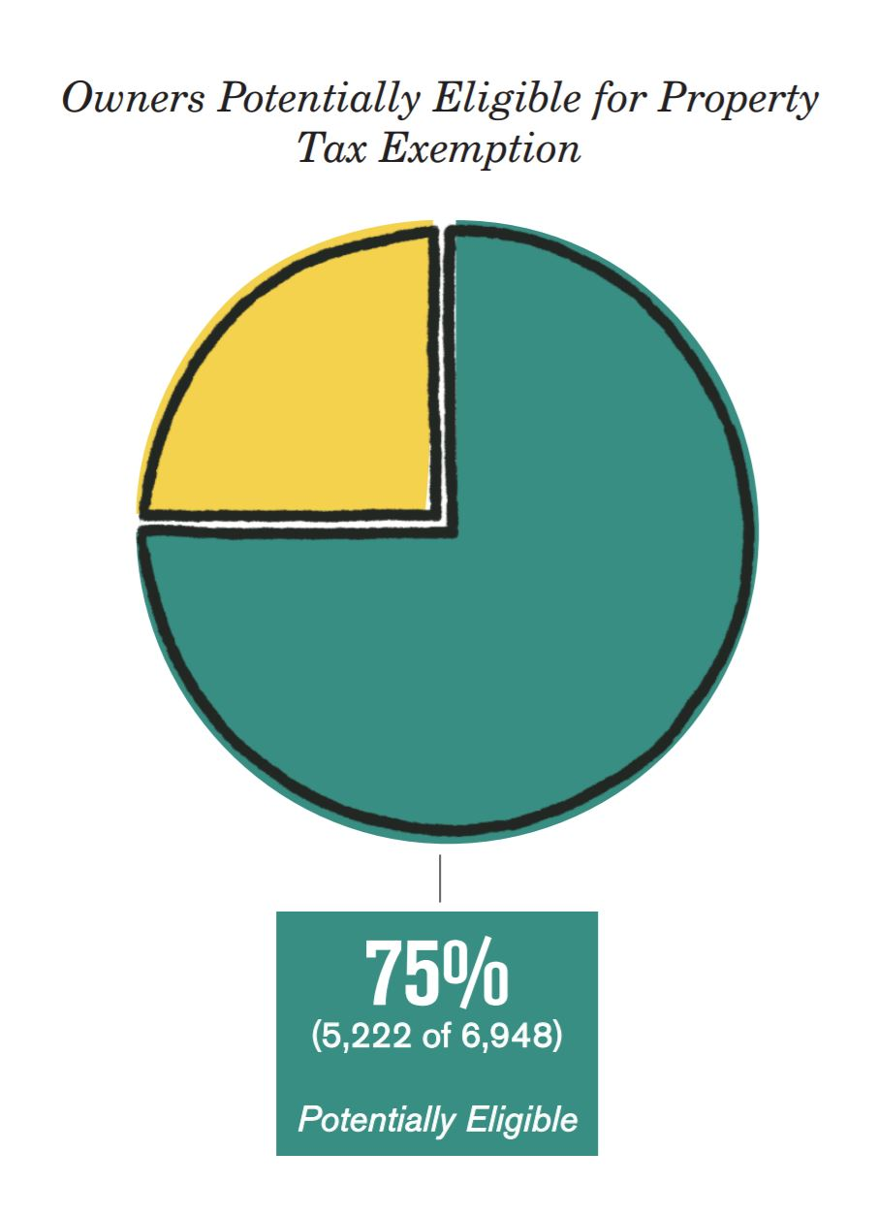
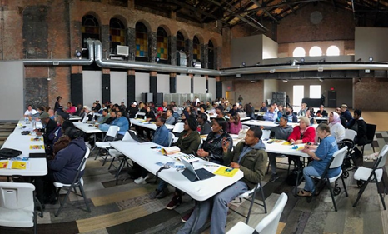
Direct human outreach based on parcel data to inform, assist, learn,
and make smart policy changes

Slide 21
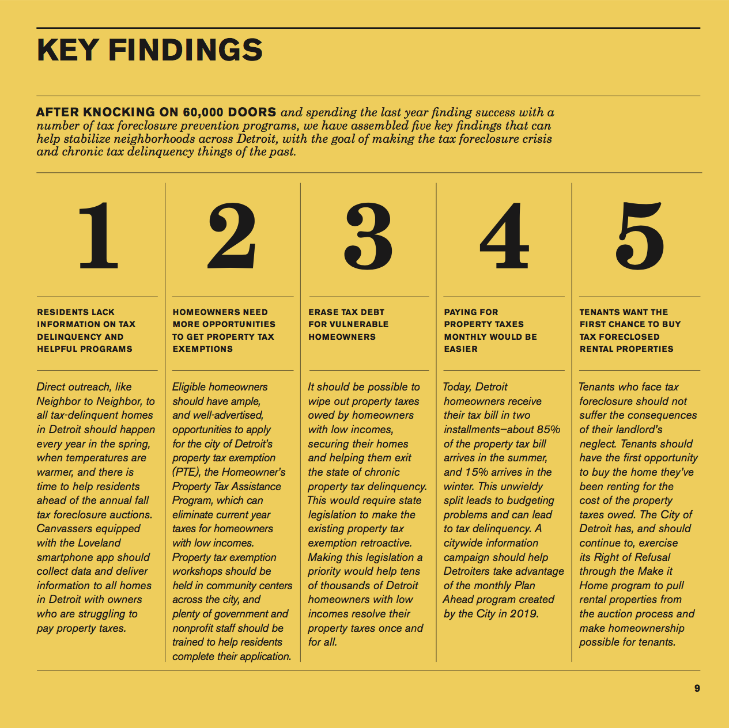
foreclosureoutreach.org
Notes:
… and this brings us to Neighbor to Neighbor study, where every tax delinquent home in the city was visited by surveyors to learn more about how tax foreclosure works on the individual/household level and who it affects.

Slide 22
Jerry Paffendorf
CEO, Loveland Technologies
landgrid.com
jerry@landgrid.com @makeloveland 313-649-LAND
Notes:
Intro...

