Slide 1

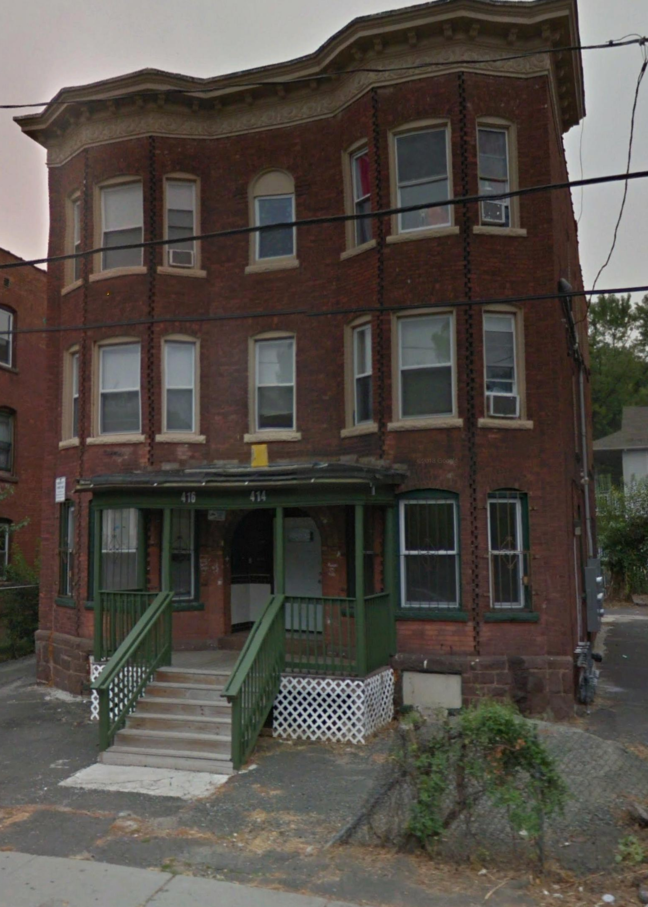
Understanding Key Legal Tools to Address Problem Properties
Karen Black, Esq.
Alan Mallach
Restoring Vacant Properties Conference 2019

Slide 2
Outline of the training session
1. Introduction and legal framework
2. Vacant property tools
3. Problem rental property tools
4. Interactive exercise
5. Takeaways – using tools strategically

Slide 3
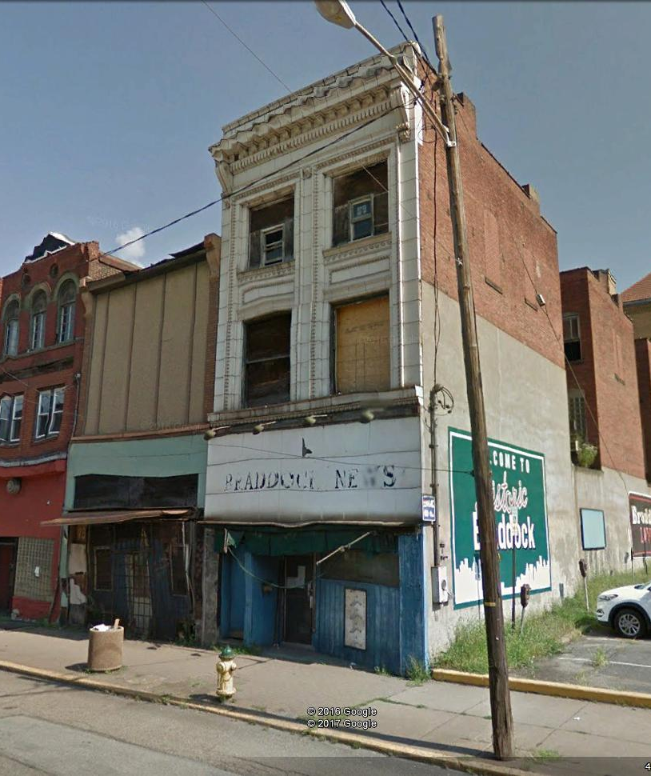
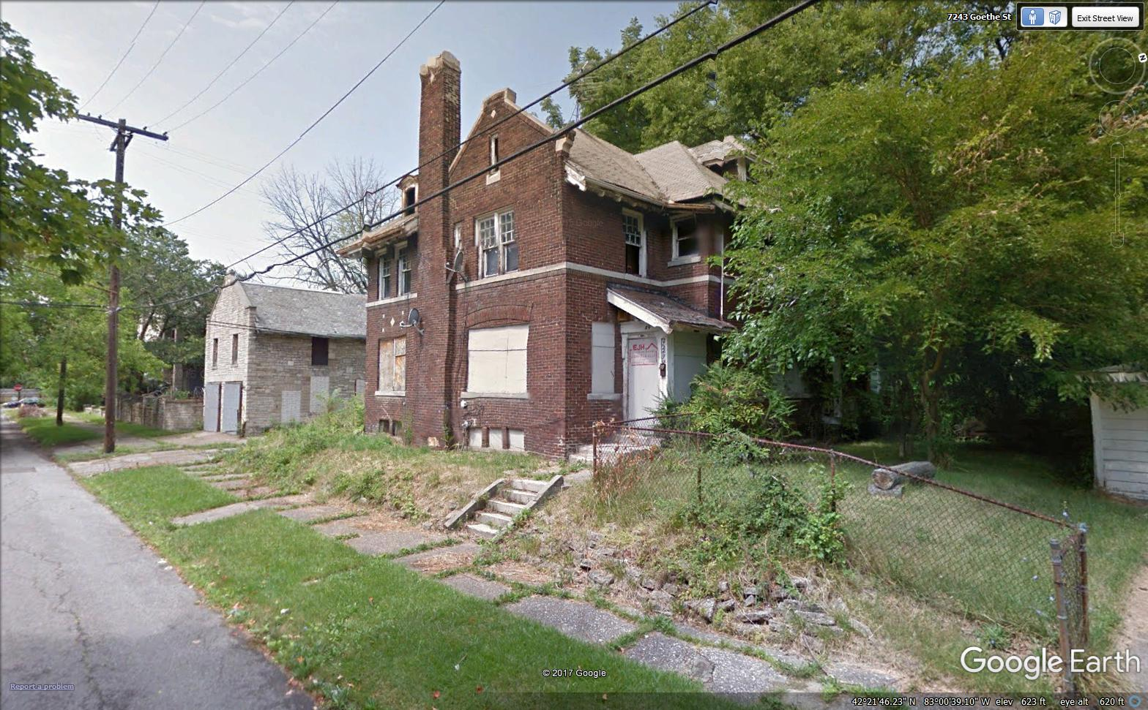
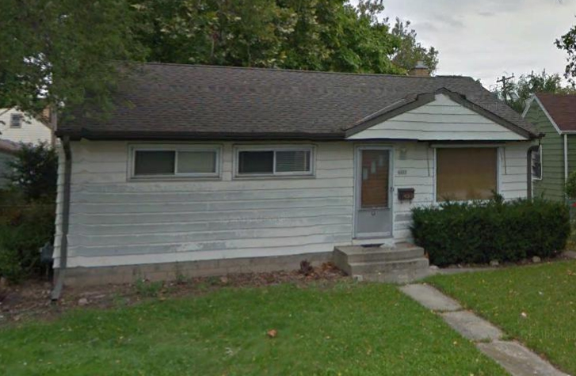
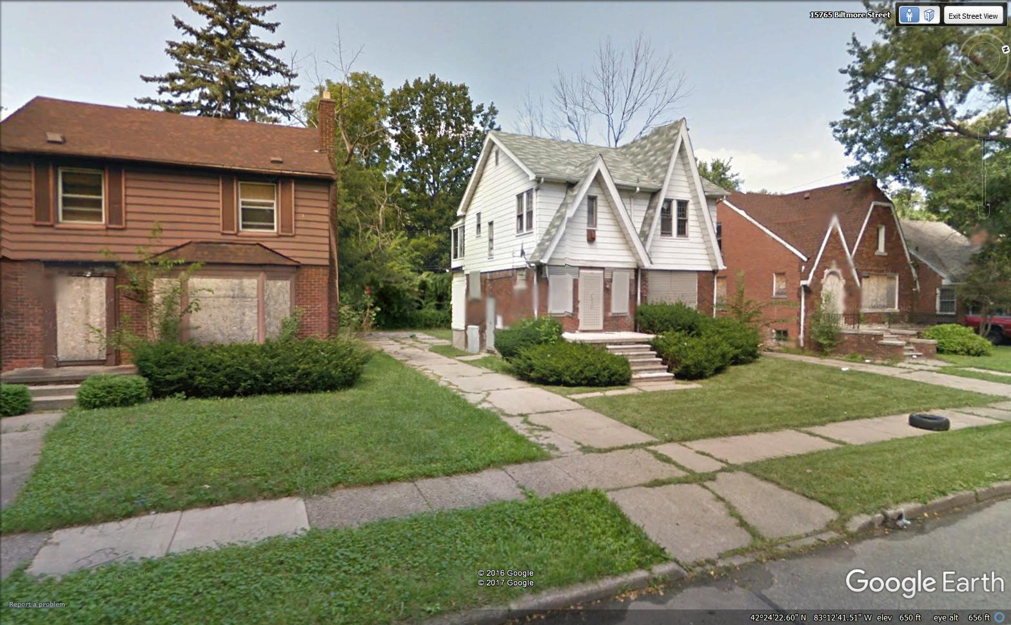
Vacant
Property
Gallery

Slide 4
The number of vacant properties is growing
+4 million
+29%
+2.4 million
+65%

Slide 5
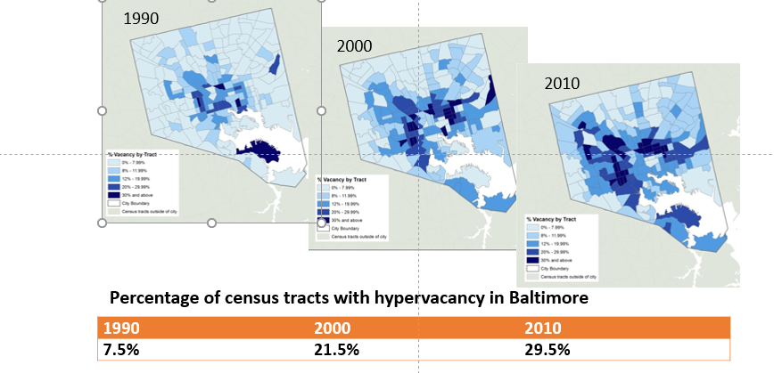
Hypervacancy is increasing

Slide 6
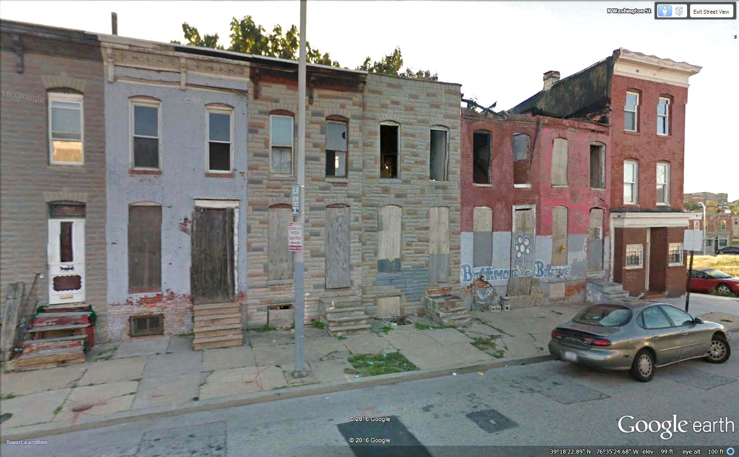
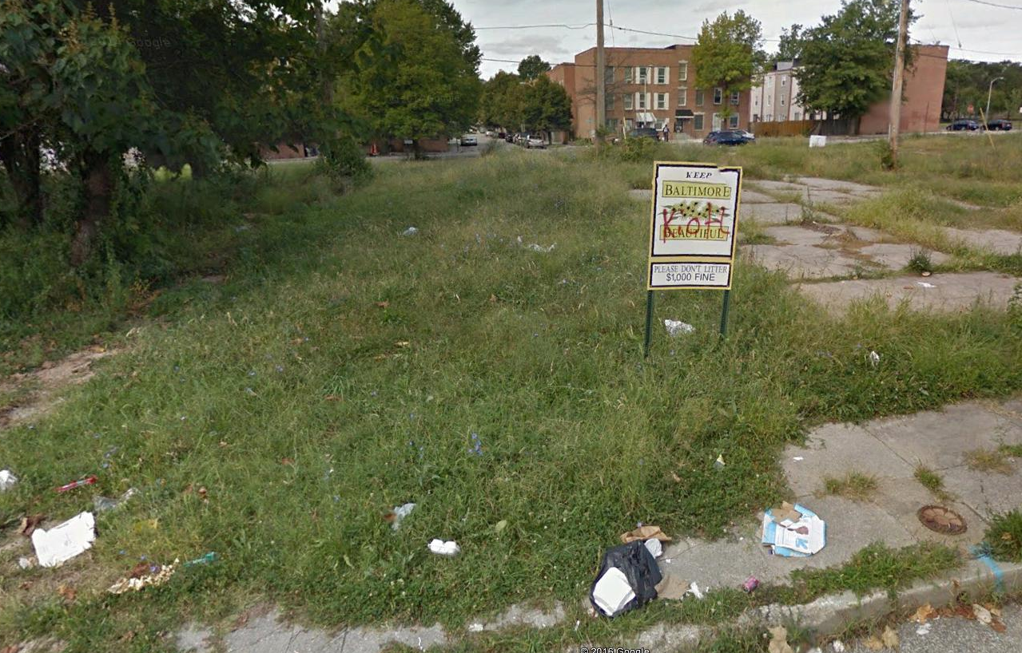
The landscape of hypervacancy

Slide 7
Vacancy, poverty and race coincide
Vacancy rate, poverty rate and African-American population share in Baltimore MD 2017

Slide 8
Remember!
Neither vacant properties nor rental properties are an inherent problem.
Vacant properties become a problem when they are neglected or abandoned
Rental properties become a problem when they are exploited, mismanaged or allowed to deteriorate or be misused.
Strategies should be designed to eliminate the problem, not the property.

Slide 9

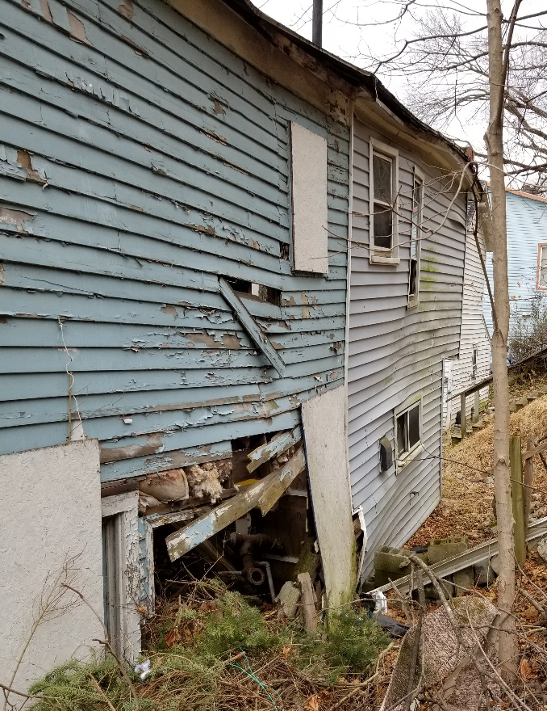
Legal Framework

Slide 10





Huge Benefits When Eliminate Blight
Reduces crime, in particular
gun-related violence
Improves health of residents
Raises surrounding property values by
up to 30% just by greening a vacant lot
Increases tax revenue for city and
school district

Slide 11
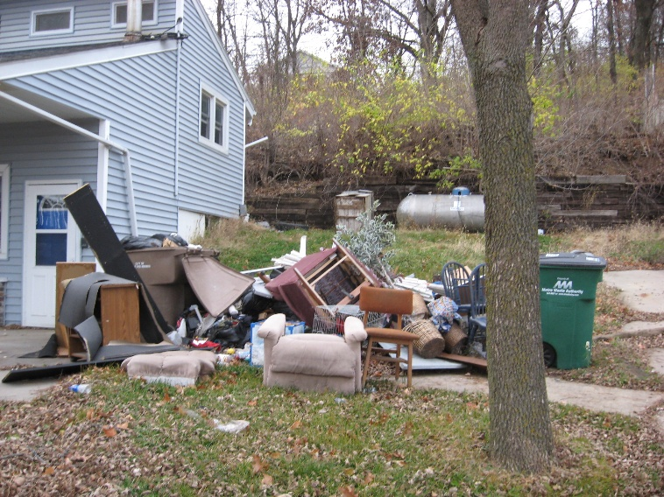
Municipalities Authorized to Address Property Condition
Federal and state law affirm local government’s police powers to enforce acceptable property conditions and compel owners to correct blighting conditions
Courts have repeatedly found that vacant and poorly maintained buildings have a profound adverse effect on the well-being of the community
Notes:
Dealing with them is complicated - issues are not just economic, but legal
Legal system in US dealing with properties is very complicated - a lot comes down to us from old English common law - varies from state to state.
fundamental property rights issues
concept of nuisance
taxation/property tax
Landlord/tenant law
codes
scope of local authority - not unlimited, but substantial
There are powerful legal tools to deal with these issues. but they are tools - they are not strategies. To be effective, a tool needs to operate within a strategic framework.

Slide 12
What is the most significant type of blight in your community?
Municipalities are Fighting Different Forms of Blight
Notes:
Our survey revealed significant differences in how Northampton County municipalities experience blight. That said, whether urban, rural or suburban, the most common type of blighted property is vacant commercial properties, foreclosed properties and deteriorated homes. (Note: The survey separated vacant buildings generally from commercial buildings, but both came back as significant challenges.)

Slide 13

States Are Modernizing Three Historic Tools
States Are Modernizing Three Historic Tools
Code Enforcement – Data-driven enforcement of a clear framework of standards
Tax Foreclosure – Improved ability to ensure new owner has capacity and willingness to improve property
Eminent Domain – Tool of last resort to transfer ownership

Slide 14
Power to Inspect
Owner Occupied: “reasonable expectation of privacy”
Must obtain a search warrant or have owner permission to enter
May not need warrant for violations visible on exterior from a public thoroughfare
Rental: Form of commerce so can regulate. (Alan)
Tenants (not landlords) have privacy interest so may consent to search
Moving from tenant complaint-based to strategic and systematic inspections
Vacant and Abandoned: Most expansive (Jessica)
Require owner to maintain and secure property
Nuisance ordinances typically allow entry to maintain exterior
Right to demolish property where poses health and safety risk
Reimbursement through lien

Slide 15
The three layers of regulation
Registration
Inspections
Enforcement and citations
Threat of losing property
Incentives
Getting the owner to do the right thing

Slide 16
The three layers of regulation
Doing what has to be done
Nuisance abatement
Receivership
Demolition

Slide 17
The three layers of regulation
Taking the property away from the owner
Lien foreclosure
Spot blight taking
Forfeiture

Slide 18
Vacant Property Tools

Slide 19
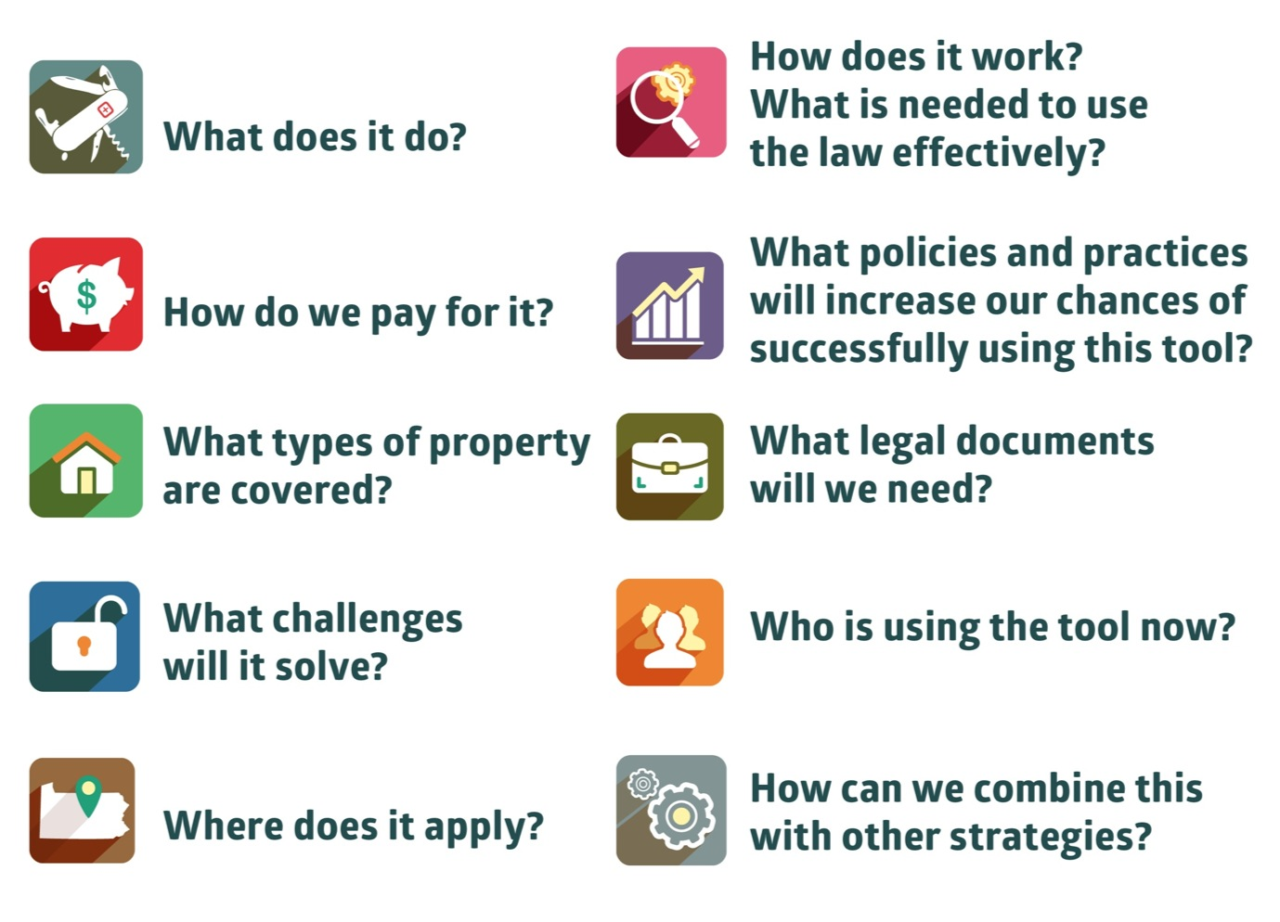
States Are Authorizing A Series of New Tools to Address Problem Properties
Notes:
Tools for adopting a Strategic Code Enforcement Framework. For each tool:

Slide 20

Two Categories of Tools that Work Together
Tools that enable you to establish a
data-driven, strategic code enforcement system to prevent and address blight.
Tools to address long-term vacant properties that pose a threat to
health and safety where code enforcement has been ineffective.

Slide 21
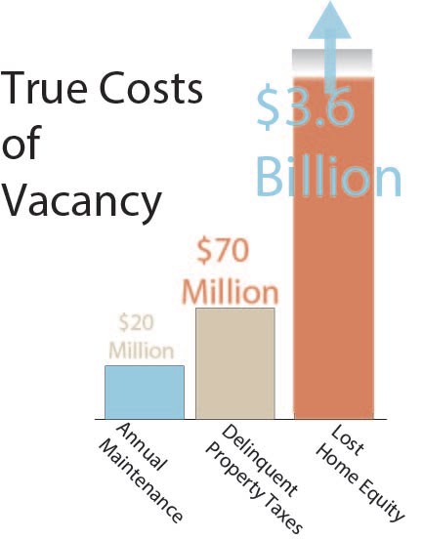
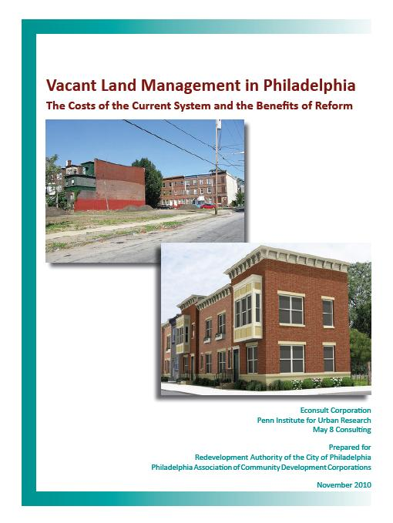
Why is Code Enforcement Important?
Philadelphia
Notes:
Status quo is not an option. Costing you money every day. Code enforcement is a money making proposition. Just need to designate it like Hartford has so it doesn’t just go into the general budget and can support anti-blight work.

Slide 22
Effective Code Enforcement Has Three Parts
Enactment of code enforcement laws that define violations and process for addressing violations (e.g. International Property Maintenance Code)
Inspection inspection of properties performed on a regular schedule or pursuant to a compliant to determine whether violations exist (May provide shared and 3rd party inspections)
Enforcement where the owner fails to comply that includes detailed procedures, record-keeping to show each interaction with property owner, progressive fines and penalties and due process. (Administrative enforcement vs. Civil enforcement)

Slide 23
When Can Inspect Without a Warrant Differs in Each Jurisdiction But Common Exceptions Include:
Violations are in plain view from legally authorized location (sidewalk or street)
Consent of owner or occupant
Public area where no reasonable expectation of privacy
Exigent circumstances
Where a Warrant is Required, Probable Cause Can be Shown if:
Code sets out regular inspection schedule with timelines
Visible observation of code violation
Resident complaint of violations on property

Slide 24
New State Authorized Tools Seek To:
Increase local government’s ability to transfer to responsible owners (land banks)
Require identification and registration of owners and properties (vacant, foreclosed and rental property registration)
Make tax and code compliance a prerequisite for obtaining some government services (permit denial)
Allow enforcement with limited court involvement (quality of life ticketing)

Slide 25
New State Authorized Tools Seek To:
Expand receivership (resident and non-profit receivers)
Create personal liability for property condition (asset attachment)
Require buyers to remediate code violations within a specific timeframe (pre-sale inspection)
Move properties out of ownership limbo (zombies)
Provide financial assistance to property owners (loans and grants)

Slide 26
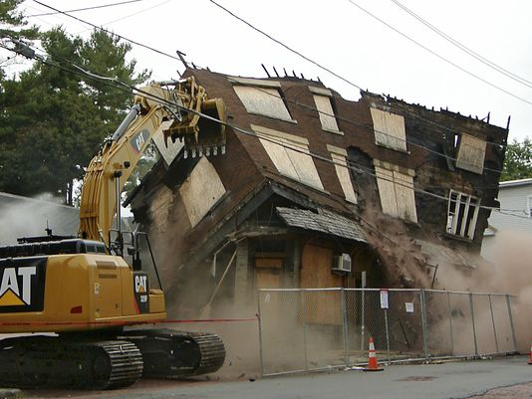
Where Enforcement Fails, Tools to Demolish or Transfer Properties
Require owner to pay for action taken wherever possible
  Asset attachment
  Eminent domain
  Receivership
  Nuisance abatement
  Impose liens
  Move properties out of limbo - zombies
Notes:
Asset attachment
Eminent domain:
Between 2000-2008, Cumberland County RDA initiated 100 condemnation actions. 95 owners fixed up or sold their properties. 5 had to be taken through condemnation process.
Conservatorship
Open Estate to Transfer Property:
Wilkinsburg RDA uses this tool where potential buyers for property exist.
Land Bank

Slide 27
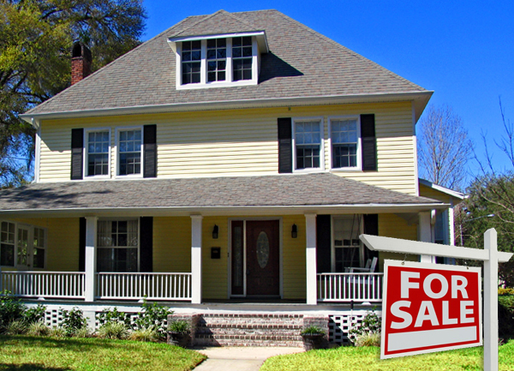
Assess property condition routinely when property changes hands, becomes vacant or requires a permit
Permit Denial
Presale Inspections
Registration of Vacant & Rental Properties

Slide 28
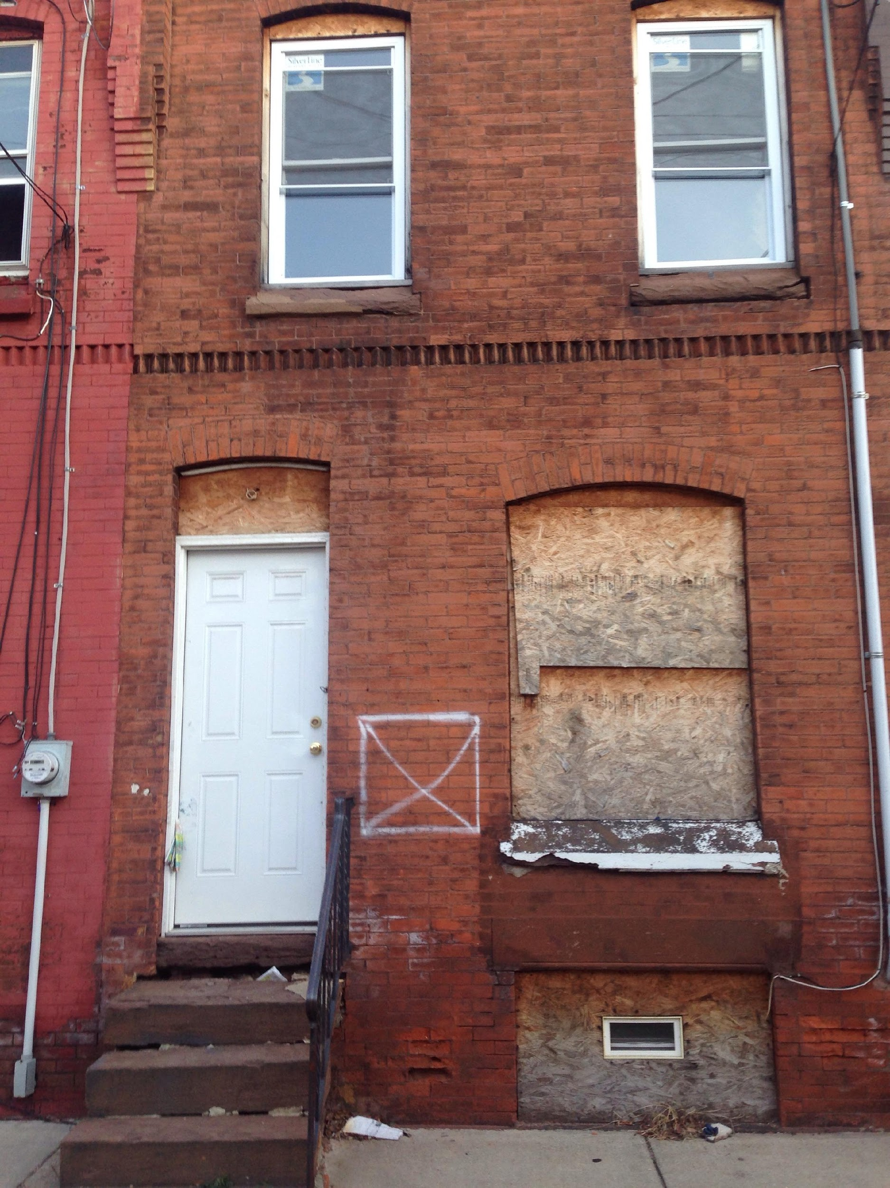
Philadelphia Doors and Windows
Requires all structures on blocks with at least 80% occupancy to have working doors and windows (i.e., not plywood or masonry).
Daily fines = $300 per opening
City can attach fines to the personal property of Philadelphia Property Maintenance Code violators. Fees and fines used to fund inspections.
Targeted owners of multiple blighting buildings
  Blight Court arbitrates a resolution of the violations and accrued fines.
* See: http://legislation.phila.gov/attachments/10949.pdf

Slide 29
Courts Uphold Doors & Windows
Courts upheld legality
Compliance by owners of long-term vacant structures increased surrounding sales prices by $74 million
Increased transfer tax revenue for city by $2.34
Area around houses saw 19% reduction in assaults and 39% reduction in gun assaults and decreased nuisance crimes.
Fees used to fund inspections and enforcement

Slide 30
Spot blight taking
Property may be taken by public agencies from its owner (eminent domain) when it is needed for a public purpose.
Depending on the provisions of state law, eliminating blight can be a public purpose for which eminent domain can be used.
‘Spot blight’ is the “surgical” use of eminent domain against specific blighting properties.

Slide 31
Lien foreclosure
Payment of taxes, other municipal liens and mortgages are legal obligations that, if not upheld, can lead to loss of property.
All state laws allow municipal liens for taxes. Some state laws allow municipality to put liens on properties for other things, such as nuisance abatement or code enforcement fines.
Foreclosure is the process by which delinquent properties are taken by the lienholder.
State law governs municipal authority to take delinquent property through tax or other lien foreclosure.
Some states give land banks power to take delinquent properties.

Slide 32
Forfeiture
Forfeiture is most well known for its use taking properties used for criminal activities.
Under some conditions can be used where properties have been neglected and owner has failed to correct problems.
Under forfeiture, such properties are taken from the owner by court order and conveyed to a public entity.
Examples are in Wayne County Michigan (called ‘nuisance abatement’), Chicago, New York State (RPAPL 19-A), and Baltimore (called ‘receivership’)

Slide 33
Baltimore Vacants to Value
Flowchart
Court proceeding to transfer title
Violation
notice issued
Property rehabilitation
initiated
Citation
process warning letter issued
First
citation issued
Second
citation issued
Litigation
prep/title work initiated
Title
received/ case filed
Property
goes to auction
Property
goes to settlement

Slide 34


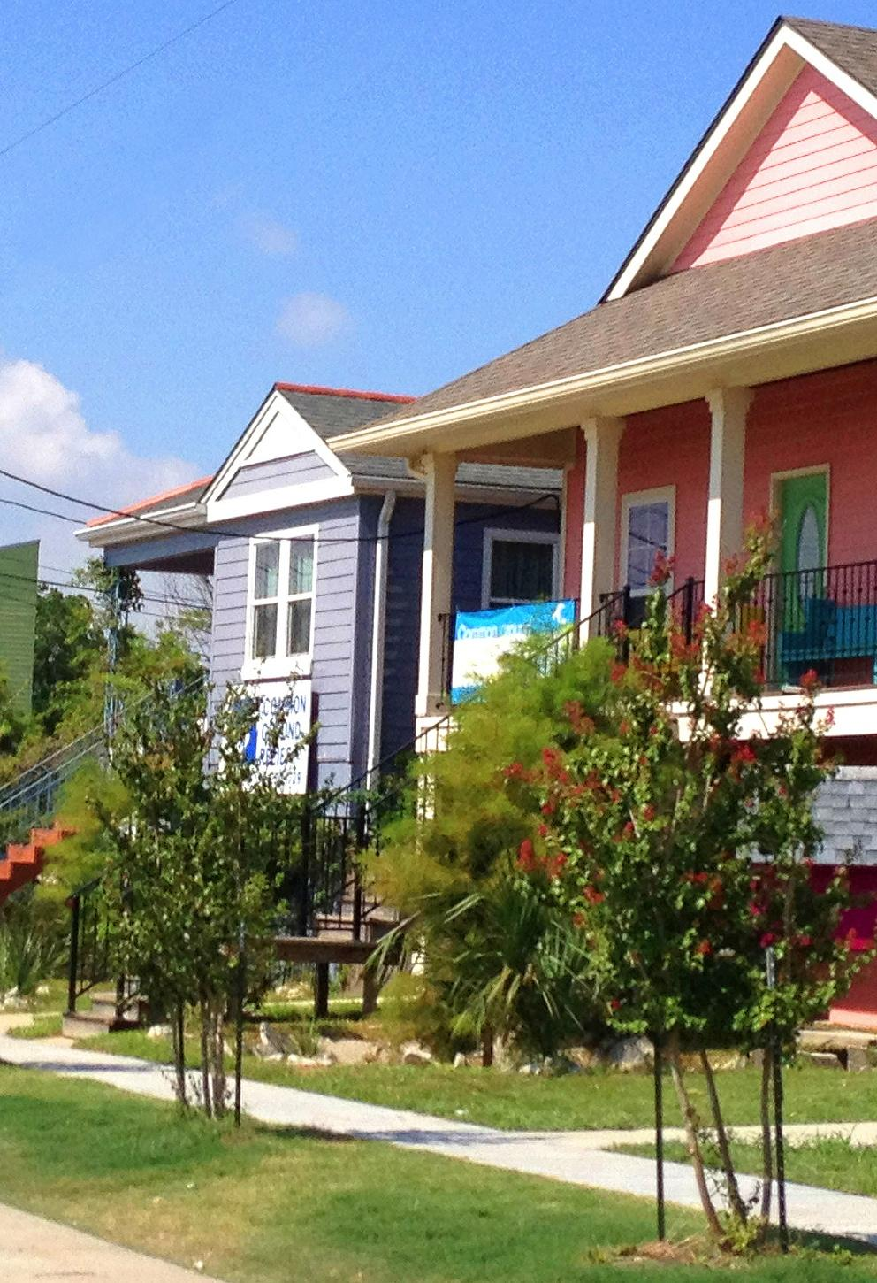
Strategies for problem rental properties

Slide 35
Rentals have rapidly grown since 2007

Slide 36
Most low-income families are renters

Slide 37
The framework of rental regulation
Complaint-based inspection | Properties inspected only in response to complaints.
Rental registration | All landlords required to register and provide contact information for emergencies and service
Registration + inspection | All landlords required to register and inspections conducted on regular basis
Rental licensing | All landlords required to obtain license conditional on property meeting code requirements and other criteria
Performance-based rental licensing | License requirements, inspection frequency and fees are adjusted on the basis of landlord’s past track record.

Slide 38
Performance-based regulation
Brooklyn Center, Minnesota
Requirement | Type I | Type II | Type III | Type IV
Action Plan | No | No | Required | No
Association for Responsible Management | Recommended | Recom-mended | Attend 25% of meetings | Attend 50% of meetings
Crime Free Housing | recommended | Phase I | Phase I and II | Phase I, II, and III
Inspections | Once every three years | Once every two years | Once every year | Once every six months
Mitigation Plan | No | No | No | Must be completed prior to council approval of license
Monthly Updates | No | No | No | Required

Slide 39

Designing a local ordinance
What can you do?
What must you not do?

Slide 40
What one can do
Generally
  Inspect properties
  Charge reasonable fees
  Establish reasonable ‘crime-free’ programs
Usually
  Require rental properties to be licensed
  Conduct regularly-scheduled inspections
  Establish different requirements for different properties based on rational, explicit and transparent standards

Slide 41
What one cannot do
Penalize owners or tenants for refusal to grant voluntary entry to property
  If entry is denied, the inspector must get a warrant
Impose ‘crime-free’ requirements that are excessive or potentially discriminatory
Charge fees that exceed the cost of the program
  But there is a gray area in terms of what ‘the program’ can include

Slide 42
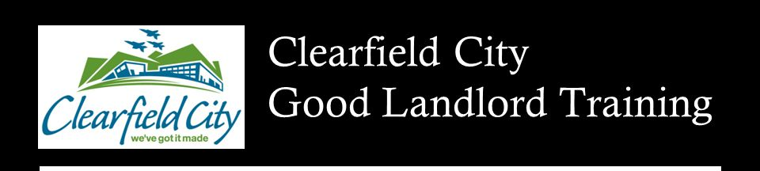


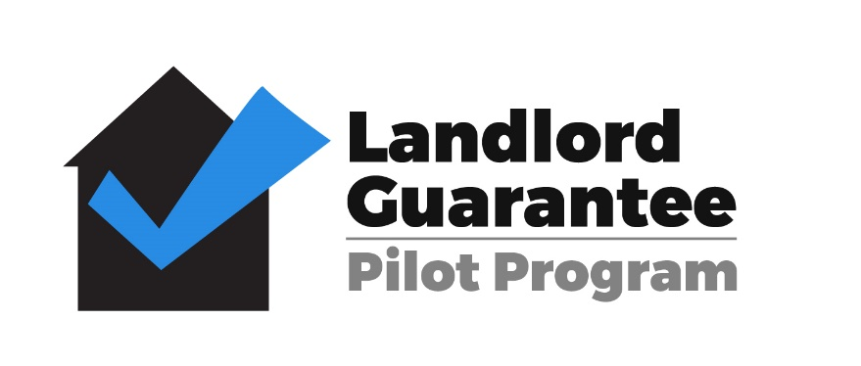
Fostering better landlords
Financial incentives
Non-financial incentives
Good landlord programs

Slide 43
Group Exercises – Applying the Tools

Slide 44
General Questions
What tools should the Pennsylvania county, city and its business or non-profit partners use to address the issues presented in each scenario?
Things to consider:
  Who owns the properties? What are their resources?
  What active organizations are based in the neighborhood?
  What capacity do the city and its partners have to take on different types of property action?
  What are the market conditions in the area? What types of activity can the market support?

Slide 45
What tools for blighted properties do you use?
Municipalities Are Using a Diverse Set of Tools
Notes:
Municipalities are using different types of tools to address blight. 72% have a property maintenance code. 53% require rental property licensing or registration and about 28% are using a for-profit company to track their foreclosed properties and hold lenders responsible for property maintenance. Interestingly not a single suburban municipality is using quality of life ticketing, but several urban and rural communities are.

Slide 46
Tools for Pennsylvania Municipalities
Consistent, Data-Driven Code Enforcement | Adopt International Property Maintenance Code or local code to enforce clear standards
Rental Property Licensing/Registration | Require rental property owners to obtain rental license and/or register property.
Vacant Property Registration | Require vacant property owners to register, pay fee and file statement of intent to reactivate
Foreclosed Property Registration | Require lenders to register and maintain foreclosed properties those in process
Quality of Life Ticketing | Replace formal code enforcement citations with tickets for immediate payment
Permit Denial | Deny permits to owners with code violations and tax delinquency
Asset Attachment | Attach owner's wages/properties to recover public dollars used to improve properties
Pre-sale Inspections | Mandatory inspection prior to sale identifies deficiencies to be fixed within set timeframe
Receivership | Third party receiver fixes violations and recovers investment through rental or sale of property

Slide 47
Pennsylvania County-wide Tools
Land Bank | Form agency to eliminate blight and reactivate properties
Redevelopment or General Purpose Authority | Create RDA to act as land bank or repurpose existing authority to obtain eminent domain powers
Educate Magistrates | Educate magistrates on adjudicating property maintenance laws
Demolition Fund (Act 152) | $15 Recorder of Deeds fee to fund demolition
County-Wide Blighted Property List | Create priority blighted properties list for limited county resources
Reform Tax Sale Process | Establish bidder eligibility standards and market properties for community gardens and sidelots
Encourage Shared Code Enforcement | Encourage municipalities to cost-effectively share code enforcement resources

Slide 48
Receivership in Pennsylvania
Eligible Property - not legally occupied for 12 months or actively marketed for 60 days, no new owner for 6 months, no foreclosure action
Must meet 3 conditions that show poor condition such as health and safety issues, not fit for occupancy
Eligible Receiver - resident, business owner within 2000 feet, lienholder, non-profit, municipality, RDA can be conservator
Receiver Fee - $2500 or 20% sale price
PA Actions Brought - 368 (2009-17) 269 in Phila, 54 in Allegheny, 13 in Northumberland and 10 in Butler.
Controversy – for-profit businesses using tool but 65% of petitioners were private non-profits
Notes:
Conservator gets fee: Conservator gets 2500 or 20% sale price
Datewide Data Collection – Who is using and with what outcome – Fels Institute Students – Quantify impact of conservatorship – Winnie Branton
2009-17 368 actions brought but 269 in Philadelphia, 54 in Allegheny, 13 in Northumberland and 10 in Butler. Went to each court of common pleas in PA.

Slide 49
Quality of Life Ticketing in Pennsylvania
Conditions addressed – Trash, high weeds, abandoned cars
Benefits – Cheaper to administer/Municipality keeps fees
Key Decisions - Warnings vs fines and door hangers vs. violation notices vs. stickers
Example - Wilkes Barre
  Taking it To The Streets: Teams of building, health and rental inspectors dedicating one day each week to WALK an assigned neighborhood. (Begins with those with higher-than-average number of complaints.)
  Most residents pay ticket – if not, magistrate hearing
  2019: 215 QOL between March and Mid-May (decreased from 355 in 2017 and 264 in 2018)
Notes:
https://www.wilkes-barre.city/home/news/third-annual-%E2%80%9Ctaking-it-streets%E2%80%9D-initiative-proves-effective
Unfair unlawful tickets to make up 30% of city budget in Missouri – fining poor people removes available money for repairshttps://www.curbed.com/2018/5/24/17382120/tickets-fees-fines-criminal-justice-ferguson

Slide 50
Scenario 1: An underutilized Pennsylvania building
A large, brick four-story building adjacent to a major commercial corridor is visibly in disrepair. The street level retail spaces have been vacant since 2007. There may be residential tenants living on the upper floors but it is unclear. The owner is an LLC that has ignored repeated code citations under the Property Maintenance Code. Neighboring businesses complain about the appearance of the building and the rodents that have spread from the building.
What are the challenges this situation poses?
How should the municipality first try to address the issue?
If those steps fail, what next?
Notes:
Slide 45: Scenario 1 Underutilized Building
This exercise focuses on a single building. The building appears dilapidated, the ground floor space is long-term vacant but there may be tenants renting space on upper floors. The owners is known and has been completely unresponsive to code citations, what should local government do? The group should be broken up into tables to discuss this situation for 10 minutes.
While there are no right answers, the facilitator/trainer should make sure that a few points are made:
Importance of knowing where occupied rental units are and the condition of those units. Rental registration or licensing law require landlords to reveal where they have rental units. It is important for municipalities to have this information in case of fire or criminal complaints and to ensure the owner is providing healthy and safe rental units.
Rodents means there is a health and safety risk that warrants inspecting the entire building. This building could pose a danger to residents living inside as well as those in nearby properties.
The owner has ignored code citations. How can you move an owner from ignoring code violations to taking action to bring their property up to Code?
Has the municipality created a detailed file showing violations over time to make its case to the Magistrate?
Is this a good candidate for Conservatorship? Is there sufficient value in the sale or rental of the building to pay for repair? Is there a resident, for-profit business or non-profit that would be willing to be named conservator?
Is the property tax delinquent? Should the county foreclose upon the property in order to transfer ownership to a responsible buyer at tax sale?
Does the owner have similar problem properties in other municipalities? Is the owner seeking permits in any of these municipalities that can be approved only if the owner addresses all code violations and delinquent taxes? (Permit denial under Act 90 of 2010, titled the Neighborhood Blight Reclamation and Revitalization Act39, allows municipalities to deny certain permits and licenses to property owners who have significant tax delinquencies or a judgment of serious code violations by a magistrate or judge anywhere in the Commonwealth.)
Should the municipality threaten asset attachment under Act 90 to force the owner to reimburse the municipality for all costs expended to date and to cover repairs needed to bring the property up to code?

Slide 51
Scenario: a Pennsylvania struggling neighborhood
Collingwood, a once-stable and still viable single-family neighborhood has seen many foreclosures, many homes go from homeowner to investor, and increased evidence of deferred maintenance. Many homeowners are elderly and struggling financially. Dozens of owner-occupied and rented single-family houses are showing evidence of disrepair and neglect. Vacant properties are popping up, and a few long term vacant and abandoned properties are open to intruders and their yards are overgrown and covered with litter and trash.
What do you do?
Where do you start?
Notes:
Slide 45: Scenario 1 Underutilized Building
This exercise focuses on a single building. The building appears dilapidated, the ground floor space is long-term vacant but there may be tenants renting space on upper floors. The owners is known and has been completely unresponsive to code citations, what should local government do? The group should be broken up into tables to discuss this situation for 10 minutes.
While there are no right answers, the facilitator/trainer should make sure that a few points are made:
Importance of knowing where occupied rental units are and the condition of those units. Rental registration or licensing law require landlords to reveal where they have rental units. It is important for municipalities to have this information in case of fire or criminal complaints and to ensure the owner is providing healthy and safe rental units.
Rodents means there is a health and safety risk that warrants inspecting the entire building. This building could pose a danger to residents living inside as well as those in nearby properties.
The owner has ignored code citations. How can you move an owner from ignoring code violations to taking action to bring their property up to Code?
Has the municipality created a detailed file showing violations over time to make its case to the Magistrate?
Is this a good candidate for Conservatorship? Is there sufficient value in the sale or rental of the building to pay for repair? Is there a resident, for-profit business or non-profit that would be willing to be named conservator?
Is the property tax delinquent? Should the county foreclose upon the property in order to transfer ownership to a responsible buyer at tax sale?
Does the owner have similar problem properties in other municipalities? Is the owner seeking permits in any of these municipalities that can be approved only if the owner addresses all code violations and delinquent taxes? (Permit denial under Act 90 of 2010, titled the Neighborhood Blight Reclamation and Revitalization Act39, allows municipalities to deny certain permits and licenses to property owners who have significant tax delinquencies or a judgment of serious code violations by a magistrate or judge anywhere in the Commonwealth.)
Should the municipality threaten asset attachment under Act 90 to force the owner to reimburse the municipality for all costs expended to date and to cover repairs needed to bring the property up to code?

Slide 52
