Slide 1
SALES STRATEGIES FOR LOW DEMAND HOUSING MARKETS: THE DETROIT EXPERIENCE

Slide 2
1.
BACKGROUND

Slide 3
DETROIT POPULATION 1930-2016

Slide 4
“The fundamental problem with population loss is that people often forget to take their homes with them” – Dan Kildee

Slide 5
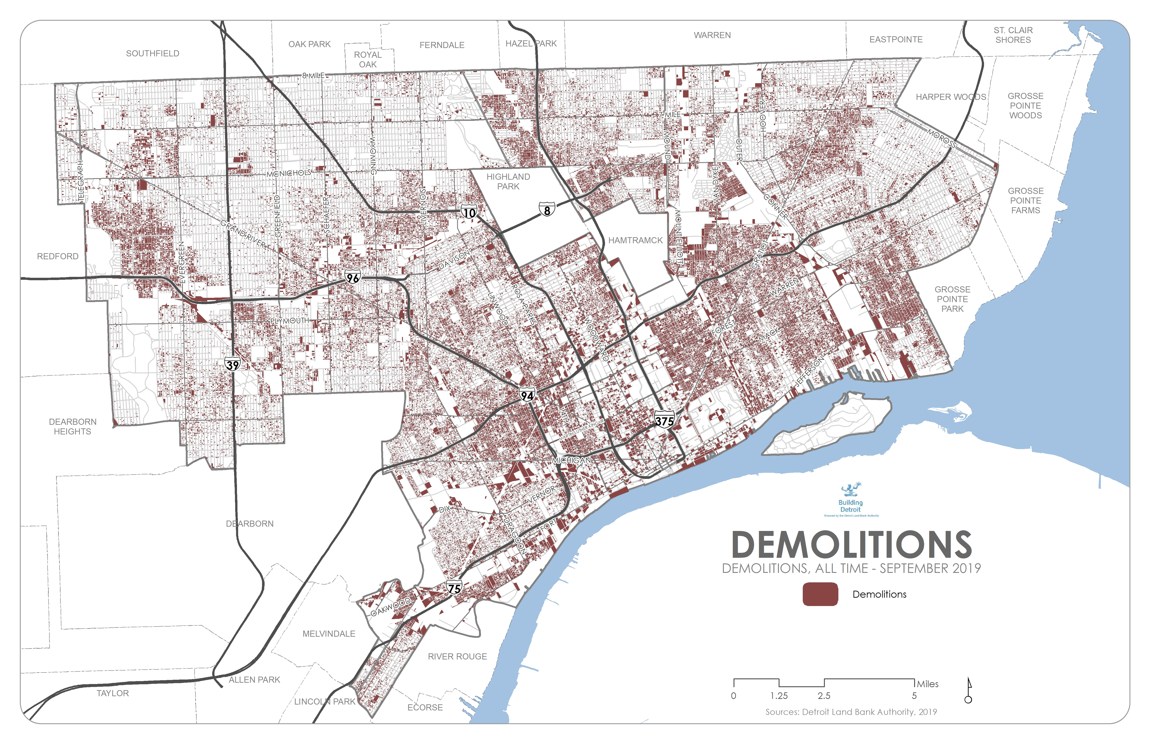

Slide 6
DETROIT TAX FORECLOSURES

Slide 7
DETROIT LAND BANK INVENTORY

Slide 8
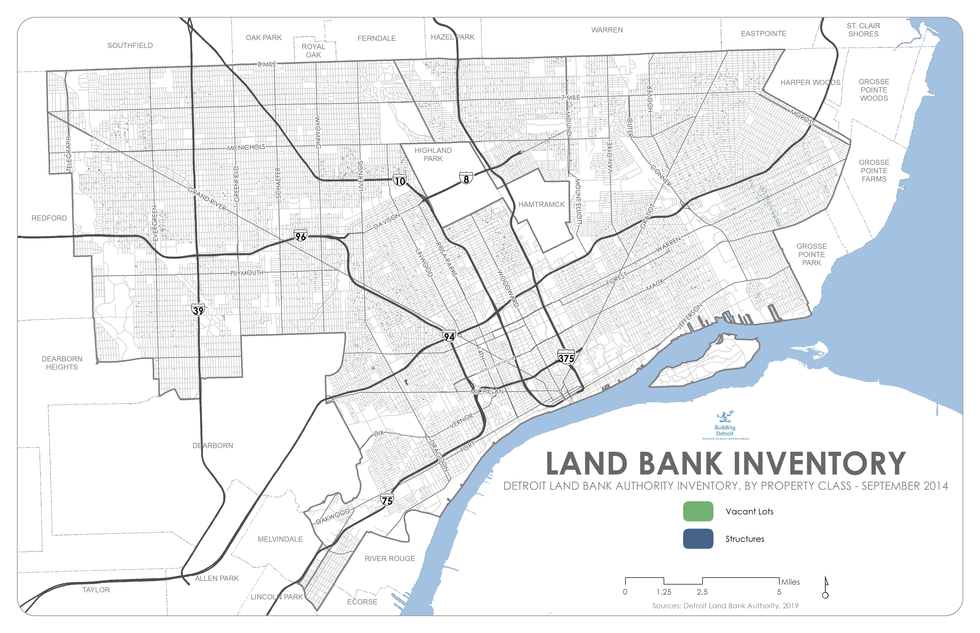

Slide 9
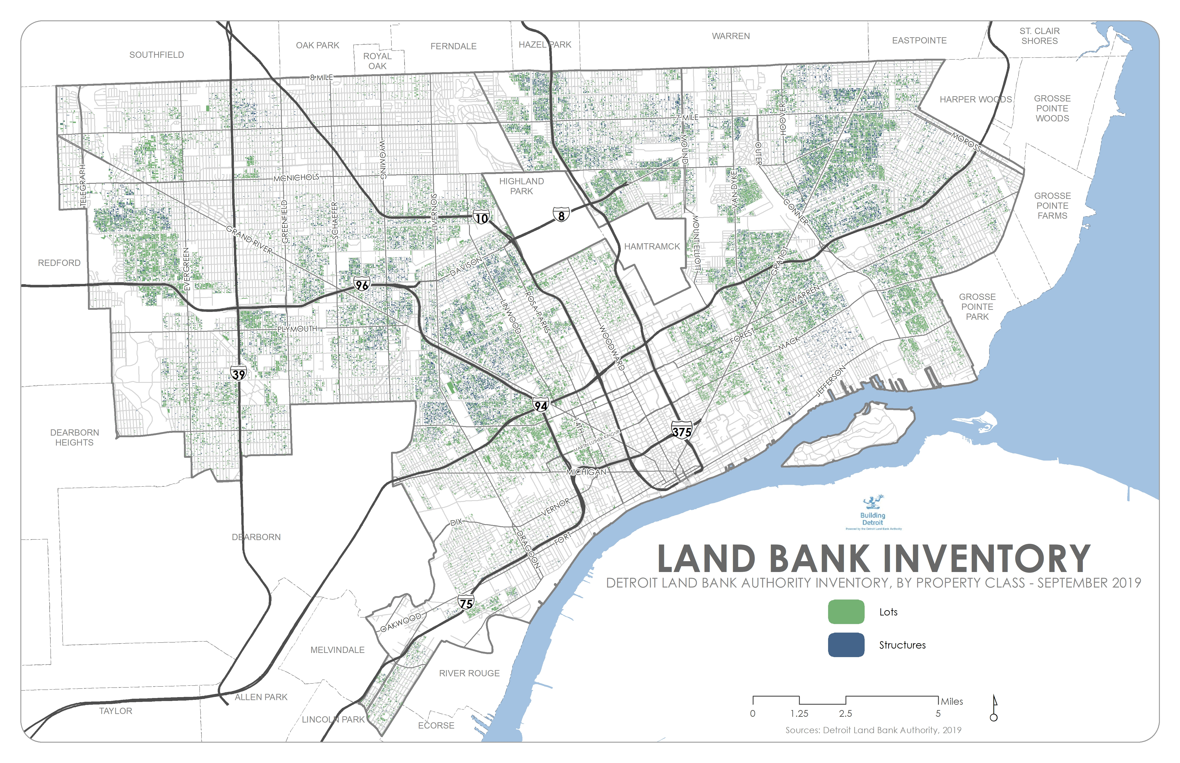

Slide 10
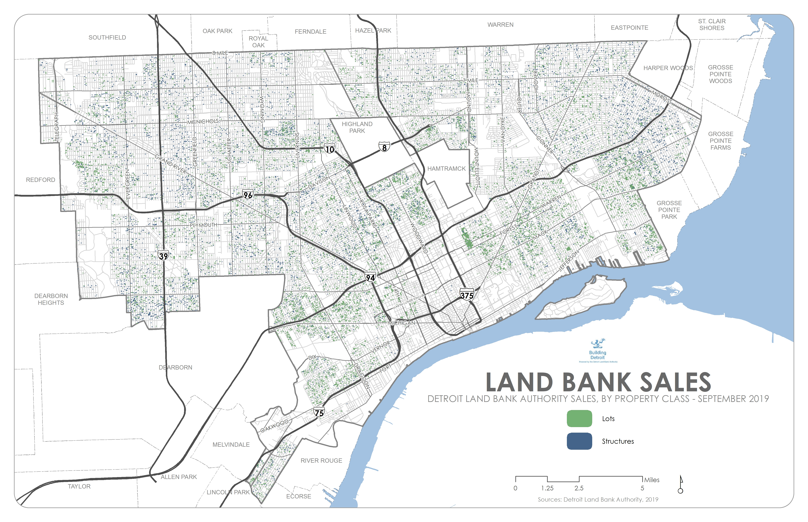

Slide 11
2.
AN EVOLVING LAND BANK INVENTORY

Slide 12
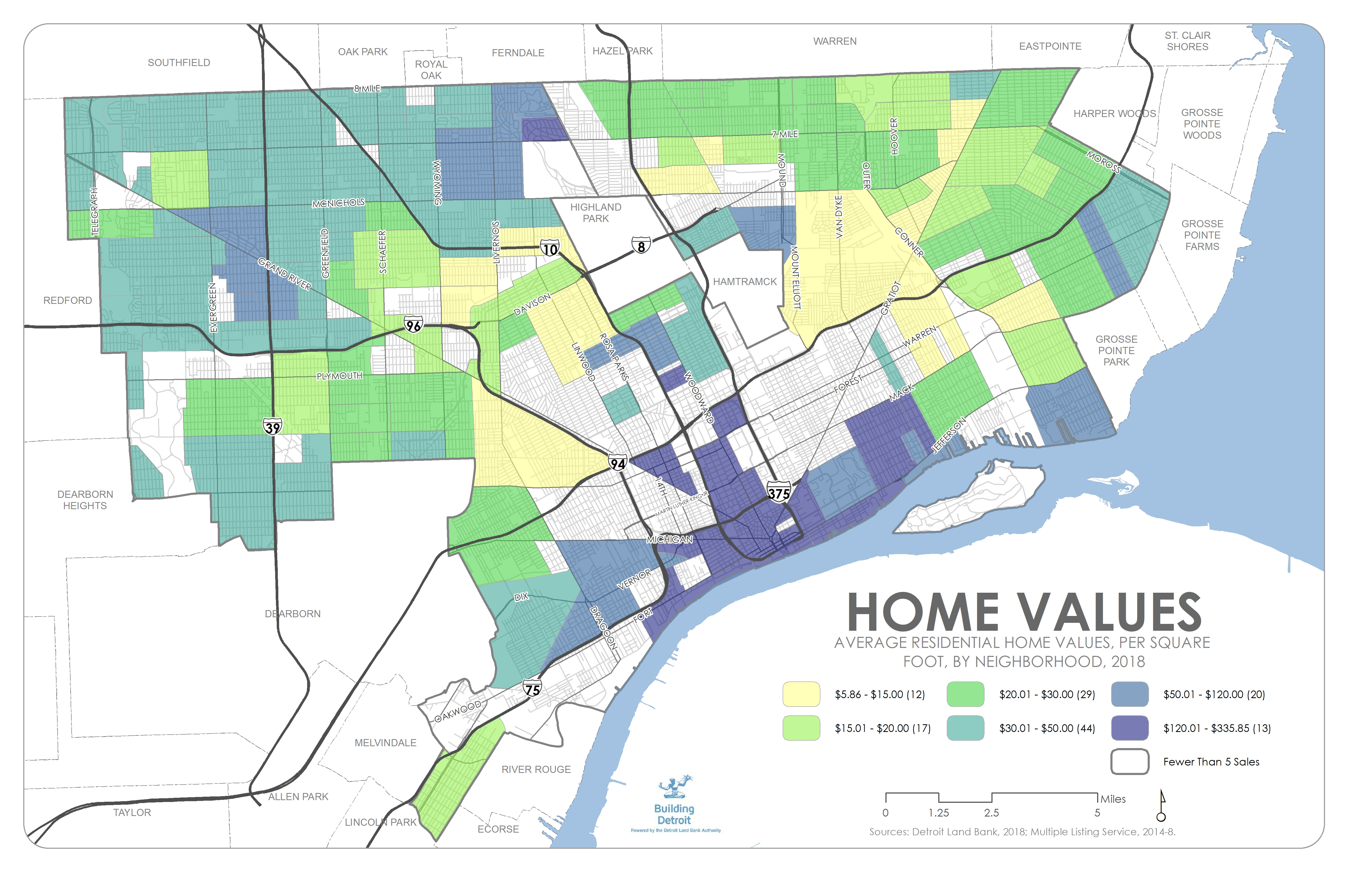

Slide 13
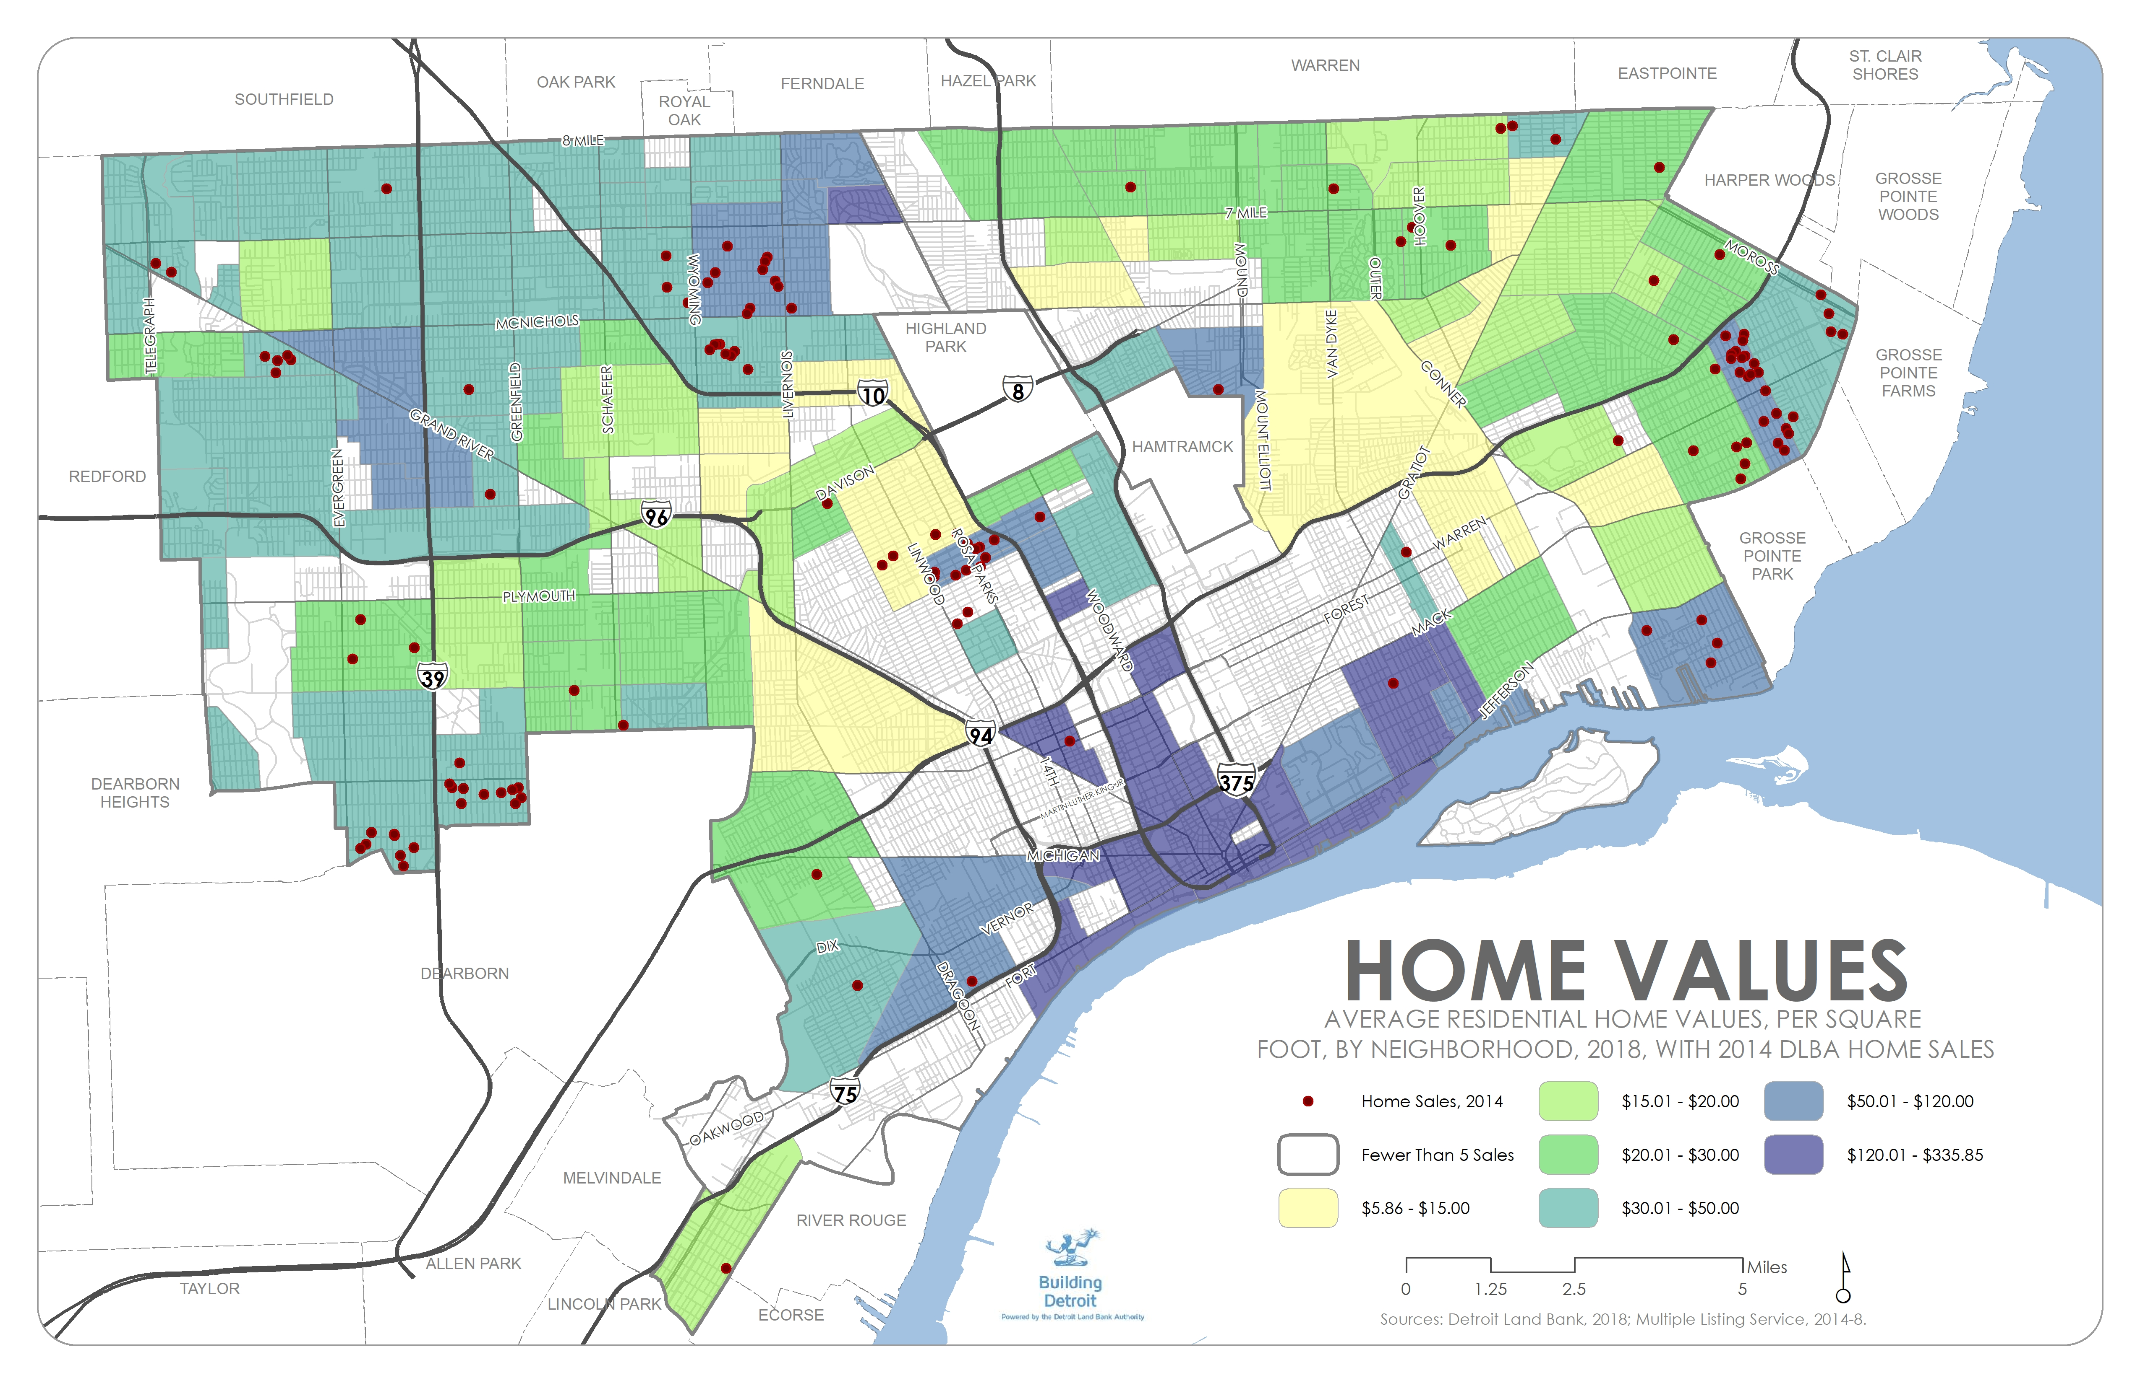

Slide 14
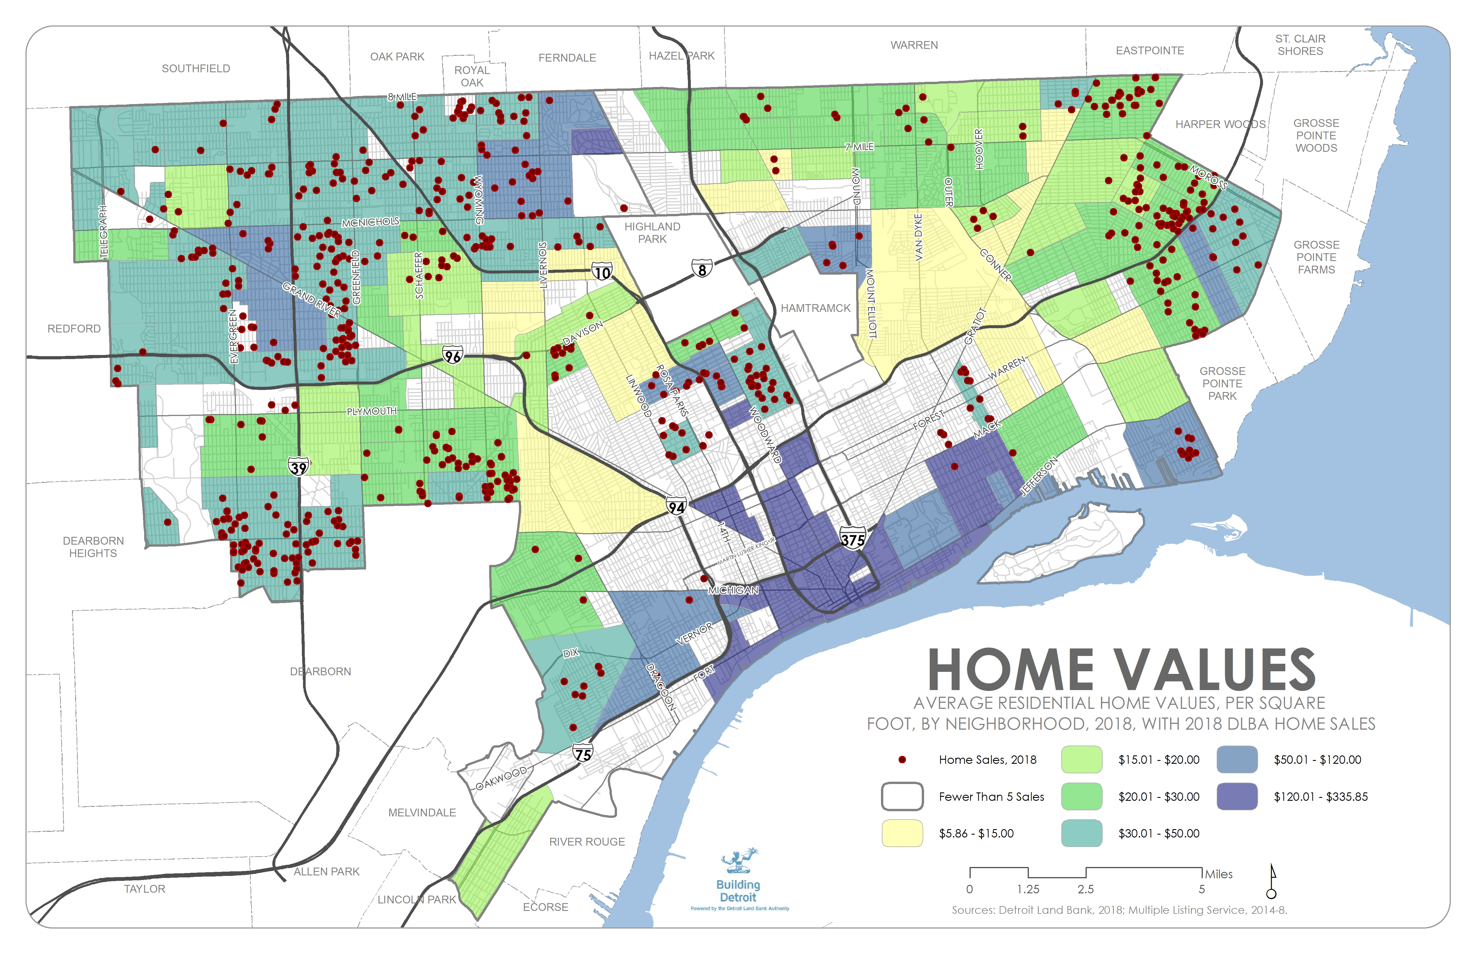

Slide 15
DETROIT LAND BANK INVENTORY
0.3%
120
+/SQF
$15.00 - $20.00/SQF
$0.00 - $15.00/SQF
$50.00 – $120.00/SQF
$30.00 – $50.00 SQF
$20.00 - $30.00/SQF
PERCENT OF SALVAGEABLE
STRUCTURES
INFILL INQUIRIES BEGIN
0.7%
PERCENT OF SALVAGEABLE
STRUCTURES
DEMOLITION RARELY NECESSARY
4.1%
PERCENT OF SALVAGEABLE
STRUCTURES
FOR PROFIT REHAB POSSIBLE
10.5%
PERCENT OF SALVAGEABLE
STRUCTURES
TYPICAL AUCTION INVENTORY
OPPORTUNITIES FOR INTERVENTION
25.1%
TYPICAL OIN INVENTORY
PERCENT OF SALVAGEABLE
STRUCTURES
59.4%
LIMITED TOOLS
PERCENT OF SALVAGEABLE
STRUCTURES

Slide 16
INVENTORY IN LOW VALUE MARKETS
Percent of Structures in sub-$15/SQF Markets

Slide 17
CHANGING SALES
Percent of Auction Sales Selling For $1,100 or Less, Per Quarter

Slide 18
3.
ASSESSING WEAK MARKETS

Slide 19
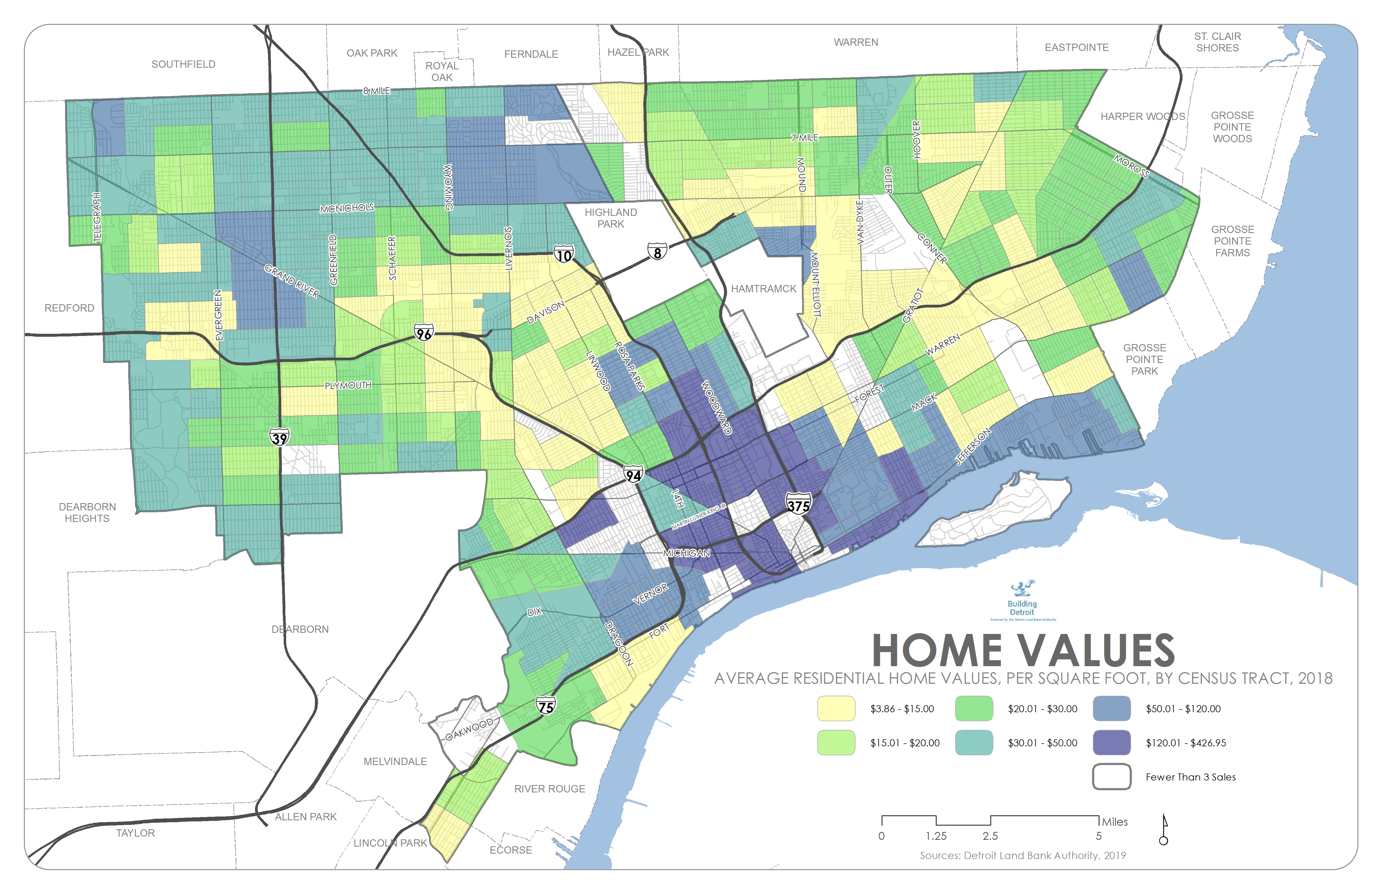

Slide 20
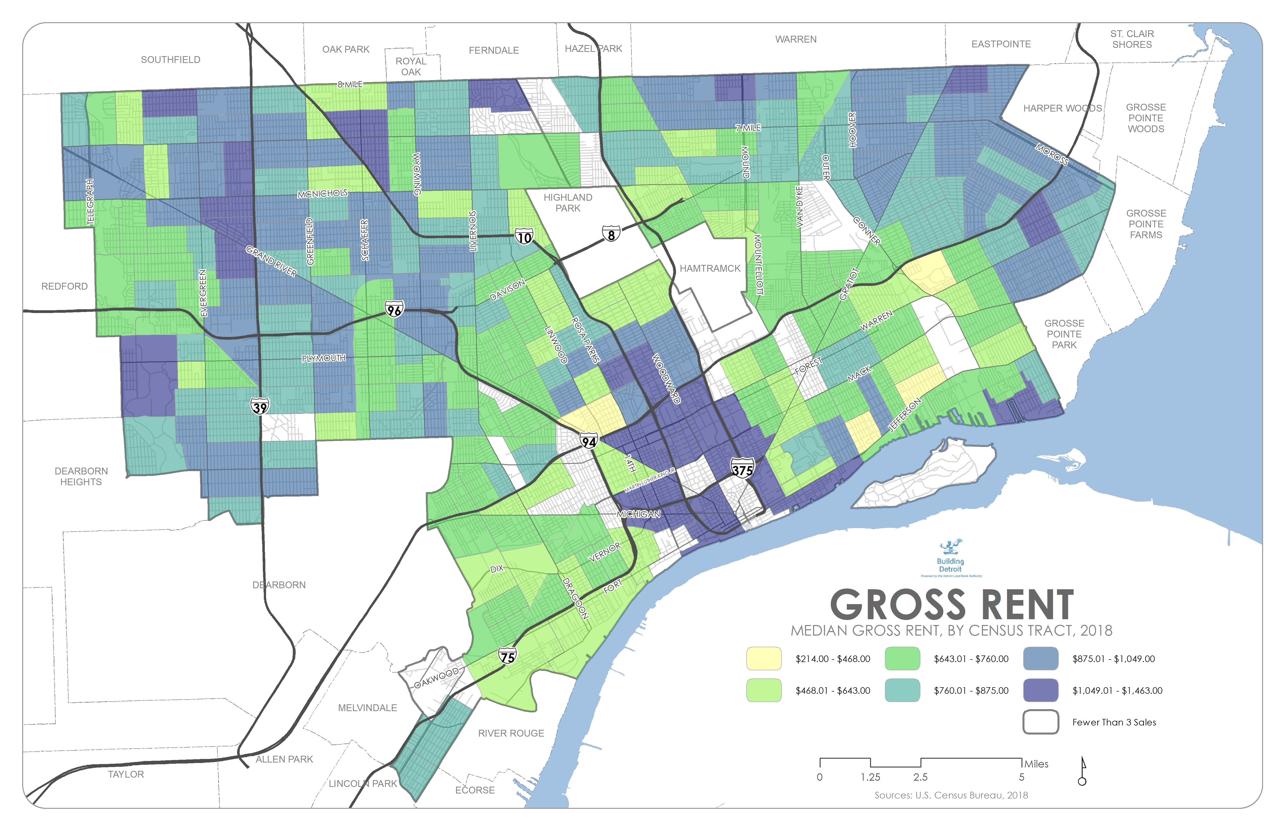

Slide 21
WEAK MARKET THEORY
Cash Value – The financial value of a home, based on supply and demand
Use Value – The inherent value of a home as a place to live
Imperfect Markets – Small numbers of buyers and sellers, incomplete information, high barriers to exit, difficulty assessing value

Slide 22
ASSESSING STRUCTURES
CONDITION
Multiple Structural Issues (foundation, roof, support structure)
High Projected Rehab Costs
No Structural Issues (foundation, roof, support structure)
Low Projected Rehab Costs
High Area Occupancy/Low Public Ownership
Optimal Home Sale/Rehab Candidate
High Private Market Home Sale Prices
Active Home Purchase Request
Growing Private Market Values/Activity
Adjacent City Investment (catalytic parks, SNF $, etc)
No Public Input
High Area Vacancy/Public Ownership
Low Private Market Home Sale Prices
Demolition Request
Decreasing Private Market Values/Activity
LOCATION
PUBLIC INPUT

Slide 23
ASSESSING WEAK MARKETS
Sales History – The organization’s past sales experience, including prices, time on market, and listing conversions
Mortgage Originations – Conventional, VA, FHA, and 203K loans, and their relative concentrations over time
Amenity Locations – The proximity of schools, churches, commercial districts, etc.
Building Permits – Tracking resident investment in their properties. Also, dumpster rentals.

Slide 24
ASSESSING WEAK MARKETS
Housing Occupancy – Housing occupancy – and changes over time
Tax Payments – Tax payment rates are a leading indicator of future foreclosures and a type of property investment
Crime– Rates of property and violent crime
Civic Engagement & Infrastructure – Indicators of civic infrastructure – voting rates, and the presence of CDCs, block clubs, neighborhood associations, etc.

Slide 25
4.
DEMOGRAPHICS

Slide 26
City of Detroit Demographics
Fact | Detroit | Michigan
Population estimates, July 1, 2018, (V2018) | 672,662 | 9,995,915
Owner-occupied housing unit rate, 2013-2017 | 48% | 71%
Median household income (in 2017 dollars), 2013-2017 | 27,838 | 52,668
Median value of owner-occupied housing units, 2013-2017 | 42,800 | 136,400
Quick Facts. United States Census Bureau. Web 30 Sept. 2019.
https://www.census.gov/quickfacts/fact/table/detroitcitymichigan,MI/PST045218

Slide 27
Dlba Demographics
Optional Survey
Ethnicity
Ethnicity | Count | %
Black / African American | 1522 | 73.07%
White | 197 | 9.46%
Hispanic / Latino | 149 | 7.15%
Middle Eastern / Arab American | 90 | 4.32%
Asian / Asian American | 56 | 2.69%
Native American | 30 | 1.44%
Multiracial | 30 | 1.44%
Other | 9 | 0.43%
Grand Total | 2083

Slide 28
Dlba Demographics
Age
Age Range | Count | %
18-24 | 185 | 8.24%
25-34 | 817 | 36.39%
35-49 | 803 | 35.77%
50-64 | 385 | 17.15%
65+ | 55 | 2.45%
Grand Total | 2245

Slide 29
Dlba Demographics
Do you currently own or rent the home you are currently living in?
Rent/Own | Count | %
Own | 589 | 38.42%
Rent | 944 | 62%
Grand Total | 1533

Slide 30
5.
EXISTING PROGRAMS

Slide 31
SALES PROGRAMS OVERVIEW
Eligibility vs. Credit Worthiness
Auction – Daily sales of vacant properties with full cleanouts, inspector scopes, and title insurance
Own it Now – Longer term listings with minimal maintenance and without scopes
Side Lots – Vacant land sold to adjacent, occupied homes for $100

Slide 32
SALES PROGRAMS OVERVIEW
Traditional Sales Approach
Marketing – Realtors list with exceptional rehab needs, allowing the vetting of purchasers
Rehabbed & Ready – An investment-intensive tool that fully rehabs properties
Partial Rehabs – Nascent program, limited rehab efforts to provide greater purchaser certainty
Bundles – Small batches of homes with minimal preparation

Slide 33
HISTORIC VACANT SALES
AUCTION
OWN IT NOW
REHABBED
& READY
0.61%
PERCENT OF CLOSINGS
31.05%
PERCENT OF CLOSINGS
68.34%
PERCENT OF CLOSINGS

Slide 34
NEW VACANT SALES OPTIONS
REHABBED & READY
PARTIAL REHABS
AUCTION
OWN IT NOW
BUNDLED SALES
MARKETING

Slide 35
6.
DEVELOPING NEW PHILOSOPHIES

Slide 36
PHILOSOPHIES
Cohort Dynamics – In areas of high vacancy, selling multiple homes at once can create certainty in future investment
Building Block Events
Self-Fulfilling Prophecies – Announcing plans and intent is a powerful tool to create excitement and a sense of inevitability.
Strategic Neighborhood Fund Zones

Slide 37
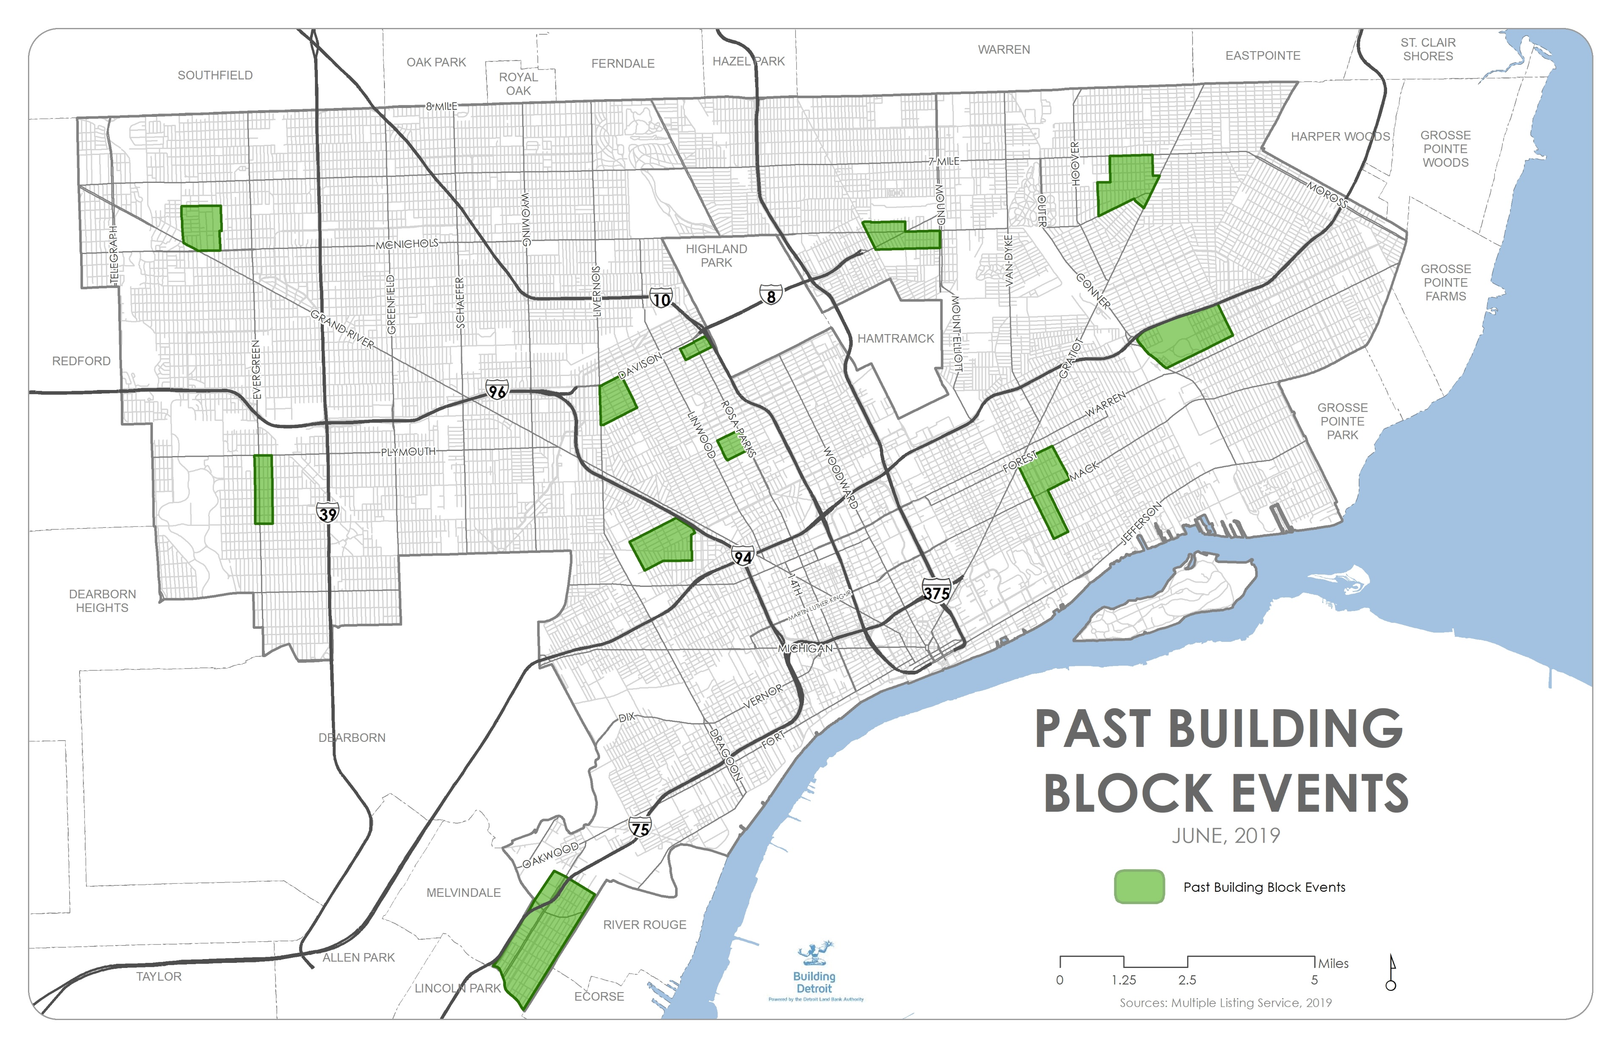
BUILDING BLOCKS
District Wide Maintenance
Engaging a Neighborhood Partner Organization
Creating a Cohort of Purchasers
Layering Other Tools

Slide 38
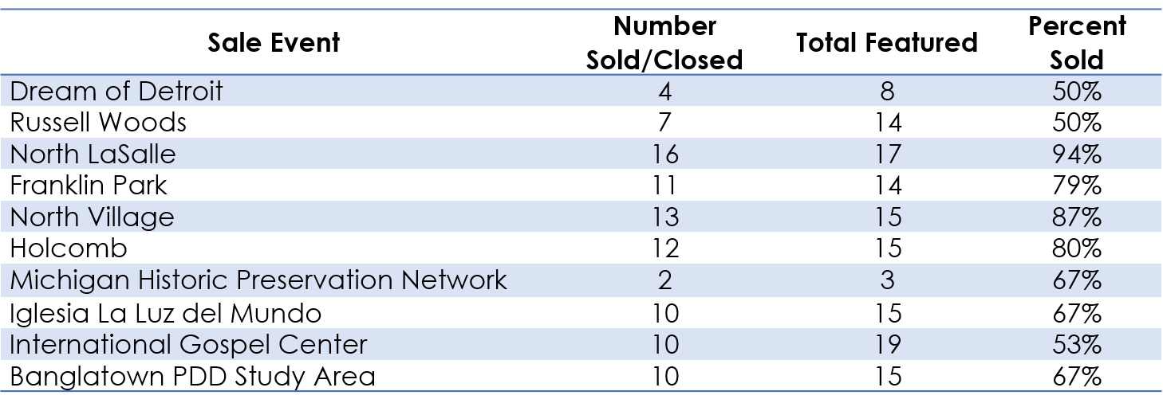
BUILDING BLOCKS
Overall: 70.31%

Slide 39
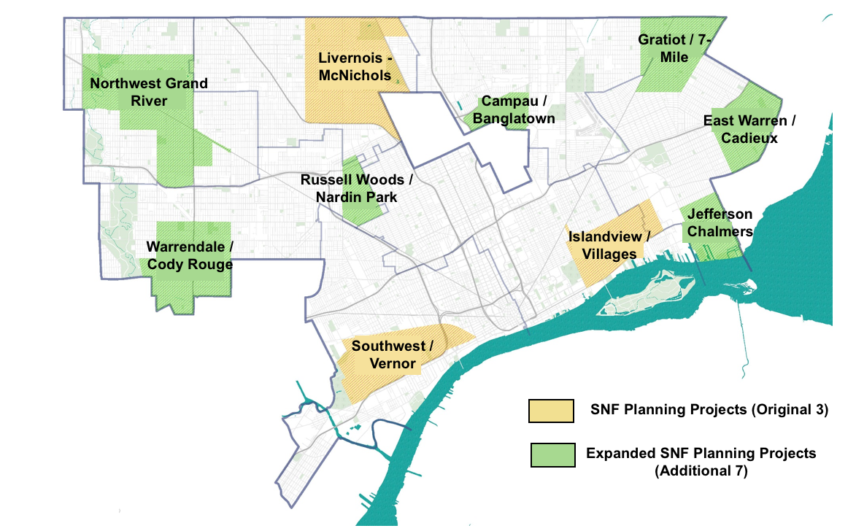
PHILOSOPHIES
Strategic Neighborhood Fund Zones

Slide 40
PHILOSOPHIES
Non-Market-Motivated Purchasers – Some buyers are not market-driven, and their investment can spur market improvement
Ancestral Homes
Layering Tools – Applying multiple tools in a single space can create an impact greater than the sum of its parts
Crary/St. Marys

Slide 41
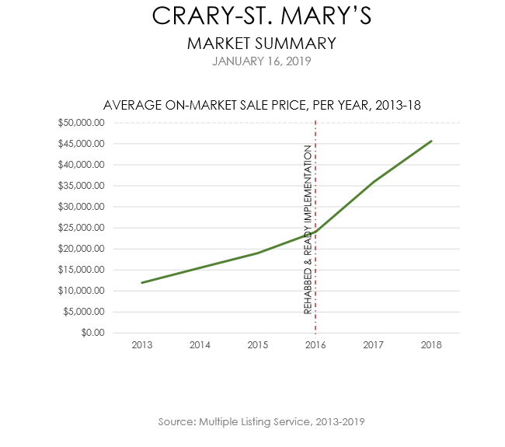
PHILOSOPHIES

Slide 42
PHILOSOPHIES

Slide 43
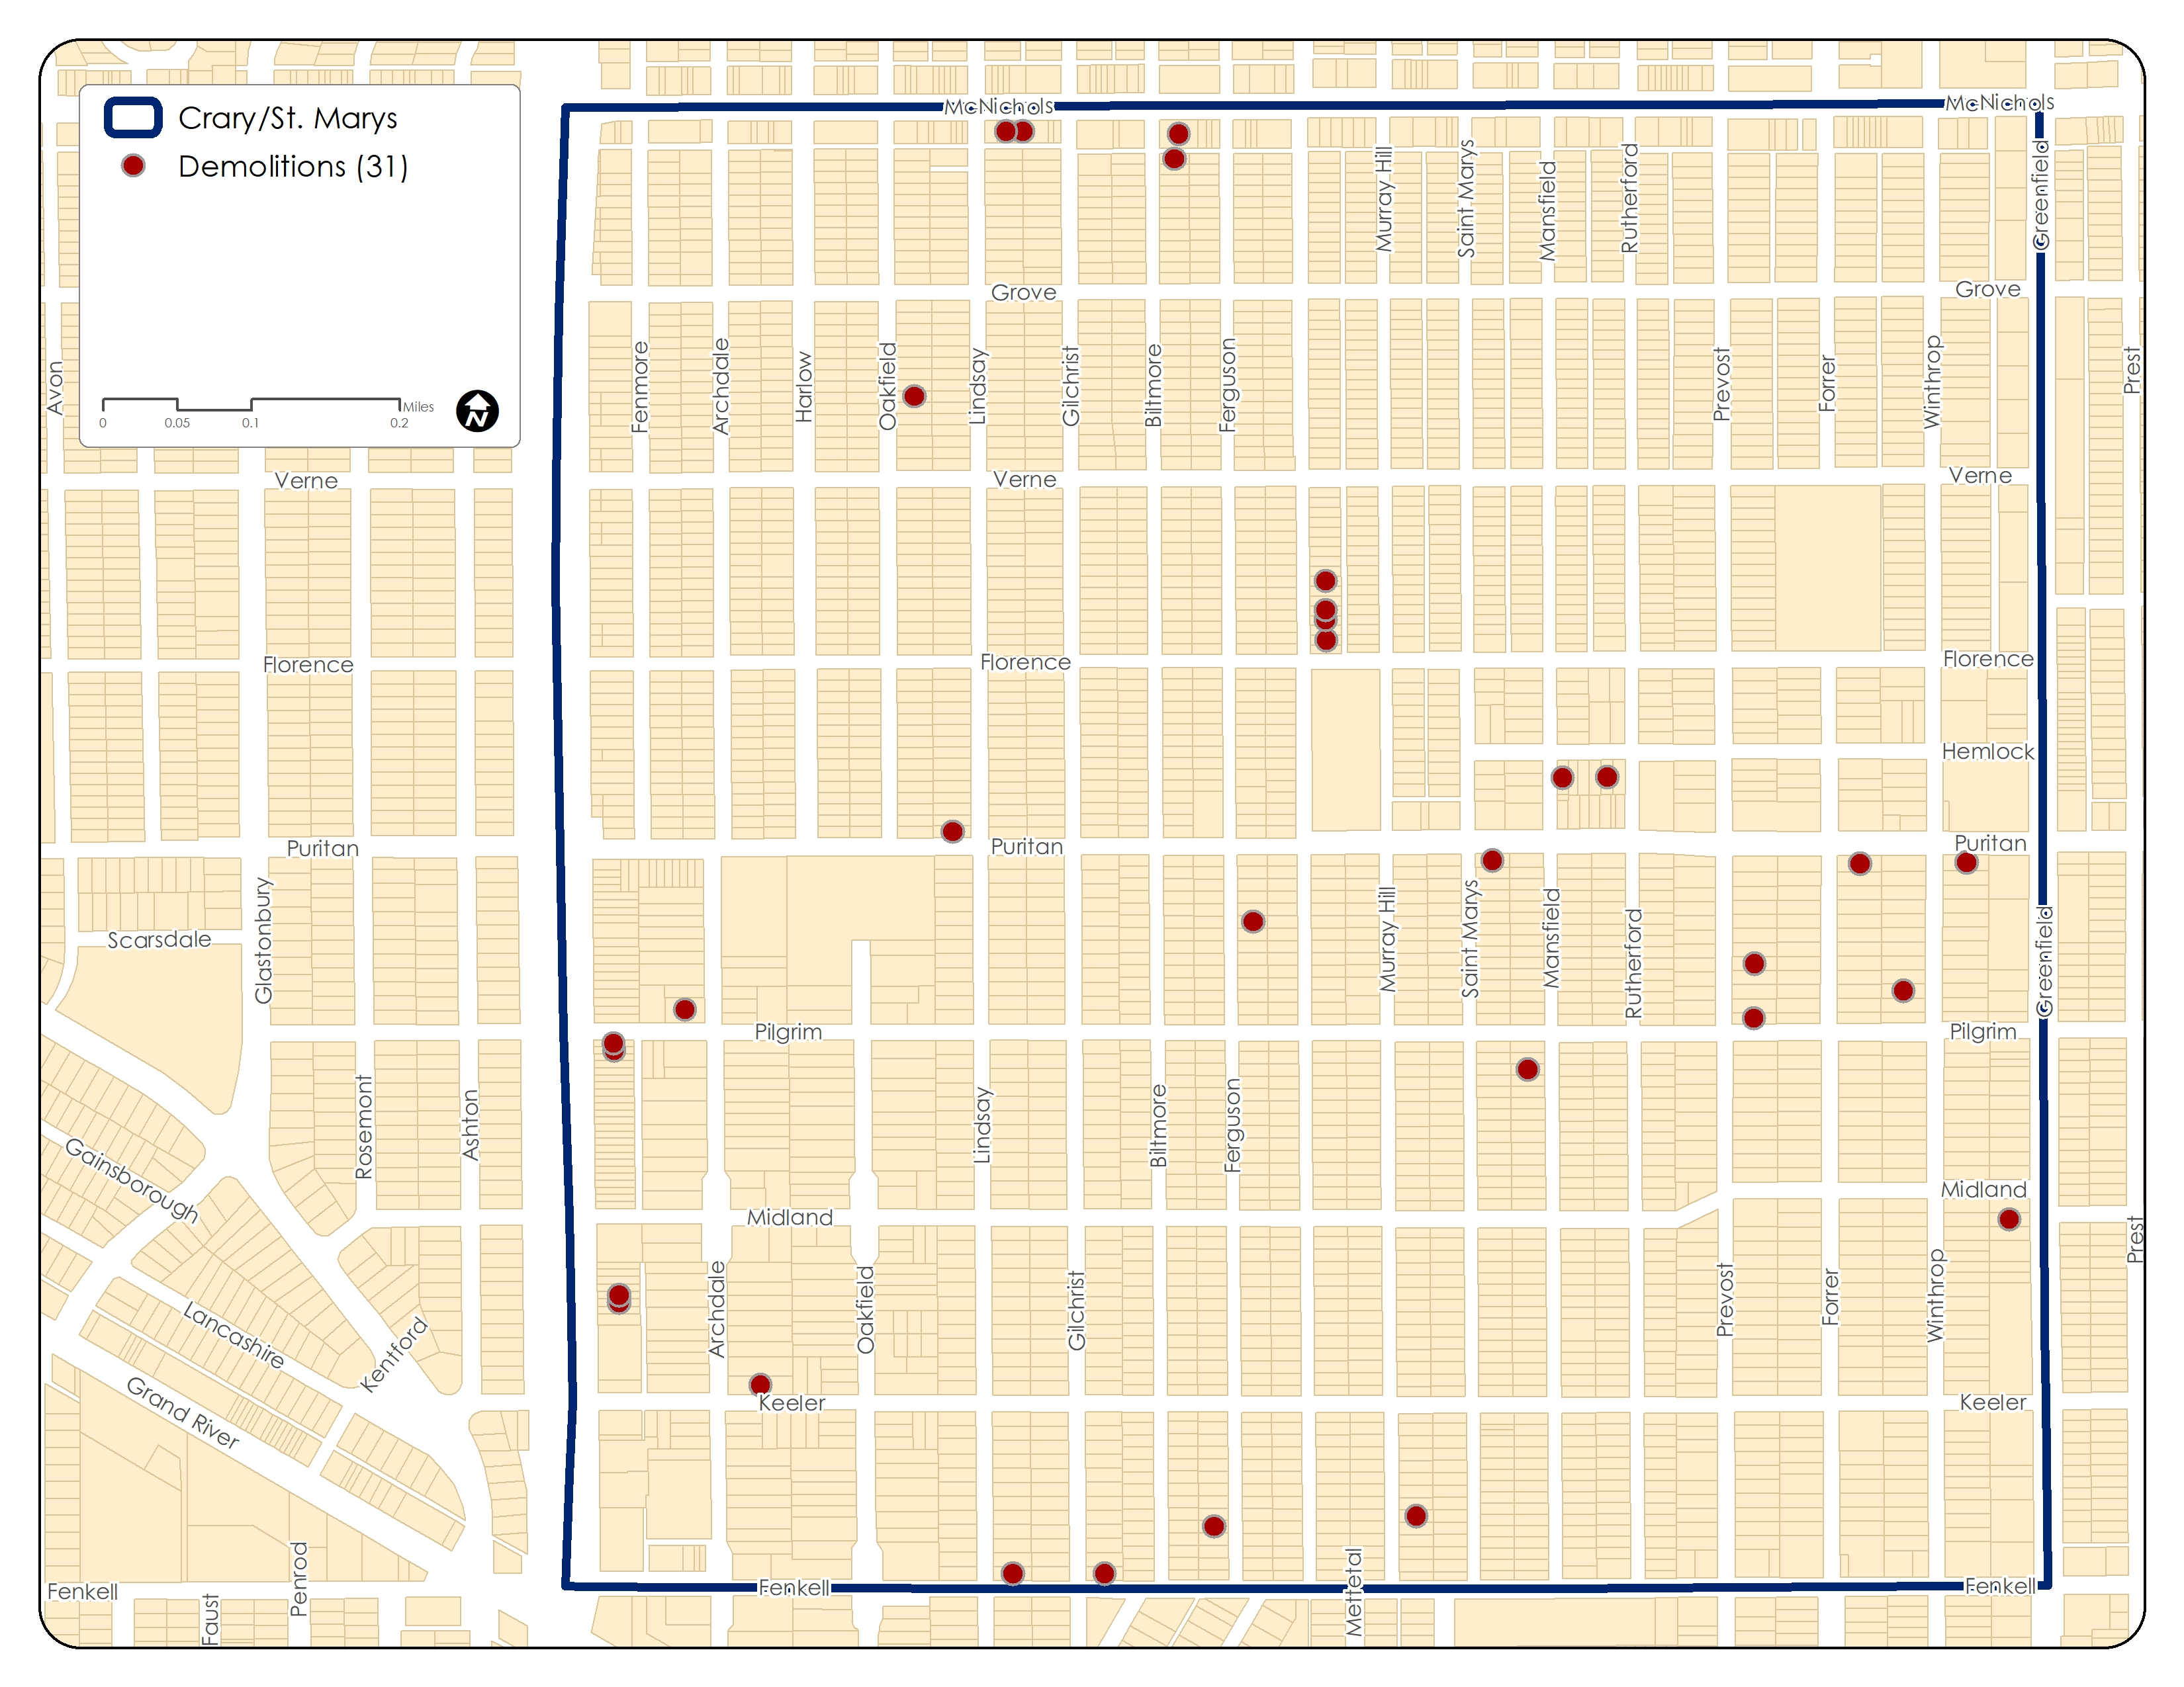

Slide 44
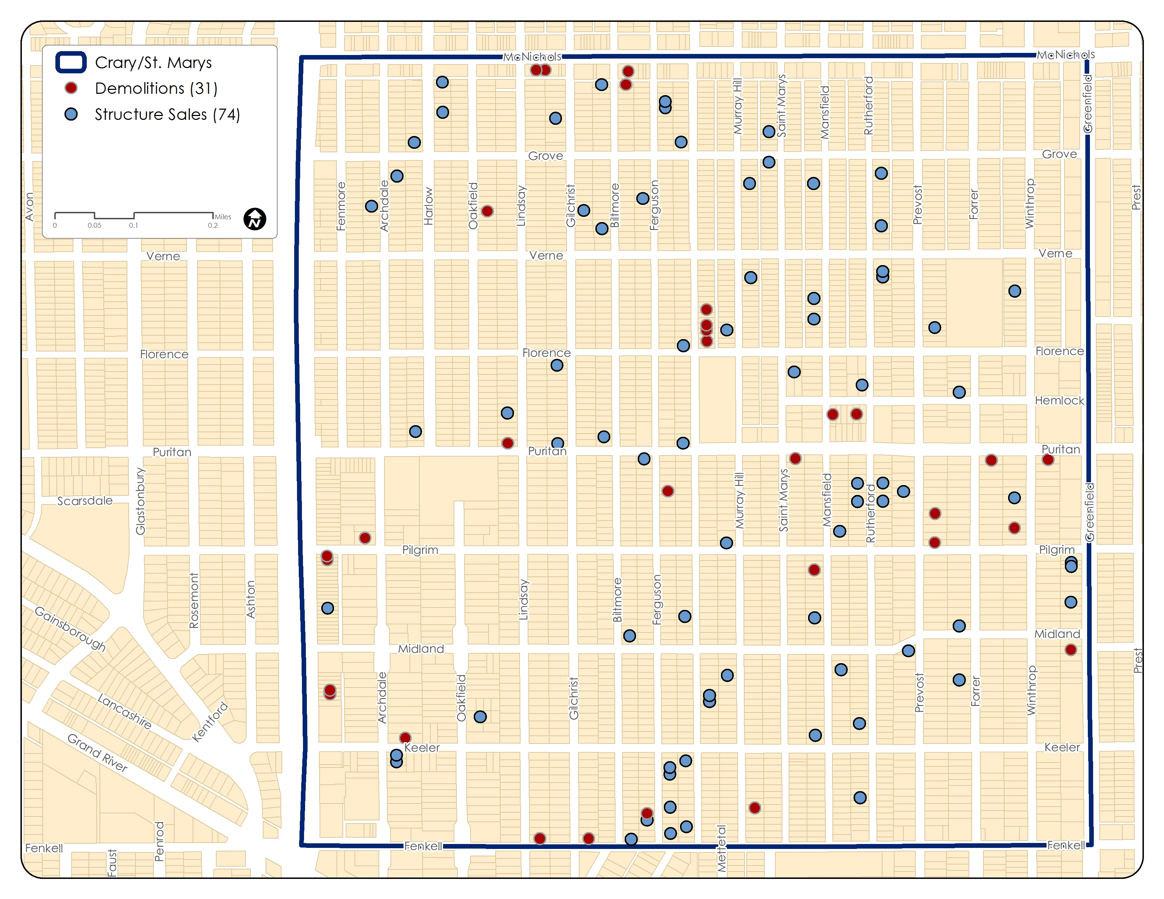

Slide 45
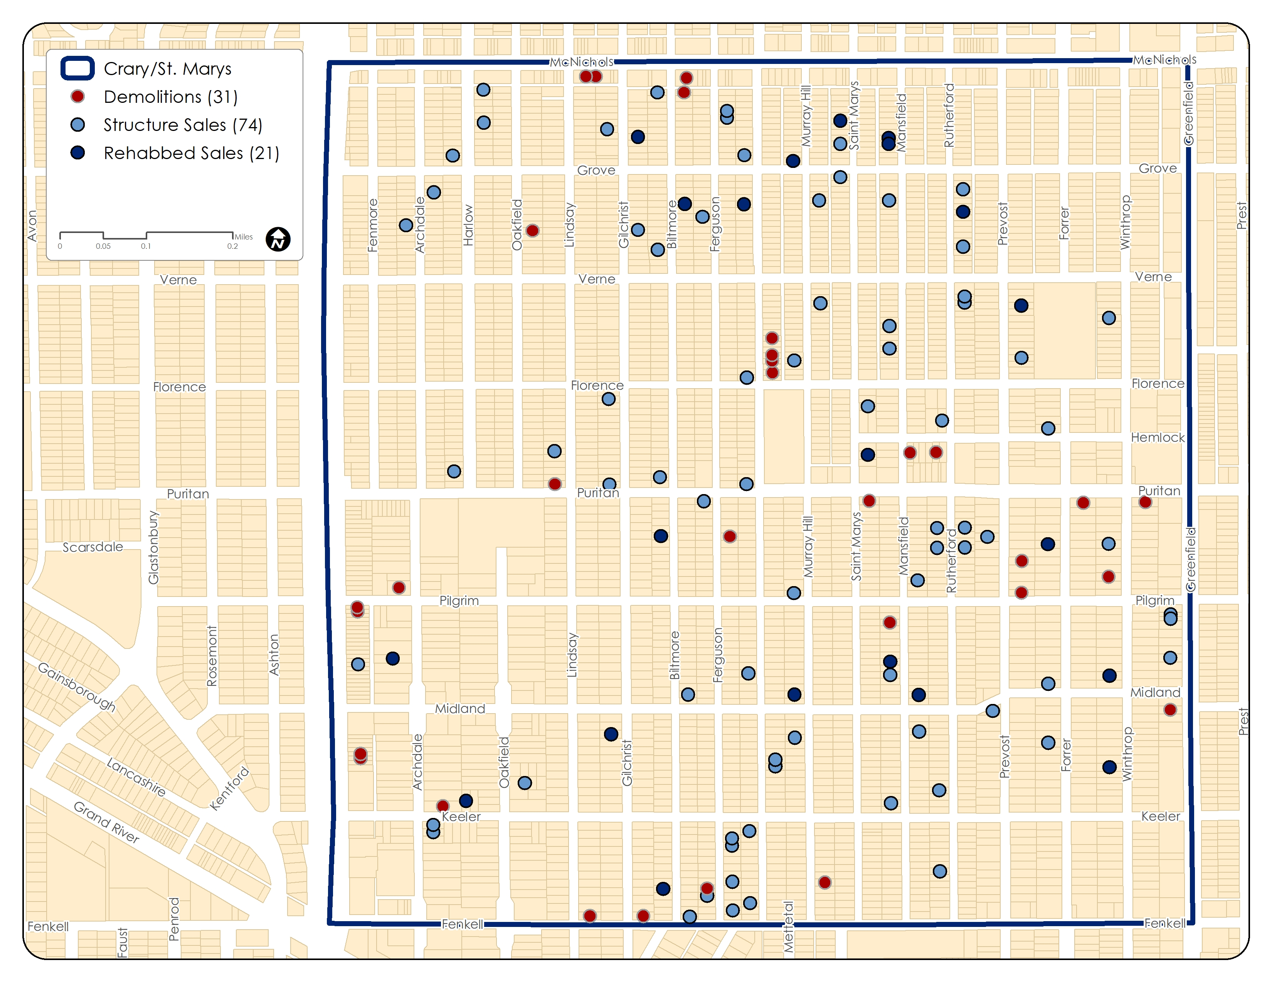

Slide 46
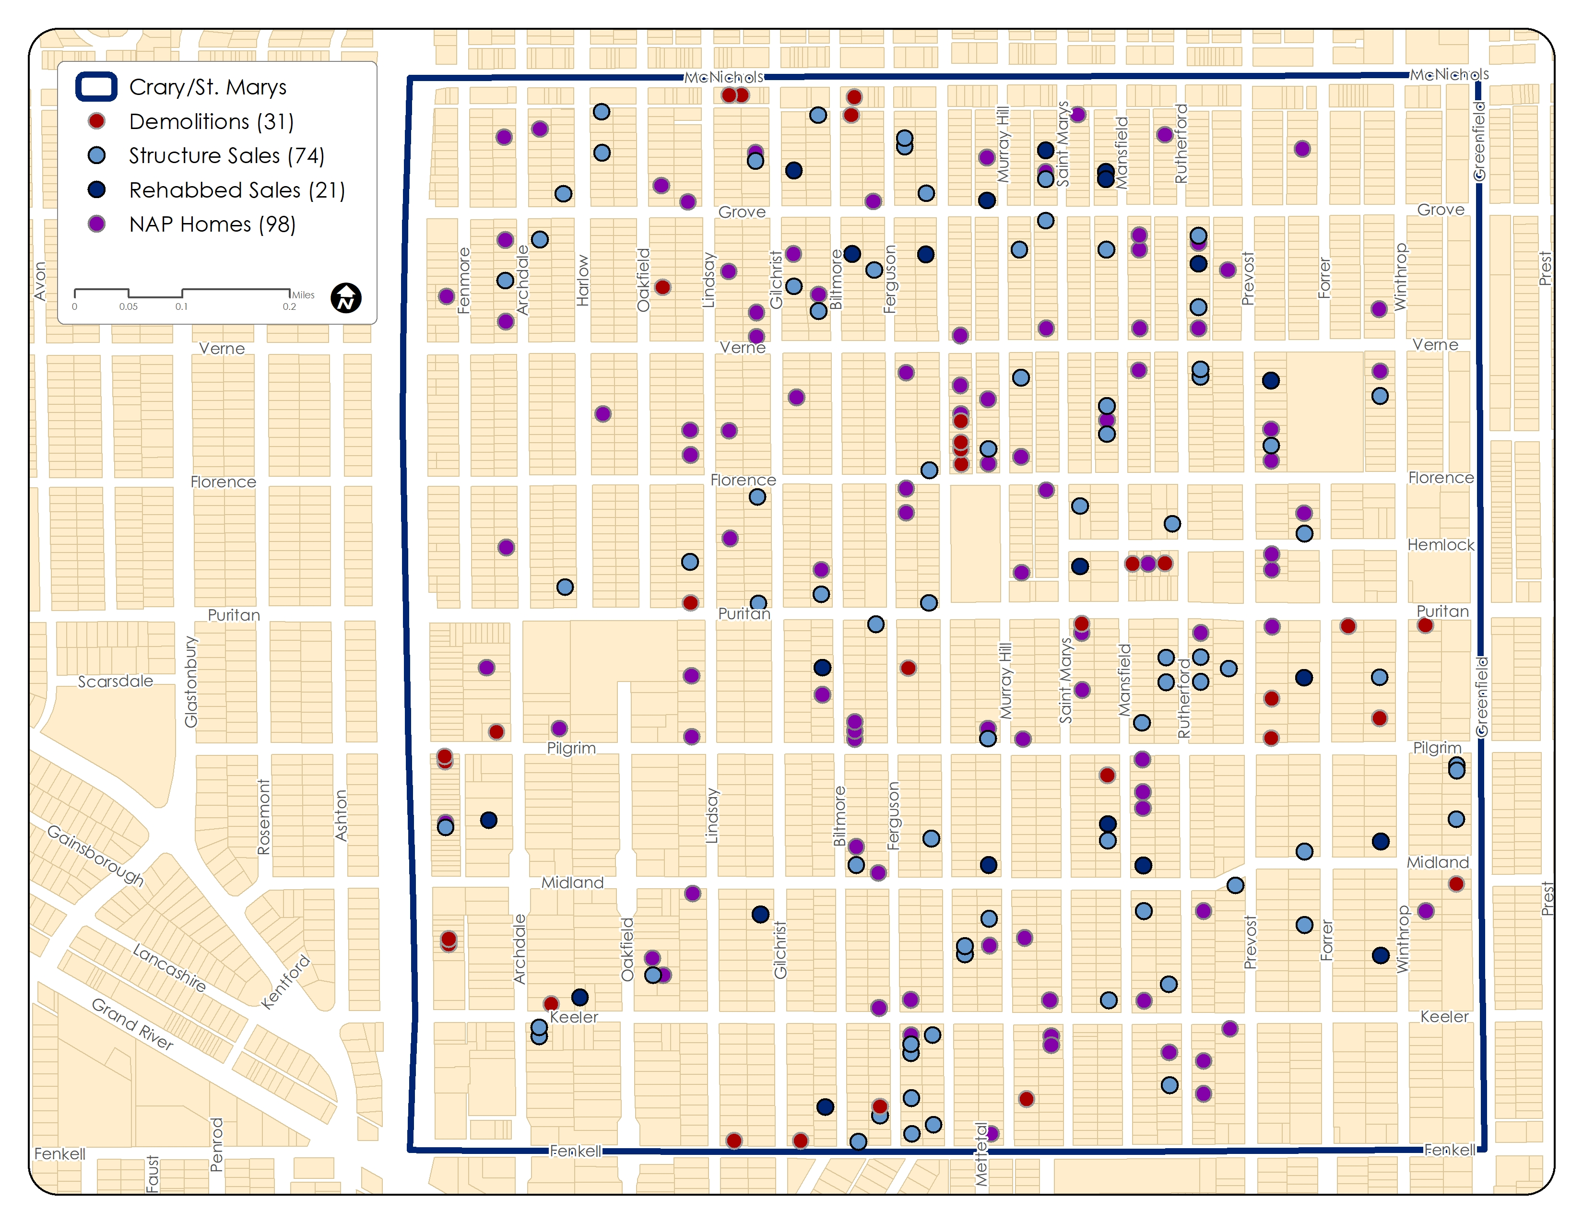

Slide 48
PHILOSOPHIES
Forming Partnerships – Leveraging neighborhood partners can ground efforts and leverage a network of prospective purchasers
Neighborhood-Level Approaches – To improve the desirability of properties, the land bank often must think holistically and look beyond its ownership
Harnessing History & Identity – Investing in opportunities to share the stories of neighborhoods
Targeting Small Constituencies – Tailored programs have the potential to attract niche purchasers who view neighborhoods differently

Slide 49
7.
ADAPTING TO WEAK MARKETS

Slide 50
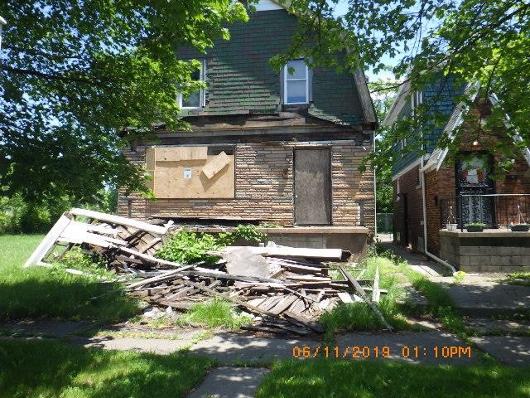
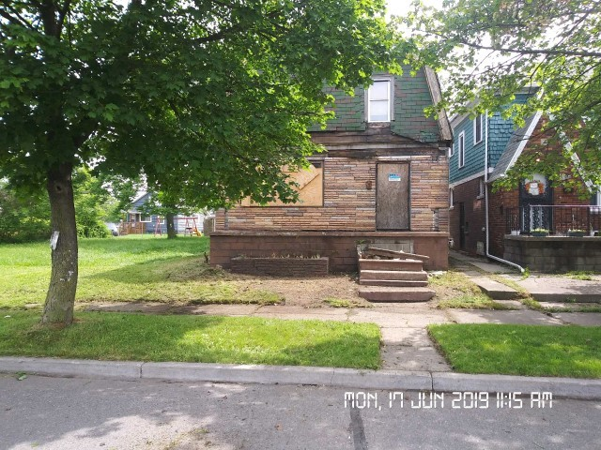
OWN IT NOW
With Shift to Weaker Markets
Exterior Maintenance
Rehab Scopes
Modifying Bidding Rules

Slide 51
Renovation Funding Model
Revolving Fund– Funds to allocate toward rehab of properties in order to grow or stabilize markets
*As houses sell, the Revolving Fund replenishes
Loss Reserve Fund– Funds to allocate toward sustained losses in order to grow or stabilize markets
* As houses sell, the loss decreases

Slide 52
Renovation Funding Model
Property: Floor Area | Estimated Rehab Cost-Prelim Budgets | Estimated List Price-w/formula | Budgeted Loss
704 | $ 113,263.60 | $ 81,631.80 | $ (31,631.80)
1152 | $ 133,763.60 | $ 106,881.80 | $ (26,881.80)
1,152.00 | $ 131,713.60 | $ 106,176.80 | $ (25,536.80)
1,218.00 | $ 164,973.60 | $ 124,986.80 | $ (39,986.80)
1,817.00 | $ 166,303.60 | $ 140,000.00 | $ (26,303.60)
1,866.00 | $ 156,165.60 | $ 128,082.80 | $ (28,082.80)
2,142.00 | $ 159,528.60 | $ 149,764.30 | $ (9,764.30)
 | $ 1,025,712.20 | $ 837,524.30 | $ (188,187.90)

Slide 53
Renovation Funding Flow
Rehabbed and Ready
Full Rehab Scope
White boxing
Limited Rehab Scope
Partial Rehab
Major Components Only
Exterior Only Rehab
Exterior Updates Only

Slide 54
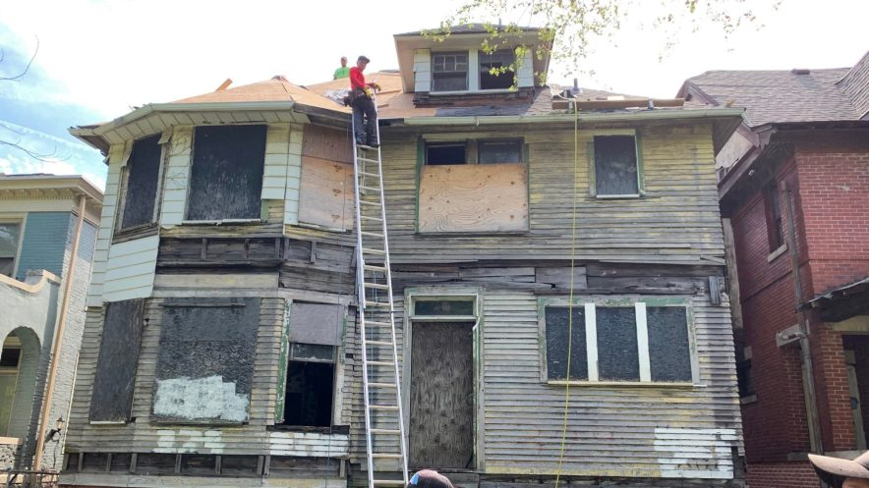
PARTIAL REHAB
Replace/Repair Major Systems – Roof, Water Line, Foundation
Create Certainty for Purchasers

Slide 55
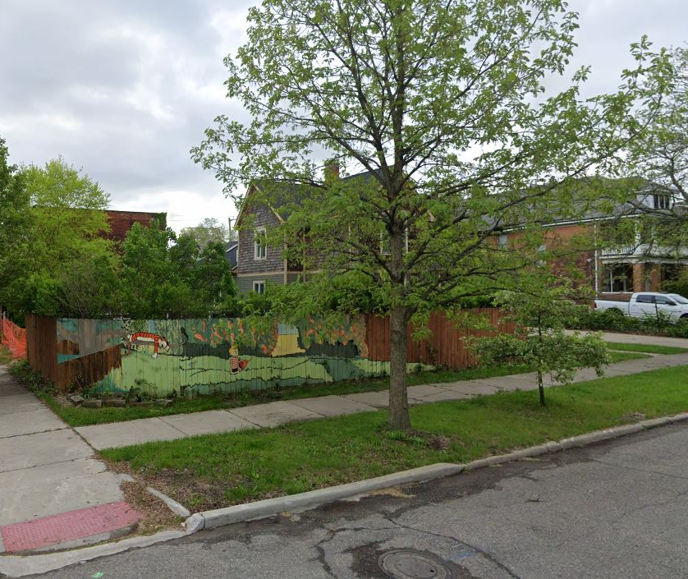
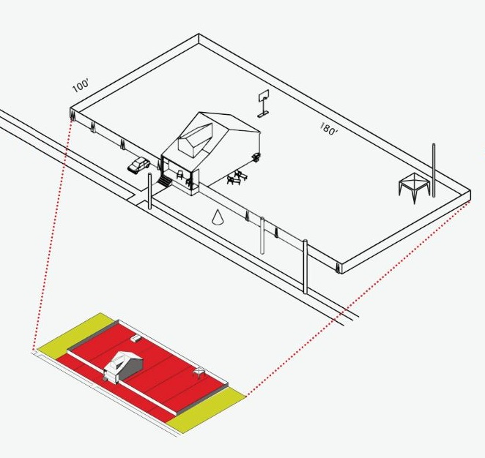
HOMESTEADS
Using adjacent vacant lots to increase equity – “putting meat on the bone”
Creates market among specialty purchasers – gardeners, in-home day care, dog care

Slide 56
FUTURE DIRECTIONS
Direct Incentives – Rededicating demolition funds to offer gap financing to eligible purchasers
Immigrant-Centered Programs– Creating programs with fewer tech and language barriers, greater through the purchase process
Microrehabs – Creating new levels of ‘rehab’ that emphasize minor curb appeal improvements

Slide 57
Thanks!
Any questions?
Reginald B. Scott II
Dispositions Director
313.261.9983
rscott@detroitlandbank.org
@buildingdet
facebook.com/buildingdetroit
Robert Linn
Inventory Director
313.261.9950
rlinn@detroitlandbank.org

