Slide 1

Opportunity zone
Summary - BOULDER census tract 122.03 project & engagement response
Yvette Bowden, Director
Community Vitality
October 4, 2019

Slide 2
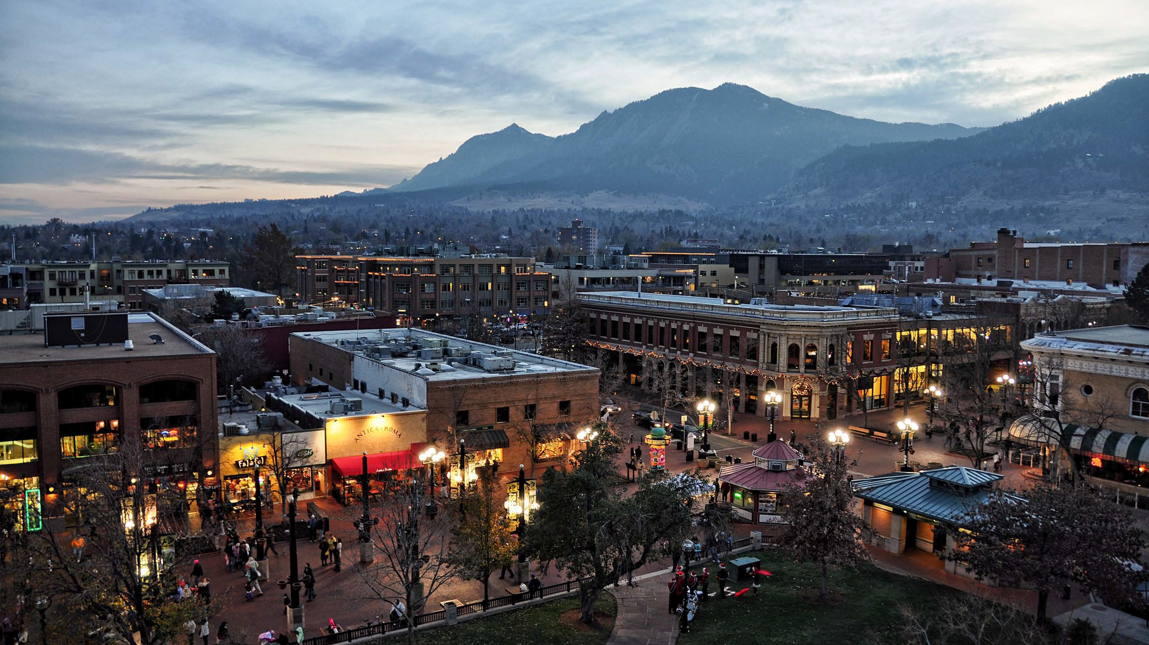
About boulder, Colorado
108,000 residents
“College Town”/large student population
Robust economy; substantial start-up community
Affordability challenges
  14% County residents below poverty line (20%+ w/i zone)
  Focus on needed progress in engagement and inclusion citywide
Policy guided by Boulder Valley Comprehensive Plan
  Maintaining economic stability
  High value placed on local quality of life
  Modeling environmentally-focused policy

Slide 4




How does it work?
Taxpayers can get
capital gains
tax deferral
(& more)
for making timely investments in
Qualified Opportunity Funds
which invest in
Qualified Opportunity Zone Property
(Primarily real estate or businesses)
Source: Novogradac and Company, OEDIT

Slide 5



opportunity zone investment types
Qualified OZ Business Property
Individual Taxpayers
Opportunity Fund
Qualified OZ Partnership Interest
The business must use “substantially all” of its tangible property within a zone (70% of basis of building excluding cost of land) and meet additional basic tests
Investments that do not qualify include funds of funds, excluded businesses and financial institutions
A substantial improvement test applies unless the business property is “original use”
Qualified OZ Stock

Slide 6
Potential investment timeline
Basis is equal to Fair Market Value
Forgiveness of gains on appreciation of investment
*Deferred gain recognized in December 2026
SALE
Basis increased by 10% of the deferred gain
Basis increased by 5% of the deferred gain
INVESTMENT
HELD FOR 5 YEARS
HELD FOR 7 YEARS
HELD FOR 10 YEARS
2018
2019
2020
2021
2022
2023
2024
2025
2026
2027
2028
Deferred gain recognized in Dec. 2026 regardless of when initial investment made
Initial investments can be made up until Dec. 2026
Opportunity zone investments can be held until Dec. 2047
Source: Novogradac and Company, OEDIT
Notes:
Program provides incentive for investing sooner and for holding investments at least ten years. Tax benefit would only apply for investments that are eventually sold and result in capital gains.

Slide 7
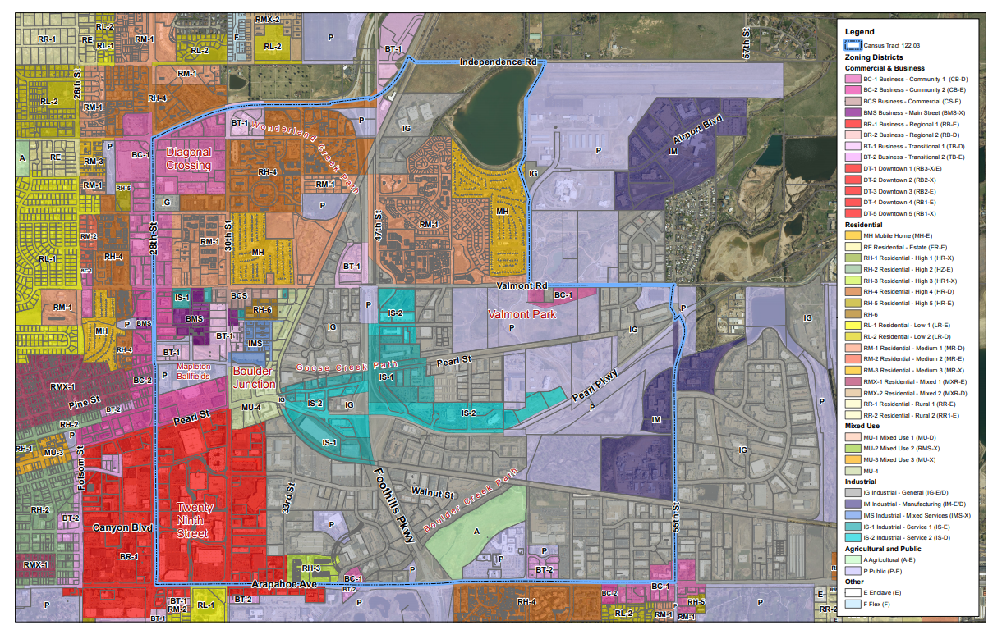
Zoning overview (Census tract 122.03)
Zoning Category | %
Industrial | 41%
Residential | 21%
Commercial | 20%
Ag | 2%

Slide 8
Population characteristics (Census tract 122.03)
Approx. 8,300 residents, 4,000 households
20.9% below poverty level (Boulder County: 14.1%)
Median household income is $51,719 (Boulder County: $70,961)
Housing concentrated north of Valmont
Median Home Value is $250,300 (Boulder: $512,600)
Source: U.S. Census Bureau 2015 American Community Survey (5-year estimates), City of Boulder
Notes:
Housing concentrated north of Valmont; Census tract includes Orchard Grove and Vista Village mobile home parks

Slide 9
Business overview (Census tract 122.03)
1,508 businesses, 23,000 employees
Mostly small
  69% have <20 employees
  2% have 100+ employees
Mix of industries
Source: City of Boulder
Notes:
Many startups and small tech companies, small manufacturers (inc. food & beverage) and small service businesses (auto repair, etc.) in OZ

Slide 10
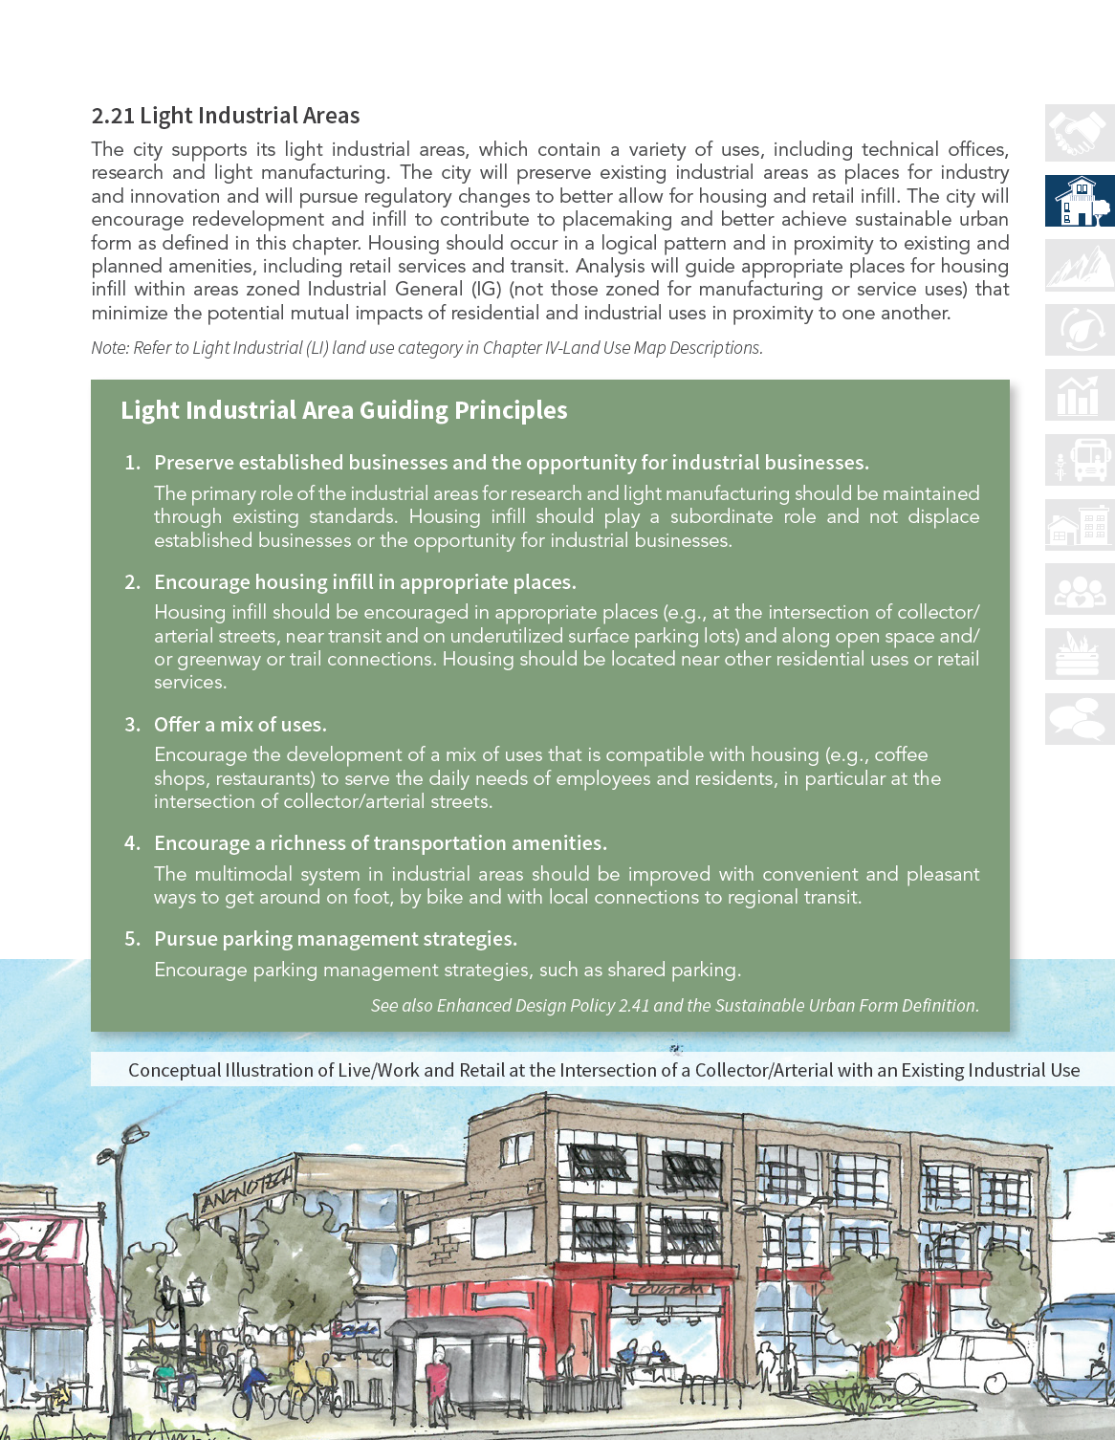
Zoning overview (Census tract 122.03) - INDUSTRIAL

Slide 11
Zoning overview (Census tract 122.03) – BVRC

Slide 12
COMMUNITY PERSPECTIVES SHARED DURING PUBLIC HEARING
  Process for selection of the census tract
  Possibility of displacement and sale/enhancement of existing “affordable” residential properties
  Retention of community-serving small/local businesses
  Desire for transparency in all land transactions/investments
  Retention of neighborhood character
  Comprehensive Housing Strategy Implementation

Slide 13
TEMPORARY moratorium CONSIDERED
What Ordinance 8308 Regulates
  Suspends applications for site reviews, use reviews and building permits
  In effect until June 22, 2020
  Applies solely to Opportunity Zone Census Tract 122.03 (with exemptions)
  Prohibits the construction of new floor area for office, medical or financial uses
  Prohibits additional dwelling units, except for projects that meet Inclusionary Housing requirements onsite

Slide 14
Proposed moratorium (Census tract 122.03)
What Ordinance 8308 Expressly Permits
  Site reviews, use reviews and building permits for anything not expressly prohibited
  Projects that add dwelling units and meet inclusionary housing requirements onsite
  Projects that have prior discretionary land use approvals
  Site reviews, use reviews and building permits pending will be processed based on rules in place at the time of application
  Prohibits additional dwelling units, except for project that meet Inclusionary Housing requirements onsite

Slide 15
Proposed moratorium (Census tract 122.03)
Suggested Motion Language
  Motion to introduce, order published by title only and adopt by emergency Ordinance 8308 temporarily suspending accepting building permit, site review, and other development applications that will result in adding floor area or dwelling units to land within the census tract 122.03 opportunity zone, generally bounded on the west by 28th Street, on the south by Arapahoe Avenue, on the east by 55th Street/Airport Road and on the north by Highway 119/Independence Road until June 22, 2020, and setting forth related details.

Slide 16
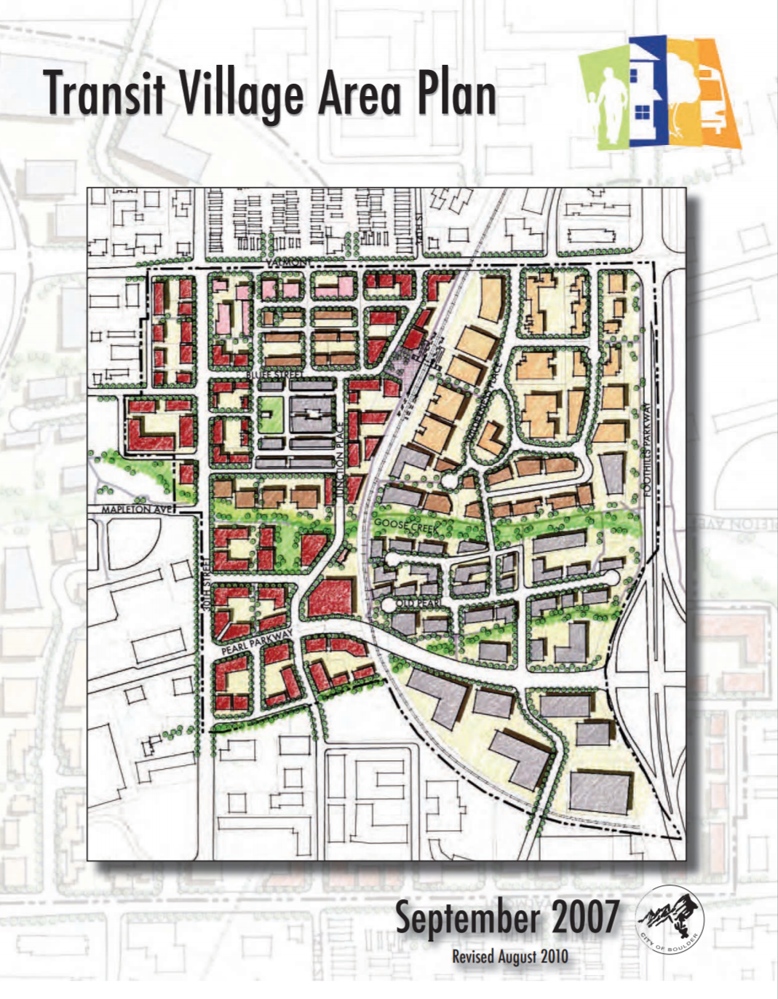
Zoning overview (Census tract 122.03) – Boulder JuNction

Slide 17
Experience to date
Implementation of Temporary Moratorium
Cross-departmental Work Plans
  Comprehensive Housing Strategy
  Citywide Retail Study
  Use Table Update
  Community Benefit pilot (housing prioritized)
  Small business initiatives enhancement (proposed)
  Diagonal Plaza focus (on-going)
  Webpage - https://bouldercolorado.gov/business/opportunity-zone-program

