Slide 1



Conducting Housing Surveys and Data Driven Housing

Slide 2
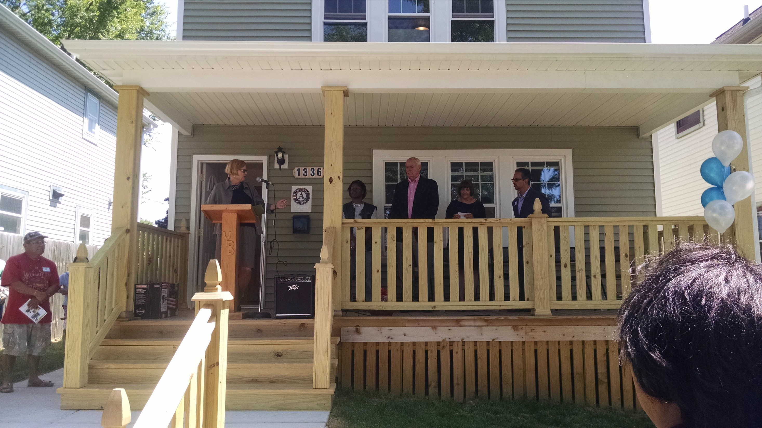
Basics

RON – Reclaiming Our Neighborhoods
Coalition of neighborhood groups who work together to improve the quality of housing in Milwaukee, WI
The housing survey is the main initiative of the RON group

Slide 3
Why do a Housing Survey?

Develop a better understanding of the local housing stock and the main issues that prevent homeowners from making repairs (Neighborhood Triage)
Identify property owners who do or do not take care of their property and:
  Acknowledging homeowners with well-maintained homes
  Connecting struggling homeowners with resources
  Holding problematic investors accountable
Collect data to track over time and across neighborhoods

Slide 4
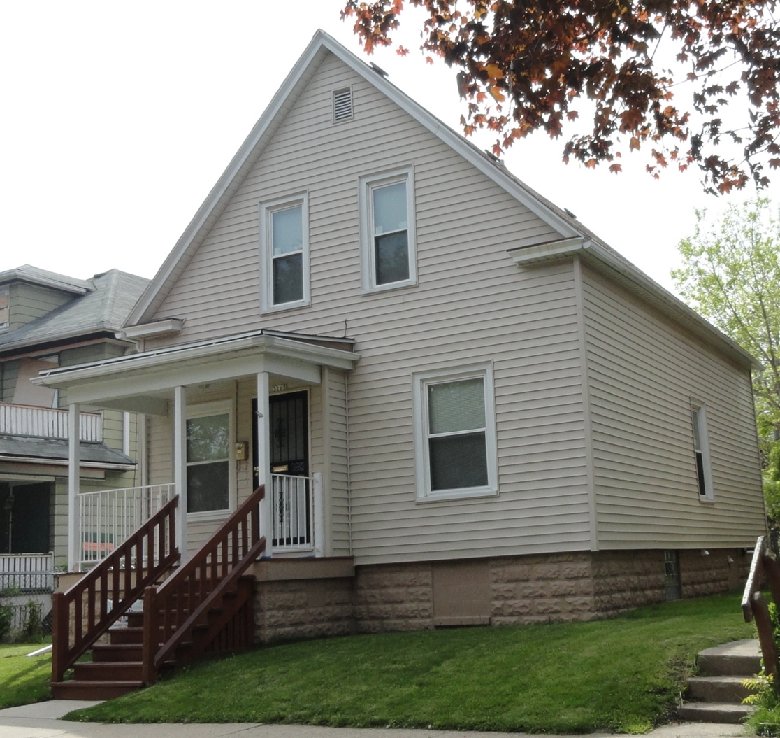
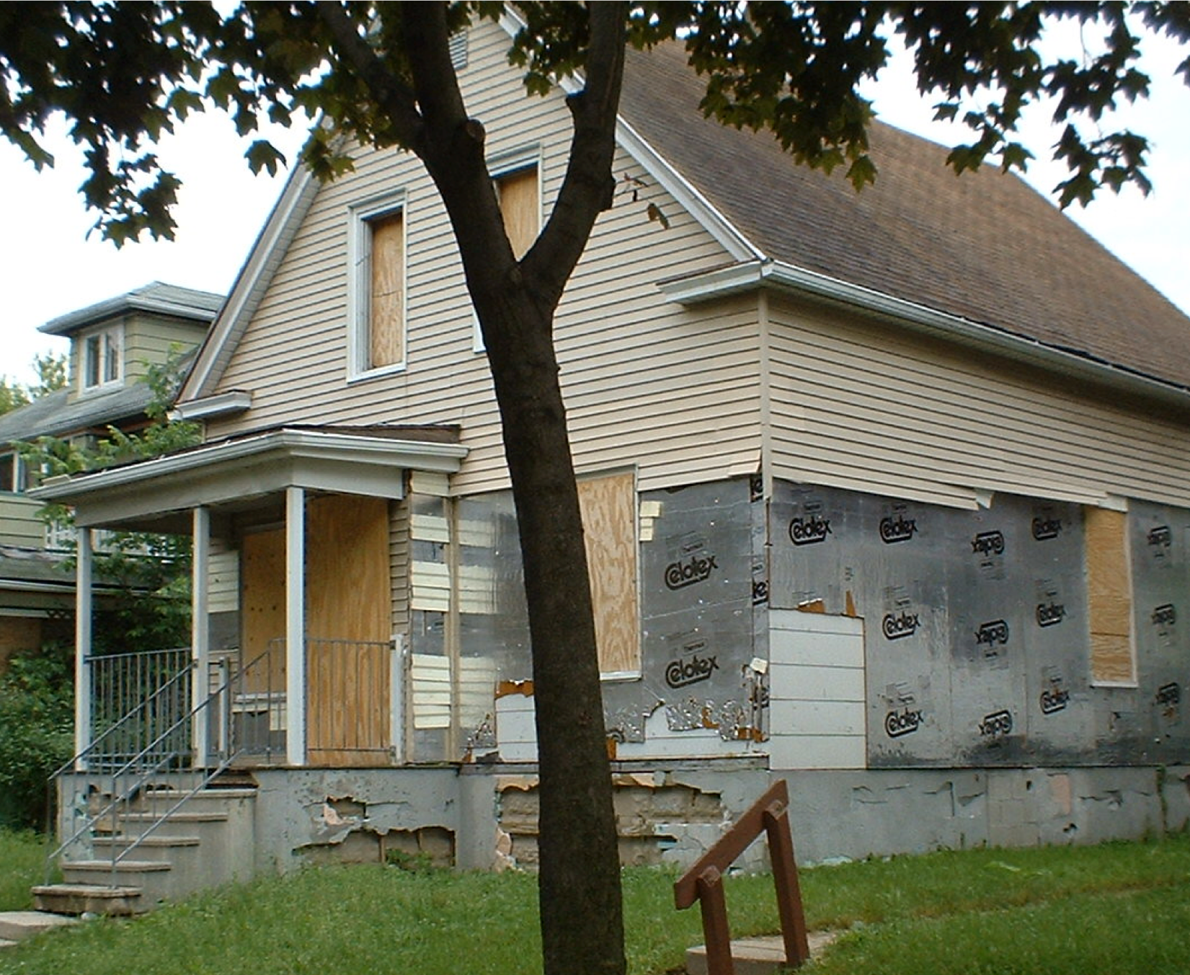
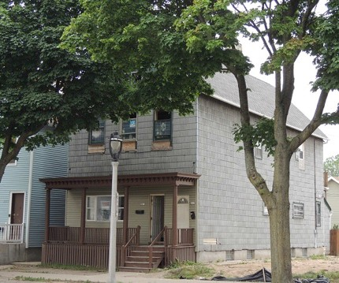
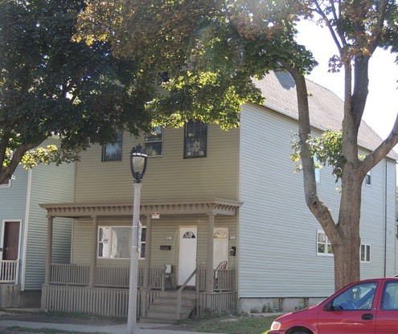
Why do a Housing Survey?


Slide 5
Outcomes of the RON Group

Impacts policies
Compliance Loan Program (City of Milwaukee)
Relationships established or strengthened with property owners and residents who can then be connected to resources
Survey Data assist the City Attorney’s Office in building cases against problematic landlords
Coalition building across neighborhoods and housing-related sectors, leading to a more cohesive housing strategy in Milwaukee

Slide 6
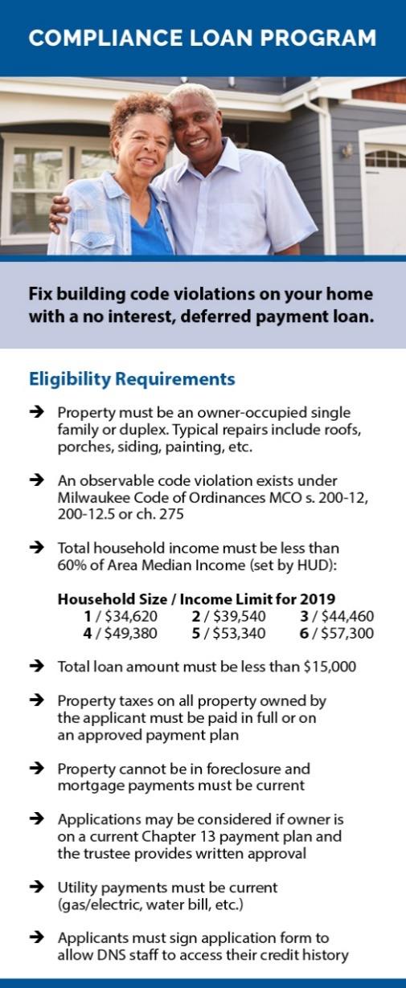


Compliance Loan Program

All work reviewed by DNS Building Inspector
Paid back when property is sold or transferred to new owner
0% interest
$15,000 deferred payment loan
City of Milwaukee approved contractor

Slide 7
Compliance Loan Program

Owner-occupied single family or duplex
Income 60% or below AMI
Property taxes current or on payment plan
Observable code violations present
Can work with applicants in Chapter 13 bankruptcy
No credit score requirement
Income Limits
Household Size | Income Limit
1 | $34,620
2 | $39,540
3 | $44,460
4 | $49,380

Slide 8
Compliance Loan Program

Number of loans 2014-2019: 225 (some in progress)
Average age of recipient: 58 years
Average length of homeownership: 19 years
Median annual household income: $20,300
Median year built: 1912
Median total property assessment: $46,200
Average total property assessment: $51,900
Average combined loan to value ratio: 89%

Slide 10

Riverworks Development Corporation
Focal Geography includes a Business Improvement District (BID), a Neighborhood Improvement District (NID) and the Riverwest and Harambee neighborhoods
Riverwest: 66% White, 27% live below Poverty Level (29% citywide)
Harambee: 78% African American, 45% live below Poverty Level

Slide 11
Median Sold Price
Although the prices of homes sold has increased in both neighborhoods a significant disparity remains between Harambee and Riverwest.

Slide 12
Housing Survey Process

Spring Housing Survey (usually April or May)
Data entered into specialized application, Compass, connected with Milwaukee Master Property data
Letters mailed to owners of properties identified as needing repair
Owner occupants are referred to repair programs
Investor owners are asked to provide a plan and timeline for repairs
Fall Housing Survey (usually October-December)
Follow-up letters
Investor owners asked to meet with DNS and neighborhood groups
Outstanding/Most Improved House Awards

Slide 13
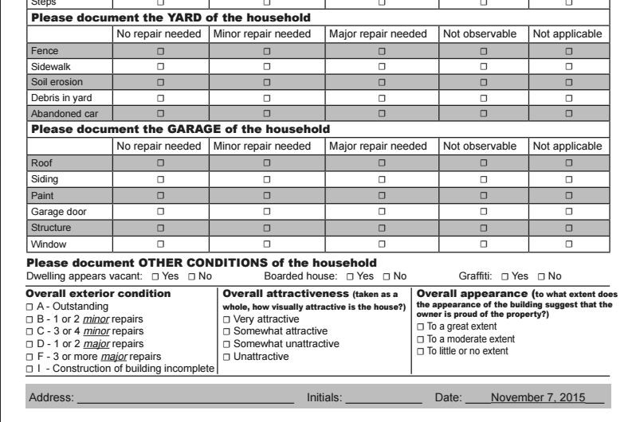
Example of the housing survey
Look at each section and mark each element of the house according to what type of repairs are needed, if any
Don’t miss these three questions!
This is your chance to give your perception of the house overall
Write the address, your initials, and the date very clearly

Slide 14
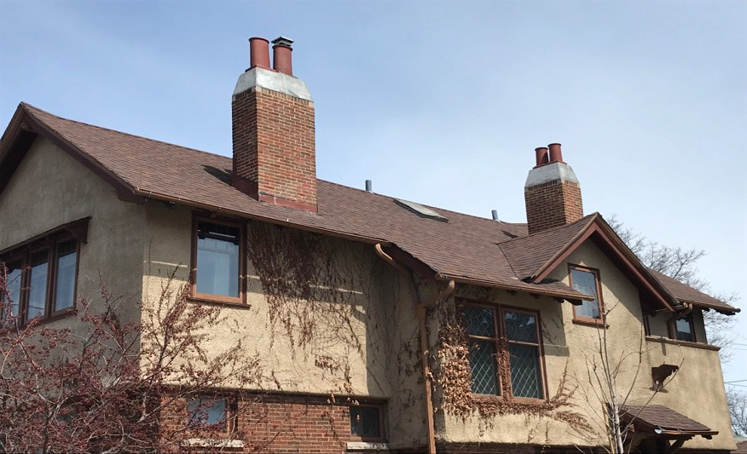
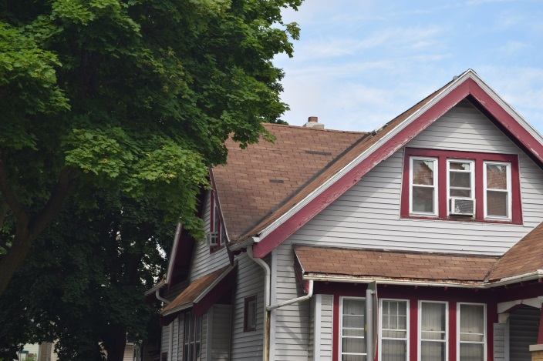
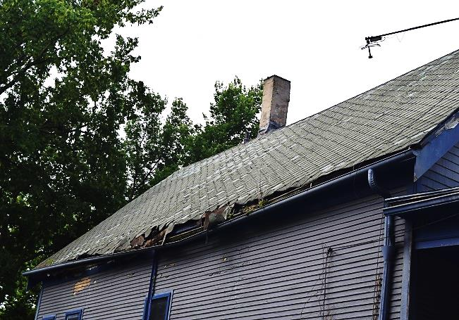
Shingles

Minor Repair Needed
No Repair Needed
Major Repair Needed

Slide 15
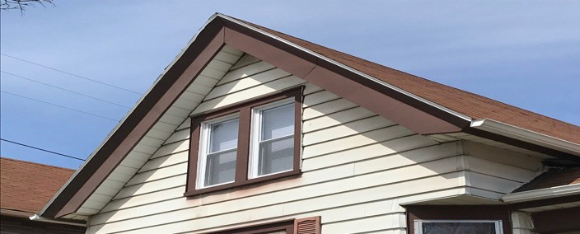
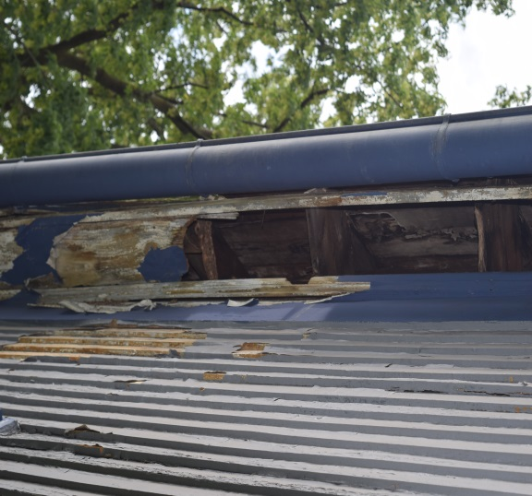
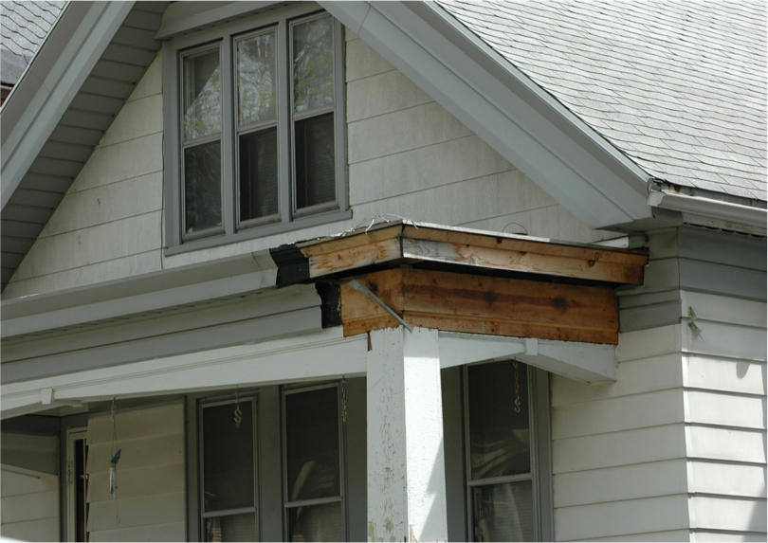
Soffit/Fascia

Major Repair Needed
No Repair Needed
Minor Repair Needed

Slide 16
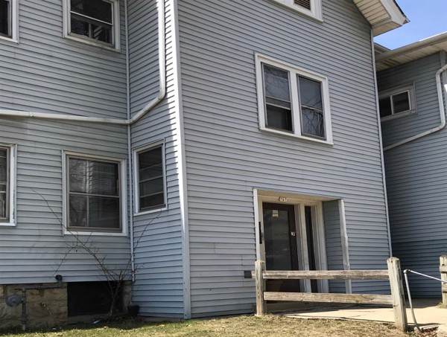
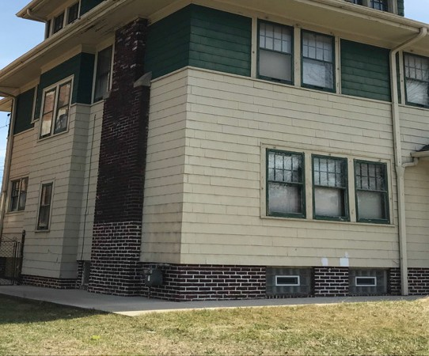
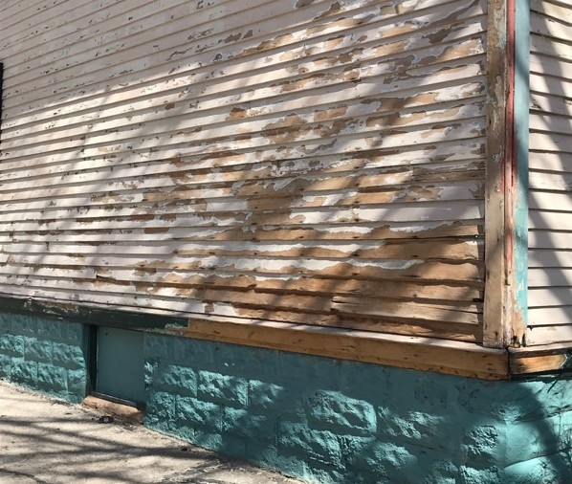
Paint (Body)

No Repair Needed
Minor Repair Needed
Major Repair Needed

Slide 17
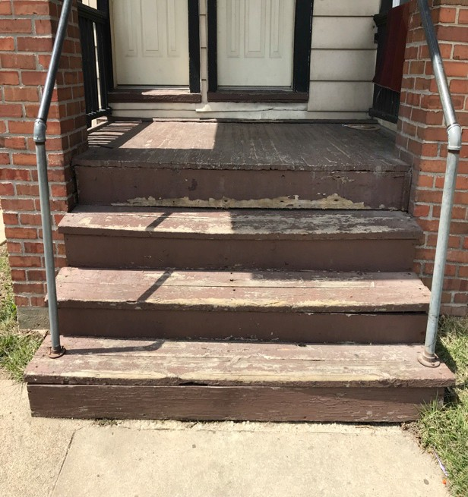
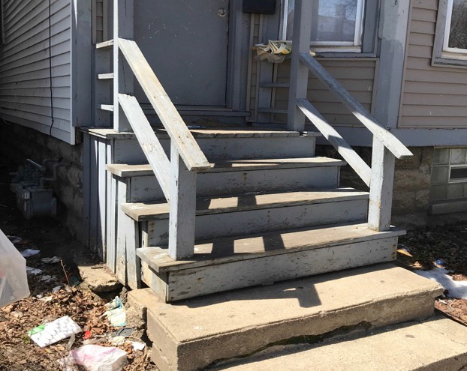
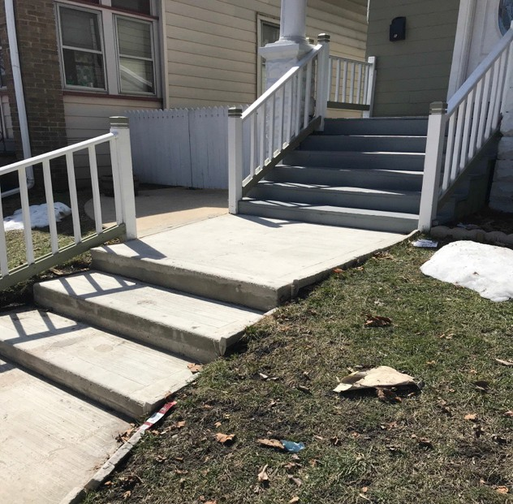
Porch Steps

No Repair Needed
Minor Repair Needed
Major Repair Needed

Slide 18
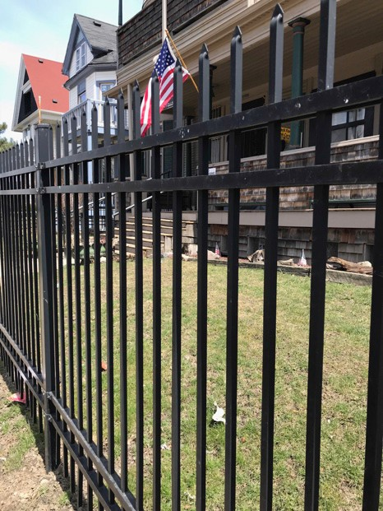
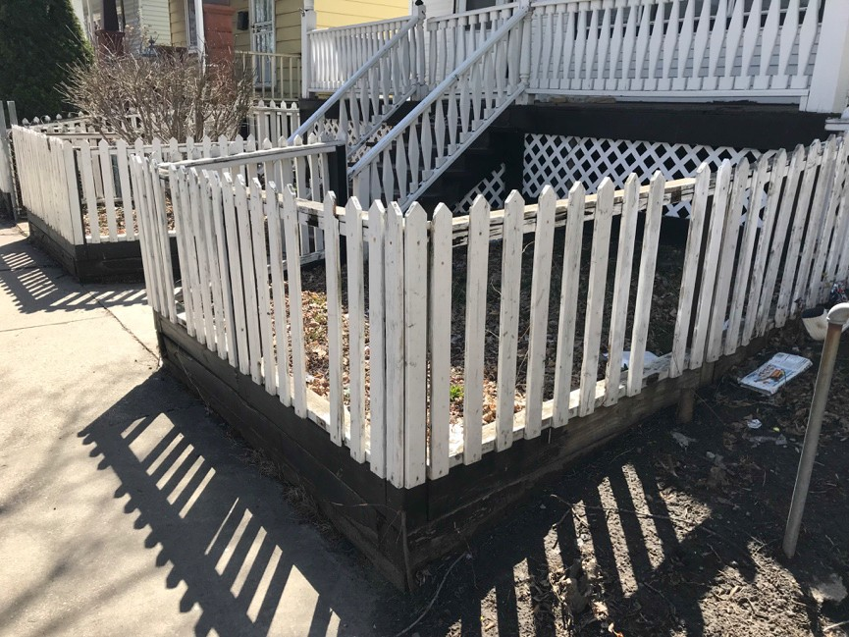
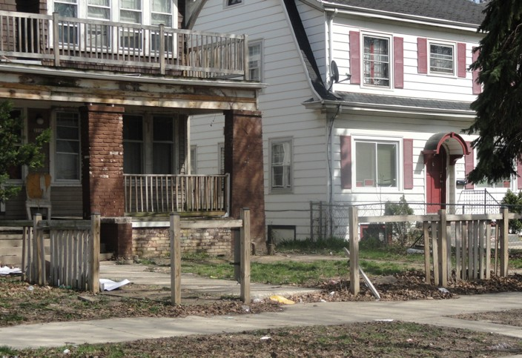
Fence

No Repair Needed
Minor Repair Needed
Major Repair Needed

Slide 19
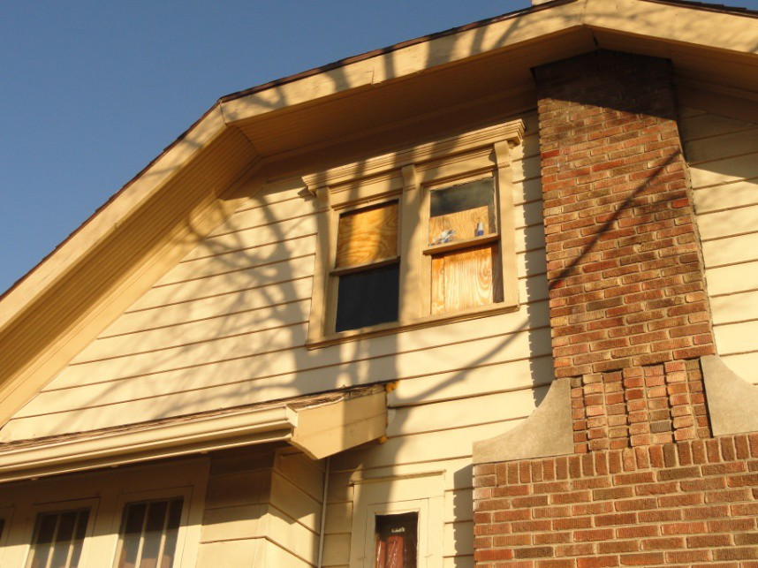
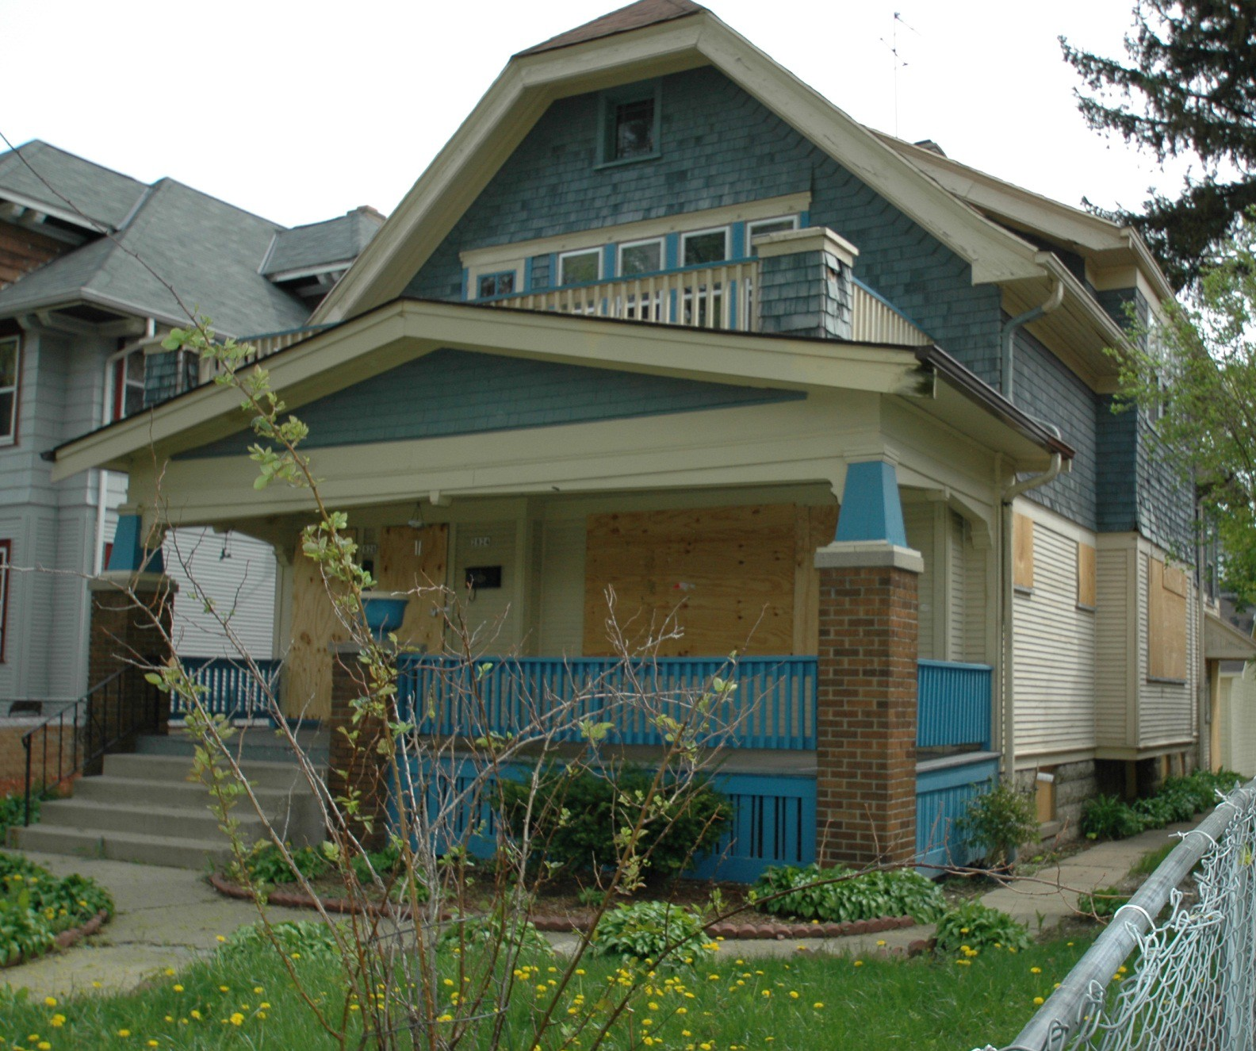
Boarded Properties vs
Properties with a boarded window

Boarded vs a board on a window
A house with boards in a couple of windows may need to be noted as needing a “Windows and Doors” repair, but is not necessarily a boarded house
Boarded properties typically have boarded up doors and windows all around the first floor of the house, and sometimes the second floor

Slide 20
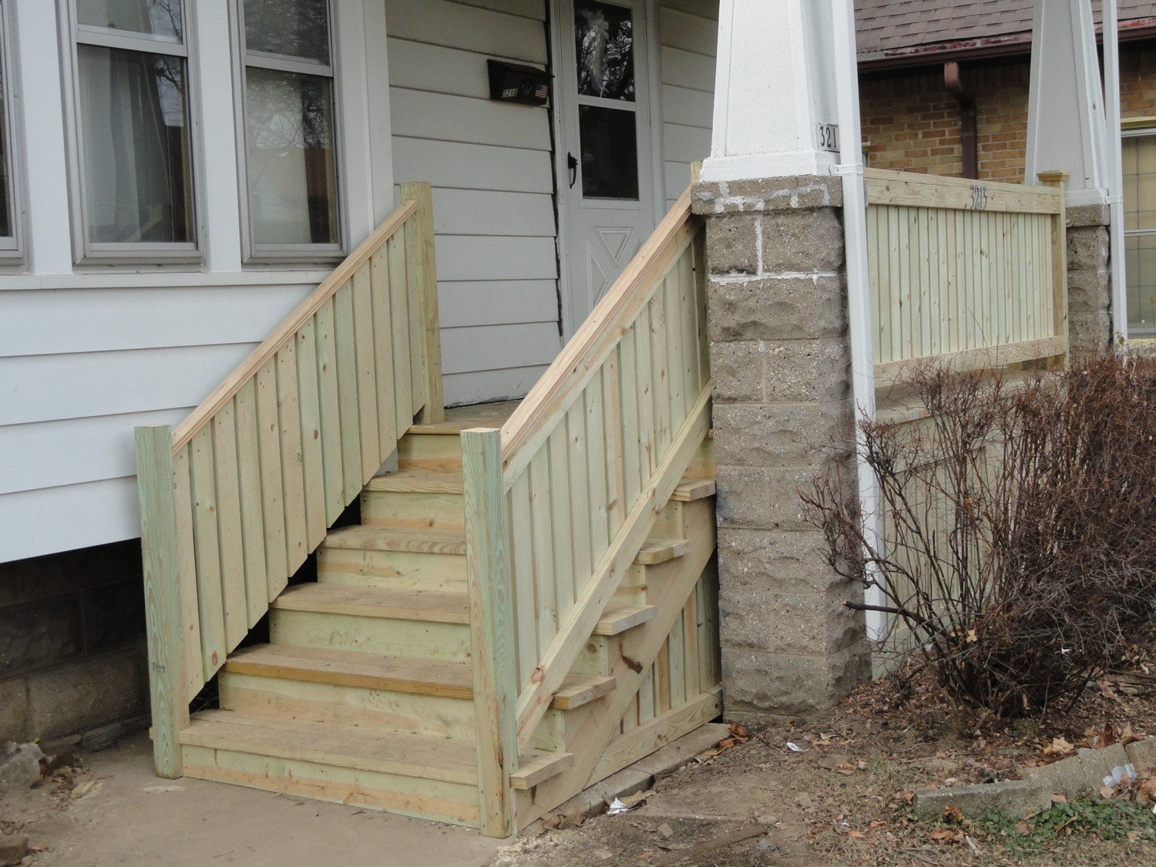
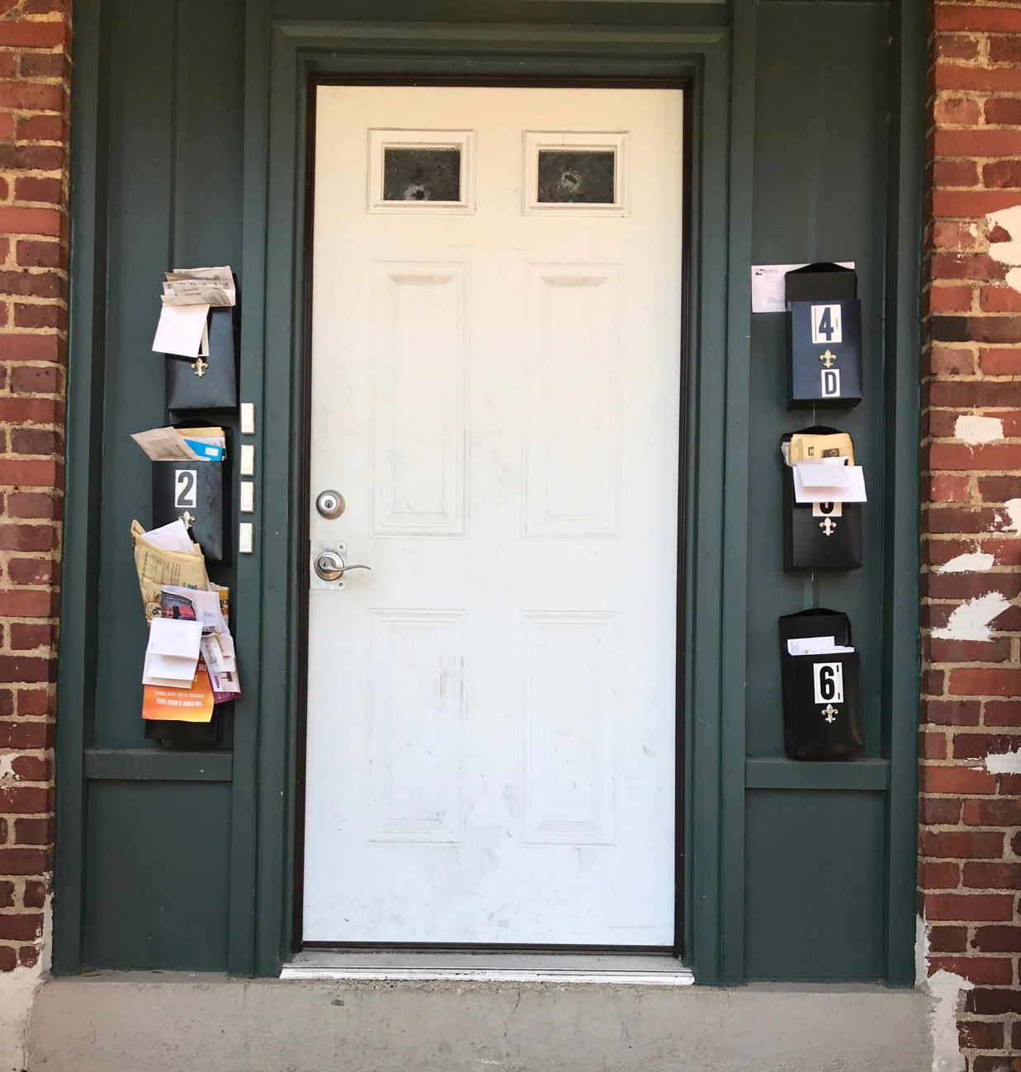
FAQs

Signs a property is vacant
What are the soffit and fascia?
Are there gutters/downspouts?
Siding needing to be painted vs replaced
Body trim paint vs door trim paint
Treated wood on porch may not be painted
Steps and sidewalks – tripping hazards?
Garbage/debris in yard – ie furniture on curb
What are some signs that a vehicle is abandoned?

Slide 21
Keep in mind while doing surveys…

Evaluate each element piece by piece, starting with the roof and working down
Survey only what is visible from the sidewalk (garage may or may not be visible)
Don’t look too hard for problems but note which repairs are needed
Record multiple unit numbers in address line
Make sure to make “clean” marks and write clearly
Only check one option per category
3-5 minutes per property (might take a little longer at first)

Slide 22
Safety Tips

Follow your gut
Be aware of your surroundings
Stay with your partner
Acknowledge people - introduce yourself and share info, if necessary
If an incident occurs or the block becomes unsafe leave immediately
Do not go into homes
During your survey, or anytime you think a vacant property has been breached, call DNS at (414) 286-2286

Slide 23
Once you’re done…

Submitting your surveys:
We will figure out a system that makes it easy on everyone!

Slide 24
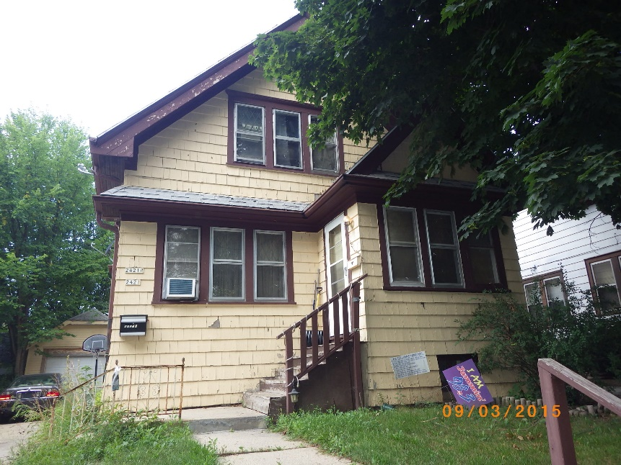
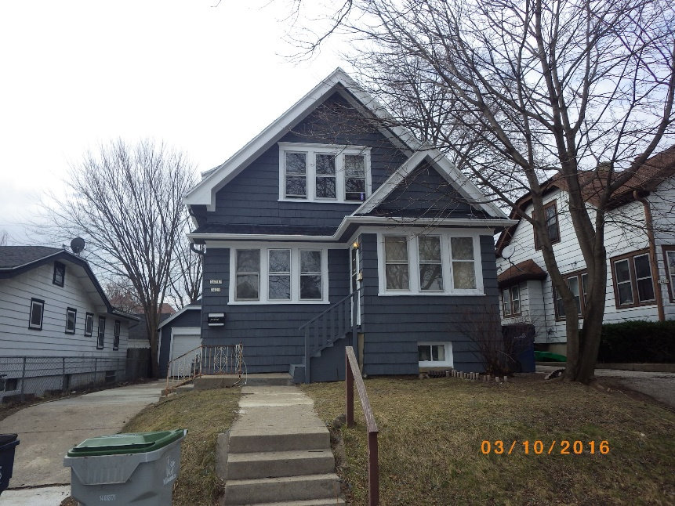
What does RON do with this info?

Coordinate data across neighborhoods
Identify potential needs for policy changes or programs that are responsive to housing issues present in neighborhoods
Track data over time, and potentially sharing with funding or city partners

Slide 25
Any Questions?
Steph O’Connor
soconn@milwaukee.gov, (414) 286-2567
milwaukee.gov/DNS
Amy Rohan
amyr@riverworksmke.org, (414) 906-9650
riverworksmke.org

