Slide 1
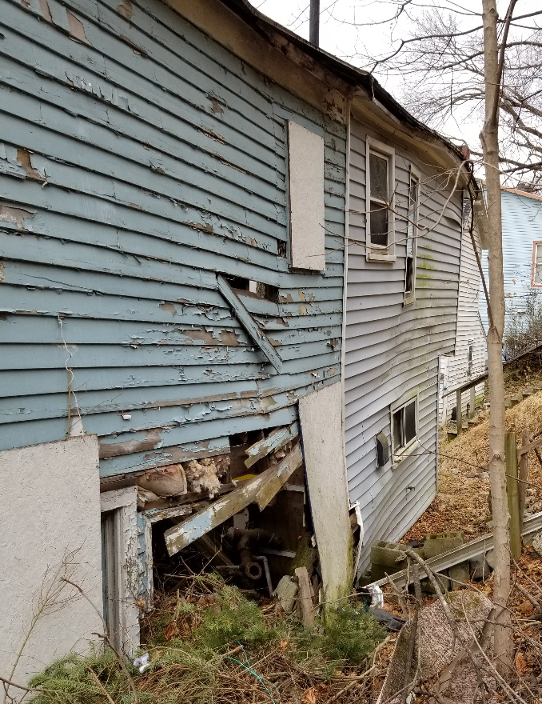
Tackling Rural and Small-Town Vacancy:
Empowering Communities with Data
October 4, 2019

Slide 2
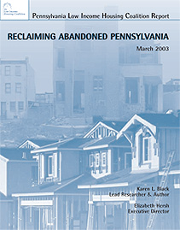
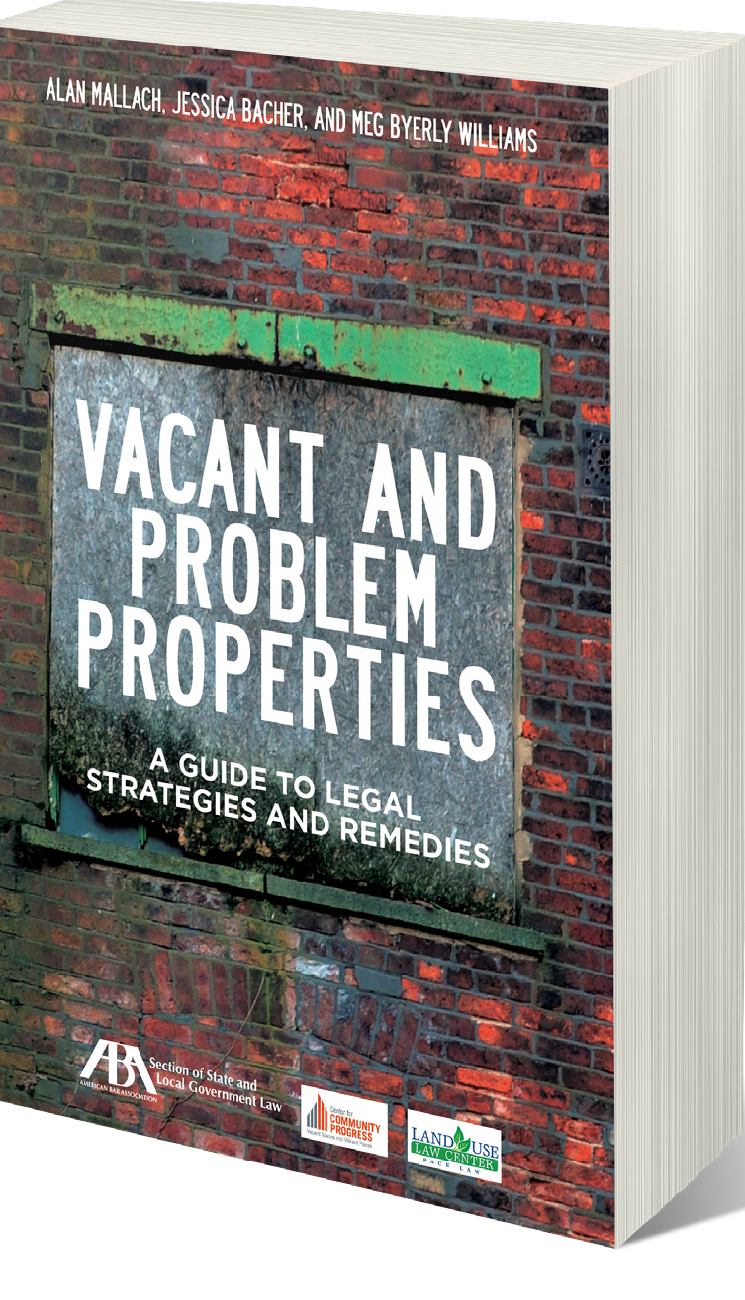
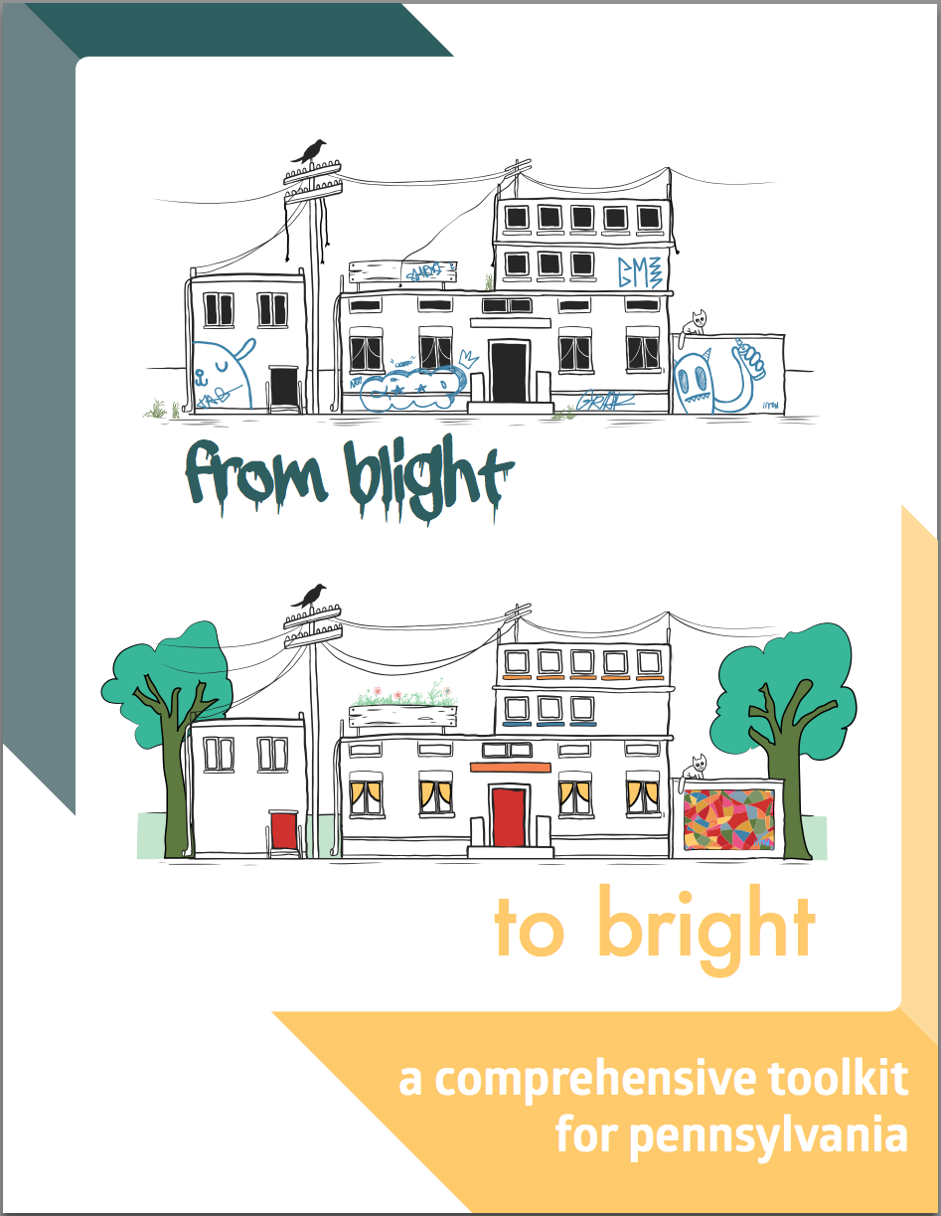
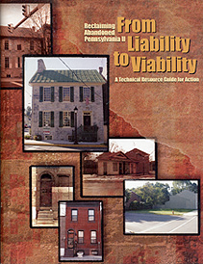
Karen L. Black, Esq.
May 8 Consulting Principal
University of Pennsylvania Lecturer
Healthy Rowhouse Project Co-Founder
Drexel University Lindy Institute for Urban Innovation Senior Research Fellow
Notes:
I have been working in this field for 20 years and I have seen many things change:
No longer waiting for market to catch up
No longer saying this is not government’s problem – owners need to fix this
No longer crying out about property rights – I have right to extend my fist only as far as your nose
No longer underestimating the importance of code enforcement

Slide 3
About Reinvestment Fund
Reinvestment Fund is a national mission-driven financial institution that creates opportunity for underserved people and places through partnerships. We marshal the capital, analytics, and expertise necessary to build strong, healthy, and more equitable communities.
Reinvestment Fund’s Policy Solutions Group
Expertise: Public management and program development; statistical research and analysis; geographic information systems
Products: Market Value Analysis; Limited Supermarket Access; Early Childhood Education Analytics; Technical Assistance
Audience: Public sector (local, state, federal agencies); foundations; nonprofit organizations; private developers and banks

Slide 5
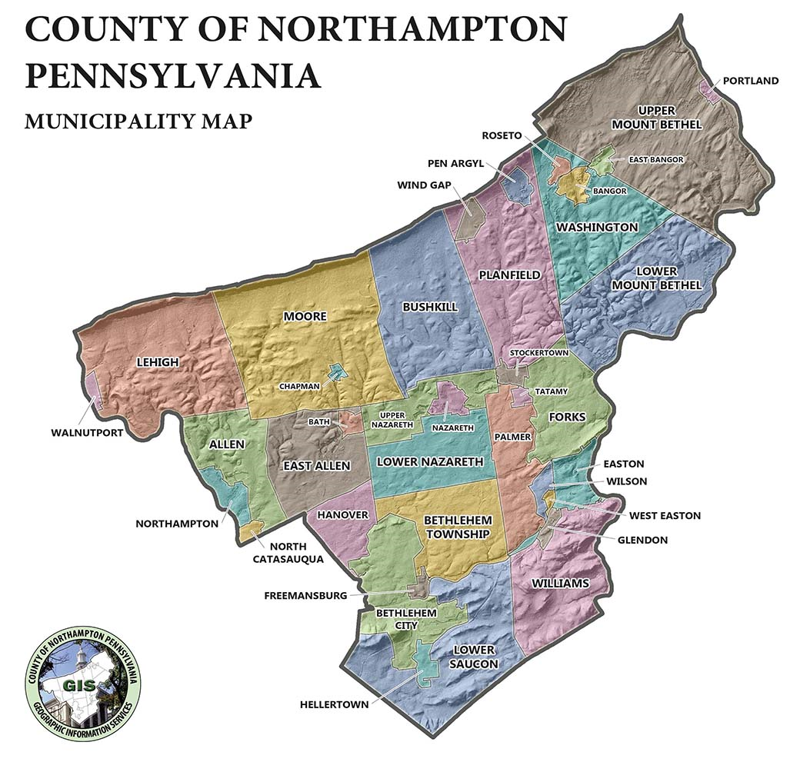
Notes:
Northampton County Pennsylvania contains 38 municipalities
2 Cities
17 Townships
19 Boroughs
has a population of ~300K

Slide 6
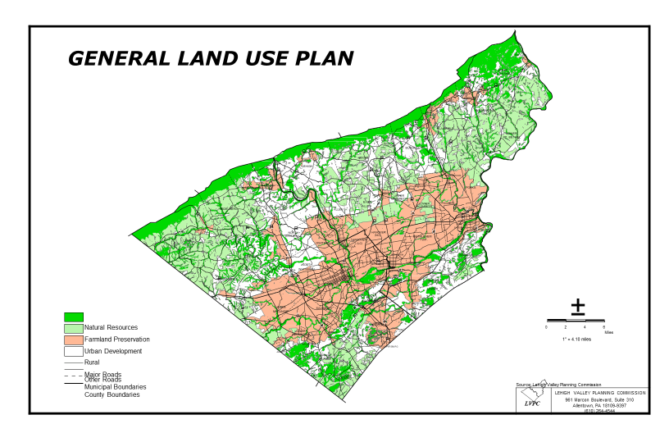

Slide 7
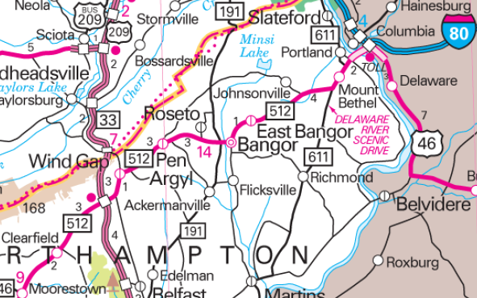
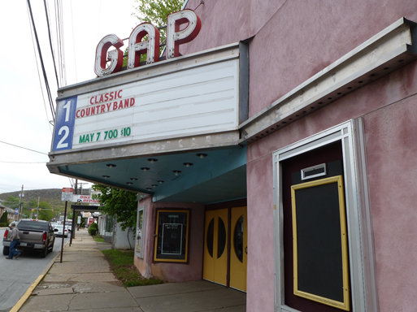
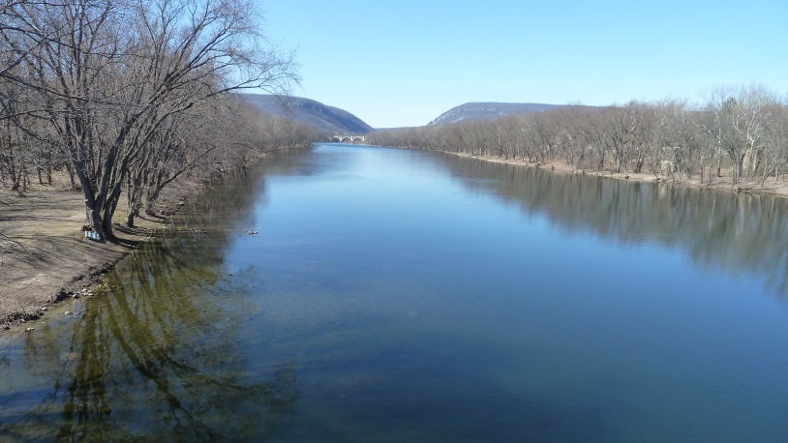
About Our Community
Page 4
Notes:
The Slate Belt is the northern-most part of Northampton County, Pennsylvania, that includes 10 municipalities: the boroughs of Bangor, East Bangor, Pen Argyl, Portland, Wind Gap, and Roseto and the townships of Upper Mt. Bethel, Lower Mt. Bethel, Washington, and Plainfield. It is bordered by Monroe County to the north and the Delaware River and New Jersey to the east. It is bordered to the north by Interstate 80 and the west by State Route 33, which provides tremendous opportunity to capitalize on the cars and trucks that currently pass through without stopping. The Slate Belt is served by two school districts: Bangor Area School District and Pen Argyl Area School District.

Slide 9
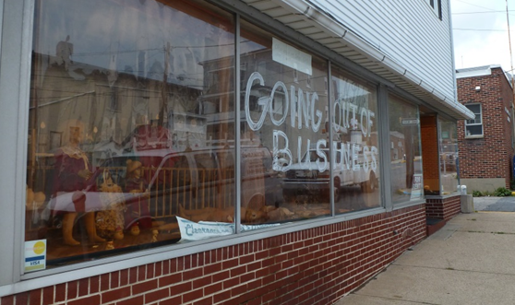
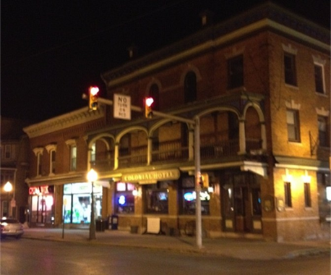
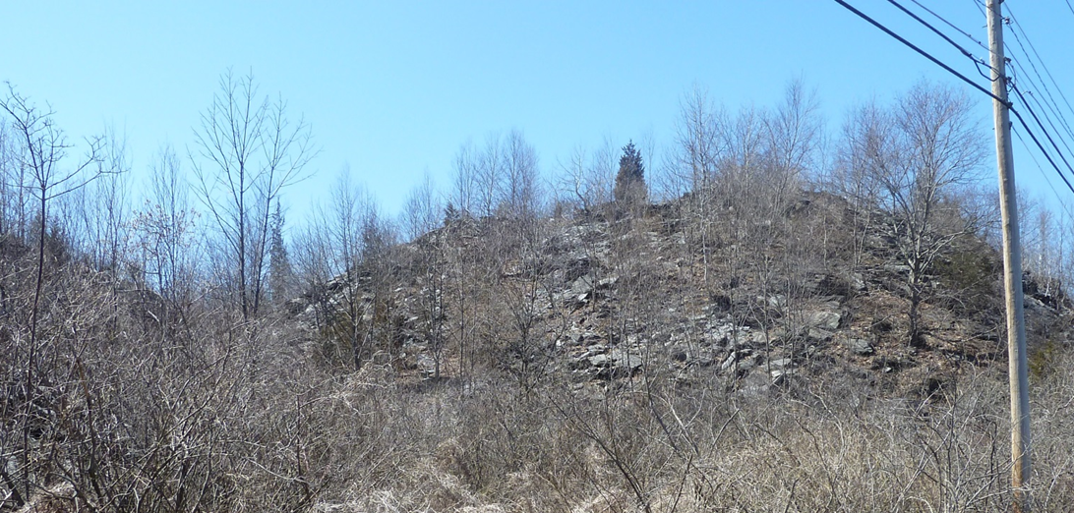
Notes:
The Slate Belt’s rolling hills and fertile land were first home to farmers, but agriculture gave way to slate production after the discovery of the Martinsburg Formation in 1836. Quarries were mined across the region due to the high quality and malleability of the slate.
Immigrants from Wales, England, Germany, and Italy soon followed, drawn by jobs and opportunity. These immigrants remained, their traditions eventually overlapping and melding to create a vibrant culture that is the heart of the Slate Belt.
The turn of the 19th century brought the decline of the slate industry as the highest quality slate in the region was running out at the same time as slate was facing competition from new materials. In the face of this economic challenge, the people of the Slate Belt turned their energy to the silk and, later, apparel industries that brought new jobs and stability to the region.
However, by the end of the 1980s, the textile industry had left the region, leaving the community to reinvent itself yet again. Since that time, more and more residents are finding work outside of the Slate Belt and commuting to other parts of the Lehigh Valley, the Poconos, and even to New York City. A 2008 study from Lafayette College Technology Clinic titled “Intelligent Development of the Slate Belt” states that 76.6% of Slate Belt residents work outside of the towns in which they live. This has changed the fabric of the community.

Slide 10
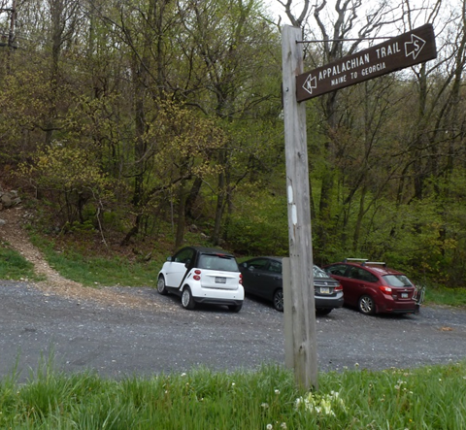
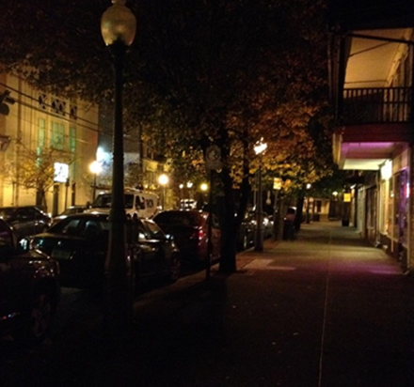
About Our Community
Page 9
Notes:
The Slate Belt has many assets, including a rich cultural history, the potential for eco-tourism due to gorgeous natural features (including trailhead access to the Appalachian Trail and Rails to Trail and access to the Delaware River for kayak, canoe and raft trips, which end in Portland), recreational facilities, walkable business districts, historic architectural structures, the potential for industrial parks, close proximity to major urban centers, and access to major thoroughfares. These assets provide a solid framework from which to strengthen the Slate Belt through community and economic development, as well as growth.

Slide 11
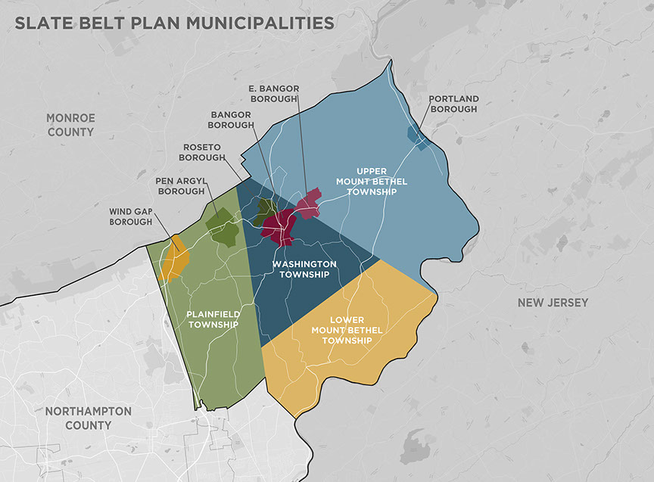
Notes:
Population of about 36K
Poverty rate among the Boroughs is more than double the county average of 9.8%

Slide 12
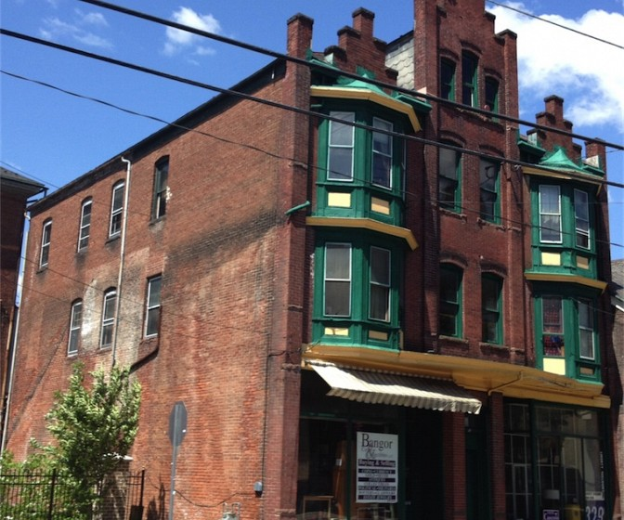
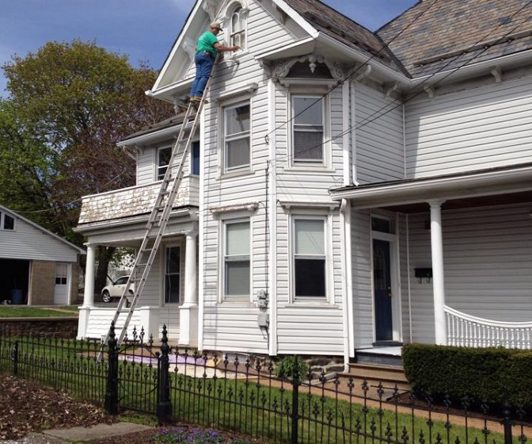
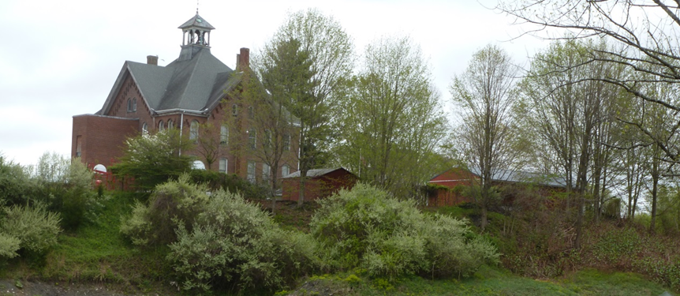
About Our Community: Housing Conditions
Page 12

Slide 13
Housing Analysis
Housing By Type
72% Owner
28% Renter
15,683 Units
Working Draft – 09/04/19
Notes:
In Northampton County, 33.8% of homeowners with a mortgage paid more than 30% of their household income for housing. All four boroughs have a higher incidence than the county of homeowners with a mortgage who are housing cost burdened: Bangor, 39.4%; Pen Argyl, 41%; Portland, 75.5%; and Wind Gap, 38.1%.
In Northampton County, 53.7% of renters pay more than 30% of their household income for housing. Two of four the boroughs have a higher incidence of renters who are housing cost burdened: Bangor, 59.1%; Pen Argyl, 37.1%; Portland, 44.2%; and Wind Gap, 62.3%.

Slide 14
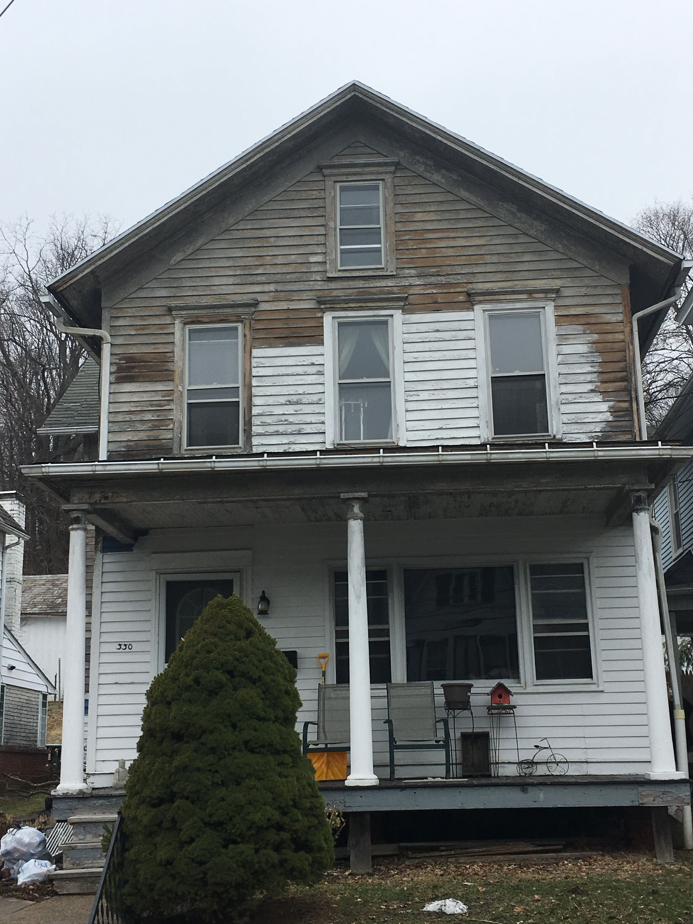

Slide 15
Housing Analysis
Housing Age
Built Before 1939
Build 1940-1979
Built 1980-1999
Built After 2000
Working Draft – 09/04/19
Notes:
The Slate Belt has a significant number of houses that were built before 1939: Bangor, 65.8%; Pen Argyl, 74.8%; Portland, 73.4%. Wind Gap’s housing stock isn’t quite as old, with 22.2% being constructed before 1939.

Slide 16
Community Indicators/
Demographic Data
Income and Poverty
Working Draft – 09/04/19
Municipality | Median Household Income $ | Median Family Income $ | Per Capita Income $ | Percent Below Poverty Level
 |  |  |  | All Persons | All Families | Female Householder Families
Bangor Borough | $41,366 | $50,668 | $22,652 | 14.8% | 12.0% | 36.9%
East Bangor Borough | $50,938 | $51,979 | $21,881 | 14.5% | 9.3% | 32.4%
Lower Mt. Bethel Township | $65,833 | $80,873 | $33,196 | 3.5% | 1.5% | 0.0%
Pen Argyl Borough | $49,542 | $79,417 | $25,067 | 11.3% | 10.0% | 35.6%
Plainfield Township | $61,540 | $76,013 | $41,799 | 5.4% | 3.6% | 6.6%
Portland Borough | $56,667 | $76,042 | $29,861 | 7.7% | 8.5% | 8.7%
Roseto Borough | $66,932 | $75,500 | $27,118 | 6.9% | 3.3% | 0.0%
Upper Mt. Bethel Township | $65,218 | $73,289 | $34,862 | 4.1% | 2.7% | 10.4%
Washington Township | $77,241 | $91,389 | $35,110 | 6.6% | 4.8% | 25.2%
Wind Gap Borough | $41,284 | $64,286 | $24,172 | 12.0% | 9.3% | 33.3%
Northampton County | $65,390 | $79,209 | $32,608 | 9.2% | 6.6% | 21.7%
Source: U.S. Census Bureau American Community Survey 2013-2017 (5-Year Estimates)

Slide 17
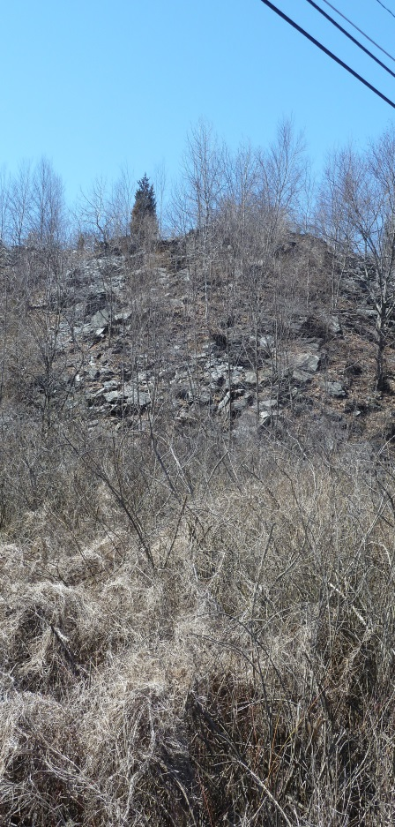
About Our Community
The Slate Belt is the northern-most part of Northampton County, Pennsylvania, that includes 10 municipalities: the boroughs of Bangor, East Bangor, Pen Argyl, Portland, Wind Gap, and Roseto and the townships of Upper Mt. Bethel, Lower Mt. Bethel, Washington, and Plainfield. It is bordered by Monroe County to the north and the Delaware River and New Jersey to the east. It is bordered to the north by Interstate 80 and the west by State Route 33, which provides tremendous opportunity to capitalize on the cars and trucks that currently pass through without stopping. The Slate Belt is served by two school districts: Bangor Area School District and Pen Argyl Area School District.
The Slate Belt’s rolling hills and fertile land were first home to farmers, but agriculture gave way to slate production after the discovery of the Martinsburg Formation in 1836. Quarries were mined across the region due to the high quality and malleability of the slate.
Immigrants from Wales, England, Germany, and Italy soon followed, drawn by jobs and opportunity. These immigrants remained, their traditions eventually overlapping and melding to create a vibrant culture that is the heart of the Slate Belt.
The turn of the 19th century brought the decline of the slate industry as the highest quality slate in the region was running out at the same time as slate was facing competition from new materials. In the face of this economic challenge, the people of the Slate Belt turned their energy to the silk and, later, apparel industries that brought new jobs and stability to the region.
However, by the end of the 1980s, the textile industry had left the region, leaving the community to reinvent itself yet again. Since that time, more and more residents are finding work outside of the Slate Belt and commuting to other parts of the Lehigh Valley, the Poconos, and even to New York City. A 2008 study from Lafayette College Technology Clinic titled “Intelligent Development of the Slate Belt” states that 76.6% of Slate Belt residents work outside of the towns in which they live. This has changed the fabric of the community.
Page 3

Slide 18
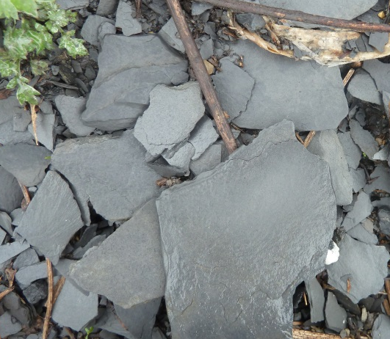
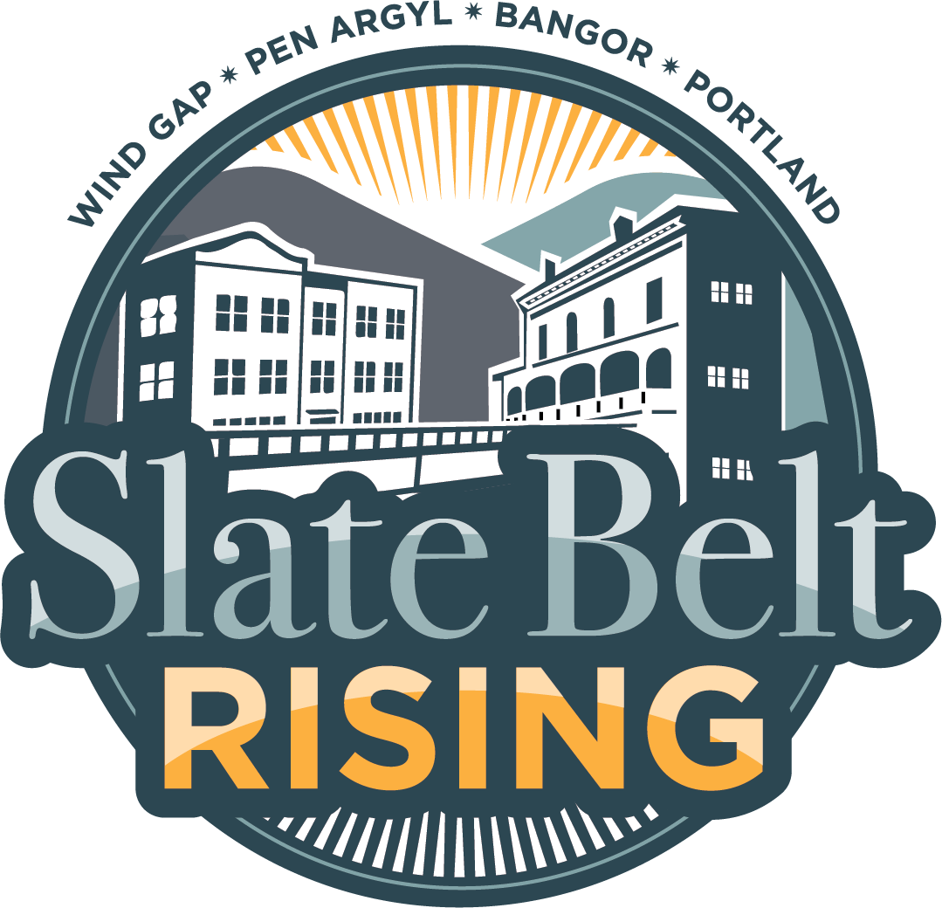
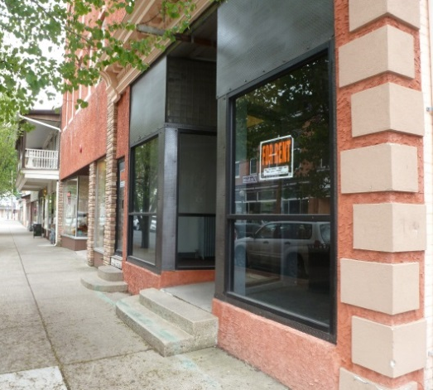
Photo
Photo
Photo
Community Revitalization Plan 2016-2022
(Approved 6/15/16)
Notes:
The Slate Belt’s rolling hills and fertile land were first home to farmers, but agriculture gave way to slate production after the discovery of the Martinsburg Formation in 1836. Quarries were mined across the region due to the high quality and malleability of the slate.
Immigrants from Wales, England, Germany, and Italy soon followed, drawn by jobs and opportunity. These immigrants remained, their traditions eventually overlapping and melding to create a vibrant culture that is the heart of the Slate Belt.

Slide 19
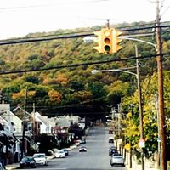
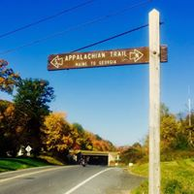
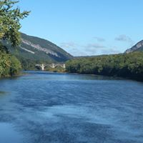

Slide 20
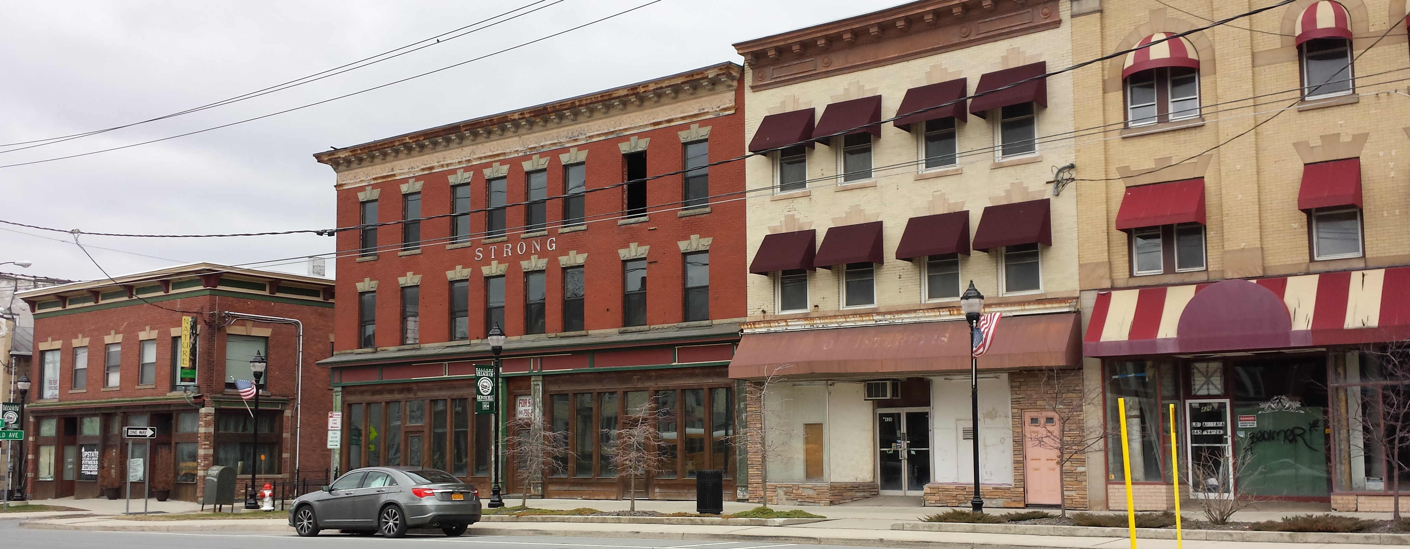
Monticello New York – A Borscht Belt Story

Slide 22
Vacant Buildings on Main Street

Slide 23
Surrounding Natural Assets

Slide 24
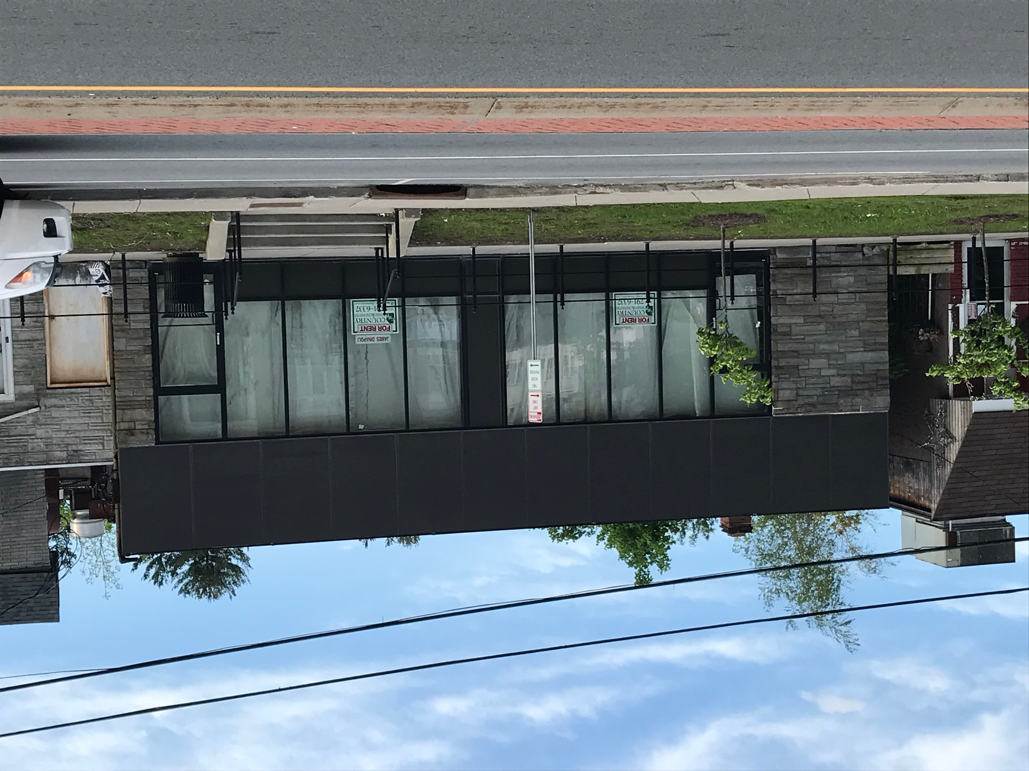
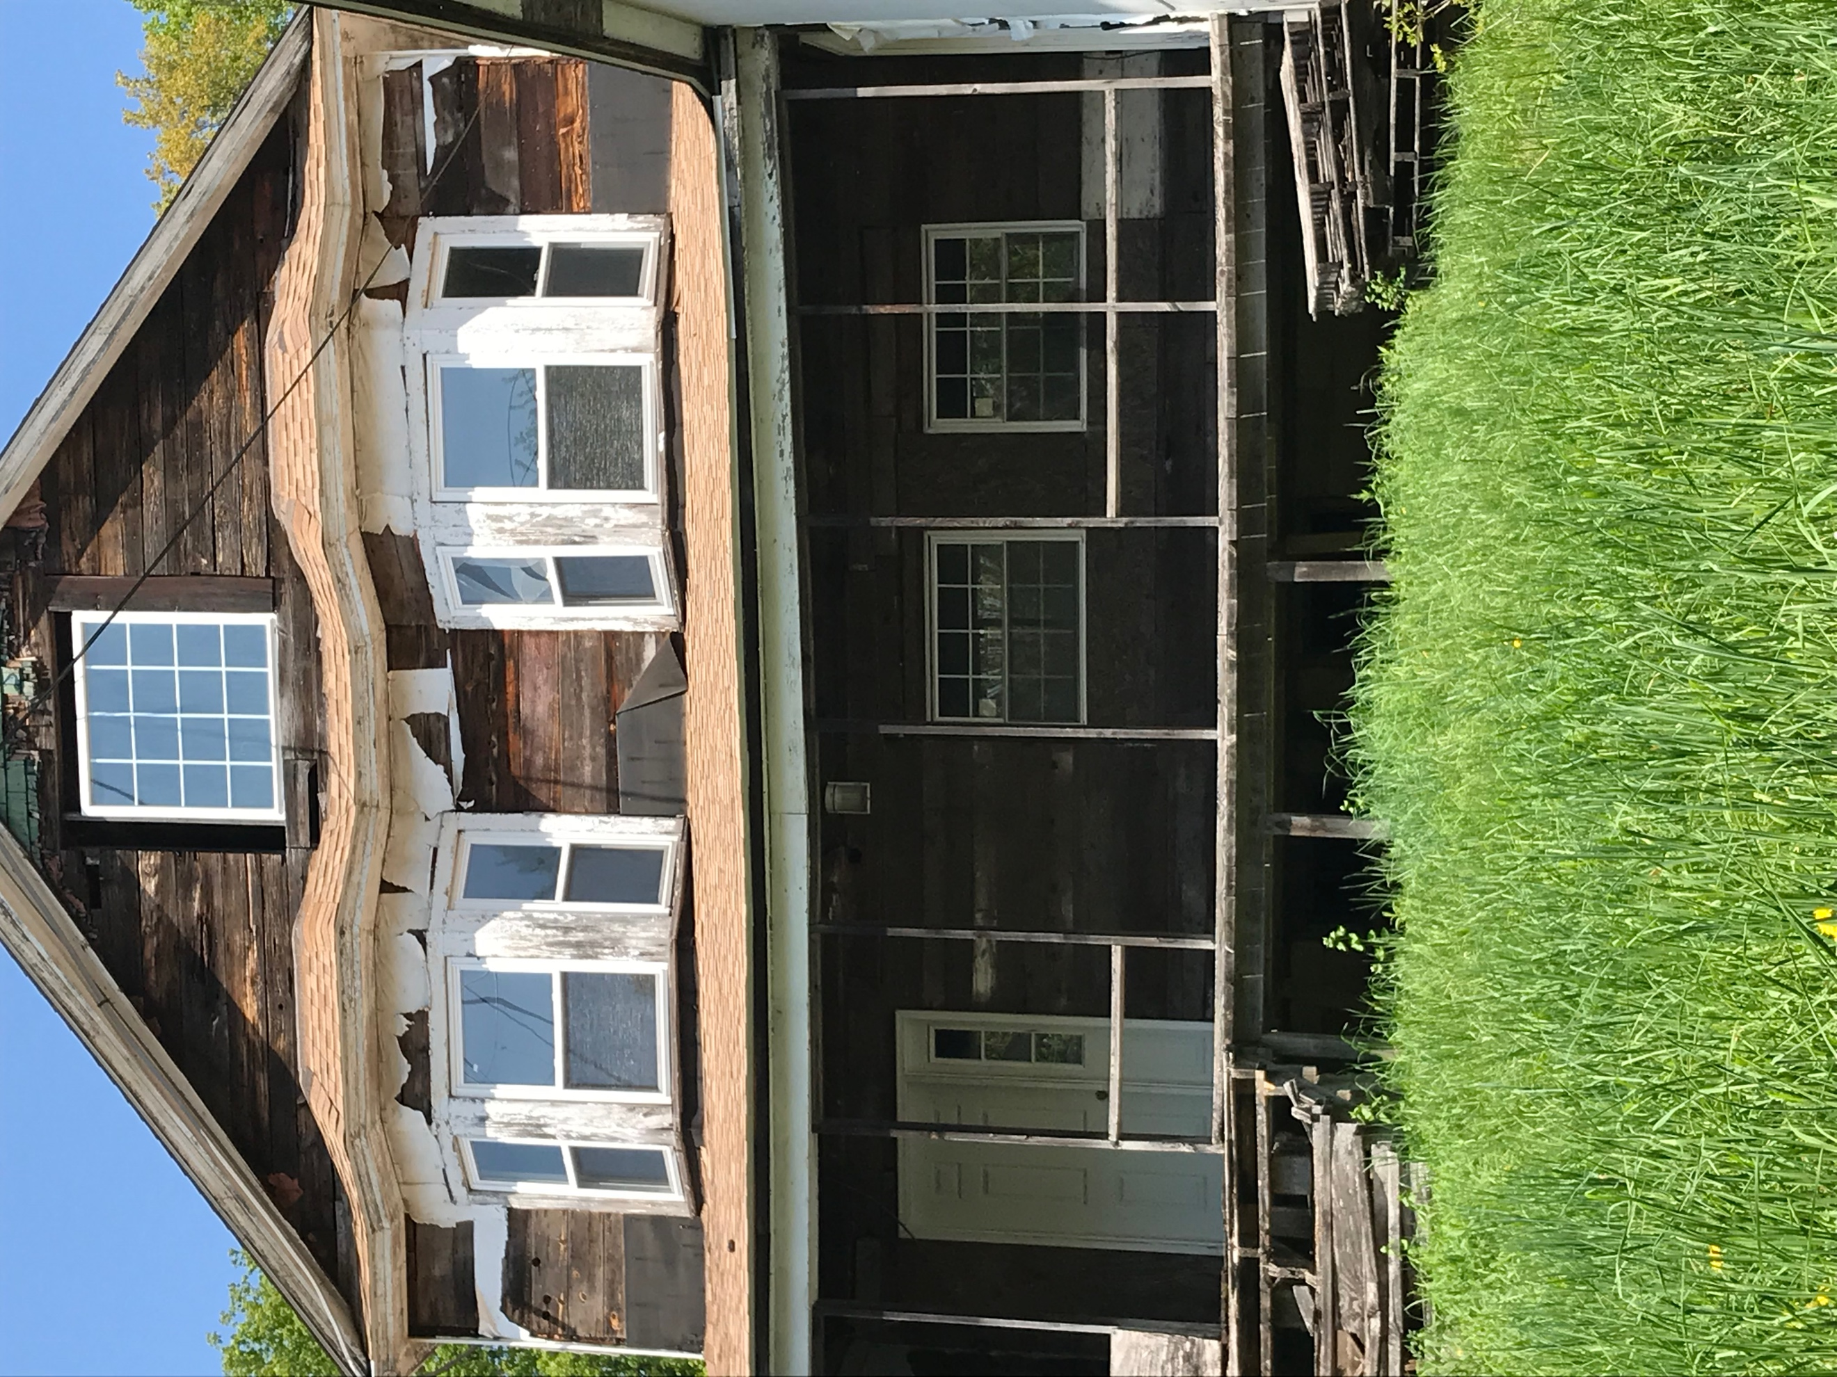
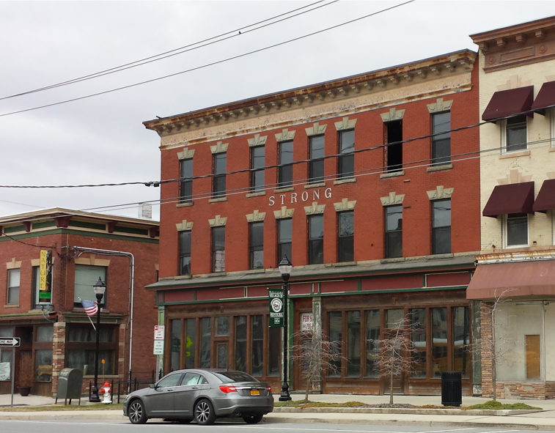
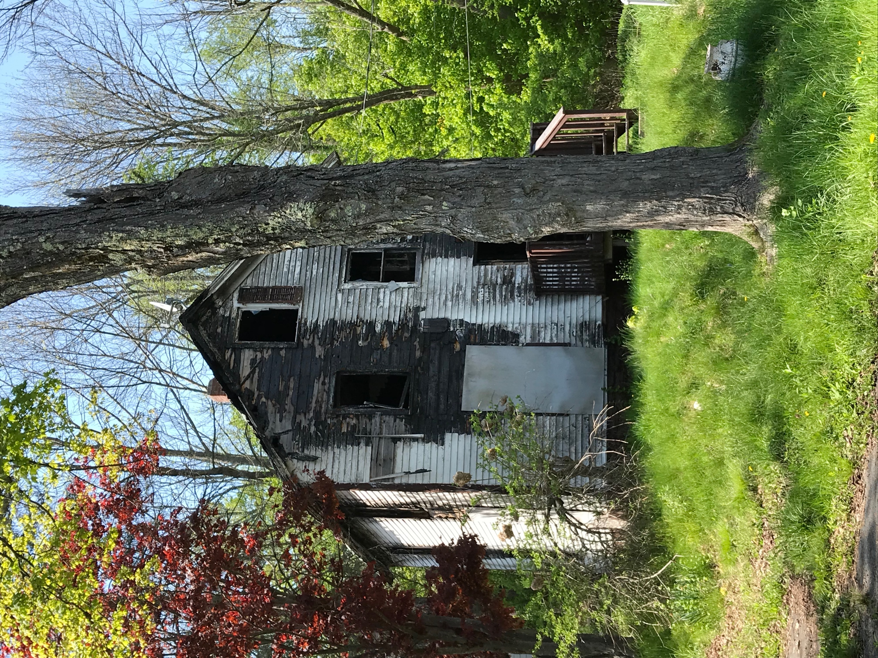
Deteriorated and Vacant Properties

Slide 25
Resort World Casino

Slide 26
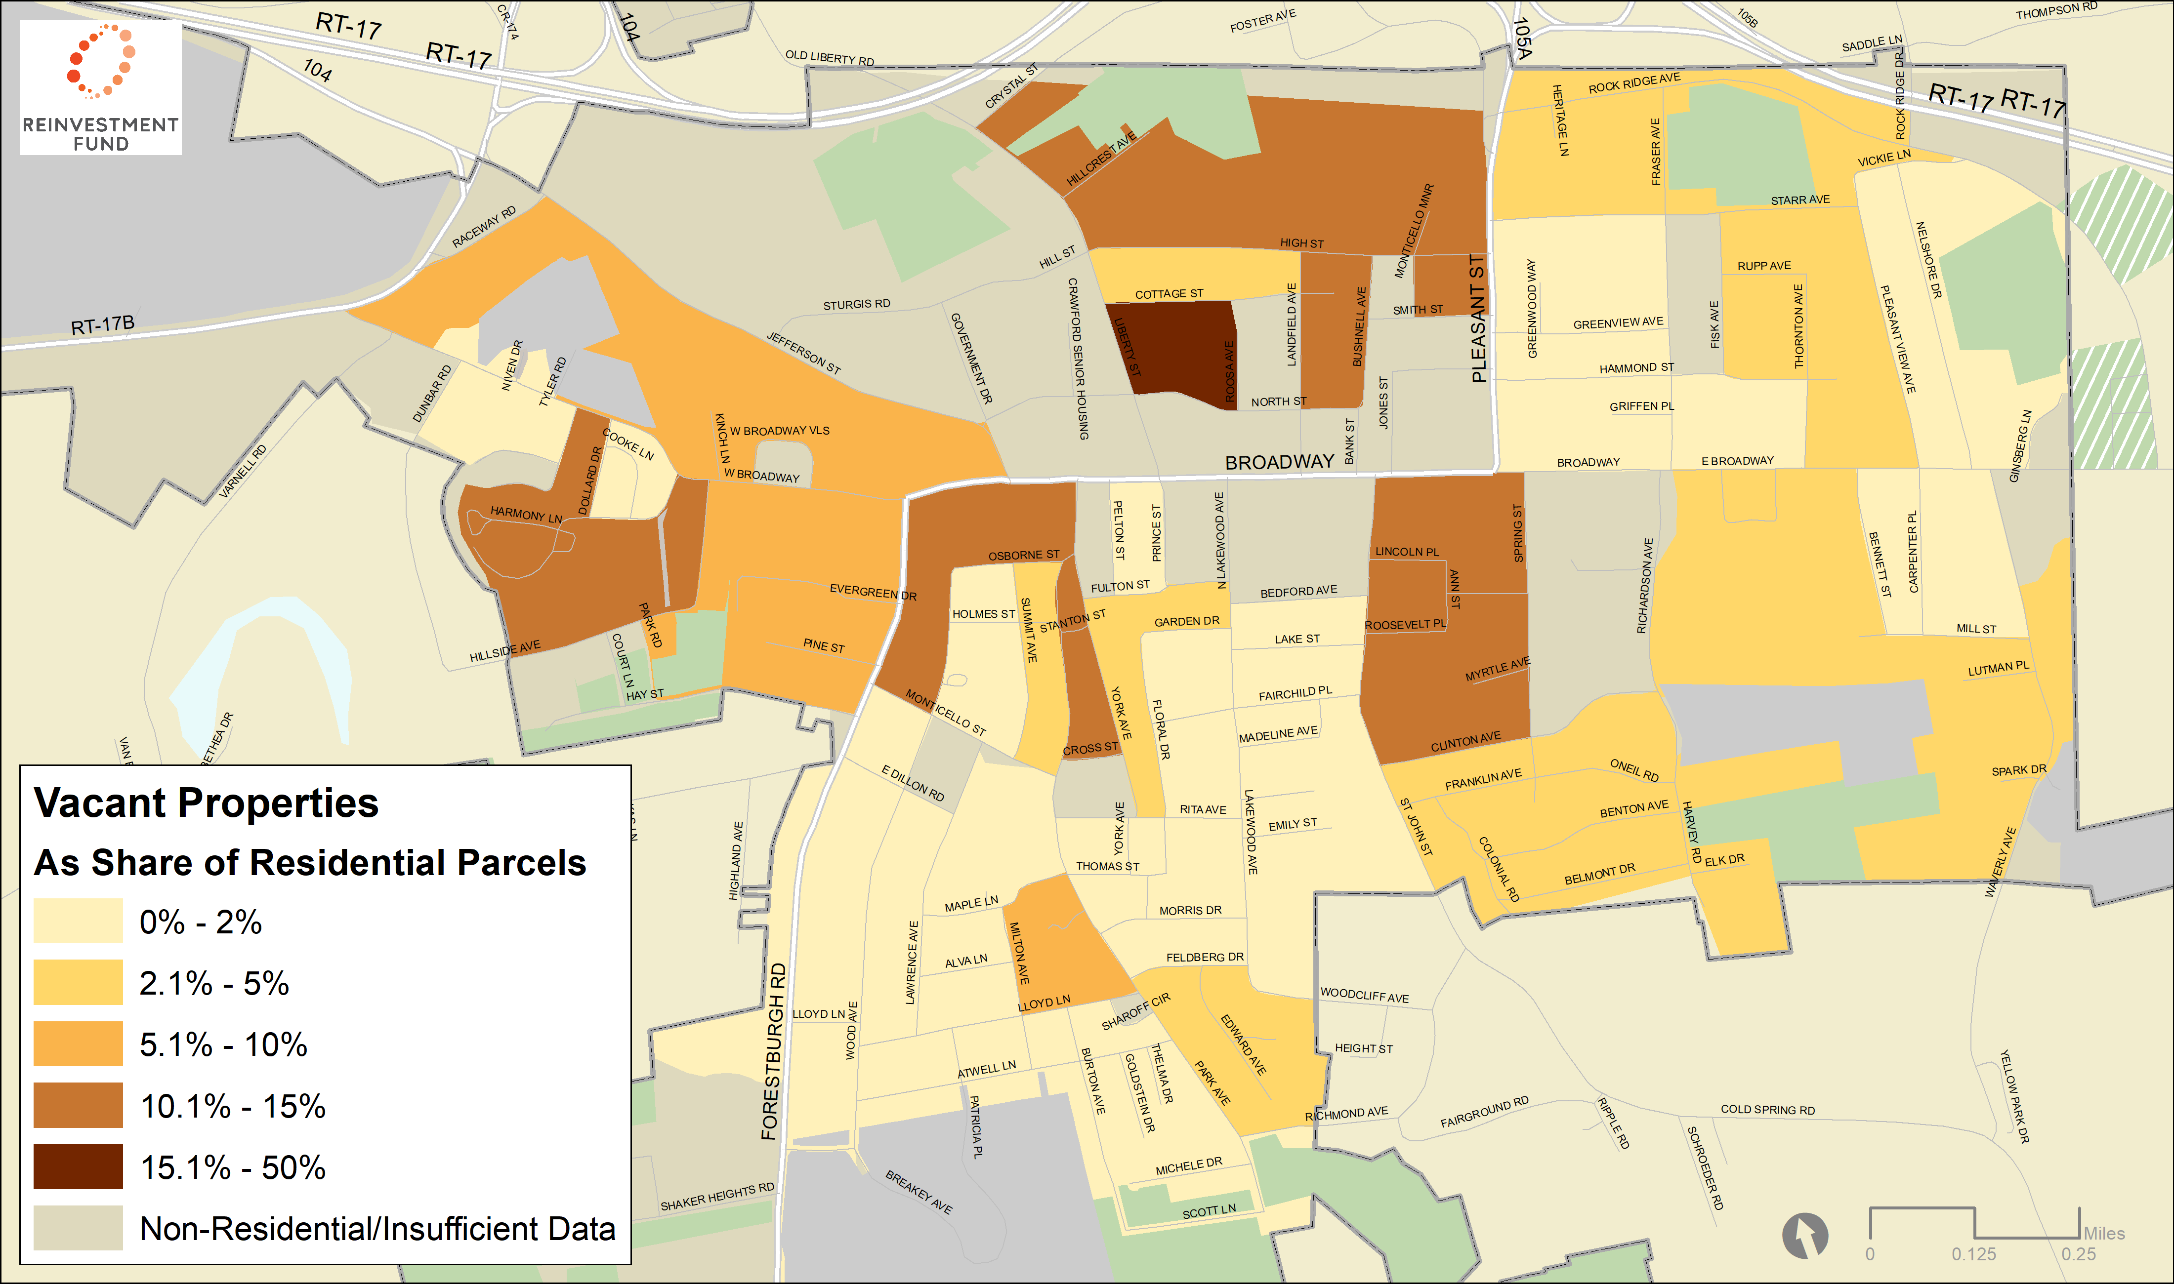
Monticello Has Significant Challenges
Properties with Code Violations or Inactive Water Account
Notes:
1,137 Households Using Housing Choice Vouchers in Sullivan County
421 Households Using Housing Choice Vouchers in Monticello
22% of Renters in Monticello Use Housing Choice Vouchers
37% of Housing Choice Voucher Users in Sullivan County live in Monticello

Slide 27
Monticello Has Significant Challenges
Vacant properties – 53 based on water shut-offs
Foreclosure – 13% of properties at risk
Investors own of one third of residential properties (524 of 1500)
Housing voucher users inflate rents – 20% of renters have vouchers (37% of the county’s vouchers in Village)
Significant number of deteriorated properties
Notes:
1,137 Households Using Housing Choice Vouchers in Sullivan County
421 Households Using Housing Choice Vouchers in Monticello
22% of Renters in Monticello Use Housing Choice Vouchers
37% of Housing Choice Voucher Users in Sullivan County live in Monticello

Slide 28
Monticello Has Limited Resources
Limited capacity: Unfilled manager position, volunteer Mayor and Council and few non-profits
1 code enforcement inspector
Paper records
Hard to cite friends and family
Continuing high foreclosure rates
Largely vacant Main Street competes with nearby more suburban options
Inflated rents due to housing voucher properties
Seasonal properties

Slide 29
Monticello Is Making Significant Progress
Rezoning to allow residential uses on Broadway
Foundational strategic code enforcement database
Added historic designation & tax abatements
Partnering with Sullivan County Land Bank
Reaching out to absentee building owners & pricing renovations
Annexing new developments upon request

Slide 30
Monticello Has An Important Opportunity
Increased demand from professional workforce (600 of 1,000 Resorts World workers are from Sullivan County)
1% increase in population due to 25% increase in foreign born residents
Increased tourism (hotel rooms up 25%, Woodstock festival, Waterpark)
Median home sale price rose from $42,500 in 2013 to $60,500 in 2018
Notes:
https://www.nytimes.com/2018/03/27/business/catskills-tourism.html

Slide 31
Mapping – Using All Available Data to Answer
Where are vacant and blighted properties?
What is their condition?
Who owns/is responsible for the properties?
Which are the priority properties to reactivate?
How do we make owners accountable for their properties?

Slide 32
Data Analysis Framework
When analyzing markets we begin with these principles:
Public subsidy is scarce; acting alone, subsidies cannot create a market
Public policy and subsidy must leverage private investment or create conditions for investment to occur
In distressed markets, build from strength by investing near strong assets
All residents are customers with an expectation of quality public services and amenities
The best decisions are based on the sound and objective analysis of quantitative and qualitative data

Slide 33
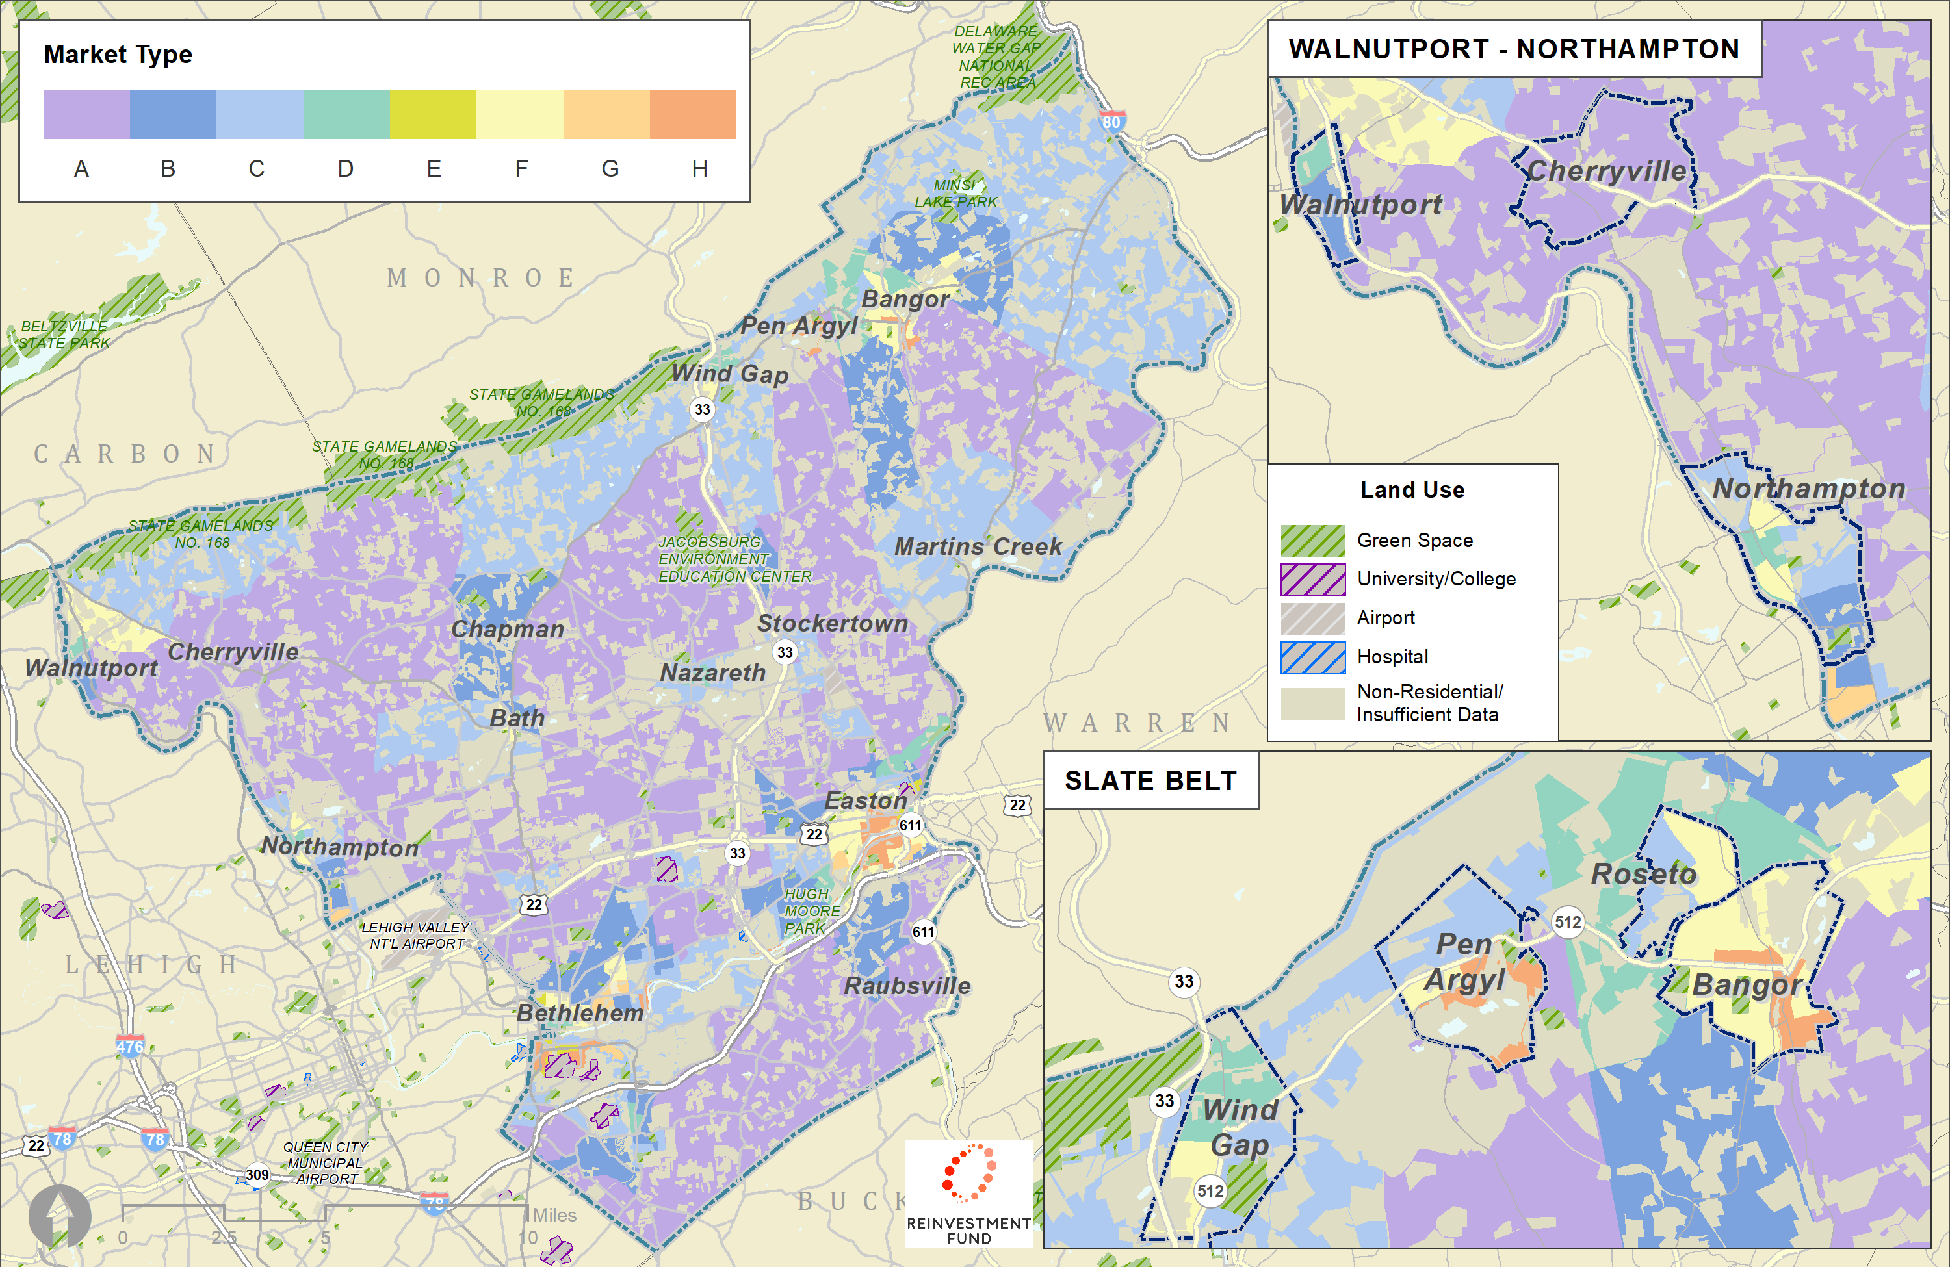
The Market Value Analysis
The Market Value Analysis (MVA) is an objective tool built on local administrative data and validated with local experts. It helps stakeholders identify and understand the elements of their real estate markets to precisely target interventions in weaker markets and support sustainable growth in stronger ones.
Northampton County MVA

Slide 34
The MVA Process
1
2
3
Acquire local administrative data and geocode to Census block group geographies.
Manually inspect and validate data layers by driving the area.
Use statistical cluster analysis to identify areas with common attributes.
Iterative
4
5
6
Manually inspect areas for conformity with local experts to assess fit.
Alter parameters; re-solve and re-inspect until model accurately represents area.
Summarize and describe the characteristics of each market.
Lessons from 15+ years of experience
Validating Data is Critical.
Researchers must systematically visit and observe neighborhoods in the city to understand the data and final model.
Geographic Scale Matters.
MSA and Census tract geographies are too large to accurately reflect the nuances of local real estate markets.
One Size Does Not Fit All.
MVA components and models share some similarities across cities but must be customized to the unique traits of each city.
Integrate Local Knowledge.
All models are tested with local experts to incorporate qualitative feedback from each geography.

Slide 35
Northampton County, PA MVA 2019

Slide 36
Northampton County, PA Market Variables
Median Sales Price (value level)
Sales Price Variance (value range)
Area of New Parcels since 2015 (new construction proxy)
Investor Sales (profit potential)
Distressed Residential Properties (disinvestment/instability)
Sheriff Sale or Tax Lien Sale Listing
Low Electricity Usage (vacancy proxy)
Owner-Occupancy Rate (distinct from strength)
Percent of Area that is Residential (key at county level)
Density of Housing Units in Residential Land Area
Subsidy (supplement to private investment)
HUD Multifamily Rental Units and Choice Vouchers
\
Value and Investment
Distress and Vacancy
Housing Characteristics

Slide 37
Northampton County, PA MVA 2019
 |  | Housing Value and Sales-Related Characteristics |  |  | Housing Characteristics |  |  |  | Investments |  |  | Distress
Cluster | Block Group (#) | Median Sales Price | Variance of Sales Price | 2-4 Family Homes | Own Occ. | Rentals with Subsidy | Housing Density | Residential Area | Invest. Purch. | New Parcel Area | Percent New Parcel | Distressed Residential Properties | Low Electricity Usage
A | 52 (25%) | $278,981 | 0.45 | 0.8% | 80% | 0% | 1.22 | 56% | 5% | 15.92 | 1.6% | 3% | 3%
B | 45 (22%) | $174,583 | 0.35 | 0.8% | 74% | 1% | 5.28 | 72% | 6% | 0.54 | 0.1% | 4% | 3%
C | 39 (19%) | $173,897 | 0.5 | 2.1% | 67% | 1% | 3.48 | 36% | 7% | 5.69 | 0.2% | 4% | 3%
D | 11 (5%) | $189,609 | 0.63 | 9.5% | 42% | 41% | 15.23 | 48% | 12% | 0.48 | 0.5% | 6% | 6%
E | 6 (3%) | $120,967 | 0.68 | 14.8% | 21% | 3% | 23.47 | 23% | 53% | 0.01 | 1.1% | 14% | 20%
F | 26 (13%) | $113,040 | 0.51 | 6.5% | 56% | 4% | 11.24 | 51% | 16% | 0.14 | 0.4% | 8% | 4%
G | 9 (4%) | $91,768 | 0.52 | 4.7% | 37% | 81% | 27.78 | 36% | 20% | 0.13 | 0.0% | 13% | 8%
H | 19 (9%) | $73,778 | 0.77 | 10.7% | 40% | 9% | 19.06 | 57% | 27% | 0.01 | 0.0% | 18% | 7%
County | 208 | $180,195 | 0.49 | 4% | 64% | 8% | 7.96 | 53% | 11% | 5.21 | 0.6% | 6% | 4%

Slide 38
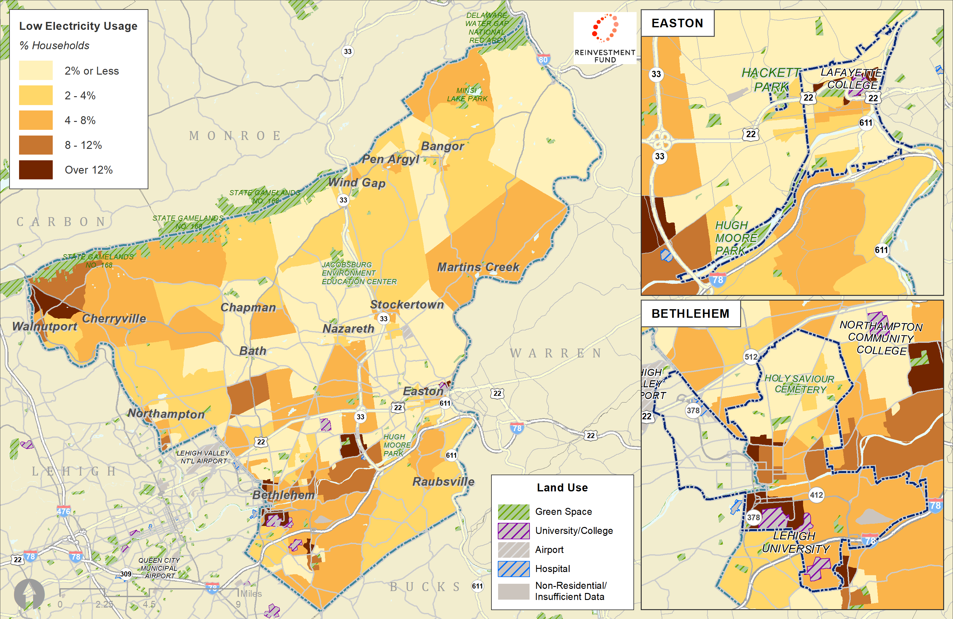
Northampton Low Electricity Usage

Slide 39
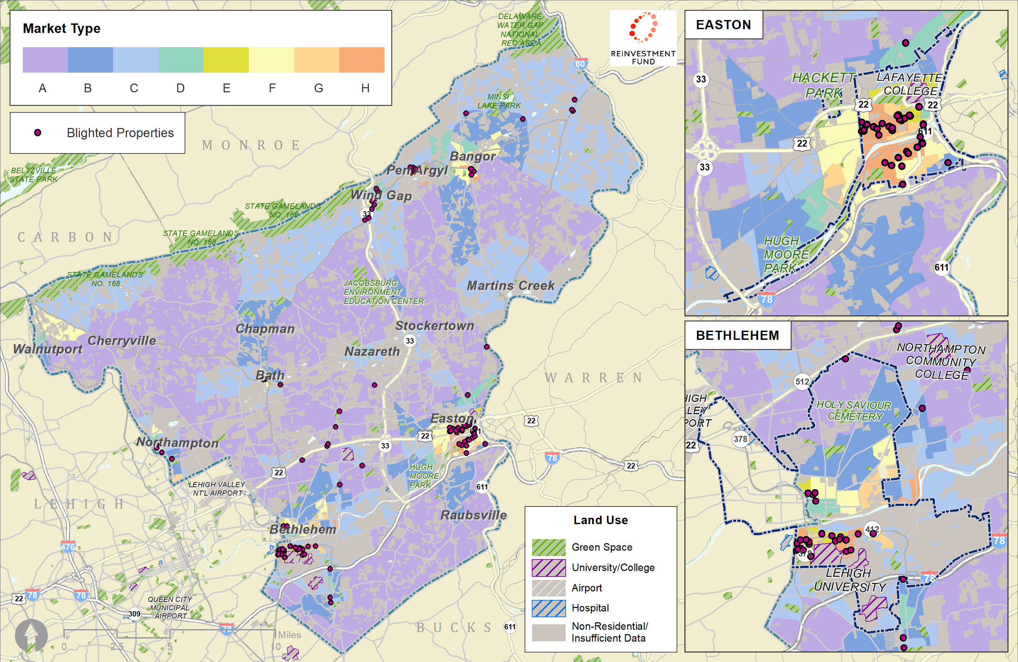
Northampton Locally Identified Problem Properties

Slide 40
Northampton Locally Identified Problem Properties
Land Use | # of Properties
2 -4 Family, Residential | 10 (9%)
Bar or Taproom | 2
Boarding House | 1
Bowling Alley | 2
Church | 1
Mobile Home - on owned land | 3
Motel/Hotel, with Restaurant | 1
NIP, Warehousing/Manufacturing | 8
Public Utility | 1
Repair Shop or Garage | 3
Restaurant | 1
Retail, Conversion | 2
Retail, General | 2
Retail, Mixed: Retail / Apt. or Office | 7
Single Family, Residential | 52 (46%)
Theater (Indoor) | 1
Truck Terminal / Distribution Center | 1
Vacant Land | 2
Unknown | 12 (11%)
Total | 112 (100%)
Market Type | Problem Properties (Total) | Certified Blight (Bethlehem & Easton)
A | 8 (7%) | 0 (0%)
B | 7 (6%) | 1 (3%)
C | 10 (9%) | 0 (0%)
D | 4 (4%) | 0 (0%)
E | 10 (9%) | 3 (9%)
F | 22 (20%) | 5 (14%)
G | 6 (5%) | 2 (6%)
H | 44 (39%) | 24 (69%)
Insufficient Data | 1 (1%) | 0 (0%)
County | 112 (100%) | 35 (100%)
Notes:
The table on the left breaks down the problem properties by their recorded land use. Just under half are single-family residential, while the rest are a mix of multifamily, commercial, and industrial properties. The table on the right shows that they are located in every type of MVA market.

Slide 41
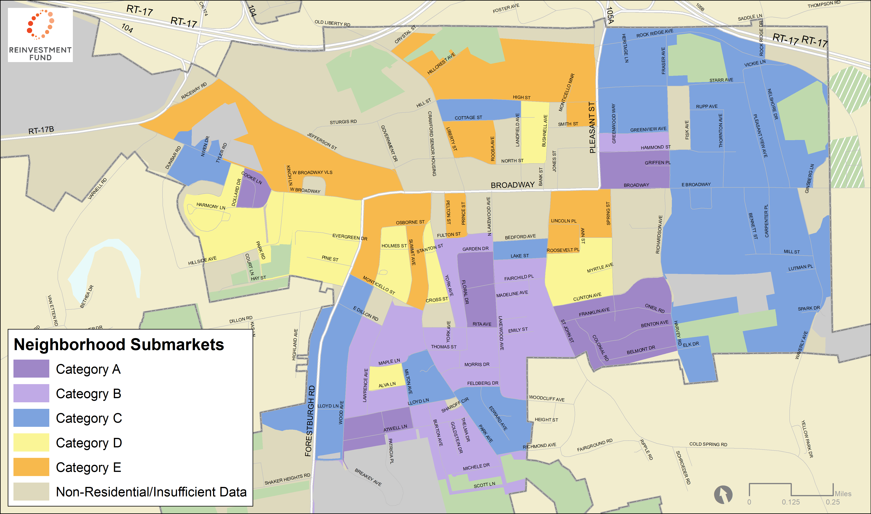
Monticello, NY Market Analysis

Slide 42
Monticello, NY Market Analysis
 | Median Sales Price, 2013-19 | Share of Single-Family Homes | Residential Parcels with Homestead Exemptions | Property Sales Per 10 Homes, 2013-19 | Homes with Permits, 2018-19 | Foreclosures Per 100 Homes, 2016-18 | Homes with Code Violation or Inactive Water Account | Share of Home Sales to Investors, 2013-19
A | $72,839 | 71% | 42% | 2.50 | 4% | 3 | 3% | 29%
B | $64,737 | 78% | 40% | 4.70 | 7% | 8 | 1% | 40%
C | $47,824 | 63% | 29% | 4.18 | 7% | 9 | 5% | 46%
D | $33,756 | 59% | 22% | 6.16 | 8% | 13 | 8% | 63%
E | $32,348 | 51% | 18% | 4.43 | 5% | 4 | 14% | 48%

Slide 43
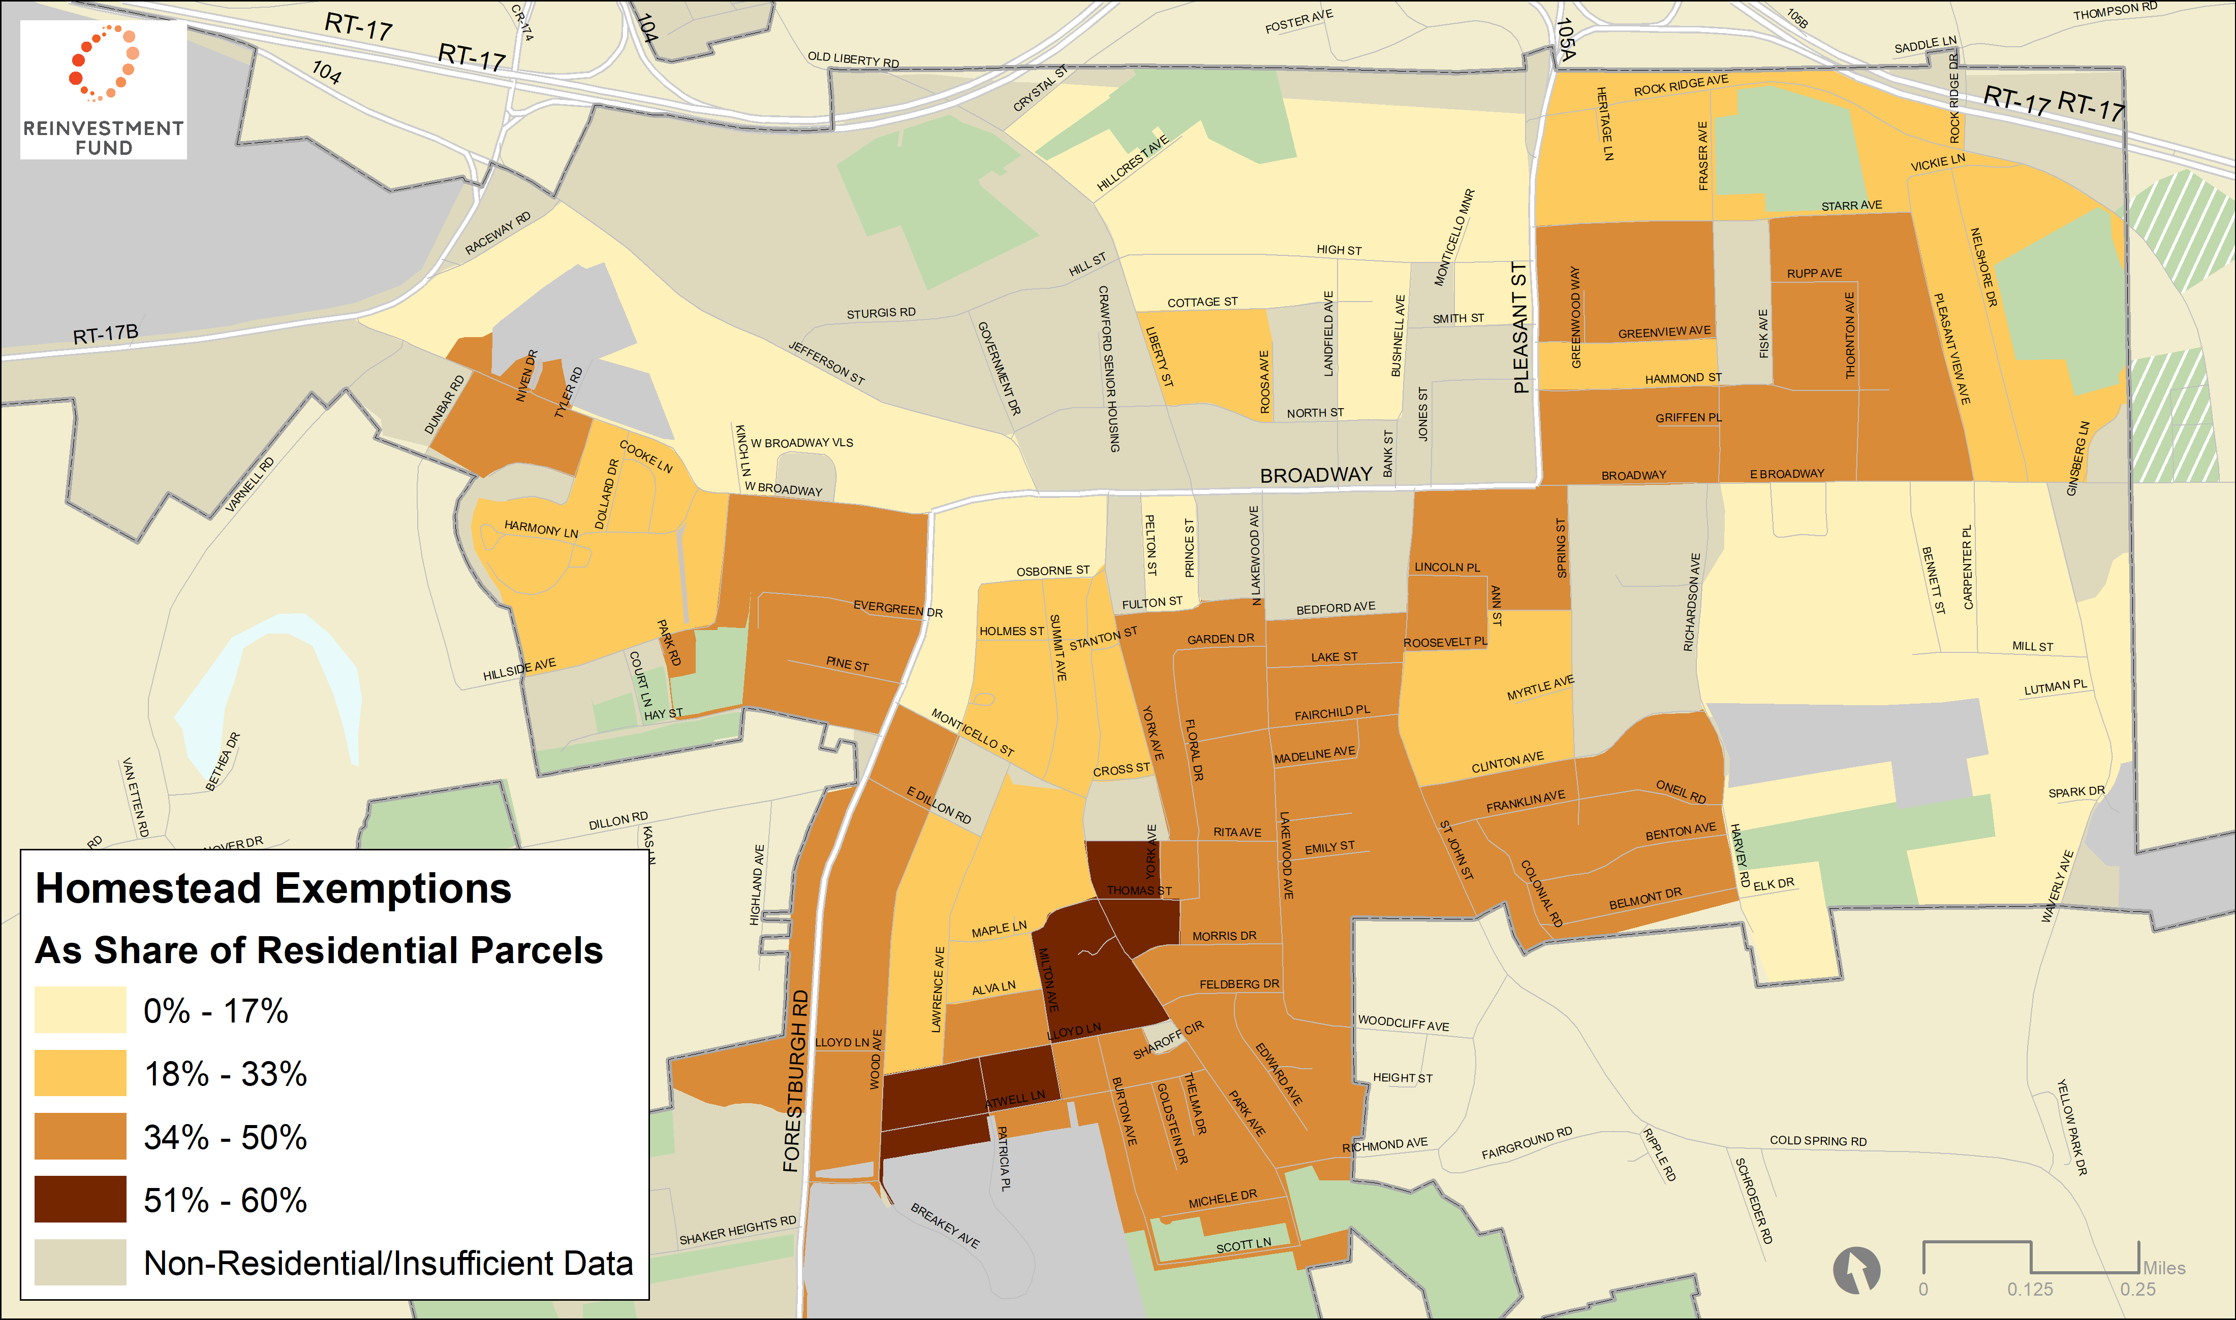
Monticello, NY: Homestead Exemptions

Slide 44
Monticello, NY: Homestead Exemptions
 | Total Residential Parcels | Parcels with Homeowner Tax Exemptions | Total Land Area (in Acres)
A | 204 (13%) | 60 (14%) | 258 (9%)
B | 331 (21%) | 123 (29%) | 376 (14%)
C | 494 (32%) | 134 (31%) | 433 (16%)
D | 189 (12%) | 44 (10%) | 127 (5%)
E | 160 (10%) | 29 (7%) | 197 (7%)
Non-Residential/ Insufficient Data | 186 (12%) | 37 (9%) | 1,354 (49%)
Village Total | 1,564 (100%) | 427 (100%) | 2,744 (100%)

Slide 45
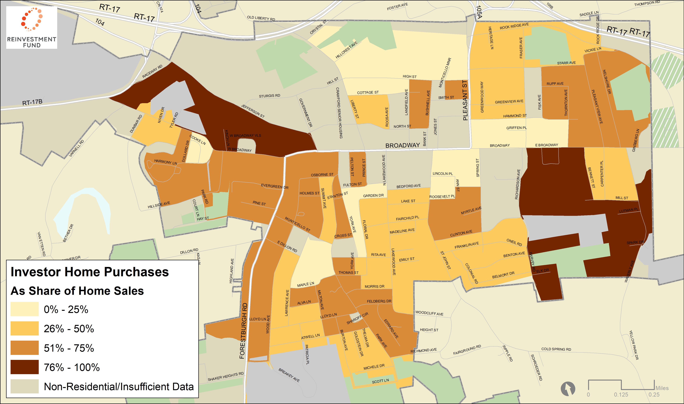
Monticello, NY: Investor/Bank Sales
Vacant Land (19%)
Types of Properties Owned by Investors in Monticello
Multi- Family (10%)

Slide 46
Northampton Recommendations Based on Market
Market Specific Tools | A | B | C | D | E | F | G | H
Quality of Life Violation Ticketing Ordinance |  | X | X |  |  | X
Municipal Code and Ordinance Compliance Act |  |  |  |  | X |  | X | X
Doors and Windows Ordinance | X | X | X | X
Asset Attachment |  |  |  |  | X | X | X | X
Conservatorship |  | X | X | X | X | X
Vacant Lot Remediation (side lots, community gardens) |  |  |  |  |  |  | X | X
Create Land Bank |  | X | X | X | X | X
Home Repair Loans |  | X | X | X | X | X | X | X
Estate Administration | X | X | X | X | X | X | X | X
Commercial Corridor Support | X | X | X | X | X | X
Notes:
It is also essential that you understand what types of real estate markets you have in various neighborhoods and tailor your actions to those markets. We mapped different types of markets across the county. In some markets, for example, conservatorship will work. There is sufficient value in a property that a neighbor could fix up the property and recover their investment through rental or sale. This is not true of a very weak market with extremely low values and demand.

Slide 47
Framework for Addressing Rural Problem Properties
Create action plan and task force to provide roadmap, collaboration and oversight capacity
Adopt legal framework (International Property Maintenance Code or Local Code)
Build self-financing strategic code enforcement - Consider shared or outsourced program – Goal Is Compliance Not Fines
Require registration of vacant and rental properties
Use receivership to rehabilitate buildings
Mandate time for buyers of properties with code violations to bring up to code

Slide 48
Framework for Addressing Rural Problem Properties
7. If allowed use administrative enforcement - quality of life ticketing
8. Use all available incentives to rehabilitate buildings including historic district designation
9. Reform tax sale to break cycle of blight – define eligible buyers and time to bring up to code
10. Provide home repair grants and loans
11. Educate magistrates/judges to adjudicate code enforcement cases
12. Share templates, forms and legal capacity

