Slide 1
Utilizing Nonprofit Legal Partnerships to Strengthen Neighborhoods
Reclaiming Vacant Properties Conference
Atlanta, GA
October 3, 2019

Slide 2
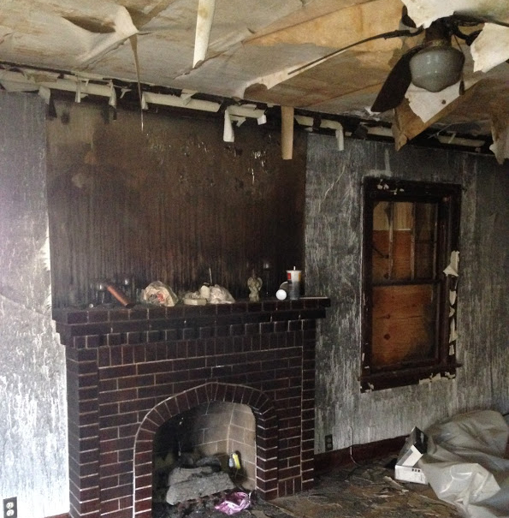
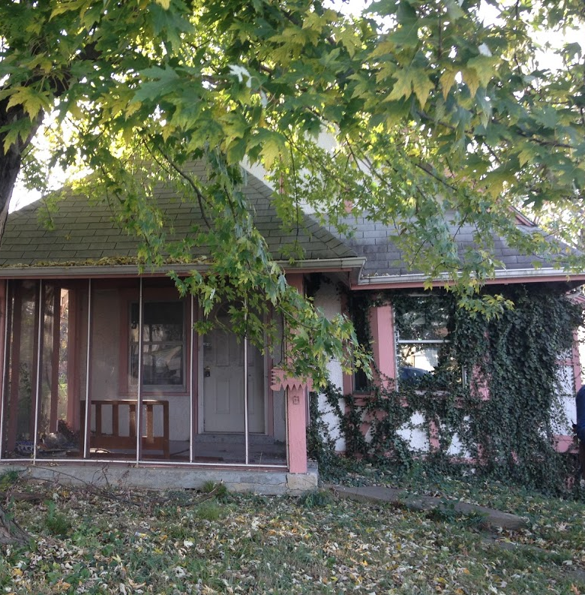
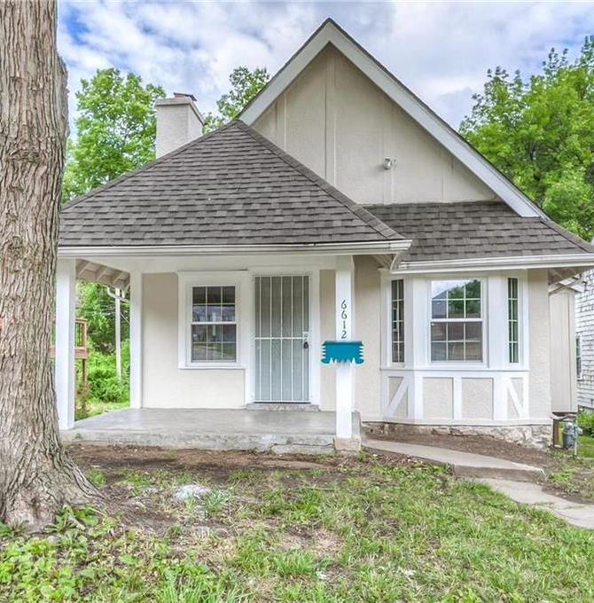
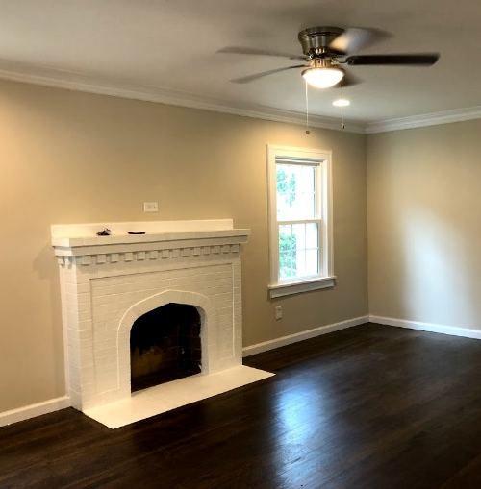
Neighbors United for Action Kansas City - 6612 Broadmoor, Kansas City, MO

Slide 3
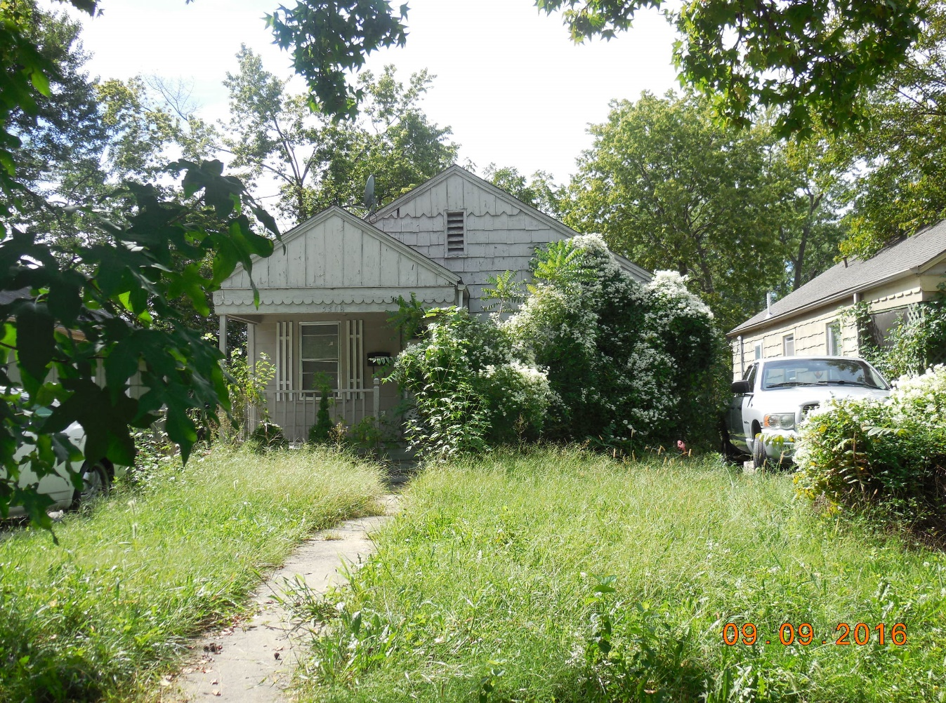
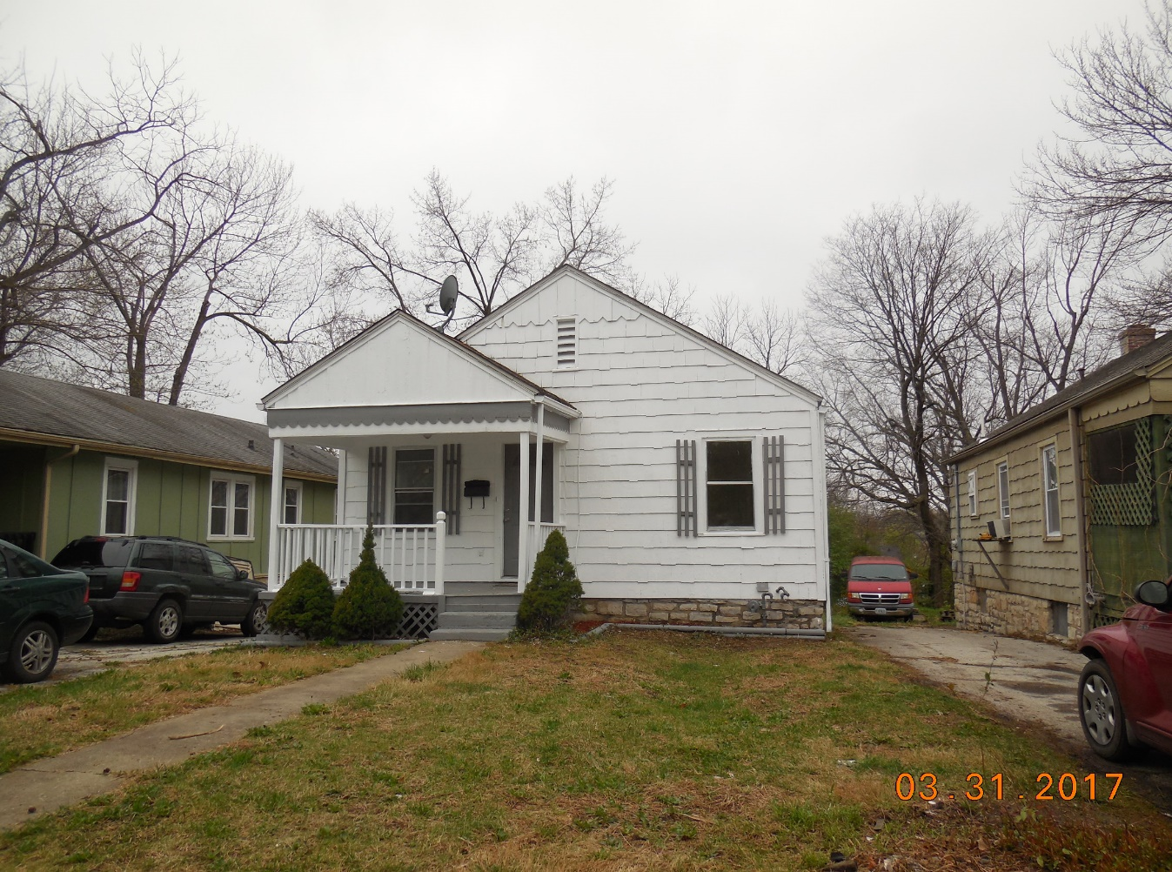
Blue Hills Neighborhood Association - 5508 Woodland, Kansas City, MO

Slide 4
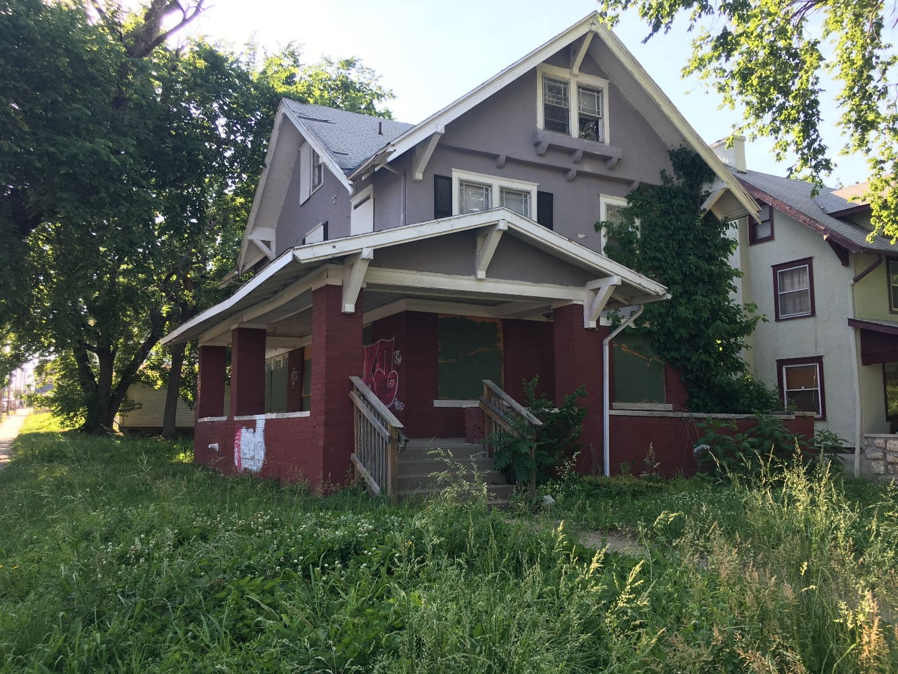
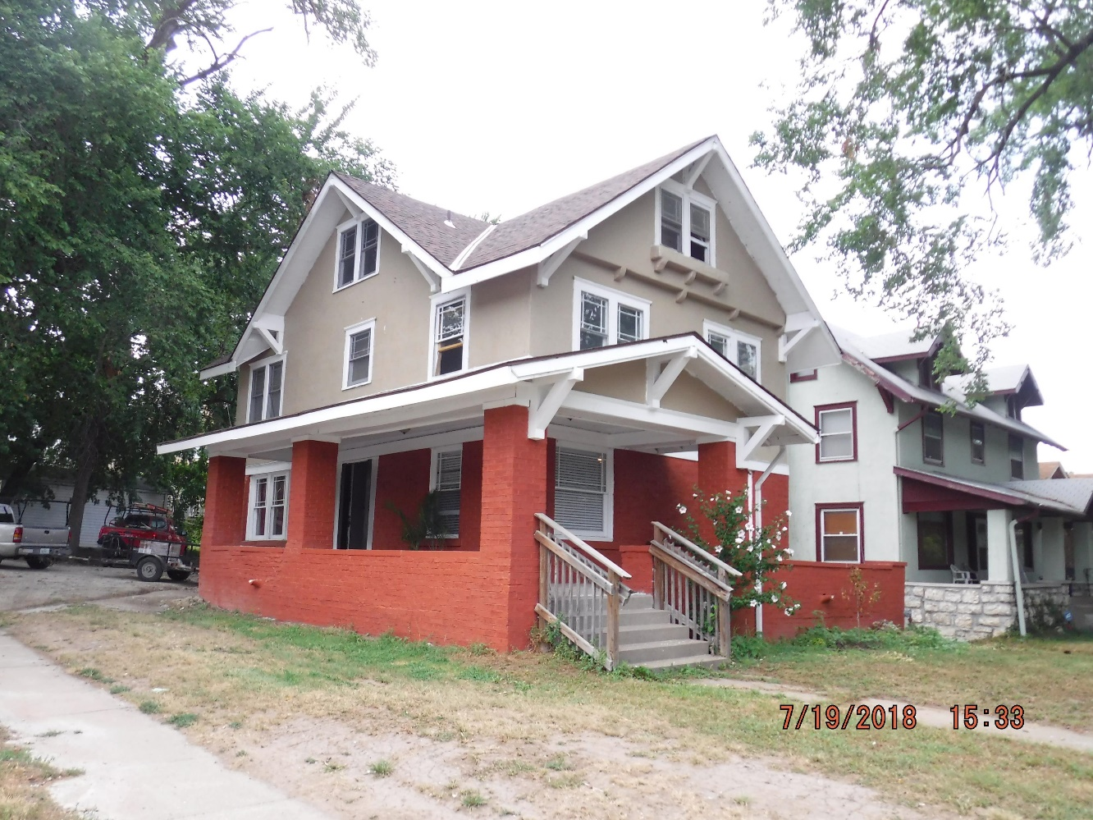
Indian Mound Neighborhood Association 100 N. Van Brunt Blvd., Kansas City, MO

Slide 5
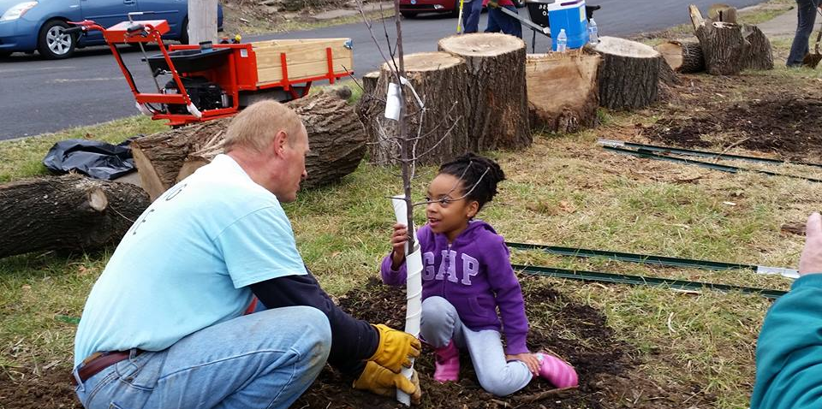
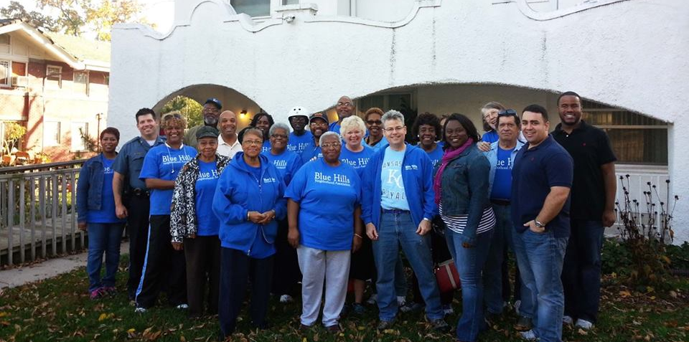
Blue Hills Neighborhood Association
Established in 1998
7,962 residents
57% homeowners
Average age: 49
In addition to cleanups and block parties, Blue Hills residents take charge of development through their Housing and Real Estate Committee
17 houses rehabbed since 2014

Slide 6
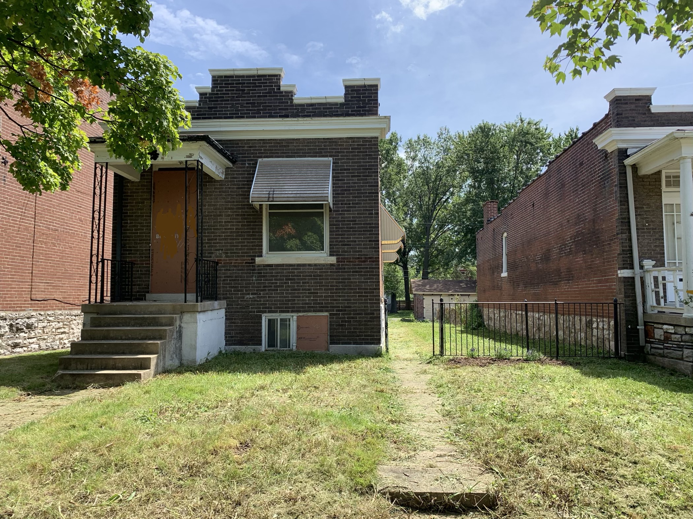
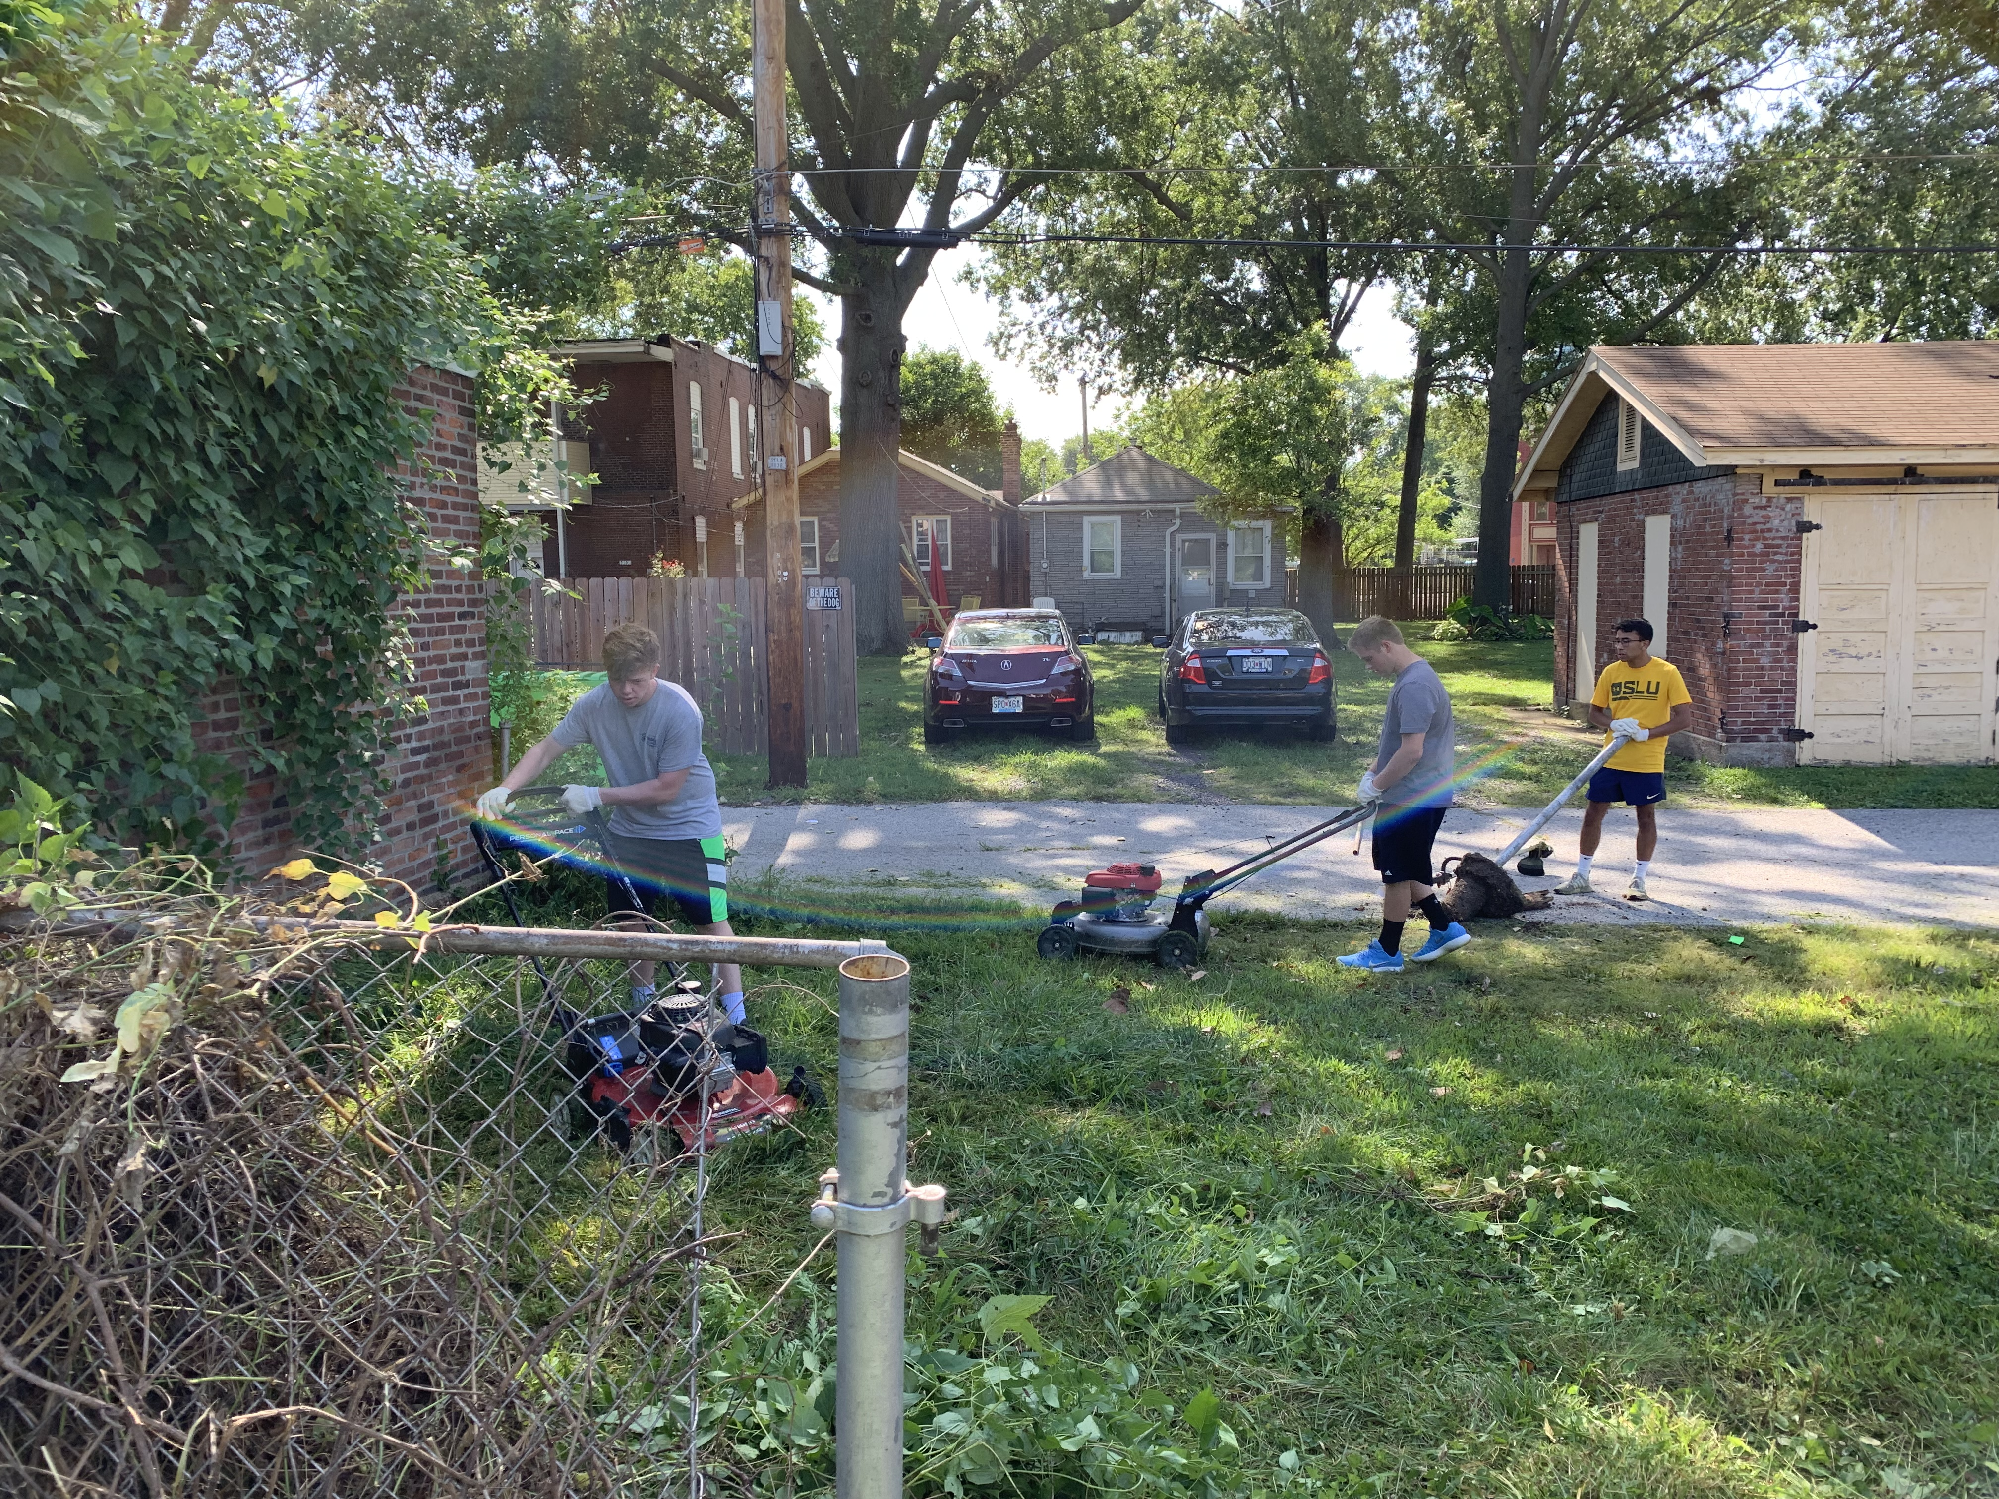
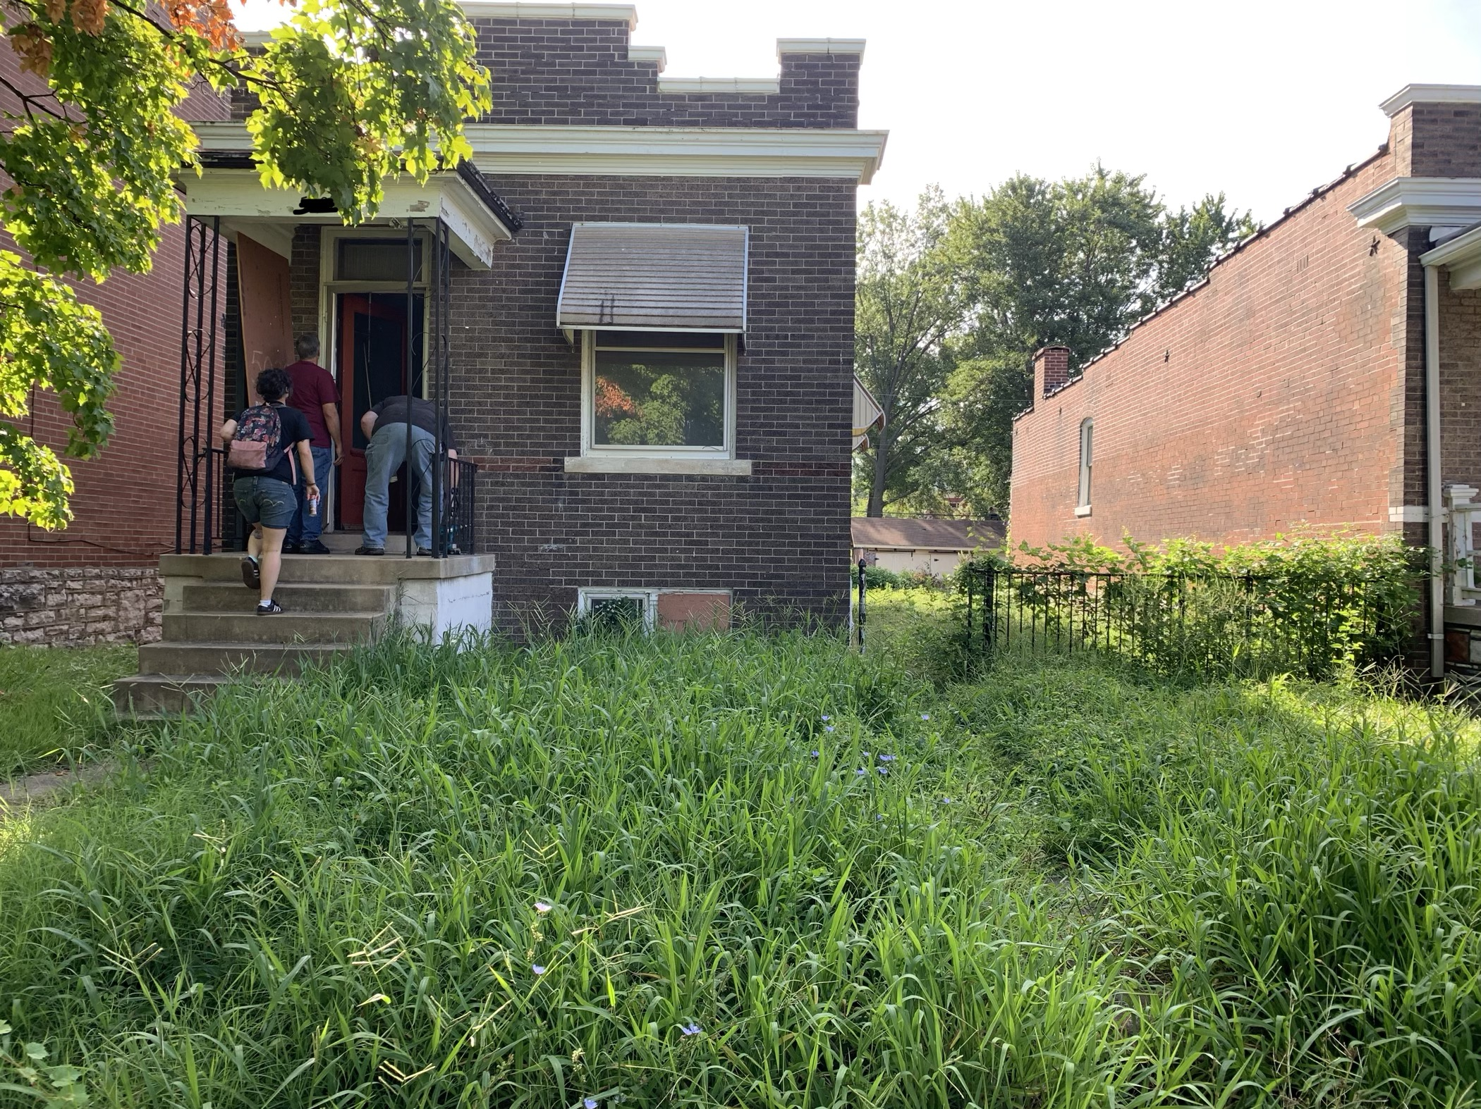
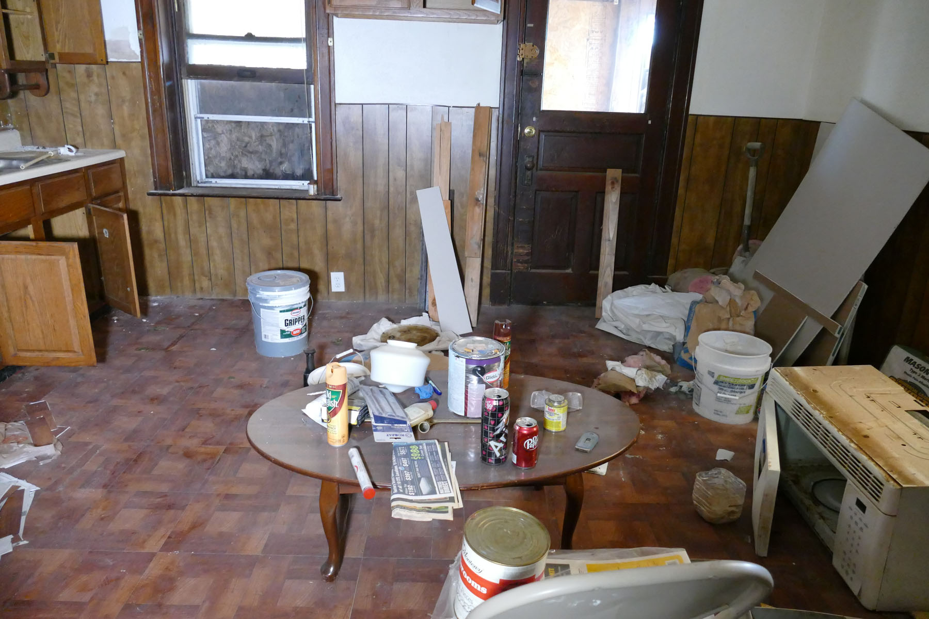
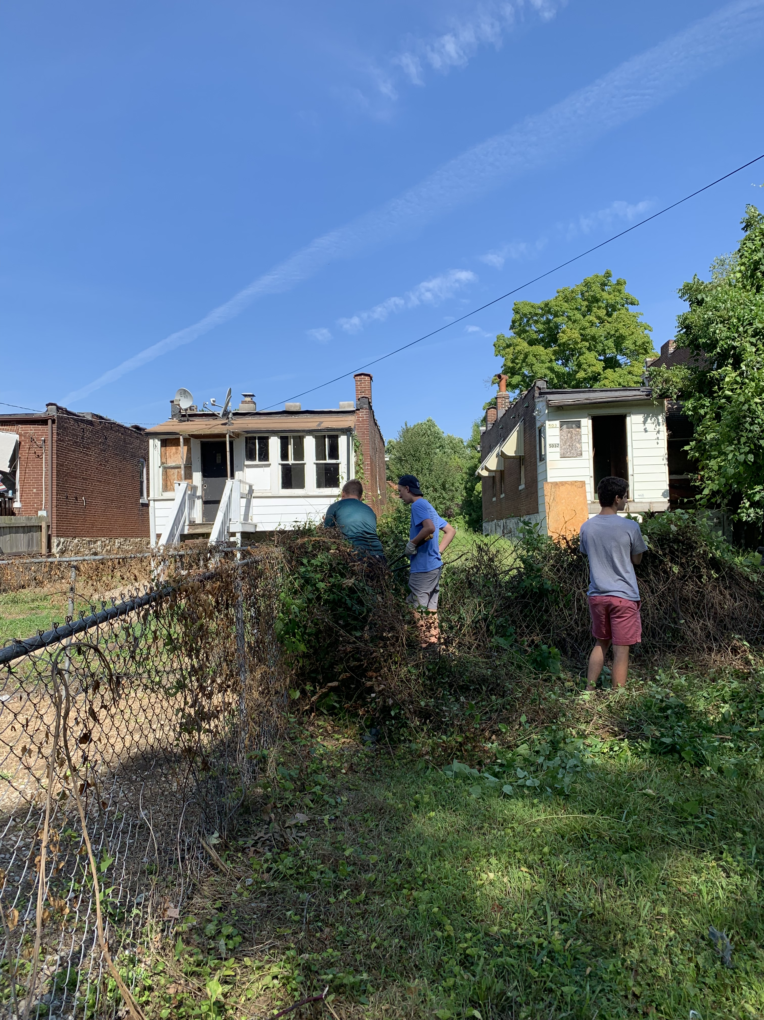
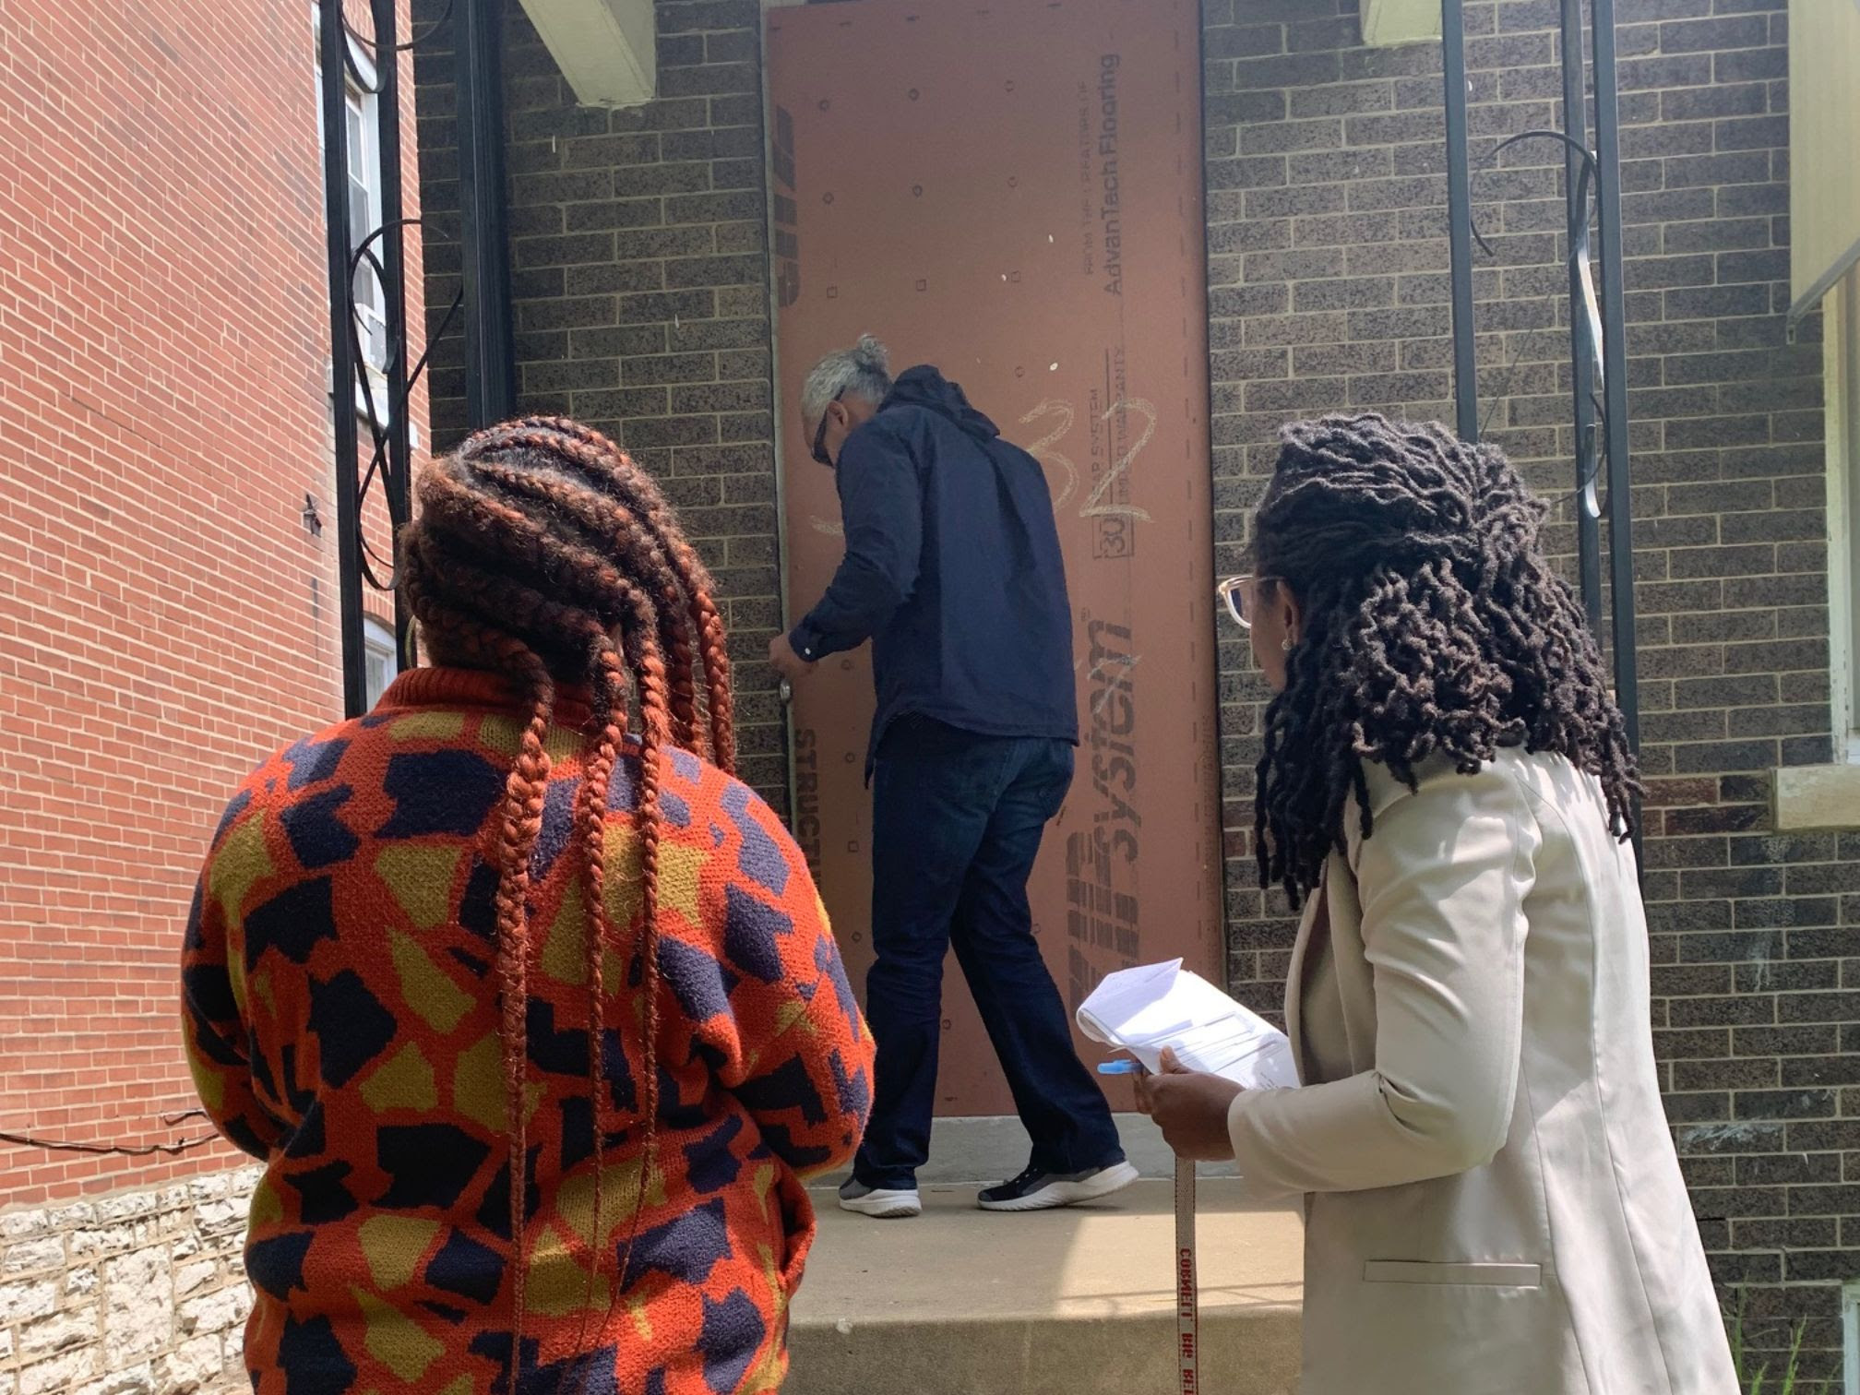
Founded in 1973
Serve 4 South St. Louis City Neighborhoods
Approx. 25,000 residents
Housing Stabilization and Community Empowerment
 | Census Tract 1155
Total pop | 6929
Children as % of pop (#) / Children in poverty | (2,200) 31%/ 59%
Vacancy | 16% (2958 units)
renter | 65%
Single unit structure | 48%
Foreign born ( city wide 6.8%) | 9.7%
Not in labor force | 2325
Executive Director
Amanda Colón-Smith

Slide 7
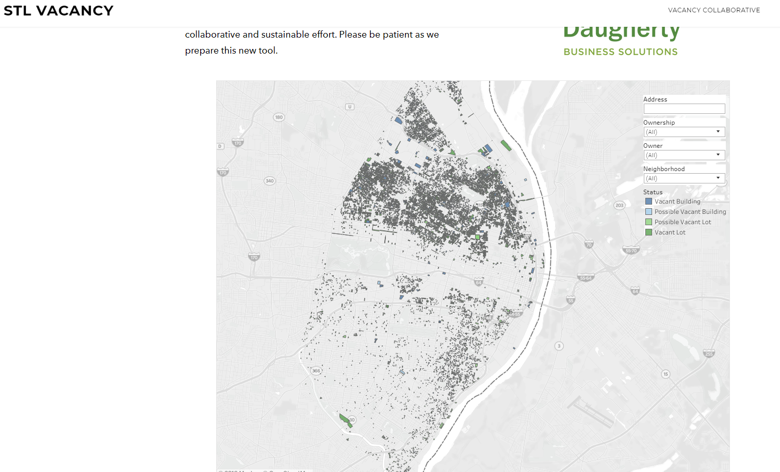
Vacancy Portal (StL)
https://www.stlvacancy.com/map.html
Can find vacant buildings, possible vacant buildings, vacant lots, and possible vacant lots
Pulls from 12 different data sets; will soon become automated

Slide 8
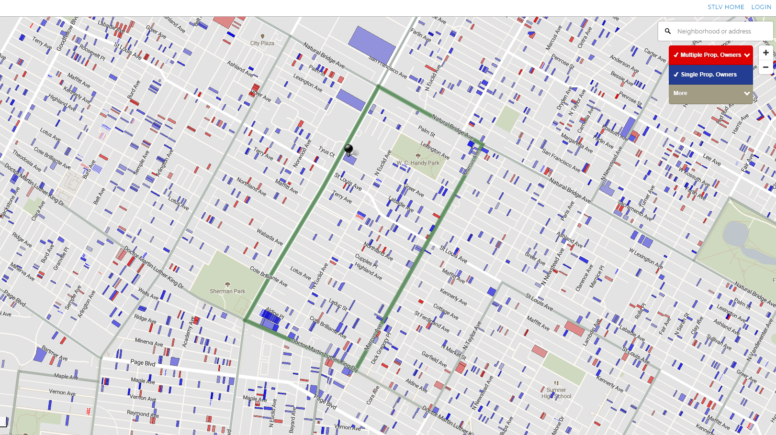
LSEM Vacancy Explorer
Keyed to elements of available legal tools
Enables more strategic use of the tools
Will be rolled into Vacancy Portal

Slide 9
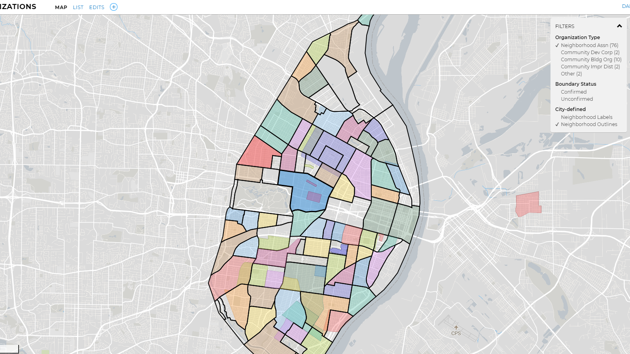
STL Community Organizations
Mapping organizations that may be able to use the legal tools
Enables more strategic use of resources and helps neighborhoods align efforts
Will be rolled into Vacancy Portal

Slide 10
Preventing Abandonment through Holistic Legal Services
Estate planning
Title issues
Nonprofit and small business development
Tax valuation appeals for homeowners
Eviction defense and consumer protection
Applications for tax abatement
And more!

Slide 11
Linda Brown, Housing Committee Chair, Blue Hills Neighborhood Association luvdoes@sbcglobal.net
Dana Malkus, Director, Entrepreneurship and Community Dev, Clinic, Saint Louis Univ. School of Law dana.malkus@slu.edu
Abby Judah, Staff Attorney, Adopt-a-Neighborhood Project, Legal Aid of Western Missouri ajudah@lawmo.org
Amanda Colon-Smith, Executive Director, Dutchtown South Community Corporation amanda@dutchtownsouth.org
Peter Hoffman, Managing Attorney, Neighborhood Vacancy Initiative, Legal Services of Eastern Missouri pjhoffman@lsem.org

