Slide 1
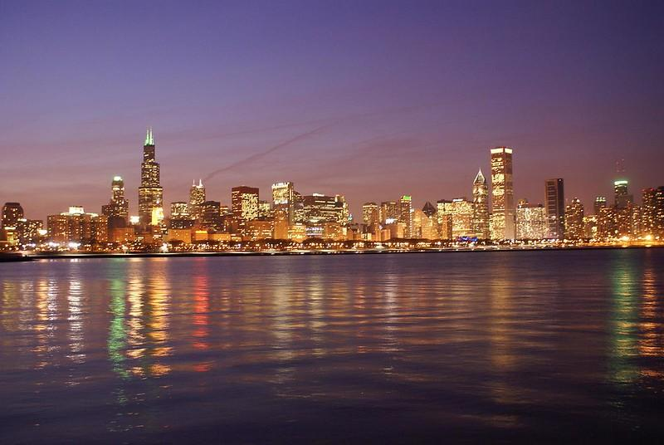
#RVP Conference
Opportunity Zone Session
October 1, 2019
Opportunity Zones
Understanding the Most Important Economic Development Tool of the
21st Century
n
@ChristopherCoes @LOCUSDevelopers

Slide 2
Smart Growth America
Smart Growth America empowers communities through technical assistance, advocacy, and thought leadership to create livable places, healthy people, and shared prosperity.

Slide 3
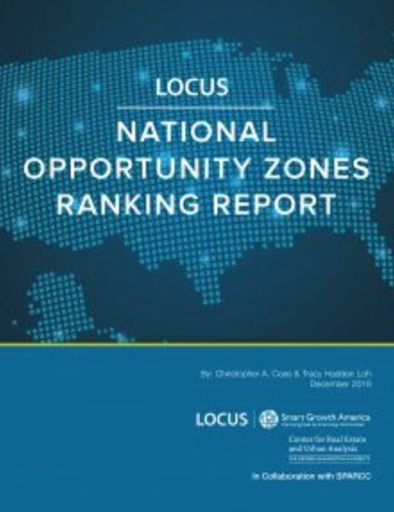
LOCUS National Opportunity Zones Ranking Report

Slide 4
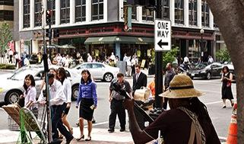
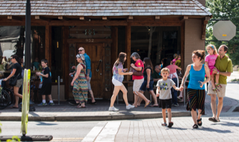
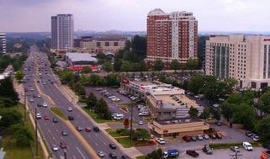
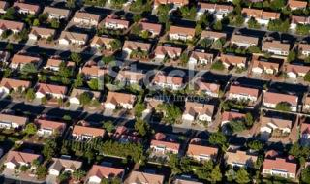
WalkUPs:
A form of development with higher density, multiple real estate product types in close proximity or within the same property, and multiple modes of transportation to move people and goods to the place.
Within the WalkUP, nearly everything is within walking distance.
METROPOLITAN LAND USE OPTIONS:
REGIONALLY SIGNIFICANT
LOCAL SERVING
WALKABLE URBAN
WALKUP: Metro Area Acreage: 1%
NEIGHBORHOOD Metro Area Acreage: 2-6%
DRIVABLE SUB-URBAN
EDGE CITY Metro Area Acreage: 3-4%
BEDROOM COMMUNITY Metro Area Acreage: 90-94 %

Slide 5
Key Findings
Walkable urban office space in the 30 largest metros commands a 105 percent rent-per-square-foot premium over rents in drivable suburban areas.
Rental multi-family commands a 61 percent rent-per-square-foot premium over rents in drivable suburban areas.
These price premiums continue to grow.
Walkable urban development is not limited to the revitalization of center cities; it is also the urbanization of suburbs.

Slide 6
Smart Growth America conducted interviews with senior-level employees at relocated companies to understand why they chose the location they did. In the course of our interviews six common themes emerged explaining why companies chose to locate downtown:
To attract and retain talented workers
To build brand identity and company culture
To support creative collaboration
To be closer to customers and business partners
To centralize operations

Slide 7
Opportunity Zone Classification Matrix
Potential WalkUPs
Census tracts whose economic, geographic, and real estate indicators do not support walkability, livability, and job, transportation, and housing diversity.
Established WalkUPs
Census tracts whose economic, geographic, and real estate indicators support walkability, livability, and job, transportation, and housing diversity.
Low Smart Growth Potential (0-6)
High Smart Growth Potential (12-20)
Low National Walkability Index score (<14)
Low job density
Low housing density
At Risk of Neighborhoods
High National Walkability Index score (14-20)
High job density
High housing density
High Social Equity
(12-20)
Emerging WalkUPs or
Bubble Communities
These communities’ social equity (7-11) and smart growth potential (7-11) fall in the middle of the pack; they are most in control of their future, but could experience the fastest rapid change in social equity or economic performance if they’re not intentional about their investment and policy frameworks.
Total Population: 494,928
High Risk of Displacement
Distance from Top 100 metro area central business district
High transit accessibility
Low H + T (<45%)
High percentage of rental units (>50%)
Total Population: 9.9 million
Proximity to Top 100 metro area central business district
High transit accessibility
Low H + T (<45%)
High percentage of rental units (>50%)
Total Population 494,928
Low National Walkability Index score (<14)
Low job density
Low housing density
Distance from Top 100 metro area central business district
High National Walkability Index score (14-20)
High job density
High housing density
Proximity to Top 100 metro area central business district
Low Social Equity
(0-6)
Low Risk of Displacement
Low transit accessibility
High H + T (>45%)
Low percentage of rental units (<50%)
Total Population: 15,554
Low transit accessibility
High H + T (>45%)
Low percentage of rental units (<50%)
Total Population: 20 million
Notes:
g

Slide 8
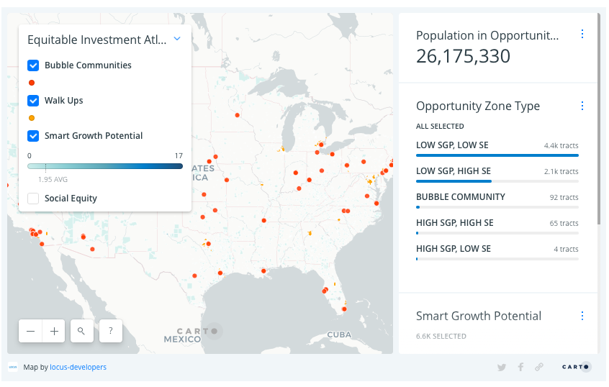
LOCUS Equitable Investment Atlas: The Equitable Investment Atlas is an interactive mapping tool that allows users to search all designated Opportunity Zones in the 50 U.S. states and the District of Columbia for information regarding their Smart Growth Potential (SGP) and Social Equity. It is intended to guide communities in designated Opportunity Zones, as well as other stakeholders and investors, to better understand designated zones’ SGP status relative to other locations across the country.
locusdevelopers.org/opportunity-zones

Slide 9
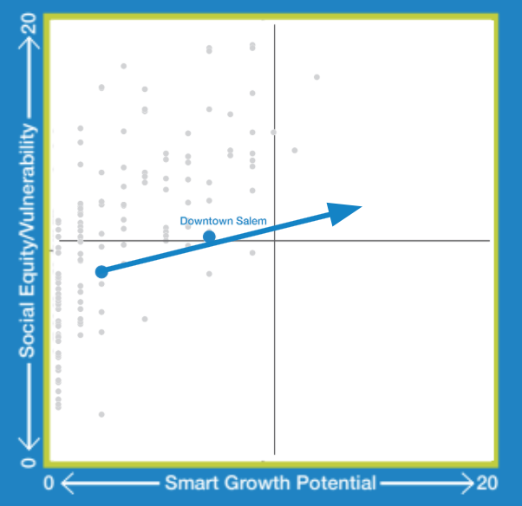
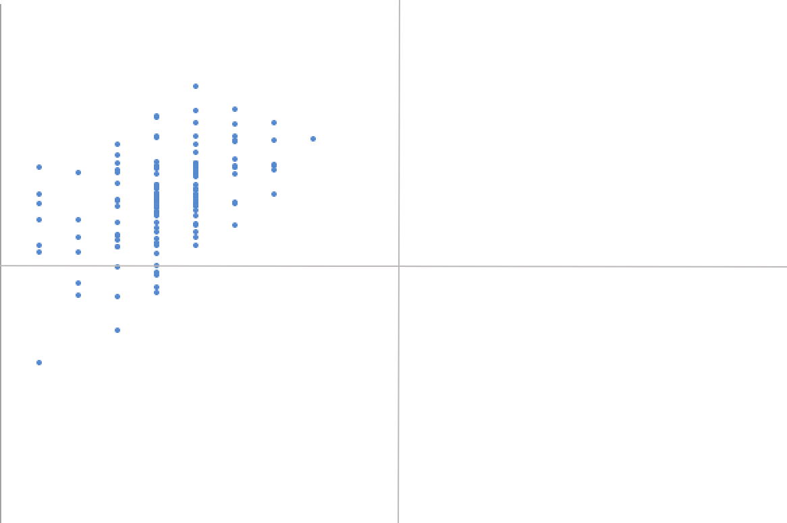
Example 1: Growing Smart Growth Potential in Chicago
What do we need to increase Smart Growth Potential?
Housing Density
Job Density via Small Business Incentives
Improving Walkability
What do we need to become more socially equitable?
Density
Access to transit
Low H + T
Diversity of housing choice

Slide 10
What can Cities do now?
Inspire investor confidence in local development projects and processes
Ensure equitable development outcomes in Opportunity Zone areas
Create Opportunity Zone Vision and Strategy
Convene an Opportunity Zones task force to establish priority projects
Align state, local and philanthropic resources and incentives.
Create one-stop shop and project pipeline database
Reduce regulatory process for project approval
Create an Opportunity Fund accessible to local residents and business
Institute “do no harm” policies
Create measurable, people-based social equity outcomes (real-time monitoring)
Develop a real attainable housing strategy
Build cross-sectional coalition in support of transit & equitable development
Establish equitable development scorecard to direct local investment

Slide 11
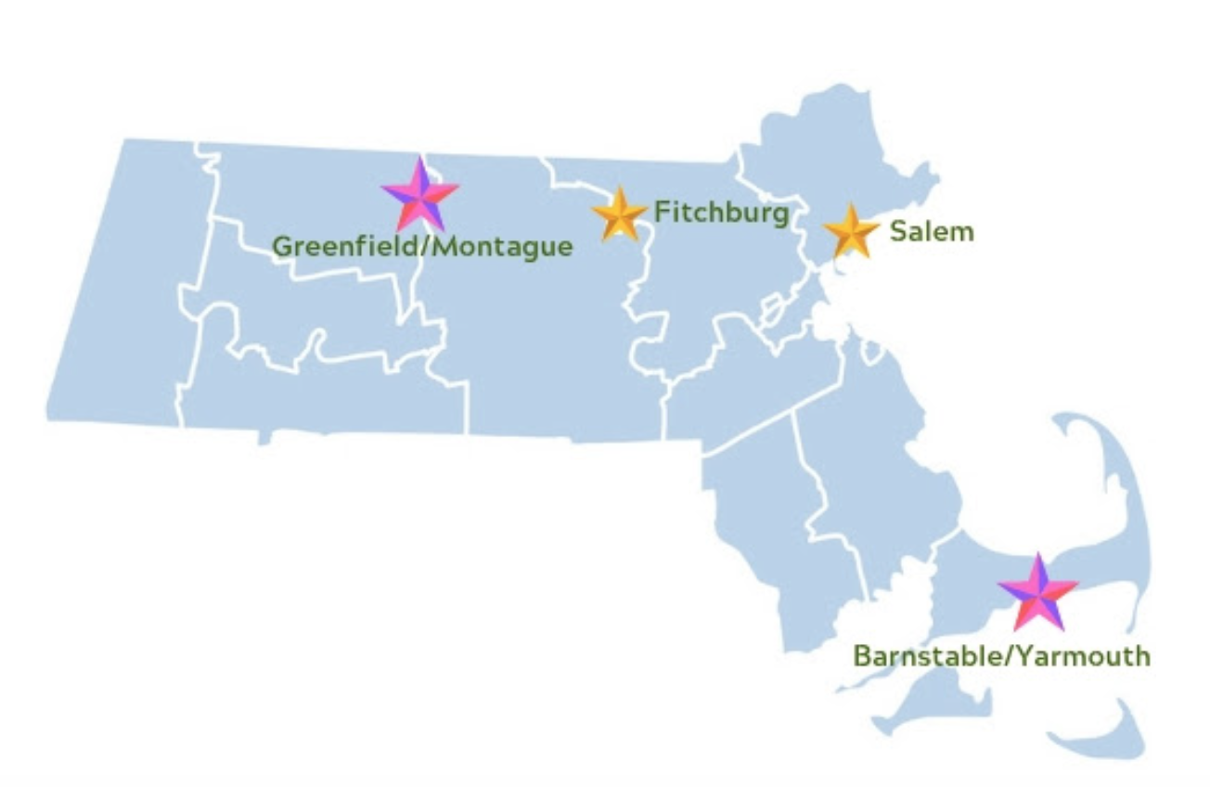
Massachusetts Opportunity Zones Academy
Aims to provide Massachusetts communities with a place-based technical assistance program that prepares them to make the most of the new federal Opportunity Zones tax incentive.

Slide 12
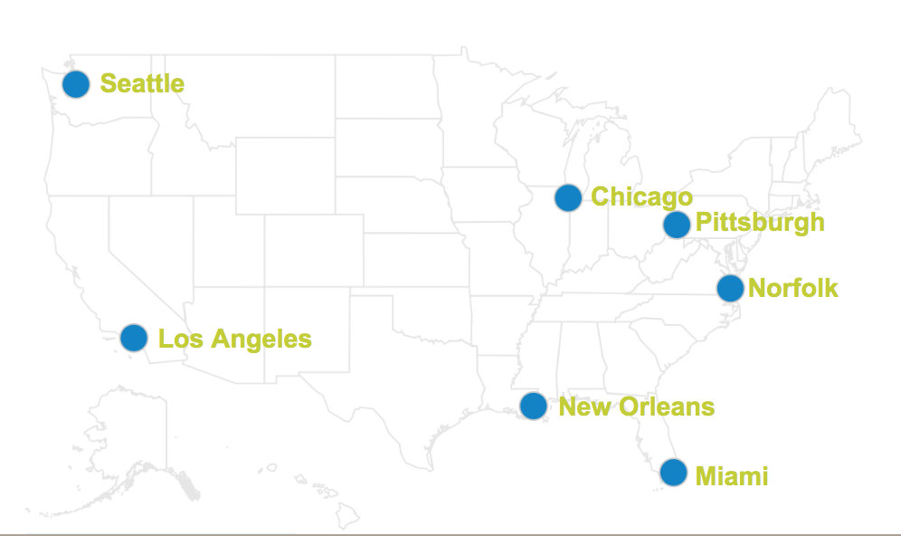
National Opportunity Zones Academy
Aims to provide the cities of Seattle, Los Angeles, New Orleans, Miami, Chicago, Norfolk, and Pittsburgh with a place-based technical assistance program that prepares them to make the most of the federal Opportunity Zones tax incentive.

Slide 13
Thank you!
Questions? Contact:
Christopher Coes at ccoes@locusdevelopers.org

