Slide 1

Atlanta Neighborhood Development Partnership, Inc.
HOME SOUTH DEKALB:
Restoring Family Equity & Health Through Suburban Revitalization
Reclaiming Vacant Properties Conference | October 3, 2019

Slide 2
ANDP Overview
Restoring Homeowner Equity & Growing our Scale
POLICY, ADVOCACY & COMMUNITY ENGAGEMENT
Convening, leading regional foreclosure response, engaging neighborhood leaders.
HOUSING DEVELOPMENT
Neighborhood stabilization and homeownership through redevelopment/preservation.
THE ANDP LOAN FUND
CDFI Loan Fund: Capital for affordable housing and community development.
2019
Nearly 100 SF homes – Doubling scale in last 3 years
Two NEW apartment communities (327 units)
Broke ground on new 147-unit facility (30,50, 80% AMI)
Deployed $1M in down payment assistance
ANDP CDFI Loan Fund at $7.25 M
Notes:
ANDP is a non profit that has been around since 1991
In the beginning we focused primarily on affordable housing policies and advocacy. We also did a good bit of community engagement.
When the foreclosure crisis hit, we led the regional foreclosure response through convening and engaging neighborhood leaders.
In fact, shifted the organization’s focus from policy advocacy to Affordable Housing Development.
We managed a number of Neighborhood Stabilization Program contracts and began fostering homeownership through redevelopment and preservation.
We also have The ALF, It is a Community Development Financial Institution that provides liquidity for affordable housing and community development by making loans to developers of affordable housing.
Our 2019
100 SF homes – Doubling scale in last 3 years
Two NEW apartment communities (327 units)
Deploy nearly $1M in down payment assistance
ANDP Loan Fund at $7.25 M – Innovative partnership w/ Reinvestment Fund

Slide 3
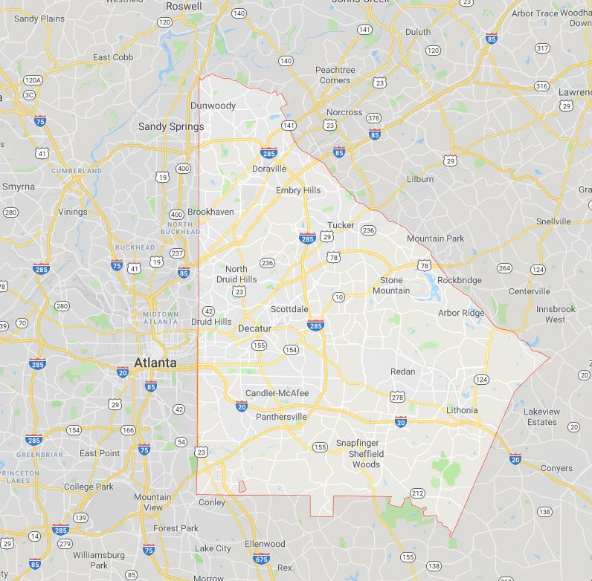
DeKalb County
Population: 756,558 (4th most populated in GA)
54.9% African American
314,302 Housing Units, 54% Homeowner Occupied
Median value of owner occupied homes: $176,000
Median monthly owner cost w/mortgage: $1,477
Median monthly gross rent: $1,062
Households with broadband subscription: 81%
Median Household Income (2017): $55,876
Per Capita Income (2017): $32,110
Persons in Poverty: 15.3%
Unemployment Rate: 3.6% (July 2019)
(U.S. Census data)
Notes:
Since the Great Recession, we’ve acquired, rehabbed and resold over 500 homes to low and moderate income families
For clarification we only sell to owner occupants and we only sell to families that are at or below 120% AMI. If we used federal HOME funds to acquire and rehab it would be 80% AMI.
120% AMI For the Atlanta Metro that income is around $95k for a family of 4 and for 80% AMI it is around $65k for a family of 4.

Slide 4
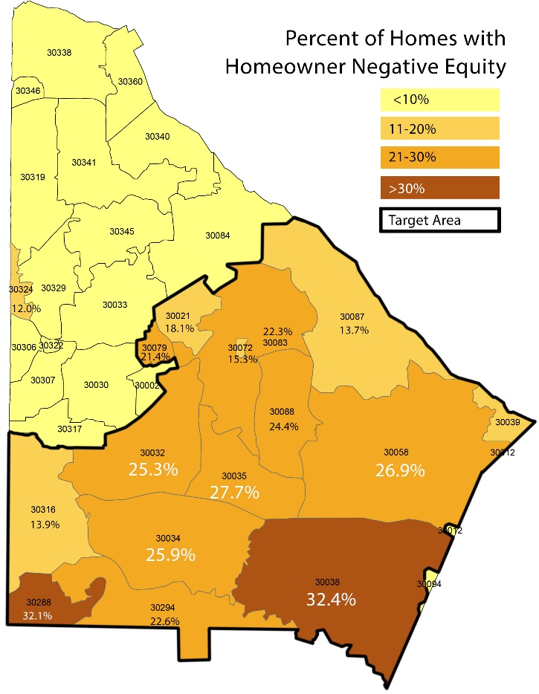
Loss of Wealth & Equity in South DeKalb
Primary Targets: 15 South DeKalb Zip Codes
Q4 2017 | South DeKalb | North DeKalb | Georgia | US
Negative Equity | 17.3% | 5.9% | 11.9% | 9.1%
Home Equity Lost | $1.04 Billion | $0.5 B | $13 B | $416 B
% AA | 82% | 17% | 31% | 13%
% White | 10% | 67% | 59% | 76%

Slide 5
Loss of Wealth & Equity in South DeKalb
Primary Targets: 15 South DeKalb Zip Codes
18,000 homes lost to foreclosure in South DeKalb
Over 17% of homeowners are still underwater in South DeKalb, compared to 8% national average.
Areas with significant wealth-stripping during foreclosure (Before foreclosure crisis, 92% of African American net worth was tied to homeownership)
Multiple City of Atlanta, placed-based initiatives. NONE in the suburbs – where Brookings identifies 88% of region’s poverty
Notes:
Why did we choose South DeKalb County for this demonstration.
While there are many initiatives in the city of Atlanta (I bet any one of you could list at least 3 initiatives going on in the city of Atlanta now), HSD is in the suburbs, where the Brookings Insitture cites 88% of the region’s poverty exists.
Pre foreclosure crisis, this area was vibrant. Like the rest of the Atl region this area was hit hard by the foreclosure crisis.
While the majority of the nation has recovered, 26% of S. DeKalb homeowners are sill underwater vs. 8% of the nation
92% of AA wealth is in home.
So if we know that the majority of African American wealth is in the home and 26% of S. DeKalb homeowners has negative equity, that means there is a lot of negative wealth out there.
Please take a look at the part of the map highlighted and with the bold border. That is our Home South DeKalb Footprint. It goes from the city of Atlanta/DeKalb through Decatur (unincorporated), up to Stone Mountain, down to Lithonia, then Ellenwood and back around through Decatur to Atlanta/DeKalb.

Slide 6
Partners
Resources
Scale
Collective Impact
Replicable
PARTNERS
60+ Member Advisory Board
DeKalb County Government
DeKalb Municipalities
Health Sector
Economic Development
Housing Nonprofits
Veterans Orgs
Education/Academia
Real Estate/Mortgage Professionals
Resident Leaders
CHODOs/Developers/Builders
HUD
Faith-Based Community
Sustainability/Green
Funders
RESOURCES
$20m ANDP commitment
The Kendeda Fund
Kaiser Permanente

Slide 7
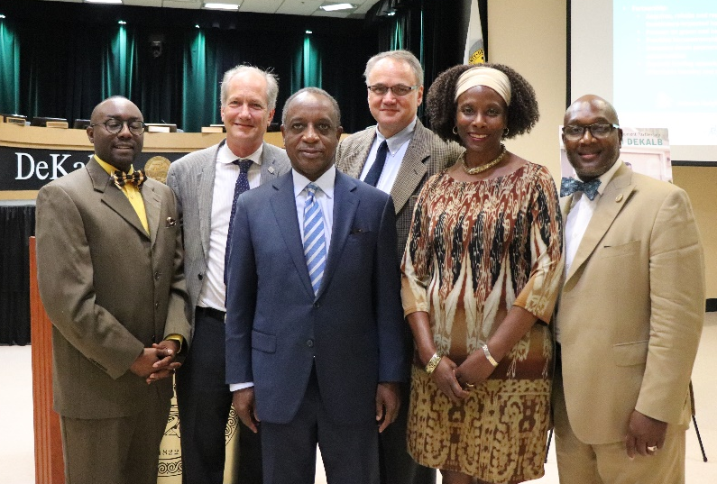
ANDP HOME SOUTH DEKALB
$20 Million Investment Plan
100 new/renovated single-family affordable homes
Utilize green, healthy rehab standards
Increase ANDP capital to affordable housing developers
Lift homeownership levels with increased awareness of down payment assistance
Partner to improve health & economic equity outcomes
Engage resident leaders to strengthen neighborhoods.
Notes:
Ok ANDP, now that you know all of this, what are you going to do to apply your learnings in the community?
We think we can do more.
That’s why in July of 2018, ANDP was joined by DeKalb county CEO Michael Thurmond, to announce it’s $20mm, 3 year investment plan, Home South DeKalb
The $20mm is new and existing capital. In fact, we’ve recently received $1.2 in grants for the program.
So what are we going to do with Home South DeKalb?
100 SF Homes – The 100 homes are primarily homeownership, but it also includes lease purchase and SF rentals.
Provide liquidity for the affordable housing development market with loans from the ALF.
We will also bring $1mm in DPA to DeKalb buyers to help bridge the affordability gap.
Provide enhanced resident community leader support.
The community leaders in the city of Atlanta have been at community development for a long time. The NPU structure is mature and functioning. DeKalb resident leaders do not have as much experience in comm development and we will provide world class training through the Neighborworks America curriculum.
Housing Plus – The previous goals were squarely in the ANDP wheelhouse, But if we want to impact the whole person, that is a S. DeKalb resident, this initiative is going to have to stretch into improving health and economic equity outcomes. This stretch will be made possible through partnerships with organizations with that expertise.
We are currently working ARCHI in the DeKalb YPI, a holistic partnership between a diverse group of DeKalb stakeholders that aims to organize and deploy resources to achieve greater impact for DeKalb residents. United Way’s Child Well Being index will be used to measure success by monitoring the child and the family that cares for them.

Slide 8


ANDP HOME SOUTH DEKALB
$20 Million Investment Plan
Demonstrate impacts of scaled housing investment with broad family and community outcomes outside of central city
Restore lost homeownership: South DeKalb lost 18,000 homeowners from 2008 to 2015
Provide access to accessible, affordable, healthy and green housing choices
Leverage partnership with DeKalb County blight removal, SPLOST, beautification and other investments
Stabilize neighborhoods and decrease student turnover
Notes:
Ok ANDP, now that you know all of this, what are you going to do to apply your learnings in the community?
We think we can do more.
That’s why in July of 2018, ANDP was joined by DeKalb county CEO Michael Thurmond, to announce it’s $20mm, 3 year investment plan, Home South DeKalb
The $20mm is new and existing capital. In fact, we’ve recently received $1.2 in grants for the program.
So what are we going to do with Home South DeKalb?
100 SF Homes – The 100 homes are primarily homeownership, but it also includes lease purchase and SF rentals.
Provide liquidity for the affordable housing development market with loans from the ALF.
We will also bring $1mm in DPA to DeKalb buyers to help bridge the affordability gap.
Provide enhanced resident community leader support.
The community leaders in the city of Atlanta have been at community development for a long time. The NPU structure is mature and functioning. DeKalb resident leaders do not have as much experience in comm development and we will provide world class training through the Neighborworks America curriculum.
Housing Plus – The previous goals were squarely in the ANDP wheelhouse, But if we want to impact the whole person, that is a S. DeKalb resident, this initiative is going to have to stretch into improving health and economic equity outcomes. This stretch will be made possible through partnerships with organizations with that expertise.
We are currently working ARCHI in the DeKalb YPI, a holistic partnership between a diverse group of DeKalb stakeholders that aims to organize and deploy resources to achieve greater impact for DeKalb residents. United Way’s Child Well Being index will be used to measure success by monitoring the child and the family that cares for them.

Slide 9
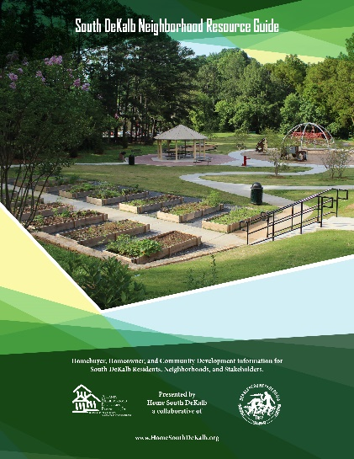
Home South DeKalb
Advancing Economic Opportunity
YEAR 1 – Laying the Groundwork
Partnership with DeKalb County
Leveraging SPLOST Infrastructure/Blight w/Rehab
Homes Sold - 14
Home acquired – 20
Advisory Council convened
YMCA partnership
DPA Provided, DPA Education (downpaymentresource.com)
Healthy, Green Rehab Upgrades – Energy Audits
DeKalb Youth Prosperity Initiative
Neighborhood Resource Guide
Community Capital Conversation – Oct 30
NeighborWorks Week - Neighbors Together
Notes:
We think we can spur a level of recovery through investment.
Remember that During NSP with DeKalb during the crisis, our study revealed that for every $1 we invested, the value of neighboring homes increased by $16. We hope that by doing that with these 100 homes, we can move the needle.
All of our rehabs will be to new green and healthy standards, to include energy audits on some S. DeKalb homes to be able demonstrate how the rehab increased energy efficiency.
HSD Home Purchase and Acquisition Update:
33 properties so far.
14 sold with an average sales price of $151k.
1 rented. We also believe that everyone isn’t ready for homeownership, but the still deserve quality place to call home.
The rest are either listed or in some phase of rehabilitation
A very powerful aspect of HSD is the partnership with the DeKalb county government
Bi monthly meetings to stay on the same page to leverage each others capabilities and services
In partnership with the county we designed and published “The South DeKalb Resource Guide”. It’s a resource that identifies home, health and human services available to residents of South DeKalb. We are proud of this deliverable from our collaboration
The idea of focusing on quality of life issues to stabilize neighborhoods is important to the initiative.
Partnering with experts in this work is important.
United way’s child Well being Index – a measure of how children and the families that support them are doing. Several partners use this index and we want to be a part of the housing solution to the equation.
I won’t go into details, but the index for our S. DeKalb footprint is 50 out of 100. We need to address the underlying issues influencing the low score.
We are also excited about our partnership with the Metropolitan Atlanta YMCA to bring a focus on the issue of “Health and Housing”. The pilot program is called “Healthy Neighborhoods”.
Healthy Neighborhoods is a pilot program in which ANDP and the Y will partner to provide an annual YMCA family memberships to families that purchase the 100 ANDP homes associated with Home South DeKalb. We will work with the family to monitor their behavioral changes that relate to health and wellness.
It is our hope that or initiative provides momentum for other programs or initiatives to develop from other organizations and S. DeKalb county stakeholders. Programs that will enhance the quality of life for residents of South DeKalb.

Slide 10
Home South DeKalb
Advancing Economic Opportunity
YEAR 1 – CHALLENGES
Deploying community development capital
Down payment assistance resources
Increasing costs associated with acquisition/rehab model (materials, labor, etc)
Acquisition – competitive market
Housing +
Notes:
We think we can spur a level of recovery through investment.
Remember that During NSP with DeKalb during the crisis, our study revealed that for every $1 we invested, the value of neighboring homes increased by $16. We hope that by doing that with these 100 homes, we can move the needle.
All of our rehabs will be to new green and healthy standards, to include energy audits on some S. DeKalb homes to be able demonstrate how the rehab increased energy efficiency.
HSD Home Purchase and Acquisition Update:
33 properties so far.
14 sold with an average sales price of $151k.
1 rented. We also believe that everyone isn’t ready for homeownership, but the still deserve quality place to call home.
The rest are either listed or in some phase of rehabilitation
A very powerful aspect of HSD is the partnership with the DeKalb county government
Bi monthly meetings to stay on the same page to leverage each others capabilities and services
In partnership with the county we designed and published “The South DeKalb Resource Guide”. It’s a resource that identifies home, health and human services available to residents of South DeKalb. We are proud of this deliverable from our collaboration
The idea of focusing on quality of life issues to stabilize neighborhoods is important to the initiative.
Partnering with experts in this work is important.
United way’s child Well being Index – a measure of how children and the families that support them are doing. Several partners use this index and we want to be a part of the housing solution to the equation.
I won’t go into details, but the index for our S. DeKalb footprint is 50 out of 100. We need to address the underlying issues influencing the low score.
We are also excited about our partnership with the Metropolitan Atlanta YMCA to bring a focus on the issue of “Health and Housing”. The pilot program is called “Healthy Neighborhoods”.
Healthy Neighborhoods is a pilot program in which ANDP and the Y will partner to provide an annual YMCA family memberships to families that purchase the 100 ANDP homes associated with Home South DeKalb. We will work with the family to monitor their behavioral changes that relate to health and wellness.
It is our hope that or initiative provides momentum for other programs or initiatives to develop from other organizations and S. DeKalb county stakeholders. Programs that will enhance the quality of life for residents of South DeKalb.

Slide 11
Mandy Eidson
Atlanta Neighborhood
Development Partnership
Notes:
Since the Great Recession, we’ve acquired, rehabbed and resold over 500 homes to low and moderate income families
For clarification we only sell to owner occupants and we only sell to families that are at or below 120% AMI. If we used federal HOME funds to acquire and rehab it would be 80% AMI.
120% AMI For the Atlanta Metro that income is around $95k for a family of 4 and for 80% AMI it is around $65k for a family of 4.

Slide 12
Atlanta Neighborhood Development Partnership, Inc.
ANDP Wealth Creation Study:
Creating Homeownership & Economic Opportunity
Reclaiming Vacant Properties Conference
October 3, 2019

Slide 13
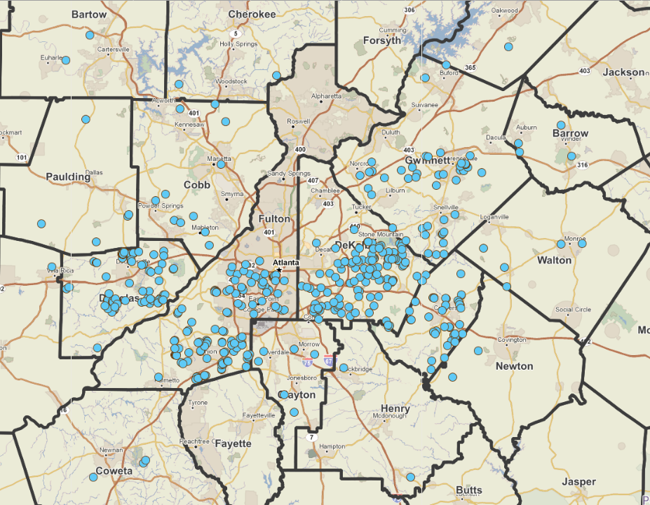
ANDP: 510+ Homes Sold since 2009
(27% in DeKalb County)

Slide 14
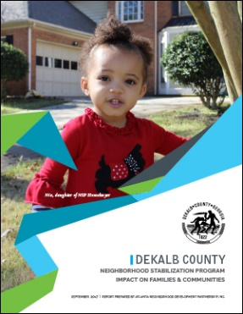
Impact of SF Rehab
Previous ANDP studies show that our rehab work is helping to raise home values and lift surrounding homeowners out of negative equity:
FOR EVERY $1
spent on rehabbing single-family homes
lifted surrounding home values by…
$15
IN DEKALB COUNTY
But how much wealth are we creating for
ANDP homebuyers?

Slide 15

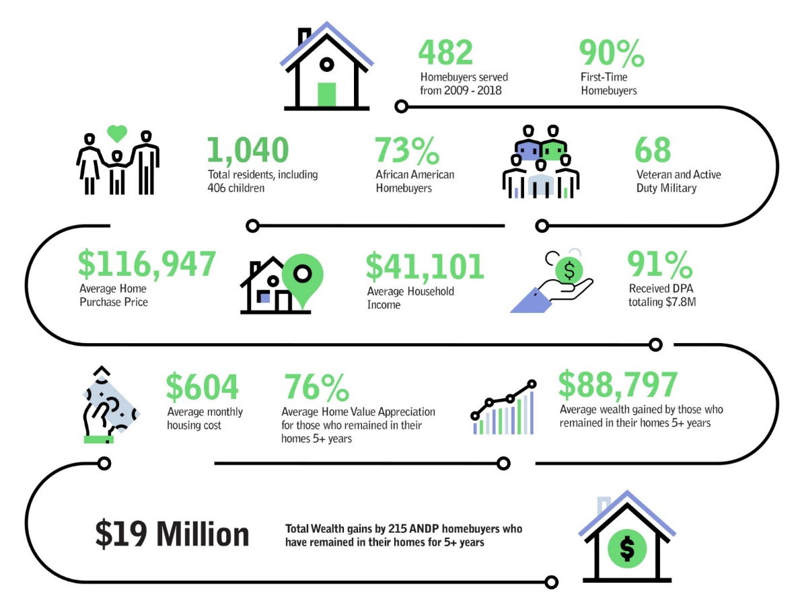

Creating Homeownership & Economic Opportunity
Study of Homeowner Savings, Retention & Wealth Creation
→ $5.4MM in DeKalb

Slide 16
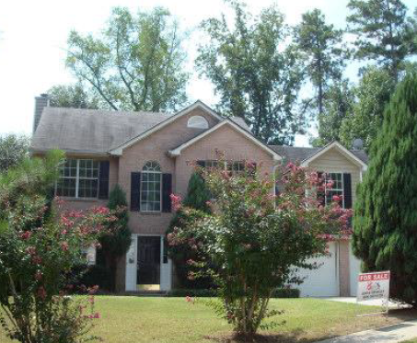
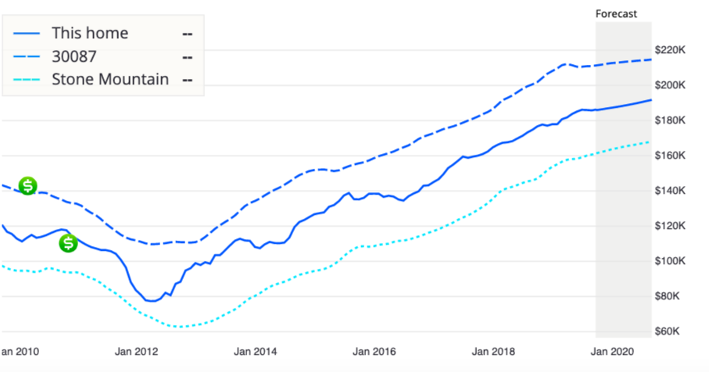
Homebuyer Example
3BR/2.5BA DeKalb NSP home
Sold in Oct. 2010 to a family of 4 for $110k
Received $24,200 in DPA
Worth $186k today
Notes:
Estimated wealth creation: $104k

Slide 17
Key Takeaways
Homeownership builds WEALTH and STABILITY
Enhances family & neighborhood outcomes
  Lowers student transience
  Increased stake in the neighborhood & community engagement
  Greater protection against gentrification
Helps restore lost African American wealth and allow for upward mobility
Importance to Metro Atlanta:
  High negative equity, suburban poverty, gentrification, racial disparities
  #1 in income inequality, 2nd to last for upward mobility

Slide 18
Tene Traylor
The Kendeda Fund
Notes:
Since the Great Recession, we’ve acquired, rehabbed and resold over 500 homes to low and moderate income families
For clarification we only sell to owner occupants and we only sell to families that are at or below 120% AMI. If we used federal HOME funds to acquire and rehab it would be 80% AMI.
120% AMI For the Atlanta Metro that income is around $95k for a family of 4 and for 80% AMI it is around $65k for a family of 4.

Slide 19
Lorraine Cochran-Johnson
DeKalb County Commission
Notes:
Since the Great Recession, we’ve acquired, rehabbed and resold over 500 homes to low and moderate income families
For clarification we only sell to owner occupants and we only sell to families that are at or below 120% AMI. If we used federal HOME funds to acquire and rehab it would be 80% AMI.
120% AMI For the Atlanta Metro that income is around $95k for a family of 4 and for 80% AMI it is around $65k for a family of 4.

Slide 20
Robyn Bussey
Atlanta Regional Collaborative
For Health Improvement (ARCHI)
Notes:
Since the Great Recession, we’ve acquired, rehabbed and resold over 500 homes to low and moderate income families
For clarification we only sell to owner occupants and we only sell to families that are at or below 120% AMI. If we used federal HOME funds to acquire and rehab it would be 80% AMI.
120% AMI For the Atlanta Metro that income is around $95k for a family of 4 and for 80% AMI it is around $65k for a family of 4.

Slide 21
dekalb youth prosperity initiative overview data
October 3, 2019

Slide 26
Jeffrey Hicks
Empire Board of Realtists
and
National Association of
Real Estate Brokers
Notes:
Since the Great Recession, we’ve acquired, rehabbed and resold over 500 homes to low and moderate income families
For clarification we only sell to owner occupants and we only sell to families that are at or below 120% AMI. If we used federal HOME funds to acquire and rehab it would be 80% AMI.
120% AMI For the Atlanta Metro that income is around $95k for a family of 4 and for 80% AMI it is around $65k for a family of 4.

Slide 27
Jay Perlmutter
Atlanta Neighborhood
Development Partnership
Notes:
Since the Great Recession, we’ve acquired, rehabbed and resold over 500 homes to low and moderate income families
For clarification we only sell to owner occupants and we only sell to families that are at or below 120% AMI. If we used federal HOME funds to acquire and rehab it would be 80% AMI.
120% AMI For the Atlanta Metro that income is around $95k for a family of 4 and for 80% AMI it is around $65k for a family of 4.

