Slide 1
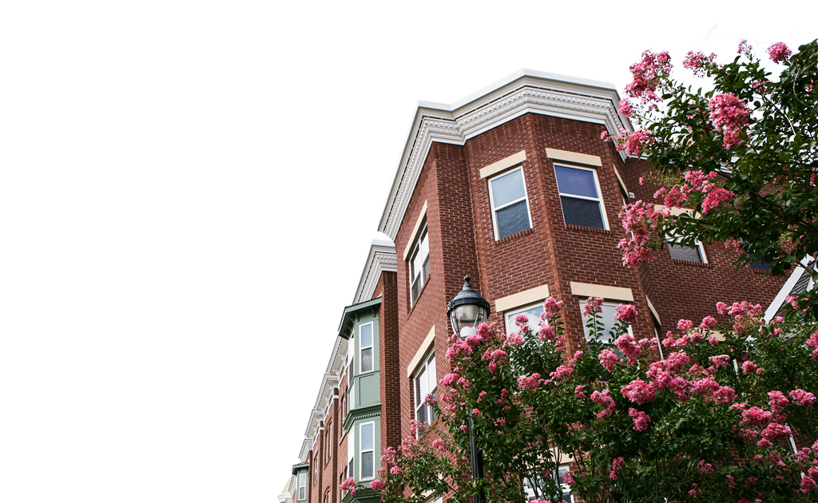
Baltimore
Green Network
October 2019
Notes:
Chris Ryer’s slide

Slide 2
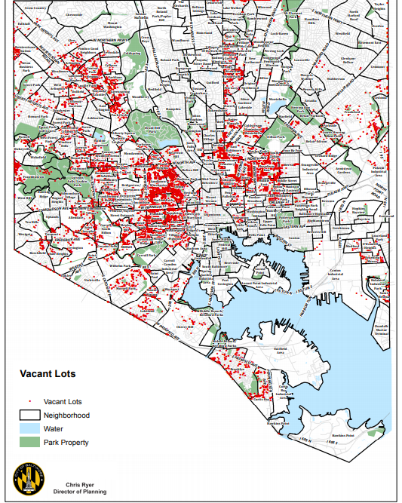
Baltimore’s 18,000 Vacant Lots
Notes:
Kim Knox’s slide

Slide 3
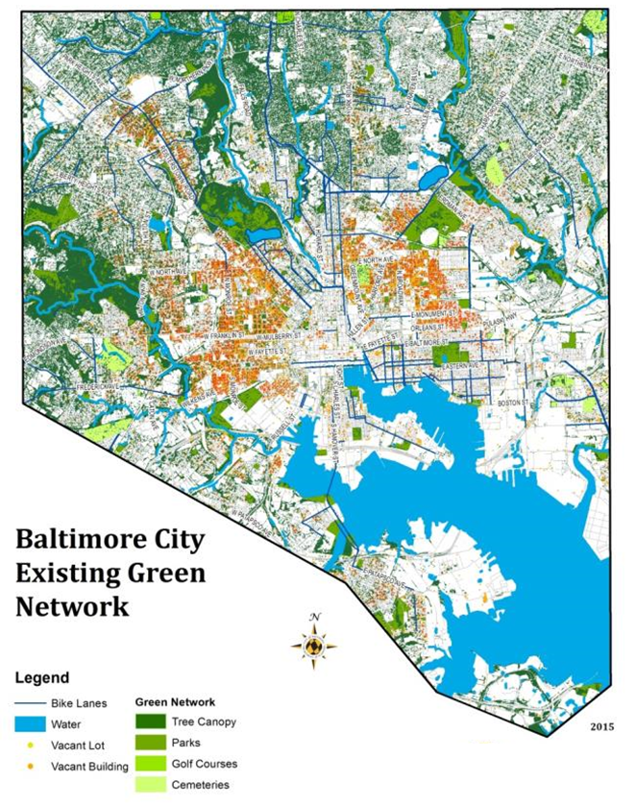
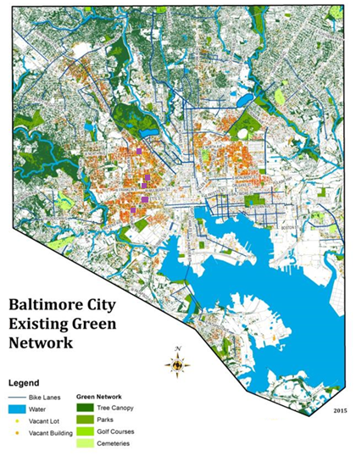
Baltimore Green Network
Baltimore Green Network Work Group’s Goals
Installing the Baltimore Green Network’s five pilot projects and corridor projects
Baltimore’s population in the 1950’s was 900,000
Baltimore’s current population is 610,000
Baltimore has 18,000 vacant lots-60% are privately owned
Baltimore has 18,000 vacant homes-70% are privately owned
Notes:
Chris Ryer’s slide

Slide 4
Baltimore Green Network’s Five Pilot Projects
-Racheal Wilson Memorial Park in the Boyd-Booth Neighborhood
-Druid Heights Legends Square in the Druid Heights Neighborhood
-Harlem Park Inner Block Park Q112 in Harlem Park
-Smithson Street Mall in Sandtown-Winchester
Notes:
Kim Knox’s slide

Slide 5
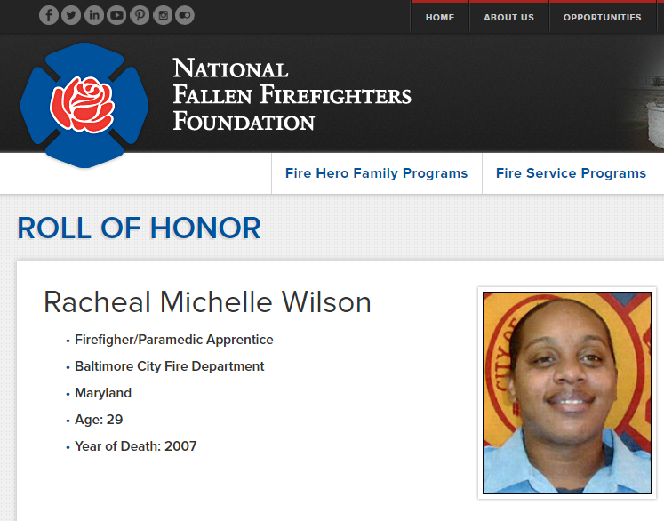
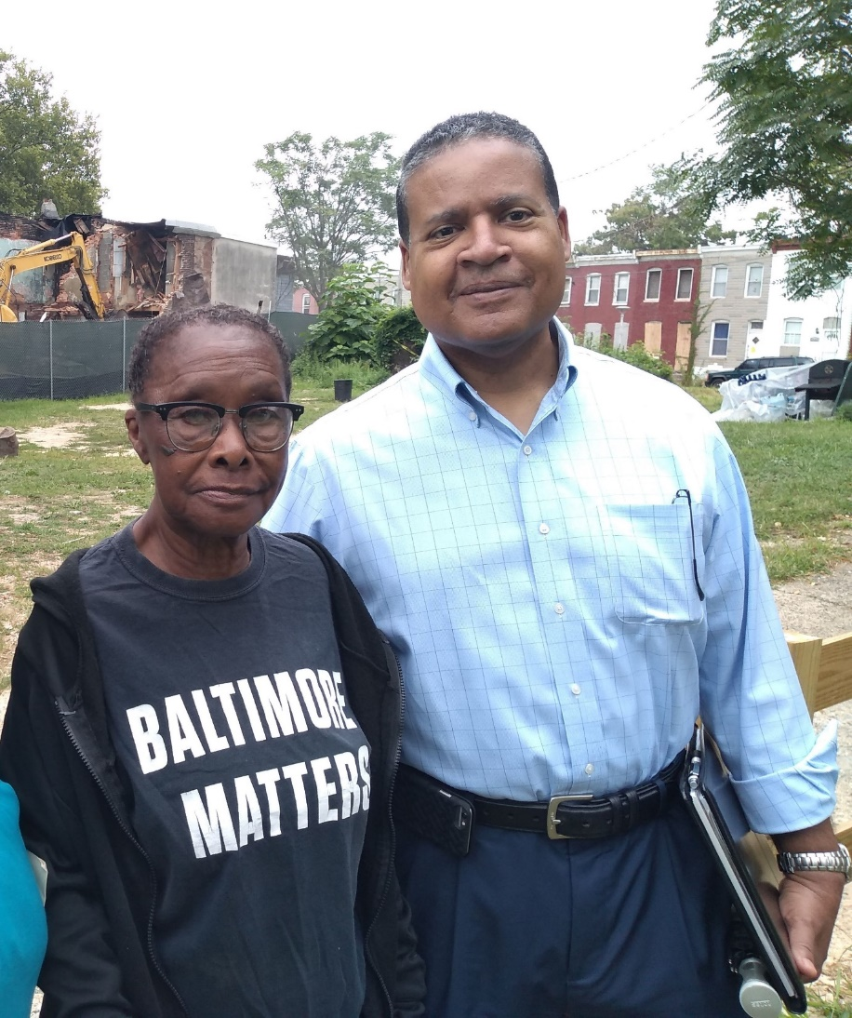
Racheal Wilson Memorial Park
Notes:
Kim Knox’s slide

Slide 6
Racheal Wilson Memorial Park
Notes:
Kim Knox’s slide

Slide 7
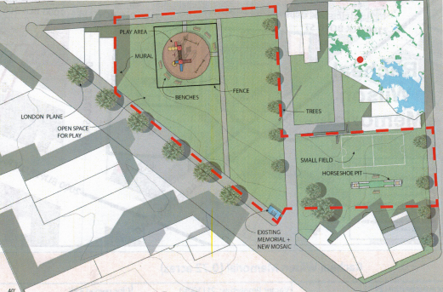
Racheal Wilson Memorial Park
Notes:
Kim Knox’s slide

Slide 8
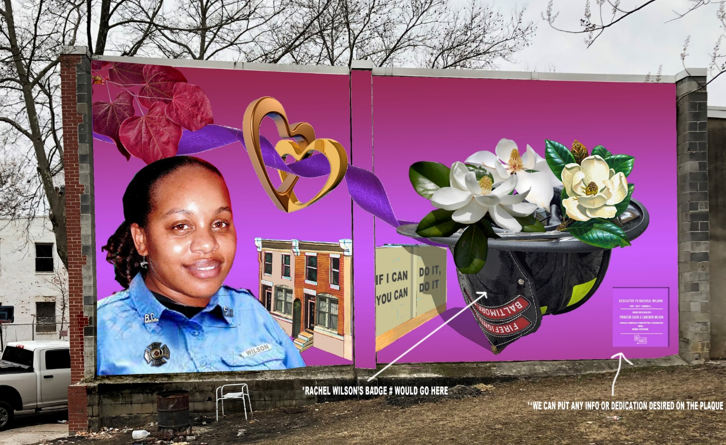
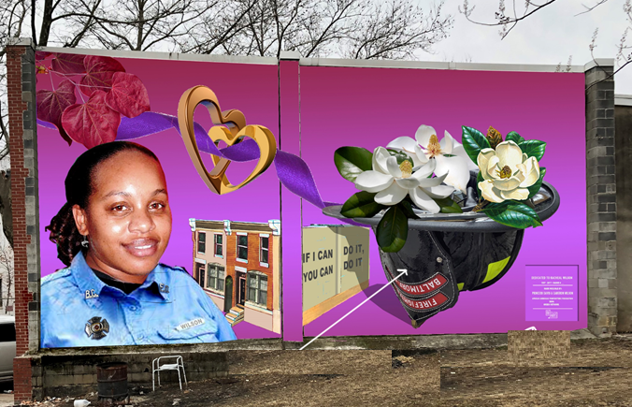
Racheal Wilson Memorial Park
Notes:
Kim Knox’s slide

Slide 9
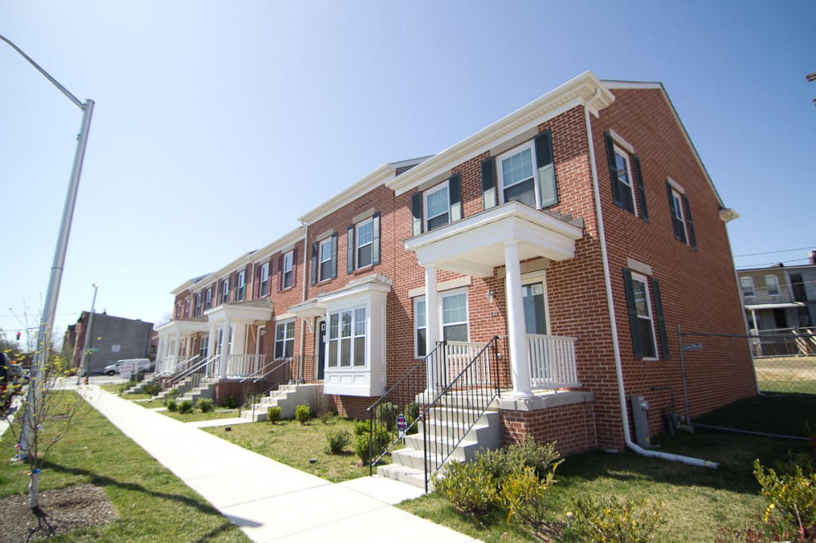
Druid Heights Legacy Park
Druid Heights Community Development Corporation’s Bakers View Townhomes
Notes:
Kim Knox’s slide

Slide 10
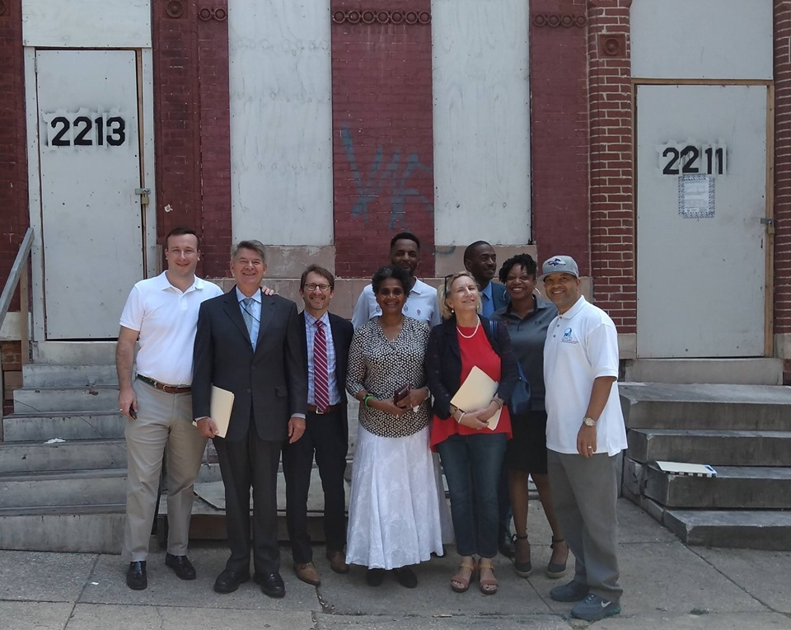
Druid Heights Legacy Park
Gateway Townhomes-Rehab 1920’s Rowhouses Along Druid Hill Avenue
Notes:
Kim Knox’s slide

Slide 11
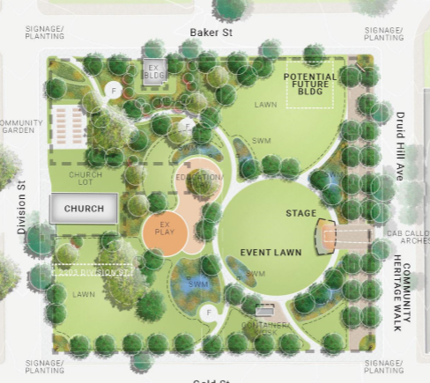
Druid Heights Legacy Park
Notes:
Kim Knox’s slide

Slide 12
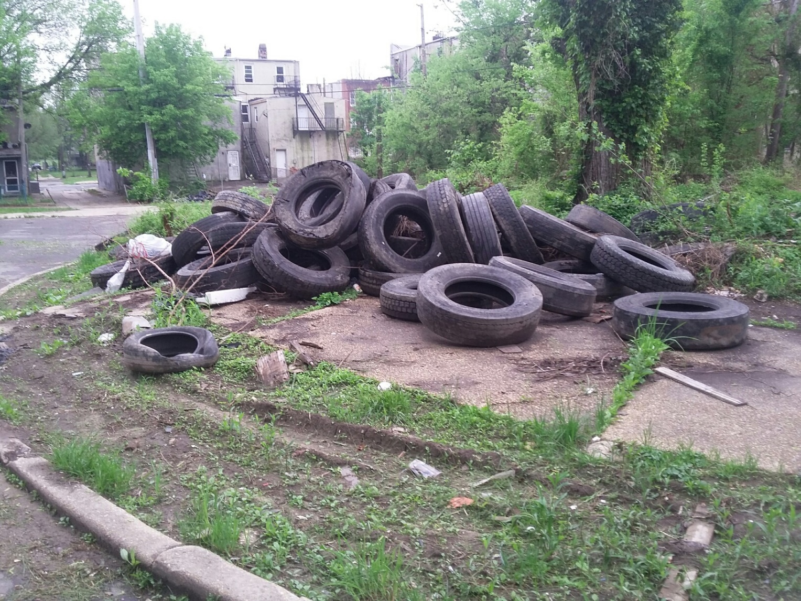
Maintenance of Vacant Lots
Notes:
Kim Knox’s slide

Slide 13
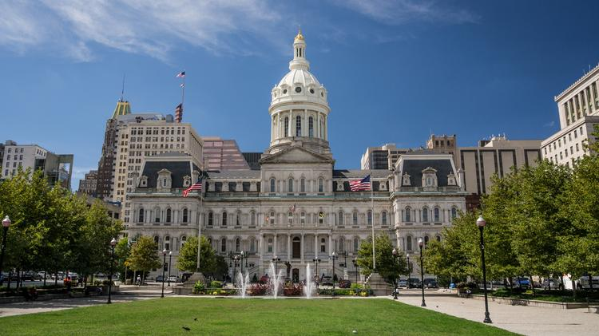
Baltimore Green Network
“A clean city is an inviting city.”
Mayor Bernard C. “Jack” Young
Notes:
Chris Ryer’s slide

Slide 14
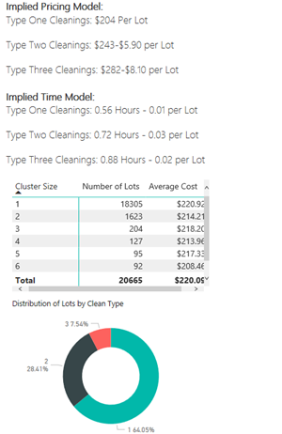
Maintenance of Green Spaces
City’s Average Cost to Clean and Mow a
Vacant Lot is $220 per lot.
Notes:
Brendan Hellweg’s slide

Slide 15
Maintenance of Vacant Lots
Current Strategies on Maintaining Vacant Lots:
Working with Community Groups (Care-a-Lot)
Partnering with Workforce Development Groups (Civic Works, Bon Secours and LifeBridge)
Working with Residents (Adopt-A-Lot)
DPW’s City Crews and Contractors
Recreation and Parks’ maintenance of park space
Lots to Love
Notes:
Kim Knox’s slide

Slide 16
Baltimore Green Network
Kimberley M. Knox, Greening Coordinator
Baltimore City Department of Planning
Baltimore Green Network Initiative
417 E. Fayette Avenue, 8th Floor
Baltimore, MD 21202
Kimberley.Knox@baltimorecity.gov
410-396-5902
Notes:
Kim Knox’s slide

