Slide 1
FOR MORE THAN PROFIT
Albert Pak, Attorney & Skadden Fellow
Building Michigan Communities Conference / April 30, 2019

Slide 2
Roadmap
Introduction
Entity Types
501(c)(3) Nonprofits
Benefit Corporations
Low Profit Limited Liability Companies
Nonprofit / For-Profit Hybrids
Q&A

Slide 3
Disclaimer
This presentation is intended to provide general information, and is NOT a substitute for legal advice, nor intended to create or constitute a lawyer-client relationship.
Please consult professional advisors such as your CPA or business attorney.
This is a brief and basic overview of legal issues arising from the business formation process.
The materials and information have been prepared for informational purposes only.

Slide 4
Who is Michigan Community Resources?
Originally known as Community Legal Resources
Project of Michigan Legal Services and ABA Business Law Section
Modeled after national pro bono law programs
Leverage private bar to effectuate change in low-income communities
Evolution into community and economic development
Today providing comprehensive array of services to nonprofits

Slide 5
Mission
Michigan Community Resources advances the missions of Michigan nonprofit organizations that serve low income individuals and communities through pro bono and low cost legal and other professional services, organizational development, and trusted guidance.

Slide 6
Vision
We envision strong Michigan communities built on strong organizations, strong leaders, and a strong nonprofit network.

Slide 7
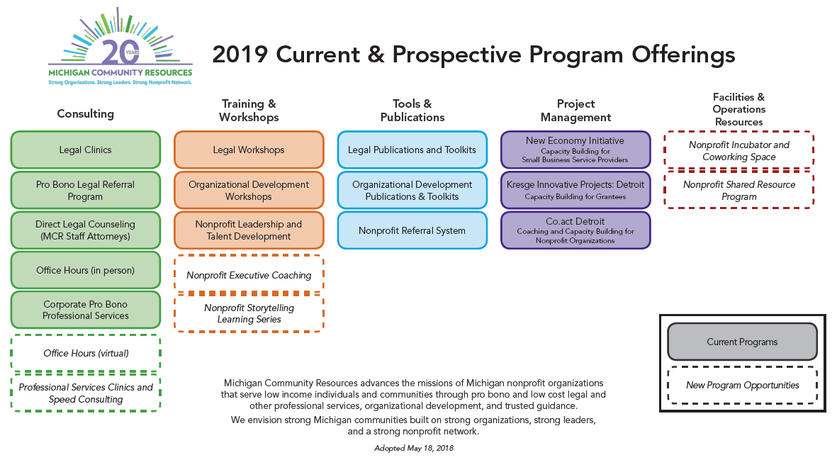
MCR Program Map

Slide 8
Presenter: Albert Pak
Professional Experience
Attorney & Skadden Fellow, Michigan Community Resources
Chief Operating Officer, 12+
Co-Founder, Ivy Advantage
Consultant, Oliver Wyman

Slide 9
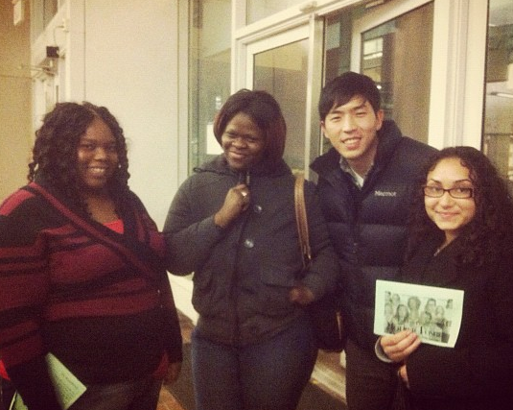
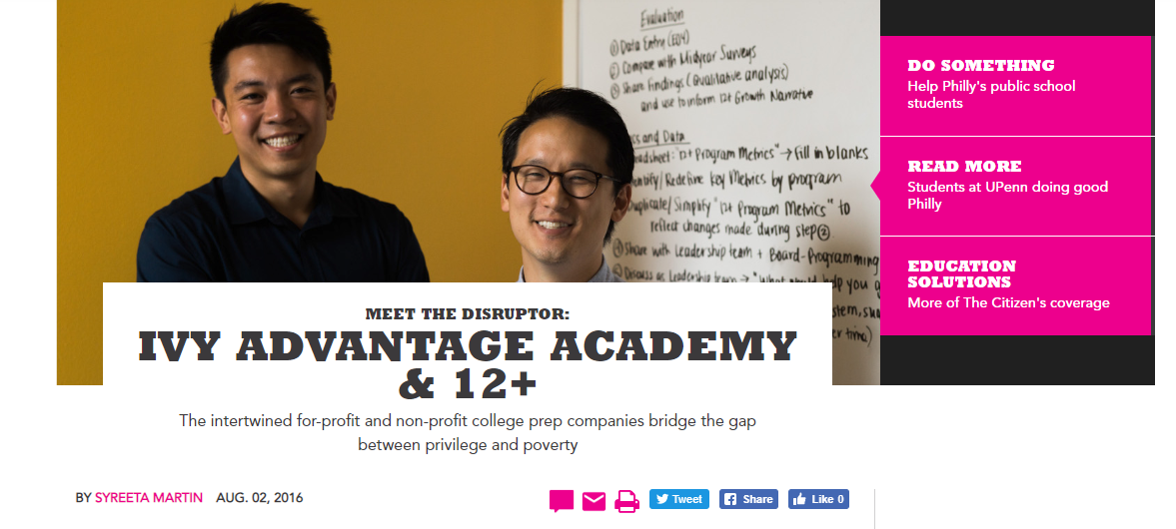
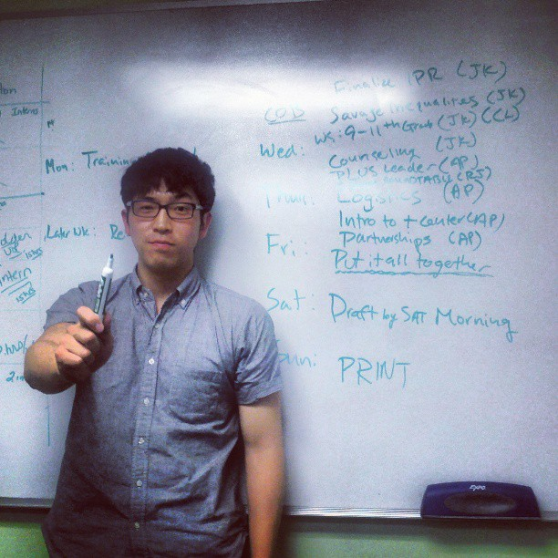
The main reason why I’m here

Slide 10
Expectation setting
What this presentation is
An introduction to mission-minded corporate structures
A high level overview of the basics
What this presentation is not
An in-depth legal study of corporate structures
Legal advice on what entity to select

Slide 11
Entity Types
Multiple ways to go about a “social enterprise”

Slide 12
What is a “Social Enterprise”?

Slide 13
The Entity Universe (or at least some of it)
Not-for-Profit Corporation
Benefit Corporations
Low Profit LLC (L3C)
Nonprofit / For-Profit Hybrid
Mission-Minded For-Profits
Flexible Purpose Corporations

Slide 14
The Entity Universe (or at least some of it)
Not-for-Profit Corporation
Benefit Corporations
Low Profit LLC (L3C)
Nonprofit / For-Profit Hybrid
Mission-Minded For-Profits
Flexible Purpose Corporations

Slide 15
The Entity Universe (or at least some of it)
Not-for-Profit Corporation
Benefit Corporations
Low Profit LLC (L3C)
Nonprofit / For-Profit Hybrid
Mission-Minded For-Profits
Flexible Purpose Corporations

Slide 16
501(c)(3) Nonprofit “Social Enterprises”
A 501(c)(3) nonprofit is an entity that is incorporated as a nonprofit at the state level and granted federal tax exemption by the IRS for having one or more charitable purposes under Section 501(c)(3) of the IRC.

Slide 17
Can nonprofits “make money”?
YES
Nonprofits can engage in revenue generating activities
They must consider whether these activities are directly related to their charitable purposes and consider unrelated business income tax (UBIT)
BUT

Slide 18
Unrelated Business Income Tax
501(c)(3) nonprofits may be required to pay federal taxes on their revenue generating activity
A 501(c)(3) is exempt from federal income taxes, whereas for-profit businesses must pay these taxes.
UBIT is a way of leveling this playing field.
Nonprofits with UBIT must file an additional 990-T each year.
Unrelated business income is income*
1
From a trade or business
2
Regularly carried on
3
That is not substantially related to the charitable purpose of the organization
*with exceptions
https://www.irs.gov/charities-non-profits/
unrelated-business-income-tax

Slide 19
Nonprofit Case Study

Slide 20
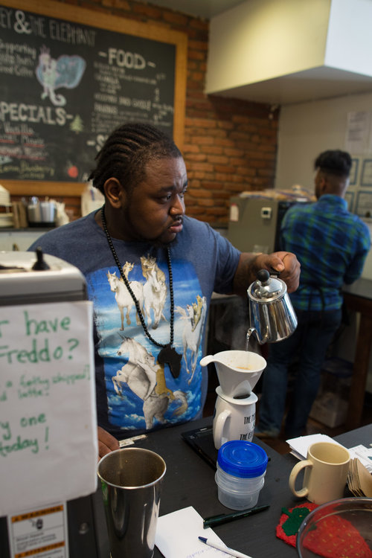
Nonprofit Case Study: Monkey & The Elephant
Began in 2011 in Philadelphia with the vision of offering a job and life skills program for youth who have aged out of foster care.
The goal is to equip them with the tools necessary to make the transition to self-sufficient adulthood.
https://www.themonkeyandtheelephant.org/ourstory

Slide 21
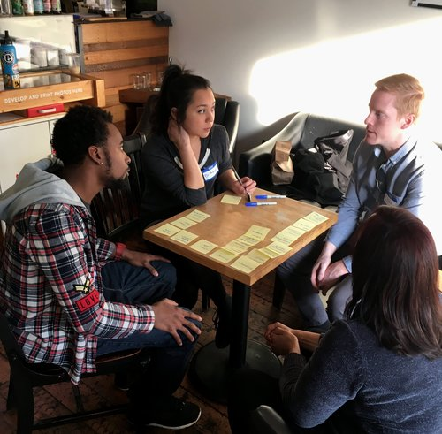
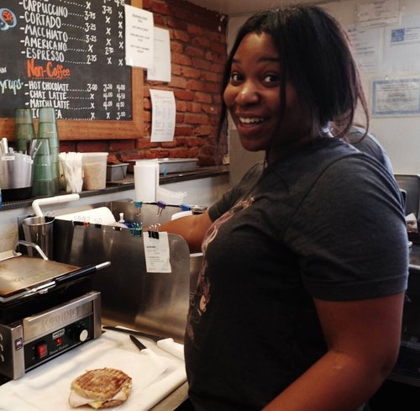
Nonprofit Case Study: Monkey & The Elephant
1
Working at the coffee shop
YEAR-LONG TRANSITIONAL PROGRAM
2
Joining a community
3
Participating in training program
https://www.themonkeyandtheelephant.org/program

Slide 22
The Entity Universe (or at least some of it)
Not-for-Profit Corporation
Benefit Corporations
Low Profit LLC (L3C)
Nonprofit / For-Profit Hybrid
Mission-Minded For-Profits
Flexible Purpose Corporations

Slide 23
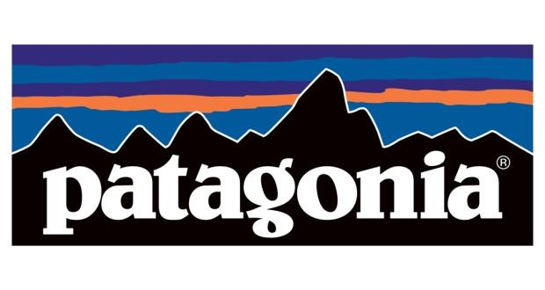
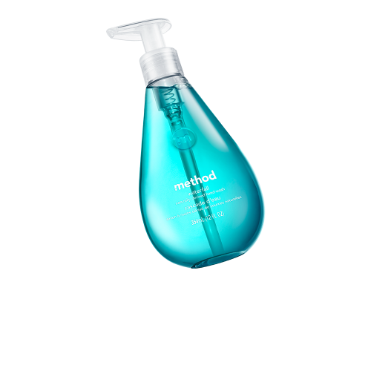
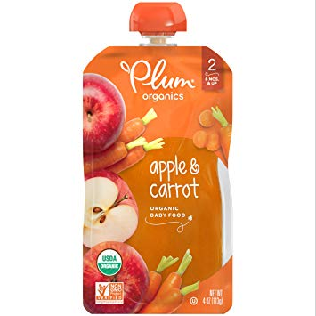
Benefit Corporations
A benefit corporation is a new legal tool to create a solid foundation for long term mission alignment and value creation.
www.benefitcorp.net

Slide 24
Benefit Corporations: Basics
1
PBCs have an expanded purpose beyond maximizing share value to explicitly include general and specific public benefit;
34
States have passed laws for PBCs
2
PBCs are required to consider/balance the impact of their decisions not only on shareholders but also on their stakeholders; and
6
States working on legislation
3
PBCs are required to make available to the public, except in Delaware, an annual benefit report that assesses their overall social and environmental performance against a third party standard.
www.benefitcorp.net

Slide 25
Benefit Corporations: Why?
Social Consciousness
Marketing
Self-Sustainability
Branding
Employee Recruitment
Investment
Nonprofit v. Benefit Corp
C Corp v. Benefit Corp

Slide 26
Benefit Corporation Case Study

Slide 27
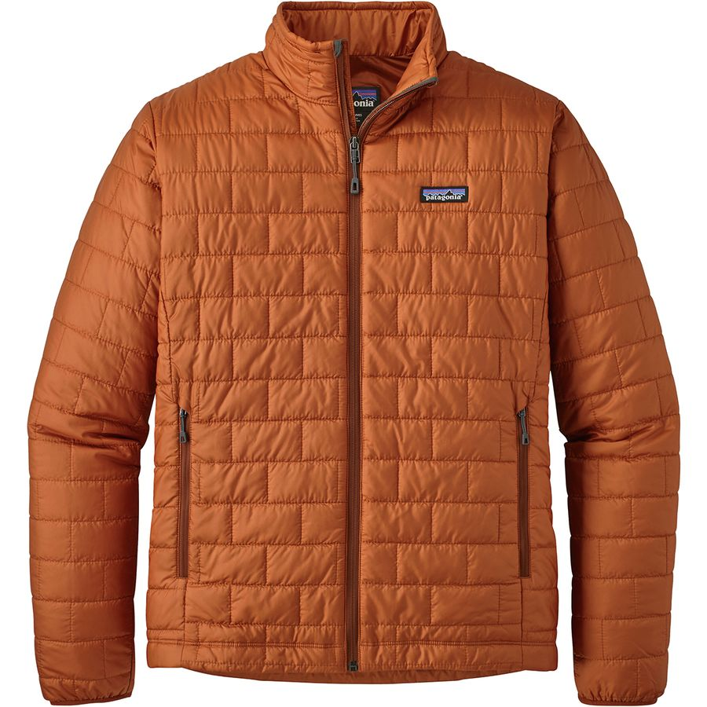
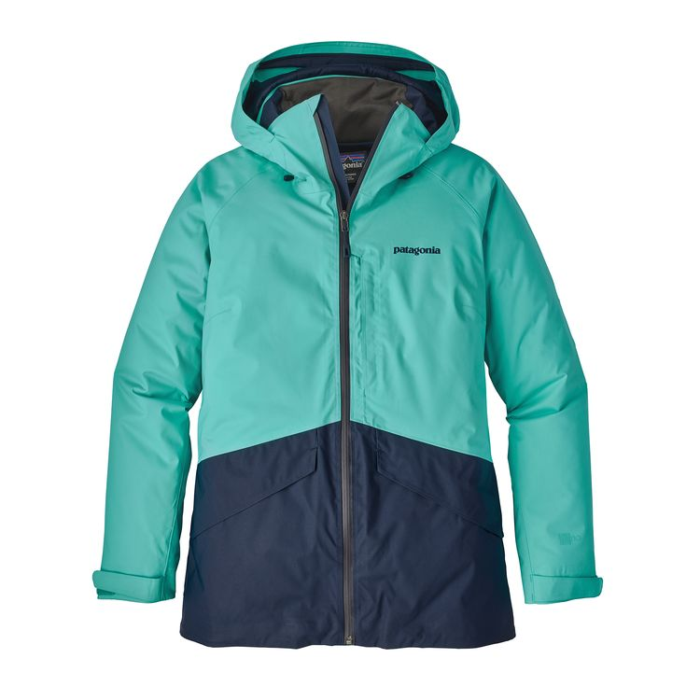
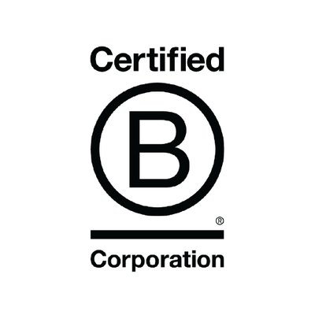
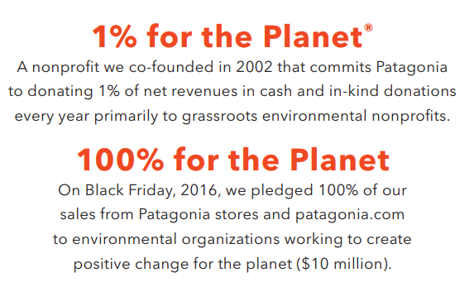
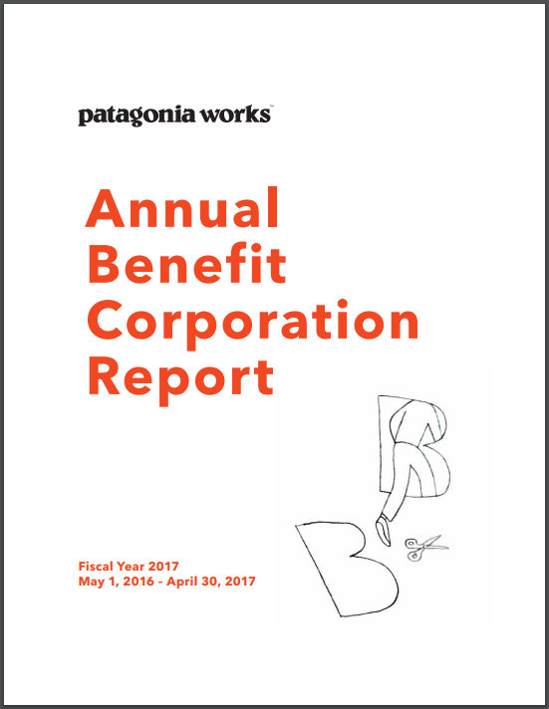
Benefit Corporation Case Study: Patagonia
Annual Revenue: $1+ billion (est.)
B Lab Score
152 out of 200
www.patagonia.com

Slide 28
Benefit Corporations v. B Corp Certification
Benefit Corporations
Benefit corporations are a legal structure that are available to companies in certain states and allows corporations to pursue positive stakeholder impact alongside profit.
B Corp Certification
The B Corp Certification is a third-party certification administered by the non-profit B Lab, based in part on a company's verified performance on the B Impact Assessment.
www.benefitcorp.net

Slide 29
Public Benefit Corporations v. B Corp Certification
Many benefit corporations are also
B Lab Certified
Many B Lab Certified Companies are
not benefit corporations

Slide 30
The Entity Universe (or at least some of it)
Not-for-Profit Corporation
Benefit Corporations
Low Profit LLC (L3C)
Nonprofit / For-Profit Hybrid
Mission-Minded For-Profits
Flexible Purpose Corporations

Slide 31
Low Profit Limited Liability Companies (L3C)
An L3C, is a hybrid of an LLC and nonprofit business model: it is a private organization that does earn profits, but only so that it can conduct business to help a certain cause.

Slide 32
L3C: Basics
1
Fulfill an educational or charitable purpose and have been formed specifically to further that purpose
11
States & federally recognized tribes w/ L3Cs
2
Have a primary purpose other than profit-earning
571
Active L3Cs in Michigan
1651
Active L3Cs nationwide
3
Have no legislative or political purpose
www.intersectorl3c.com

Slide 33
L3C: Program Related Investments
Program Related Investments (PRIs) are those in which:
The primary purpose is to accomplish one or more of the foundation’s exempt purposes;
Production of income or appreciation of property is not a significant purpose; and
Influencing legislation or taking part in political campaigns on behalf of candidates is not a purpose
The IRS has not confirmed that contributions to L3Cs will be treated as PRIs

Slide 34
L3C Case Study

Slide 35
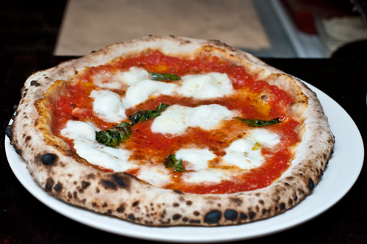
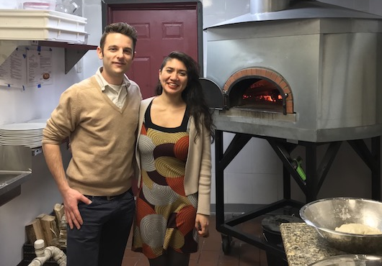
L3C Case Study: PizzaPlex, L3C
Founded in 2016 in Southwest Detroit as an L3C serving VPN Certified Neapolitan pizza
“[PizzaPlex] engages in activities designed to foster greater urban sustainability by working on community programs that promote healthy foods, green restaurant strategies, and cultural exchanges.”
[Articles of Incorporation]

Slide 36
PizzaPlex’s “Charitable Purposes”
Healthy Food Options
Sourcing quality local ingredients
Working with local farms and vendors
Affordable Prices
“Sospeso” - giving back to the community
Keeping costs low
Green Restaurant Strategy
Composting everything and recycling the rest
Working with neighborhood on green initiatives
Cultural Exchange
Allowing groups to use the space free of charge
Hosting events for cultural groups

Slide 37
The Entity Universe (or at least some of it)
Not-for-Profit Corporation
Benefit Corporations
Low Profit LLC (L3C)
Nonprofit / For-Profit Hybrid
Mission-Minded For-Profits
Flexible Purpose Corporations

Slide 38
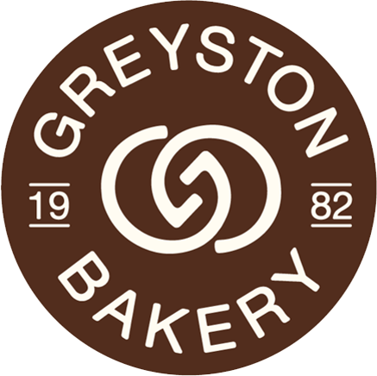
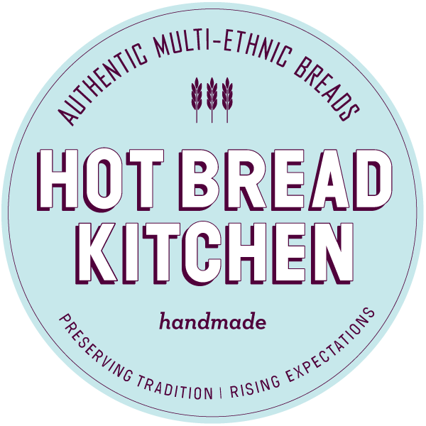
Nonprofit / For-Profit Hybrids
Hybrid structures typically involve two (or more) entities, a nonprofit and a for-profit, with the former owning part of, if not all of, the equity in the latter.

Slide 39
Nonprofit / For-Profit Case Study

Slide 40
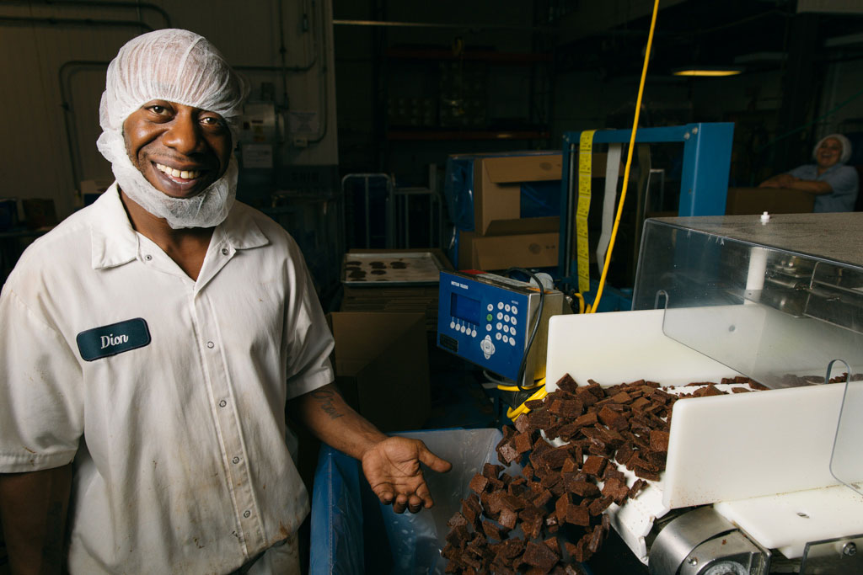
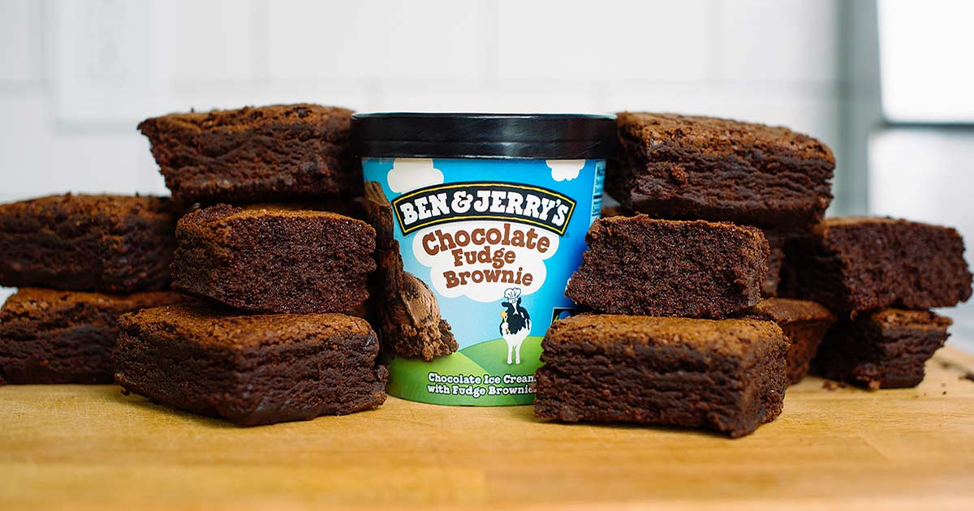
Hybrid Case Study: Greyston Bakery
Located in Yonkers, NY
Created in 1982 by an “engineer-turned-Buddhist-monk”
“We don’t hire people to bake brownies, we bake brownies to hire people”
Make all the brownies for Ben and Jerry’s
Profits from the bakery flow up to the Greyston Foundation
Pioneering the “Open Hiring” model

Slide 41
Hybrid Case Study: Greyston Bakery
Greyston Foundation
501(c)(3) Nonprofit
Direct community services
Administrative support for entire operation
Fundraising
Open Hiring Model
Greyston Bakery
NY Benefit Corporation
Bakes the brownies
Pays management fees
Sends dividends to parent
Hires workers through Open Hiring Model
(100% owned subsidiary)
https://greyston.org/financials/

Slide 42
Hybrids: Important Considerations
Governance
How are the boards of directors and management teams set up?
Charitable Purpose
Do the for-profit’s actions jeopardize the nonprofit’s tax-exempt status?
Self Dealing / COI
Is there a risk of a person in authority acting in his or her own interest?
UBIT
Do the subsidiary’s revenue generating activities trigger UBIT?

Slide 43
The Entity Universe (or at least some of it)
Not-for-Profit Corporation
Benefit Corporations
Low Profit LLC (L3C)
Nonprofit / For-Profit Hybrid
Mission-Minded For-Profits
Flexible Purpose Corporations

Slide 44
THANK YOU!

