Slide 1
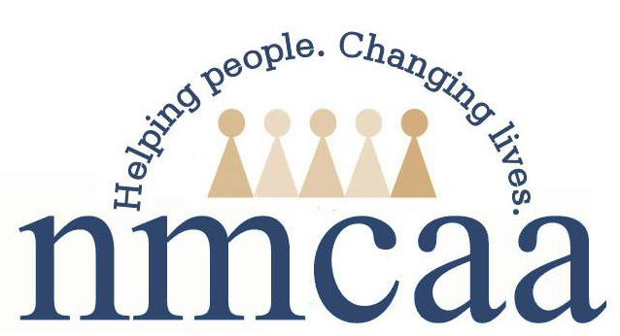
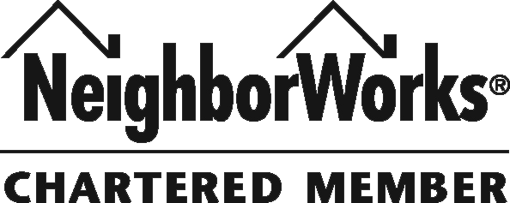
Northwest Michigan Community Action Agency
“Helping people by linking services, resources, and opportunities.” Panelist Kris Brady, Community Services Director
kbrady@nmcaa.net

Slide 2
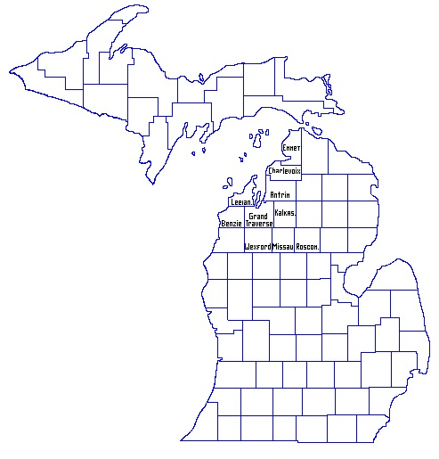
About NMCAA
A private, non-profit agency celebrating 45 years in 2019!
Umbrella Agency with Numerous Programs
Covering over 5,000 square miles
A NeigborWorks Member Organization
Three offices in Traverse City, Petoskey and Cadillac serve 10 counties (with add’l counties in some programs)
NMCAA covers 10 RURAL counties in lower Northwest Michigan. They are as follows:
Antrim
Benzie
Charlevoix
Grand Traverse
Emmet
Kalkaska
Leelanau
Missaukee
Roscommon
Wexford

Slide 3
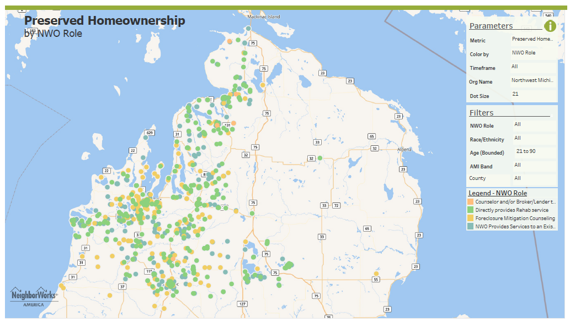
Since 2013 NMCAA has provided Homeowner RETENTION Rehab and Weatherization services to
595 households across a 5,000+ square mile area.

Slide 4
NORTHWEST MICHIGAN COMMUNITY ACTION AGENCY
HOMEOWNER RETENTION BEST PRACTICES
CDBG Homeowner Rehabilitation Re-tool
Partnership with Grand Traverse County, Grand Traverse Health Department for PFAS mitigation
Cherryland Community Solar Pilot
NMCAA NeighborWorks Habitat for Humanity Grand Traverse Region Partnership

Slide 5
CDBG Homeowner Rehabilitation Re-tool
2016 – State of Michigan discontinues CDBG for Homeowner Rehabilitation but allows counties with loan portfolios to continue providing services with returned Program Income
The Program Income model has changed to only allow for Emergency Repairs. Lower quality program, but still very NEEDED.
Currently there are millions of dollars of secured loans outstanding that could come back to municipalities and be used for Homeowner Rehabilitation
NMCAA is currently administering PI Grants for Emergency Repairs in four rural counties. Total funds: $375,000+

Slide 6
Stretching the Dollars for Homeowner Emergency Rehab
NMCAA has revolving loan funds from other grants:
Home Depot Affordable Housing for Rural Veterans
Rural Development Housing Preservation Grants (5 counties)
Total funds available: $61,500+
Matching Local Grants:
Benzie County Community Chest - $7,500
Cherryland Cares Grant - $6,750
These funds are used to cover more items per home, and stretch the program to assist more residents and keep them in safe and affordable housing.

Slide 7
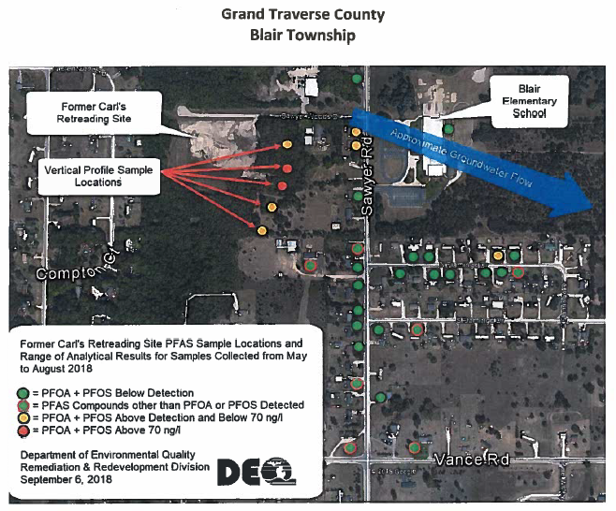
Partnership with Grand Traverse County, Grand Traverse Health Department for PFAS mitigation

Slide 8
What is PFAS?
PFAS are a group of man-made chemicals that have been manufactured and used in a variety of industries in the US and around the globe since the 1940s.
They are persistent in the environment and the human body – meaning they don’t break down and can accumulate over time.
PFAS are found in food, commercial products like fire fighting foam, drinking water, living things like fish, animals and humans in which they have the ability to build up and persist over time.
Many more studies need to be done, but so far PFAS are being linked to reproductive and developmental problems, liver and kidney disease, and immunological effects in lab animals.

Slide 9
NMCAA will partner with the Grand Traverse County Health Department and Grand Traverse County CDBG Program Income Fund to mitigate PFAS for homeowners in the plume.
To provide a long term solution NMCAA is offering the Grand Traverse County Program Income rehabilitation loans at no interest to homeowners so they can be connected to the municipal water system. NMCAA will coordinate the project.
Cost per home is approximately $7,500.

Slide 10
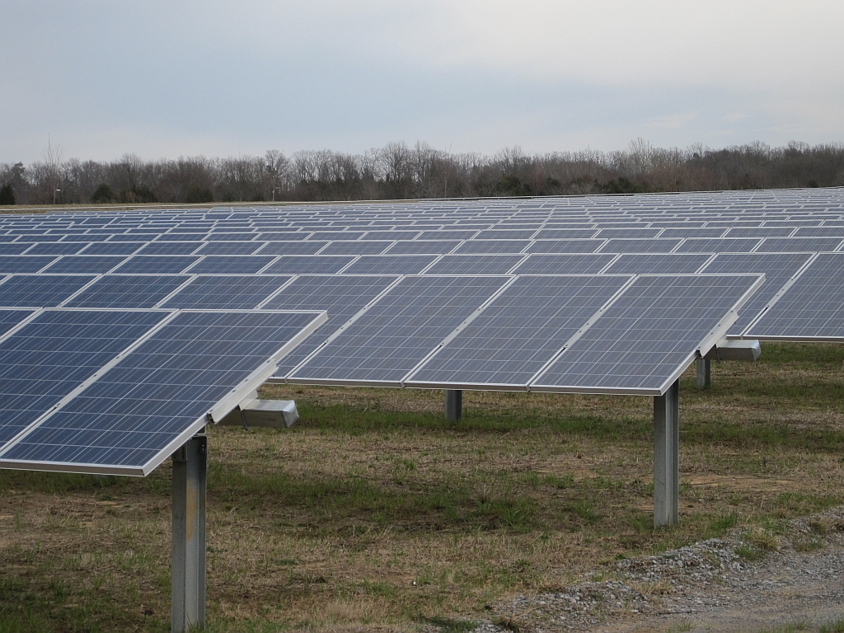

Slide 11
Cherryland Community Solar Project
Provides 50 Cherryland Electric low income customers with ownership of 9 solar panels in Community array through corporation grant.
2016 Cherryland request NMCAA as partner.
NMCAA identifies 50 homeowners/Cherryland customers that have been or will soon be Weatherized.
Weatherization Staff reach out to homeowners, educate and recruit for Community Solar Opportunity
Outcomes:
50 Energy Efficient Homes
9 Solar Panels Each
2017 Average Bill Credit per home = $343
Total Bill Credits for 50 Homes = $17,127
2018 Average Bill Credit per home = $349
Total Bill Credits for 50 Homes = 17,447
Total Bill Credits realized to date = $34,574

Slide 12
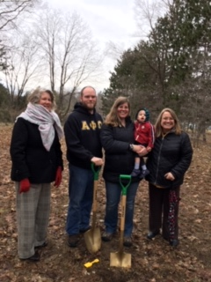
NMCAA NeighborWorks Habitat Grand Traverse Region Partnership
NMCAA is using its NeighborWorks Restricted Capital funds to invest with Habitat Grand Traverse Region in:
A New build near net zero home to be sold to a Habitat Family
Rehabilitation of an existing home to be sold to a Habitat Family
NeighborWorks Restricted Capital Funds invested per home:
$100,000 + 2% one time fee (no interest)
NMCAA will provide restricted capital and homeowner education.
Habitat will provide project management and homebuyer selection per the Habitat model.

Slide 13
THANK YOU!

