Slide 1
Understanding and Improving your Credit - Getting Ready for Home Ownership

Slide 2
What We Will Cover Today – The Stages of Starting a New Business
Brief overview of why understanding and improving credit is important
Credit Reporting Agencies, the FCRA and the FDCPA
Credit Score: How is it calculated
Nuts and Bolts strategies to improve and understand your credit score.

Slide 3
Brief overview of why understanding and improving credit is important
According to Fox Business, 68 Million people in the U.S. have credit scores of less than 601.
According to the World Population Review. The United states population is around 327 million. http://worldpopulationreview.com/countries/united-states-population/
What does that mean? Let’s discuss.

Slide 4
Brief overview of why understanding and improving credit is important
How does you credit rating effect
Home Ownership
Impact on ability to buy
The ability to Rent
Impact ability to rent
Employment Opportunities
Banks and other institutions check credit before hiring
Insurance
Impact on insurance prices
Education
Ability to pay for education with outside student loans

Slide 5
Credit Reporting Agencies, the FCRA and the FDCPA
There are 3 major credit reporting agencies
Experian
Transunion
Equifax
Fun Fact- All three of the major credit bureaus are publicly-traded, for-profit companies—they're not owned by the government.
Fun Fact-
Experian is based in Dublin, Ireland
Equifax is based in Atlanta, Georgia
Transunion is based in Chicago, Illinois
They a For-Profit Competitors that get paid by banks and credit issuers

Slide 6
Fair Credit Report Act
The FCRA regulates:
Consumer reporting agencies;
Users of consumer reports; and,
Furnishers of consumer information.
If a consumer's rights under the FCRA are violated, they can recover:
Actual or statutory damages;
Attorney's fees;
Court costs; and,
Punitive damages if the violation was willful.[7] ”The threat of punitive damages under 1681n of the FCRA is the primary factor deterring erroneous reporting by the reporting industry."[8]
Was passed in 1970 to protect consumers and abusive creditors.

Slide 7
Fair Credit Report Act
The Fair Credit Reporting Act can be found here:
https://www.ftc.gov/system/files/545a_fair-credit-reporting-act-0918.pdf
Here are some highlights:
Page 79
§ 616. Civil liability for willful noncompliance [15 U.S.C. § 1681n] (a) In general. Any person who willfully fails to comply with any requirement imposed under this title with respect to any consumer is liable to that consumer in an amount equal to the sum of (1) (A) any actual damages sustained by the consumer as a result of the failure or damages of not less than $100 and not more than $1,000;…

Slide 8
Fair Credit Report Act
The Fair Credit Reporting Act can be found here:
https://www.ftc.gov/system/files/545a_fair-credit-reporting-act-0918.pdf
Here are some highlights:
Page 22, 23
§ 605. Requirements relating to information contained in
consumer reports [15 U.S.C. § 1681c]
c) Running of Reporting Period (1) In general. The 7-year period referred to in paragraphs (4) and (6)6 of subsection (a) shall begin, with respect to any delinquent account that is placed for collection (internally or by referral to a third party, whichever is earlier), charged to profit and loss, or subjected to any similar action, upon the expiration of the 180-day period beginning on the date of the commencement of the delinquency which immediately preceded the collection activity, charge to profit and loss, or similar action

Slide 9
Fair Debt Collection Practices Act
The Fair Debt Collection Practices Act can be found here:
https://www.ftc.gov/enforcement/rules/rulemaking-regulatory-reform-proceedings/fair-debt-collection-practices-act-text
Only about 13 pages long and really easy to read.
I recommend everyone read it for themselves but here are some highlights.

Slide 10
Fair Debt Collection Practices Act
Highlights:
§ 805. Communication in connection with debt collection
(c) Ceasing communication
If a consumer notifies a debt collector in writing that the consumer refuses to pay a debt or that the consumer wishes the debt collector to cease further communication with the consumer, the debt collector shall not communicate further with the consumer with respect to such debt, except --
(1) to advise the consumer that the debt collector's further efforts are being terminated;
(2) to notify the consumer that the debt collector or creditor may invoke specified remedies which are ordinarily invoked by such debt collector or creditor; or
(3) where applicable, to notify the consumer that the debt collector or creditor intends to invoke a specified remedy.
If such notice from the consumer is made by mail, notification shall be complete upon receipt.

Slide 11
Credit Score: How is it calculated
You have more than on Credit Score.
Each credit bureau reports their own data. In addition, each credit bureau has its own credit score calculation.
Transunion created an Empirica Score
Experian created a Vantage Score
Equifax created a Beacon Score
There are other models such as a Fico Score
Most Lenders use the FICO score to determine if you will be issued credit.
With this knowledge you have at least 12 different CREDIT SCORES. Focus on your FICO score on each bureau. Since the bureaus are paid by creditors… what is reporting on each of your reports can differ.

Slide 12
Credit Score: How is it calculated
FICO (formerly Fair, Isaac and Company) is a credit scoring company that produces FICO credit scores. The algorithms, or formulas used to calculate FICO scores are proprietary to them. However, like all other credit scores, FICO scores are calculated using the information in your credit report.
FICO scores weight five types of information from your credit report in the calculation:
Payment history is by far the most important factor in credit scores. It is essential to pay your bills on time, every time. Any late payment is going to have a significant effect on credit scores. Your payment history accounts for about 35 percent of a credit score.
Utilization, which is the balance-to-limit ratio on your credit cards, is the second most important criteria in credit scores. You never want a balance to be higher than 30 percent of the credit limit on a single credit card or in total.
To determine your utilization rate, add up all of your balances and all of your credit limits and divide the total of your balances by the total of your limits. That percentage should not be more than 30 percent as a maximum. The lower your utilization, the better.
Ideally, you should pay your balances in full each month. People with the best credit scores have zero late payments and utilization rates of less than 10 percent. Your utilization rate accounts for about 30 percent of your credit score.
The first two factors account for nearly two-thirds of your score. Paying your bills on time and keeping your balances low on your credit cards are essential to having good credit scores. The other elements in a credit score build on those first two:
Length of credit history is based on the length of time each account has been open and how long it has been since you used certain accounts. A longer credit history can increase your credit scores. Length of history accounts for approximately 15 percent of a FICO score.
Recent activity looks at how much new credit you have applied for in the past three to six months. Applications for credit are shown as new inquiries. Recent credit isn't limited to inquiries, though. It also includes paying off accounts, whether accounts have become delinquent or have been brought current and whether account balances have increased or decreased significantly. Recent credit accounts for 10 percent of a FICO score.
Credit mix refers to the different kinds of accounts you have including mortgages, credit cards, auto loans, and other installment loans. Having a variety of credit types can help increase your score slightly, but you should not apply for several accounts all at once to try to improve this element. Doing so will likely do more harm than good because of the impact on recent credit activity. Instead, use credit wisely and you will naturally build a good mix of credit types over time. The mix of various types of credit accounts for 10 percent of a FICO score.

Slide 13
Nut & Bolts
Ways to get your credit report.
https://www.annualcreditreport.com/index.action
Free Annual Credit Report. No Fee
Pull your reports.
Know your rights, the FCRA and the FDCPA
Determine any erroneous information
Create dispute letters for any information that is not reporting correctly
Don’t talk to collection agents.
You don’t know over the phone…send something in writing
Rinse and Repeat.
Or you can do it an easier way – Lance Petway

Slide 14
Nuts & Bolts of Credit- What you will learn- Lance Petway
Myths Surrounding the Credit Industry
The truth about your Credit
How to Increase your Credit Score Quickly
Consumer Laws that are on your side.
Paying off debt Effectively
The Must-have financial documents to protect your family
How you can use what you learn in THIS business to help yourself and others make a significant income.
How you can start a profitable online business from home and build wealth

Slide 15
Welcome To
THE POWER OF CREDIT

Slide 16
What You Will Learn
Myths Surrounding the Credit Industry
The truth about your Credit
How to Increase your Credit Score Quickly
Consumer Laws that are on your side.
Paying off debt Effectively
The Must-have financial documents to protect your family
How you can use what you learn in THIS business to help yourself and others make a significant income.
How you can start a profitable online business from home and build wealth

Slide 17
Financial Education Services
Financial Services and Literacy
Emphasis on Credit Restoration
Founded 2004
100% Satisfaction guaranteed
Headquarters in Farmington Hills, MI
A+ Rating with The Better Business Bureau
Over 100% Annual Sales Growth
Debt Free Company
Mike Toloff
Parimal Naik

Slide 18
Lets Talk Facts: Did You Know
61 Million Americans have a 599 credit score or less (Source: CNN Money)
Nearly half of American don’t even know their credit score
There a over $58 billion in unclaimed life insurance policies, bank accounts, pensions, stocks and other assets and property
Currently 4 in 5 credit reports have errors on them, causing lower credit scores
Over the Course of your lifetime: having less than perfect credit can cost you up to one million dollars in interest rates, fees, and other unnecessary charges
Your credit score is a 3-digit number that has a six-figure impact on your life. Fortunately, rebuilding your credit score is a lot easier than you think.

Slide 19
Destroying The Myths
Myth #1 Credit Agencies are empowered by government authorities
Credit agencies have no legal authority at all, they are simply private companies who are in the business of selling credit information.
Myth #2 The credit agencies are required by law to keep derogatory items on your credit report for 7 to 10 years?
There is no law that the credit agencies report anything on you at all. Credit Agencies are required by law to automatically remove all derogatory items older than 7 years student loans and more, or in the case of a bankruptcy, 10 years.
Myth #3 Paying a past due debt removes it from your credit report?
Just because you pay an old debt does not change or erase the fact that at one time you were not paying on it as you agreed.
Myth #4 A poor score will haunt me forever.
Just the opposite is true. A score is a "snapshot" of your risk at a particular point in time. It changes as new information is added to your bank and credit bureau files. Scores change gradually as you change the way you handle credit.
Myth #5 You can’t buy a house with bad credit
False. You can buy a house with as low as a 580 credit score however your interest rate and down payment will be significant in comparison to someone with great credit.

Slide 20
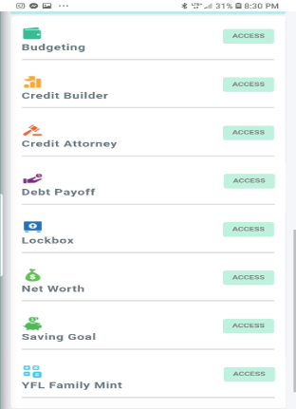
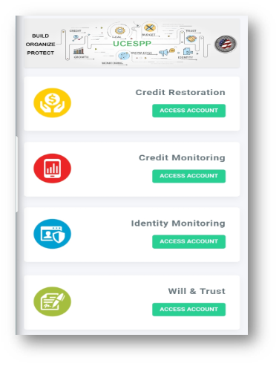
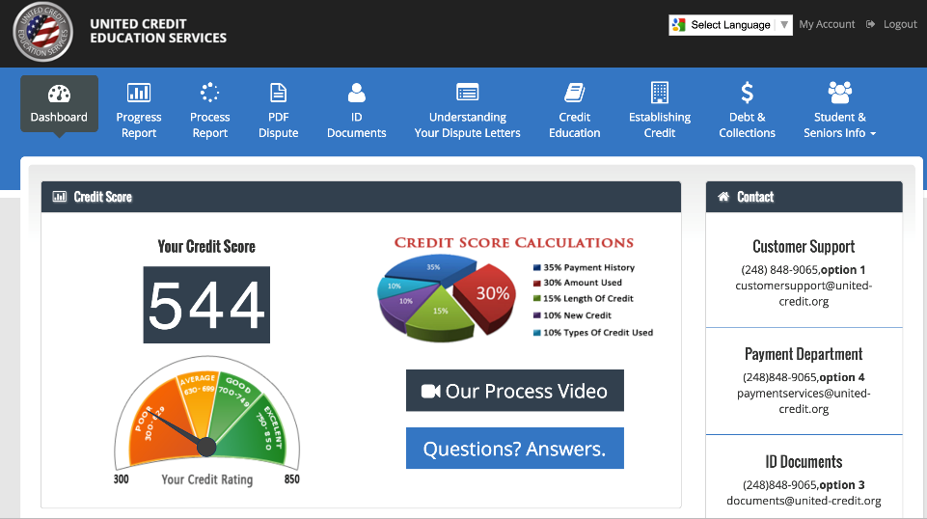
Services One Time Activation of $99 and $89 Monthly (No Contract)
Credit Restoration
Credit Builder
Credit Attorney
Smart Credit
Privacy Armour
Fes Debt Zero
Will, Trust, & POA
Financial Lock Box
Life Insurance (Agents only)
And much more!

Slide 21
YFL Foundation
Each Protection Plan Membership Donates $2 to the YFL
Educates Young People Ages 8-18 on the matter of personal Finances
Annual College scholarship-YFL gave away $25 in 2014, 50k in 2015, $200k in 2016, $180k in 2017, & $250k in 2018

Slide 22
Contact Us
TEXT
GreatCredit
To
33444
For More Information

