Slide 1
Less Work and More Success
FSS & Client Management
Tips and Tricks

Slide 2
Welcome and Introductions
Suzanne Eman-Jaehnig
Statewide Family Self-Sufficiency(FSS) Coordinator
Michigan State Housing Development Authority
Shannon Bonesteel
FSS Direct Service Specialist & Home-Ownership Coach
Wayne Metropolitan Community Action Agency
Lindsay Westin
Foreclosure Coordinator
Wayne Metropolitan Community Action Agency

Slide 3
ADULT LEARNING THEORY
https://www.instructionaldesign.org/theories/andragogy/
https://pdxscholar.library.pdx.edu/cgi/viewcontent.cgi?referer=https://www.google.com/&httpsredir=1&article=1007&context=liw_portland

Slide 4
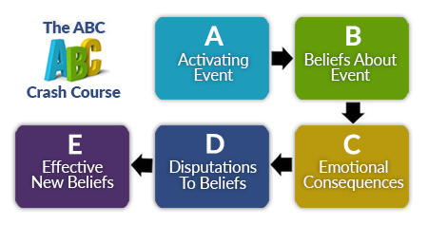
RATIONAL EMOTIVE BEHAVIOR THEORY
https://www.smartrecovery.org/smart-recovery-toolbox/abc-crash-course /
https://albertellis.org/rebt-in-the-context-of-modern-psychological-research/
https://www.therapistaid.com/worksheets/abc-model-for-rebt.pdf

Slide 5
Activating Event: Having to take the GED Math Test
Belief/Thought about the event:
I am going to fail.
I’ll never understand Algebra.
I’ve always hated math.
Consequences (emotionally and physically)
Emotionally: discouraged, self defeated, intimidated, depressed.
Physically: lack of effort, giving up, failure.

Slide 6
Disputing Beliefs: (be real with yourself)
I haven't failed, I've barely passed.
I didn’t put in much effort.
I got this. I just can't give up.
I am good at everyday math
Effects of New Belief
Increased problem solving and insight
Desire to overcome, increased effort
Passed the test.

Slide 7
Make Your Meeting Minutes Count
Meeting Variety
Topic Focus

Slide 8
Utilize Email
Online appointment scheduling
Example: Gmail Appointment Slots
Create your own appointment slots in your calendar
Either add someone to a specific appointment or send the link to have others book their own appointments
Follow-Up

Slide 9
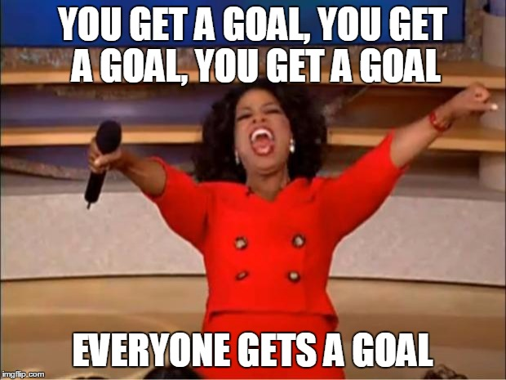
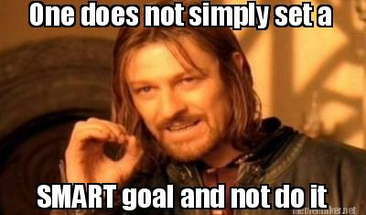
Examples of Memes Keeping it Light

Slide 10
Keep in mind...
Flexibility Balancing Act
Ease of use vs. easy to reschedule.. again, and again, and again..
Texting and messaging
NEVER give out your personal email or phone number
Paperless Communication Agreement

Slide 11
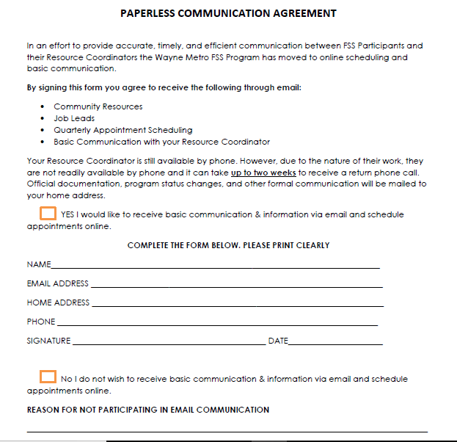

Slide 12
Stop Drowning in Admin Duties
Data
Keep it real time
Memory is fresh
Admin Days
NO client appointments

Slide 13
FSS Bonuses
Your agency receives additional dollars for client success
Completed education
Gained employment
Double earned income
Over-income
Credit scores improved

Slide 14
FSS Bonuses
Your agency receives additional dollars for client success
Increased all 3 credit scores by 60 points
All 3 credit scores are 640+
Completed Financial Capabilities and Homebuyer Club courses, and they’ve been accepted into Key to Own Homeownership Program
Purchased a home

Slide 15
Audit Ready File Habits to Have
Periodically conduct internal file audits
Develop a file checklist
Before an audit verify data has been correctly entered into your Client Management System
DOCUMENT! If it isn’t documented, it didn’t happen!
Don’t stress

Slide 16
Importance of Billing Reconciliations
Monthly: Review the active list, check to see if there are participants you don’t recognize or have been closed out previously
Remember: Briefings, Graduations and Termination will have lagged processing time
Be Mindful: Contract dates are important, Near the end of the 4th year, assess the participant will meet the graduation requirements by the end of their 5th year.

Slide 17
MSDHA IS HERE FOR YOU
Never hesitate to contact MSHDA
Communicate consistent client concerns with MSHDA FSS staff
If you would like additional training on the FSS program or other MSHDA programs please let them know

Slide 18
Questions?

Slide 19
Survey

