Slide 1
Building Michigan Communities Conference
April 30, 2019
Notes:
Hello everyone! Thank you for joining us today for the first of two trainings we will be doing together to bring Abode Family Services onto HandUp.org.
I’m going to lead off with some housekeeping items. You all may notice that you are muted. I’ll be stopping a few times during the next hour so we can answer any questions based on what you’ve heard. There is also a chat function on Zoom that allows you submit a question as you think of them.

Slide 2
Who Are We?
Jenny Poma, MSW
Chief Operating Officer
Max Glick, MSW
HandUp Director

Slide 3
Our mission: Building communities that end homelessness.
With an emphasis on homeless prevention and sustainable housing solutions, SOS implements strategies and programs that provide realistic options for homeless and at-risk individuals and families seeking stabilization and self-sufficiency.

Slide 4
South Oakland Shelter
Rotating 30 bed emergency shelter located in Metro-Detroit
Serves 200+ adults and children annually
Engages over 60 host congregations and 8,000 volunteers
Raised $40,000 in first year of full implementation of HandUp
Acquired HandUp in November 2017

Slide 5
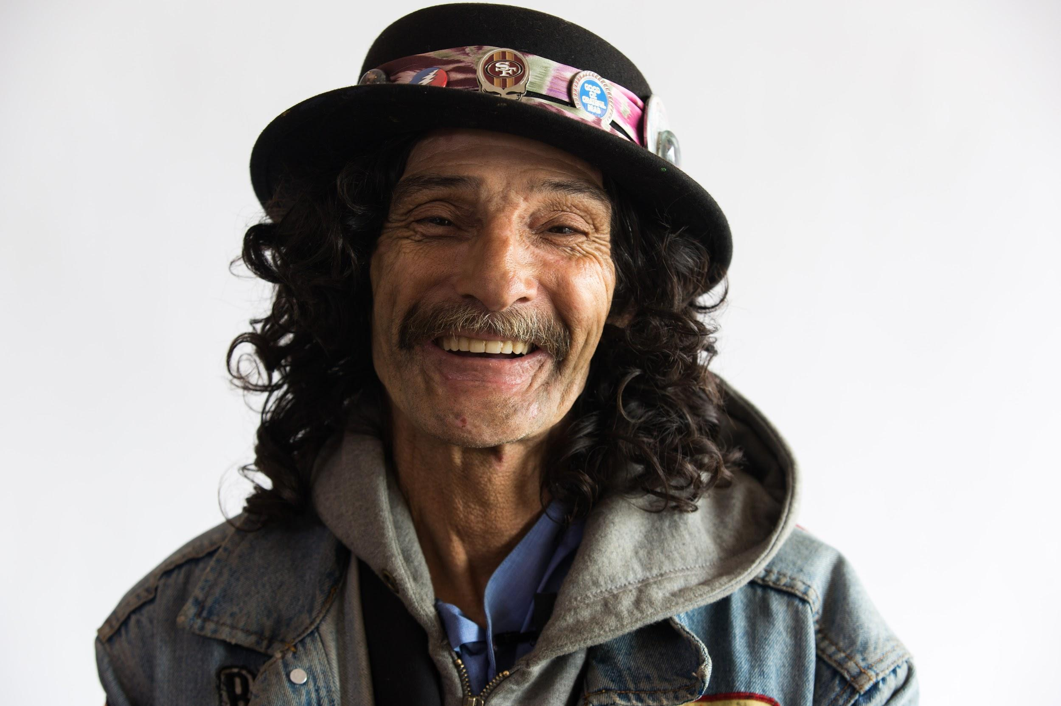
Today’s Agenda
What Is HandUp?
How It Works
Creating A Compelling Profile
Member Examples
Impact and Results
HandUp Detroit
What We Have Learned
Notes:
Our agenda today is designed to give you all a base level of knowledge about HandUp that will be helpful going into our second training. The second training will go more in depth on the behind the scene portion of the site and we will work together to get some profiles live.
Today, I’m going to be:
Explaining what HandUp is and it’s origins
How the South Oakland Shelter got involved in HandUp with our Director of Emergency Services
Then we will be taking a focused look on what profiles look like, how to tell a compelling story and look at a few examples.
Finally, we will discuss the impact HandUp has had on its partner organizations and some next steps.

Slide 6
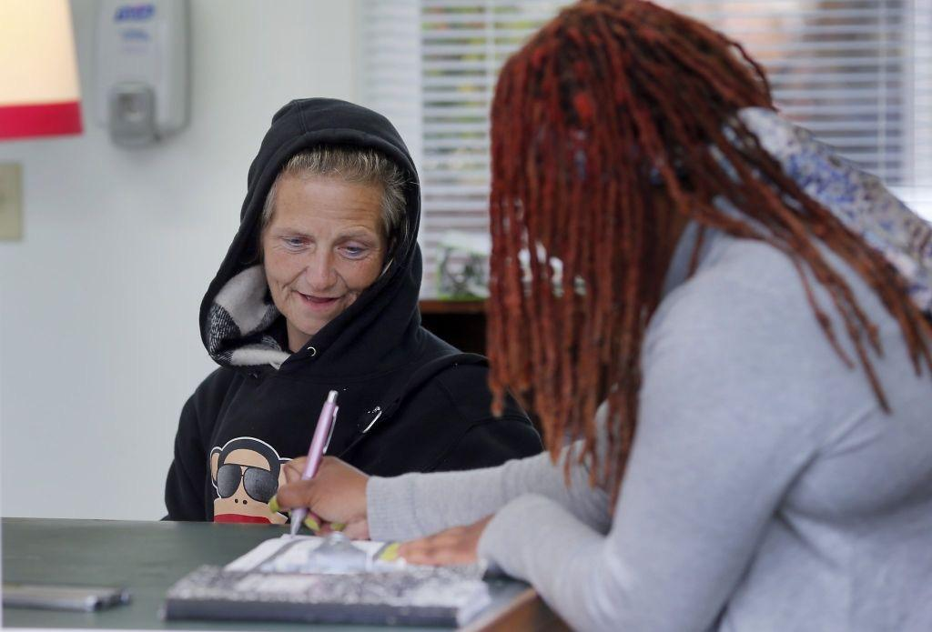
Clients have unique and diverse needs that require flexible programming
Notes:
Jenny
Prior to connecting to HU, SOS was brainstorming ways we could more efficiently meet our clients unique needs.
If you’ve worked in the social service world, you know that the people we serve all have unique needs that might not be covered by an existing agency program or government program. Ex. SD and car expense. We set aside a small amount, $2k, in our budget annually to meet these needs, but we didn’t have a formal way to fundraise for that line item.

Slide 7
Donors want to help, but don’t know how!
Notes:
Jenny
B/c of our rotating shelter model...volunteers build relationships...SOS donors were coming to us wanting to give to individual clients needs and we didn’t have a fair and equitable way to accept and distribute these types of donations.
And in general, community members who see people experiencing street homelessness don’t always feel comfortable giving. Perhaps you have been in that situation yourself.
And so, we were looking for ways to…..connect the two

Slide 8
connects donors directly to the people who need their help.
Notes:
HandUp is firstmost a case management resource that utilizes fundraising to help fill the gap needs of the people we serve. 100% of donations go directly to your organization to be used on behalf of your clients.
Too often, we are dealing with limitations of government funding or grant dollars that don’t allow us the flexibility to assist our clients with the small needs that may fall outside of a focus area. This may be finding $25 to get a copy of a birth certificate or $1,000 to help cover a security deposit.

Slide 9
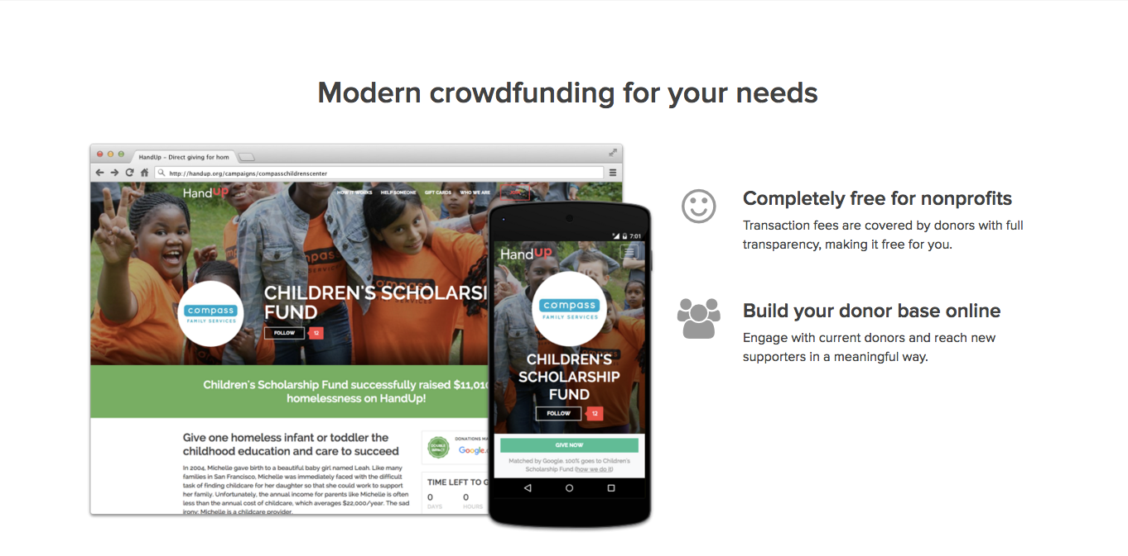
Notes:
Abby
So the community collaboration we’ve been hinting at is called HandUp Detroit.. But before we get in to what that is exactly, we have to talk about HandUp.
Based out of San Francisco, HandUp a technology for client engagement and flexible fundraising which gives donors a compassionate and responsible way to respond to people experiencing homelessness and poverty within their community.

Slide 10
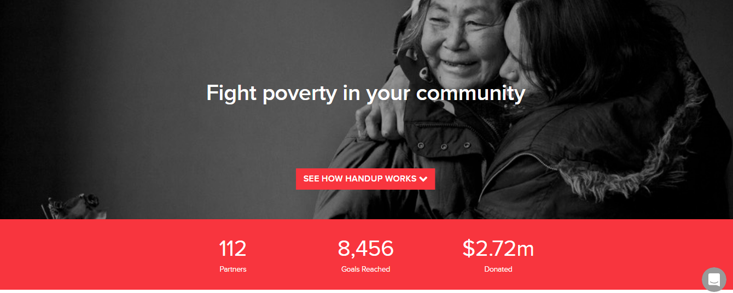

Slide 11
Two Core Products:
Profiles
Campaigns
Notes:
Jenny
HandUp offered SOS two tools to help us meet our needs...

Slide 12
How Do
Member Profiles Work?
Notes:
Now that we know a little bit about what HandUp is and heard from Jessie about what it looks like in action, lets focus on how a client is able to join the site and what happens next. After this, we will look at what it takes to create a compelling member profile.

Slide 13
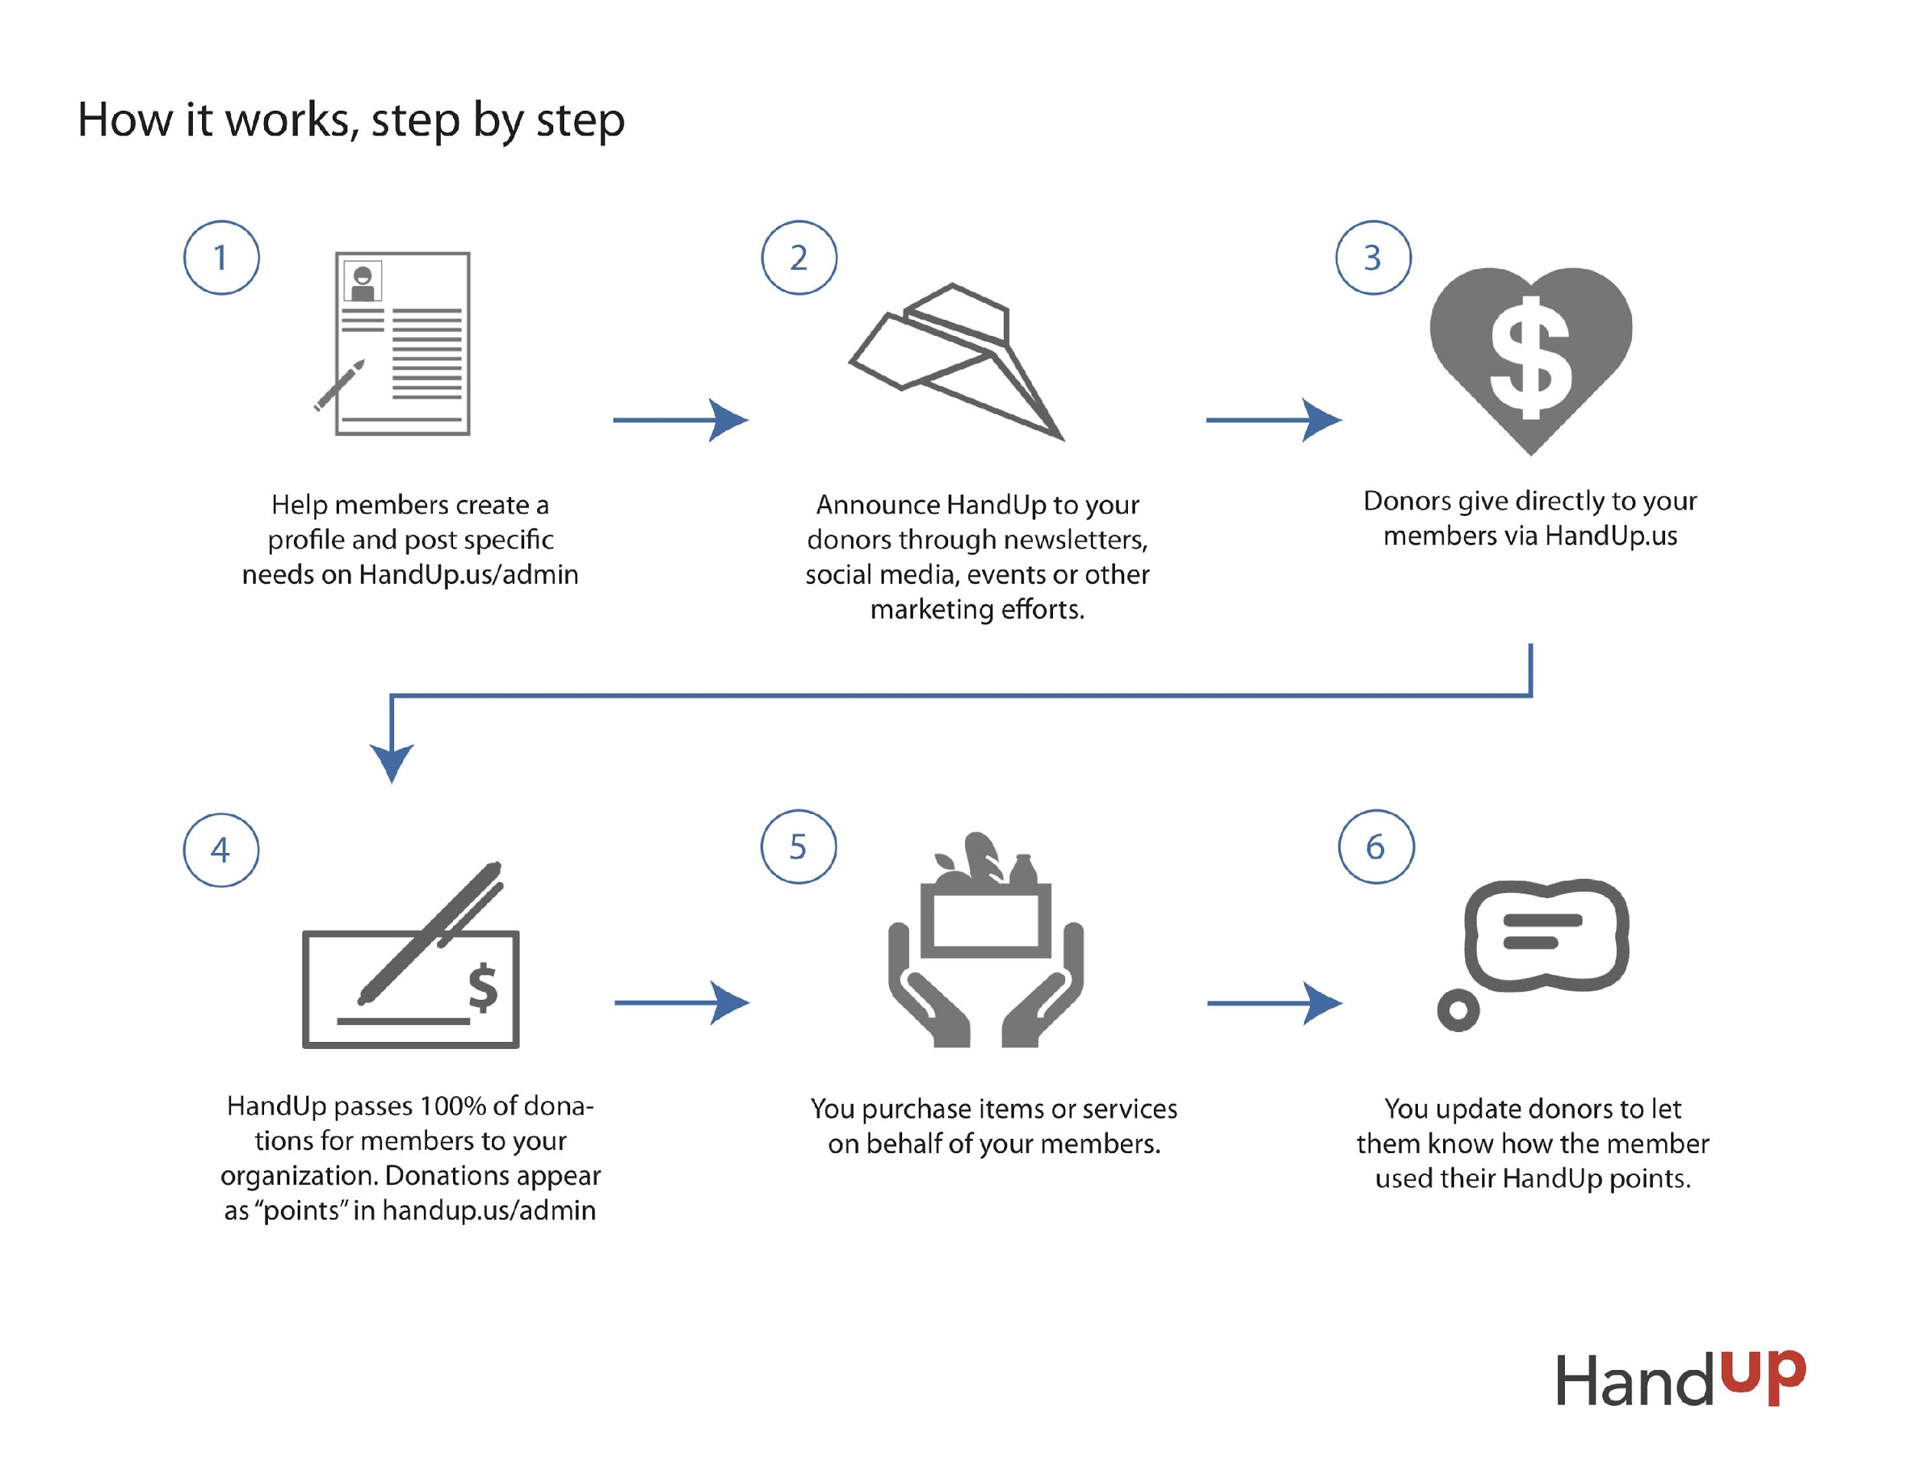
Notes:
The first step is helping a member create a profile and posting their needs. Using our Member Worksheet, you are able to use the client’s own words and share their story. These prompts are more personal than typical intake questions and help open them up to stories you may not have known about before. Members are asked to sign a release waiver which acknowledges that their story will be published on the site and that they are okay with that. If you have clients that want to be confidential, you can use an alias name and stock photo to protect their privacy.
Once a profile is created and a goal is set, the profile is live and ready to share. Abode can share the link to all clients in newsletters, on social media, at events or in other materials. Members will also have access to little business cards which they can share that have a link on how someone can support them. These cards are a great resource to share if they have family members, fellow congregants, or random strangers who want to support.
As money starts coming in, 100% of donations for members goes directly to your organization. What makes HandUp different from something like GoFundMe is that the money should never go directly to the member but is instead spent by the organization on behalf of the client. This would mean that if a client is raising money to help pay rent, Abode writes a check directly to the landlord. You can also use this to purchase gift cards to share with clients for food, gas or bus tickets. This is how we are able to ensure to our donors that their donations are being effectively used.
As you purchase items and redeem goals, you are encouraged to share the suggest with the donors who helped. This could be a simple message saying thank you or a photo of the client with whatever their goal items may have been. Once a goal is completed, you are able to continue on with a new goal for that individual or close out their profile.
Let’s say a client isn’t able to successfully reach their full goal of $500 to furnish their apartment but instead raised $200 when their car broke down. They have access to the money already donated and can modify the goal to be used towards something else such as the car repair.

Slide 14
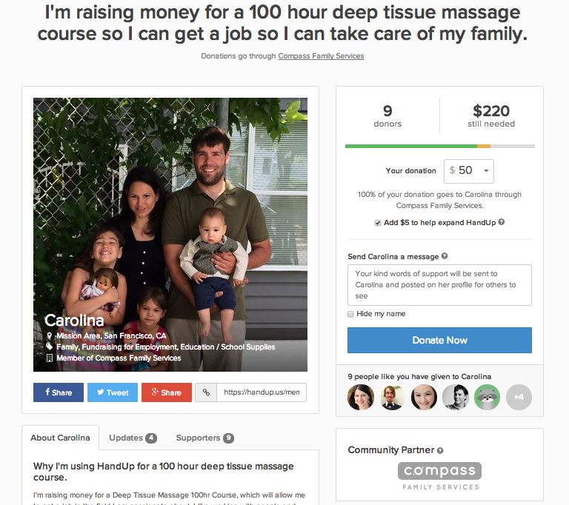
Notes:
Carolina’s story is similar to many of our HandUp member profiles. She has a specific goal in which she is working towards. In this case, it is raising money to take part in a 100 hour training course to assist her in gaining employment. If someone from the community wants to assist her and her family, they can easily do so with just a few clicks.
Since 2014, nearly 4,000 people like Carolina and her family have joined HandUp representing clients from over 110 organizations.

Slide 15
Creating a
Member Profile
Notes:
So, what do we mean by a compelling member profile? We know that the more information you are able to give members of the public, the more likely it is that your client will reach their goals. Here are a few tips from the HandUp team which can make the difference between an okay profile and a successful profile.

Slide 16
Member Worksheet Prompts
About Me
Share where you’re from, how long you’ve lived in the city, where you work or worked, about your family, and anything else about how you spend your time.
My Backstory
Tell us a little bit about how you got to your current situation? What lead to your current challenges? If you’re homeless, what are the reasons?

Slide 17
Member Worksheet Prompts
My Goals Moving Forward
What comes next for you? Tell your donors about your goals in life that you're working toward and how you're working to get there.
Other Things I'd Like to Share About Myself
Describe what makes you happiest, your proudest moment, wildest dream – or anything else you’d like share.

Slide 18
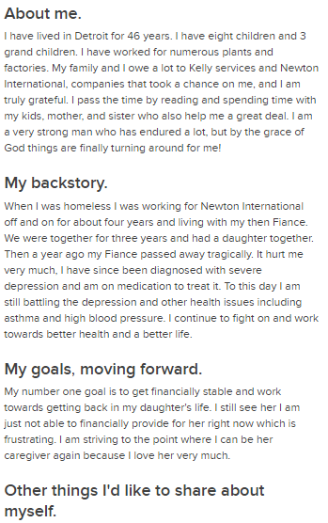
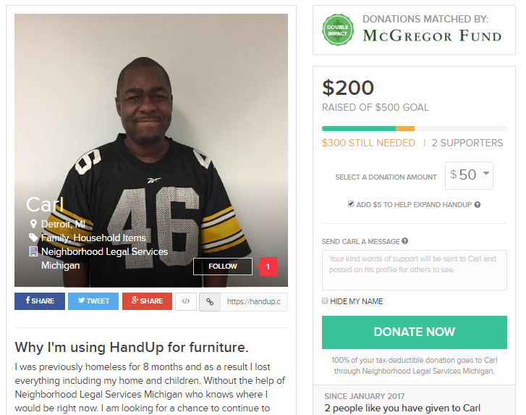
Notes:
Creating a profile is often very empowering to clients as well because they’re telling their story in a personal way that they don’t often get the chance to do. And the questions are much more holistic and positive than those on an intake form. All of the questions are open-ended; tell us about yourself, what is your backstory? What are your goals? It leaves a lot of room for creativity. Usually when I’m making a profile with someone I’m the one typing but I always read it back to them to make sure it’s actually their words and their story.
Goals can be flexible based on your agency. At COTS we vet goals and make sure their HandUp goal coincides with their self-sufficiency goals. Example of “good” goals and “Bad” goals. Talk about common goals and common needs of people in Detroit = Driving tickets, Outstanding utility bills, security deposits, items for school

Slide 19
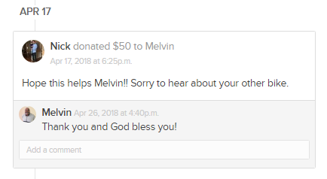
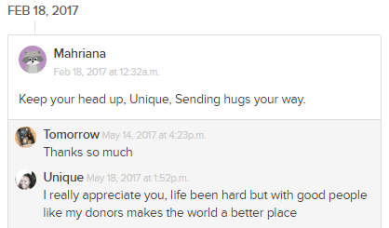
Notes:
One aspect that donors and client we're really enjoy is the interactiveness of the process. Donors & community members are able to send supportive messages to the client and clients are able to respond.

Slide 20
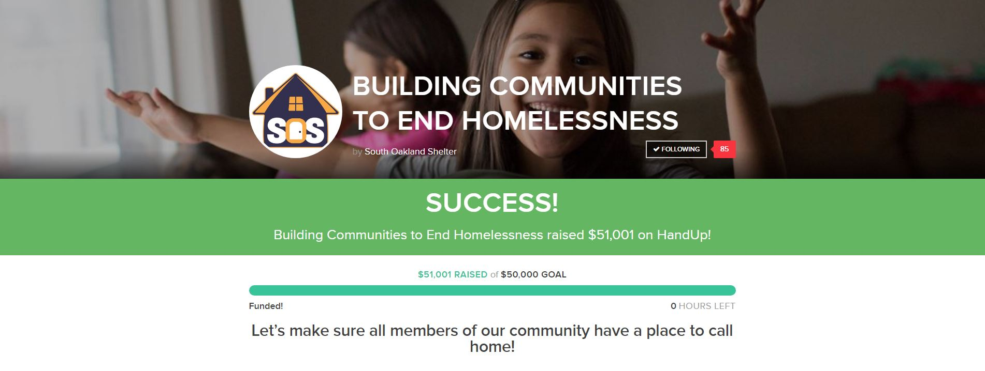
Campaign Example
Notes:
Through the Campaign feature, SOS was able to raise a lump sum of funds to help pay for an ongoing program expense. This was a great opportuinity for us to engage groups/businesses - third party event.

Slide 21
Agency Impact
Brings visibility to agencies
Sparks use of technology and marketing efforts
Fills gaps in resources
Notes:
Brings visibility to agencies: people interested in new way to support agency, brings in new set of donors who prefer to give online, in smaller amounts, and/or directly to clients,
Along those lines, for agencies with low online presence, this crowdfunding opportunity has sparked an increase in newer marketing efforts such as social media and email.
Fills in gaps that were otherwise not able to help with. For instance, if someone has a $500 outstanding DTE bill and can't get housing until it’s paid that directly effects our work and our ability to house people.

Slide 22
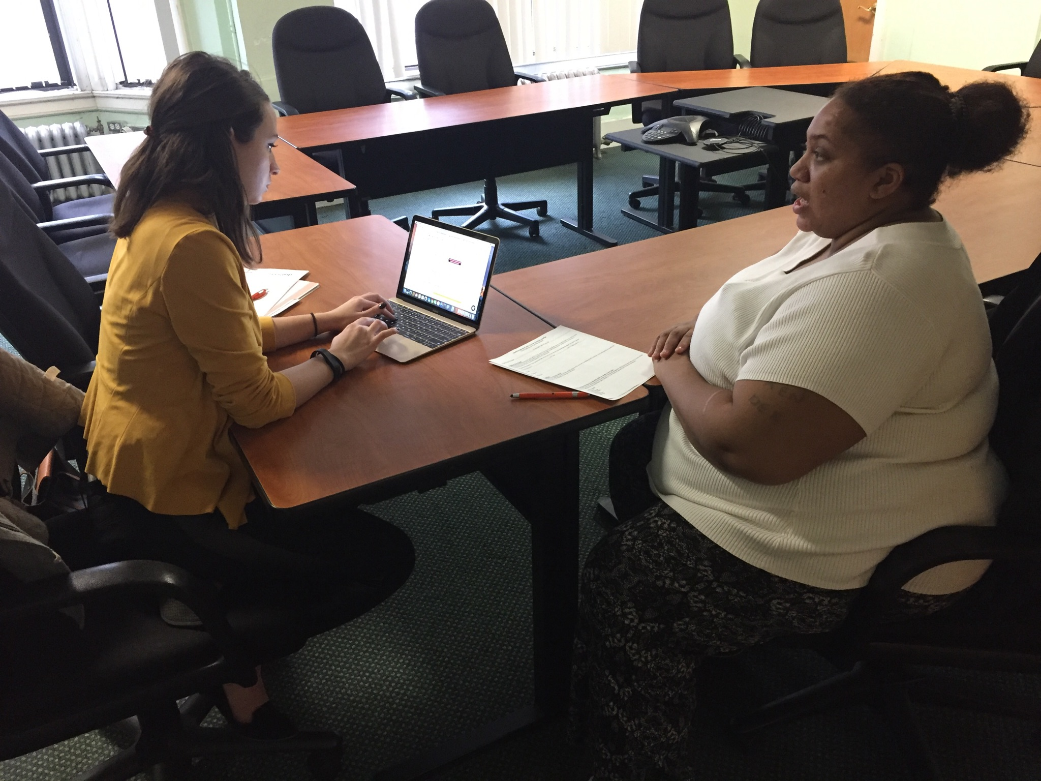
Client Impact
Tool for empowerment and self advocacy
Allow clients to build a network
Can also be used as an incentive or be reserved for certain programs
Notes:
HandUp’s most powerful impact is on the clients. Not only are they raising money for a critical goals they need, but we’ve seen our families grow in tremendous ways.
HandUp is a tool for empowerment and self-advocacy: It was can be powerful for people to tell their story to the world and have essentially strangers donate to them and support their cause.
HandUp is a way for clients to build their own individual network. We encourage clients to reach out to their own circle of family, friends, church members, mentors, etc. to help them build their network and increase donations. This is a great way for a uncle or cousin to help you out on something specific and tangible without “enabling” but used to help you get to stable.
As I said before COTS reserves HandUp just for our Passport to Self-Sufficiency participants, who are clients that work long-term with our coaches to really move up the ladder of self-sufficiency. We build relationships with PTS participants so it’s easier to build their HandUp profiles and to keep their profiles active even after they achieve their first goal.
Clients can use business cards with their profile link on them to pass out to their networks and even people they don’t know. Allows for opportunities for self advocacy

Slide 23
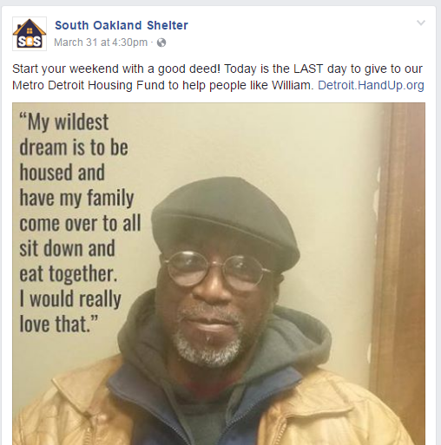
Donor Impact
New set of donors exposed to your mission
New way to connect existing donors to mission
Educating community on real causes and effects of homelessness
Notes:
We can’t forget the impact HandUp is having on donors.
New donors connecting with your agency online. Even if they had a good online presence before, this is now a form of engagement that is more interesting than just a “donate now” button on your website.
For existing donors you can connect them to the agency’s mission in a new way. Either by directly connecting them to clients through HandUp profiles or by connecting them to specific programs or projects through a crowdfunding campaign.
Also handup profiles offer individual stories of homelessness and poverty and connect donors that might not be familiar to real people’s stories. Beyond donations it has served as a tool for educating the community.
We find that people are more likely to donate when the needs are specific and you’re able to connect a need to a specific person. There’s actually a book called “Against Empathy” that Yale Professor Paul Bloom recently published. In the book he makes the case that a person's empathy is increased the more specific the problem is presented to them. So for example, if we say “Over 30K people experience homelessness in our region annually, help. They’re actually less inclined to help than if you say, “Rick needs help with his rent this month to prevent her from being evicted.”

Slide 24
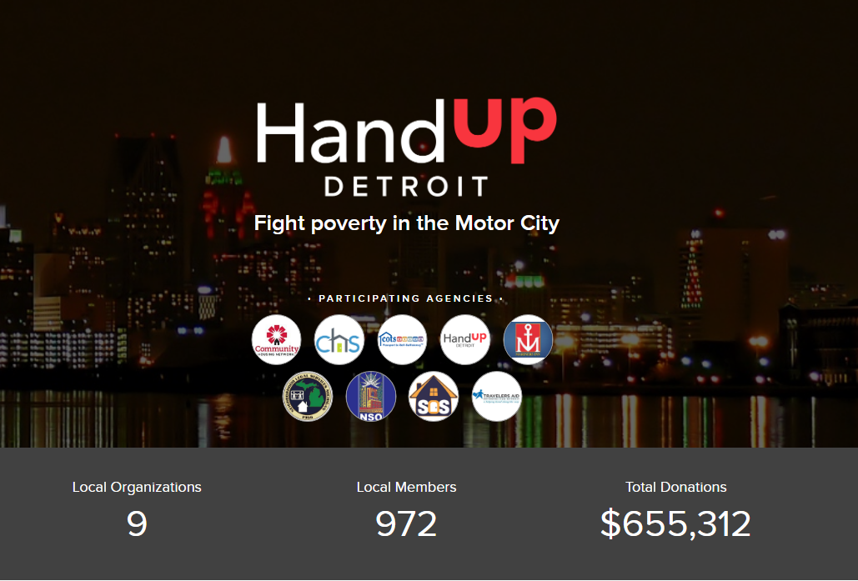
HandUp Detroit………
Notes:
Led by Michigan-based social service agency South Oakland Shelter, HandUp Detroit is a community-driven collaboration among Detroit homeless and housing service agencies. Agencies throughout our region have committed to working together to more effectively move people out of homelessness and into housing. The goal of HandUp Detroit is to bring critical services offered through HandUp to more people in need throughout Metro Detroit to help reduce barriers to housing and stability.

Slide 26
What Have We Learned After One and a Half Years?
Notes:
Now that we know a little bit about what HandUp is and heard from Jessie about what it looks like in action, lets focus on how a client is able to join the site and what happens next. After this, we will look at what it takes to create a compelling member profile.

Slide 27
Thank You!
Max Glick
HandUp Director
max@handup.org
Jenny Poma
SOS, COO
jenny@oaklandshelter.org

