Slide 1
Michigan Coalition
Against Homelessness
Empowering Communities
Ending Homelessness
BMCC 2019
#EndMIHomelessness

Slide 2
Notes:
Meets on the 4th Monday of the month from 12-1

Slide 3
Advocacy 101
Advocacy: Identifying, embracing, and promoting a cause (such as fighting against homelessness)
Lobbying: Influencing legislation (such as contacting your legislator and asking them to either vote for/against a piece of legislation)
Nonprofits and staff can participate in lobbying dependent on unrestricted funding availability
Notes:
Expenditure (generally 20%) or substantial part test

Slide 4
Advocacy Dos and Don’ts
DO know your purpose - come in with an ask
DO know your legislator - look up their bio and find commonalities in advance
DO be confident - you are the expert on these issues and your community needs
DO share personal stories and local data with something you can leave behind if possible
DON’T be disappointed if you meet with staff
DON’T get aggravated if they disagree with your perspective - educate them!
DON’T forget to follow up - invite them to events, say thank you!

Slide 5
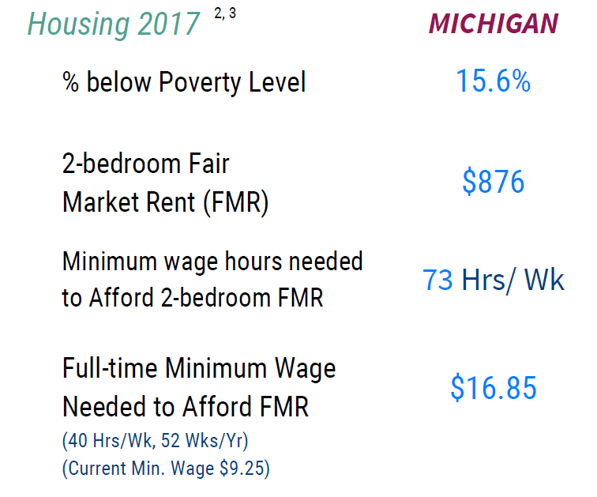
The Need for Affordable Housing
Notes:
2018 Out of Reach

Slide 6
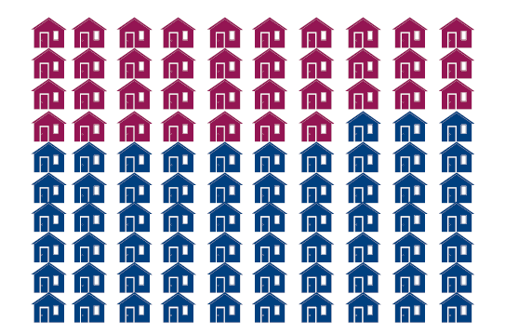
The Need for Affordable Housing
In MI for every 100 extremely low income renters there are only 37 affordable and available units
Notes:
2019 The Gap

Slide 7
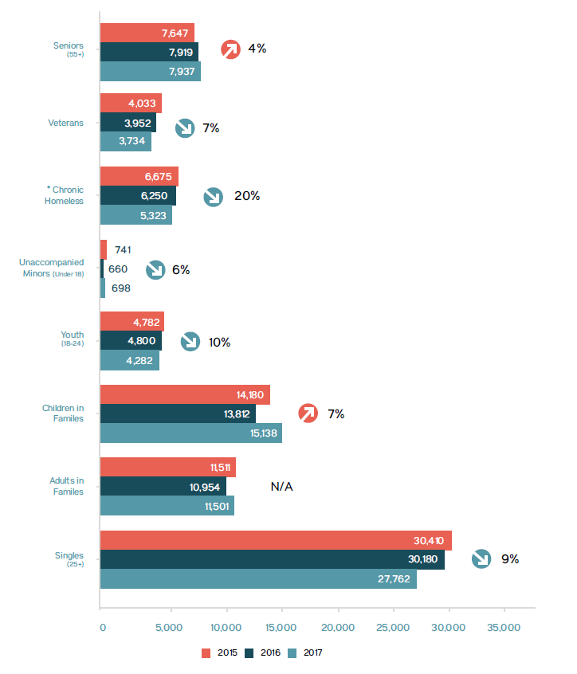
In 2017, 63,024 individuals experienced literal homelessness.
African Americans continue to be disproportionately impacted - 53% of the homeless population are African Americans, but they only make up 14% of MI total population.

Slide 8
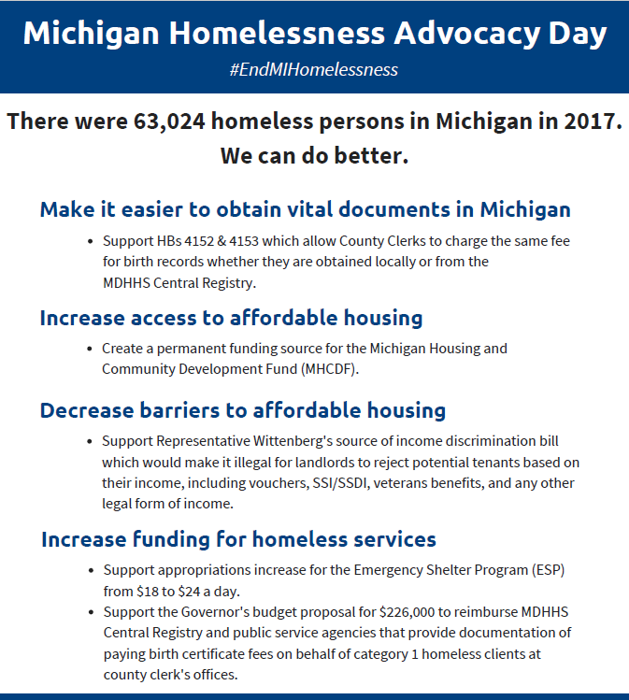
MCAH State Advocacy

Slide 9
Vital Documents
Background
MCAH, the State ID Taskforce, and the MI Interagency Council on Homelessness have been working together to make it easier to access vital documents like birth certificates.
Legislation
HB 4152 (Rep Johnson) and HB 4153 (Rep Guerra)

Slide 10
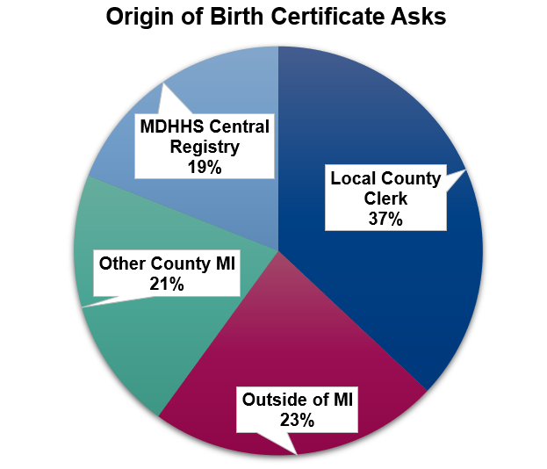
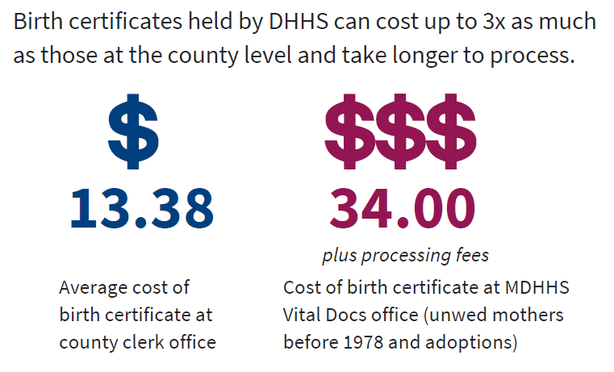
Vital Documents

Slide 11
2. Increase Access
Background
The Michigan Housing and Community Development Fund was created in 2004, but has only received funding twice (2008 and 2012). The Fund supports programs for affordable housing and homeless prevention programs across Michigan.
Legislation
Create a permanent funding source for the Michigan Housing and Community Development Fund (MHCDF).

Slide 12
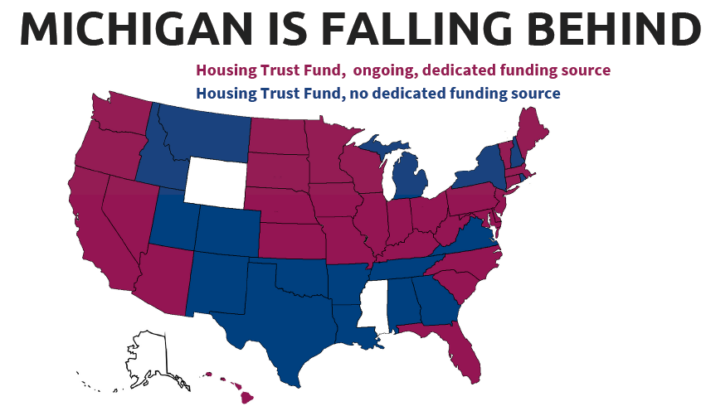
2. Increase Access
Notes:
•47 States have a Housing Trust Fund
–30 have permanent source of funding
–24 use some type of document filing fee to supplement the fund
•Real estate transfer tax or documentary stamp tax

Slide 13
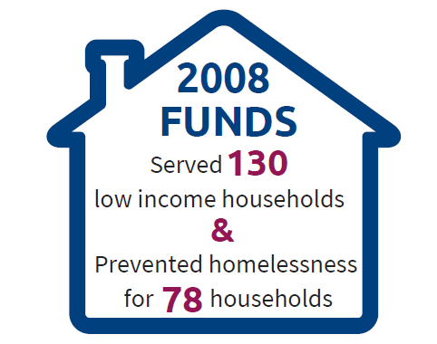
2. Increase Access
In 2008 $2,163,400 was appropriated from General Fund.
Funded projects included:
9 Habitat for Humanity projects
16 units of Permanent Supportive Housing
Security Deposits for precariously-housed persons
Programming for homeless or at-risk households
Mixed-use affordable housing
Energy efficient senior housing
Notes:
–2012 - $3,700,000 allocated from National Mortgage Settlement

Slide 14
3. Decrease Barriers
Background
Michigan does not provide any protections against discrimination of tenants based on their source of legal income. This creates additional barriers for individuals with subsidies and benefits to access housing.
Legislative Ask
Source of income discrimination bill.

Slide 15
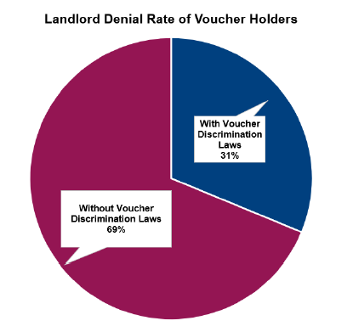
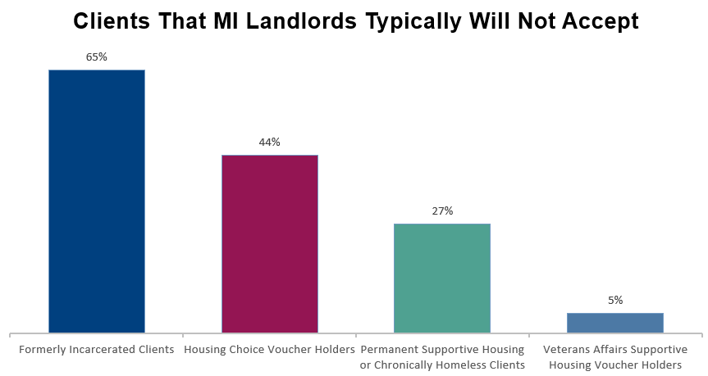
3. Decrease Barriers
Notes:
Center for Budget Policy Priorities (CBPP): Prohibiting Discrimination Against Renters Using Housing Vouchers Improves Results (2018)

Slide 16
4. Funding
Background
The majority of homeless services in Michigan are federally funded, but there are some opportunities to increase state funding this year.
Appropriations
Appropriations increase for the Emergency Shelter Program (ESP) from $18 to $24 a day
Governor’s budget proposal for $226,000.00 to reimburse MDHHS Central Registry and public service agencies that provide documentation of paying birth certificate fees on behalf of category 1 homeless clients at county clerk's offices

Slide 17
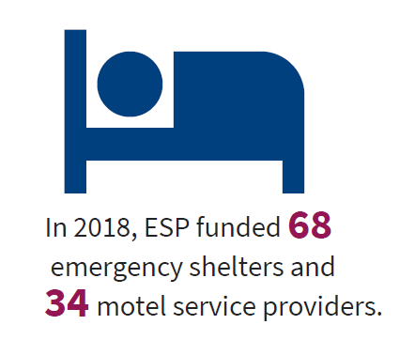
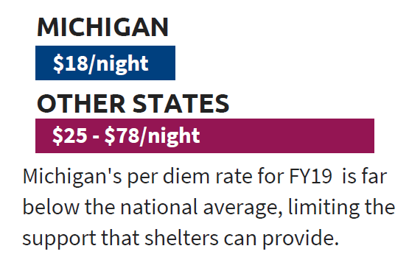
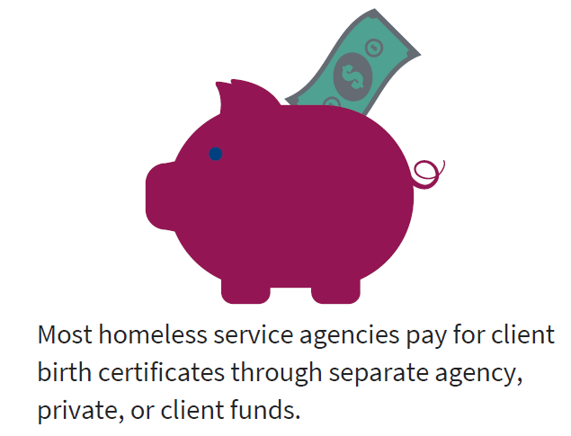
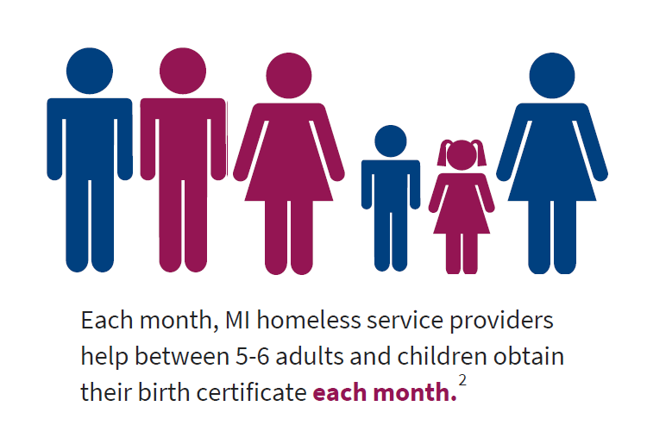
4. Funding
ESP
Vital Documents
Notes:
Update ESP and add funding for vital docs image

Slide 18
Federal Advocacy
(116th Congress)
Budget
American Housing and Economic Mobility Act (Sen Warren)
Housing Choice Voucher Mobility Demonstration Act (Sen Todd)
Ending Homelessness Act (Sen Waters)
Working Families Tax Relief Act (Sens Brown, Bennet, Durbin, and Wyden)
Notes:
American Housing and Economic Mobility Act https://nlihc.org/sites/default/files/Warren-HEOM-Bill.pdf
Housing Choice Voucher Mobility Demonstration Act: https://www.congress.gov/bill/116th-congress/house-bill/1122
Ending Homelessness Act: https://financialservices.house.gov/uploadedfiles/03.26.2019_-_ending_homelessness_act_2019_section-by-section.pdf
Working families tax relief act: https://www.cbpp.org/research/federal-tax/working-families-tax-relief-act-would-help-46-million-households-cut-poverty
Last year’s bills:
Booker
Harris

Slide 19
Questions?
Notes:
Update ESP and add funding for vital docs image

Slide 20
THANK YOU
Eric Hufnagel
Executive Director
517-853-3885 // EHufnagel@mihomeless.org
Jason Weller
Director Provider Support
& Marketing
517-853-3888 // JWeller@mihomeless.org
Laurel Burchfield
Manager of Marketing, Growth and Development
517-853-3894 // LBurchfield@mihomeless.org

