Slide 1
NCI Charrette System
Collaboration by Design

Slide 2
Overview of Topics
Intro to NCI
Three Big Challenges
Demonstrate Sticky Wall
Overview of NCI Charrette System
Six examples
System Principles Summary
Reflective Exercise
Q&A

Slide 3
NCI Collaboration by Design
Mission
NCI is a program at MSU dedicated to transforming the way people work together by building capacity for collaboration.
Purpose
NCI trains and supports professionals and community leaders in the NCI Charrette System. Through research and publications NCI continues to bring innovation to the process of transformative collaboration.

Slide 4
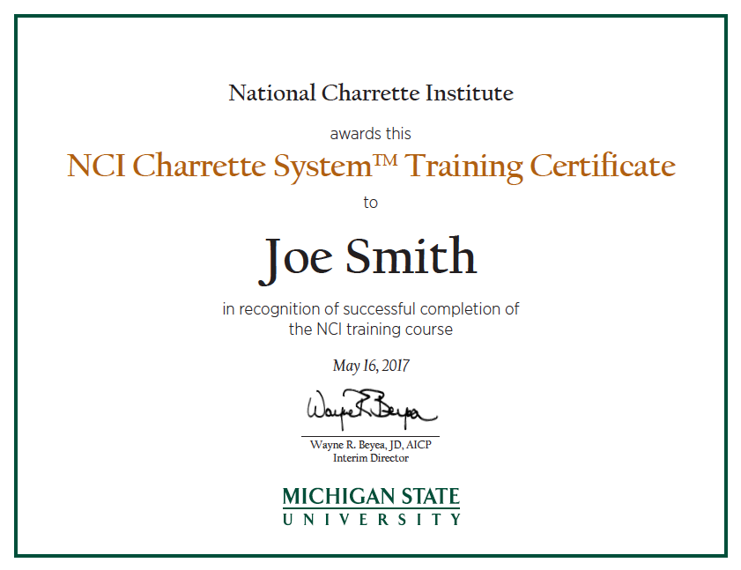
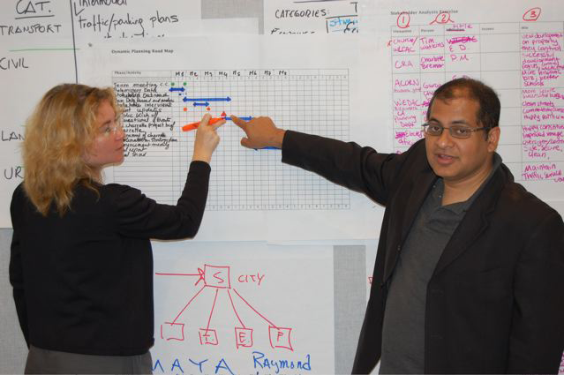
NCI Collaboration by Design Services
Trainings, Coaching, Facilitation
  Harvard, Chicago, D.C, Portland
  World Bank, DOD, HUD, GSA, US Navy
  City and County Planning Nationally
Notes:
You will get a certificate that lots of other people have gotten…3350 and counting.

Slide 5
Three Big Challenges to Collaboration
Lack of Trust
Fear of Change
Specialty Silos
Notes:
10:30
Now that we know how the charrette works within the context of Dynamic Planning, it’s time to examine the tools and techniques for each of the three phases in detail.
Go over the big WHY
Part of it is, we teach collaborative design. Using a design process to get people thinking outside of the box.

Slide 6
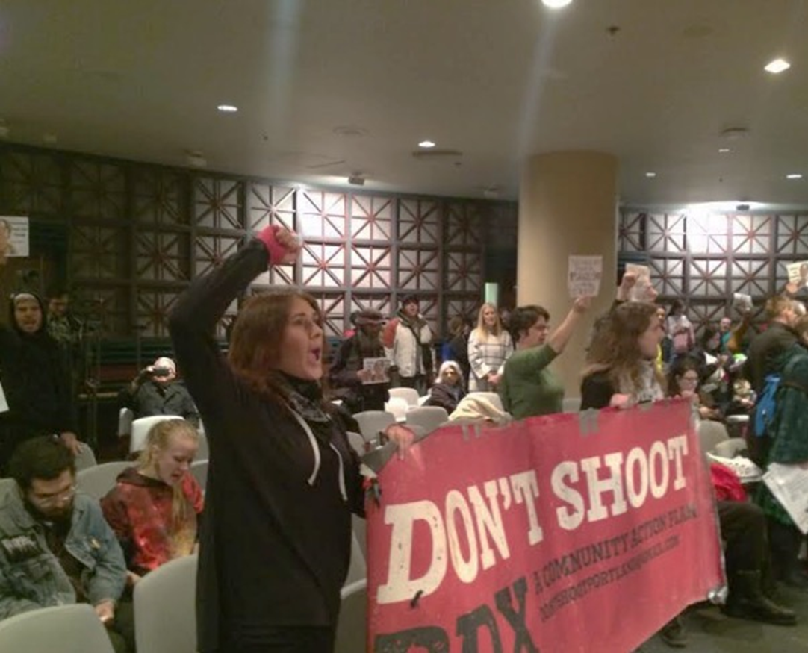
Lack of Trust Undermines a Creative Process
Notes:
NCI is interested in the process for turning this resistance into a positive collaborative movement.
This photo is In Portland during a city council meeting. Gun/police related policies weren’t on the agenda, but these people didn’t know where to else to go to be heard, so they came to the council meeting and disrupted the agenda/meeting.

Slide 7

Change is Hard for Everyone
Notes:
10:00
If you are bringing change into people’s lives, you are behind from the start. Transitions are tough for people.
Participants are change agents, from buildings to neighborhoods, etc.. Change is hard. Ask for how they’ve facilitated change in their work.

Slide 8

Notes:
We still find change hard we just find different ways to express it.

Slide 9
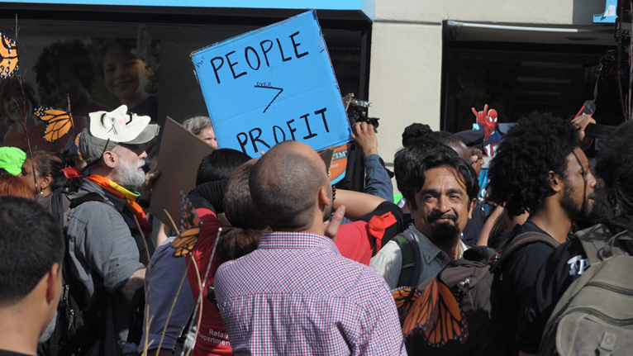
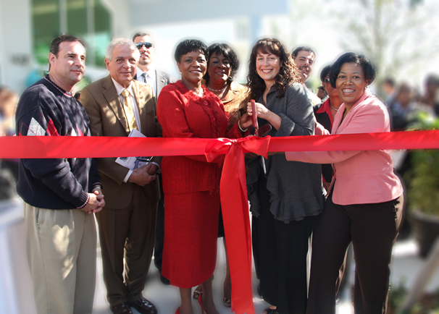
How can Resistance Turn Into Positive Community Transformation?
Notes:
NCI is interested in the process for turning this resistance into a positive collaborative movement.
Sometimes a situation gets so bad that people hit the streets. We want to use that energy BEFORE they hit the street, to build the solution.

Slide 10
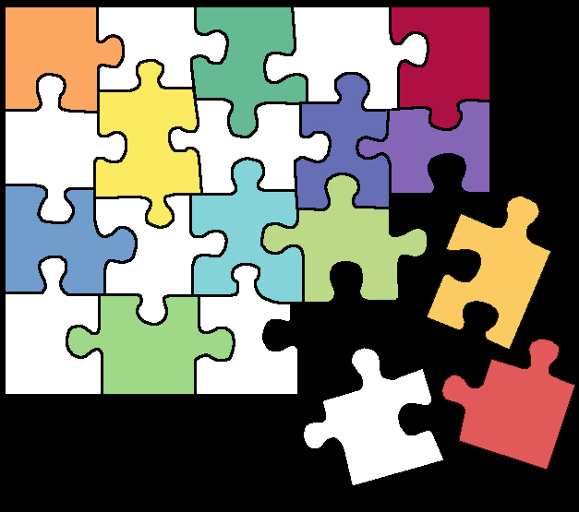
Each Piece of the Community Development Puzzle Protects its Domain
engineering
residential
zoning
transit
construction
marketing
open space
transportation
environmental
utilities
public involvement
retail
politics
public space
architecture
affordability
density
sales
financing
parking
Notes:
The problem is that people work in their own parts of the puzzle not seeing how they fit into a larger whole.

Slide 11
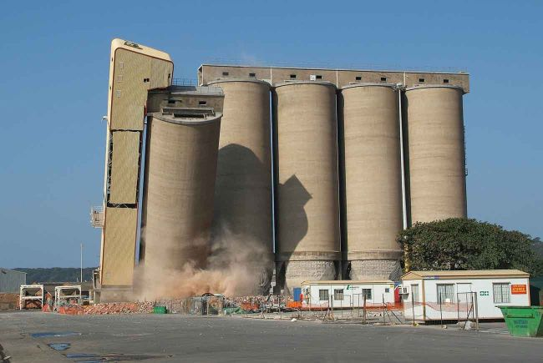
Notes:
10:00
If you are bringing change into people’s lives, you are behind from the start. Transitions are tough for people.

Slide 12
NCI Charrette System Saves Time/Money
NCI Charrette System
4-7
Day
Charrette
Public
Mtg.
Public
Mtg.
Approval
Conventional Planning Process
Public
Mtg.
Public
Mtg.
Public
Mtg.
Public
Mtg.
Public
Mtg.
Public
Mtg.
Approval
2
Months
4
Months
6
Months
8
Months
10
Months
12
Months

Slide 13
Sticky Wall Report
How long have you been in your role?
What is the biggest barrier you face in your work with communities?

Slide 14
The NCI Charrette System™
Notes:
This is what we will cover until 3pm

Slide 15
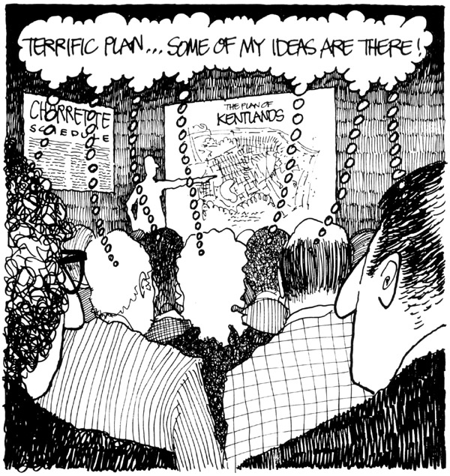
What is a NCI Charrette?
An NCI Charrette is NOT:
A one-day workshop
A marathon involving everyone all the time
NCI Charrette IS:
Co-design
3 feedback loops
Collaborative, multi-disciplinary
Results in a detailed feasible plan
Drawn for The Washington Post, 1988, by Roger K. Lewis, FAIA, Professor, U. Maryland School of Architecture

Slide 16
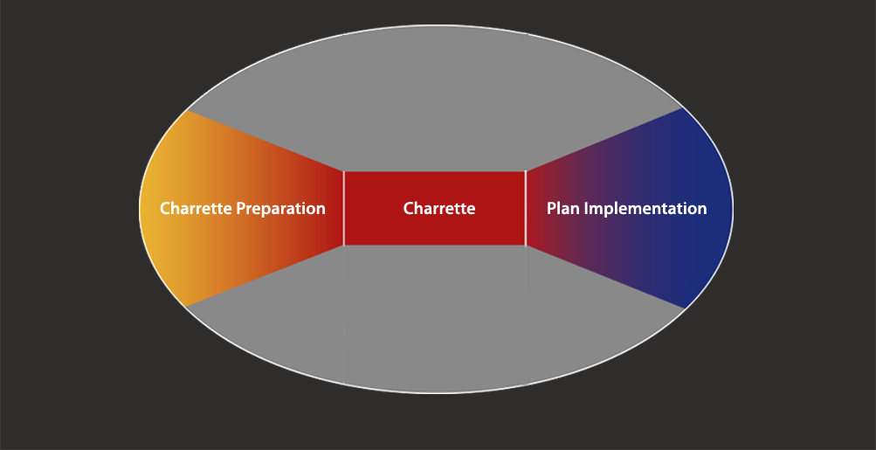
The NCI Charrette System
Notes:
The three phases with the charrette as the main event. Designed to take the experience of a charrette and make the whole project run with efficient, creativity, involvement, and lack of rework

Slide 17
The Charrette System Phases
research, education, charrette preparation
plan
implementation
charrette
1
2
3
1-9 months
2-4 months
Project Assessment and Organization
Stakeholder Research, Education, Involvement
Base Data Research and Analysis
Feasibility Studies and Research
Charrette Logistics
Organization, Education, Vision
Alternative Concepts Development
Preferred Plan Synthesis
Plan Development
Production and Presentation
Project Status Communications
Product Refinement
Presentation and Product Finalization
Notes:
When we first started the institute, we knew we’d have to describe this in a linear fashion and like a cook-book, even though it is neither of those.
The way we teach the tools and techniques is first to cover the charrette phase 2. Once you fully understand the charrette phase you will better understand phase one by knowing what it is that you are planning for.
Before we cover the charrette I do want you to look at phase one and understand that all of this happens months before the charrette. You are basically getting the people and the information charrette ready.
Tell them we’ll go through all this to 3pm. We’ll dive deep on 1, practice on 2.
When NCI was made, a conscious decision to focus training on being charrette ready.

Slide 18
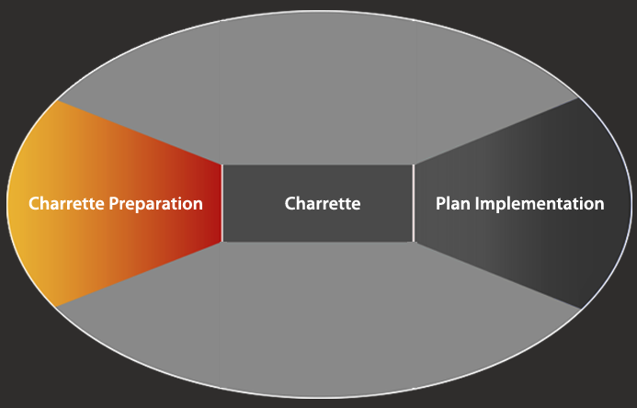
The NCI Charrette System
Phase One: Charrette Preparation
Notes:
11:30
now that we understand the details of the charrette we are going to step back to see how do you get ready to do one of these things? Dynamic Planning phase one is about getting the people and the data ready for the charrette. This takes place a minimum of 6 weeks to perhaps 9 months ahead of the charrette.

Slide 19
Phase One: Charrette Preparation
people
ready
data
place
Notes:
Projects usually go wrong when one of these things aren’t ready.

Slide 20

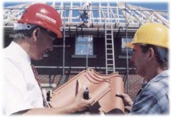

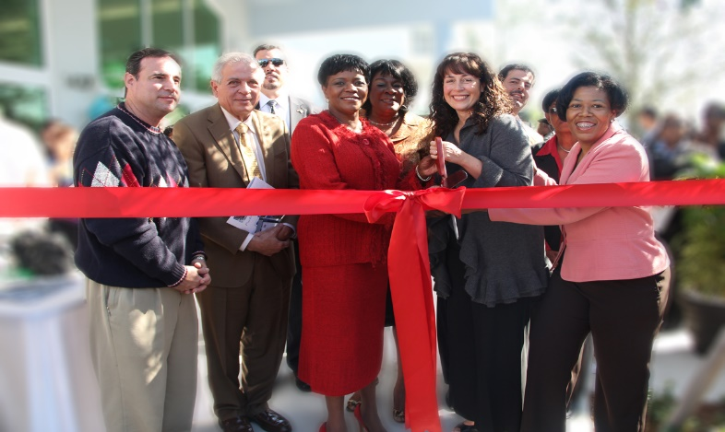

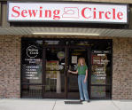

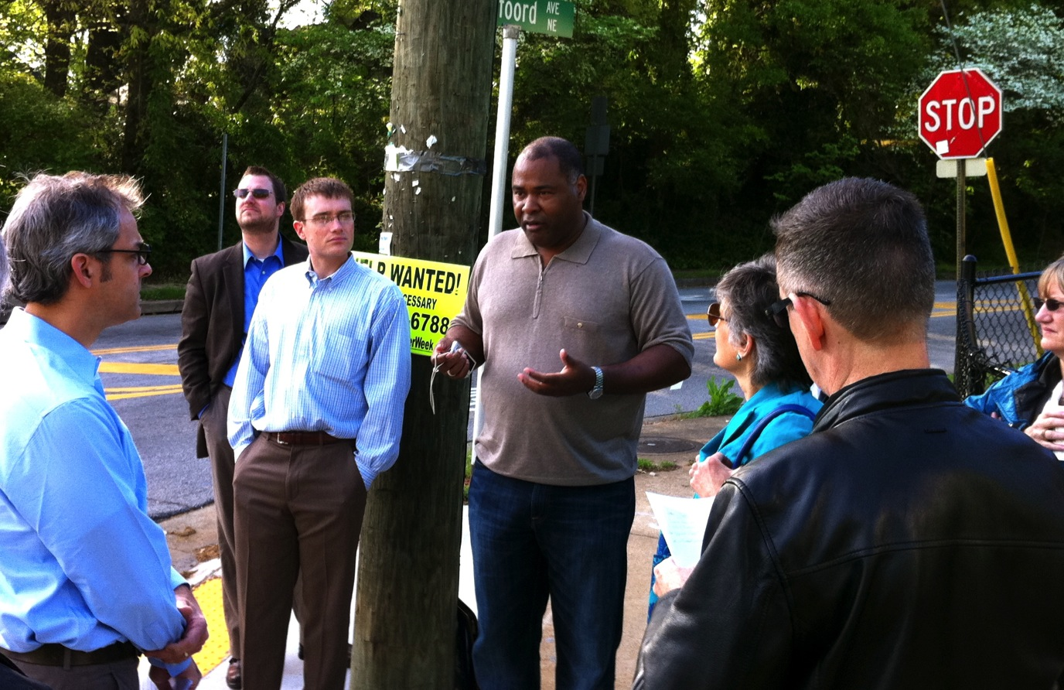
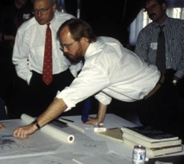
Stakeholders Unique Viewpoints
Fire Chief
Transportation
engineers
Developer
Elected officials
Business owners
Environmentalists
Neighbors
Urban designers
Notes:
10:00
If you are bringing change into people’s lives, you are behind from the start. Transitions are tough for people.

Slide 21
Who are “the People”?
Decision makers.
Those who may supply valuable information.
Those historically left out of planning process.
Those who will be affected by the outcome.
Those who have power to promote the project.
Those who have power to block the project.
Notes:
Identify, connect, with these people who need to be included early and often.

Slide 22
Stakeholder Levels of Involvement
less
involved
more
involved
Primary Stakeholders
Secondary
Stakeholders
All are involved at key decision points
General
Stakeholders

Slide 23
Sample Stakeholder Analysis
Viewpoint | Person / Affiliation | Issues | Win | Level | Outreach Strategy | Charrette Participation
Elected Official | Lucinda Wallis, Capital County | 25 years of controversy, with nothing to show. Wallis is the project “champion.” | A plan and codes agreed upon by the developer, and the neighborhood. A bulletproof public process. A national exemplar project. | Primary | Email, phone | Daily Team Meetings
Elected Official | Percival Moccasin, Capital County | Concerned about project costs. Interested in a non-controversial outcome. | A project that can be approved and supported by neighbors. | Primary | Email, phone | Public Meetings
Neighborhood Activists | Carrie Snodgras, Kris Tal, Terry Jensen, Medford District Improvement Association | Deep distrust of County Supervisors and staff. Traffic, visual impacts, property values, safety. | Minimal traffic impacts, maximum housing, low buildings across from neighborhood, pedestrian access, local retail only, no increase in transit parking. The County must keep its promise and build the regional trail. | Secondary | Emails, letters | Separate Meeting
Neighboring Commercial Owners | Katrina Moskawitz, Hollywood Boosters | Workers have limited local services. | Compatible uses with existing business, amenities for office workers, traffic management. | Secondary | Emails, letters | Separate Meeting
Developer | Tom Bates, Dick Bernard, Big Sky Development | Last development proposal failed. | Economic and market feasible plan. | Primary | Email, phone | Daily Team Meetings and Reviews
Notes:
Show this slide during the exercise
Students turn to page 94

Slide 24
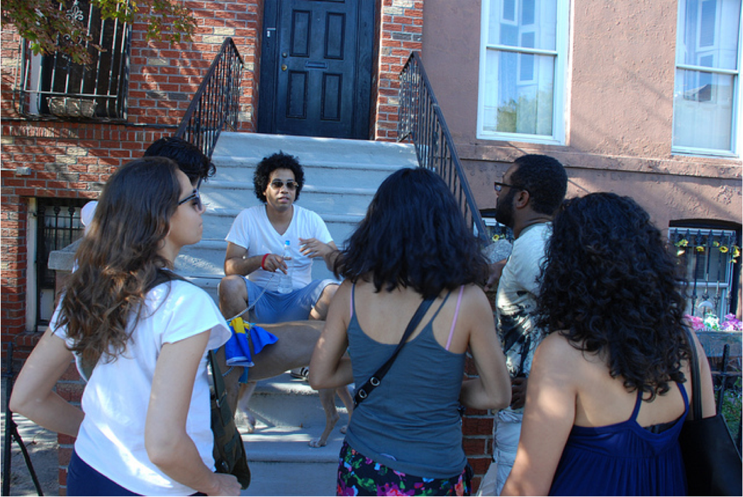
Building Empathy and Trust in Planning
Interviews
Walking tours
Neighborhood meetings
Topical workshops
Social media

Slide 25
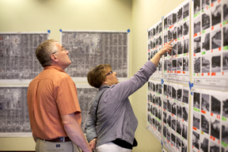
Charrette Logistics
Tool: Studio Logistics and Set-up
Purpose: To provide a functional space for charrette team work and public participation
Process: The charrette manager works with local staff to organize all charrette logistics to support a sustained, focused effort
Charrette gallery
Notes:
You find a good place wher eyou can work, receive people and have meetings.

Slide 26
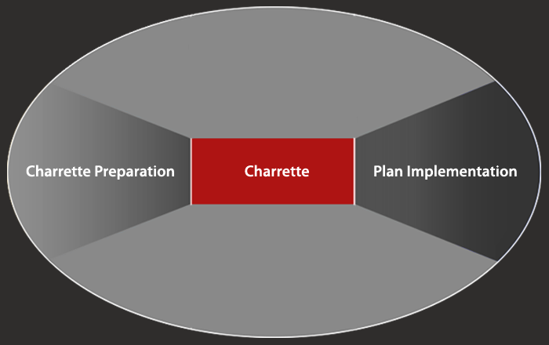
The Charrette

Slide 27
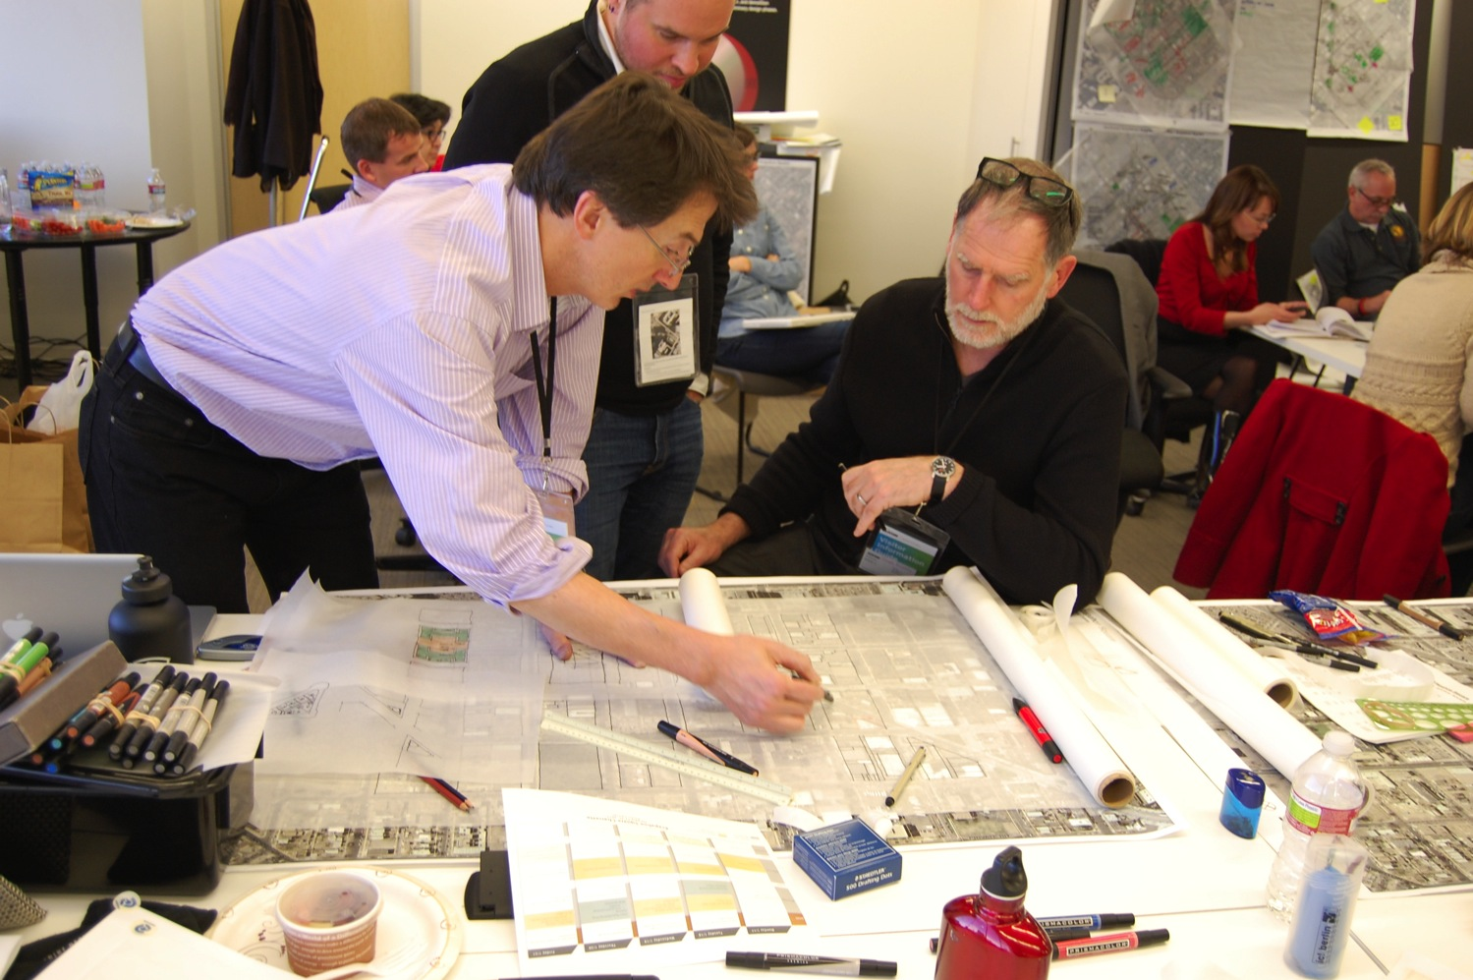
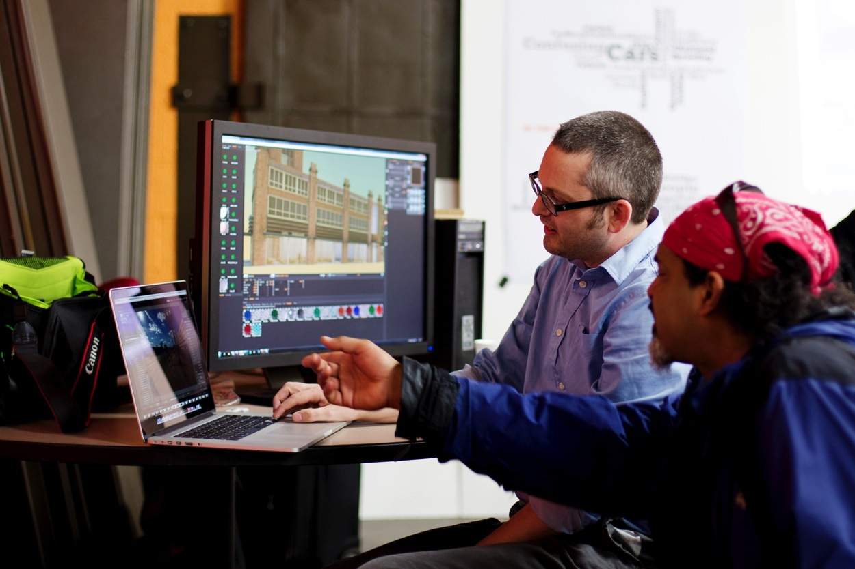
Charrette Roles and Process
Charrette Team
A multi-disciplinary team of specialists entrusted to carry on the design process on behalf of the stakeholders
Notes:
First let us understand the roles.
The charrette team is made up normally of consultants.
The team sets up the studio which is a working office on site where there team creates the plan from scratch. The studio is also the location for meeting with stakeholders (transition to next slide)

Slide 28
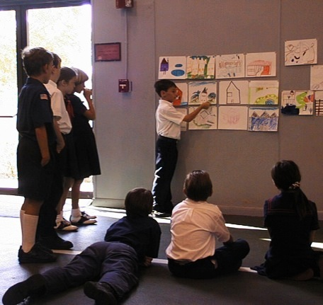
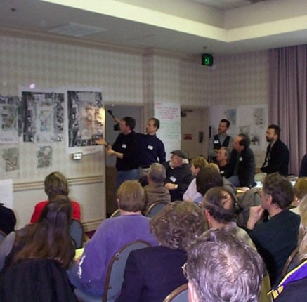
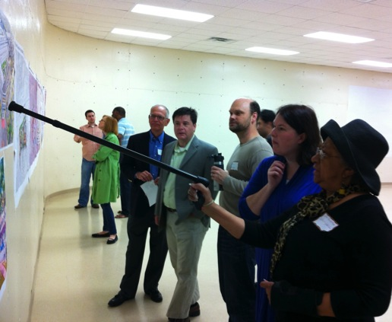
Charrette Roles and Process
The Stakeholder’s Role
Stakeholders provide vision, input and review at key moments during scheduled and impromptu, meetings
They are not there all the time!
Stakeholder meeting (Scheduled)
Public meetings (Scheduled)
Drop by the studio (Unscheduled)
Notes:
The other role is the stakeholder. Most of the stakeholders are not there all the time. There are scheduled meetings for stakeholders each day. The beauty of the charrette is that it involves a lot of hours and days to accommodate people’s schedules.

Slide 29
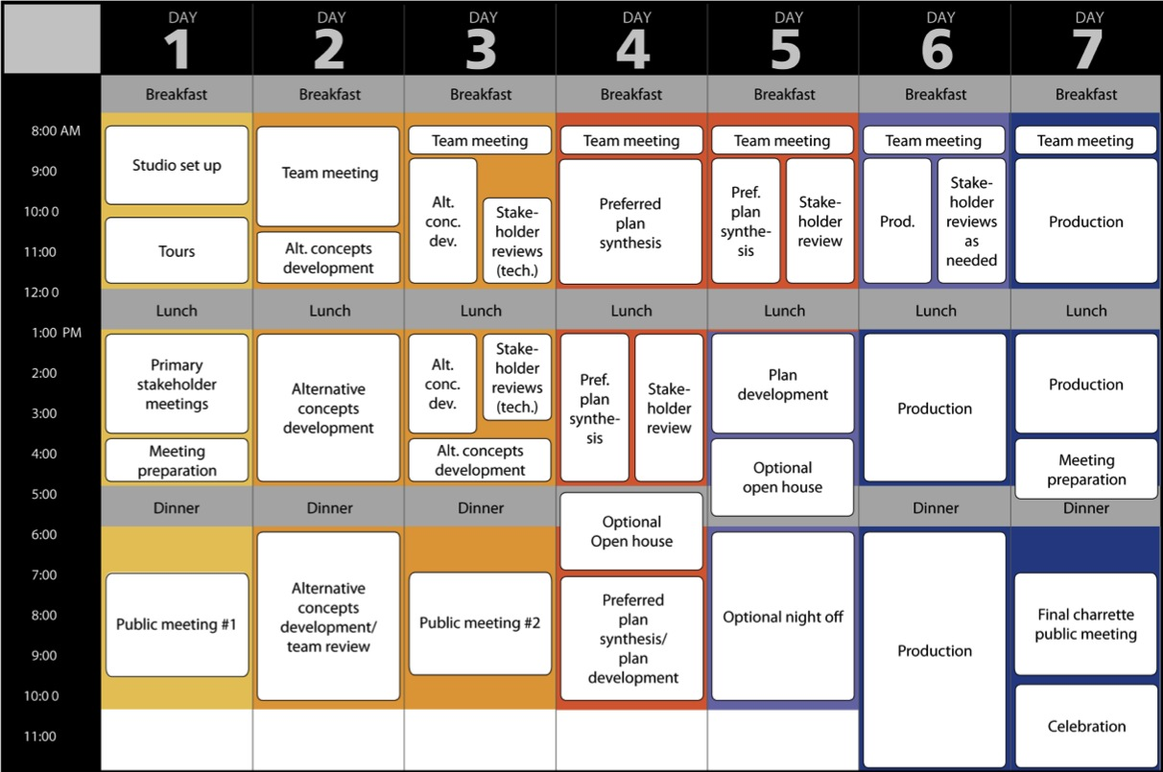
Charrette Schedule
Notes:
HAVE THEM LOOK AT THE COLORED HANDOUT
NCI uses the classic 7 day charrette to explain dynamic planning This is the rolls-royce. Not all charrettes will include all of this nor be this long. The 7 day model allows us to show all the accessories if you will.
The background colors. The second color is the alternative concept part. The third color, the red, the “scheduled train wreck,” let’s see what happens when the dust clears. Then things cool off, and then finally, the production.
That’s the basic flow of a seven day charrette.

Slide 30


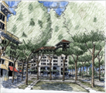


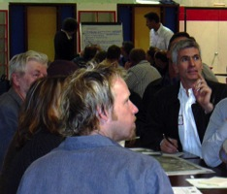
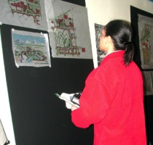
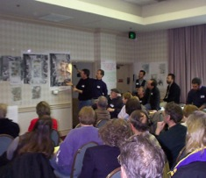
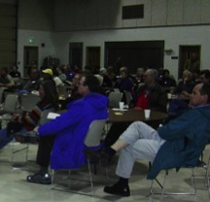


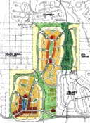
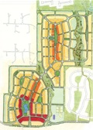

Charrette Work Cycles
public meeting
vision
public meeting review
open house review
public meeting
confirmation
alternative concepts
preferred plan
plan
development
Notes:
The charrette, no matter how many days, can take you through those a series of collaborative design and public input cycles for multiple, consecutive days.
[click] On day 1, the public provides vision and project direction through a hands-on workshop.
The design team takes this vision and creates a series of alternative plans. This is the taxi driver…where do you want to go. Confirm vision. Listen first!
[click] and then solicits public input at another public meeting.
[click] This describes the first feedback loop, the central process of the charrette.
This input is used to synthesis the alternatives into a preferred plan
(click and stop to make the next point.) Processes that last two to three days can often produce a preferred plan that people like. But that plan may not have gone through the critical testing to assure feasibility. The designers may find themselves announcing at a later date that the preferred plan that everyone was so excited about has some fatal flaws. This can erode public confidence and require costly rework.
The charrette doesn’t stop with the preferred plan. While you have all the specialist present you keep working for a few more days in order to develop, test, refine
(click) and present a feasible plan.
(click) At the end of the charrette you can look the stakeholder in the eye and say that at least back of the envelope the plan is feasible. Charrette plans have a very good track record of not requiring major redesign through engineering.

Slide 31
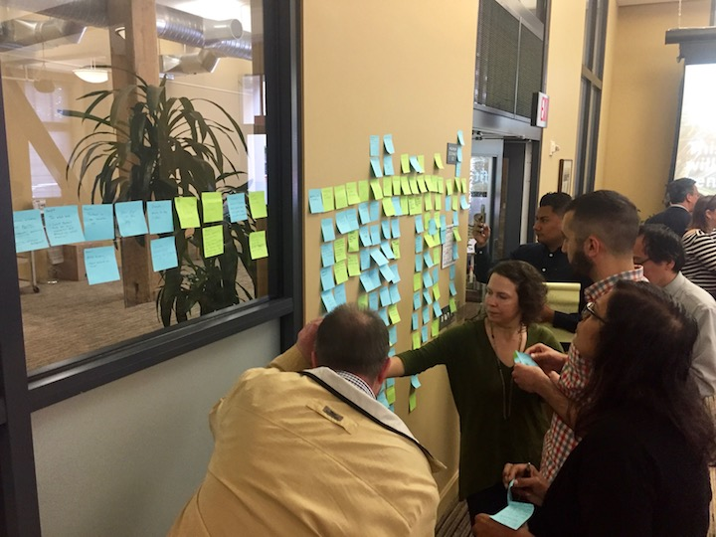
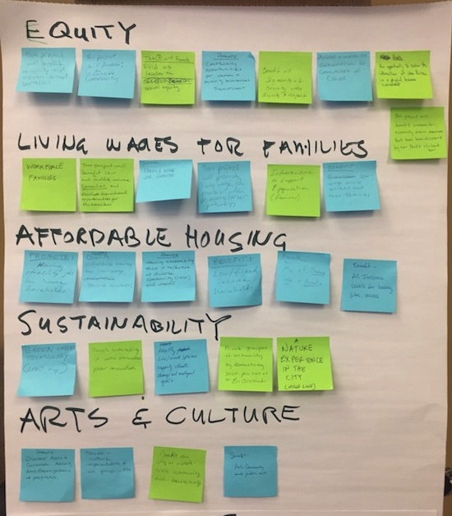
Co-Design Tool – Vision Wall

Slide 32
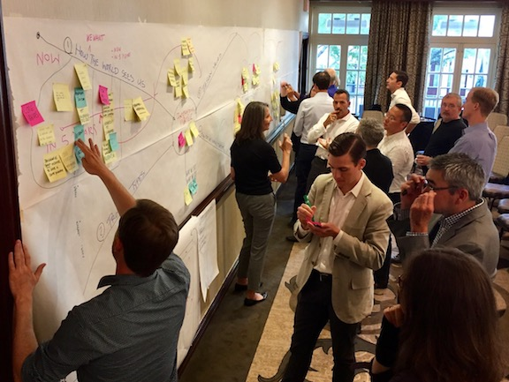
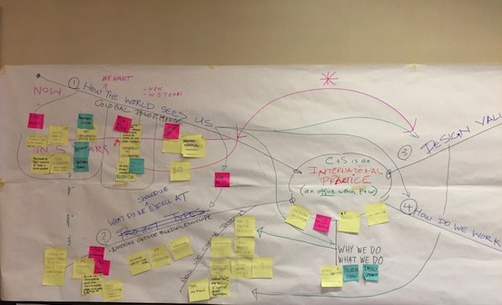
Co-Design Tool
Mindmaping for Strategic Planning
Notes:
The final meeting is a comprehensive presentation of the evolution of the plan and the complete final documents
This meeting should be an impressive, positive and persuasive event.
A well orchestrated final charrette public meeting can provide tremendous momentum to help the project through the inevitable hurdles during implementation.
This image is from an architectural firms strategic plan

Slide 33
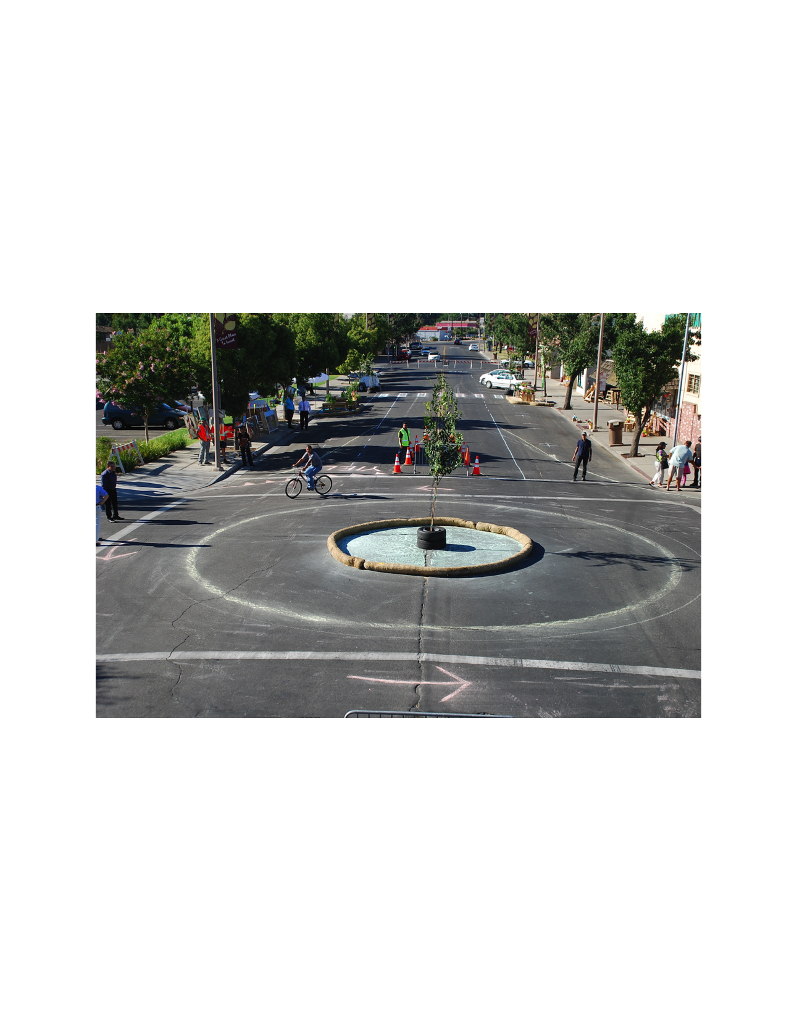
Co-Design Tool
Tactical Urbanism

Slide 34
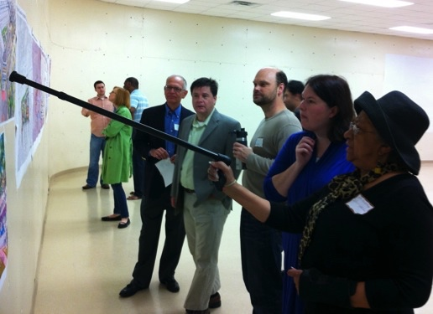
Co-Design Tool
Charrette Gallery Review

Slide 35
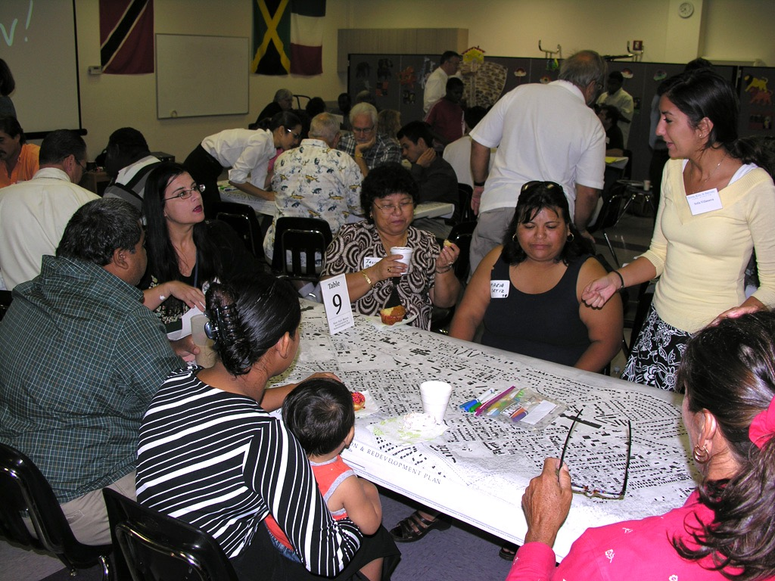
Co–Design Tool
Charrette Hands-on Workshop

Slide 36
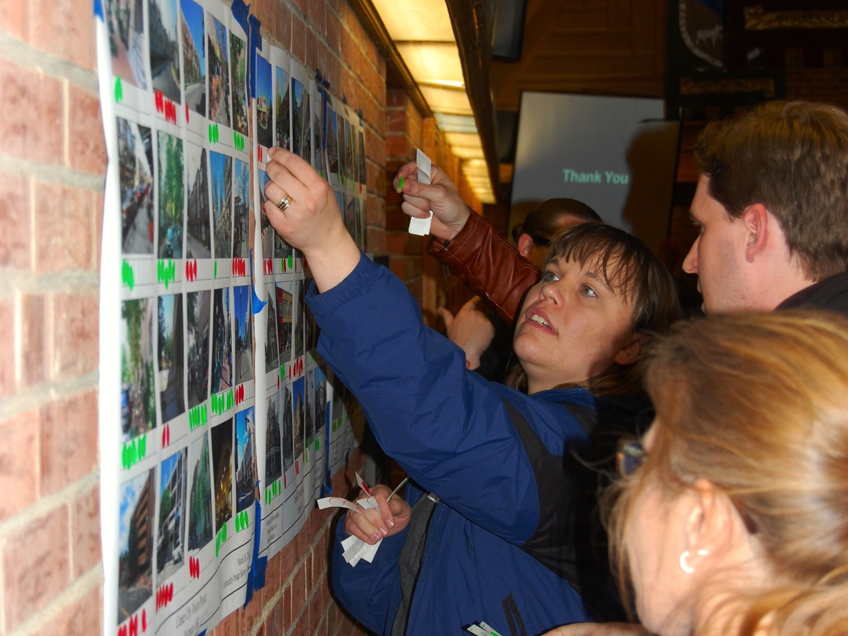
Co-Design Tool
Charrette Visual Preference Exercise

Slide 37
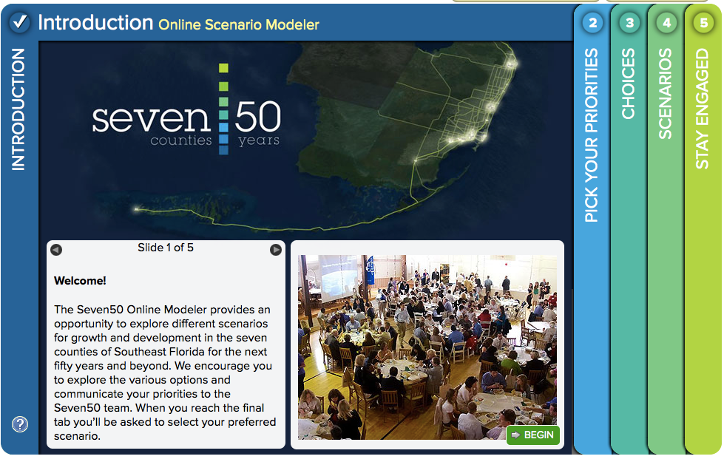
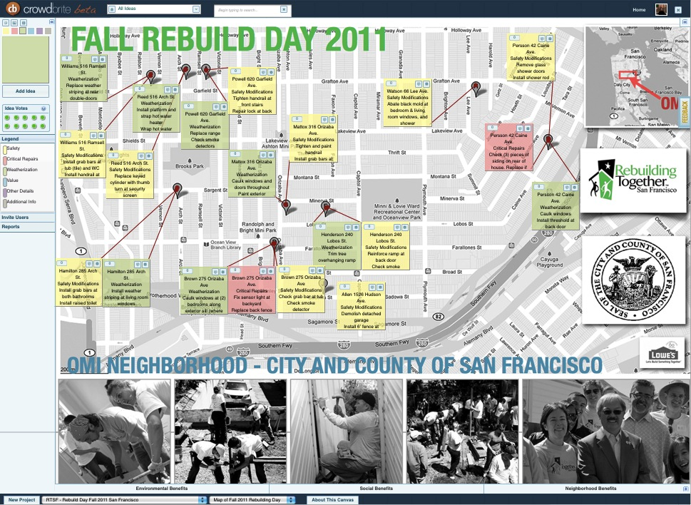
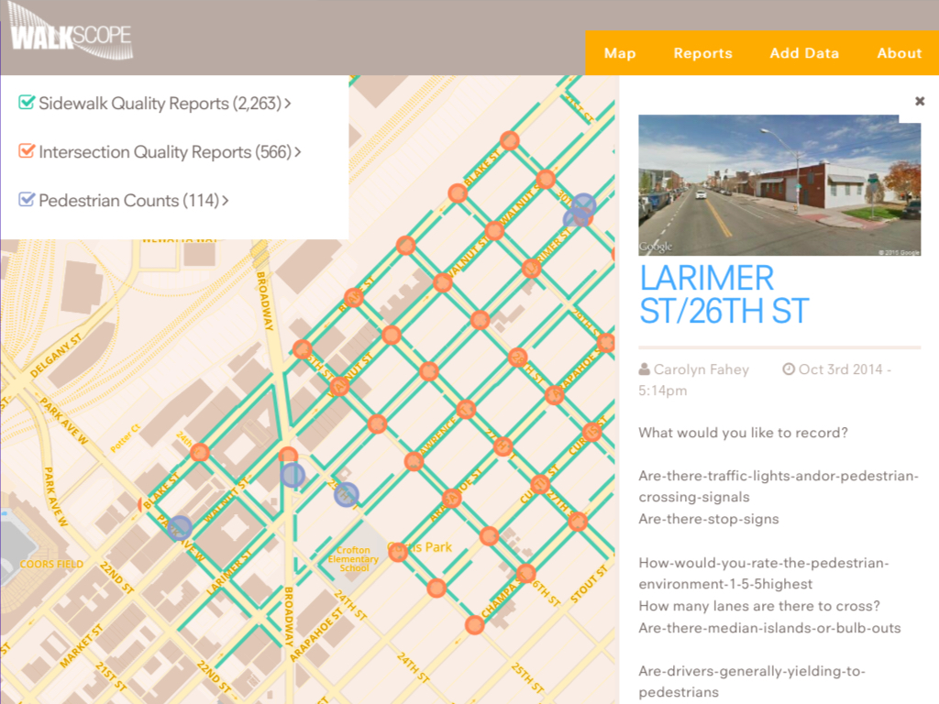
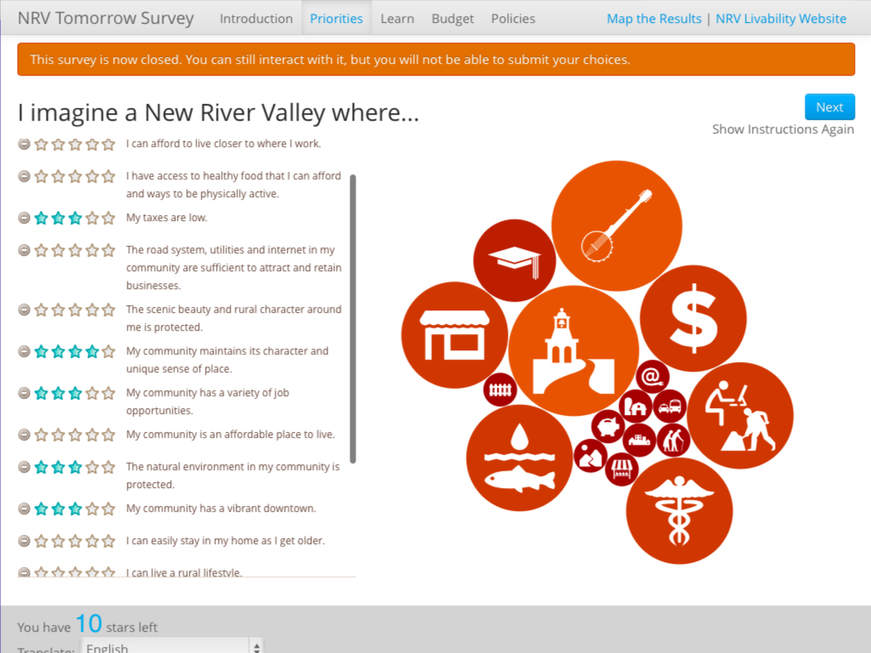
Co-Design Tool
Web-based Participation

Slide 38
Charrette Feedback Loops
The Three Transformative Moments
Loop 2
Alternative
Concepts
Preferred
Alternatives
Test
Preferred
Plan
Loop 1
Loop 3
Notes:
A series of at least three feedback loops is perhaps the most important aspect of the Charrette.
Planners often just have one feedback loop, starting at vision and ending in plan. People want to be involved in the design process.
In these three major feedback cycles, design ideas are created based upon a public vision, and presented within hours for further review, critique, and refinement. These feedback cycles foster a holistic understanding of complex problems by all participants and form the basis of a plan that reflects all vital viewpoints. It results in true buy-in by everyone involved, and participants are thereby inspired to support the plan, helping it to overcome the inevitable challenges on its path to implementation.
The first part of the feedback loop is created when a proposal is made to a group of key stakeholders. There is a collaborative discussion of the merits of the proposal and recommended changes. The author of the proposal modifies it according to the input and it is then re-presented to the key stakeholders. The degree to which the stakeholders become invested in the process is in part directly effected by the length of time that elapses between the presentations. In other words the length of the loop.
It is convenient to engage in the beginning and the end only. If you do that, and bring the product only to them a the end, people won’t know/understand how/why you got there.

Slide 39
Co-Design Lexicon
Notes:
Other models. According to project complexity, decide which type of charrette/co-design process you need. Scale the project to complexity (primarily political) and budget.

Slide 40
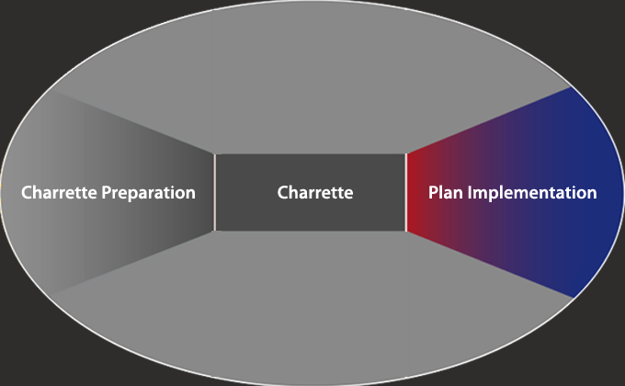
Phase Three: Plan Implementation
Notes:
Now we’re going to jump to…now, what’s the deal after the charrette?

Slide 41
Project Status Communications
Tool: Public Communications
Purpose: Continue to inform on the outcome of the charrette, the next steps, and how they can be involved
Process: Disseminate information though e-mails, websites, and publications such as The Town Paper
Notes:
Meet with that committee or team after the charrette, as soon as possible…What are we doing next? What are we putting on the website?
Make sure you debrief on your team so they know what they are doing.
The communications themselves, at this stage, are absolutely key. For you to take the lead on the information on what happened at the charrette. If you don’t somebody else might. If you don’t set the table, some body else might. Get the word out, have a website. Load it up during the charrette. Constantly be leading.

Slide 42
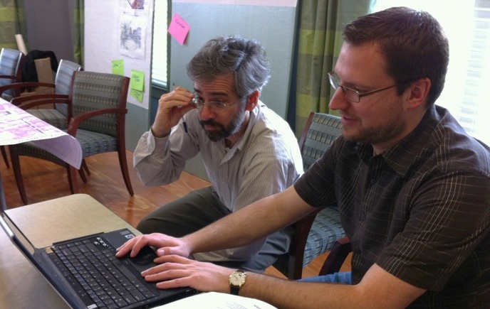
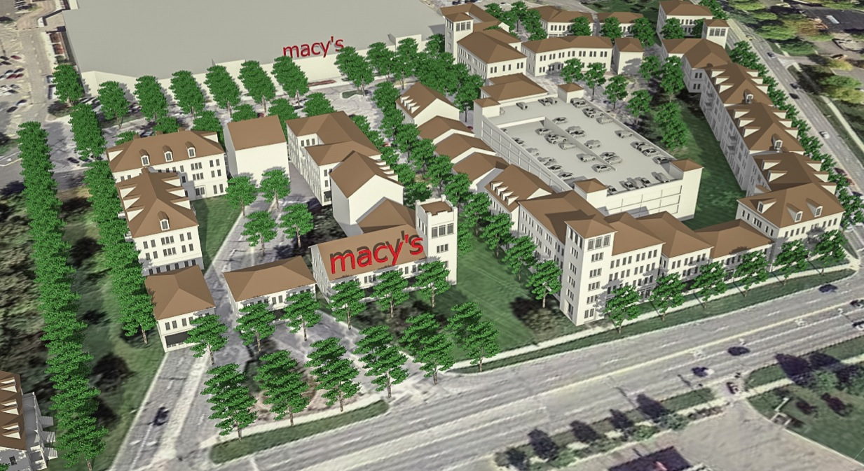
Product Refinement
Goal: Ensure that the Charrette Plan is feasible
Tools:
Document Review and Feedback
Document Revision
Purpose: Complete the revisions required by the review process
Process: Charrette team members complete revisions to their assigned products
Notes:
Your team is refining what they did at the charrette…
Revising your documents, so that when you go back to your “final”…

Slide 43
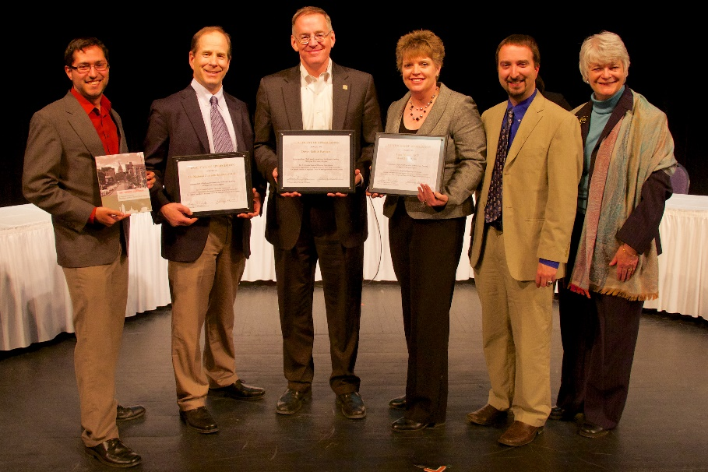
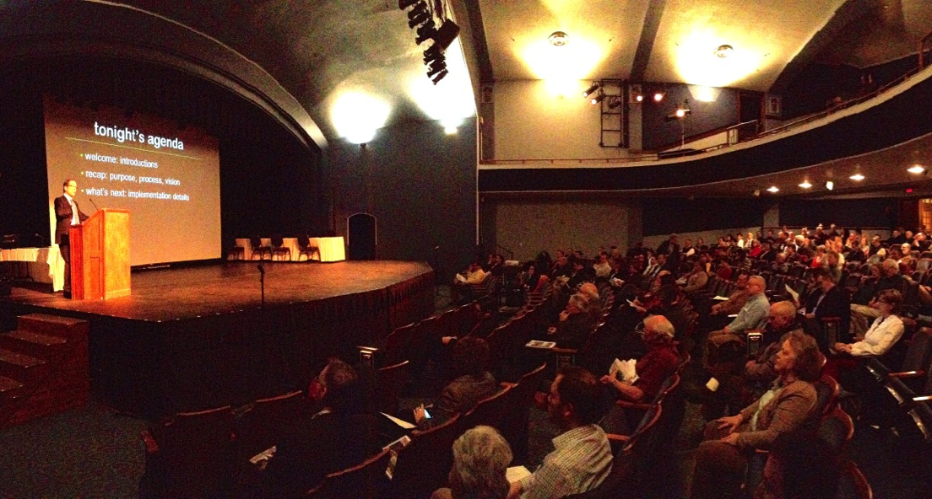
Presentation and Product Finalization
Goals
Solicit a final round of public input
Complete the full set of charrette drawings and documents
Tool: Final Project Public Meetings
Purpose: Perform one last feedback loop with the public
Process: Hold one or two public meeting on subsequent days
Notes:
It allows you another feedback loop. Being able to stick around and respond to latecomers, things like that happen, and come back for another feedback loop.
We came back for a presentation. Met with Kellogg center to go through the details.

Slide 44
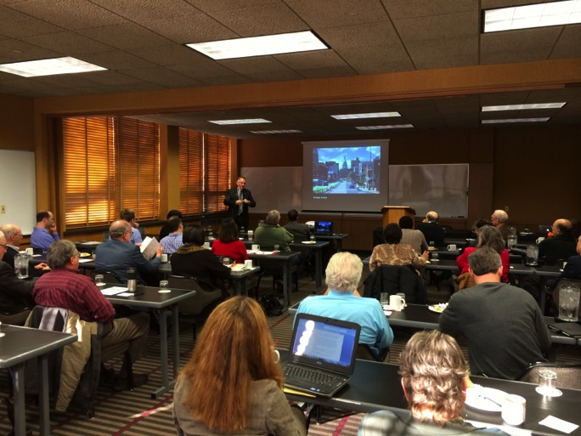
Presentation and Product Finalization
Tool: Educational Sessions
Purpose: Build local capacity to implement the plan
Process: Presentations and discussions with local staff and officials focused on the implementation aspects of the plan
Notes:
Closing out the project with a report and documents that show a bullet-proof process. I like to document the project as clearly as possible.

Slide 45
Presentation and Product Finalization
Tool: Project Closeout
Purpose: Complete the charrette report and code documents required for a feasible plan
Process: The charrette manager directs the completion and distribution of documents
Notes:
Closing out the project with a report and documents that show a bullet-proof process. I like to document the project as clearly as possible.

Slide 46
Charrette Examples

Slide 47
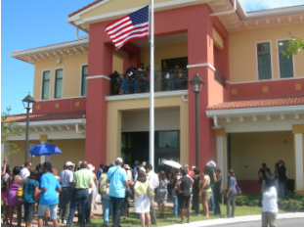

Lauderdale Lakes
Location: 30 miles north of Miami
Processes: bring 3 neighbors strategy
Products: Master Plan adopted; 73% of voters approved a $15M General Obligation Bond for projects from the charrette
Outcomes: 20,000 sf of new civic space, 551 residential townhouse units, 12 new bus shelters, 2 miles of linear trail, 45 acres of public parklands
Notes:
In the 1970’s, Lauderdale Lakes was a well visited city but interest dwindled and in the early 2000’s, city officials saw an opportunity to bring back investment into the community. Located between two major Broward County roads, Lauderdale Lakes was a prime location to attract more local residents and businesses.
To increase attendance at the pre-charrette meetings and charrette, team members would encourage participants to come back and bring 3 neighbors with them. As the project moved forward, support from the community grew as more and more people became involved.
The Charrette created a new Master Plan for the community that helped build out 20,000 sf of new civic space, 551 residential townhouse units, 12 new bus shelters completed, 2 miles of linear trail and approximately 45 acres of public parklands. 73% of voters approved a $15M bond to fund projects created during the charrette.

Slide 48


SW Lansing
Location: neighborhood in SWLansing region
Process: 1 charrette for 2.5 days, utilizing student designers, kick-off design meeting, stakeholder reviews, open house gallery review, final presentation with gallery review
Product: PPT Final Report, summarizing charrette; 8 design concepts focused on crime prevention
Outcome: 8 design concepts and recommendations for advancing them, renewed interest in redevelopment of vacant school
Notes:
Date: May of 2013 and October of 2013
Description: With help from several other consulting firms, the National Charrette Institute facilitated two charrettes in the Lansing region.
The charrettes were designed for the community so that they could express their ideas on the direction they want the Capital Corridor to head towards.
Process: Unlike most projects, the charrette team utilized two charrettes.
The first was designed to figure out where residents felt redevelopment should occur and why these places were important to them.
The second charrette took the places mentioned in the first charrette and went further in designing how the selected neighborhoods will look.
Product: Following the conclusion of the second charrette, the Capital Corridor Report was created as a summary of what occurred at both charrettes.
Outcome: Following the charrettes, recommendations were given for all communities along the corridor as well as specific places like the Eastside District, Red Cedar/Frandor District, and Meridian Center.
http://migrand-charrette.com/

Slide 49


Contra Costa Transit Village
Location: 125-acre site in Walnut Creek, CA, 25 miles east of San Francisco Bay
Goal: turn a BART-owned, 18-acre parking lot into the center of the Transit Village
Process: Created a steering committee made up of local stakeholders that previously resented each other. Steering committees allowed for further collaboration and acceptance throughout the community.
Product: County Supervisors approved the plan with absolutely no opposition
Outcomes: 2,700 residential units, 35,590 square feet of local serving retail, 423 hotel rooms, 19,400 square feet of business conference center, and 2.4 million square feet of class A office.
Notes:
Date: 2001
Description: Contra Costa is a 125-acre transit village district in Walnut Creek, California, located 25 miles east of the San Francisco Bay.
The goal was to use a charrette to turn a BART-owned 18-acre parking lot into the center of the Transit Village.
Process: The charrette team used the power of drawing ideas to allow residents to test their ideas on the spot with architects and designers and make them feel engaged in the process.
The team also created a steering committee made up of local stakeholders that previously resented each other. These unique steering committees allowed for further collaboration and acceptance throughout the community.
The new Contra Costa County Transit Village plan helped construct 2,700 residential units, 35,590 square feet of local serving retail, 423 hotel rooms, 19,400 square feet of business conference center, and 2.4 million square feet of class A office.

Slide 50


Liberty Harbor North
Location: 80-acre brownfield site in Jersey City, New Jersey, close to New York City
Process: provided free lunch everyday to help facilitate discussion between developers, officials, and the public
Product: Master Plan for the Liberty Harbor North district that was quickly implemented following the charrette because of a wide range of support
Outcomes: 600 units of occupied housing, 500 parking spaces, 35,000 sf of retail, Montessori School, and approximately 2, 12,000 sf parks
Notes:
Date: March of 1999.
Description: Liberty Harbor North is an 80-acre brownfield site within Jersey City, New Jersey and has very close proximity to New York City.
The project had standstills in the 1980’s and 90’s due to different powers having ownership of the land. The charrette team worked hard in the pre-charrette phase to rebuild trust between the city redevelopment authority and the former land owners.
Process: The charrette team provided free lunch everyday to help facilitate discussion between developers, officials, and the public. Every group felt more comfortable saying how they truly feel when they were just having open conversation over lunch.
Product: The 7-day charrette created a Master Plan for the Liberty Harbor North district that was quickly implemented following the charrette because of a wide range of support.
Outcome: The Liberty Harbor North Master Plan brought the developer, city officials, and the public back to the same page and inevitably created 600 units of occupied housing, 500 parking spaces, 35,000 sf of retail, Montessori School, and approximately 2, 12,000 sf parks.

Slide 51


Marin County
Location: just across the Golden Gate Straight from San Francisco
Process: Utilized the fishbowl technique – allows experts to inform and educate local residents and stakeholders while these stakeholders share their experiences and recommendations
Product: list of recommendations following the charrette that informed the county how to prevent homelessness and educate residents about homeless people
Outcomes: Address criminalization of homeless people, held training sessions and created support programs to help police/homeless people to interact with each other
http://
Notes:
Date: June of 2012.
Description: Marin County, California is located just across the Golden Gate Straight from San Francisco.
The county decided to host a CSH charrette because they were looking to update their current plan and further work towards ending homelessness.
The charrette was different than any one they had held before because they introduced a new topic, criminalization of homelessness.
Process: Like the Hillsborough County CSH charrette in Florida, this charrette team utilized the fishbowl technique. This technique allows the experts to inform and educate the local residents and stakeholders while these stakeholders still get a chance to give their experiences and recommendations.
Product: The charrette team, including both local officials and the CSH team, made a list of recommendations following the charrette that informed the county how to prevent homelessness and educate residents about homeless people.
Outcome: Addressing criminalization of homeless people was something that the community felt strong about and after the conclusion of the charrette, they held training sessions and created support programs to inform police and homeless people how to interact with each other.
http://www.csh.org/2012/07/marin-county-embraces-csh-charrette/

Slide 52

Ontonagon
Location: small village in UP along Lake Superior, 90 miles west of Marquette
Goal: vision for waterfront property along Lake Superior
Process: create three alternative designs for the public waterfront and a sustainable vision that could be added to their new master plan
Product: a shared community vision for the public waterfront to add to Ontonagon’s Plan for 2035.
Outcome: Ontonagon Plan for 2035 was proposed to the Village Council and accepted later as Harbor Sustainability Plan
Notes:
Date: November of 2015.
Description: Ontonagon is a small village in Michigan’s Upper Peninsula, located along Lake Superior.
Ontonagon is about 90 miles west of Marquette, the largest city in the Upper Peninsula.
The village decided to conduct a charrette to hear what residents wanted to do with the waterfront property along Lake Superior.
Process: The charrette team used a three-day charrette to create three alternative designs for the public waterfront and through community discussion, developed a refined design that residents felt proud of.
Along with the public waterfront design, Ontonagon created a sustainable vision that could be added to their new plan.
Product: The charrette was successful in creating a shared community vision for the public waterfront that will be added to Ontonagon’s Plan for 2035.
Outcome: The Ontonagon Plan for 2035 was proposed to the Village Council on January 8th, 2016 and accepted later that year, titled as Harbor Sustainability Plan.
http://www.miseagrant.umich.edu/smallharborsustainability/communities/ontonagon/

Slide 53


Capitol Corridor
Location: Lansing region, 21 miles, 12 jurisdictions
Process: 2 charrettes: first to figure out where redevelopment should occur and second to design how the selected neighborhoods will look
Product: Capitol Corridor Report, summarizing both charrettes
Outcome: recommendations given for all communities along the corridor as well as specific places like the Eastside District, Red Cedar/Frandor District, and Meridian Center
http://migrand-charrette.com/
Notes:
Date: May of 2013 and October of 2013
Description: With help from several other consulting firms, the National Charrette Institute facilitated two charrettes in the Lansing region.
The charrettes were designed for the community so that they could express their ideas on the direction they want the Capital Corridor to head towards.
Process: Unlike most projects, the charrette team utilized two charrettes.
The first was designed to figure out where residents felt redevelopment should occur and why these places were important to them.
The second charrette took the places mentioned in the first charrette and went further in designing how the selected neighborhoods will look.
Product: Following the conclusion of the second charrette, the Capital Corridor Report was created as a summary of what occurred at both charrettes.
Outcome: Following the charrettes, recommendations were given for all communities along the corridor as well as specific places like the Eastside District, Red Cedar/Frandor District, and Meridian Center.
http://migrand-charrette.com/

Slide 54
Principles of the
NCI Charrette System

Slide 55
NCI Charrette System Strategies
Work collaboratively
Design cross-functionally
Compress work sessions
Communicate in short feedback loops
Study the details and the whole
Produce a feasible plan
Use design to achieve a shared vision and create holistic solutions
Conduct a multiple day charrette
Hold the charrette on or near the site
Notes:
Here’s 10 take-aways that are imbedded in the process I just explained to you.

Slide 56

Charrette System Strategies
1. Work collaboratively
Collaboration is based on valuing each individual’s unique contribution
Anyone who might build, use, sell, approve, or attempt to block the project is involved before the start of design and throughout the project

Slide 57

Charrette System Strategies
2. Design cross-functionally
A multi-disciplinary team method results in decisions that are realistic avoiding costly rework
Teams typically include planning, architecture, environmental, transportation, economics

Slide 58

Charrette System Strategies
3. Compress work sessions
“Great things happen when you have a plan and not quite enough time.”
Leonard Bernstein
Notes:
The answer came when the sponsors used a new urbanist approach with a 6 day charrette. People who were against it turned around and supported it. I challenge you to find a more difficult environment. It still has challenges today, but it is making it through.

Slide 59

Charrette System Strategies
4. Communicate in short feedback loops
Regular stakeholder reviews quickly build trust in the process and foster
true understanding and support of the product
Notes:
The fourth key strategy is to communicate in short feedback loops. Regular stakeholder reviews quickly build trust in the process and foster true understanding and support of the product.

Slide 60
Charrette Feedback Cycles
Participants work in a series of short feedback loops
public review
concepts
alternatives
refinement
plan
public review
public review
Notes:
A series of at least three feedback loops is perhaps the most important aspect of the Charrette.
Planners often just have one feedback loop, starting at vision and ending in plan. People want to be involved in the design process.
In these three major feedback cycles, design ideas are created based upon a public vision, and presented within hours for further review, critique, and refinement. These feedback cycles foster a holistic understanding of complex problems by all participants and form the basis of a plan that reflects all vital viewpoints. It results in true buy-in by everyone involved, and participants are thereby inspired to support the plan, helping it to overcome the inevitable challenges on its path to implementation.
The first part of the feedback loop is created when a proposal is made to a group of key stakeholders. There is a collaborative discussion of the merits of the proposal and recommended changes. The author of the proposal modifies it according to the input and it is then re-presented to the key stakeholders. The degree to which the stakeholders become invested in the process is in part directly effected by the length of time that elapses between the presentations. In other words the length of the loop.

Slide 61


Charrette System Strategies
5. Study the details and the whole
Designs at varying scales inform each other and reduce the likelihood that a fatal flaw will be overlooked that could result in costly rework
Notes:
True buy-in and assured feasibility can only be achieved by designing in detail. This way, critical issues are brought to the surface and addressed completely. This can only be accomplished by looking at the details, for example building types, block sizes, and public space, and the big picture, such as site circulation, transit, land use, and major public amenities, concurrently. Studies at these two scales also inform each other and reduce the likelihood that a fatal flaw will be overlooked in the plan.

Slide 62
Charrette System Strategies
6. Produce a feasible plan
To create a feasible plan, every decision point must be fully informed, especially by the legal, financial, and engineering disciplines
The focus on feasibility brings a level of seriousness and rigor to the process for everyone involved
Financial feasibility analysis
Notes:
Having the goal of creating a feasible plan creates a focus and adds rigor to the process. This underscores the importance of getting everyone’s input and buy-in from beginning to end. There are constant reminders along the lines of, “Hey folks, this has to work.” This makes the creative process about more than what people want, it’s also about what can actually be built. It creates a higher level of seriousness and engagement when people know that the result is going to be an actual construction project, which in turn heightens their level of participation.

Slide 63


Charrette System Strategies
7. Use design to achieve a shared vision and create holistic solutions
Design illustrates the complexity of the problem and can be used to resolve conflict by proposing previously unexplored solutions that represent win/win outcomes
Existing Condition
Proposal - Computer Simulation
Notes:
Design is a powerful tool for establishing a shared vision. Drawings help illustrate the complexity of the problem and can be used to resolve conflict by proposing previously unexplored solutions that represent win/win outcomes.
The charrette design team specializes in capturing ideas quickly in drawings that help educate and focus the discussion. One of the most important ground rules used throughout the Charrette is “talk with your pen.” This applies not only to designers but to all Charrette participants.

Slide 64


Risks of Designing Without Clear and Accurate Visual Representations
Maps and charts are not enough to change perceptions
Notes:
The standard zoning map and uses chart cannot give a clear enough picture of the proposed change to shift people’s understanding and perceptions. While these are essential elements to any plan, without design drawing, it is impossible to translate ideas to the general public
Without the use of drawing, photographs, computer simulations and other such tools for creating 3 dimensional visual representations, you forego the ability to control the message and tell the complete story.

Slide 65

Charrette System Strategies
8. Conduct a multiple day charrette
Most charrettes require more than four days, allowing for three feedback loops
Notes:
This is probably the most often ignored strategy in well-intentioned but marginally successful workshop processes.
Most charrettes require between four and seven days, allowing for three feedback loops. Three loops allow for a change in participants’ perceptions and positions. However, only simple projects with little controversy should be attempted in four days. More complicated projects typically take seven days. The more difficult the problem, the longer the charrette.

Slide 66


Charrette System Strategies
9. Hold the charrette on or near the site
Working on site fosters the charrette team's understanding of local values and traditions, and provides the necessary easy access to stakeholders and information
Notes:
Working on site fosters the design team's understanding of local values and traditions, and provides the necessary easy access to stakeholders and information. Therefore, the studio should be located in a place where it is easily accessible to all stakeholders and where the designers have quick access to the project site.
Charrette studios have been located in empty main street storefronts, community centers, high schools, and armories.

Slide 67
Reflective Exercise
How can you use charrettes or their
principles or strategies in your work?

Slide 68
Reflective Exercise Instructions
Consider how you can use charrettes or an element described today in your work. How will you implement what you learned today?
Independently write 3 ideas: one per post-it
Read them round robin until everyone has read all three.
Place sticky notes on new sheet (group themes by each other)
Discuss the ideas with each other
Report out

Slide 69
Concentric Circles Instructions
What did you learn about the charrette process?
What about the charrette process, tools or techniques stood out to you today?
Identify a design or policy issue in a community you work with today and which tool or technique from this session could you apply to it?
Notes:
The group is divided in two, with half of them forming a tight circle in the center of the room. The remaining people then pair up with someone in the circle. The facilitator then poses a question for each pair to answer in a few minutes. Then, either the inner or outer circle is asked to rotate "x" spaces to the right or left. Another question is asked for the new pair to discuss.

Slide 70
Summary
Intro to NCI
Three Big Challenges
Demonstrate Sticky Wall
Overview of NCI Charrette System
Six examples
System Principles Summary
Reflective Exercise
Notes:
Here’s 10 take-aways that are imbedded in the process I just explained to you.

Slide 71

Notes:
We are in the second edition of our handbook

Slide 72

http://www.canr.msu.edu/nci/index

