Slide 1
Creating Art From
Stories of Homelessness
Michigan Coalition Against Homelessness
& Michigan State University

Slide 2
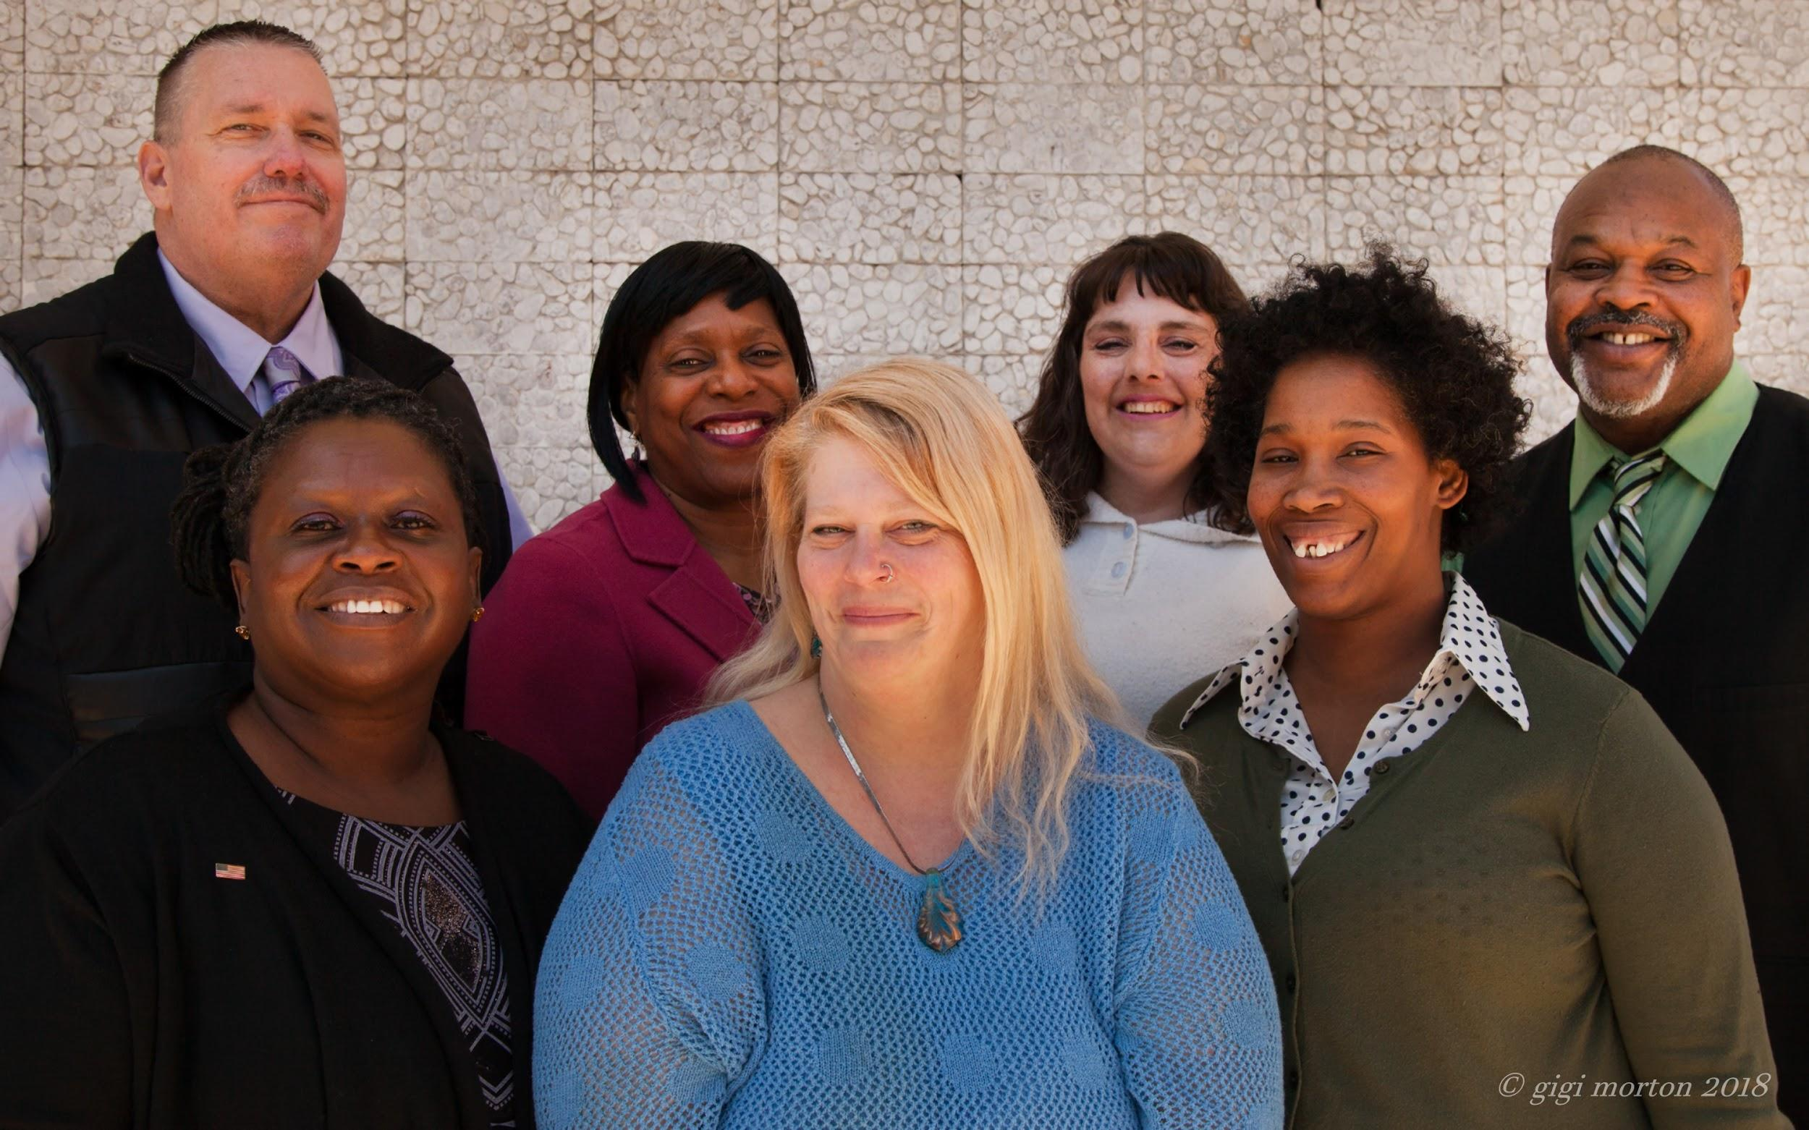

Slide 3
Purpose
The Speakers Bureau is a platform for those who have experienced homelessness in Michigan to share their stories. We empower our speakers with training so that they can confidently talk about their experiences. The ultimate goal is to remove the stigmas associated with homelessness and raise awareness about this very real problem that affects many people both throughout the state of Michigan and around the country.

Slide 4
Goals
Raise awareness among target populations
Break stereotypes and stigma associated with homelessness
Put a face to homelessness through personal stories
Effect proactive change in Michigan

Slide 5
SPONSORS

Slide 6
Notes:
https://youtu.be/-3whdAjwzLY

Slide 7
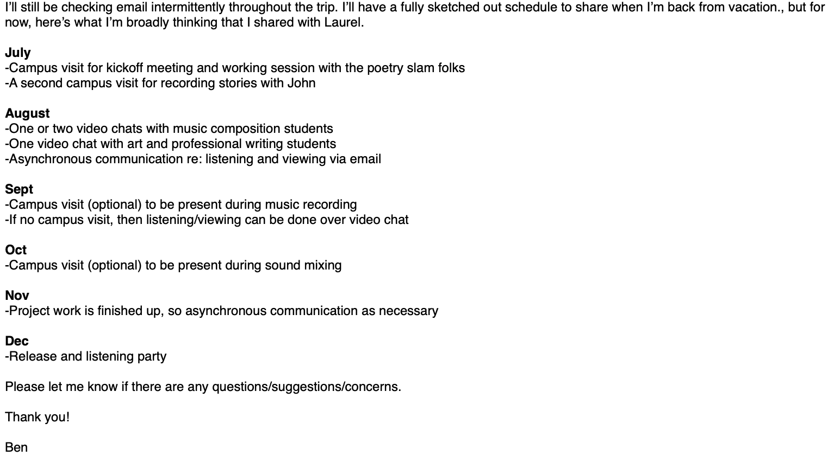
Managing the Project

Slide 8
Failing
The first time I heard Terri’s recording, I understood that I’d made a terrible mistake.
The mistake: I did not position the speakers as collaborators. I was planning for them, not with them. Them isn’t even the right word.

Slide 9
With, Not For
Emphasizing relationship-building
Imagining futures together
Attending to care and caring
Developing a language for collaborating
Learning, listening, seeking to understand

Slide 10
Managing this Sort of Project
Meeting agendas are suggestions
Timelines may change
Milestones are co-defined
Vision and leadership are appreciated
Culture of feedback is essential

Slide 11
Why this Structure?
The work is emergent. Art is speculative. There are all sorts of twists and turns, and the group has to navigate this work together.
Progress can be made--and must. But how we define progress--what it looks like--requires a flexible timeline and timetable.

Slide 12
How Agile Can Help
Working in short, regular bursts
Feedback loops
Periods of action, followed by periods of reflection (repeat)
Embrace learning

Slide 13
Story
Notes:
Jewels or Terri placeholder

Slide 14
Contact
Speakers Bureau:
Laurel Burchfield
www.mihomelessvoice.org
@mihomeless
Lburchfield@mihomeless.org
517-853-3894
MSU:
Ben Lauren
benlauren.com
@benlauren
blauren@msu.edu
517-355-2400
Notes:
Add your contact info?

