Slide 1
Need Good Tenants?
Housing Counseling Agencies Can Help!

Slide 2
Welcome and Introductions
Shannon Bonesteel
Wayne Metropolitan Community Action Agency
Madeline Jaks
Community Housing Network
Dannielle Laura
Wayne Metropolitan Community Action Agency
http://blog.getkahoot.com

Slide 3
What is Rental Education and Counseling?
Education - practical guidance and information (in a group setting) to current and future renters on topics such as landlord-tenant rights and responsibilities, affordability assessments, reasonable accommodations and modifications, and residential choice.
Counseling - personalized or tailored information, provided in a one on one setting, to an individual or household in an ongoing, supportive role.

Slide 4
Why Rental Education and Counseling?
Tenant benefits
Credentialing and greater self sufficiency
Greater confidence and increased knowledge
Greater mobility - geographic disparities
groups.commonfloor.com

Slide 5
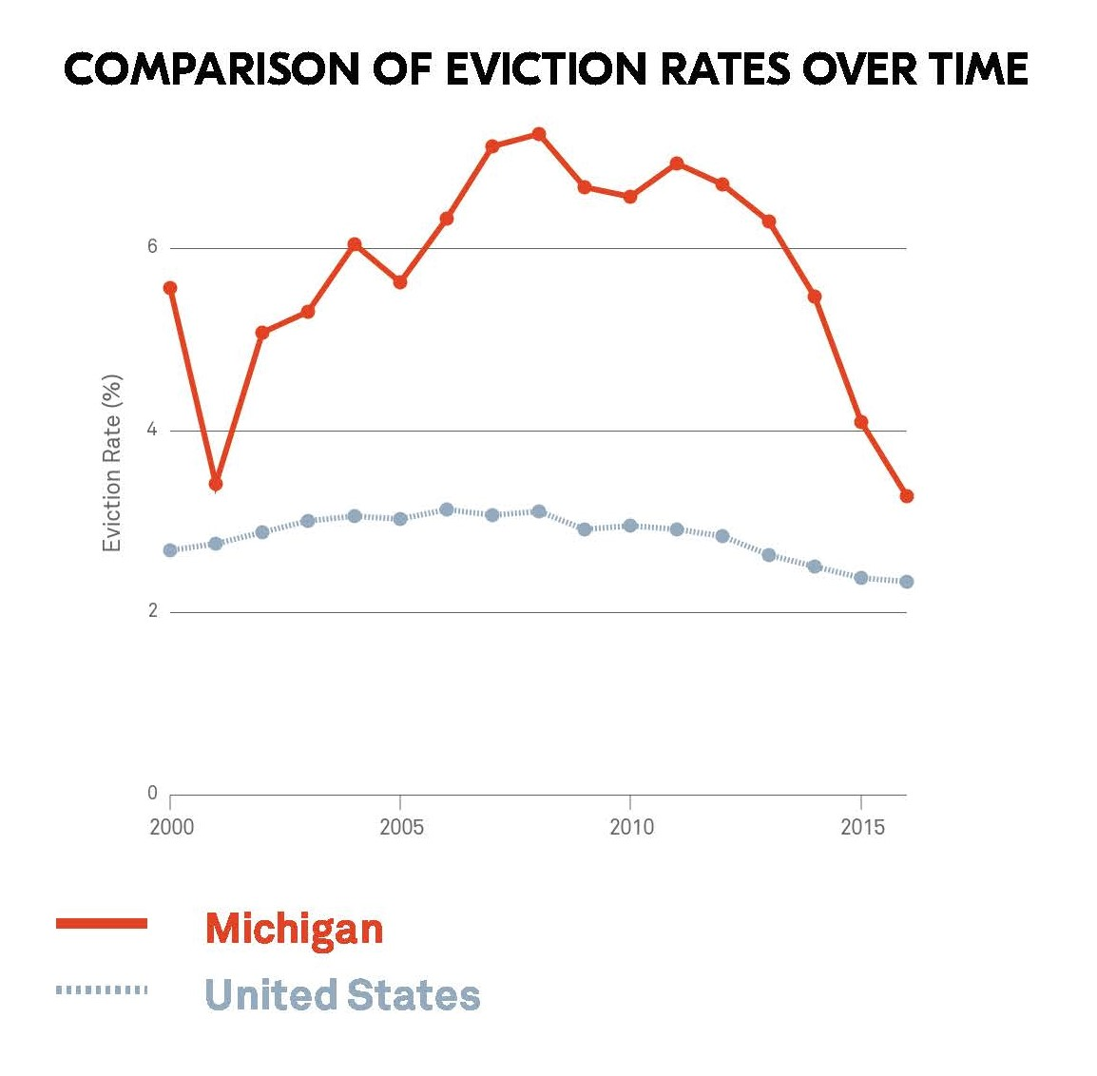
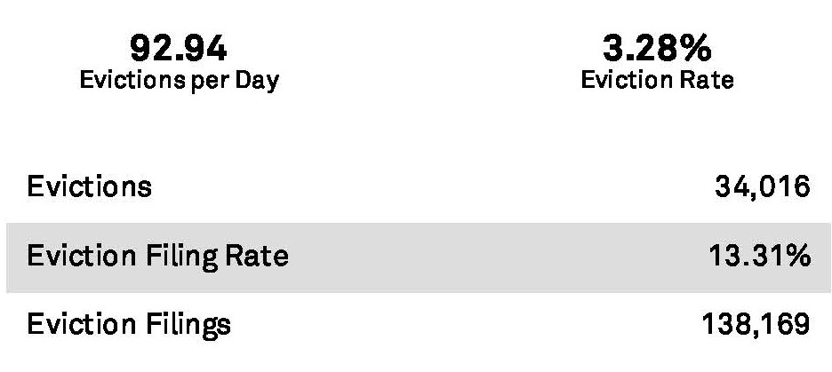
Why Rental Education and Counseling?
Landlord benefits
Rent ready tenants
Fewer tenant problems/faster resolutions
Average Eviction = $5000
Low to no cost
Access to mitigation
funds
Michigan Eviction Data (2016) - evictionlab.org
*Landlord mitigation funds, if partnered with an education program, are used fewer than 1%

Slide 6
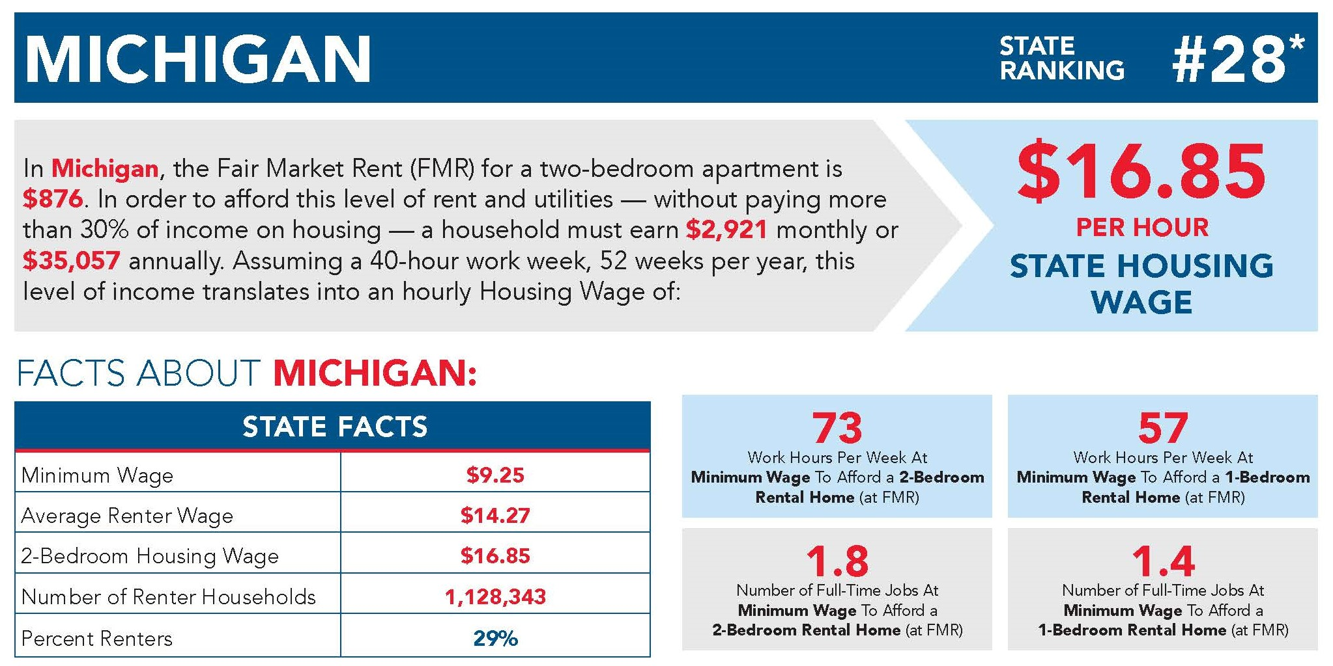
Why Rental Education and Counseling?
PHA and Agency benefits
PHA’s and non-profits may spend fewer dollars due to eviction diversion, emergency repairs, etc. -
Proactive approach can also foster outside funding opportunities.
National Low Income Housing Coalition - Out of Reach 2018 Report

Slide 7
What is Rental Education and Counseling?
The key to successful programs is partnership.
Landlords
Multi-family Housing Developers
Public Housing Authorities
Homeless Service Organizations

Slide 8
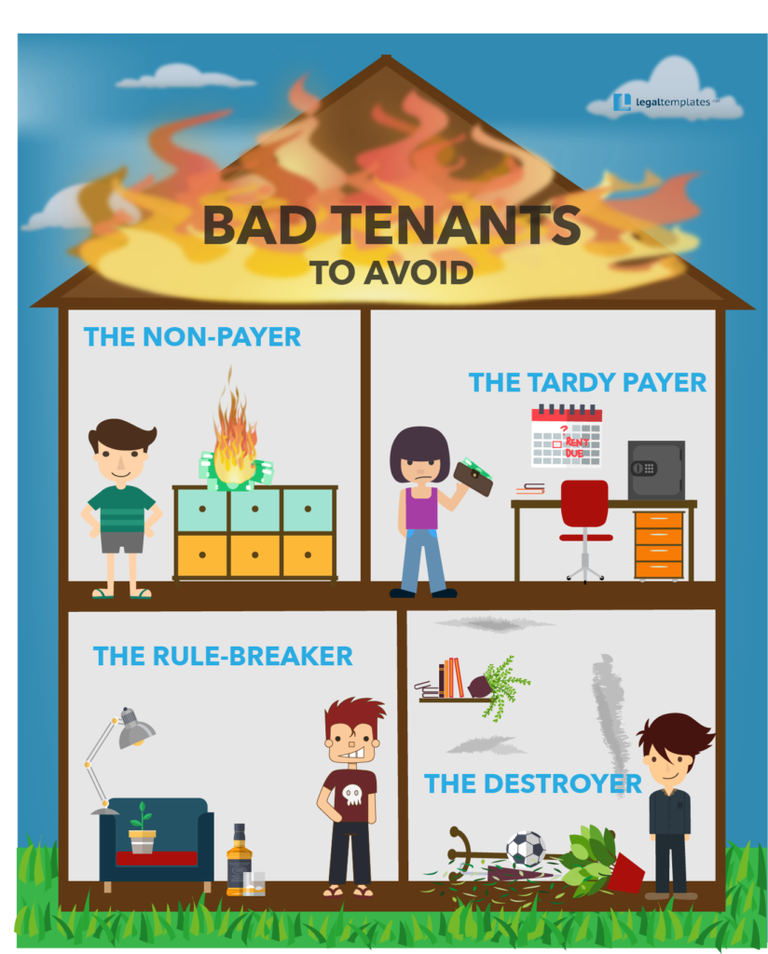
How Does Rental Education Create Good Tenants?
Tenants learn:
Their rights according to Michigan law
Their responsibilities according to Michigan law AND their lease
How to be a good neighbor
How to manage conflict
Tenant & Landlord (A Practical Guide) (517) 373-2275
Legal Templates, LLC.

Slide 9
How Does Rental Counseling Create Good Tenants?
Financial Coaching
Budgeting
Credit Reports & Rental Kharma
Renter’s Insurance
Referrals
Issue-specific Action Plans
Paying rent on time
Avoiding lease violations
Resolving conflict
Consumer Finance Protection Bureau

Slide 10
Who Provides Rental Education and Counseling?
HUD-Approved Local Housing Counseling Agencies
Non-profit Housing Counseling Agencies partnered with MSHDA
Funded by HUD, MSHDA, Lenders, Sponsorships, Donations, Program Revenue, etc.
National Industry Standards www.homeownershipstandards.org

Slide 11
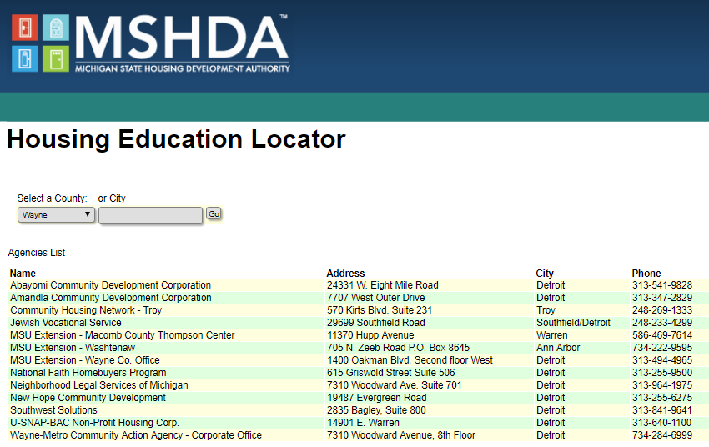
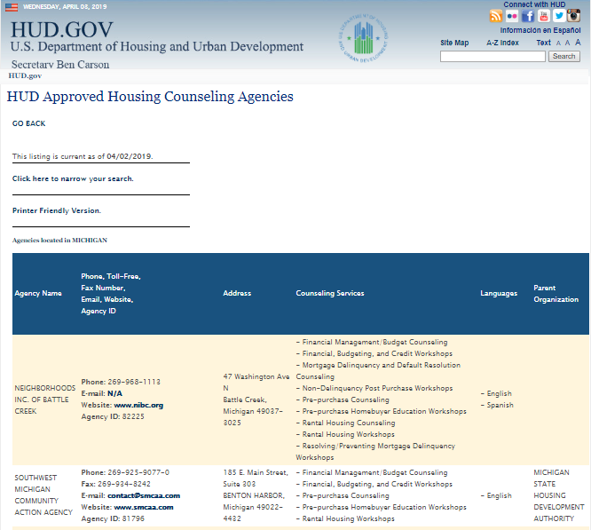
Where Can I Find a Housing Counseling Agency?
https://www.michigan.gov/mshda
https://www.hud.gov/findacounselor

Slide 12
How Do I Partner With a Housing Counseling Agency?
Accept a certificate of completion in lieu of credit check and/or application fee
Sponsor education and counseling fees
Sponsor tenant workshops
Make referrals and share data
Bring your creative ideas
CapeStyle Magazine Online

Slide 13
Sources
RentWell- Oregon & Washington State <http://www.rentwell.org/>
RentSmart – <https://fyi.extension.wisc.edu/rentsmart/>
Move to Opportunity – Virginia HOME
<http://homeofva.org/mtop#.XLXZcphKiM8>
Community Housing Network, Inc. - “Rent Right” - Troy, MI <https://communityhousingnetwork.org/services/rent-right/>
Landlordology.com - <https://www.landlordology.com/cost-to-evict-a-tenant/>
Oregon Housing Alliance - <https://www.oregonhousingalliance.org/hb-2724-amplifying-the-power-of-renter-education-with-a-landlord-mitigation-fund/>
HUD, Find a Counselor - https://apps.hud.gov/offices/hsg/sfh/hcc/hcs.cfm
Eviction Lab <www.evictionlab.org>
Rent Smart - <https://flp.ces.uwex.edu/files/2012/08/Rent-smart.pdf>
HUD Exchange - <https://www.hudexchange.info/resources/documents/Housing-Counseling-Bridge-Newsletter-2017-02.pdf>
Wayne Metropolitan Community Action Agency - www.waynemetro.org
A Practical Guide for Tenants and Landlords - http://www.legislature.mi.gov/Publications/tenantlandlord.pdf
MSHDA Housing Education Locator - https://housing.state.mi.us/webportal/default.aspx?page=counseling_start
NLIHC Out of Reach 2018 Report- <https://nlihc.org/sites/default/files/oor/OOR_2018.pdf>
Rental Kharma -< www.rentalkharma.com>

Slide 14
Questions?

