Slide 1
Michigan’s Statewide Housing Needs Assessment
Building Michigan Communities Conference
April 29, 2019

Slide 2
Demand
Supply
Pricing/Affordability

Slide 3
Demand
Notes:
Combination of increases in household counts, changes in household characteristics, and fluctuations in income

Slide 4
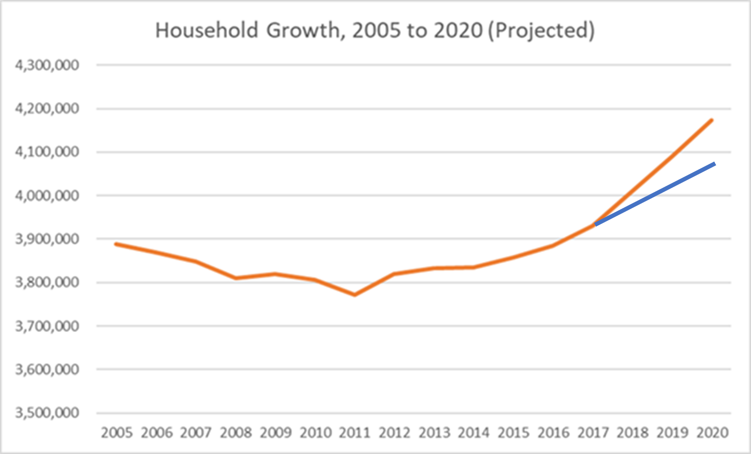
Notes:
Household counts have recovered from the decreases seen during the Great Recession, and further growth is expected as long as the economy maintains its upward trajectory
Both moderate and aggressive growth scenarios call for a household count over 4.1 million by 2020
Household characteristics can modify the types of housing that consumers are searching for; for example senior households moving to service-enhanced housing alternatives, or younger, smaller households looking for appropriately-sized units

Slide 5
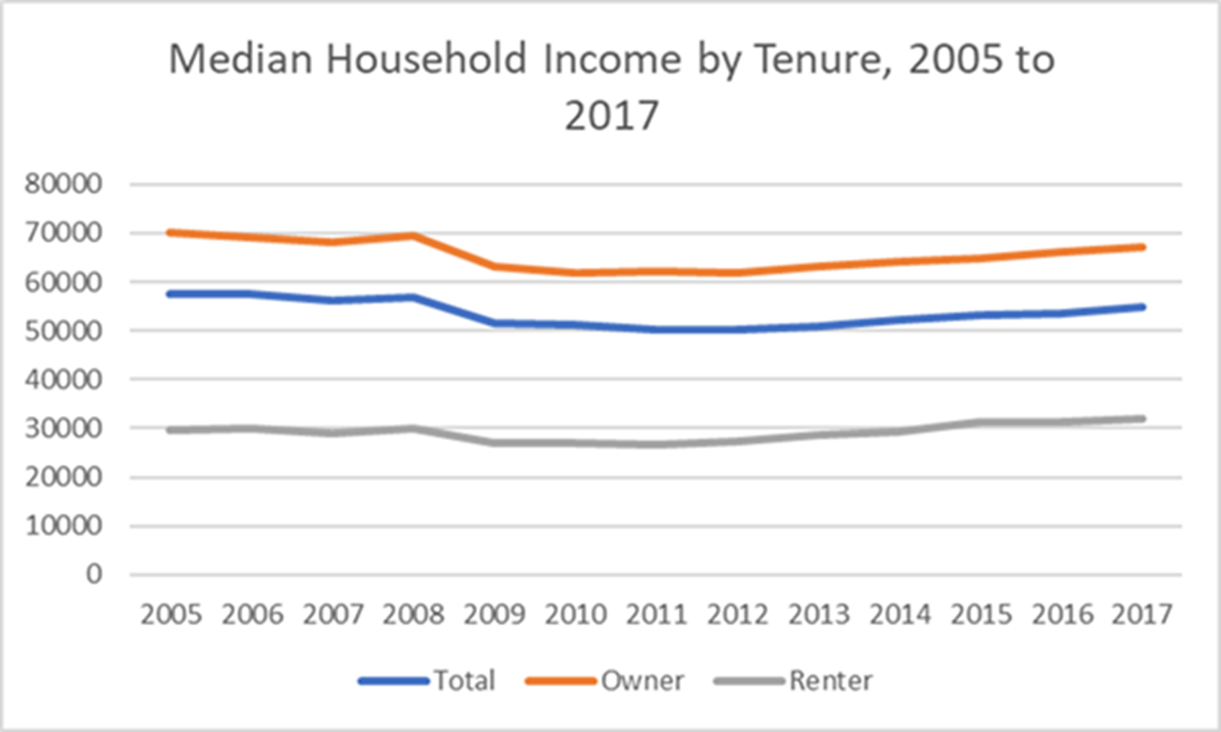
Notes:
Income is on the rise since the trough of the recession, but overall has not achieved its 2005 level in constant dollars.
There are also key differences in income levels between owners and renters;
a long-lived situation,
but changing lately with renter incomes showing slightly more growth than owner incomes over the same period.

Slide 6
Supply
Notes:
Connotes the units ready to be consumed by households
Important attributes include:
numbers of units,
their age,
size,
structure type and
tenure

Slide 7
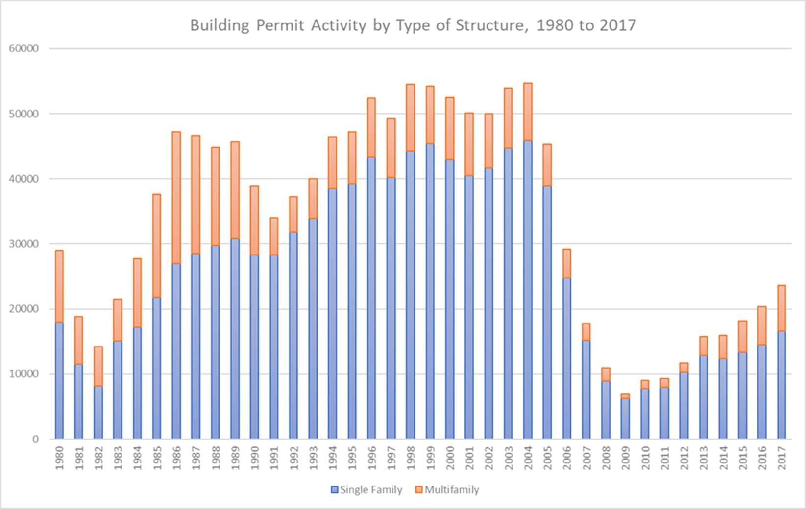
Notes:
This chart, showing building permit information, influences a great deal of the conditions surrounding Michigan’s housing stock
New housing supply is not being built at usual pace
Relative lack of new housing causes the state’s stock to be older than other areas; 40% of its units were constructed before 1960.
This influences pricing (older stock tends to be less expensive to purchase), attractiveness (outdated floor plans or amenities may push down prices further or limit the pool of prospective buyers) and condition (deferred maintenance or need for updates to home systems makes these units more expensive to bring to modern standards or to inhabit generally)
The state’s housing stock is predominately (90%) made up of single-family detached structures.

Slide 8
Pricing
Notes:
Results from the interplay of both supply and demand
Two concepts—
purchase price (value or contract rent) and
continuing costs to remain in housing (monthly owner costs and gross rent).

Slide 9
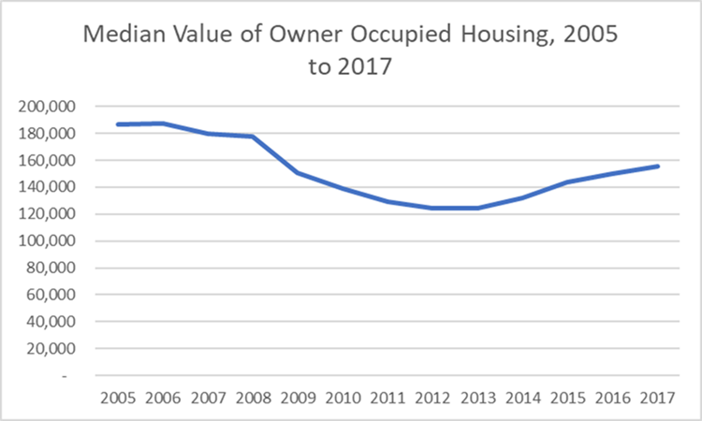
Notes:
Median value of housing has not achieved its pre-Recession high in constant dollars, though as the sales information in the homeownership study shows, selling prices have approximately reached that level.

Slide 10
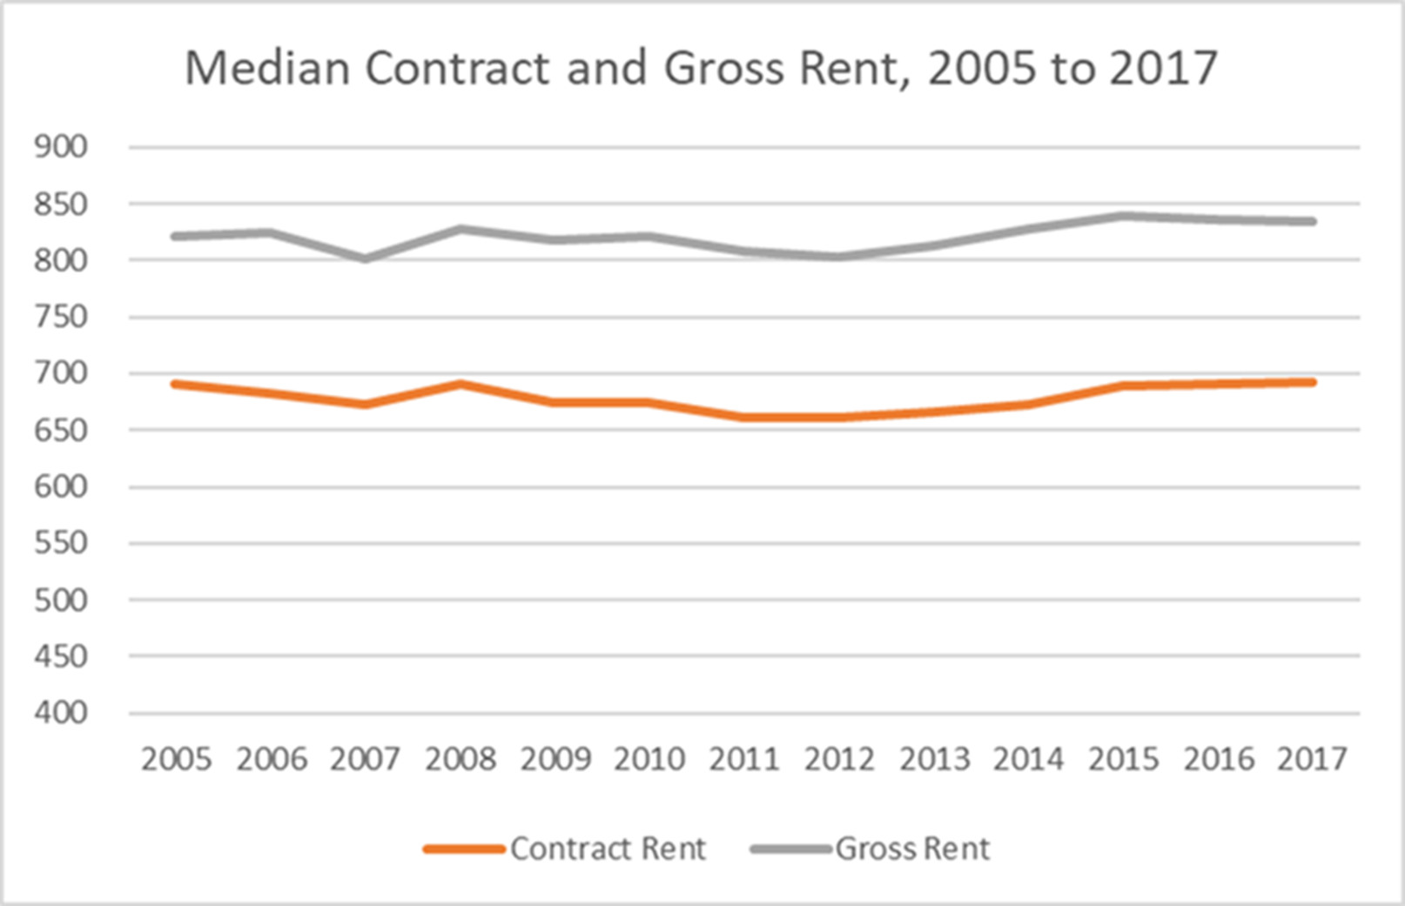
Notes:
Median contract rent has not varied as much as median values in Michigan, and are about at their 2005 level (again in constant dollars)
Median gross rents show a similar trajectory, showing that utility costs have stayed relatively constant statewide in real terms.
It also shows that the relatively slight increases in monthly gross rent are comparable to the modest increases in monthly renter incomes

Slide 11
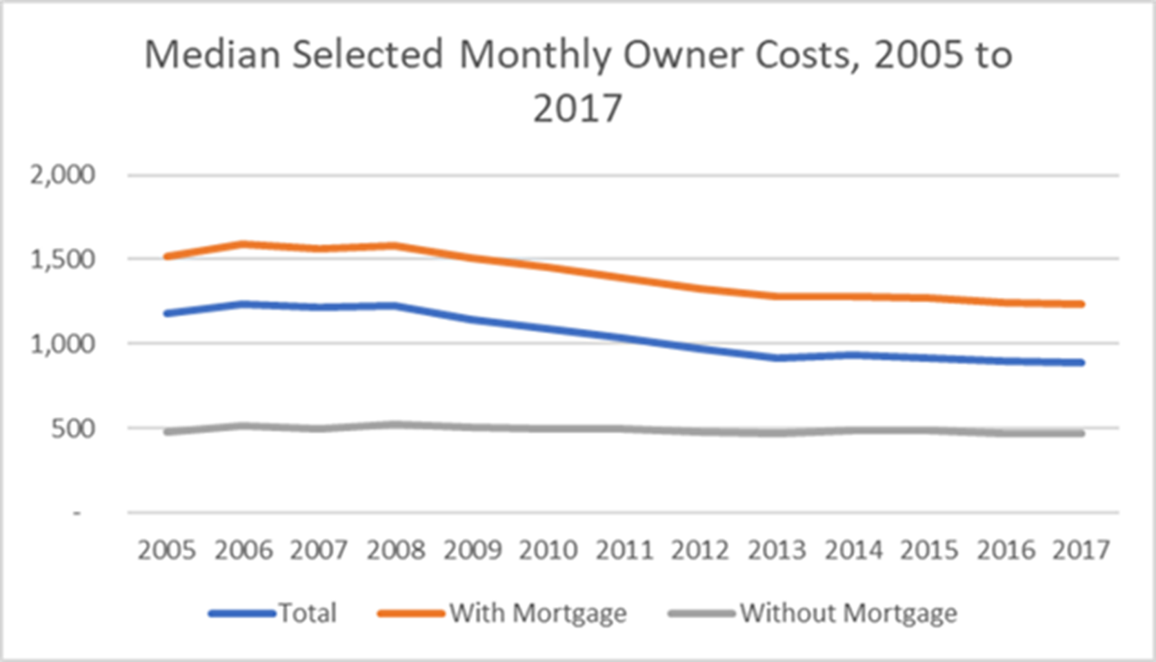
Notes:
Monthly owner costs vary strongly according to mortgage status, as mortgages are the largest variable in owner costs;
Mortgaged households have seen decreased costs due to changes in interest rates
Non-mortgaged households have not seen much change in their monthly costs since 2005.

Slide 12
Affordability

Slide 13
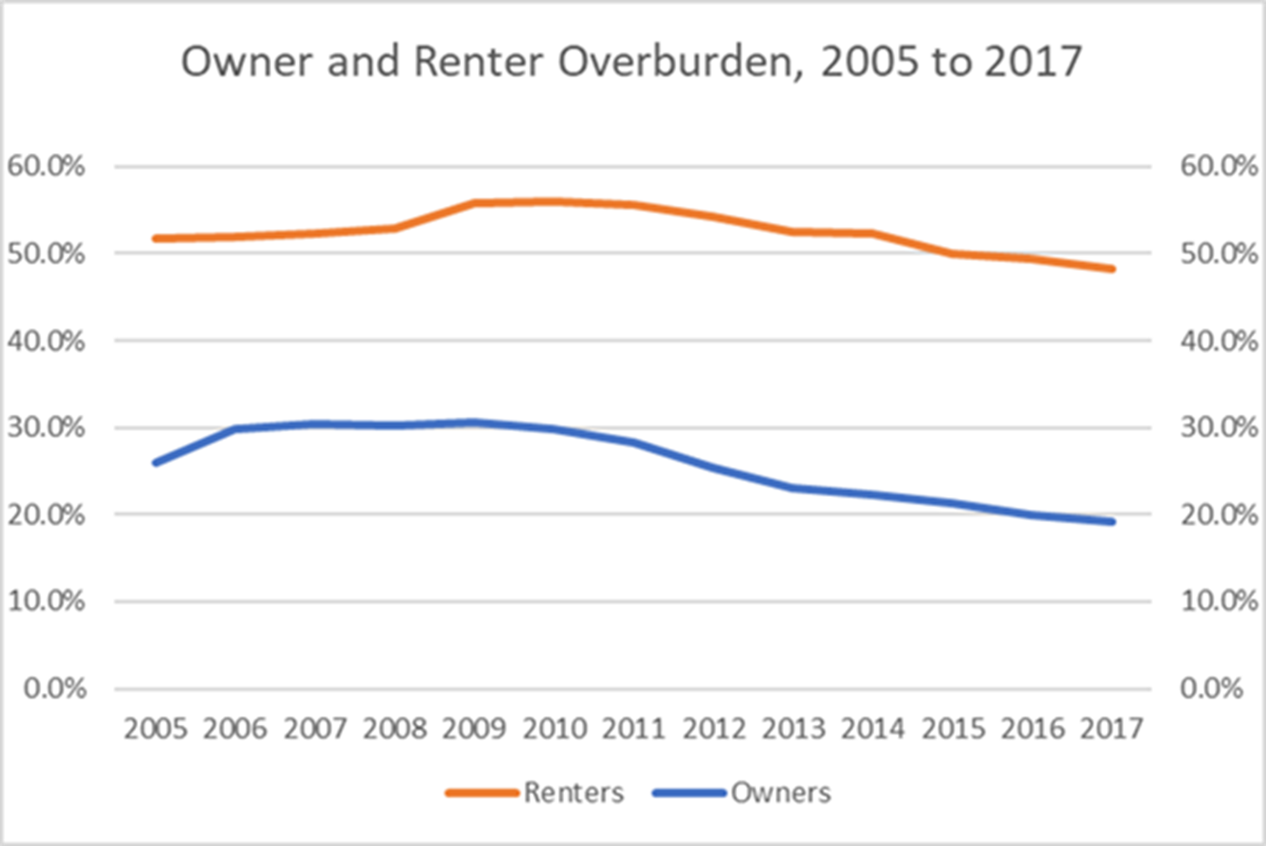
Notes:
Measured by shelter overburden (paying more than 30% of income on shelter costs)
About 20% of owners pay this amount per month; lower than in 2005.
About 50% of renters are overburdened, lower than in 2005 but not by much.
In addition, about 25% of all Michigan renters are severely overburdened, paying in excess of 50% of income on shelter costs.

Slide 14
Geographic Variation in Market Conditions
Notes:
Demand, supply and pricing/affordability are variable across the landscape, but as they are part of a system, they tend to reflect the same pattern.
An analysis of 28 housing market variables yields a picture of the state that shows four distinct regions, each with their own market dynamics
Most central cities across the state, whether gentrifying nodes or distressed neighborhoods, share at least some similarities that make them, in turn, different from other portions of the state
Newer suburban and exurban markets away from metro centers. These areas have seen the most growth over the last decade, and can be expected to continue down that path in the near future
Resort-oriented areas, primarily in the northern part of the state, combine relatively low incomes of full-time residents with higher-priced stock, much of it for seasonal use
Smaller economic centers in rural southern and central Michigan, focused on agricultural and industrial concerns

Slide 15
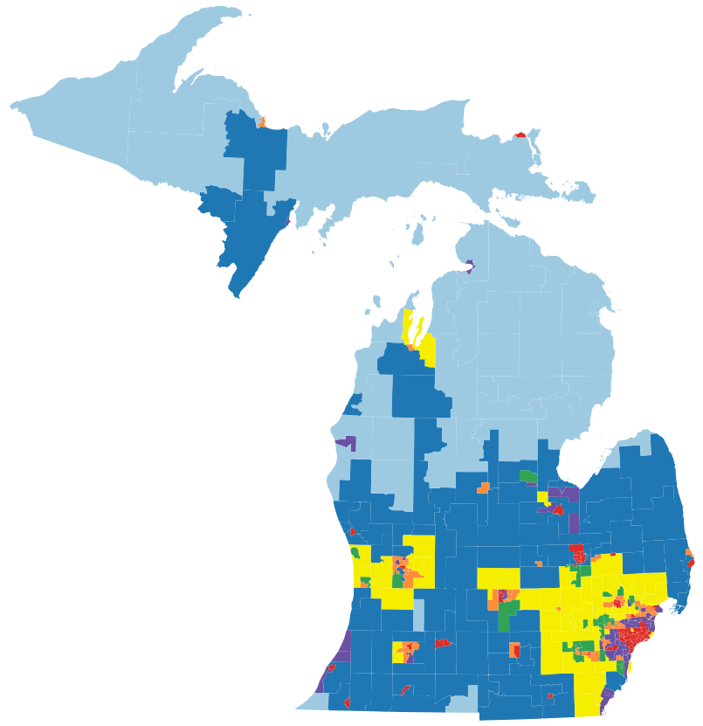
Notes:
An analysis of 28 housing market variables yields a picture of the state that shows four distinct regions, each with their own market dynamics
Most central cities across the state, whether gentrifying nodes or distressed neighborhoods, share at least some similarities that make them, in turn, different from other portions of the state
Newer suburban and exurban markets away from metro centers. These areas have seen the most growth over the last decade, and can be expected to continue down that path in the near future
Resort-oriented areas, primarily in the northern part of the state, combine relatively low incomes of full-time residents with higher-priced stock, much of it for seasonal use
Smaller economic centers in rural southern and central Michigan, focused on agricultural and industrial concerns

