Slide 1
Recuperative Shelter:
Accessing Health and a Pathway Home
HOPE Recuperative Care Center
Pontiac, MI
Rebecca Fitzgerald, Quality Manager
Danielle Redilla, Shelter Manager
Elizabeth Kelly, CEO
www.hopewarmingpontiac.org

Slide 2
What is Recuperative Care?
“DISCHARGE TO HOME”
Recuperative care is acute and post acute medical care for homeless persons who are too ill or frail to recover from a physical illness or injury on the streets but are not ill enough to be in a hospital.
National Healthcare for the Homeless Council
Notes:
Elizabeth will cover this slide

Slide 3
HOPE Recuperative
The terms “medical respite care” and “recuperative care” are used interchangeably to describe the same service.

Slide 4
Standards for Medical Respite Care Programs
National Health Care for the Homeless Council
7 basic standards, Released in 2016
Framework to fit a variety of programs
Notes:
The standards were created through a task force of providers and consumers.

Slide 5
HOPE Recuperative Care Center
Launched Oct 2015; 10 bed pilot
Expanded in April 2018; 15 beds
FY 19 Successes:
54 total served to date
46 Positive exit destination
Notes:
The standards were created through a task force of providers and consumers.

Slide 6
Medical respite program provides safe and quality accommodations
Standard 1:

Slide 7
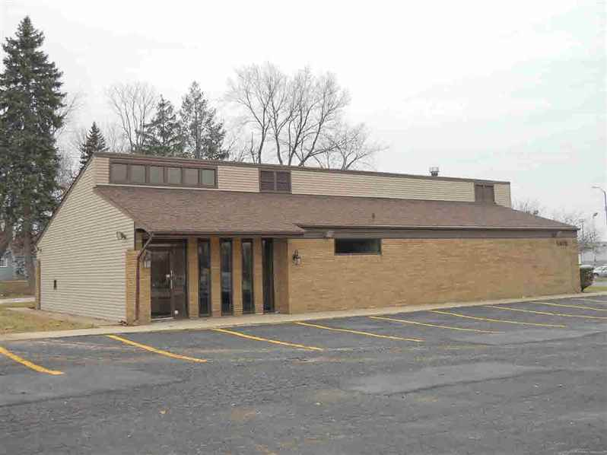
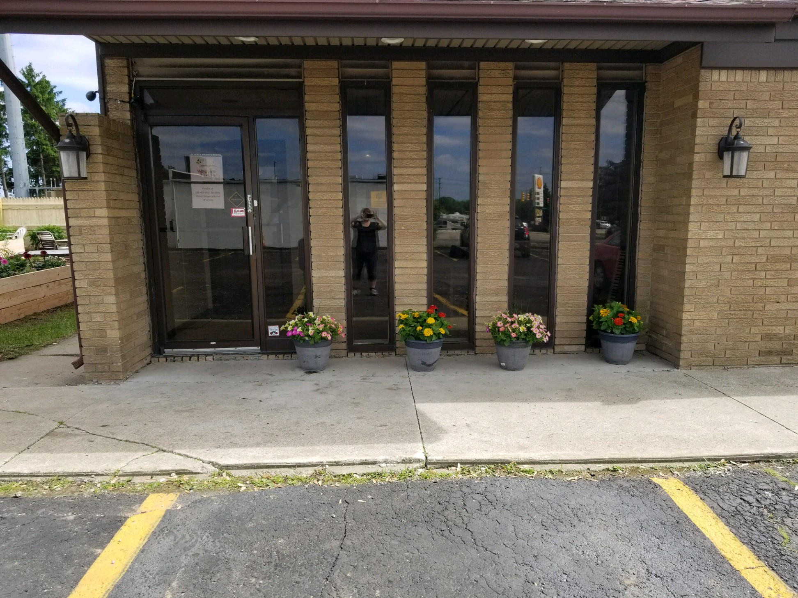
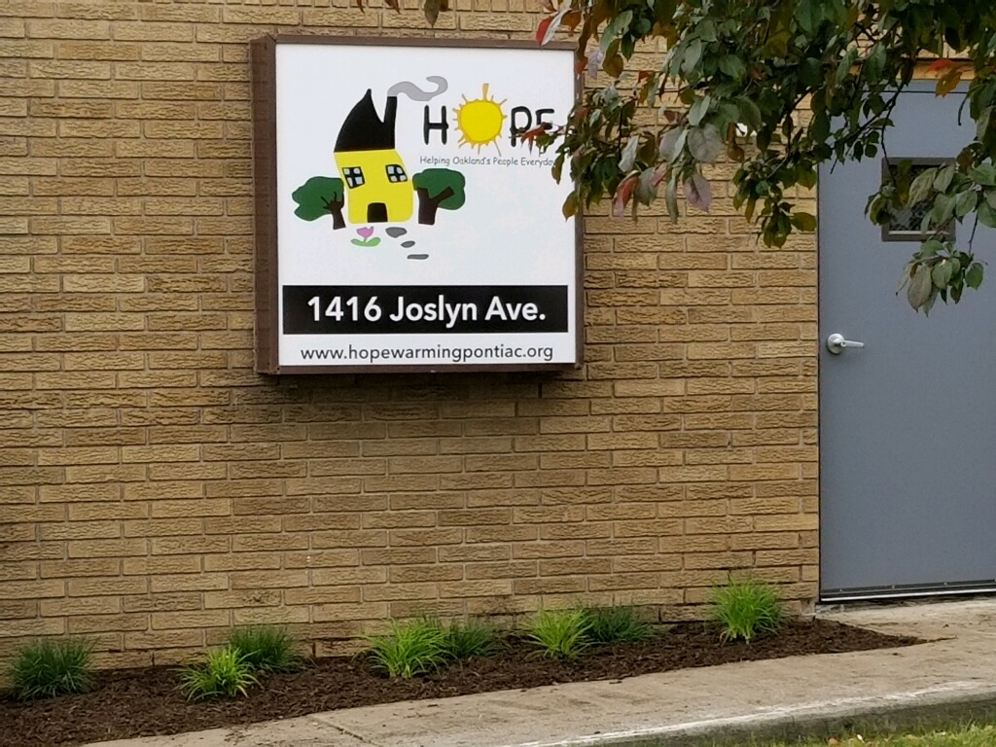
Standard 1

Slide 8
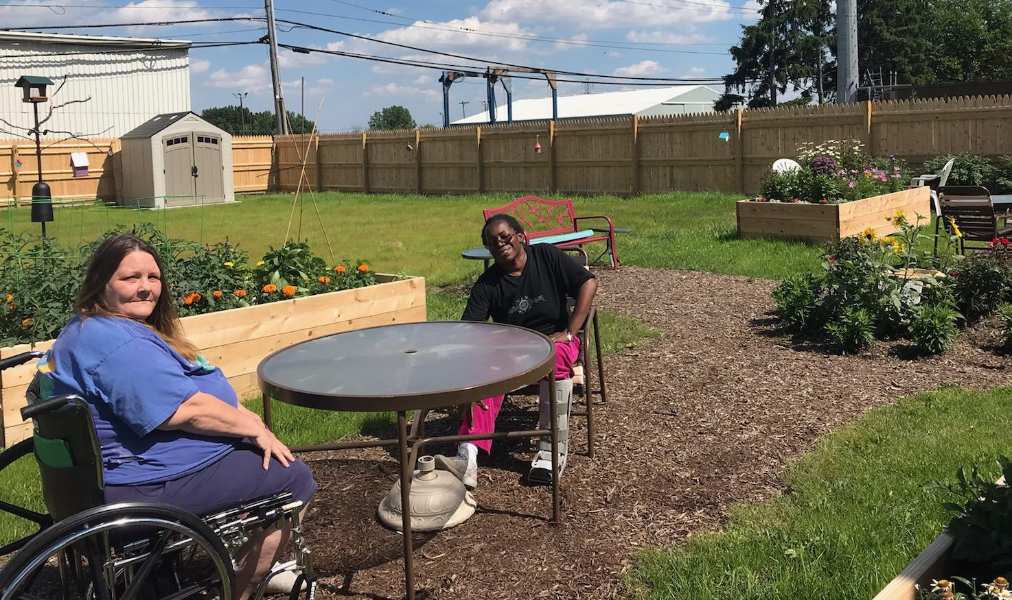
Standard 1

Slide 9
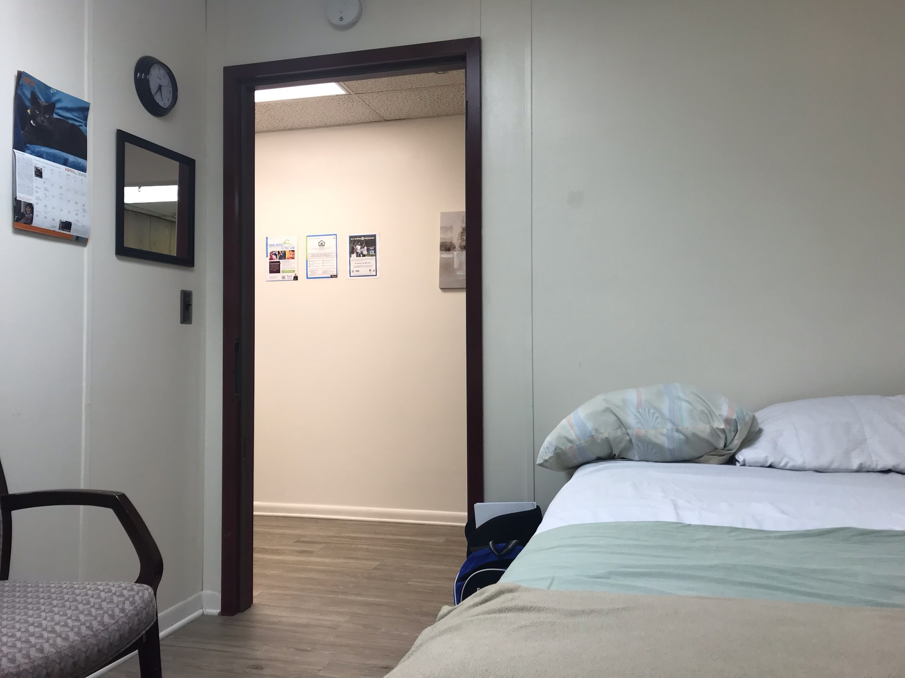
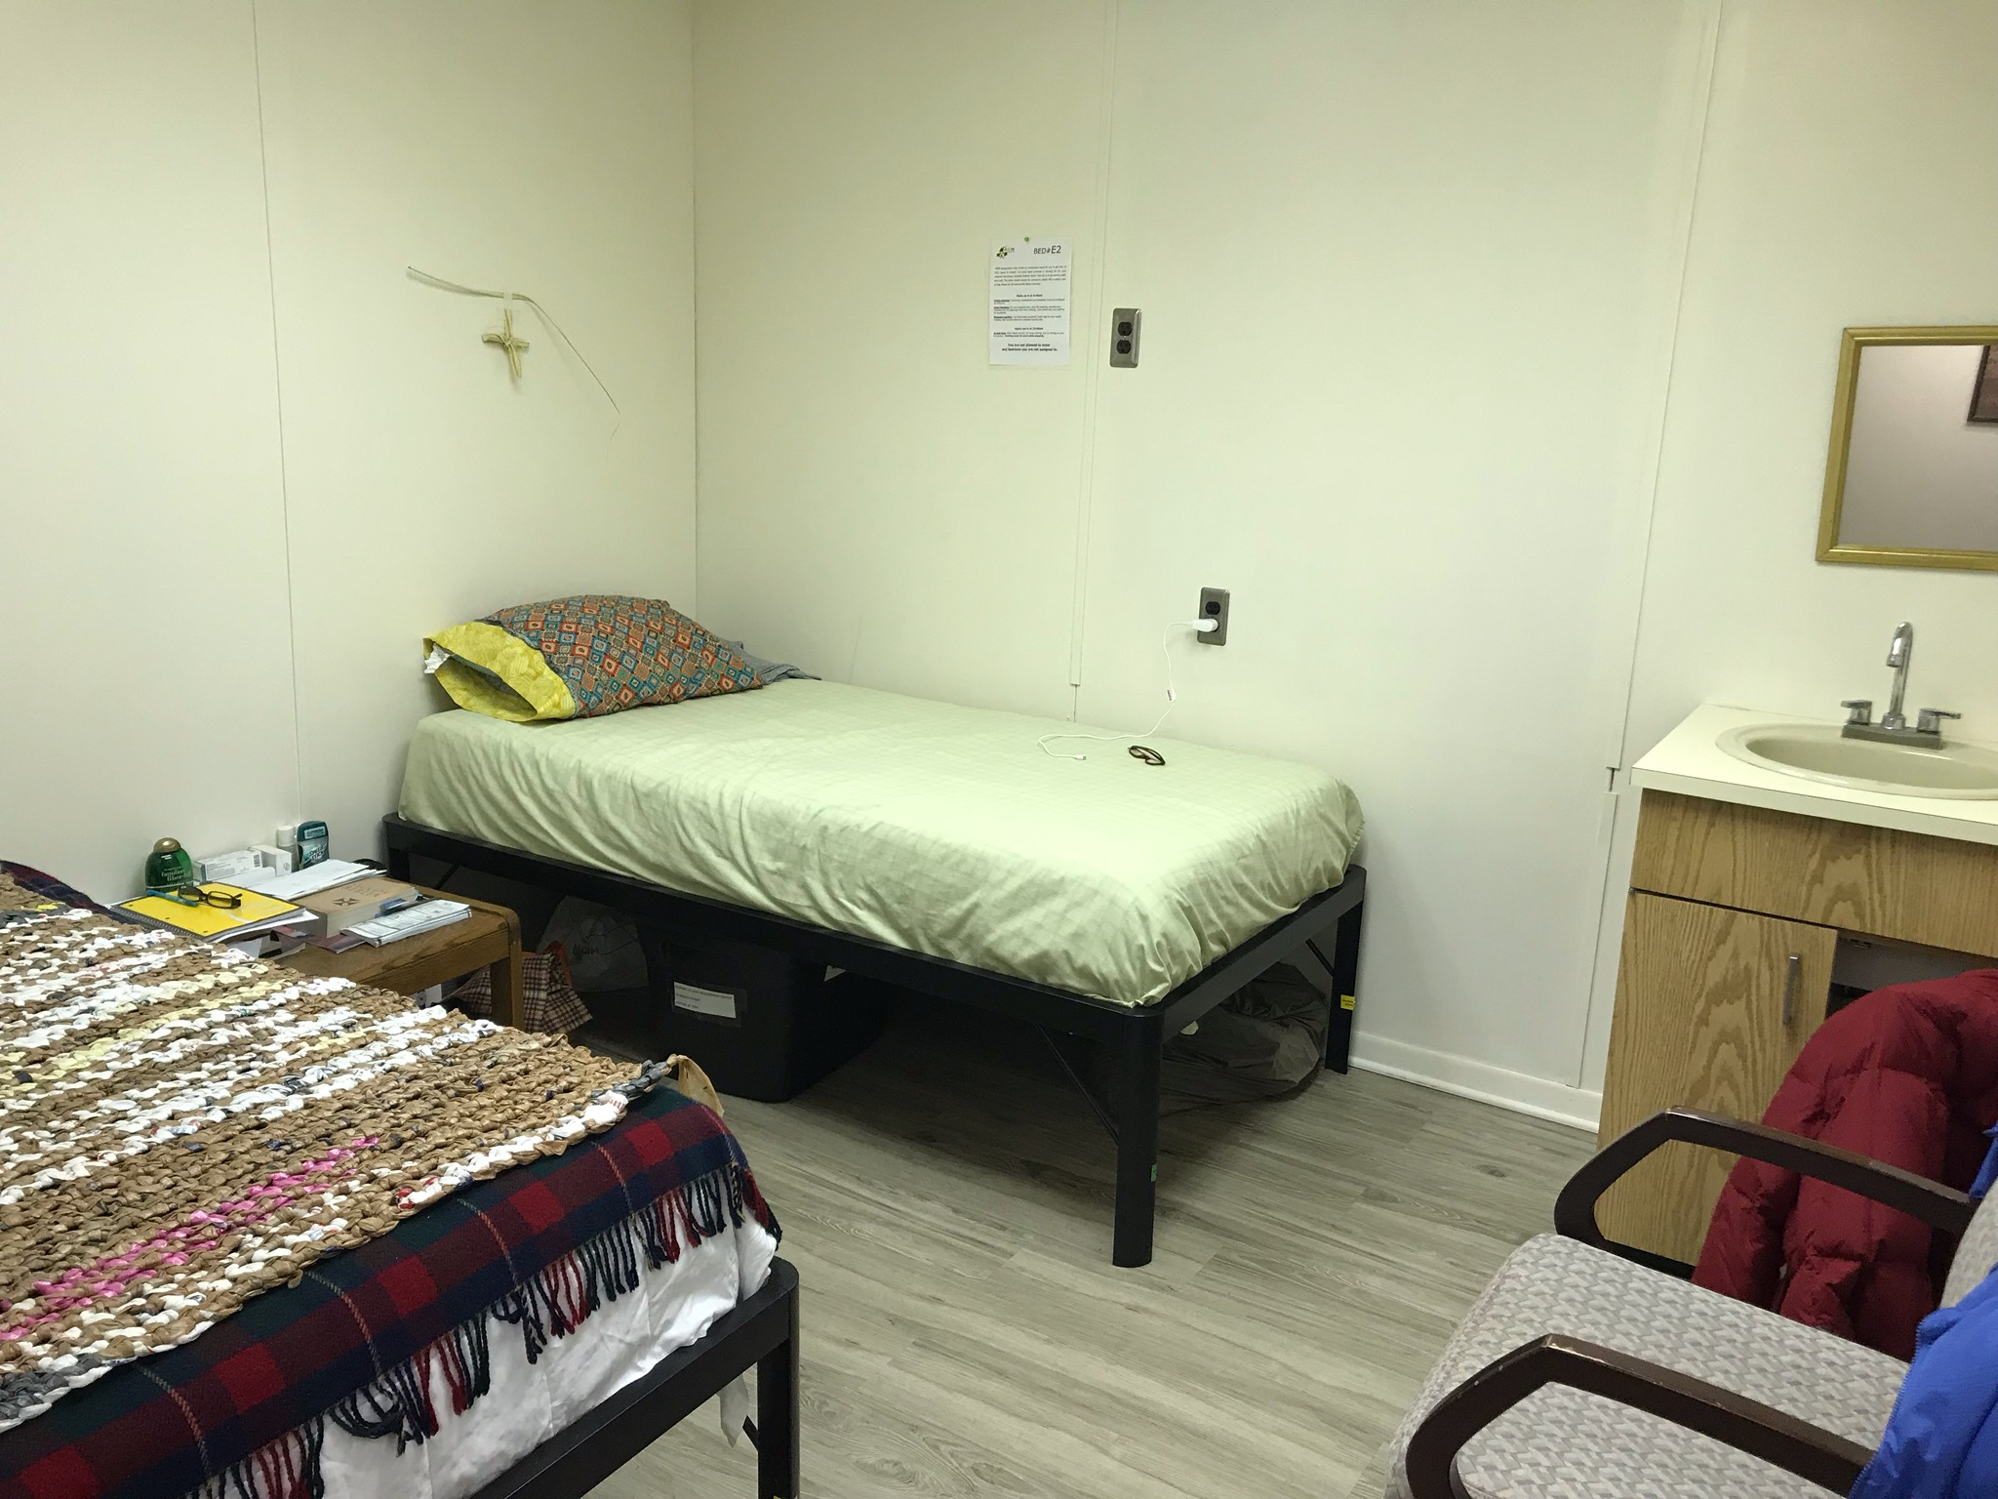
Standard 1
Showers
Three meals plus snacks
Clean bed linens
Accessible facility
Semi private rooms
Under bed personal belongings’ storage
Notes:
HOPE Recuperative Care provides safe and quality accommodations for all guests in our program
Staffed 24/7 - staff trained - also routinely practice emergency drills
Handicapped accessible facility
Semi private rooms - 2 guests to a room, more privacy
Provide showers, nutritious meals that try to accomodate dietary needs (diabetes, HTN)

Slide 10
Standard 1
24/7/365 Staffing
RN support 5 days a week
All staff trained in AED, CPR, Naloxone, etc.
Policy Manual
Safety Drills

Slide 11
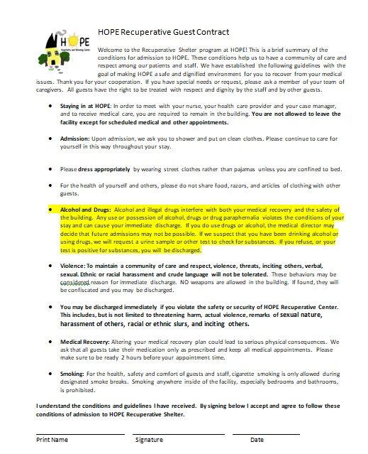
Standard 1
Guest Contract
Outlines expectations of all guests in program
Explains conditions of stay
Notes:
Guest contract - gives guests clear expectation of rules upon entry (so there’s no surprises)
Guests agree to abstain from substances, aggressive behavior, sharing food/hygiene items, touching other guests to ensure safety of all guests in program

Slide 12
Medical respite program provides quality environmental services
Standard 2:

Slide 13
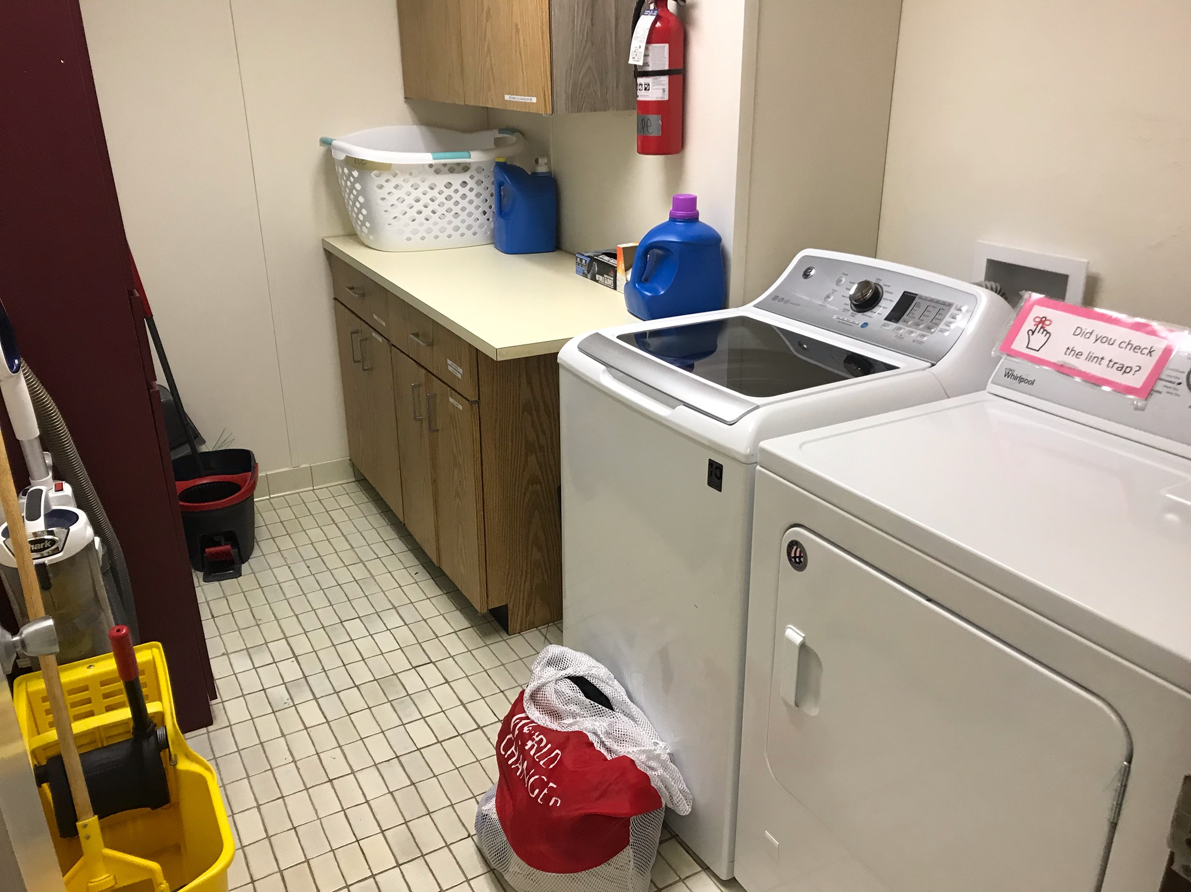
Standard 2
Cleaning checklist
Infection control protocols
Notes:
“These are some of the ways in which HOPE strives to provide quality environmental services at RCC: “
Staff on all shifts have cleaning duties/checklist
Nurses provide information for proper infection control protocols
Medications (including narcotics) locked and stored in staff area

Slide 14
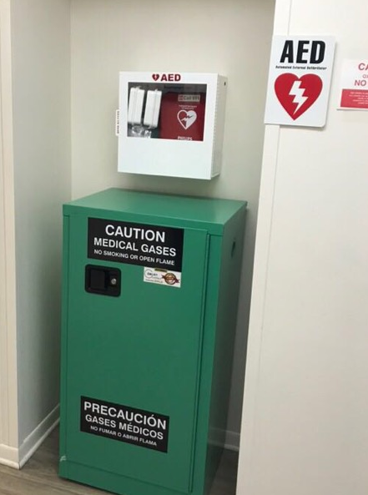
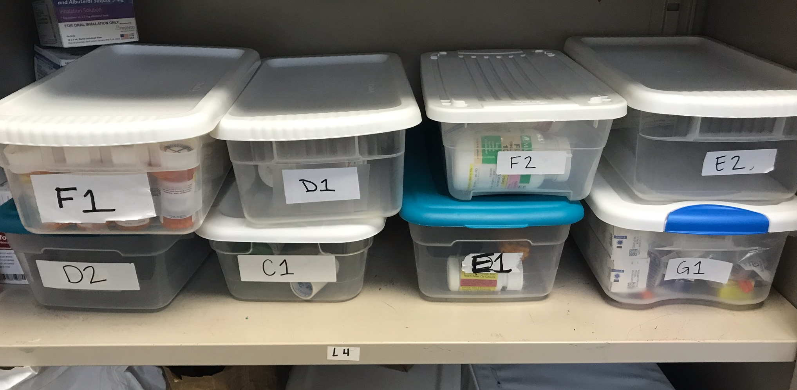
Standard 2
Oxygen storage
Medication storage
Notes:
“These are some of the ways in which HOPE strives to provide quality environmental services at RCC: “
Staff on all shifts have cleaning duties/checklist
Nurses provide information for proper infection control protocols
Medications (including narcotics) locked and stored in staff area

Slide 15
Medical respite program manages timely and safe care transitions to medical respite from acute care, specialty care, and/or community settings
Standard 3:

Slide 16
Standard 3
Admission Criteria
Patient must be able to perform activities of daily living independently (bathing, eating, dressing)
Principal diagnosis must be medical
Patient must be homeless with nowhere to go upon discharge
Does not accept patients with IVs, highly contagious diseases
Notes:
Admission criteria:
Pt must be able to perform ADLs, bathe and dress independently
Primary admitting diagnosis cannot be psych - must be inpatient medical hospitalization

Slide 17
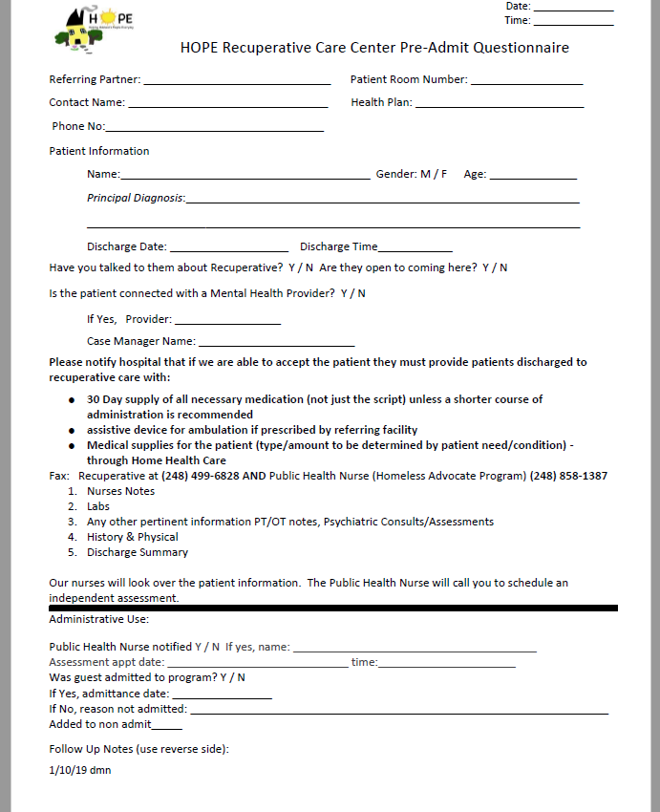
Standard 3
Pre-admit form
Completed by RCC staff when receiving a referral from a partner hospital
Basic patient information, health condition
Referring partner also sends chart notes for patient
Notes:
Basic demographics + principal diagnosis
Discuss short term medical goals for pt - can include home OT/PT, stabilize BS/BP, follow up with specialists
Write as many notes as possible - gain as much information as we can about the pt to ensure RCC is appropriate
Health plan - helps to know this so we can connect pt to CHW or complex CM
Bed # - for public health nurse assessment
Fax history & physical, labs, nurse’s notes, etc. to both Recup and PHNs

Slide 18
Standard 3
Role of Public Health Nurses
Partnership with Oakland County Health Division Homeless Advocate Program
PHNs provide in-person assessments
Help RCC staff and partner hospital determine appropriate placement for patient
If patient is accepted into RCC, PHNs continue to work with patient
Notes:
2 PHNs from OCHD Homeless Advocate Program
Recup staff contact them upon receival of referral from partner hospital
PHNs assess pt in person to gain more information and determine appropriateness for RCC

Slide 19
Medical respite program administers high quality post-acute clinical care
Standard 4:

Slide 20
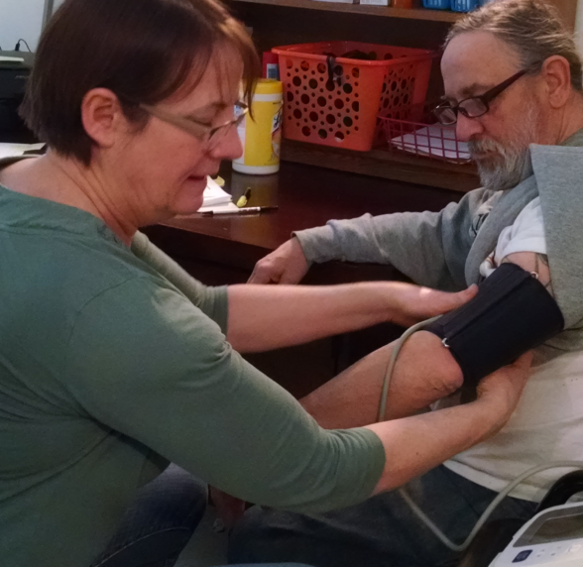
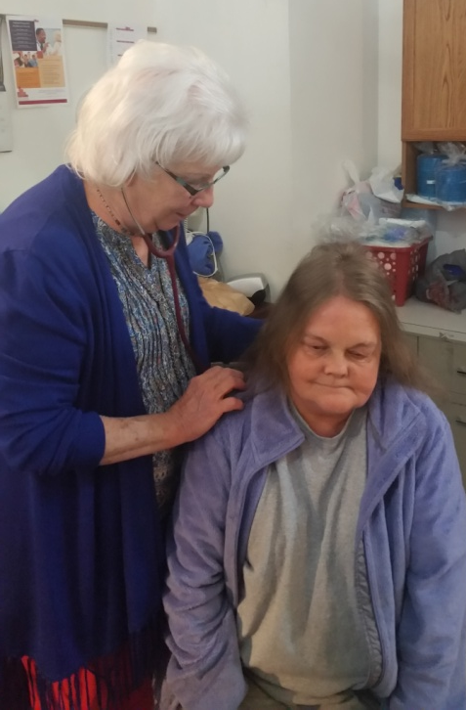
Standard 4 Criteria
Role of HOPE Nursing Staff
Set Short term Medical Goals with guests
Medical oversight
Medication oversight
Notes:
Onsite 5 days per week
Check vitals - communicate with guest’s providers - ensure guest has PCP - help coordinate care & communicate with PHNs who continue to follow patients after they’re admitted to RCC

Slide 21
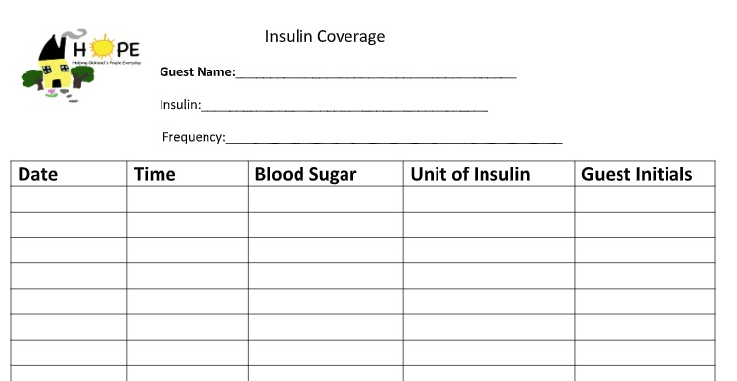
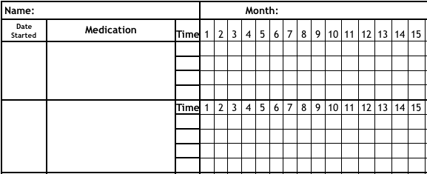
Standard 4
Medical Treatment and Medication Oversight

Slide 22
Standard 4 Criteria
Role of HOPE Nursing Staff
Patient education
Care coordination
Ensure guest is receiving proper follow up post hospitalization
Serve as liaison between guest and healthcare providers
Notes:
Onsite 5 days per week
Check vitals - communicate with guest’s providers - ensure guest has PCP - help coordinate care & communicate with PHNs who continue to follow patients after they’re admitted to RCC

Slide 23
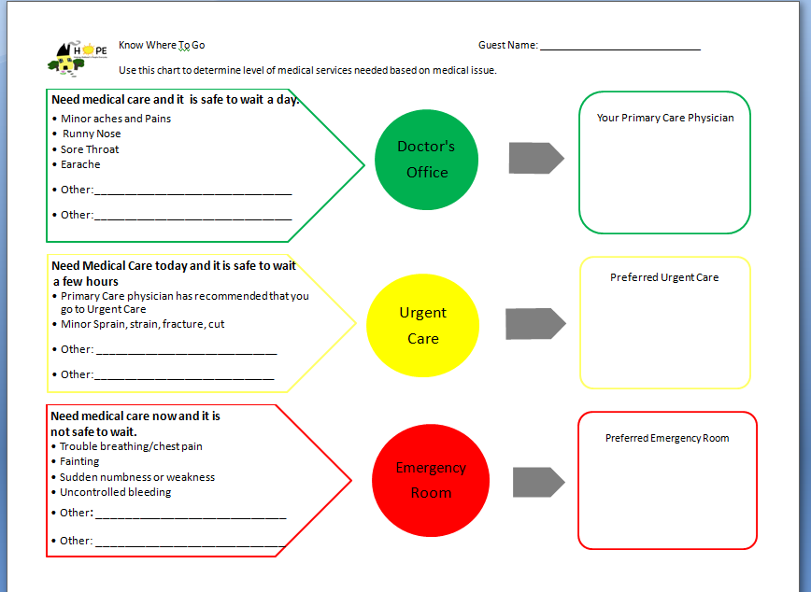
Standard 4
Know Where to Go

Slide 24
Medical respite program assists in health care coordination and provides wrap around support services
Standard 5:

Slide 25
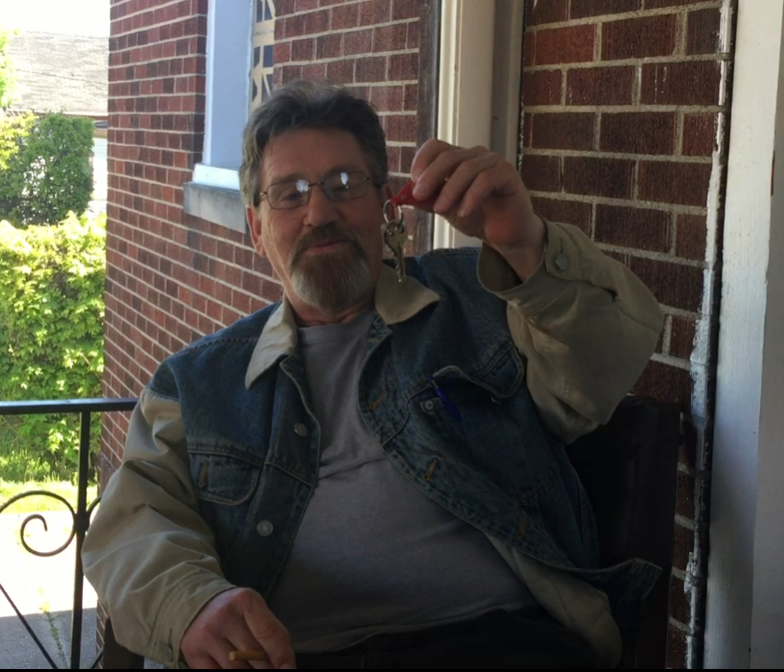
Standard 5 Criteria
Navigator
Housing
Mental Health
FQHC
Specialty services such as therapy dog, yoga classes
Notes:
Through onsite service navigator and relationships with community partners HOPE provides care coordination and wraparound supportive services

Slide 26
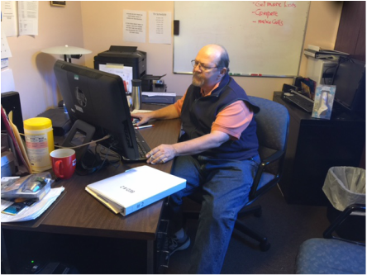
Standard 5
Role of HOPE’s Service Navigator
Helps guests obtain vital documents
Assists guests in achieving housing goals
Assistance with applying for benefits, housing, and securing income
Notes:
HOPE helps provide wraparound services through service navigation
Navigator helps guest overcome SDOH - secure income and permanent housing

Slide 27
Community Partners
Notes:
Relationships with partner agencies is key - have open communication/coordination
Agencies come onsite to meet with guests - eliminating transportation barrier
ES and OCHN onsite MH screenings, intakes and case management visits
CHN regularly onsite to do housing intakes and answer housing questions

Slide 28
Medical respite program facilitates safe and appropriate care transitions out of medical respite care
Standard 6:

Slide 29
Standard 6 Criteria
Seek to create long term linkages with community agencies
Complex care connection for those unable to live independently
Mental Health
Public Health Nurses
Connection with Primary Care Provider/FQHC
Notes:
Work to connect guests with resources that they can continue to utilize in the community after they discharge
Goal is stability through health education and permanent housing
Not all guests follow the path to housing, talk about alternative discharges

Slide 30
Standard 6 Criteria
Reasons for discharge
Housing or other appropriate housing destination
Completion of medical goals
Non-compliance/ Self-discharge
Discharge Policy
Discharge Summary
Community Resource List
Know Where to Go
Notes:
Work to connect guests with resources that they can continue to utilize in the community after they discharge
Goal is stability through health education and permanent housing
Not all guests follow the path to housing, talk about alternative discharges

Slide 31
Medical respite is driven by quality improvement
Standard 7:

Slide 32
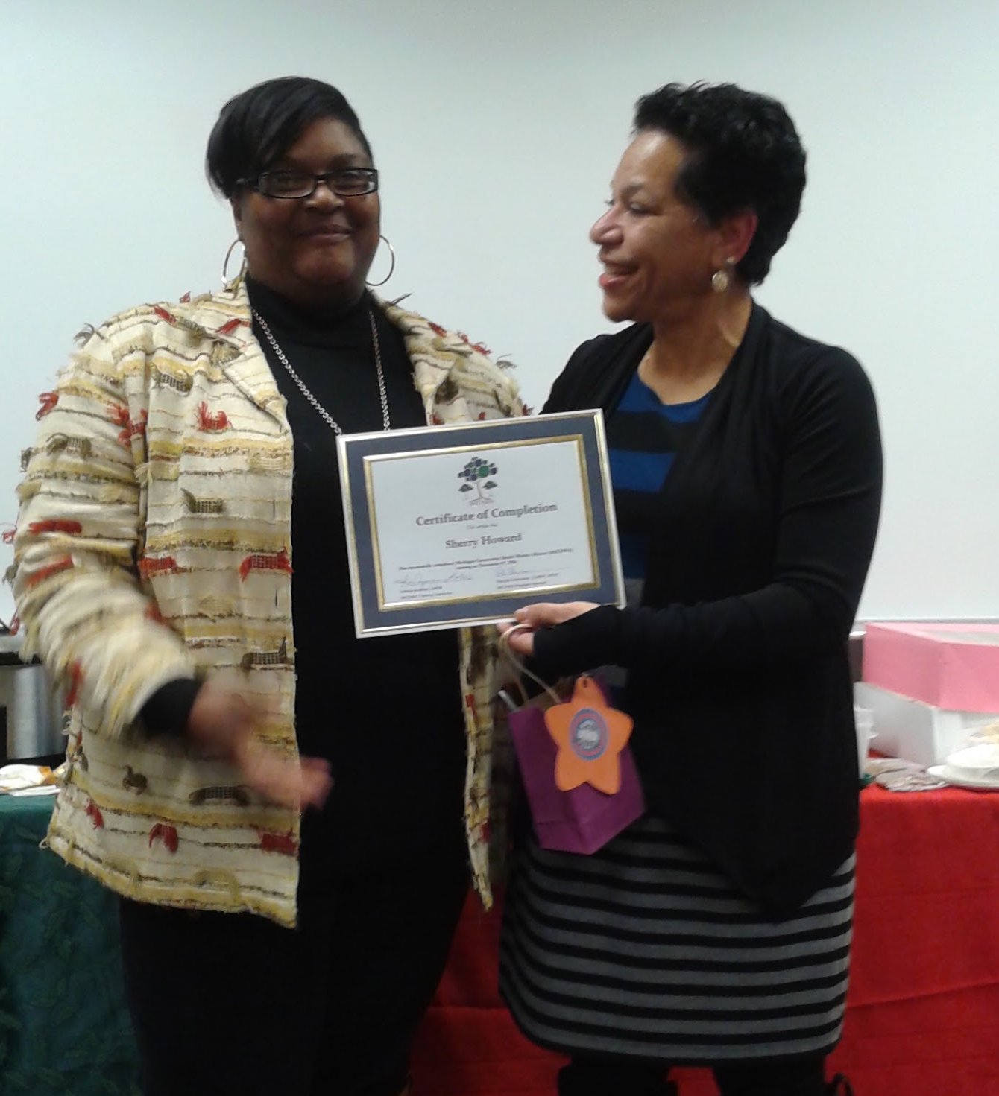
Standard 7 Criteria
Seek to employ CHW, CNAs, RN/BSN, EMT, BSW, & MSW
Staff training—AED, CPR, Naloxone, trauma informed, mental health first aid, de-escalation
Training Plan for internal policies and procedures
Notes:
Continually striving to improve our services:
Regular staff training and refreshers
Seek staff with background in health/SW
Management holds quality and operations meetings to improve processes and procedures in shelter
Document incident reports for guest and staff safety
Communication log

Slide 33
Standard 7 Criteria
Quality Improvement
Quality & Operations Meetings
Identify Gaps
Create new procedures
Discuss client barriers
Policy revision
Staffing/Scheduling
Shelter Program Needs
Notes:
Continually striving to improve our services:
Regular staff training and refreshers
Seek staff with background in health/SW
Management holds quality and operations meetings to improve processes and procedures in shelter
Document incident reports for guest and staff safety
Communication log

Slide 34
Funding and Economic Impact of Recuperative Shelter

Slide 35
Door Openers and Relationships
To access a new system you need a door opener
Build relationships and work to maintain them
Information, Information, Information!
Need a compelling reason to support your idea

Slide 36
Launch Funding

Slide 37
Hospital Community Benefit Funding
Target hospital C-Suite
Have an example of a super-utilizer of the target hospital
Have a written proposal that clearly outlines what you will do and what you want from the hospital
Leave behind your proposal, business card
Follow up immediately with a thank you note

Slide 38
Foundation Funding
Target Health Focused Foundations
Metro Health Foundation
Blue Cross Blue Shield Foundation
The Jewish Fund
Community Foundations
Aetna Foundation
Kresge Foundation, etc.

Slide 39
Other Funding Sources
Traditional shelter funders—ESG, ESP. etc.
Medical professional groups
Faith communities
Social media fundraisers for equipment
World Medical Relief
Hospital and Clinic In-kind

Slide 40
Sustainability Funding
Hospital Community Benefit Funds
Medicaid Billing
Some of the launch funding sources

Slide 41
Economic Impact of HOPE Recuperative
20 Patient Sample Year 1 Where EOB Cost Data Was Available
Total ED Cost Change--$187,532*
*calculated as cost 60 days post entry minus cost 60 days prior to entry
Total Inpatient Cost Associated with ED visit change--$55,589**
** calculated as cost 60 days post entry minus cost 60 days prior to entry
Total Outpatient Costs--$13,415.32 ***
***Calculated at cost 60 days post entry minus cost 60 days prior to entry

Slide 42
Lessons Learned
Provide hospital discharge planners with written information on criteria for entry, health information to be faxed to the shelter prior to entry, expectation that prescriptions are filled at the hospital and patients are transported to the shelter
Once hospitals were trained to do this, they also did it from the ER to the emergency shelter

Slide 43
Lessons Learned
Hospitals were well trained but those discharged from inpatient to a rehab/nursing facility prior to Recup had more issues—prescriptions not filled, equipment not ordered and Medicaid assignment not transferred at discharge
It is important for someone to meet the individual at the hospital to get the patient’s agreement to go to Recup, and to ensure the person is appropriate for Recup discharge.

Slide 44
Lessons Learned
Maintain constant contact with hospitals, reminding them of the effectiveness of the Recuperative Center
During the launch phase, not all Recup staff are comfortable with procedures that are more in progress then established
The physical environment of a recuperative shelter is important—congregate setting not as conducive as private/semi-private rooms

Slide 45
Questions???
Danielle Redilla, Manager HOPE Recup
dredilla@hopewarmingpontiac.org
248 499 6437
Rebecca Fitzgerald, Manager, Quality
rfitzgerald@hopewarmingpontiac.org
248 481 4394
Elizabeth Kelly, CEO
ekelly@hopewarmingpontiac.org
248 481 4394

