Slide 1
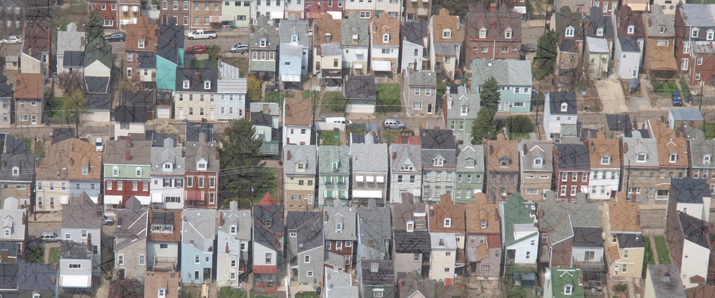
Reclaiming vacant homes builds strong neighborhoods
Building Michigan Communities Conference
The Impact of Community Stabilization in Michigan: NCST at 10 Years
April 29, 2019

Slide 4
About NCST
NCST, a non-profit organization, has programs that facilitate the rehabilitation of vacant but structurally sound homes, enable safe, targeted demolition when necessary, and support creative and productive re-use of vacant land.
NCST Sponsors:
Provide community-based buyers an opportunity to acquire distressed properties as part of a neighborhood revitalization strategy through our programs, including First Look. | Partner with Fannie Mae and Freddie Mac in their Neighborhood Stabilization Initiative to offer their REO properties to affordable housing and community development organizations in 28 strategic markets.
Work with policymakers, research solutions, and advocate for policies alongside national and local partners, to help communities address high rates of vacant, abandoned, and distressed properties. | Own and manage a portfolio of highly distressed mortgages with national partners, to resolve delinquencies, assist homeowners, and prepare vacant properties for productive disposition.

Slide 5
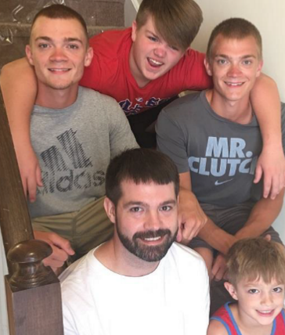
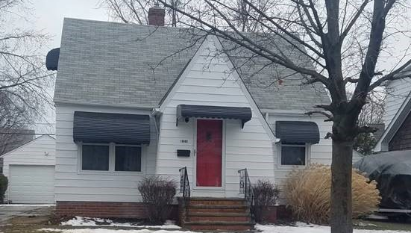
NCST By The Numbers
25,000 Since 2009, NCST has conveyed approximately 25,000 properties at a discount to local housing providers across the U.S., who rehabilitate homes to improve their communities.
$1.5 Billion
In our first 10 years of operation, NCST has conveyed $1,555,434,228 in real estate back to the community through local housing providers.
53% Fifty-three percent of the properties transferred through the Neighborhood Stabilization Initiative (NSI) are located in census tracts where the average household income is 80% or less of AMI.
1,290
Acquired more than 1,200 low-value, non-performing loans, now being resolved using customized solutions that address the unique challenges of vacant properties.
$251 Million
Our community buyers have saved more than $251,000,000 by buying their properties through NCST’s programs.

Slide 6
Neighborhood Stabilization Initiative (NSI)
NCST operates NSI, and we partner with FHFA, Fannie Mae, and Freddie Mac to stabilize neighborhoods hardest hit by the housing downturn. Access to REO properties is provided in strategic locations, which helps community buyers acquire and rehabilitate properties in a way that helps break the cycle of neighborhood distress.
NSI operates in 28 strategic markets with large concentrations of REO:
Akron, OH
Albany-Schenectady-Troy, NY
Atlanta-Sandy Springs-Roswell, GA
Baltimore-Columbia-Towson, MD
Birmingham-Hoover, AL
Chicago-Naperville-Elgin, IL
Cincinnati, OH-KY-IN
Cleveland-Elyria, OH
Columbus, OH
Dayton, OH
Detroit-Warren-Dearborn, MI
Flint, MI
Indianapolis-Carmel-Anderson, IN
Jacksonville, FL
Kansas City, MO-KS
Louisville/Jefferson County, KY-IN
Miami-Fort Lauderdale-West Palm Beach, FL
Milwaukee-Waukesha-West Allis, WI
New York-Newark-Jersey City, NY-NJ-PA
Orlando-Kissimmee-Sanford, FL
Palm Bay-Melbourne-Titusville, FL
Philadelphia-Camden-Wilmington, PA-NJ-DE
Pittsburgh, PA
St. Louis, MO
Tampa-St. Petersburg-Clearwater, FL
Toledo, OH
Trenton, NJ
Youngstown-Warren-Boardman, OH-PA
For more info visit: https://www.fhfa.gov/PolicyProgramsResearch/Programs/Pages/Neighborhood-Stabilization-Initiative.aspx

Slide 7
Timing Considerations
Key Reminders
Interest (or disinterest) should be expressed on every opportunity – NCST encourages buyers to have at least 2 REOMatch users to monitor properties
Buyers should complete due diligence and physical inspections (if possible) on all properties prior to requesting a price or accepting
Buyers commit to a 45 day closing – funding must be available to close on time
First Look
24 Hours
Express Initial Interest on New Properties
2-4 Business Days
Inspect Properties
5th Business Day
Confirm Interest to Receive Pricing
24 Hours
Accept or Decline Offer Price
48 Hours
Return Signed Purchase Agreement
Neighborhood Stabilization Initiative (NSI)
48 Hours
Express Initial Interest on New Properties
2-7 Business Days
Inspect Properties
8th Business Day
Confirm Interest to Receive Pricing
48 Hours
Accept or Decline Offer Price
48 Hours
Return Signed Purchase Agreement

Slide 8
70% of all Americans currently live in single-family homes
80% of all Americans would like to
Source: National Association of Realtors

Slide 9
Single-Family Housing Stock, 2015 (as a percentage of total housing units)
Source: 2011-2015 American Community Survey 5-Year Estimates [NB: data excludes mobile homes]

Slide 10
Challenges to Revitalization and Repopulation
Aging housing stock in need of repair
Low supply – shortage of move-in-ready starter homes
Difficult to get mortgages – lenders concerned about insufficient collateral

Slide 11
What Are We Proposing?
The Neighborhood Homes Investment Act (NHIA)
This proposal is a new federal tax credit to attract capital to distressed neighborhoods. It can be used for new construction and substantial rehabilitation of single family (1-4 unit) housing, both vacant and owner-occupied.

Slide 12
Neighborhood Homes Coalition (national)

Slide 13
NHIA Financing
Covers up to 35% of total development costs (building acquisition*, rehab, demo, and construction)
$25,000 minimum rehab per unit
*Eligible building acquisition costs limited to 75% of rehab/construction costs. Land costs excluded.

Slide 14
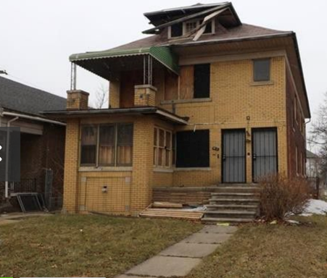
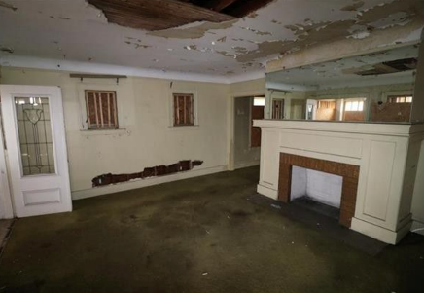
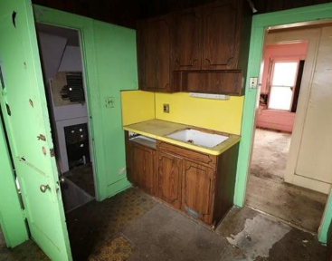
Local Property A (Detroit): 4900 Dailey St.
2-unit; ea. 3 bed/1 bath
2,762 sq. ft. – $6,000
Significant rehab

Slide 15
4900 Dailey St. (significant rehab)
Purchase price | $6,000
Rehab cost (estimated) | $140,000
Developer fee (estimated) | $10,000
Total Development Cost | $156,000
Appraised market value at resale (estimated) | $110,000
Total Appraisal Gap | $46,000
Eligible basis = Rehab cost + acquisition up to 75% of Rehab cost | $150,000 + $6,000 = $156,000
Maximum Tax Credit: $156,000 x 35% | $54,600

Slide 16
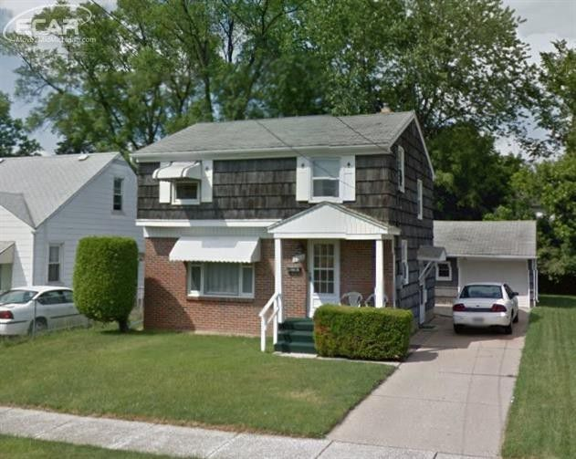
Local Property B (Flint): 2812 Sloan St.
3 bed/1.5 bath – 1,170 sq. ft. – $15,000
Moderate rehab

Slide 17
2812 Sloan St. (moderate rehab)
Purchase price | $15,000
Rehab cost (estimated) | $35,000
Developer fee (estimated) | $10,000
Total Development Cost | $60,000
Appraised market value at resale (estimated) | $45,000
Total Appraisal Gap / NHIA Allocation | $15,000
Eligible basis = Rehab cost + acquisition up to 75% of Rehab cost | $45,000 + $15,000 = $60,000
Maximum Tax Credit: $60,000 x 35% | $21,000

Slide 18
Claiming the NHIA
NHIA credits claimed when a home is completed, inspected, and occupied by an eligible owner, i.e., “pay for success”
Investors not subject to recapture
If home resells within 5 years, homeowner must pay 50% of property appreciation (up to tax credit amount) to state housing agency for re-use in neighborhood revitalization

Slide 19
Unused Private Activity Bonds, by state (AL-NE)

Slide 20
Unused Private Activity Bonds, by state (NV-WY)

Slide 21
NHIA Outcomes
Livable homes built or rehabilitated
Reduced blight and vacant properties
Affordable homeownership opportunities created
Private equity investment generated
New jobs in construction and related industries
Tax revenues for federal, state, local government
Asset-building for wide range of households

Slide 22
Contact Us
For more information about the NHIA proposal and coalition advocacy efforts, please visit our website:
www.neighborhoodhomesinvestmentact.org
Contact us at:
info@neighborhoodhomesinvestmentact.org

Slide 23
NCST in Michigan
Since 2009, NCST has conveyed nearly 2,500 properties (2,384 as of December 31, 2018) to our partners in Michigan.
Over the past 10 years, our partners have rehabbed homes for-sale and for-rent, as well as a good portion for demolition (particularly with Land Banks).
The majority of our activity have been in Low & Moderate income communities – creating and preserving housing in naturally occurring affordable housing (NOAH) markets.
NCST has been active throughout all of Michigan, although the majority of our activity has been focused in Michigan’s major metro areas (Detroit region in particular).

Slide 24
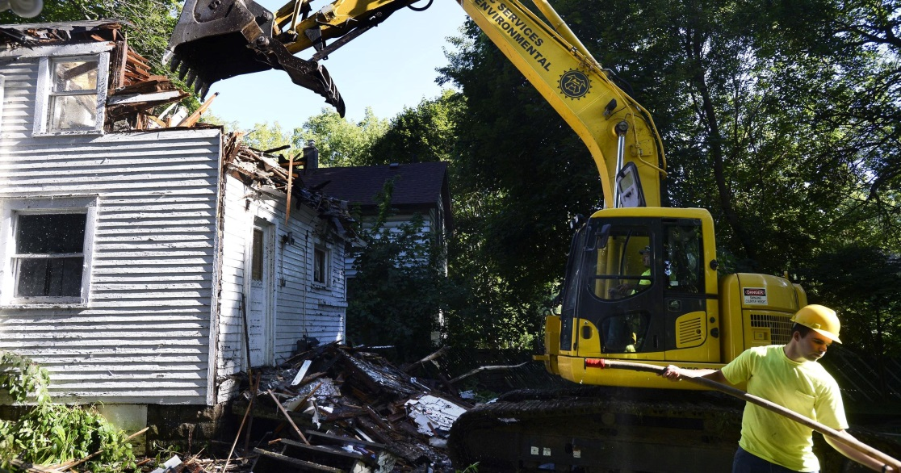
NCST in Michigan: Land Banks
Past & Present: Kent, Ingham, Calhoun, Genesee, Jackson, Kzoo and the DLBA
Assembly/Pipeline of NSP Candidates
Pipeline of demo candidates (often with contributions toward demo when severely distressed)
Continued source for demo with advent of new resources (HHF).
Resale/No Rehab
Photo Credit: Lansing State Journal

Slide 25
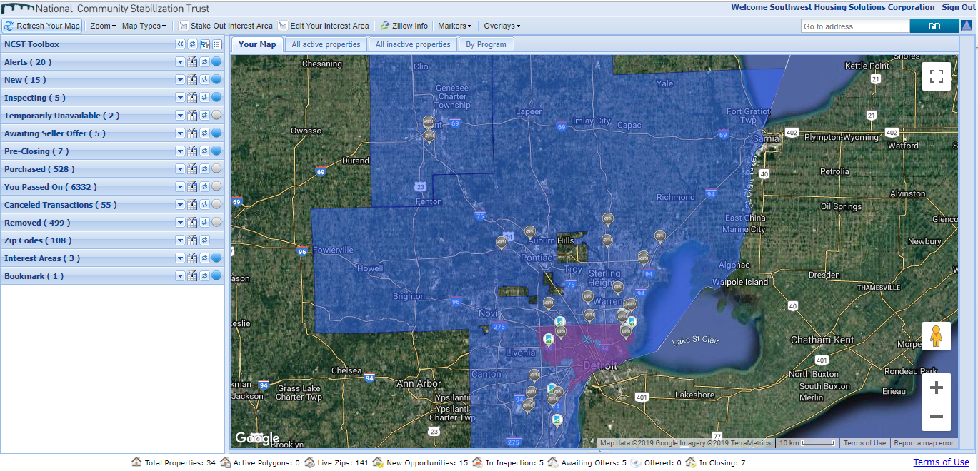
GO LIVE CALL | REOmatch demo
Large Target Areas

Slide 26
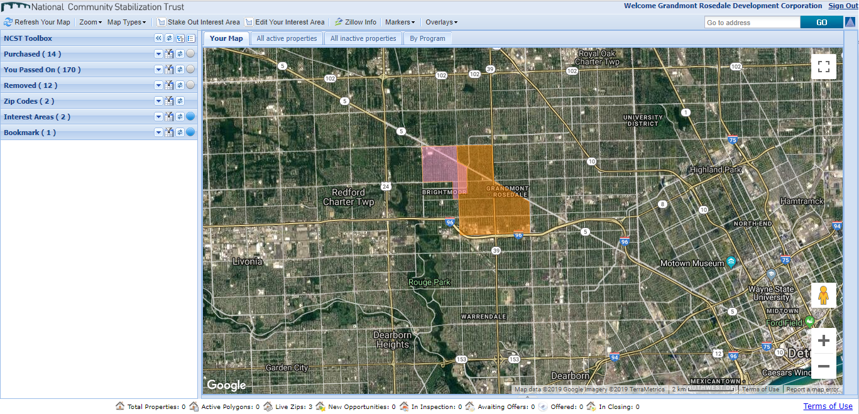
GO LIVE CALL | REOmatch demo
Smallscale Local Target Areas

Slide 27
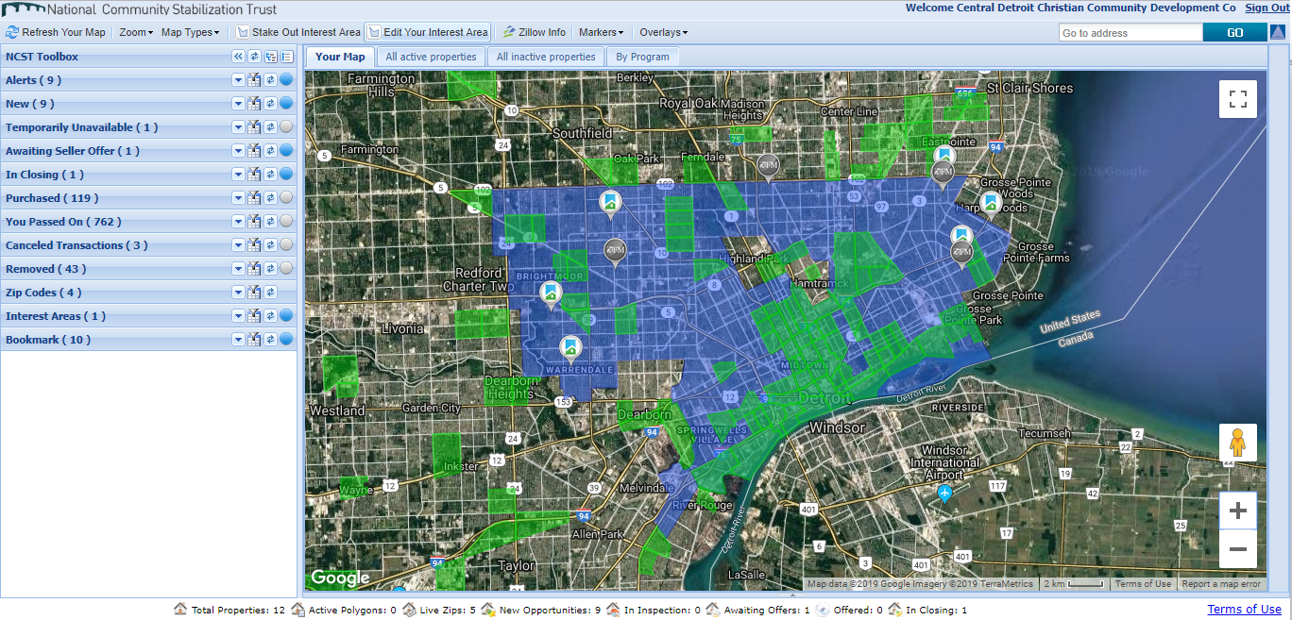
GO LIVE CALL | REOmatch demo
Overlays: Opportunity Zones (below), NSP Areas, zipcodes/census tracts, custom

Slide 28
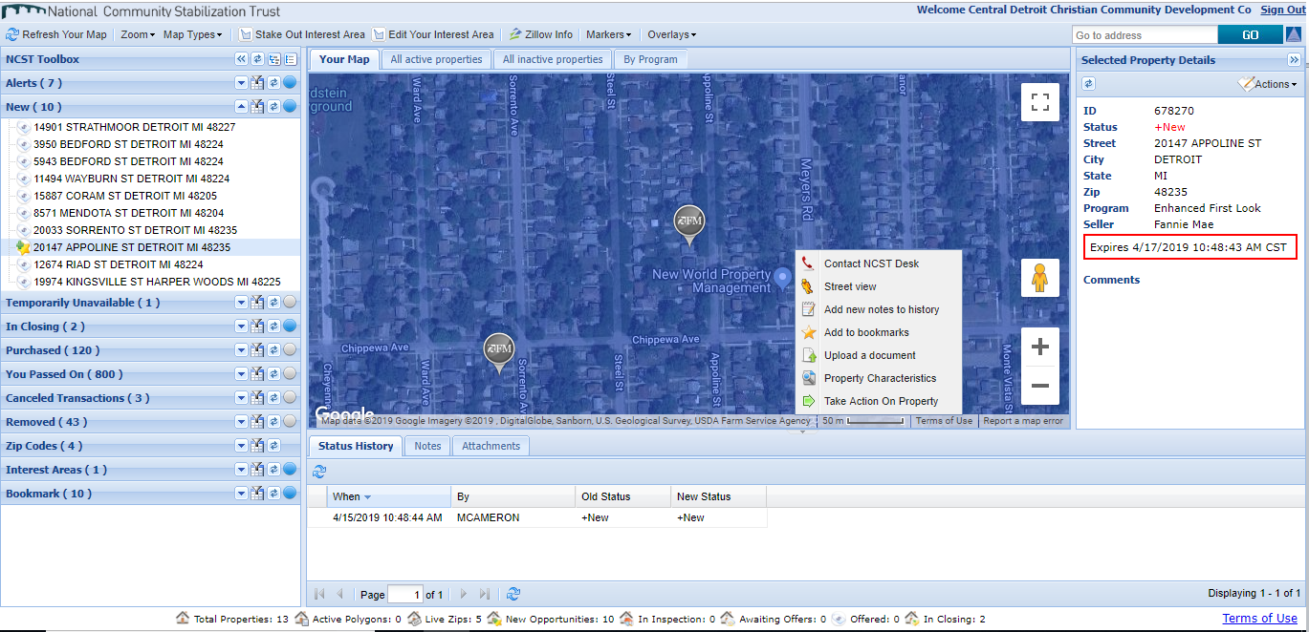
GO LIVE CALL | REOmatch demo
New Property Example: Little Detail, possible actions

Slide 29
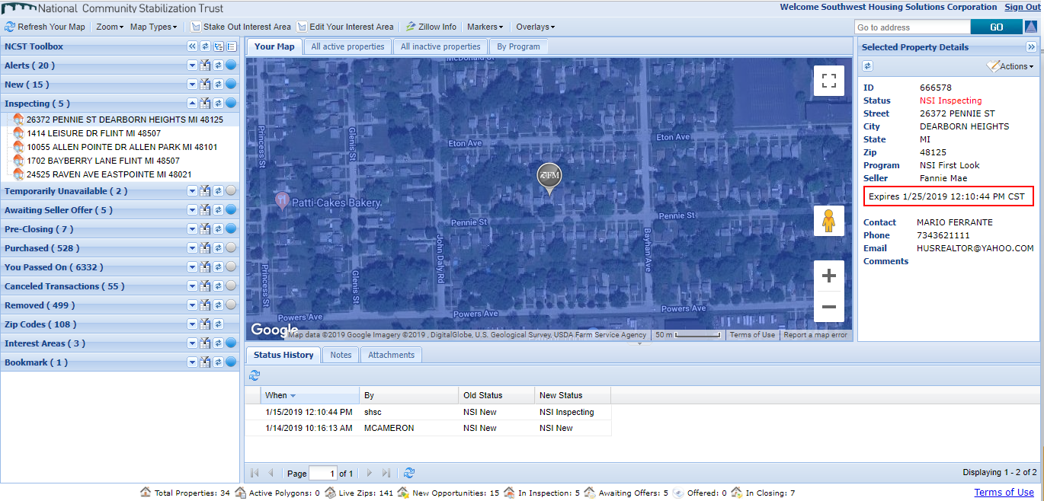
GO LIVE CALL | REOmatch demo
Inspection Example: Agent info provided, expiration date

Slide 30
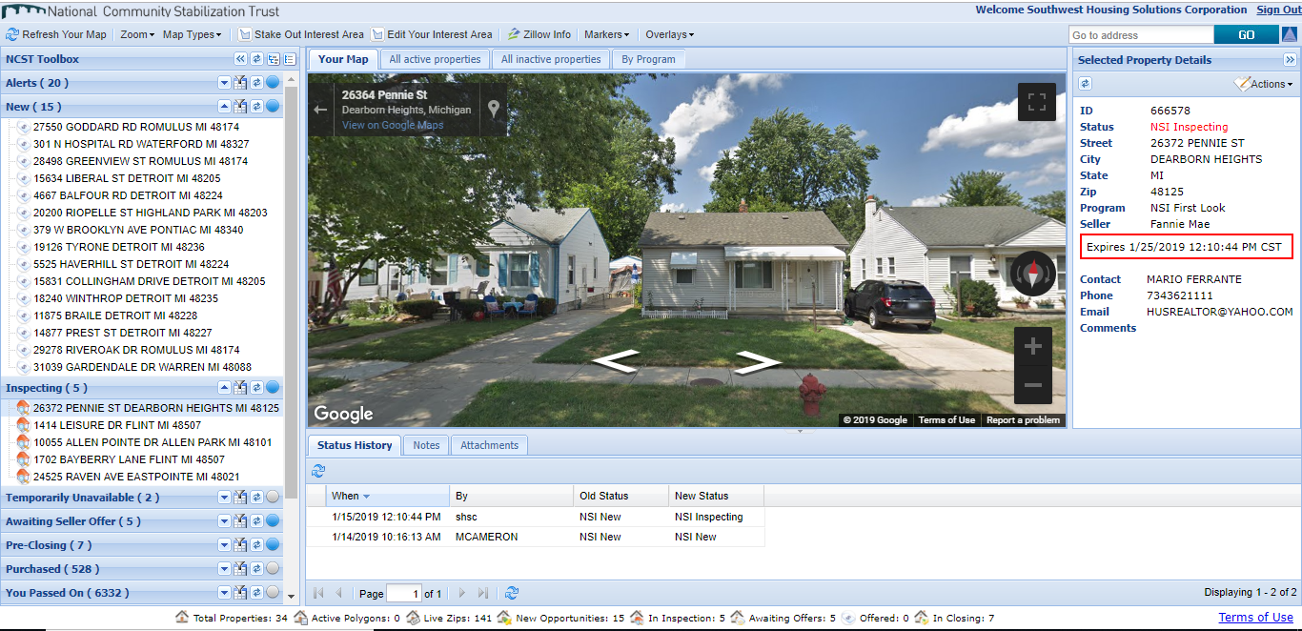
GO LIVE CALL | REOmatch demo
Desk Review: Link to Google Street view, Zillow information

Slide 31
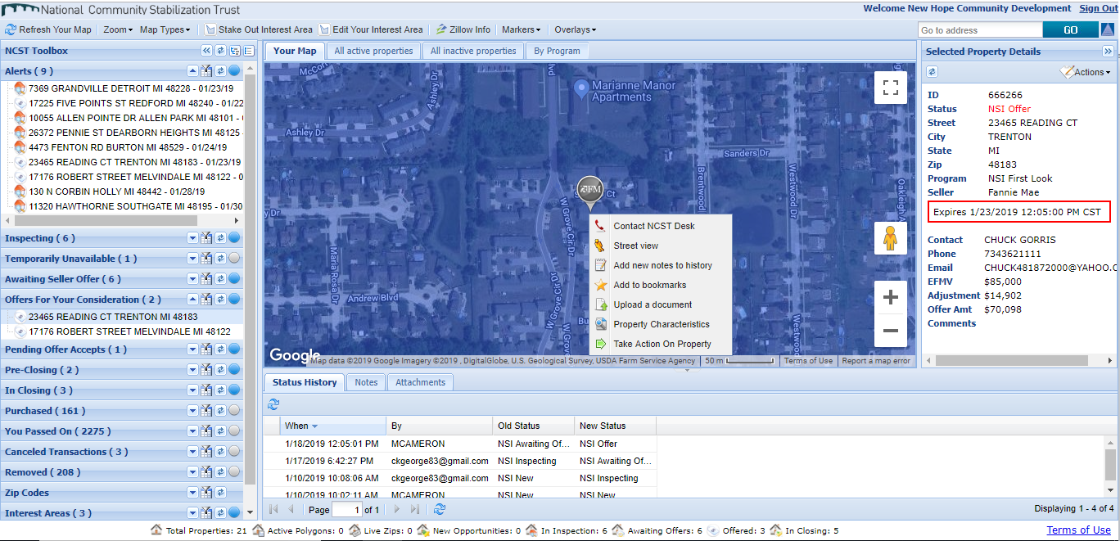
GO LIVE CALL | REOmatch demo
Offer example: EFMV, discount, actual offer amount, timeline to accept or decline

Slide 32
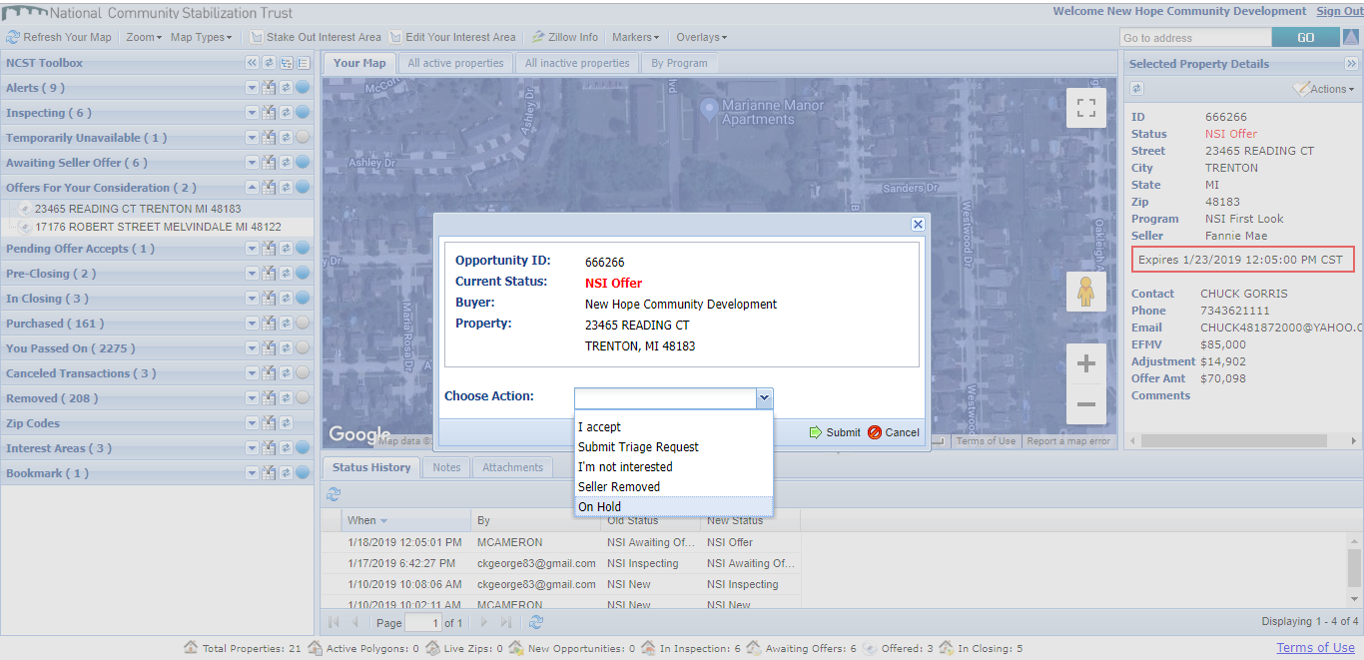
GO LIVE CALL | REOmatch demo
Take Action: Accept, Decline, Triage. Will differ depending on status

Slide 33
NCST in Michigan
2,384

Slide 34
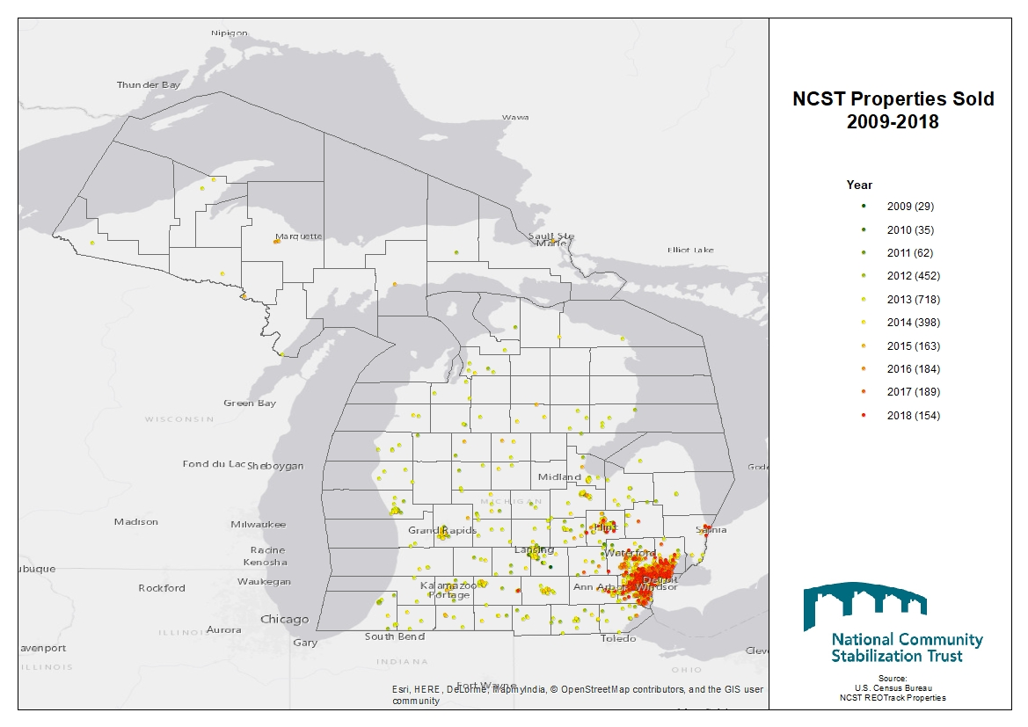
NCST in Michigan

Slide 35
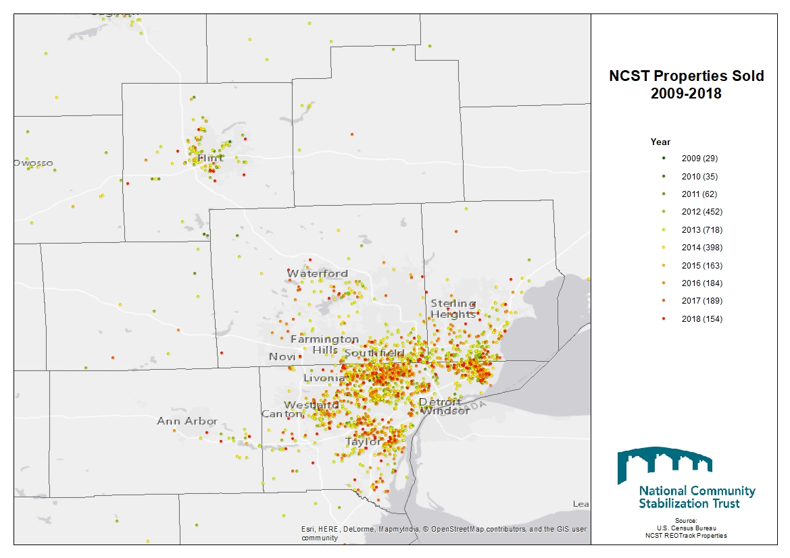
NCST in Michigan

Slide 36
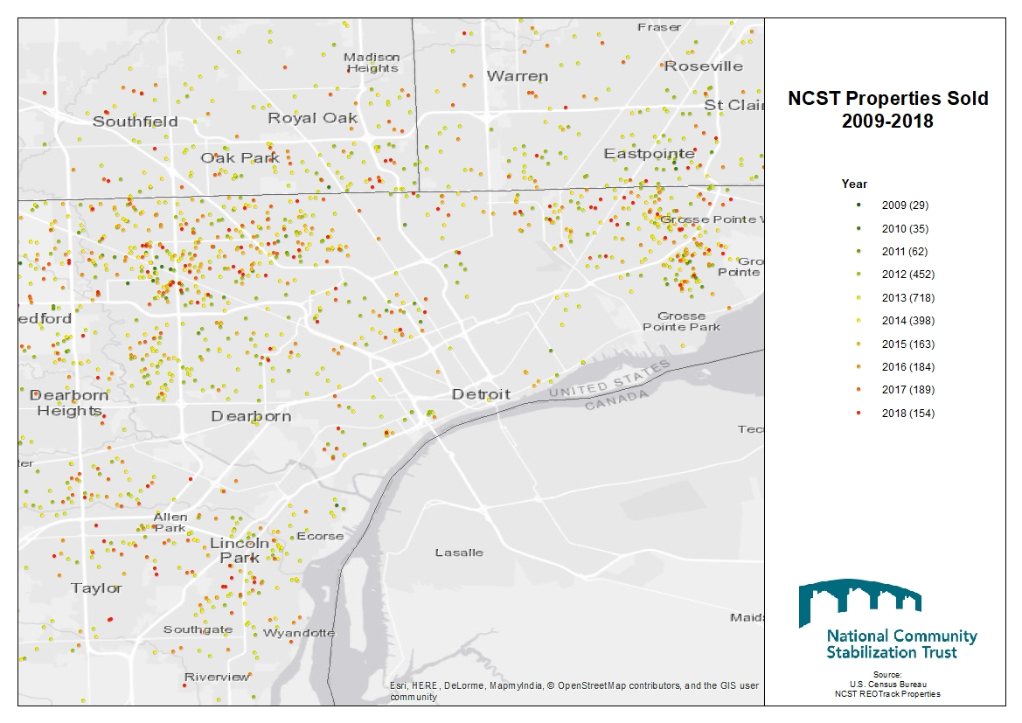
NCST in Michigan

Slide 38
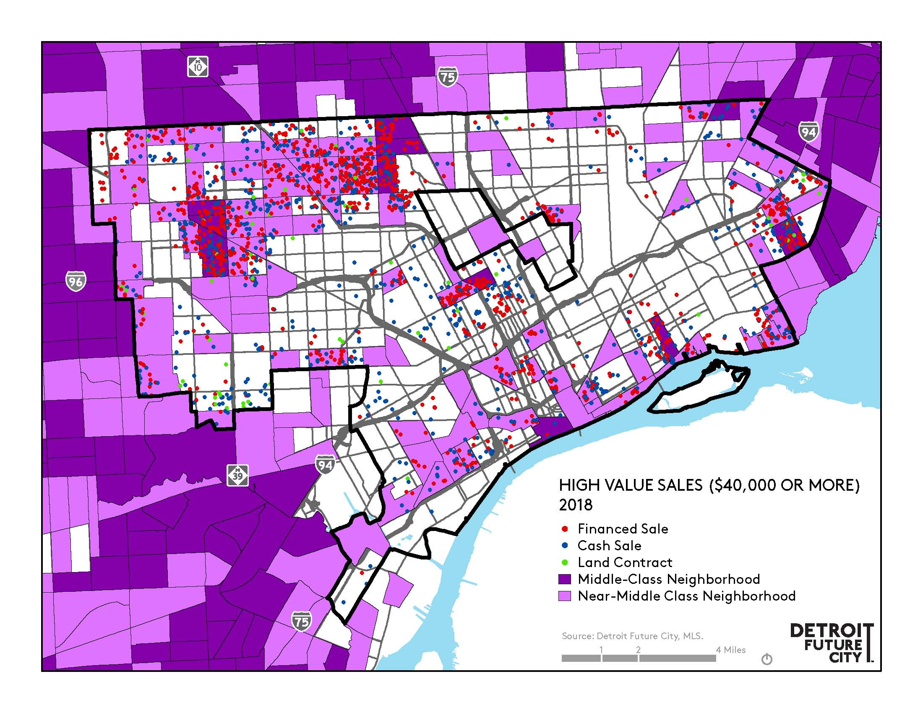

Slide 40
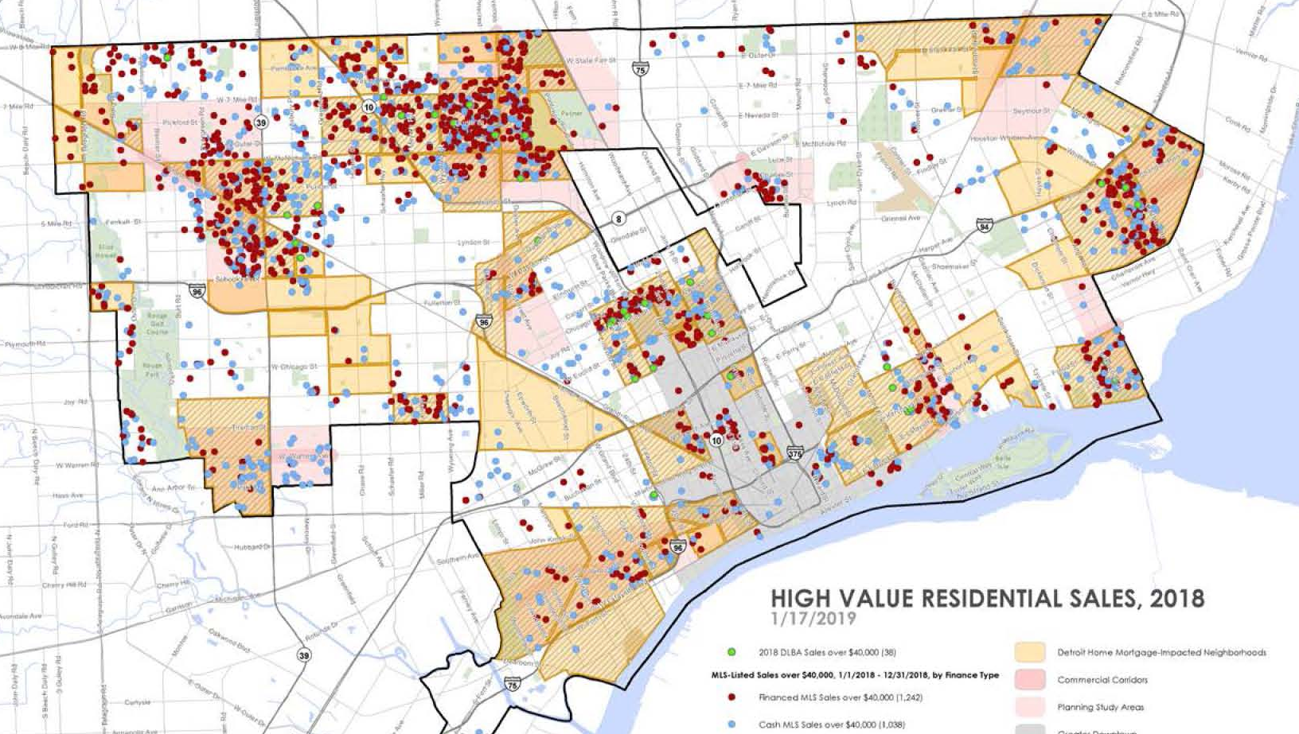

Slide 41
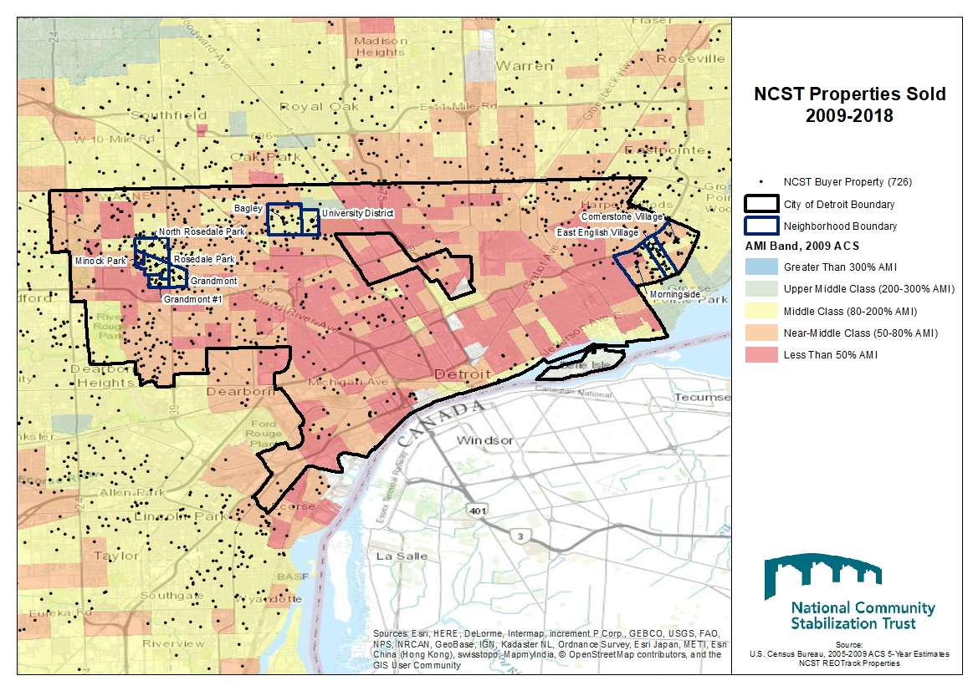
NCST in Michigan: 2009

Slide 42
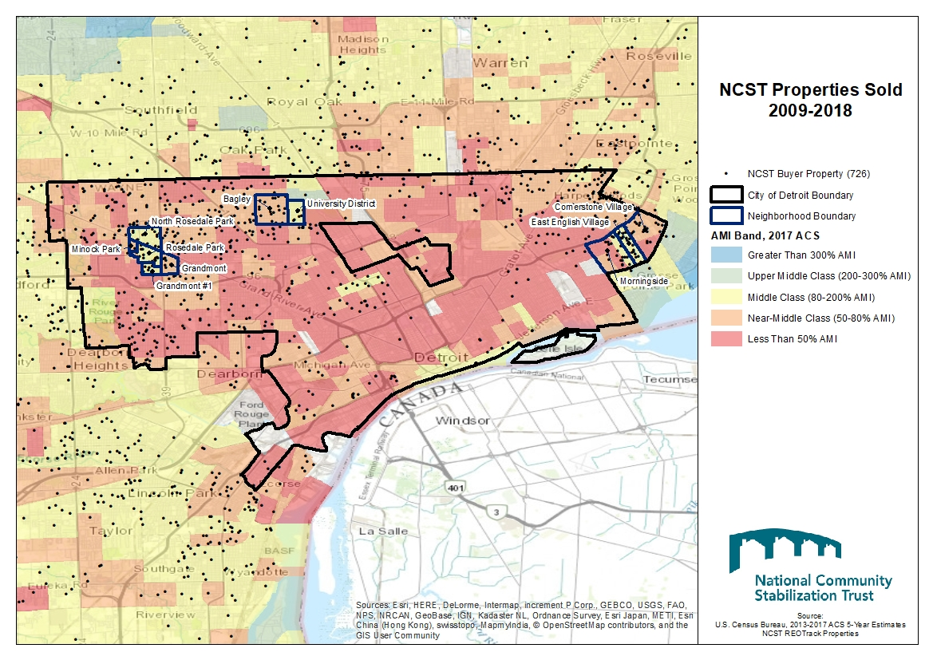
NCST in Michigan: 2017

Slide 43
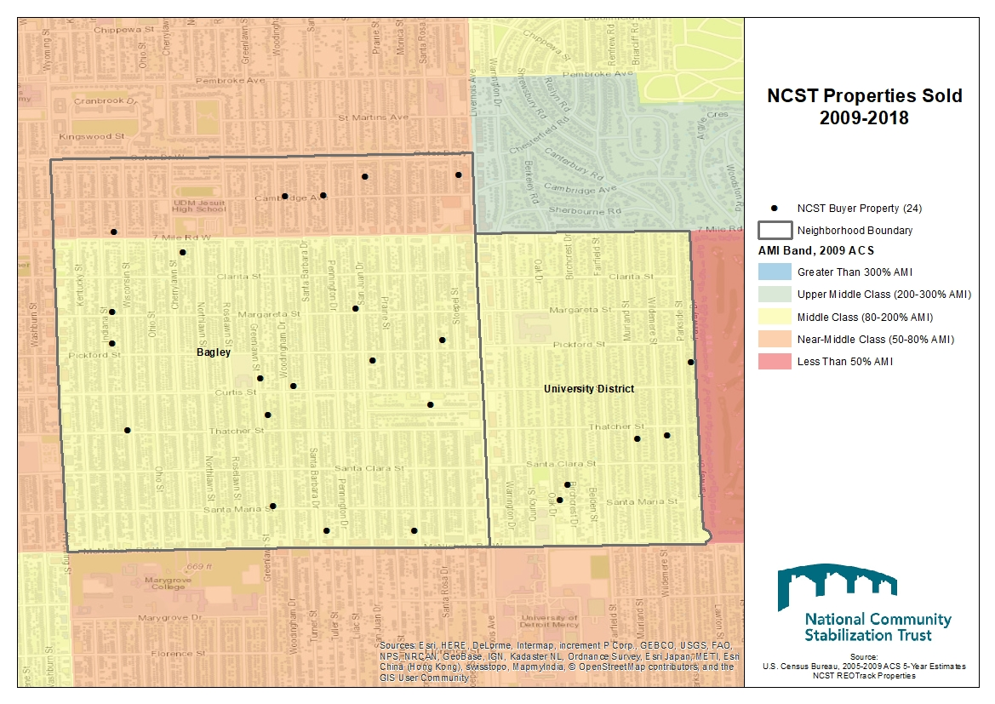
NCST in Michigan: 2009

Slide 44
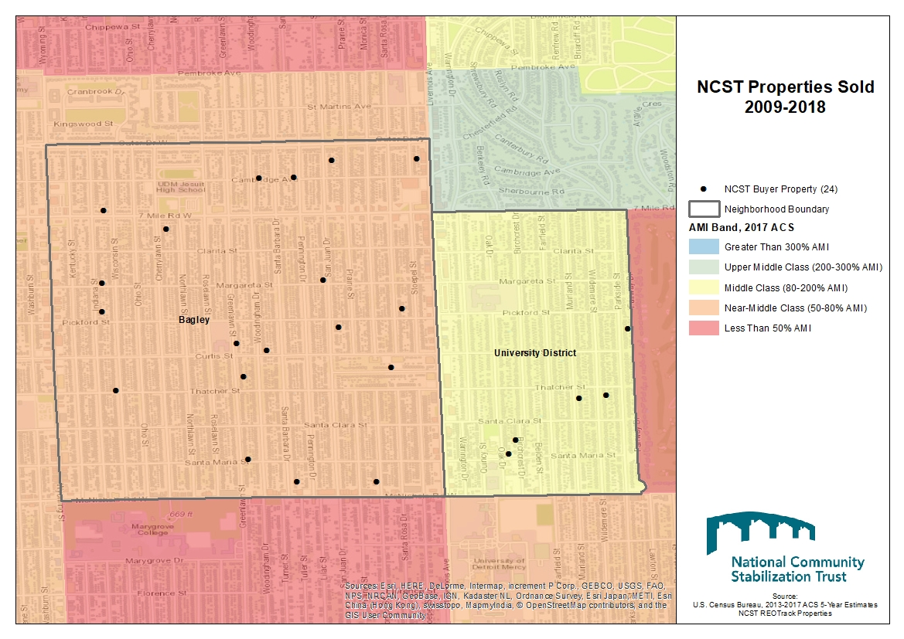
NCST in Michigan: 2017

Slide 45
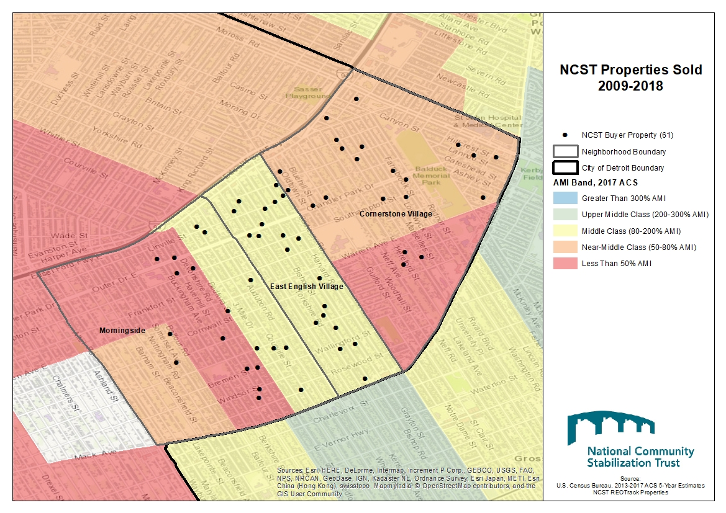
NCST in Michigan: 2009

Slide 46
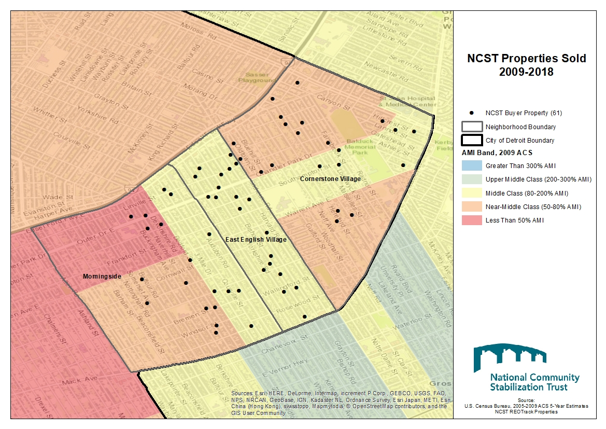
NCST in Michigan: 2017

Slide 47
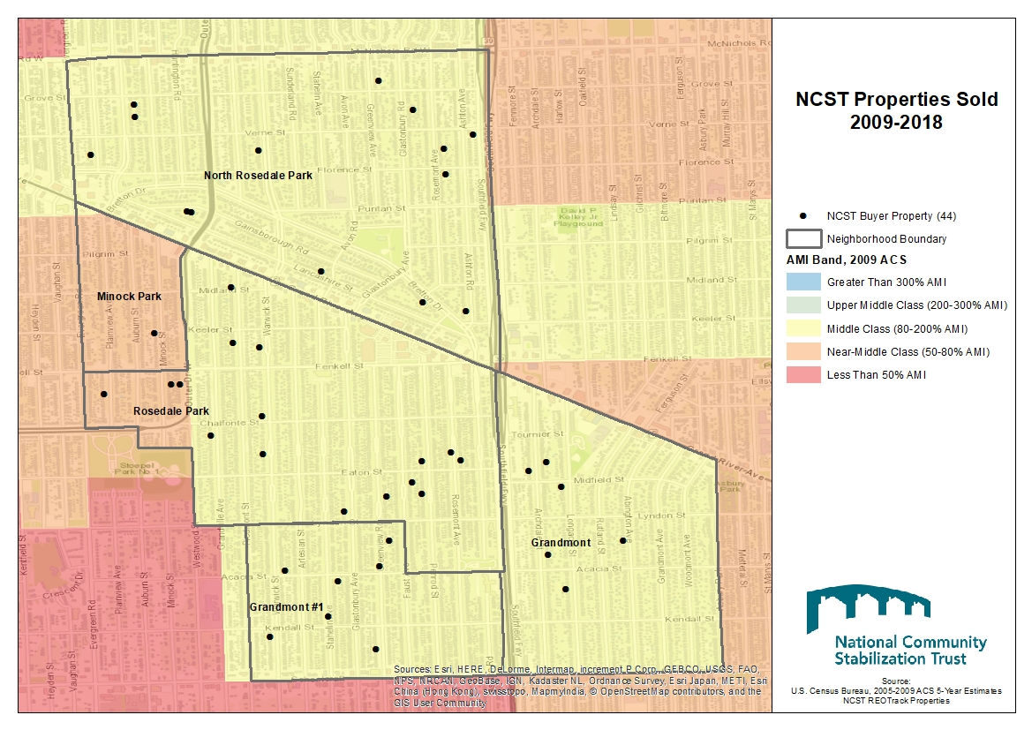
NCST in Michigan: 2009

Slide 48
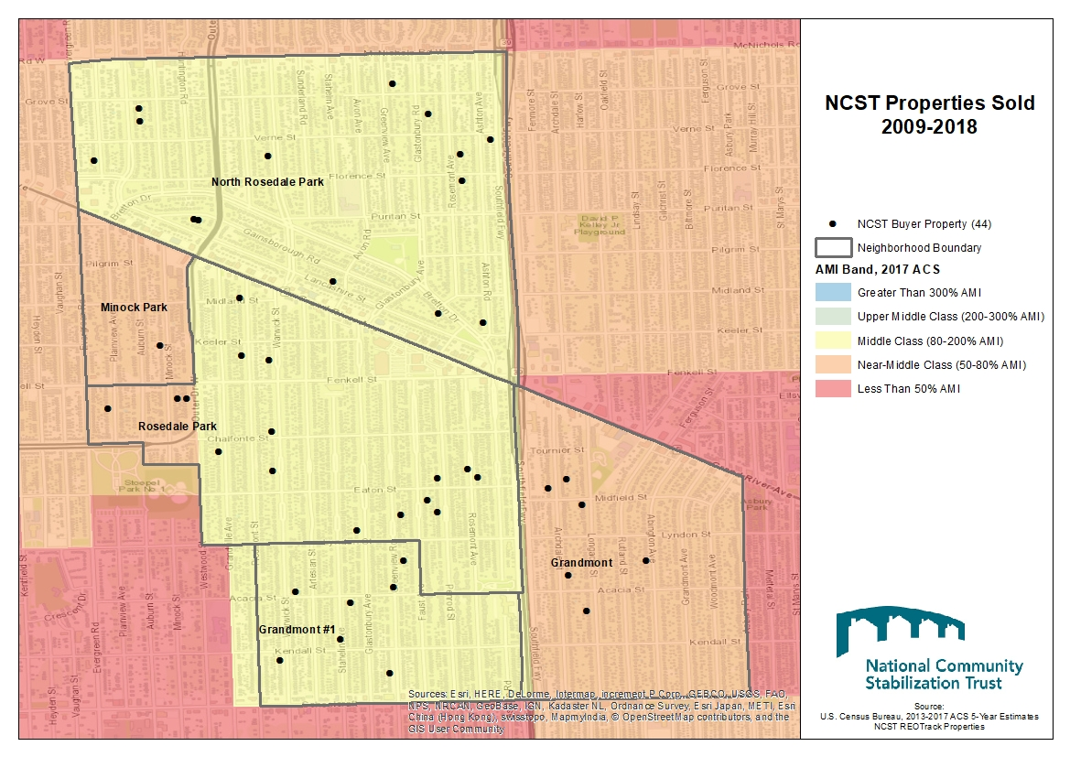
NCST in Michigan: 2017

Slide 49
NCST in Michigan

Slide 50
NCST in Michigan

Slide 51
NCST in Michigan

Slide 52
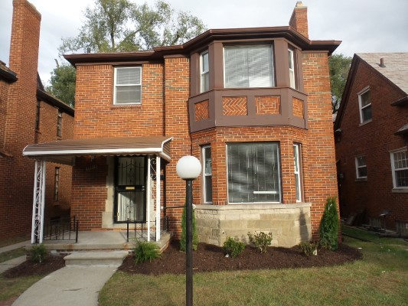
NCST in Michigan: Case Study – 18212 Woodingham Dr., Detroit
This property originally built in 1940 in the Bagley neighborhood, acquired by Southwest Housing Solutions.
EFMV of $18,000 at the time of acquisition
Rehab took approx. 3 months with $45,000+ in rehab costs (including interior and exterior)
Sold to an owner occupant for $62,000

Slide 53
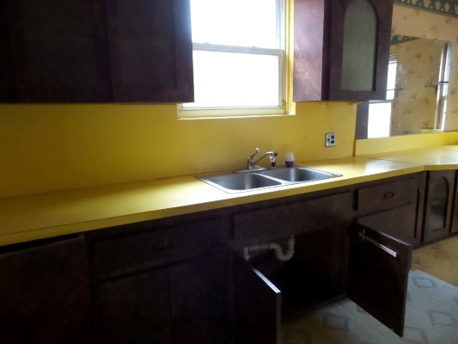
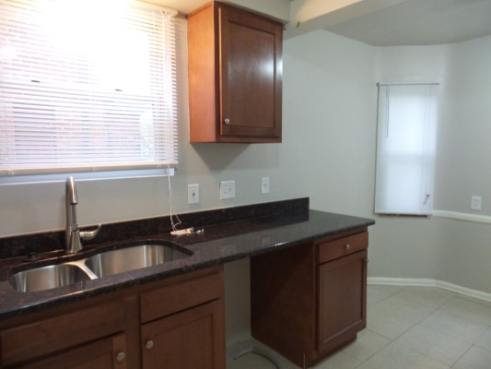
NCST in Michigan: Case Study – 14321 Greenview Road, Detroit
Before
After

Slide 54
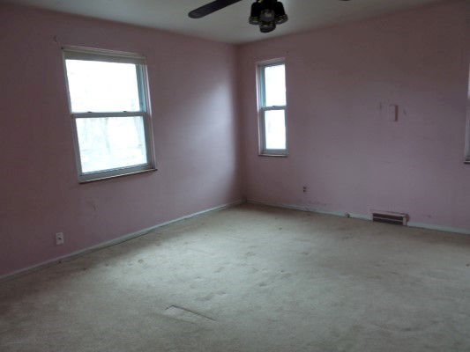
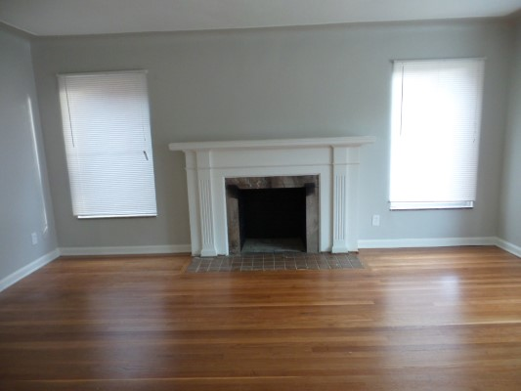
NCST in Michigan: Case Study – 14321 Greenview Road, Detroit
Before
After

Slide 55
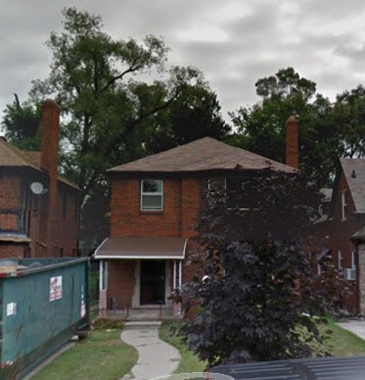
NCST in Michigan: Case Study – 14321 Greenview Road, Detroit
Before
After

Slide 56
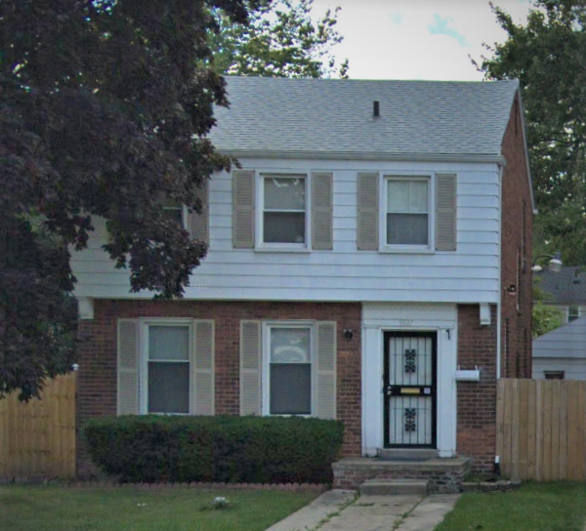
NCST in Michigan: Case Study – 5927 Cadieux Rd., Detroit
This property originally built in 1945 in the East English Village neighborhood, acquired by National Faith Homebuyers.
EFMV of $13,000 at the time of acquisition (triaged)
Rehab took approx. 7 months with $43,000+ in rehab costs (including interior and exterior)
Sold to an owner occupant (<80% AMI) for $44,900

Slide 57
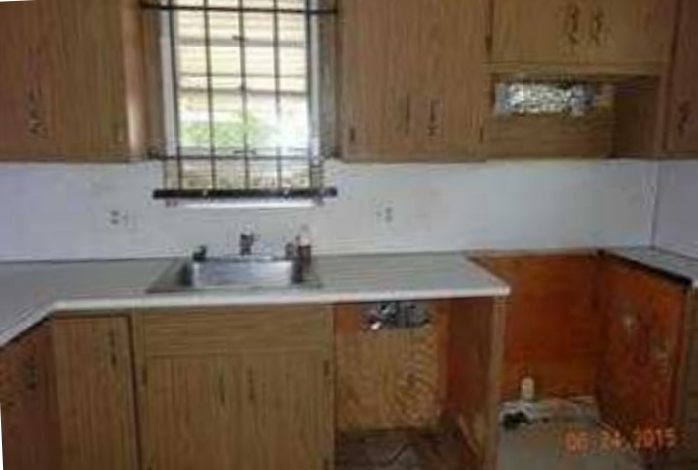
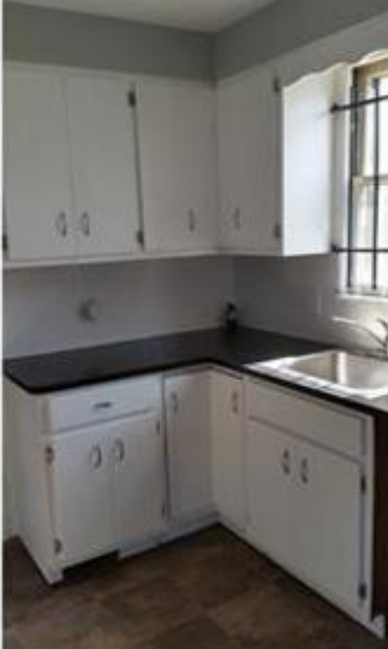
NCST in Michigan: Case Study – 5927 Cadieux Rd., Detroit
Before
After

Slide 58
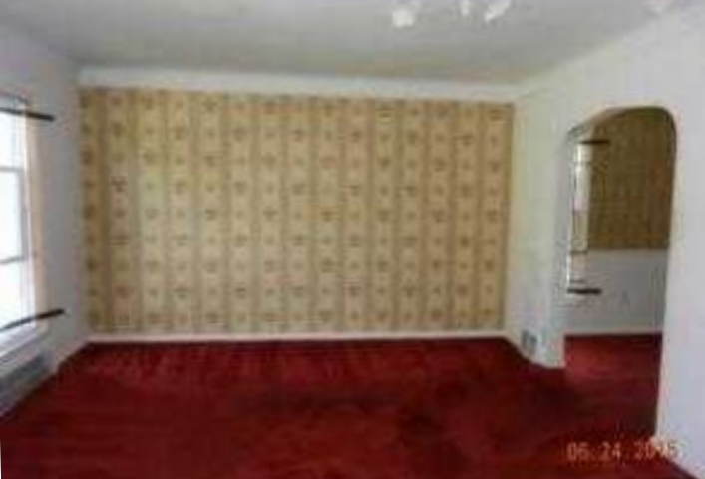
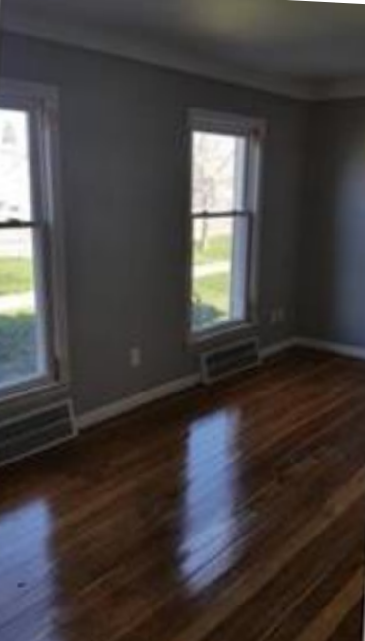
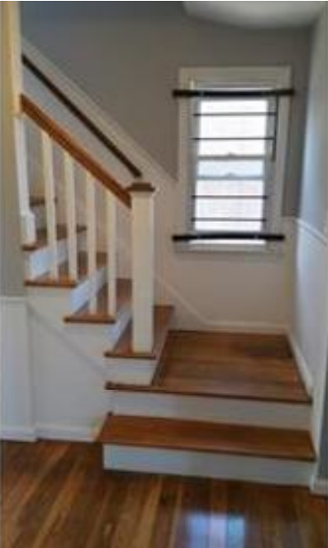
NCST in Michigan: Case Study – 5927 Cadieux Rd., Detroit
Before
After

Slide 59
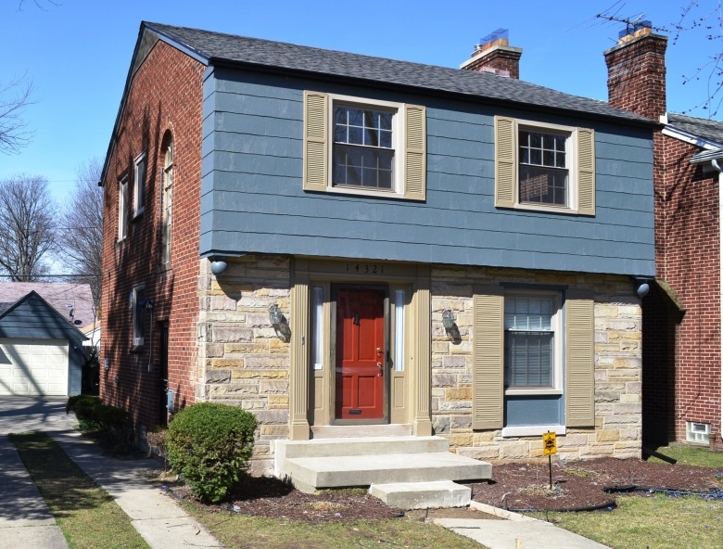
NCST in Michigan: Case Study – 14321 Greenview Road, Detroit
80 year-old property in the Grandmont #1 neighborhood, acquired by Grandmont Rosedale CDC
EFMV of $45,000 at the time of acquisition
Rehab took approx. 3 months with $50,000+ in rehab costs (including interior and exterior)
Sold to a returning resident for $105,000

Slide 60
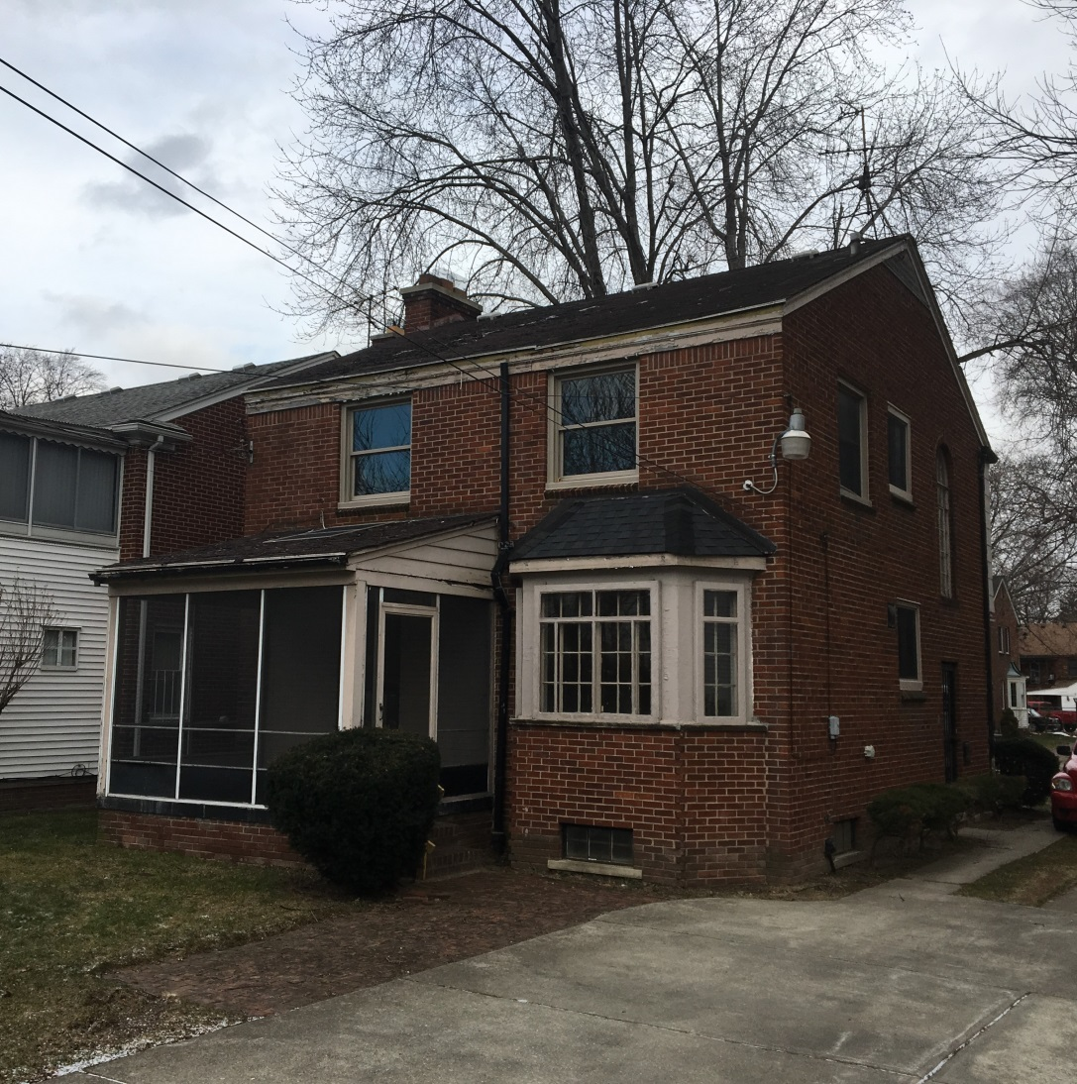
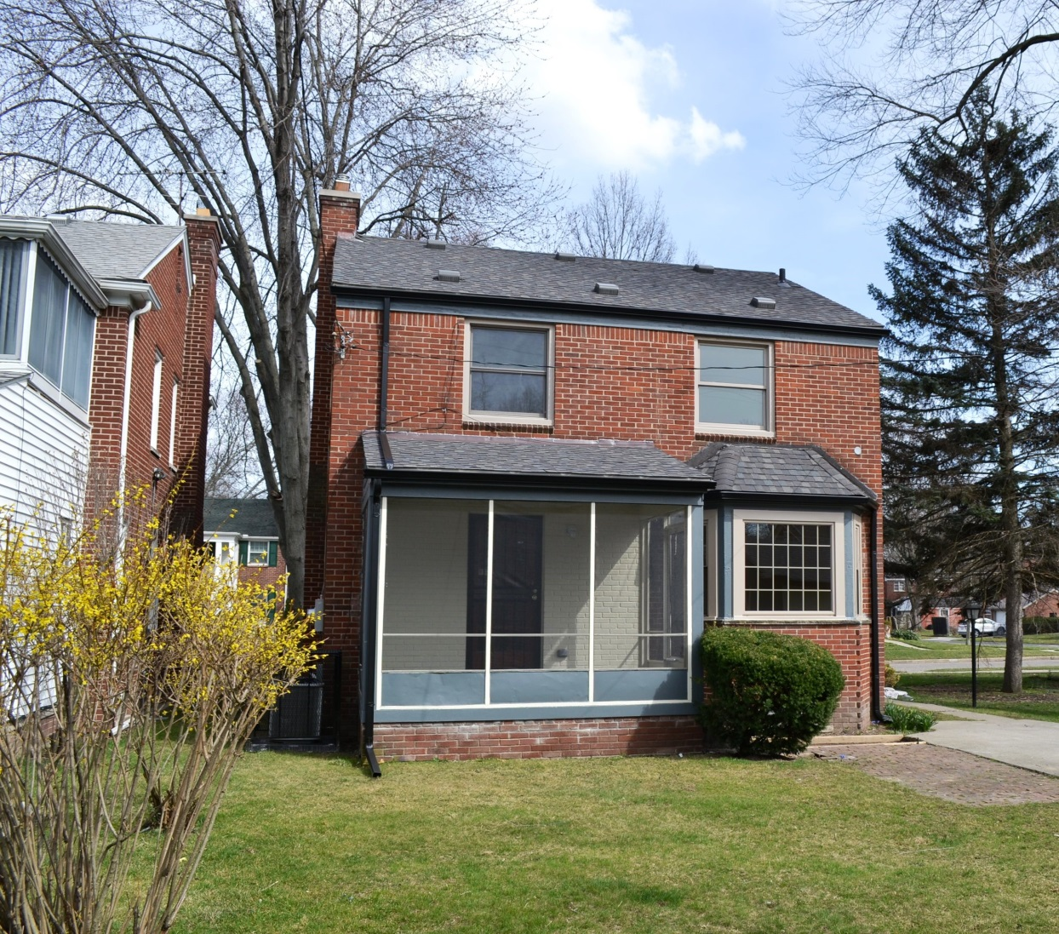
NCST in Michigan: Case Study – 14321 Greenview Road, Detroit
Before
After

Slide 61
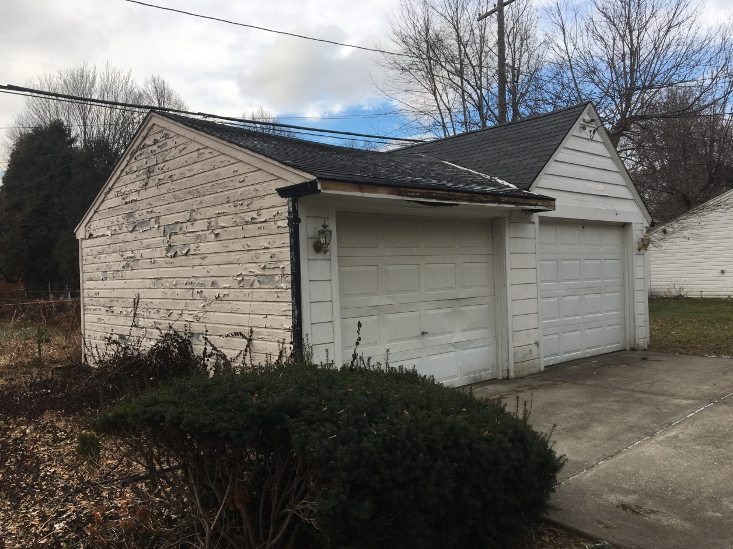
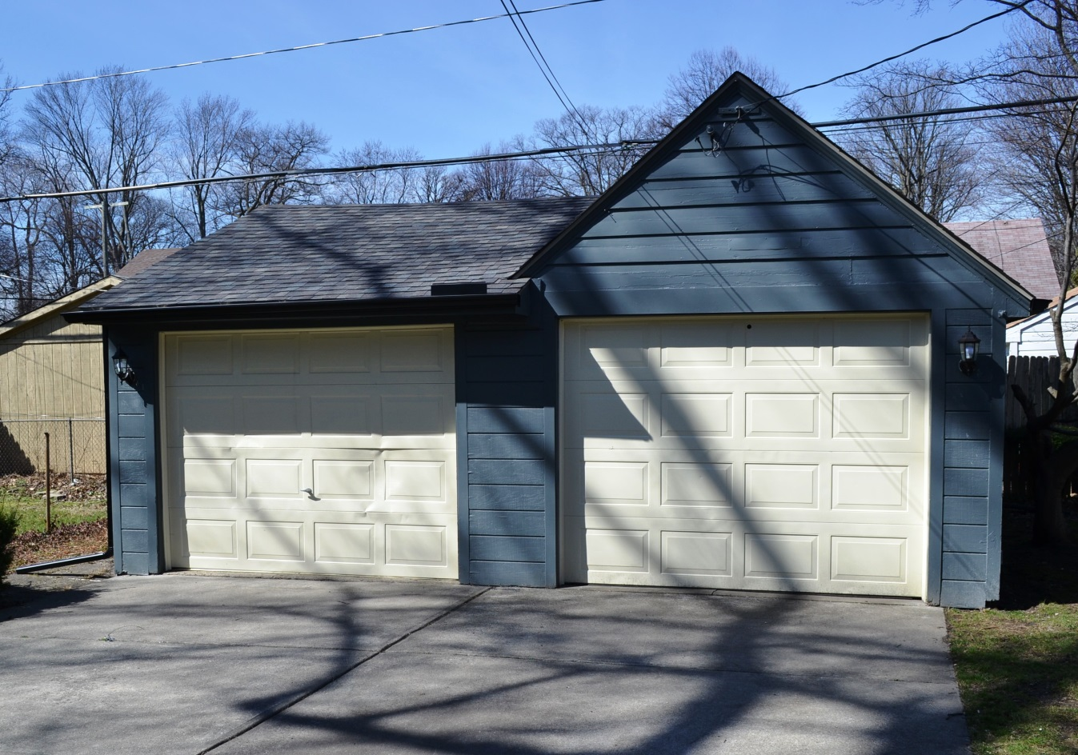
NCST in Michigan: Case Study – 14321 Greenview Road, Detroit
Before
After

Slide 62
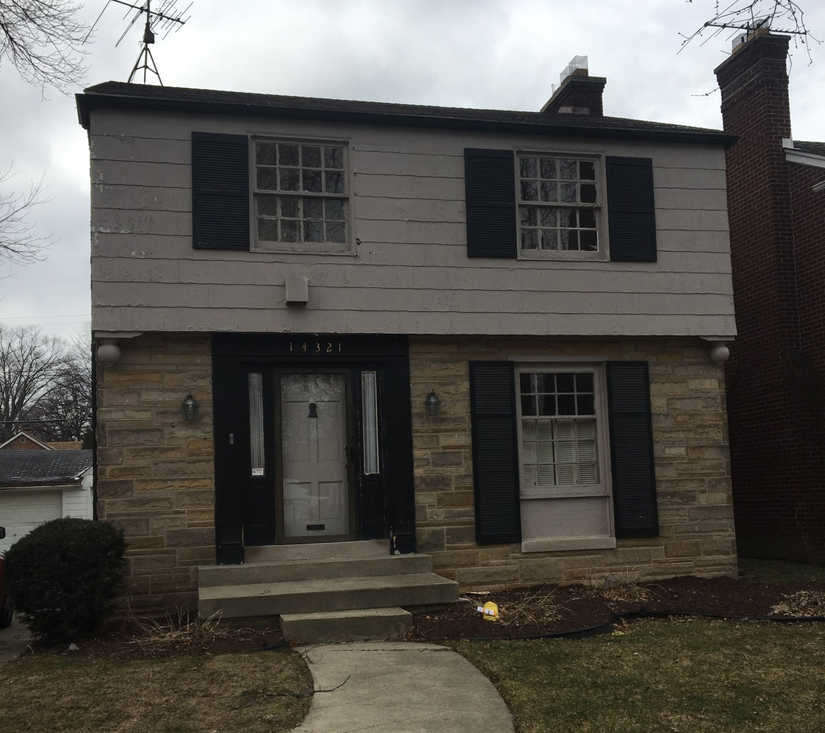
NCST in Michigan: Case Study – 14321 Greenview Road, Detroit
Before
After

Slide 63
NCST in Michigan
2,384

Slide 64
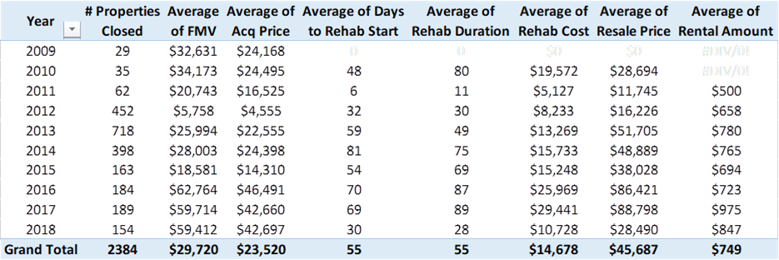
NCST in Michigan

Slide 65
NCST in Michigan

Slide 66
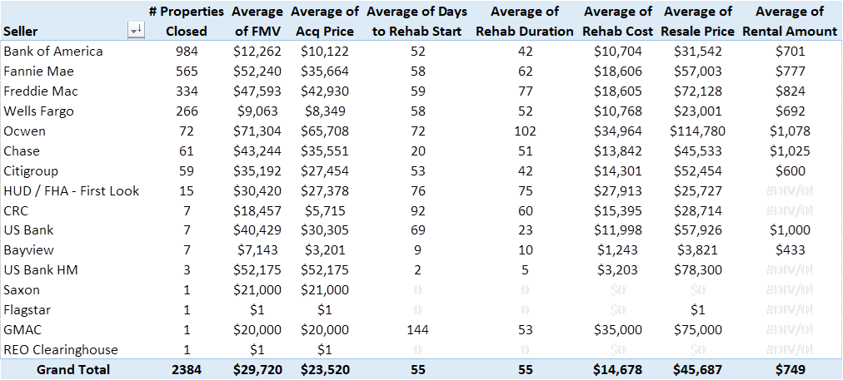
NCST in Michigan

Slide 67
NCST in Michigan

Slide 68
NCST in Michigan

Slide 69
Thank You
NCST Community Development Manager – Ohio & Michigan
Chris Garland
cgarland@stabilizationtrust.org
Office: 214.710.3399
Cell: 216.533.5629

